Slide 1

Cal-ABA 28th Annual Western Regional Conference
Performance Feedback:
Use It of Lose It
Randy Keyworth
Ronnie Detrich
Jack States

Slide 2
To be sure of hitting the target,
shoot first and whatever you hit,
call it the target.
Ashleigh Brilliant

Slide 3
Performance Feedback Systems rely on Staff Behavior
In order for a performance feedback system to be effective, staff must:
implement it
correctly
over time
compliance
competence
sustainability

Slide 4
Performance Feedback Systems compliance / competence
• ask the right questions
• identify appropriate data to collect (validity)
• implement interventions according to plan (treatment integrity)
• collect data accurately (reliability)
• display / analyze data
• interpret data / draw correct conclusions
• give / receive feedback based on the data
• modify interventions based on data

Slide 5
Performance Feedback Systems sustainability
• implemented with procedural fidelity and desired outcomes (effectiveness) at the consumer level
maintains over time
maintains over generations of practitioners and decision-makers
operates within existing resources (financial, staff, materials) and existing mandates
becomes institutionalized, routine…
“the way we do business”
National Implementation Research Network (NIRN)

Slide 6
Performance Feedback Obstacles
staff resistance to a performance feedback:
long standing mistrust of the purpose of data
educator autonomy, implicit power relationships
cynicism about fads, new ideas, education reform
resistance to performance feedback
data collection is too difficult
data collection causes too much change
desired outcomes take too long to materialize
perceived costs exceed perceived benefits

Slide 7
System’s Change Track Record
average life of an education innovation is 18-48 months (Latham, 1988)
initial data on comprehensive school reform models initiated in 2000:
1 in 5 maintained reforms through 2002
1 in 10 maintained reforms through 2004
(American Institute for Research)

Slide 8

A Buddhist View of Culture
Kōan
A Kōan consists of a story, dialogue, question, or statement, the meaning of which cannot be understood by rational thinking but may be accessible through intuition.
VERBAL BEHAVIOR
AUTOMATIC BEHAVIOR

Slide 9
Kōan of the Day
To implement and sustain a performance feedback culture….
you need a performance feedback culture.

Slide 10

Sustainable implementation requires:
• a social / cultural change process
• across all levels of an organization
changes in adult professional behavior (all stakeholders)
changes in organizational contingencies, both formal and informal (systems, policies, contingencies, values, procedures)
changes in relationships to consumers, stakeholders, and systems partners (metacontingencies)

Slide 11
the uncomfortable feeling caused by holding conflicting ideas simultaneously
cognitive dissonance
Culture change requires an expanded unit of analysis
organizations, systems, cultures…in addition to individual behavior
new analytic tools
utilization of expanded forms of research
(group designs, quasi-experimental, qualitative)

Slide 12
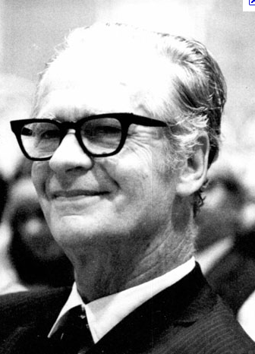
A Behavioral View of Culture
“As a set of contingencies of reinforcement maintained by a group…
it has…
a continuing existence beyond the lives of members of the group,
a changing pattern as practices are added, discarded, or modified…
A culture so defined controls the behavior of the members of the group that practice it.”
B.F. Skinner

Slide 13
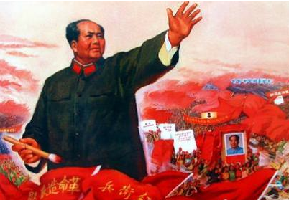
A Marxist View of Culture
The idea of continuous revolution implied that the function of the Communist Party was not to staff an authoritarian bureaucracy, but to enable and guarantee a process of development and to supervise a continuous process of change.
Mao Tse Tung

Slide 14

Continuous Regeneration
continuous regeneration is the process of:
iterative monitoring of both fidelity and outcomes,
adaptation and re-adaptation of a practice over time while keeping its critical features intact, and
ongoing investment in implementation and re-implementation.

Slide 15
What is an Organizational Culture?
The complex interaction of formal and informal contingencies governing the behavior of all stakeholders, embodied in:
Stakeholders
policy makers
parents
school administrators
classroom staff
students
External Contingencies
laws & regulations
funding
job market
training and ideology
Internal Contingencies
policies
practices
values
resource allocations
data systems feedback systems reporting requirements
program evaluation
recruitment & hiring
initiatives
job expectations
compensation
staff training
staff coaching
staff feedback

Slide 16
Building a Performance Feedback Culture
Performance feedback cultures deliberately shape all cultural contingencies to reinforce the effective use of performance feedback
increase reinforcement for the target behaviors
decrease aversive consequences for the target behaviors
decrease reinforcement for competing behaviors
increase aversive consequences for competing behaviors

Slide 17
Overcoming Baseline Cultural Obstacles: Calibration, Process and Engagement
a “learner centered” culture (calibration)
focus on student learning and educational practices
establishing consensus on standards, definitions, goals
a culture of “inquiry” rather than “compliance” (process)
use of data to answer questions, problem solve
use of data-based decision making at all levels of the organization
not having all of the answers
a culture of “universal participation” (engagement)
wide-spread involvement (ownership, pride, participation)
collaboration across disciplines
giving, receiving, and using feedback
data analysis as positive, non-threatening experience
(Wayman, et. al. 2006)

Slide 18
Overcoming Baseline Cultural Obstacles: Alignment
Alignment of all organizational cultural components so that contingencies consistently support data-based decision making
policies
practices
values
resource allocations
data systems
feedback systems reporting requirements
program evaluation
recruitment & hiring
initiatives
job expectations
compensation
staff training
staff coaching
staff feedback

Slide 19
Using Performance Management for cultural alignment
Increase the number of staff using effective performance feedback
Goals:
Definitions:
Outcomes:
staff share common values about data, accountability, feedback and problem solving
staff have technical skills in instruction, data analysis, problem solving
staff positions filled by qualified staff
qualified staff are retained
performance feedback systems implemented

Slide 20
Using Performance Management for cultural alignment
Process Measures
Outcome Measures
Strategies
staff training
X
X
X
staff feedback
X
X
X
staff evaluation
X
X
X
recruitment
X
X
X
selection
X
X
X
hiring
X
X
X
policies
X
X
X
practices
X
X
X
resource allocations
X
X
X
job expectations
X
X
X
compensation
X
X
X
initiatives
X
X
X

Slide 21
The secret of success is sincerity.
Once you can fake that
you've got it made.
Daniel Schorr

