Slide 1

How to take care of monthly money
This session is aimed at Key Stage Three (recommended for Year 7)

Slide 2
Unit outline
Session 1 | Session 2 | Session 3 | Session 4 | Session 5 | Session 6
Spending decisions | How to budget | Getting a job | The impact of inflation | Being a critical consumer | Budgeting for a holiday

Slide 3
Having a respectful learning environment
We will listen to each other respectfully
We will avoid making judgements or assumptions about others
We will comment on what has been said, not the person who has said it
We won’t put anyone on the spot and we have the right to pass
We will not share personal stories or ask personal questions
If there is a question that you do not wish to ask aloud, you can write it on a Post-it Note which will be collected throughout the session and answered at the end
Notes:
Teacher delivery
Students should be invited to ask questions and they should be provided with an opportunity to ask questions anonymously. It is useful to have a question box or allocated space on the whiteboard for students to share questions.
It is suggested that students are provided with post-its or slips to write their questions on and as the teacher circulates throughout the lesson these questions can be collected and answers throughout the session or using an allocated ‘question time’ at the end of the session.
Students can be invited to respond to questions asked by their peers. If responses to questions are based on personal preference or opinion, the teacher should be clear to preface any answers with this.

Slide 4
Session 4:
The impact of inflation
Notes:
See Money Matters lesson 5
https://natwest.mymoneysense.com/teachers/resources-8-12s/topic-8-what-affects-my-choices-about-money/lesson-plan/

Slide 5
By the end of the session, I will be able to:
Describe what inflation is and how it is measured
Calculate how budgets are affected by inflation
Explain how inflation can impact people's cost of living

Slide 6
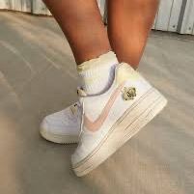
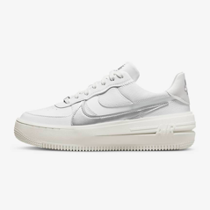
Inflation - Starter
How much do you think the cost of Nike Air Force 1s has changed over time?
What other products have you seen change in price over time?
Can you remember the previous price and today’s price?
Explore your ideas with the person next to you and prepare to share your thoughts.
But why?!
~£35 more expensive
2007
Nike Air Force 1 £76.36
Nike Air Force 1 £110
2024
Optional supporting video resource: https://www.bbc.co.uk/newsround/59320010
Notes:
Teacher guidance notes
Explain that although brands will periodically review prices, they also increase due to inflation

Slide 7
What is inflation?
What is inflation?
Use the keywords below to help you.
Think-Pair-Share
Prices
Products
Go up/increase
Average
Inflation is when the average price of products increases over time

Slide 8
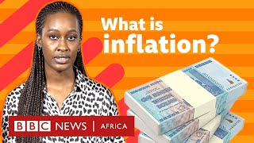
What is inflation?
See link here. Play until 1m 25s

Slide 9

What is inflation?
Copy this definition: What is inflation?
The word we use to describe the rise in average prices
What does this mean?
If inflation is 2% a year, something that cost £1 last year will now cost £1.02 — it got more expensive by 2%.
When inflation goes up, prices rise, so people can’t buy as much with the same amount of money unless their income also increases.
We therefore say that the cost of living increases
Stretch: What is the current inflation rate? (Check here)
Notes:
UK current inflation rate updated here

Slide 10

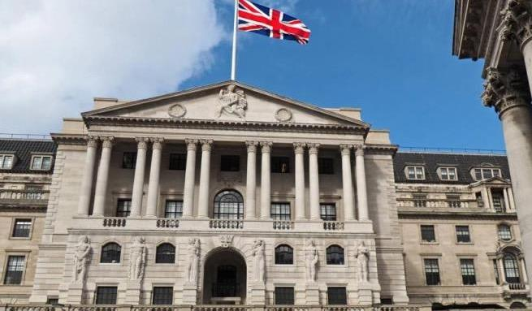
The Bank of England
Welcome to the Bank of England.
The Bank of England is the UK’s central bank and one of its roles is to keep prices stable. It does this by having an inflation target rate of about 2%.
Andrew Bailey
Governor of the Bank of England
See this optional video for a further explanation of the Bank of England

Slide 11
Are rising prices, aka inflation, always a bad thing?
Generally, prices rise every year a small amount.
This shows that the level of demand in the economy is growing.
It’s when prices rise very fast that people worry as they can’t buy as much with the same amount of money.
Optional supporting video resource: Cost of Living Crisis: YOUR Questions Answered | Newsround

Slide 12
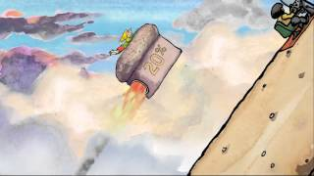
Optional Video: Hyperinflation
Watch the video here

Slide 13
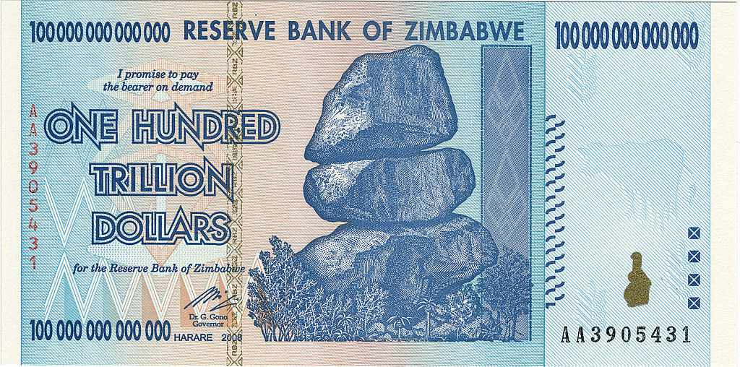
What happens when inflation gets out of control…?
2008: Zimbabwe
Zimbabwe’s inflation crisis happened when the country printed too much money
This led to prices rising extremely fast.
At its worst, prices doubled every day, making basic goods like food unaffordable.
The value of Zimbabwe’s currency collapsed, and eventually they stopped using it
This 100 trillion dollar note was only worth about 30p!
Notes:
Teacher notes:
Zimbabwe was a very extreme example, but this demonstrates that if inflation isn’t controlled by the government, it can get totally out of hand.
Why does printing money increase prices?
When there’s too much of something, it loses its value. So if more and more money is printed, existing money (such as savings) becomes less and less valuable.

Slide 14
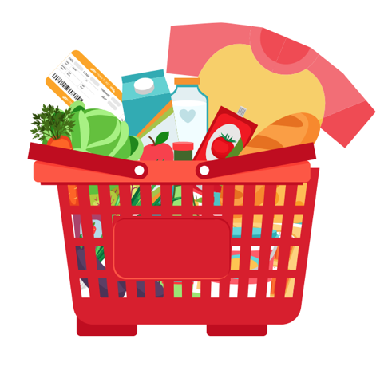
Measuring inflation | Basket of goods
Inflation is measured by tracking how the price of a representative basket of everyday items changes over time.
Consumer inflation is measured by taking a sample ‘shopping basket’ of around 700 goods and services each month in the UK, and monitoring how the total price of the basket changes.
Goods include things like food, clothes and petrol. Services include things like transport, restaurant meals and cinema trips.
This is known as the ‘Consumer Prices Index’ (CPI)
Notes:
More information about the Consumer Prices Index can be found here: ONS

Slide 15
Inflation through the years
Can you guesstimate how much £10 worth of goods (e.g. can of cola, vegetable oil, petrol) and services (e.g. airline ticket, cinema ticket, restaurant meal) cost when you were born compared to now?
Notes:
Delivery instruction
Can you guesstimate how much £10 worth of goods (e.g. can of cola, vegetable oil, petrol) and services (e.g. airline ticket, cinema ticket, restaurant meal) cost when you were born compared to now?
Example answer:
£10 in 2010 would be worth £15.40 in August 2025

Slide 16
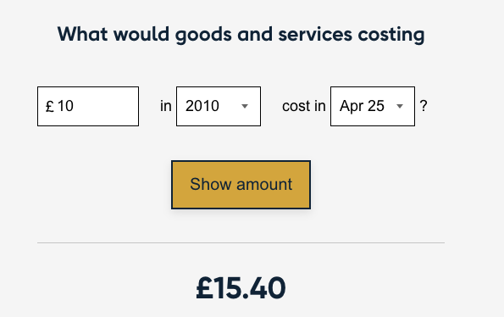
Inflation through the years
Bank of England inflation calculator
Notes:
Delivery instruction
Can you guesstimate how much £10 worth of goods (e.g. can of cola, vegetable oil, petrol) and services (e.g. airline ticket, cinema ticket, restaurant meal) cost when you were born compared to now?
Example answer:
£10 in 2010 would be worth £15.40 in August 2025

Slide 17
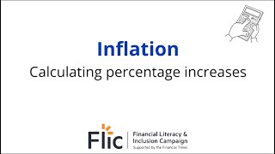
Calculating price changes
Video | How to work out percentage increases
Notes:
Delivery instruction
Can you guesstimate how much £10 worth of goods (e.g. can of cola, vegetable oil, petrol) and services (e.g. airline ticket, cinema ticket, restaurant meal) cost when you were born compared to now?

Slide 18

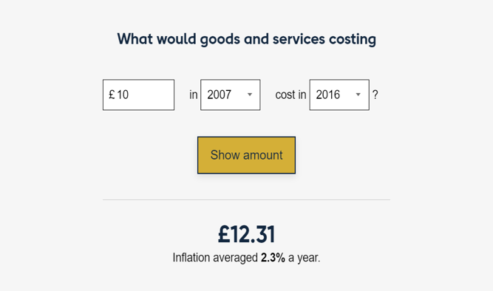
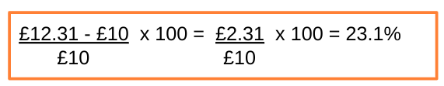
Inflation through the years
Click on the Inflation Calculator. Can you guesstimate how much £10 worth of goods (e.g. can of Coke, vegetable oil, petrol) and services (e.g. airline ticket, cinema ticket, restaurant meal) cost when you were born compared to now? Or the cost from when your parent/guardian was born compared to now?
Bank of England inflation calculator
Stretch | Can you work out the percentage increase?
Worked example: If goods and services cost £10 in 2007 AND then cost £12.31 in 2016, we calculate the percentage increase as:
Notes:
Delivery instruction
Encourage less confident students to choose dates to increase engagement and more confident students to work out percentage changes

Slide 19
By the end of the session, I will be able to:
Describe what inflation is and how it is measured
Calculate how budgets are affected by inflation
Consider how inflation can impact people's cost of living

Slide 20
Now over to you to see how food prices have changed over the last few years…

Slide 21
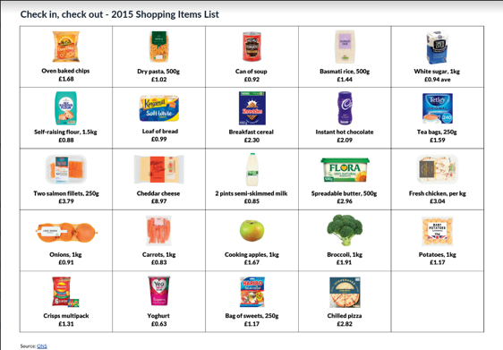
Check in, check out
Part 1 | It’s 2015
Suppose someone is going food shopping and has a £30.00 budget for their weekly food shop.
Your task is to pick all of the ingredients and items you want to purchase to make meals for a week, sticking to your budget.
Session 4 Resource 1 | Check in, check out

Slide 22
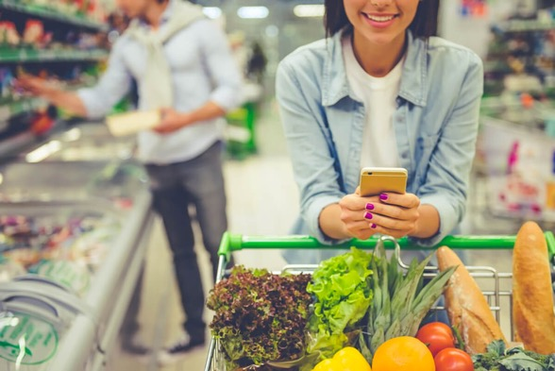
Check in, check out
Part 2 | It’s 2025
We’ve jumped forward a few years and it’s now 2025.
Using the 2025 Grocery Items List, calculate the total cost of the same shop at the same supermarket using the updated price list.
Session 4 Resource 1 | Check in, check out
Optional supporting video resource: https://www.youtube.com/watch?v=3dwJYArFsVc
Notes:
Extension teacher prompt questions - Can you differentiate items in your shopping baskets into needs and wants?

Slide 23
Check in, check out
When your shopping lists are completed, answer the following questions:
Is the total cost in your shopping basket higher or lower than the original £30.00?
Which items have increased or decreased in price and why do you think these changes have taken place?
If the cost of products like food have gone up, what does this mean for the money people have left to spend on their needs and wants or that they want to put away to save or invest?
Session 4 Resource 1 | Check in, check out
Notes:
Teacher explanation
Explain that while the weekly food shop has increased in price, the money coming in (income) likely hasn’t, so people won’t need to be able to afford all of the same things previously bought.
https://drive.google.com/file/d/1OhLZkWTlXt6yS48hjehRwSBs_7nEP7Yu/view?usp=share_link

Slide 24

Optional video
What does inflation mean for people’s money?
Watch the video on the rising cost of Freddos. Use the video to answer the following questions.
Video made in collaboration with Olamide Majekodunmi
Inflation is when the price of things like_________, heating and ____________ go up.
When inflation goes up quickly, what are some ways to help stretch money further?
What’s the impact of rising inflation on savings?
food
petrol

Slide 25
By the end of the session, I will be able to:
Describe what inflation is and how it is measured
Calculate how budgets are affected by inflation
Consider how inflation can impact people's cost of living

Slide 26
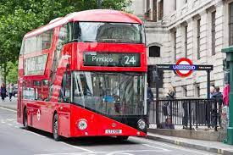
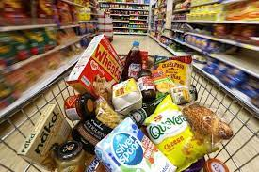
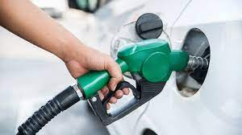
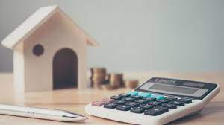
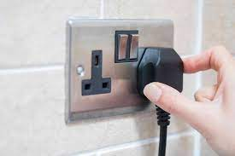
What are some of the main factors that make up the cost of living?
The cost of living is the amount of money a person needs to live
Notes:
Ask students to use the images to help them.

Slide 27
What are some of the main factors that make up the cost of living?
The cost of living is the amount of money a person needs to live
Transport
Food
Fuel
Rent/ Mortgage repayments
Electricity
Notes:
Teacher explanation
These are some of the core factors that contribute to the cost of living. You may ask students to consider other factors. These may include: taxes, healthcare, entertainment, water and gas.

Slide 28
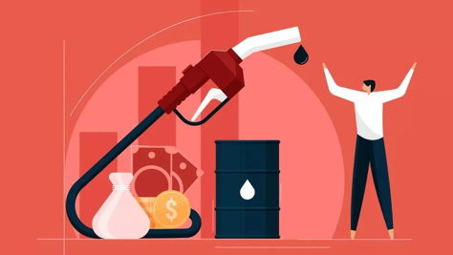
Inflation and the cost of living
Watch the video (2:29) and/or read the article and discuss the following questions
Discussion
What is the ‘cost of living crisis’?
How are Reuben and Jensen helping their mum keep monthly costs down?
Video: https://www.bbc.co.uk/newsround/68370090 (2024)
Resource 2: Cost of Living Questions

Slide 29
Inflation and well-being
For many families rising inflation leading to a rising cost of living has been stressful to manage.
Remember that inflation changes over time and this period will not last forever.
As you have learnt, there are things that people can do to adjust their budgets including reconsidering what things are needs and wants.
There are many sources of advisory services and help for families who are experiencing financial difficulties.
Optional supporting video resource | What is the COST OF LIVING Crisis? | Newsround

Slide 30
Any questions?
?

Slide 31



Services available for people who have concerns about their personal finances
Citizens Advice – Debt and Money – This resource contains links to advice on a number of topics, including financial difficulties, cost of living and communicating with creditors.
National Debtline – Debt and Money – a debt advice charity run by the Money Advice Trust, offering a free and confidential debt advice service.
Childline Helpline
0800 1111
At school, you can speak with an adult you trust.
This could be your form tutor, head of year or the school’s safeguarding officer.

Slide 32
Links to learn more!
Articles to extend learning
Please visit the FLIC Learning Hub for further resources
How is inflation affecting your household costs? (Census, May 2025)
‘What is the UK's inflation rate and why is the cost of living going up? (BBC, Updated 2025)
Cost of living crisis: What is it and when will it end? (BBC, 2024)
Notes:
A number of the video links have been added to the relevant slides;
https://www.bbc.co.uk/news/uk-61744144
https://www.youtube.com/watch?v=KL7V2A190ws
https://www.youtube.com/watch?v=669PyOJJohY
https://www.bbc.co.uk/newsround/63664110
https://www.ft.com/cost-of-living-crisis
UK households cut back on beer, meat and domestic appliances after prices surge

Slide 33
By the end of the session, I will be able to:
Describe what inflation is and how it is measured
Explain how inflation is measured
Consider how inflation can impact people's cost of living

Slide 34
OPTIONAL MULTIPLE CHOICE QUIZ

Slide 35
Inflation | Multiple choice
Inflation is…
A | B | C
The average increase in prices of goods and services over time | The decrease in prices of goods and services over time | When prices of goods and services remain the same over time

Slide 36
Inflation | Multiple choice
Inflation is…
A | B | C
The average increase in prices of goods and services over time | The decrease in prices of goods and services over time | When prices of goods and services remain the same over time

Slide 37
Inflation | Multiple choice
2. The Bank of England wants to keep the target inflation rate at around…
A | B | C
0% | 2% | 7%

Slide 38
Inflation | Multiple choice
2. The Bank of England wants to keep the target inflation rate at around…
A | B | C
0% | 2% | 7%

Slide 39
Inflation | Multiple choice
3. When shrinkflation happens, a product's price in shops (retail price) stays the same, but what happens to its size?
A | B | C
Decreases | Increases | Stays the same

Slide 40
Inflation | Multiple choice
3. When shrinkflation happens, a product's price in shops (retail price) stays the same, but what happens to its size?
A | B | C
Decreases | Increases | Stays the same

Slide 41
Inflation | Multiple choice
4. Inflation is measured by taking a sample ‘shopping basket’ of around how many goods and services across the UK?
A | B | C
70 | 700 | 7000

Slide 42
Inflation | Multiple choice
4. Inflation is measured by taking a sample ‘shopping basket’ of around how many goods and services across the UK?
A | B | C
70 | 700 | 7000

Slide 43
Inflation | Multiple choice
5. The ……………………….. is measured by taking a sample ‘shopping basket’ of goods and services across the UK
A | B | C
Bank of England | Producer price index | Consumer price index

Slide 44
Inflation | Multiple choice
5. The ……………………….. is measured by taking a sample ‘shopping basket’ of goods and services across the UK
A | B | C
Bank of England | Producer price index | Consumer price index

