Slide 1
20XX
FASHION MAGAZINE
PRESENTATION TEMPLATE

Slide 2



01
SPAIN
CLICK TO ADD CAPTION TEXT
02
ITALY
CLICK TO ADD CAPTION TEXT
03
GERMANY
CLICK TO ADD CAPTION TEXT
CONTENTS
04
FRANCE
CLICK TO ADD CAPTION TEXT

Slide 3
PART 01
SPAIN
CLICK TO ADD CAPTION TEXT

Slide 4

TITLE HERE
TITLE HERE
We use well-known development methodologies to create a customized approach for each of the projects. This allows us to achieve high quality outcomes and full transparency towards.

Slide 5

STEP HERE
We use well-known development methodologies to create a customized approach for each of the projects. This allows us to achieve high quality outcomes and full transparency towards.

Slide 6


STAGE HERE
We use well-known development methodologies to create a customized approach for each of the projects. This allows us to achieve high quality outcomes and full transparency towards. We use well-known development methodologies to create a customized approach for each of the projects. This allows us to achieve high quality outcomes and full transparency towards.

Slide 7
OPTION HERE
OPTION HERE
OPTION HERE
OPTION HERE
OPTION HERE
We use well-known development methodologies to create a customized approach for each of the projects. This allows us to achieve high quality outcomes and full transparency towards.
We use well-known development methodologies to create a customized approach for each of the projects. This allows us to achieve high quality outcomes and full transparency towards.
We use well-known development methodologies to create a customized approach for each of the projects. This allows us to achieve high quality outcomes and full transparency towards.
We use well-known development methodologies to create a customized approach for each of the projects. This allows us to achieve high quality outcomes and full transparency towards.

Slide 8
PART 02
ITALY
CLICK TO ADD CAPTION TEXT

Slide 9

TITLE HERE
A complex idea can be conveyed with just a single still image, namely making it possible to absorb large amounts of data quickly.

Slide 10

STEP HERE
We use well-known development methodologies to create a customized approach for each of the projects. This allows us to achieve high quality outcomes and full transparency towards.

Slide 11

STAGE HERE
We use well-known development methodologies to create a customized approach for each of the projects. This allows us to achieve high quality outcomes and full transparency towards.

Slide 12

OPTION HERE
We use well-known development methodologies to create a customized approach for each of the projects. This allows us to achieve high quality outcomes and full transparency towards. We use well-known development methodologies to create a customized approach for each of the projects. This allows us to achieve high quality outcomes and full transparency towards.

Slide 13

TITLE HERE
TITLE HERE
TITLE HERE
TITLE HERE
TITLE HERE
Text here...
Text here...
Text here...
Text here...

Slide 14
PART 03
GERMANY
CLICK TO ADD CAPTION TEXT

Slide 15

STEP HERE
We use well-known development methodologies to create a customized approach for each of the projects. This allows us to achieve high quality outcomes and full transparency towards.

Slide 16

STAGE HERE
01
STAGE HERE
We use well-known development methodologies to create a customized approach for each of the projects. This allows us to achieve high quality outcomes and full transparency towards.
02
STAGE HERE
We use well-known development methodologies to create a customized approach for each of the projects. This allows us to achieve high quality outcomes and full transparency towards.
03
STAGE HERE
We use well-known development methodologies to create a customized approach for each of the projects. This allows us to achieve high quality outcomes and full transparency towards.

Slide 17

NEW
OPTION HERE
We use well-known development methodologies to create a customized approach for each of the projects. This allows us to achieve high quality outcomes and full transparency towards.

Slide 18




TITLE HERE
We use well-known development methodologies to create a customized approach for each of the projects. This allows us to achieve high quality outcomes and full transparency towards.

Slide 19
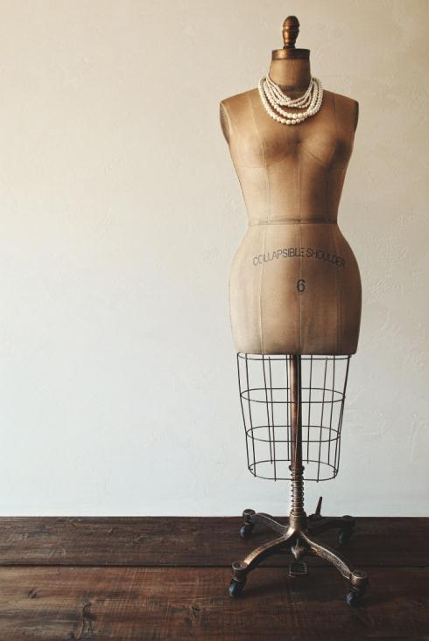


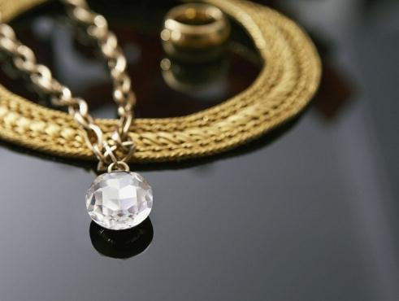
STEP HERE
We use well-known development methodologies to create a customized approach for each of the projects. This allows us to achieve high quality outcomes and full transparency towards.

Slide 20
PART 04
FRANCE
CLICK TO ADD CAPTION TEXT

Slide 21



STAGE HERE
We use well-known development methodologies to create a customized approach for each of the projects. This allows us to achieve high quality outcomes and full transparency towards. We use well-known development methodologies to create a customized approach for each of the projects. This allows us to achieve high quality outcomes and full transparency towards.

Slide 22

OPTION
HERE

Slide 23


TITLE HERE
We use well-known development methodologies to create a customized approach for each of the projects. This allows us to achieve high quality outcomes and full transparency towards.

Slide 24



G
STEP HERE
We use well-known development methodologies to create a customized approach for each of the projects. This allows us to achieve high quality outcomes and full transparency towards.

Slide 25

STAGE HERE
We use well-known development methodologies to create a customized approach for each of the projects. This allows us to achieve high quality outcomes and full transparency towards.

Slide 26
20XX
THANK YOU!
Special thanks to all the people who made and released these awesome resources for free:
Presentation template by GoogleSlides.org
Photographs by Picpng.com

