Slide 1


MACHINE LEARNING
MACHINE LEARNING SHORT COURSE
HOME STUDY VERSION
TECHNOLOGY
COURSE

Slide 2
Objectives
CORE
Understand what machine learning is
Understand potential issues with the application of machine learning
CHALLENGE
Be able to identify ways in which a machine learning model could solve a real world problem

Slide 3
Course activities
Activities
What is machine learning?
How do machines learn?
Facial recognition
Self-driving cars
Natural language processing
Instagram’s anti-bullying AI
Uses of machine learning
Spot possible problems
Explore your idea
Develop your idea
Design your model
Explain your idea

Slide 4
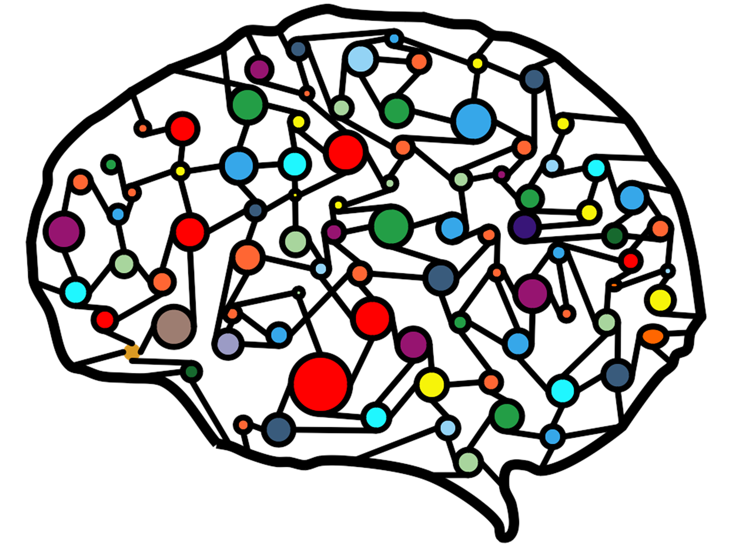
Introduction
Machine learning is playing an increasingly important role in lots of different aspects of all our lives.
It’s important that you understand what machine learning is and how it is being used - not just those of you who will go on to invent it or build with it (although that is important), but also those of you who will use it and be affected by it.
And that’s everyone!
Notes:
Image source - https://pixabay.com/illustrations/artificial-neural-network-ann-3501528/

Slide 5

1 – What is machine learning
Activity
Go to Activity A in your Student Workbook and answer the questions in the top section:
Have you heard of the term machine learning? YES / NO
If yes what do you think it means?
When you have answered the questions watch the video on the following slide and then answer the remaining questions.

Slide 6
ACTIVITY A
WHAT IS MACHINE LEARNING?
COURSE
MACHINE LEARNING SHORT COURSE
Questions to answer before you watch the video
Have you heard of the term machine learning? YES / NO
If yes what do you think it means?
After you have watched the video on the next slide answer these questions
What is machine learning?
Why is the use of machine learning increasing rapidly?
Can you think of any any issues or problems caused by the increase in the use of machine learning?
Understanding what ML is and how it functions should help you recognise where you are interacting with computers in your everyday life and what this means for you (as a human?).

Slide 7
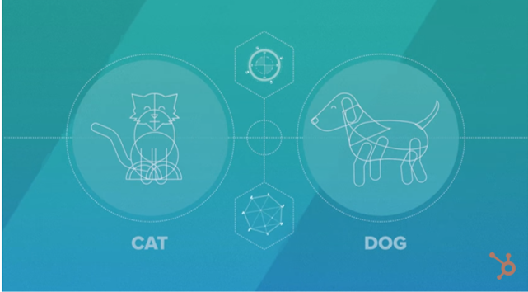
1 – What is machine learning?
Watch this video: What is Artificial Intelligence (or Machine Learning)? (6 mins, 14s). Have you changed your definition of what machine learning is? When you have watched the video go back to Activity A and answer the remaining questions.

Slide 8
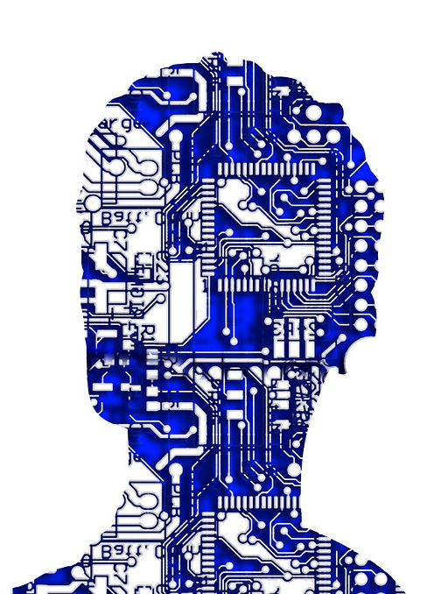
1 – What is machine learning?
Machine learning is a system where - rather than a computer programmer deciding the best way to sort, organise, classify or use information – a computer program develops its own set of instructions based on information that users feed it.
Notes:
Image source - https://pixabay.com/en/artificial-intelligence-507813/

Slide 9
2 – How do machines learn?
You want a computer to perform a complex task…
With computer programming:
You break down the complex activity into a set of simple instructions.
You use these instructions to tell the machine how to perform the task.
With machine learning:
You collect a set of examples of the task being done.
The computer learns how to do the task from the examples you give it.
The next activity shows how this works in practice. In this case, the machine is being taught to recognise images.

Slide 10
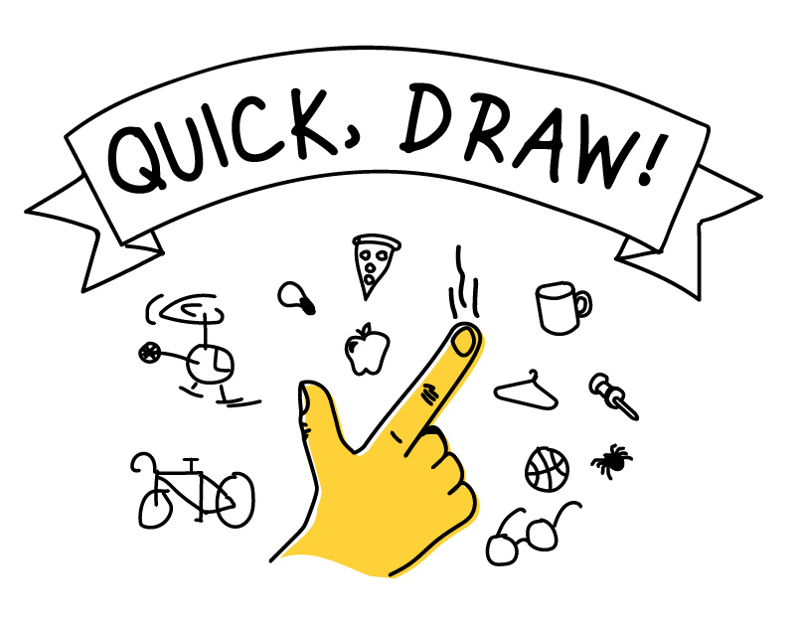
2 – How do machines learn?
Activity - Quick, Draw
This is a game built with machine learning. You draw, and a neural network tries to guess what you’re drawing. When you have finished, look at how your drawings were recognised and also the ‘data set’ of images that have been drawn by others.
Play the game here:
https://quickdraw.withgoogle.com/
Find out how it works here:
https://www.youtube.com/watch?v=X8v1GWzZYJ4

Slide 11
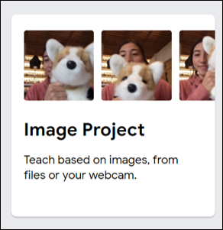
2 - How do machines learn?
Activity - Teachable Machine
Teachable Machine allows you to capture images with your webcam, or upload images from your computer, to train a computer model:
https://teachablemachine.withgoogle.com/train/image
Watch the tutorial video, then follow its instructions to train your own model. Note: If the webcam is disabled on the computer you’re using, you’ll need to upload images as samples instead.

Slide 12
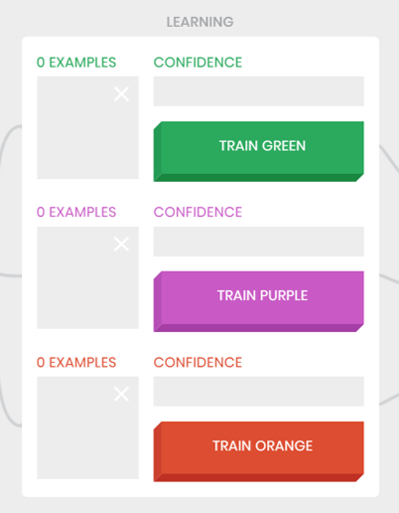
2 – How do machines learn?
Activity - Teachable Machine
In this, the previous version of Teachable Machine, you can train a model to recognise different gestures using your camera live in your browser.
Watch this video to see how the activity works: https://www.youtube.com/watch?v=3BhkeY974Rg
Play the game here (if your camera is not disabled):
https://teachablemachine.withgoogle.com/v1/

Slide 13
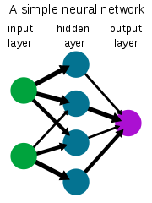
2 – How do machines learn?
The Quick,Draw activity you tried earlier uses neural networks to analyse your drawing and compare it with thousands of other drawings in its library.
Neural networks are modelled loosely on the human brain and enable computers to learn from being fed data.
The typical neural network consists of thousands of interconnected artificial neurons, which are stacked in rows that are known as layers, forming millions of connections.
Notes:
Image source -https://en.wikipedia.org/wiki/File:Neural_network_example.svg

Slide 14
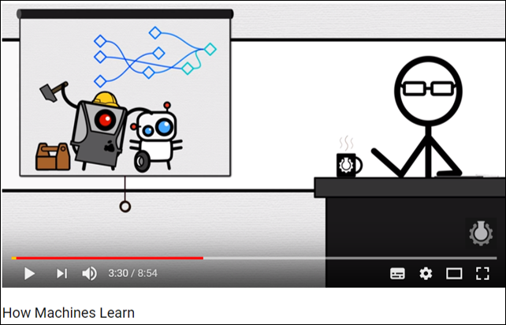
2 – How do machines learn?
This video, How Machines Learn (8 mins, 54s), explains how neural networks are used to train machine learning models.

Slide 15
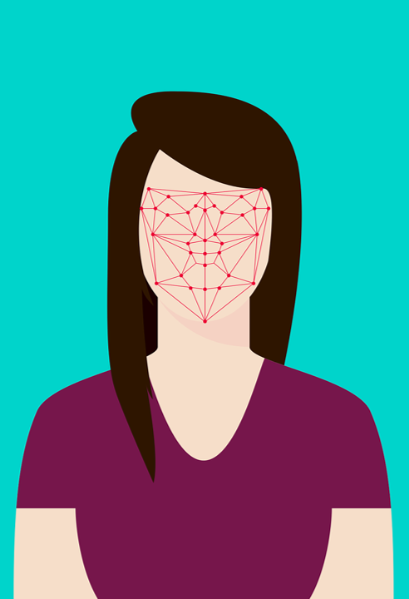
3 – Facial recognition
Facial recognition is increasingly being used for a wide range of applications:
Identity check e.g. unlocking your phone, checking in at the airport
Security e.g. scanning crowds entering a pop concert to spot potential terrorists
Police support e.g. scanning people in the street for wanted criminals
What do you think are the advantages and disadvantages of using facial recognition technology? Record your answer in the first section of Activity B in the workbook.
Notes:
Image source - https://pixabay.com/illustrations/flat-recognition-facial-face-woman-3252983/

Slide 16
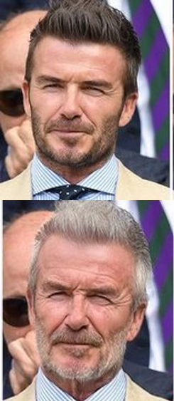
3 – Facial recognition
FaceApp
FaceApp uses machine learning algorithms to alter people's faces with various filters.
Users take or upload a photo from their phone and the app's algorithms do the rest. You can make yourself look younger or older, swap your gender, or transform your expression.
However, concerns have been raised with regards to privacy and security issues. Who owns the photos that you have uploaded and how they will be used by the person owning / holding them.
Notes:
Image source - https://www.dailystar.co.uk/tech/news/792470/FaceApp-Warning-Old-Age-filter-is-fun-but-be-careful-what-information-you-re-sharing

Slide 17
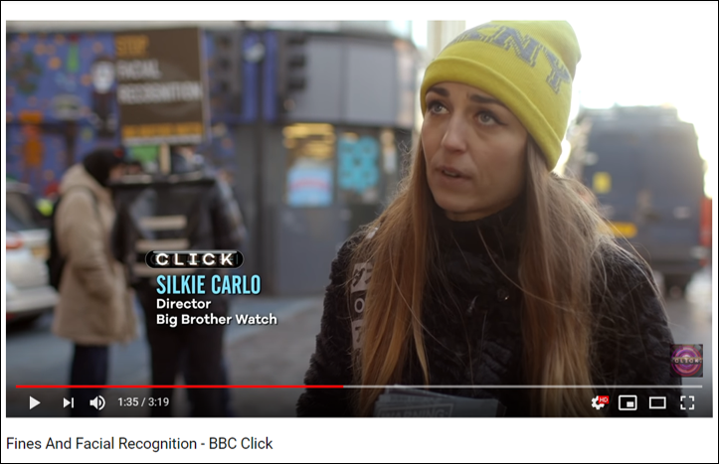
3 – Facial recognition
This video (3 minutes, 19s) discusses concerns raised over police trials of facial recognition technology. Do you think the police are right to use this technology to track down criminals? Are people right to be concerned? Mark your answer in the second section of Activity B in the workbook.

Slide 18
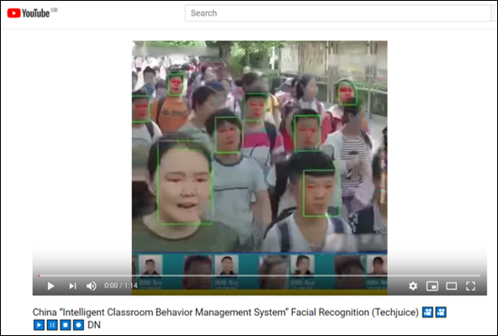
3 – Facial recognition
This video (1 minute, 14s) explains how facial recognition is being used in China to monitor students in class. Do you think this would be beneficial in your school? Record your answer in the third section of Activity B in the workbook.

Slide 19
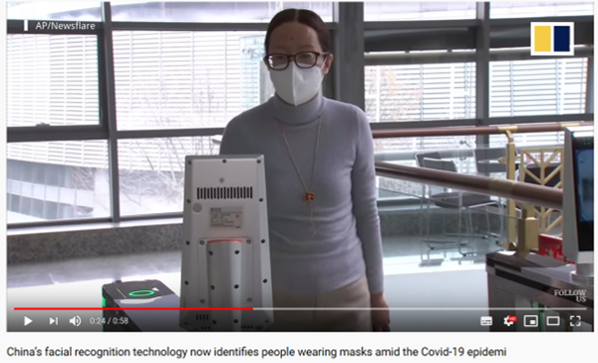
3 - Facial recognition
Facial recognition software is becoming more sophisticated all the time, watch this video (58s) to see how it has already been adapted for use during the Coronavirus pandemic.

Slide 20
ACTIVITY SHEET B
FACIAL RECOGNITION
COURSE
MACHINE LEARNING SHORT COURSE
What are the advantages and disadvantages of using facial recognition technology?
Are the police right to be trialling facial recognition technology to track down criminals? Are people right to be concerned?
Should schools in this country use facial recognition technology in the classroom? Explain your answer.
What are the issues surrounding facial recognition technology?

Slide 21
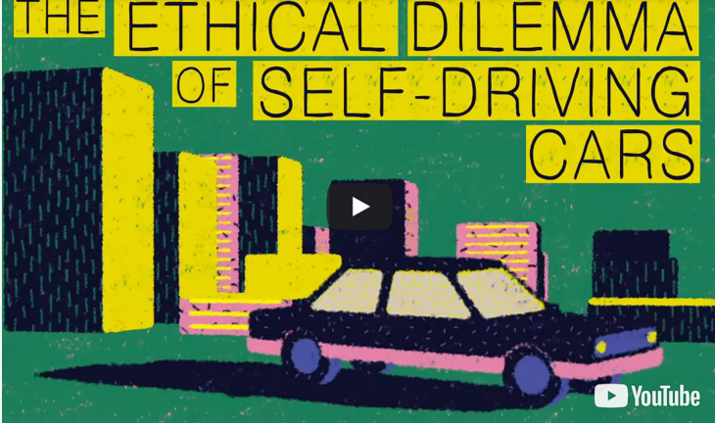
4 – Self-driving cars
Machine learning can be used to develop decision-making algorithms for self-driving cars. Watch this video The ethical dilemma of self-driving cars (4 mins 15s). What are the potential issues with this?

Slide 22
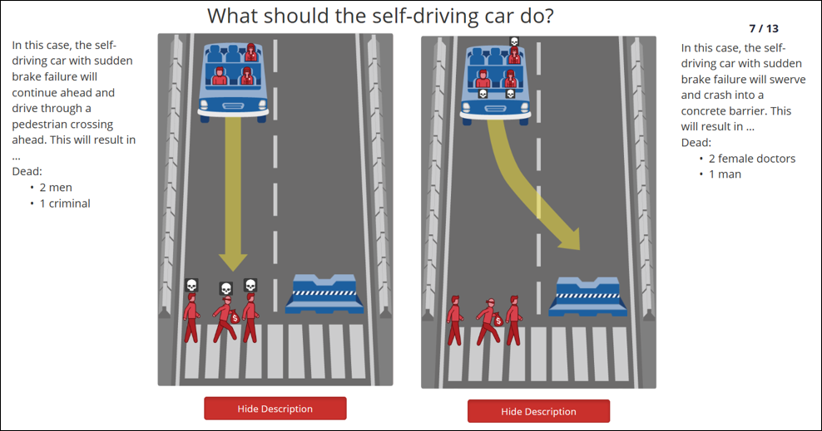
4 – Self-driving cars
Log on to moralmachine.mit.edu/, watch the intro video and then click on ‘Start Judging’ to select your response to each of the self-driving scenarios.
When you have completed this answer the questions on Activity C of the workbook.

Slide 23
ACTIVITY SHEET C
SELF-DRIVING CARS
COURSE
MACHINE LEARNING SHORT COURSE
What do you think are the most important factors for the self-driving cars decision making algorithms? E.g. the age or gender of the person
What would happen if these decisions were not pre-programmed?
Is it morally or ethically right to pre-program these decisions? Explain you answer.
What are the issues surrounding self-driving cars?

Slide 24
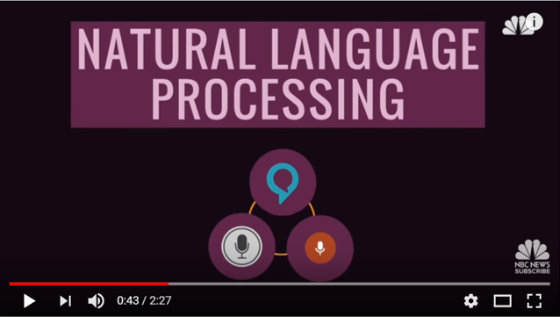
5 – Natural Language Processing
Watch this video ‘This Is The Algorithm That Lets Siri Understand Your Questions’ (2 mins, 27s)

Slide 25
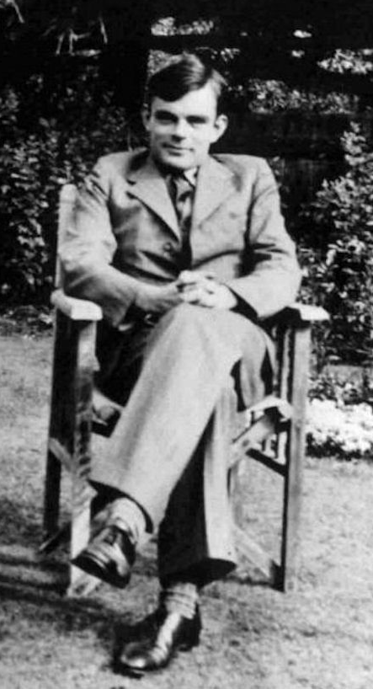
5 – Natural language processing
For natural language processing to work well/be really effective, computer responses need to feel as human-like as possible.
Alan Turing, the founder of modern computing, proposed the Turing test in 1950 to determine whether or not a computer can think intelligently like a human. A computer would be considered intelligent if its conversation couldn’t easily be distinguished from a human’s.
The Loebner Prize is an annual competition in artificial intelligence that awards prizes to the computer programs considered by the judges to be the most human-like.
Notes:
Image source - https://commons.wikimedia.org/wiki/File:Alan_Turing_az_1930-as_%C3%A9vekben.jpg

Slide 26
5 – Natural language processing
Activity - Test out a Chatbot
You are going to test out a chatbot to see how human-like it is in its conversation.
First, go to Activity D in your Student Workbook and write down three questions you think might trip up a chatbot. Try to think of questions that will help you decide whether it is a chatbot or a real person.
Once you have your questions, go to http://www.cleverbot.com/ and try out the chatbot. In your Workbook:
Note down anything silly or unusual that it says
Would this chatbot pass the Turing test?

Slide 27
ACTIVITY D
NATURAL LANGUAGE PROCESSING
COURSE
MACHINE LEARNING SHORT COURSE
Write down your three questions for the chatbot
Did the chatbot say anything unusual or silly?
Would this chatbot pass the Turing test? Explain your answer.
What could be done to make the chatbot seem more human?

Slide 28
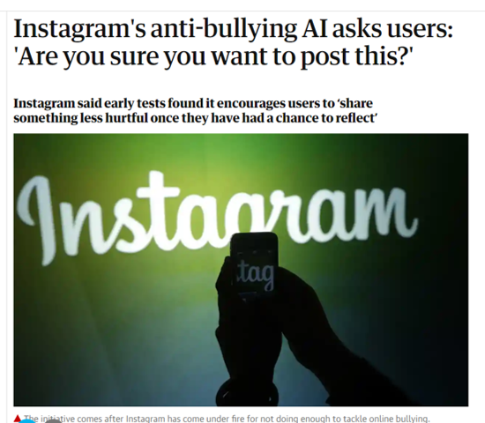
6 – Instagram’s anti-bullying AI

Slide 29
6 – Instagram’s anti-bullying AI
Instagram is inviting users to think again before posting unkind comments with a new tool designed to curb bullying on the social media platform.
The company is rolling out a new feature that uses machine learning to identify negative comments before they are published and asks “Are you sure you want to post this?” before it is shared on another person’s post. It does not stop people from making negative comments, but it gives them the opportunity to cancel the message before it is posted.
This feature uses natural language processing to interpret and classify the posts.
Notes:
Source - https://www.theguardian.com/technology/2019/jul/09/instagram-bullying-new-feature-do-you-want-to-post-this

Slide 30

6 – Instagram’s anti-bullying AI
You are going to build a prototype of this anti-bullying AI model using the Machine Learning for Kids online tool. This tool creates machine learning blocks and adds them to Scratch so you can include them in your code and build an AI model.
To get started go to:
https://machinelearningforkids.co.uk/
Click on Get started and select the Try it now option.

Slide 31
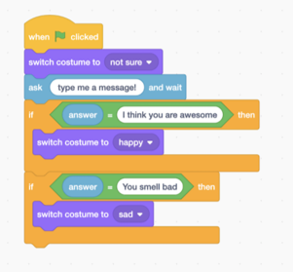
6 – Instagram’s anti-bullying AI
If we were building this model using traditional programming in Scratch, we could use a series of IF statements to check the tone of each message before sending it.
We could then display a happy face if the message was kind and a sad face if the message was mean.
What would be the problem with this approach?

Slide 32
6 – Instagram’s anti-bullying AI
The problem with this approach is our Scratch model would need to have an IF statement for every possible message it might receive. This would be very time consuming to build and would probably still not cover all possible variations of text that people might type in.
Using machine learning, however, we can train a model by giving it lots of examples of kind and mean messages.
From this input, the model can learn to recognise whether a message it has not seen before is kind or mean.

Slide 33
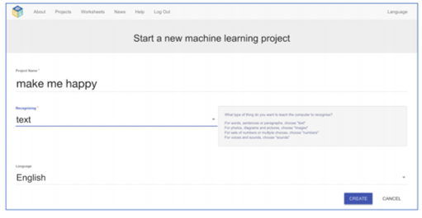
6 – Instagram’s anti-bullying AI
To get started building your model, click on Add a new project. Give the project the title ‘Make me Happy’ and set it to recognise text. Click on Create to set up your project.

Slide 34
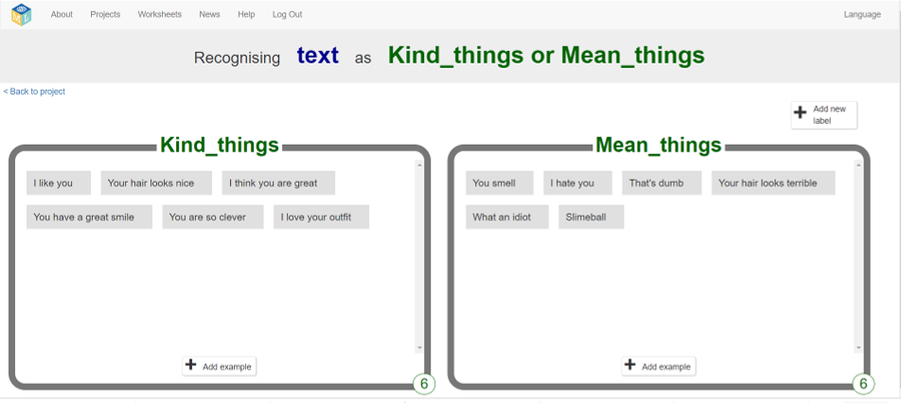
6 – Instagram’s anti-bullying AI
Click on the project’s name to open it and select Train. Create two labels - ‘Kind Things’ and ‘Mean Things’ and add at least six examples (sentences or phrases) of each.

Slide 35
6 – Instagram’s anti-bullying AI
Now, click on the:
< Back to project link
Learn & Test button
Train new machine learning model button (it may take a while to train)
As long as you’ve collected enough examples, the computer should start to learn how to recognise messages from the examples you’ve given to it.
Once the training has completed, a Test box will be displayed. Try testing your model to see what the computer has learned. Test it with examples that you haven’t shown the computer before. If you’re not happy with how the computer recognises the messages, go back to Train and add some more examples.

Slide 36
6 – Instagram’s anti-bullying AI
What have you done so far?
You’ve started to train a computer to recognise text as being kind or mean. Instead of trying to write rules to be able to do this, you have done this by collecting examples. These examples are being used to train a machine learning ‘model’. This is called ‘supervised learning’ because of the way you are supervising the computer’s training.
The computer will learn from patterns in the examples you’ve given it, such as the choice of words and the way sentences are structured. These will be used to recognise new messages.

Slide 37
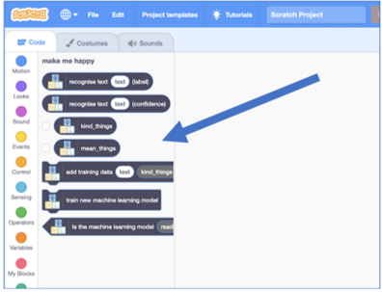
6 – Instagram’s anti-bullying AI
Click on the:
< Back to project link (at the top)
Make button
Scratch 3 button
Read all the information about the Scratch blocks, then click the Open in Scratch 3 button to launch the Scratch editor. You should see the new blocks from your project at the bottom of the code list in Scratch.

Slide 38



6 – Instagram’s anti-bullying AI
Building your model in Scratch
Follow the instructions on the next page to create a sprite with three costumes: a happy face, a sad face and an unsure face. .

Slide 39
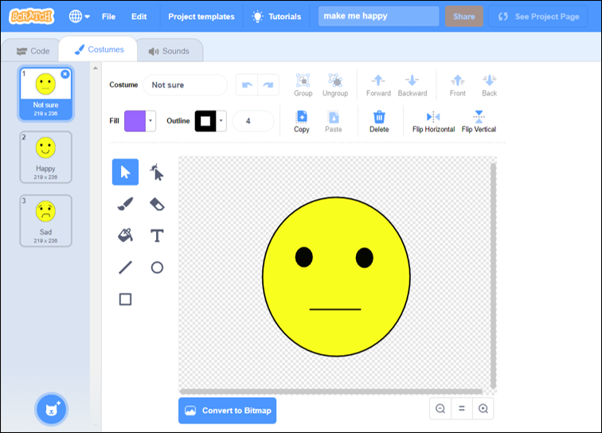
6 – Instagram’s anti-bullying AI
1. Click on costume
4. Right click here and duplicate two more faces
5. Complete the faces by adding a mouth with the paintbrush and name each costume here
2. Click on the cat and select paint
3. Use the circle and paintbrush tools to draw a face and eyes

Slide 40
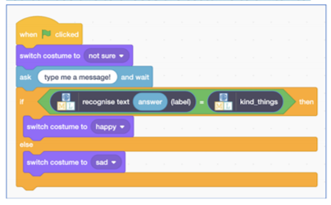
6 – Instagram’s anti-bullying AI
Click on the Code tab and create the script to use your machine learning model.
The Scratch 3 Top Tips! document will help you do this.
Click on the green flag to run your script.
When you enter your ‘message’, your model will return either ‘kind things’ or ‘mean things’ using the training you’ve given the computer. Based on this output, a happy face or a sad face will be displayed.

Slide 41
6 – Instagram’s anti-bullying AI
It’s time to test your model with examples that you haven’t shown the computer before.
If your original example for training was “What an idiot”, try testing the model with “You are an idiot” or “I think you are an idiot”.
Try your new message in Scratch and note down the result in Activity E in the workbook. Did the model correctly carry out your instructions? Why? Why not?
If you’re not happy with how the computer recognises the instructions, add some more examples in ML4K. Make sure you run ‘Train new model’ with the new examples though!

Slide 42
ACTIVITY SHEET E
TESTING AND IMPROVING YOUR MODEL
COURSE
MACHINE LEARNING SHORT COURSE
Test message
Outcome
Correct Y/N?
Try new instructions and note down the result. Did the model correctly carry out your instructions? Why do you think your model did or didn’t understand?

Slide 43
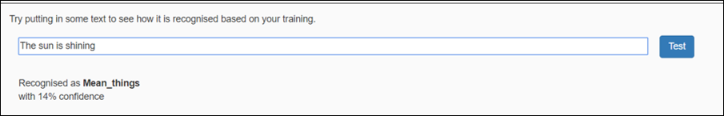
6 – Instagram’s anti-bullying AI
Leave Scratch open, return to Machine Learning for Kids and go < Back to Project.
Open the Learn & Test page in the training tool. Type a message into the Test box that has nothing to do with kind or mean messages.
The confidence score should be very low. The computer is telling you that it’s not certain it understands your command, because what you typed doesn’t look like what it learned from your earlier examples.

Slide 44
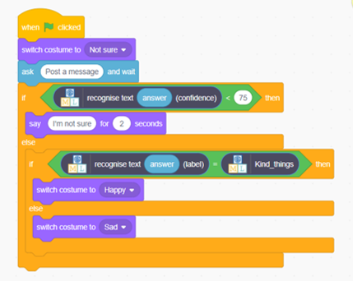
6 – Instagram’s anti-bullying AI
Use the Scratch 3 Top Tips! document to help you add the confidence score to your code.
2. Try typing commands that have nothing to do with kind or mean messages. Check that your model reacts in the right way - a happy face if the message is kind and a sad face if it is mean.
1. Go back to Scratch and modify the script so that it uses this confidence score.

Slide 45
6 – Instagram’s anti-bullying AI
Ideas and extensions
Instead of just kind and mean messages, can you add another category?
Is 75% the right threshold to use to decide whether the computer has recognised the command?
Experiment with different values until you have a value that works well for your machine learning model.
If you choose a number that is too high, the computer will say “Sorry I’m not sure what you mean” too often. If you choose a number that is too low, the computer will get too many decisions wrong.

Slide 46
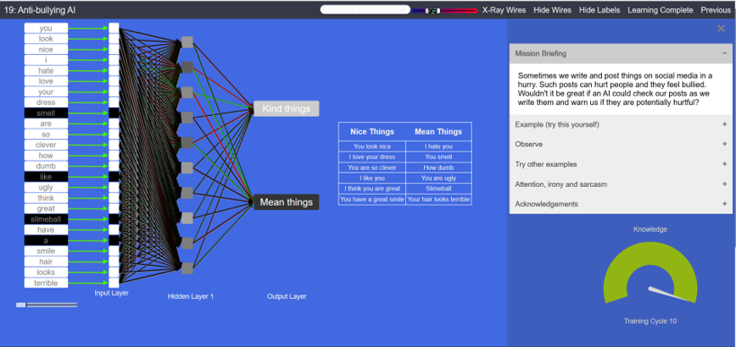
6 – Instagram’s anti-bullying AI
This Digital Technologies Institute experiment shows how a neural network is trained to understand the difference between kind and mean comments. Work through the steps outlined on the right hand side of the webpage to explore how this works.
Notes:
This scenario has been inspired by and developed in cooperation with the Digital Technologies Institute, Australia and Apps for Good.

Slide 47

7 - Uses of machine learning
Now we've seen how machine learning models are trained and built, let's explore some ways they are being used to solve current problems in real-life. This video (3 mins, 57s) explains how machine learning is being used to track the Coronavirus pandemic and diagnose illnesses.

Slide 48
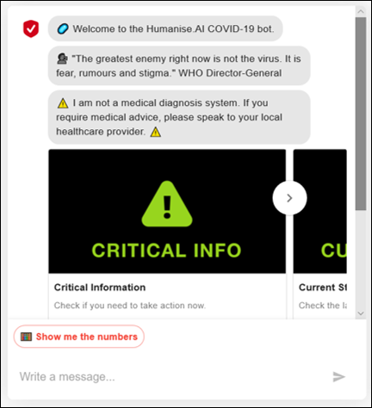
7 - Uses of machine learning
Problem
People have lots of questions about Coronavirus and don’t know who to ask
Solution
This chatbot:
http://covid19bot.com
uses natural language processing to answer questions about the Coronavirus.

Slide 49
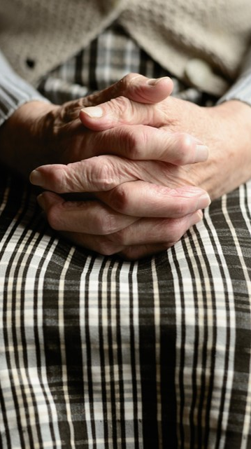
7 - Uses of machine learning
Problem
Many people suffering with dementia still keep a lot of their conversational abilities even as their illness gets worse. However, the shame and frustration that many dementia sufferers feel often makes it hard for them to have normal, everyday talks with even close family members.
Solution - Endurance
This chatbot is a virtual companion that can speak with senior people on general topics such as the weather and news. It can also monitor any deterioration in the person’s condition.
Notes:
Image source - https://pixabay.com/photos/hands-human-old-human-age-seniors-4051469/

Slide 50

7 - Uses of machine learning
Problem
Students find revision boring and struggle to concentrate.
Solution - Zoe (Zone of Open Education)
Zoe is a chatbot that talks to you about physics revision. This was the winning app in the Polish Apps for Good Awards. It helps you to revise faster, and in a more effective way for exams, but also acts as your friend.
Notes:
Image source - https://pixabay.com/vectors/student-teenager-book-learning-147783/

Slide 51
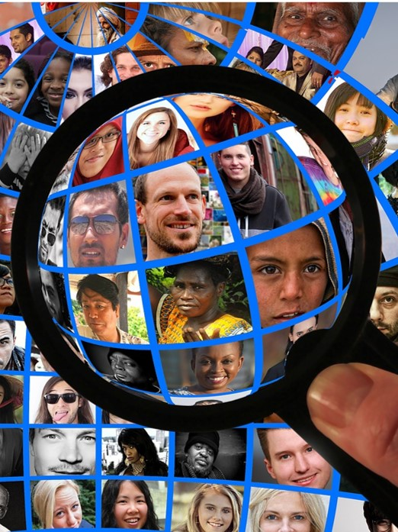
8 – Spot possible problems
Activity
It’s now time for you to identify problems that could be helped by machine learning. This might be a model that could tackle an issue related to the current pandemic situation. Alternatively, it might be something that could help your community more generally.
Activity F in your Student Workbook has some prompts to help you identify potential problems you might solve with your planned machine learning model.

Slide 52
ACTIVITY SHEET F
SPOT POSSIBLE PROBLEMS
COURSE
MACHINE LEARNING SHORT COURSE
Think about issues that have been caused by the current coronavirus pandemic
Think through your average day – what frustrations or issues do you encounter?
Things that I would like to be different in my local community or my life
Things that I wish more people knew about or understood better
Use this sheet to jot down your ideas about possible problems.

Slide 53
9 - Explore your idea
Once you have decided on a problem to tackle, you need to make sure you fully understand what you are trying to solve. This will help you plan the right functionality for the model and make sure that there is a market for your model. Take some time to think through the problem you have identified and answer the following questions in Activity G in your workbook:
Was there a time when this problem didn’t exist?
If so, what has changed?
If not, how have people coped with the problem so far?
Who is impacted most by this problem?
What will happen if this problem is not solved?
What will happen if it is solved?

Slide 54
ACTIVITY G
EXPLORE YOUR IDEA
COURSE
MACHINE LEARNING SHORT COURSE
Was there a time when this problem didn’t exist? If so, what has changed? If not, how have people coped with the problem so far?
Who is impacted most by this problem?
What will happen if this problem is not solved?
What will happen if it is solved?
Think through the problem you have identified and answer these questions.

Slide 55
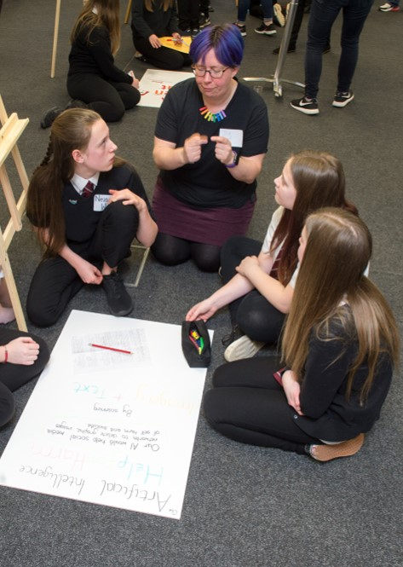
10 - Develop your idea
Next, it’s time to start developing your ideas for how your machine learning model will work.
Summarise the problem you are trying to solve
Think about what your machine learning model will do and what data it will need
Describe who will benefit from your model
Use Activity H in the workbook to make notes on your ideas.
Notes:
Image source - https://pixabay.com/illustrations/chatbot-chat-application-artificial-3589528/

Slide 56
ACTIVITY SHEET H
DEVELOP YOUR IDEA
COURSE
MACHINE LEARNING SHORT COURSE
The problem I have identified
Who the problem affects
My proposed solution
Data I’m going to need
Use this sheet to jot down your ideas about possible problems.

Slide 57

11 - Design your model
What will your solution look like?
Sketch out what your user interface will look like (e.g. the three faces used in ‘Make me happy’)
If you are developing a chatbot, draft an example conversation between your user and the chatbot
Use Activity I in your workbook to make notes on your ideas.
Notes:
Image source - https://pixabay.com/illustrations/chatbot-chat-application-artificial-3589528/

Slide 58
ACTIVITY SHEET I
DEVELOP YOUR IDEAS
COURSE
MACHINE LEARNING SHORT COURSE
Sketch of user interface
Example chatbot conversation
Use this page to sketch out your design ideas

Slide 59
12 - Explain your idea
The final task in your planning/prototyping is to explain your idea for a machine learning model to others. Think about all the different ways you could present your machine learning model design to potential investors. You could:
Create a presentation or report detailing the problem and how you are going to use machine learning to tackle it
Use an online tool such as Powtoon to create an animation to explain your ideas
Create a video using your phone and an app such as Splice or PowerDirector
Use a free online tool such as Pixton to create a comic strip
If you are entering our Awards a video or Powtoon would be the best options

Slide 60

Want to continue developing?
Ways to keep developing
Apps for Good can help you:
Learn more about the application and ethical considerations concerning machine learning
Develop your model using Machine Learning for Kids or program your solution using Python
Explore problems that could be helped by image, voice or numerical based models
Decide on your business model to monetise your idea

Slide 61
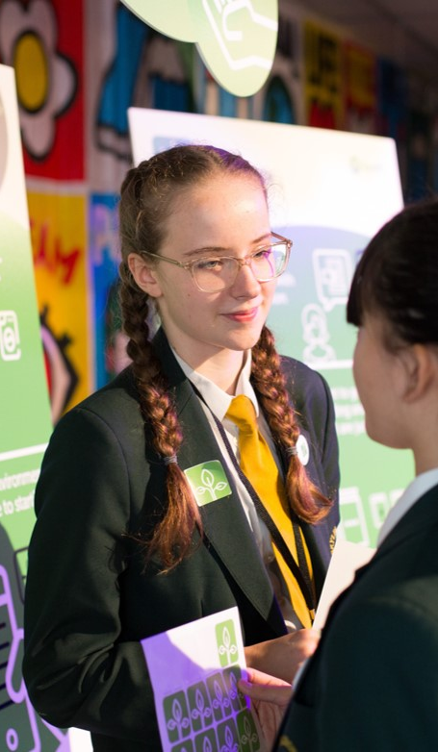
The Awards
The 2020 AfG competition – this year open to all students, UK and international, who take part in Apps for Good courses – gives students the chance to shine on a public stage.
The annual Apps for Good Awards recognise top apps, IoT devices and machine learning models created by students in our courses.
The closing date for this year’s competition is 18 May 2020. See the ‘Preparing for the Awards’ presentation for help completing the entry form.

Slide 62

Feedback
Please let us know what you think of this course.
Your feedback will be invaluable in making sure that we can adapt and improve our courses to help you continue your studies at home.
https://docs.google.com/forms/d/e/1FAIpQLSf2iv4FcyQWJU5JeQHca__UgXlP7G3RyKUGmD8uLBHCA56gLw/viewform
Notes:
Image source - https://pixabay.com/photos/desk-paper-feedback-smartphone-pen-3400724/

Slide 63
COURSE COMPLETE
WELL DONE
YAY!

Slide 64
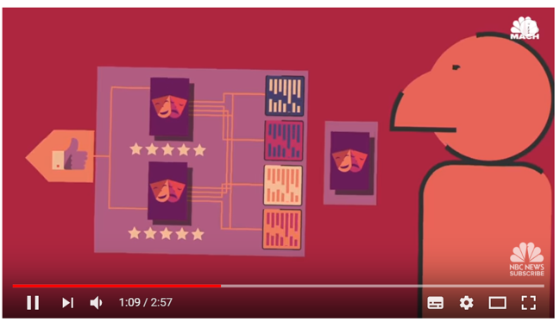
Optional activity – Recommendation systems
Watch this video Why Netflix’s Algorithm Is So Binge-Worthy (2 mins, 57s). How does Netflix produce recommendations?

Slide 65
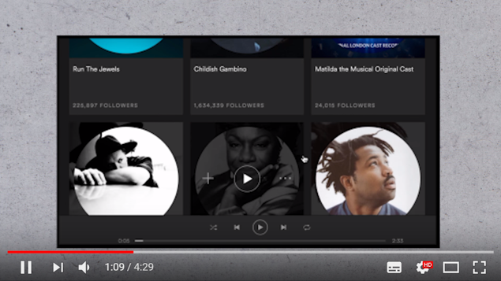
Optional activity - Recommendation systems
Watch this video The Science Behind Spotify's Discover Weekly (4 mins 29s). How does Spotify produce Discovery Weekly?

Slide 66
OPTIONAL ACTIVITY
RECOMMENDATION SYSTEMS
COURSE
MACHINE LEARNING SHORT COURSE
How does Netflix produce recommendations?
How does Spotify produce Discover Weekly?
Can you think of any other machine learning recommendation systems?
Can you think of any drawbacks of recommendation systems?
How well do you think Spotify/Netflix or other recommendation systems know you? Why is this?

Slide 67


Using these materials
Apps for Good materials are licensed under the Creative Commons Attribution-NonCommercial-ShareAlike CC-BY-NC-SA License
You are free to:
Share — Copy and redistribute the material in any medium or format
Adapt — Remix, transform, and build upon the material
Under these terms:
Attribution – You must attribute the material to Apps for Good
Non Commercial – You may not use the material for commercial purposes
Share Alike – If you remix, transform, or build upon the material, you must distribute your contributions under the same license as the original

