Slide 1

Feedback as Education Reform
What We Know
Jack States
Ronnie Detrich
Randy Keyworth

Slide 2
Intermountain Health Care (IHC)
Group of 30 hospitals and Clinics Utah and Idaho
Exemplar for patient care and reduced costs
Medicine excels at evidence-based selection but implementation relying on professional judgment alone decreases outcomes
Professional judgment:
Professional judgment combined with feedback produces better outcomes
IHC established a key Indicator system
Best practice guidelines and goals established
System tracks Doctor outcomes against standards
Performance reviewed and feedback provided
Notes:
Social significance

Slide 3
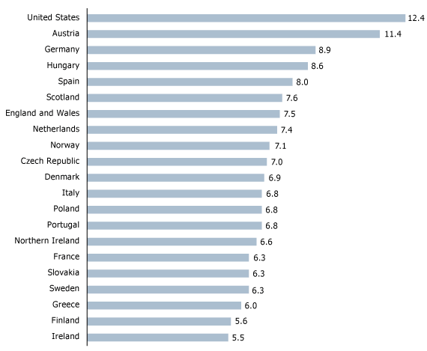
IHC Outcome: Child Mortality US Ranked: 42nd
Premature Birth
Ranking
Infant mortality reduced by 13%
IHC - 2001
30% of births induced
IHC - 2009
2% of births induced
Notes:
1. Voluntary induced labors contributor
2. 1998 guidelines set to limit
3. In 2001 Intermountain – 30% of births induced before 39 weeks
4. Setting goals, monitoring doctors performance, and provide
feedback
5. 2009 dropped to 2%
Consequence: sent request for justification, sent list of inductions Dr. performed, asked to have him ID what had been incorrectly classified.

Slide 4
What is Feedback?
What it is:
“…Information about performance that allows individuals to adjust his or her performance. Feedback shows a performer where current performance is in relation to past performance and usually some goal.”
(Daniels, A., 1994, Bringing Out the Best In People)
What it is not:
General information
Notes:
Data Based: Objective, reliable, measurable, and specific

Slide 5
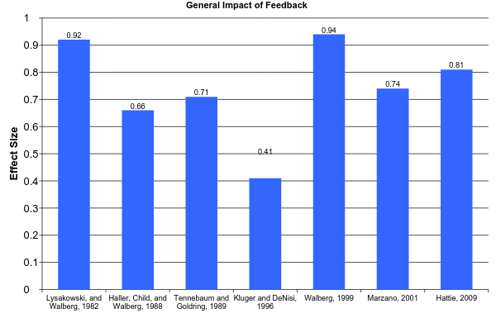
How Powerful is Feedback?
0.5 = Medium Effect
Notes:
1/3 of studies had negative results out of 607 – if focus on the task +, focus on the person -

Slide 6
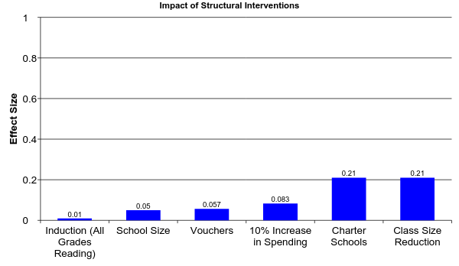
How Effective Are Are Structural Interventions
0.8 = Large Effect
The Social Impact on Student Achievement Has Been Small
0.5 = Medium Effect
0.2 = Small Effect
Notes:
Spend over $20 billion on class size
Take home Message: There are no simple solutions we want to make a difference the road is complex and we cannot avoid managing performance

Slide 7
Who is the Focus of Feedback
Student
System
Teacher
Notes:
Locus of the feedback – who is the feedback about who is delivering the feedback

Slide 8
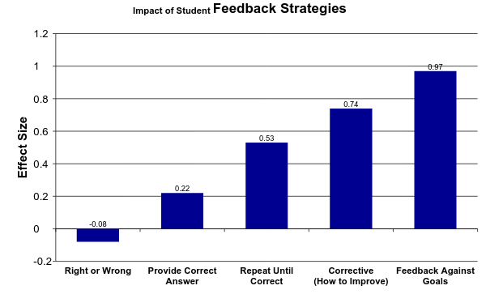
Student Own Performance Student Focus
How You Provide Feedback to Students Makes a Difference
Marzano, 2005
Notes:
Peer Feedback = 0.62

Slide 9
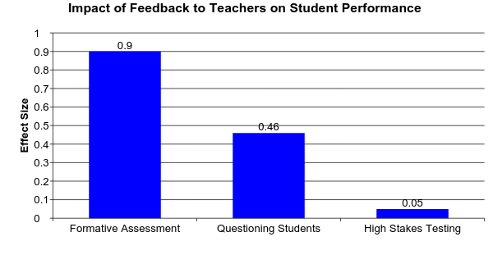
Teacher Feedback on Student Performance
(Fuchs and Fuchs, 1986)
(Hattie, 2009)
(Yeh, 2007)

Slide 10
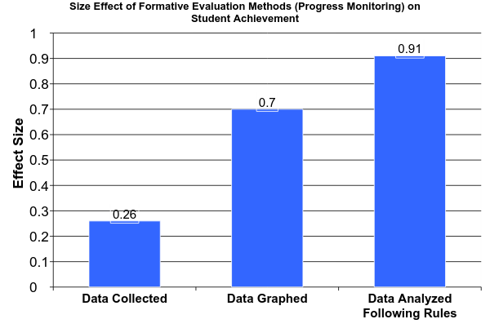
Teacher Feedback on Student Performance
Effects of Systematic Formative Evaluation: A Meta-Analysis, Fuchs & Fuchs, 1986

Slide 11
Effect of Feedback for Supervisors
Monitoring improves performance even when there are no consequences (Larson & Callahan, 1990)
Contingent consequences result in significant improvement in performance when compared to non-contingent (Cherrington, Reitz, & Scott, 1973; Komaki, Waddell, & Pearce, 1977; Orpen, 1974; and Pierce & Risley, 1974)
Monitoring results in leaders providing more consequences (Komaki & Citera, 1990)
Monitoring improves works satisfaction (Millenson, 1967)

Slide 12
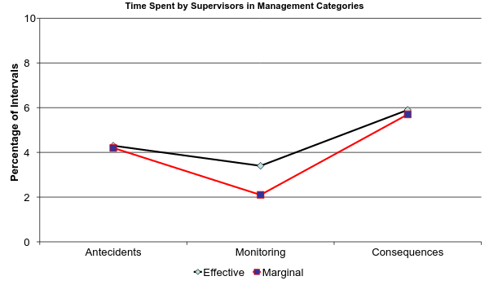
How Effective and Marginal Supervisors Differ
Categories From the Operant Supervisory Taxonomy and Index
Komaki, 1986
Notes:
7 categories

Slide 13
Effect of Feedback Delivered Through Reporting Systems
Relative performance improves performance, Murthy and Schafer (2011)
Outcome data alone produces minimum results, Kludger and DeNisi (1996)
Outcome data combined with process data produces best results, Leung and Trotman (2005)
Positive and negative feedback can increase performance, Murthy and Schafer (2011)
Notes:
Effects of Relative Performance Information and Framed Information Systems Feedback on Performance in a Production task

Slide 14
Features of Effective Feedback
Performance measures must be reliable and valid.
Staff need to know the variables being measured
Skills must be identified to attain these measures
Staff feedback should be frequent and immediate
Feedback should trigger and guide effective coaching.

Slide 15
Feedback Content “Not All Feedback is the Same”
Positive feedback was more powerful than negative (critical ) comments. Murthy, U. and Schafer, B., 2011
Negative impact (1/3 of the studies) for feedback is personnel vs. a positive effect (d. = 0.41) for feedback focused on the task (Kluger, A., and DeNisi, A., 1996)

Slide 16
Temporal Dimensions of Feedback (Frequency and Immediacy)
Feedback increases maintenance of education interventions, Codding, et al., 2005, O’Reilly et al., 1994
Targeted teaching behaviors acquired more quickly when feedback was immediate, O’Reilly et al., 1994, Coulter and Grossen, 1997
Immediate feedback in applied studies achieved best results 0.28 Effect size, Kulik, J., and Kulik, C., 1988

Slide 17



What Models Have Worked
Curriculum
Graduation
Teaching
Input
Process
Outcomes
Feedback
Loop
Rummler & Brache, (1990)
Improving Performance
Notes:
Post WWII Japan where the American statistician W. Edwards Demings by focusing on quality and save $ turned electronics and auto into great success story of 1980s
Geary Rummler is credited along w/other of founding Six Sigma at Motorola incorporates TQM features

Slide 18
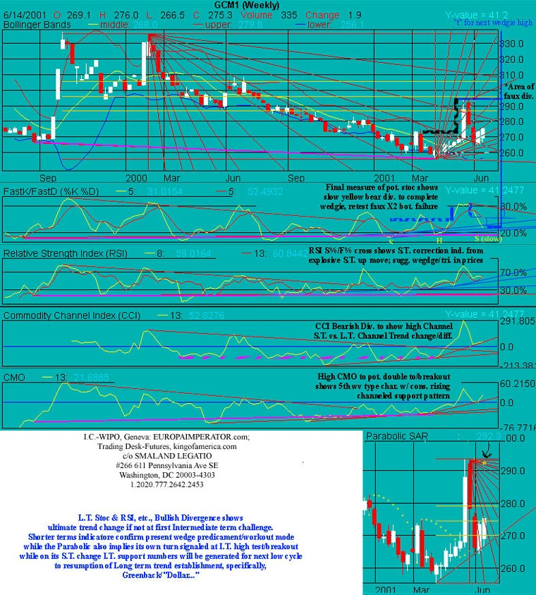
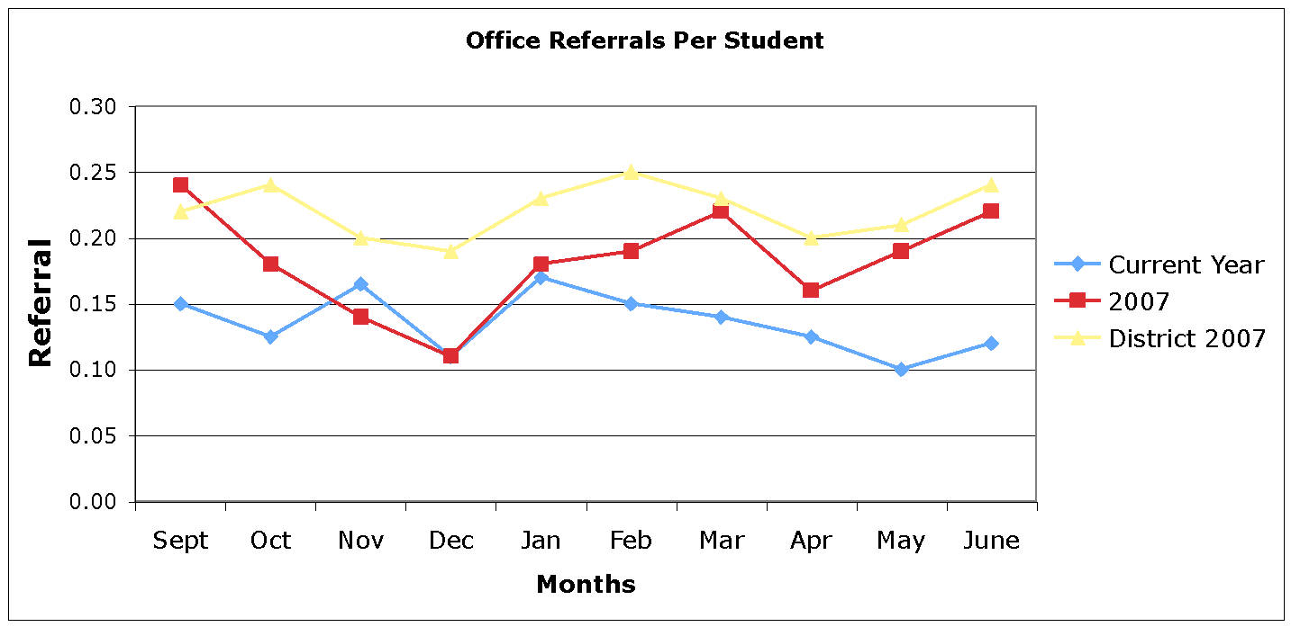
Desirable vs Undesirable
Too Much Data!
Status, Trends, and Standards
Notes:
Feature: Graph the data – 1. easier to read and interact 2. graphing is powerful example formative assessment .26 to .70
Relative information: Murthy and Schafer, 2011 and positive feedback

Slide 19
Indicator Selection
Student Performance | Teacher Performance | System Performance
Achievement | Teaching/Treatment Integrity | Staff Attraction & Retention
Summative | Training | Parent Satisfaction & Participation
Formative |  | Resources & Funding
Retention/Completion |  | Standards & Curriculum
Graduation/Drop out |  | Business Operations
Conduct/Safety |  | Compliance w/Laws and Regulations

