Slide 1

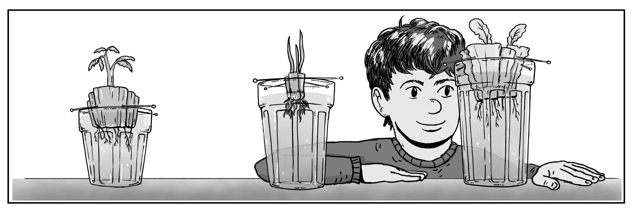
Hydroponic Plants
Type: Class Demo
Time: 15 mins over the course of 1-2 weeks
NGSS: 5-LS1-1. Support an argument that plants get the materials they need for growth chiefly from air and water.
Focus: In this extension, students observe the regrowth of food scraps over a period of 1-2 weeks. These first-hand observations will provide students with additional evidence that plants use materials from air and water for their growth.
How does a tiny seed become one of the heaviest trees on Earth?
Materials (quantity is per class demo):
3 clear cups filled with water
12 toothpicks
Knife (for prep)
Celery
Green Onion
Romaine Lettuce
Paper towels (for clean up)
Digital scale (optional)
Prep (can be done at home prior to coming to school):
Cut about 1” from the bottom of the Romaine Lettuce, Green Onion, and Celery. You can use the tops to make a delightful green salad for yourself since these parts of the veggies will not be used in the experiment!
Instructions:
Place the 3 cups filled with water somewhere the class can see. Preferably near a window if possible.
Use 4 toothpicks per vegetable to poke into the sides of the lettuce, onion and celery just enough so it can support itself on top of the cup. Tip: Use a digital scale to weigh the food scraps at the start of the experiment.
Make sure the bottom of each vegetable is submerged in water to ensure proper growth.
Have students record their observations of the food scraps over 1-2 weeks every other day.
At the end of the experiment, discuss the differences you notice in each vegetable. Tip: Use a digital scale to weigh the food scraps at the end of the experiment.
Discuss: What differences do you notice in the vegetables at the end of the experiment? If you weighed the vegetables before and after the experiment, what did you notice? Where do you think that additional growth and weight came from?
What’s going on?
Hydroponics is a type of gardening that utilizes only water and light to grow plants. Along with adequate light, plants can grow solely in water due to the nutrients it provides. Hydroponic gardening can be done all year round.

