Slide 1

facilitybot
Training

Slide 2
Updating the Request (for Responders)
WEB PORTAL

Slide 3
Notes
The responders' key action is updating Request ticket status.
Four available statuses: "PENDING," "PROCESSING," "COMPLETE," and "CANCELED."
PENDING:
  Initial status when Request is made.
PROCESSING:
  Indicates Responder's work has begun.
  Used when multiple team members handle the same Request.
  Can show who's working or if Responder arrived on site.
  Transition from Pending to Processing is Response time.
COMPLETE:
  Shows Request is finished.
  Transition from Pending to Complete is Rectification time.
  Corrective Request possible even after completion.
CANCELED:
  Used for mistaken Requests.

Slide 4
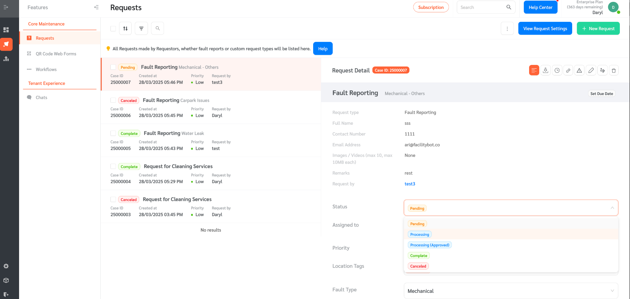
Changing the status of a request in the web portal
Change the status to accordingly. Cancel to reject

Slide 5
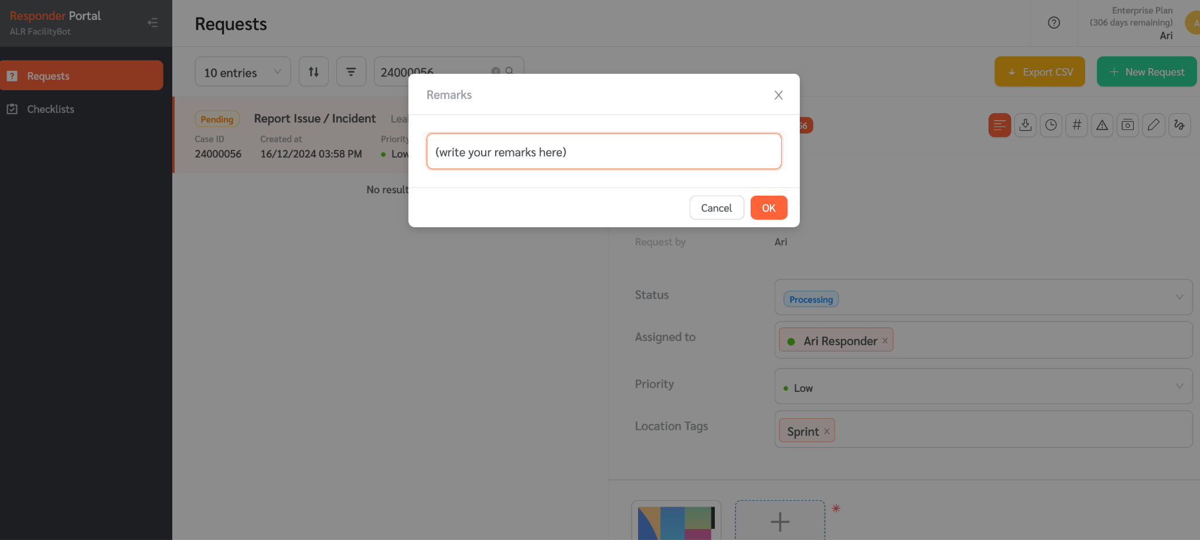
Processing a request on the web portal
Add a remark if necessary when you update the status

Slide 6
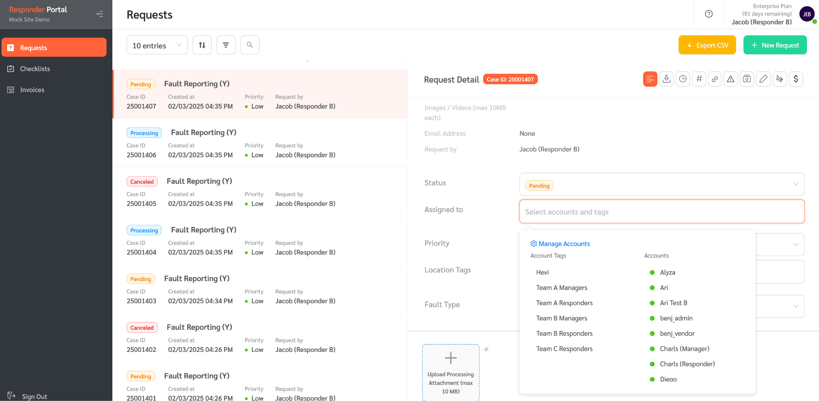
Assigning a request to accounts in the web portal
You can manually assign an account to the request

Slide 7
Resources
Responder Web Portal articles
Responder Mobile App articles
Knowledge Base

