Slide 1
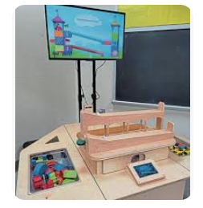

RAMPS
Using the Scientific Method to Explore Forces and Motion
Lesson 2: Exploring Scientific Method with Ramps
Lesson 3: Using Scientific Method to Explore Forces & Motion
SmartRamps
Lessons 2 & 3

Slide 2
Welcome Little Scientists!
What are Ramps?
Ramps are a flat surface with one end higher than the other
Lessons 2 & 3

Slide 3
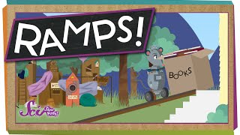
What are Ramps used for?
Ramps are used to help move things from one place to another place.
https://www.youtube.com/watch?v=3COvm0TtxWg
Lessons 2 & 3
Notes:
Lesson 2 and 3 are combined in these slides. Lesson 2 is designed to be a whole class activity reviewing the scientific method while introducing basic ramp knowledge.

Slide 4
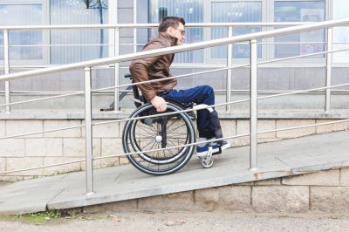
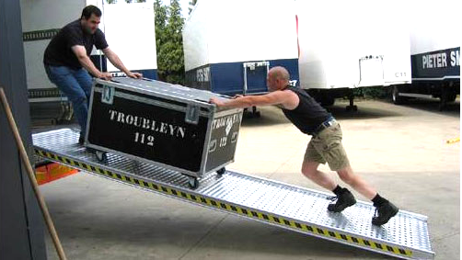
Where have you seen ramps in use in everyday life?
Lessons 2 & 3

Slide 5
Have you ever been on a ramp or slide?
Have you ever been on a roller coaster?
What happens if you place on object at the top of a ramp and let it go?
What makes an object go faster on a ramp?
Lessons 2 & 3

Slide 6
Vocabulary
Scientist
Ramp
Friction
Mass
Gravity
Potential Energy
Acceleration
Lessons 2 & 3

Slide 7
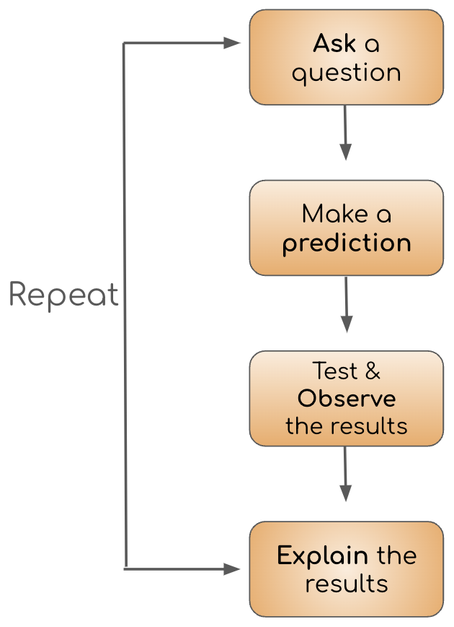
Scientific Method
The scientific method is a process or method of research.
It helps scientists to explain how the world around them works.
Lesson 2

Slide 8
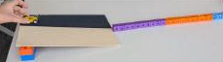
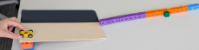
Let’s test out some ramps!
Ask a question: Will the car travel the further on wood or textured surface?
Predict: I think that the car on …
Observe: Watch the car
Explain: Why did that happen?
Lesson 2

Slide 9
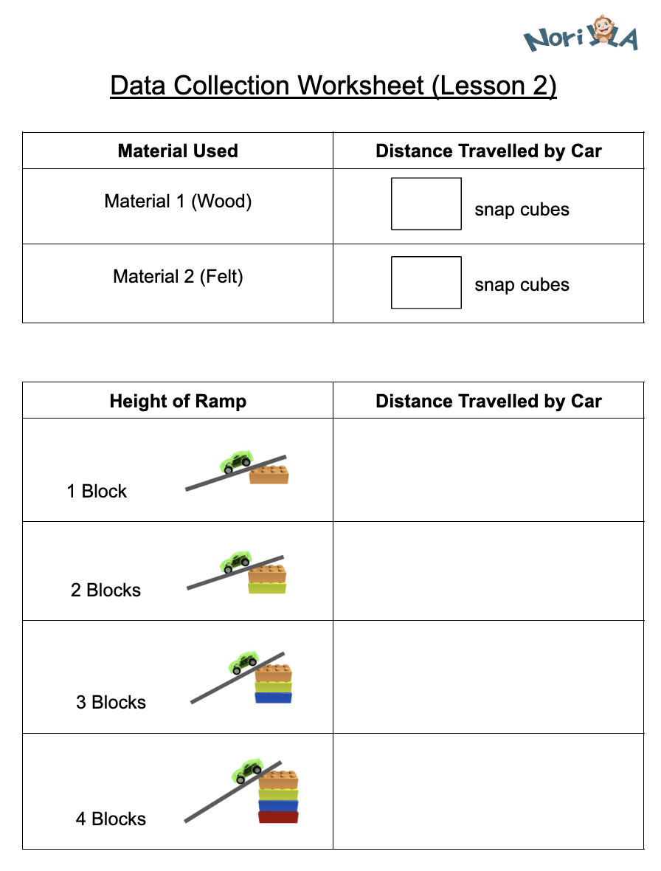
Data Collection
Scientists record the results of their experiments so that they can show their results and learn from them.
Lesson 2

Slide 10
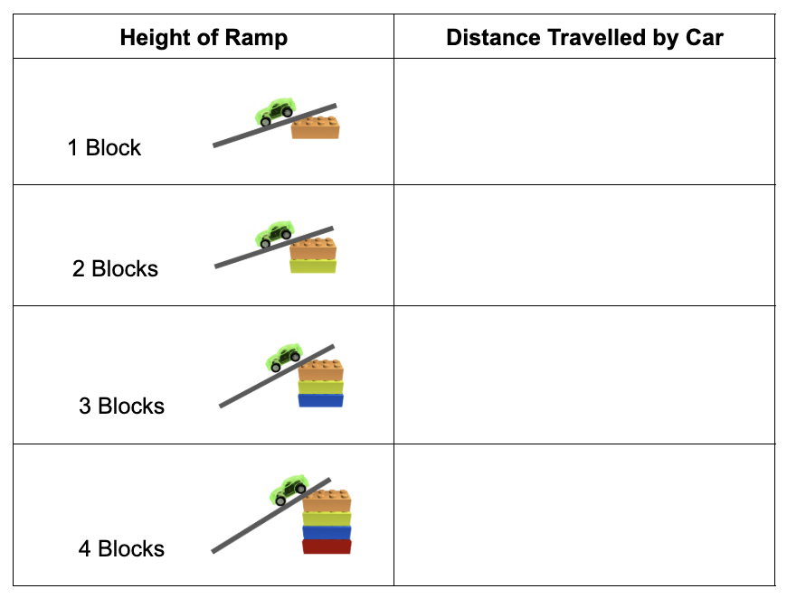
Data Collection
What observations can you make from our data?
What patterns do you notice?
Lesson 2

Slide 11


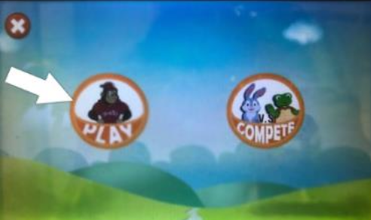
Let’s experiment on Norilla!

Slide 12
At NoRILLA
We are going to use Norilla to observe some different objects rolling down ramps. Some of you will get to come up to the table today. You will all get a chance in the next few classes.
Remember the scientific method while using NoRILLA!
Ask: ”Which object will reach the end fastest?”
Make a prediction and tell why you think so
Observe the results
Explain the results
Lesson 3

Slide 13
What did we learn?
How does friction affect an object rolling down a ramp?
How does the shape of the object affect it rolling down a ramp?
What did you find interesting about this lesson?
Lesson 3

Slide 14
Optional Videos: Ramps videos
Ramps: A Super, Simple Machine!
https://www.youtube.com/watch?v=3COvm0TtxWg
Force and Motion for Kids | Ramps | Kids Academy
https://www.youtube.com/watch?v=y6VjHcOX8_o

