Slide 1
Chapter 18
How to Think Strategically
The Prisoner’s Dilemma and the Challenge of Cooperation
Multiple Equilibria and the Problem of Coordination
Advanced Strategy: First and Second Mover Advantages
Advanced Strategy: Repeated Games and Punishments
Game Theory
and
Strategic choices
Notes:
Teacher Tip:
There's too much material here for one lecture
If you only want to do one lecture on game theory, consider teaching as far as the Prisoner's dilemma, or coordination games.
If you are okay with two lectures on game theory, consider using the first lecture for foundational concepts, and the second to teach all or some of the advanced concepts.

Slide 2
Chapter 18
Apply the four steps for making good strategic decisions:
Introduce game theory
Four step recipe
How to Think Strategically
The Prisoner’s Dilemma and the Challenge of Cooperation
Multiple Equilibria and the Problem of Coordination
Advanced Strategy: First and Second Mover Advantages
Advanced Strategy: Repeated Games and Punishments

Slide 3
One image involves game theory. The other does not.
Left: Barratts/PA Images Archive/Getty Images; Right: Bettman/Getty IMages
Notes:
Teacher Tip:
Before formally defining game theory, have students try to guess what game theory is about using this slide as a discussion starter.
Highlight and reinforce student responses that are on the right path.
Game theory: When two boxers meet, the outcome is determined not only by their skill and strength, but also by the interaction of their competing strategies.
Game theory is laying out a framework for the analysis of strategic interaction and decision making.

Slide 4
Introducing game theory
Game theory is the science of making good decisions in situations involving strategic interaction.
Strategic interaction: when your best choice may depend on what others choose, and their best choice may depend on what you choose.
Underlying idea comes from the interdependence principle.
Your decisions are intertwined with those of others.
Strategic interactions in relation to both competition and collaboration.

Slide 5
Strategic interactions are all around you
Games:
Boxing, Football, Basketball, Baseball, Soccer
Chess, checkers, tic-tac-toe, rock-paper-scissors
Business:
Your decision to cut your price depends on how your rivals will respond.
How you position your product depends on how competitors position their product.
Your decision to enter a new market depends on whether incumbent firms will respond with a price war.
The profitability of your investment in a project may depend on how much your partners invest in that project.

Slide 6
Strategic interactions are all around you
Politics and international affairs:
The payoff from voting on a bill depends on whether others vote for it too.
My decision to vote for something depends on how I think my constituents (or opponents) will respond.
A leader’s decision to amass troops near the border depends on how they think other countries will respond.
Friends and family:
You will go to the party only if your friends also go to the party.
What state you live in (or part of the state) you chose to live and work in, depends on where you friends and family live.

Slide 7
Four steps for making good strategic decisions
Consider all the possible outcomes.
Think about the “what ifs” separately.
Evaluate your best response.
Put yourself in someone else’s shoes.

Slide 8
Step 1: Consider all the possible outcomes
Every combination of choices that both you and other players might make.
Payoff table: a table that lists…
your choices in each row
the other player’s choices in each column
and thus shows all possible outcomes, listing the payoffs in each cell.
 | Professor puts game theory on the exam | Professor omits game theory from the exam
You read the rest of this chapter | Ace the exam | You study more than necessary
You don’t read the rest of this chapter | Fail the exam | Save time and still get a good grade
© Worth Publishers
Notes:
Teacher Tip:
POST this slide for STUDENTS to print (printer-friendly version of payoff table).

Slide 9
Step 1: Consider all the possible outcomes
Every combination of choices that both you and other players might make.
Payoff table: a table that lists…
your choices in each row
the other player’s choices in each column
and thus shows all possible outcomes, listing the payoffs in each cell.
 | Professor puts game theory on the exam | Professor omits game theory from the exam
You read the rest of this chapter | Ace the exam | You study more than necessary
You don’t read the rest of this chapter | Fail the exam | Save time and still get a good grade
© Worth Publishers
Notes:
Teacher Tip:
USE this slide IN CLASS when presenting the various elements of the payoff table to students.

Slide 10
Step 2: Think about the ‘What Ifs” separately
Side-step the potential for going down the rabbit hold of,
“I think that they think that I think that they think…”
Break the problem into simpler components, which are the various choices the other person could make.
What if they do? What if they don’t?
 | Professor puts game theory on the exam | Professor omits game theory from the exam
You read the rest of this chapter | Ace the exam | You study more than necessary
You don’t read the rest of this chapter | Fail the exam | Save time and still get a good grade
© Worth Publishers
Notes:
Teacher Tip:
USE this slide IN CLASS when presenting the various elements of the payoff table to students.

Slide 11
Step 3: Evaluate your best response
HELPFUL HINT: when evaluating each “what if” scenario, place a checkmark next to your best response.
For each “what if?” you want to evaluate your best response.
Best response: the choice that yields the highest payoff given the other player’s choice.
 | Professor puts game theory on the exam | Professor omits game theory from the exam
You read the rest of this chapter | Ace the exam | You study more than necessary
You don’t read the rest of this chapter | Fail the exam | Save time and still get a good grade
“What if” the professor puts game theory on the exam?
Your two ‘responses’ are read, or don’t’ read.
Given the possible outcomes, your best response is ‘read’ for this particular “What if” scenario.
You Try! Repeat this thought experiment for the other “What if” scenario: “omits”
© Worth Publishers
Notes:
Teacher Tip:
POST this slide for STUDENTS so that they work through the second “What if” scenario on their own.
This slide does not include the second “best response checkmark”

Slide 12
Step 3: Evaluate your best response
HELPFUL HINT: when evaluating each “what if” scenario, place a checkmark next to your best response.
For each “what if?” you want to evaluate your best response.
Best response: the choice that yields the highest payoff given the other player’s choice.
 | Professor puts game theory on the exam | Professor omits game theory from the exam
You read the rest of this chapter | Ace the exam | You study more than necessary
You don’t read the rest of this chapter | Fail the exam | Save time and still get a good grade
“What if” the professor puts game theory on the exam?
Your two ‘responses’ are read, or don’t’ read.
Given the possible outcomes, your best response is ‘read’ for this particular “What if” scenario.
You Try! Repeat this thought experiment for the other “What if” scenario: “omits”
© Worth Publishers
Notes:
Teacher Tip:
USE this slide IN CLASS when presenting the various best responses to students.

Slide 13
Step 4: Put yourself in someone else’s shoes
Work your way through someone else’s thought process to better predict their choices.
Repeat Steps 1-3 but from the perspective of the OTHER player (the professor).
 | Professor puts game theory on the exam | Professor omits game theory from the exam
You read the rest of this chapter | Ace the exam | You study more than necessary
You don’t read the rest of this chapter | Fail the exam | Save time and still get a good grade
“What if” the student reads the chapter?
Professor’s two ‘responses’ are put, or omit.
Given that professors want to reward effort, the Professor’s best response is ‘put’ for this particular “What if” scenario.
You Try! Repeat this thought experiment for the other “What if” scenario: “don’t read”
© Worth Publishers
Notes:
Teacher Tip:
POST this slide for STUDENTS so that they work through the second “What if” scenario on their own.
This slide does not include the student’s second “best response checkmark” for the “don’t read” scenario.

Slide 14
Step 4: Put yourself in someone else’s shoes
Work your way through someone else’s thought process to better predict their choices.
Repeat Steps 1-3 but from the perspective of the OTHER player (the professor).
 | Professor puts game theory on the exam | Professor omits game theory from the exam
You read the rest of this chapter | Ace the exam | You study more than necessary
You don’t read the rest of this chapter | Fail the exam | Save time and still get a good grade
“What if” the student reads the chapter?
Professor’s two ‘responses’ are put, or omit.
Given that professors want to reward effort, the Professor’s best response is ‘put’ for this particular “What if” scenario.
You Try! Repeat this thought experiment for the other “What if” scenario: “don’t read”
© Worth Publishers
Notes:
Teacher Tip:
USE this slide IN CLASS when presenting the various best responses to students.

Slide 15
Concept Check: Reading the payoff table
You are the row player, Amtrak. You are thinking about how to best respond to the various “What if” scenarios.
When choosing your best response to Greyhound bus, should you compare your payoffs across a given row or compare payoffs up and down a given column?
 | Greyhound runs 1 route per day | Greyhound runs 2 routes per day | Greyhound runs 3 routes per day
Amtrak runs 1 route | You earn $6 m They earn $6 m | You earn $3 m They earn $8 m | You earn $2 m They earn $7 m
Amtrak runs 2 routes. | You earn $7 m They earn $3 m | You earn $4 m They earn $4 m | You earn $1 m They earn $2 m
As the row player, Amtrak, you find your best response by comparing the payoffs up and down .a given column .
Notes:
Teacher Tip:
Click to reveal the answers in the payoff table first, and then the answers to parts A and B, respectively.

Slide 16
Key take-aways: How to think strategically
Strategic interaction
When your best choice depends on what others choose (and vice versa).
Your decisions and payoffs are intertwined with those of others.
Four steps for making strategic decisions
Consider all possible outcomes
Think about the “What ifs” separately
Play your best response
Put yourself in the OTHER player’s shoes.

Slide 17
Chapter 18
How to Think Strategically
The Prisoner’s Dilemma and the Challenge of Cooperation
Multiple Equilibria and the Problem of Coordination
Advanced Strategy: First and Second Mover Advantages
Advanced Strategy: Repeated Games and Punishments
Understand how the Prisoner’s Dilemma highlights the problems of getting people to cooperate:
Failure of cooperation
Nash equilibrium

Slide 18
What’s your advice for the CEO of Coca-Cola?
CEO of Coke asks you for strategic advice:
CEO’s new idea: “Why don’t we just abolish our advertising budget altogether?”
CEO’s logic: “If Pepsi does the same thing, then both firms will earn higher profits, because both will sell roughly the same amount of cola, with neither of us wasting billions of dollars on useless advertising.”
Cola market background facts:
Advertising increases a company’s market share.
BUT the impact of Coke and Pepsi’s advertising ultimately offset one another.
Advertising does not convince people to drink more soda overall.

Slide 19
Step 1: Consider all the possible outcomes
Payoff table: a table that lists…
Coke’s choices in each row
the Pepsi’s choices in each column
Payoffs for possible outcomes:
Currently, both earn $1 billion in profits (after spending $1 billion in advertising).
The deal: save $1 billion in advertising, thus increasing profits to $2 billion.
If one company defects from the deal, they can steal market share from the other company (an extra $1 billion).
© Worth Publishers

Slide 20
Step 2 & 3: For each “What if”, play your best response
You are ‘Coke’ :
What if Pepsi cooperates? → what’s your best move?
What if Pepsi defects? → what’s your best move?
You Try! Work through the “What if Pepsi defects?” scenario on your own.
What if Pepsi cooperates?
Your two options are ‘cooperate’ or ‘defect’.
Cooperation earns you $2b
Defect earns you $3b
Thus, if Pepsi cooperates, then your best response is to defect.
© Worth Publishers
Notes:
Teacher tip:
POST this slide FOR STUDENTS to print (this excludes the ‘best response checkmark’ for the ’Pepsi defect’ scenario)
During class, have students work through Coke’s best response under the other scenario: “What if Pepsi defects?”

Slide 21
Step 2 & 3: For each “What if”, play your best response
You are ‘Coke’ :
What if Pepsi cooperates? → what’s your best move?
What if Pepsi defects? → what’s your best move?
You Try! Work through the “What if Pepsi defects?” scenario on your own.
What if Pepsi cooperates?
Your two options are ‘cooperate’ or ‘defect’.
Cooperation earns you $2b
Defect earns you $3b
Thus, if Pepsi cooperates, then your best response is to defect.
© Worth Publishers
Notes:
Teacher tip:
USE this slide DURING CLASS when presenting the best response to the “What if Pepsi defects” scenario.
Have students work through Coke’s best response under the other scenario: “What if Pepsi defects?” and then reveal the answer.

Slide 22
Step 4: Put yourself in the OTHER player’s shoes
You are now ‘Pepsi’:
What if Coke cooperates? → what’s your best move?
What if Coke defects? → what’s your best move?
You Try! Work through the “What if Coke defects?” scenario on your own.
What if Coke cooperates?
Your two options are ‘cooperate’ or ‘defect’.
Cooperation earns you $2b
Defect earns you $3b
Thus, if Coke cooperates, then your best response is to defect.
© Worth Publishers
Notes:
Teacher tip:
POST this slide FOR STUDENTS to print (this excludes the ‘best response checkmark’ for the ’Coke defect’ scenario)
Have students work through Pepsi’s best response under the other scenario: “What if Coke defects?” and then reveal the answer.

Slide 23
Step 4: Put yourself in the OTHER player’s shoes
You are now ‘Pepsi’:
What if Coke cooperates? → what’s your best move?
What if Coke defects? → what’s your best move?
You Try! Work through the “What if Coke defects?” scenario on your own.
What if Coke cooperates?
Your two options are ‘cooperate’ or ‘defect’.
Cooperation earns you $2b
Defect earns you $3b
Thus, if Coke cooperates, then your best response is to defect.
© Worth Publishers
Notes:
Teacher tip:
USE this slide DURING CLASS when presenting the best response to the “What if Coke defects” scenario.
Have students work through Pepsi’s best response under the other scenario: “What if Coke defects?” and then reveal the answer.

Slide 24
The equilibrium outcome versus the best outcome
Nash equilibrium: an equilibrium in which the choice that each player makes is a best response to the choices other players are making.
wherever TWO checkmarks appear in one cell.
It’s an equilibrium because no one can do better by changing their choice alone.
They are making their best choice given the choices that others are making.
Equilibrium prediction:
Both defect and earn $1b each.
Socially optimal outcome:
Both cooperate and earn $2b each.
Maximizes joint economic surplus.
Equilibrium ≠ Socially optimal!!!
© Worth Publishers

Slide 25
Understanding why Coke and Pepsi fail to cooperate
They are jointly better off if they cooperate!
Why does Coke defect?
Coke understands that Pepsi has a financial incentive to defect from the deal.
If Pepsi defects, this leaves Coke as the only ‘cooperator’ and Coke is left with $0.
Why does Pepsi defect?
Pepsi understands that Coke has the same temptation to defect.
Why can’t they just agree to cooperate?
Best response is to defect! → temptation to defect undermines their cooperation.
Any agreement to cooperate is NOT credible.

Slide 26
Prisoner’s Dilemma: How markets can deliver bad outcomes
Key take-away: People often fail to cooperate even when there’s a project that could make them all better off.
The temptation to ‘take advantage’ undermines cooperation.
RECALL Chapter 7: Competitive markets generally yield efficient outcomes.
True: markets maximize economic surplus in perfectly competitive settings.
False for market setting in which there is strategic interaction.
In a world full of strategic interaction, there’s no reason to assume that free markets will yield good outcomes.
Notes:
Teacher Tip:
In perfectly competitive settings we assume limited interdependence → my choices don’t affect your; we are all price-taker).
Thus, in perfectly competitive settings there is no strategic interaction.
When there is strategic interaction, prisoner’s dilemma situations can arise, in which case economic surplus is lost.

Slide 27
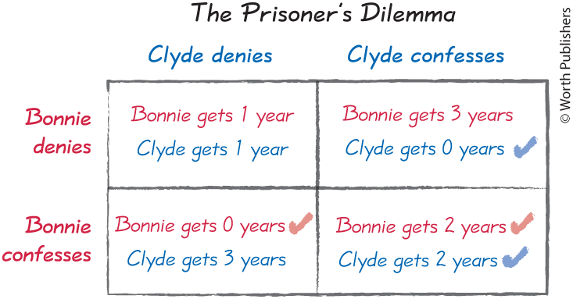
The Prisoner’s Dilemma
Police catch two criminal speeding away from the scene of a bank robbery.
If the police can’t extract a confession, then Bonnie and Clyde are only charged with speeding away, which is 1 year in jail.
The police offer each the following deal:
If you help us by confessing, then you go free and your friend takes the fall.
If your friend helps us but you don’t, then you go to jail for 3 years.
If you both confess, then you both go to jail for 2 years.
STEP 1: Payoff table
Bonnie’s choices in each row
the Clyde’s choices in each column
show all possible outcomes, listing the payoffs in each cell.
© Worth Publishers

Slide 28
The Prisoner’s Dilemma
Step 2 and 3: For each “what if”, play your best response, and then Step 4, play as the OTHER player.
You are Bonnie:
What if Clyde denies?
Bonnie’s best response: Confess, 0 years
What if Clyde confesses?
Bonnie’s best response: Confess, 2 years
You are Clyde:
What if Bonnie denies?
Clyde’s best response: Confess, 0 years
What if Bonnie confesses?
Clyde’s best response: Confess, 2 years
HELPFUL HINT: When comparing payoffs in a given “What if” scenario….
The row player (Bonnie) compares payoffs up and down a given column.
The column player (Clyde) compares payoffs across a given row.
© Worth Publishers

Slide 29
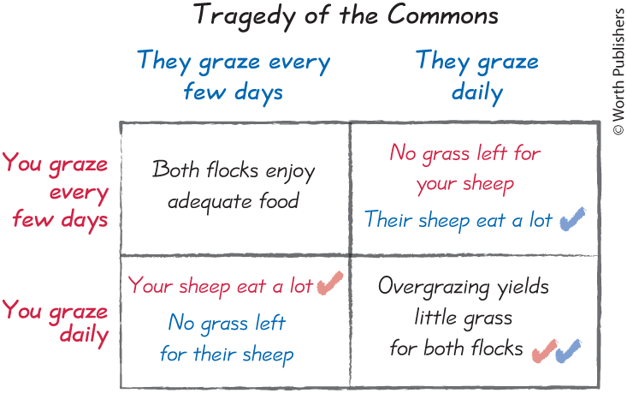
You Try! More examples of the prisoner’s dilemma
The tragedy of the commons leads shared resources to be overused.
Everyone is worse off compared to if they cooperated.
More shared resources examples:
Overfishing
Pollution emission
Public roads and traffic jams
Politicians who overspend for special interest groups.
Friends who overorder when you agree to split the bill.
© Worth Publishers
Notes:
Teacher Tip:
POST this slide FOR STUDENTS to print --- this slide EXCLUDES all best response checkmarks.
Have students work through the ‘Tragedy of the Commons’ game during class.

Slide 30
You Try! More examples of the prisoner’s dilemma
The tragedy of the commons leads shared resources to be overused.
Everyone is worse off compared to if they cooperated.
More shared resources examples:
Overfishing
Pollution emission
Public roads and traffic jams
Politicians who overspend for special interest groups.
Friends who overorder when you agree to split the bill.
© Worth Publishers
Notes:
Teacher Tip:
USE this slide IN CLASS when presenting answers --- this slide INCLUDES all best response checkmarks.
Have students work through the ‘Tragedy of the Commons’ game during class.

Slide 31
Concept Check: Nash Equilibrium
Collusion: Competitors get together and agree to charge the same high price. The payoff table shows the profits you and the other player earn under each scenario.
What is the Nash equilibrium of this game?
Does the Nash correspond the ‘best’ outcome (i.e., the socially optimal outcome)?
 | They undercut the high price | They charge the high price, as agreed.
You undercut the high price | You earn $2 m They earn $2 m | You earn $4 m They earn $0 m
You charge the high price, as agreed. | You earn $0 m They earn $4 m | You earn $3 m They earn $3 m
The Nash equilibrium is both undercut, and you each earn $2 million in profit.
No. The best outcome is for both to charge high prices, earning $3 million each.
Nash equilibrium ≠ Best outcome
Notes:
Teacher Tip:
Click to reveal the answers in the payoff table first, and then the answers to parts A and B, respectively.

Slide 32
Key take-aways: The prisoner’s dilemma and the challenge of cooperation
Nash Equilibrium
An equilibrium in which the choice that each player makes is a best response to the choices that other players are making.
Visually, wherever there are TWO best response checkmarks in a single cell.
Prisoner’s dilemma
Yields a failure to cooperate.
Temptation to take advantage undermines cooperation.
Nash equilibrium outcome ≠ Best outcome (cooperation).

Slide 33
Chapter 18
How to Think Strategically
The Prisoner’s Dilemma and the Challenge of Cooperation
Multiple Equilibria and the Problem of Coordination
Advanced Strategy: First and Second Mover Advantages
Advanced Strategy: Repeated Games and Punishments
Figure out how best to coordinate with you allies to make complementary choices:
Coordination games
Anti-coordination games

Slide 34
Understanding the difficulty of coordination
Coordination games: when all players have a common interest in coordinating their choices.
You want to make a choice that is complementary to mine.
 | They buy an iPhone | They buy a Samsung
You buy an iPhone | Text messages come through cleanly. | Clunky cross-platform messaging.
You buy a Samsung | Clunky cross-platform messaging. | Text messages come through cleanly.
Smartphone example:
You want to buy the same smartphone brand as your family to maximize the compatibility of the two phones’ operating systems.
Your best response is to coordinate so that you’re making the same choice as your family (or friends).
Difficult to coordinate because there are multiple equilibria → more than one equilibrium.
May fail to coordinate, yielding an out-of-equilibrium outcome.

Slide 35
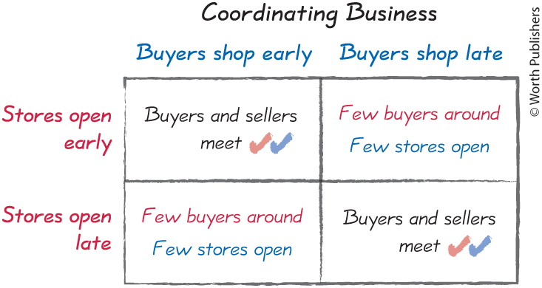
Another coordination game: Business hours
Setting your hours of operation:
Your customers want to shop when your store is open.
You want to open your store when you customers are out shopping.
Problem: Multiple equilibria
‘Early’ equilibrium.
’Late’ equilibrium.
What will your customer’s do?
Will you successfully coordinate with them?
© Worth Publishers

Slide 36
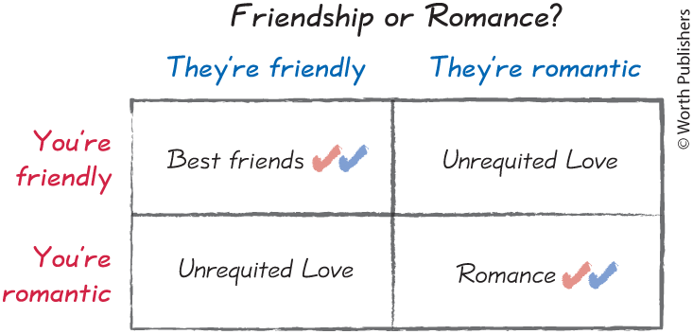
Another coordination game: Friendship or romance?
You have a crush on your friend. What should you do?
If they are “friendly”
Your best response is to be friendly because you don’t want to ruin what you have as friends.
If they are ”romantic”
Your best response is to be romantic!
Problem: Multiple equilibria
‘Friends equilibrium.
’Romance’ equilibrium.
When you don’t know what the other person is going to do, you might end up making the wrong choice for both of you.
© Worth Publishers

Slide 37
A different type of coordination games: Anti-coordination games
Coordination games → your best response is the same choices as the other player.
Anti-coordination games → your best response is to take a different action than the other player.
Playing phone tag after a dropped call
Common elements:
Your best response is complementary to the other player’s action.
There is more than one equilibrium.
Multiple equilibria makes it difficult for players to coordinate their actions.
 | They call back | They wait
You call back | Busy signal (or goes to voicemail) | Call connects
You wait | Call connects | You both sit around waiting.

Slide 38
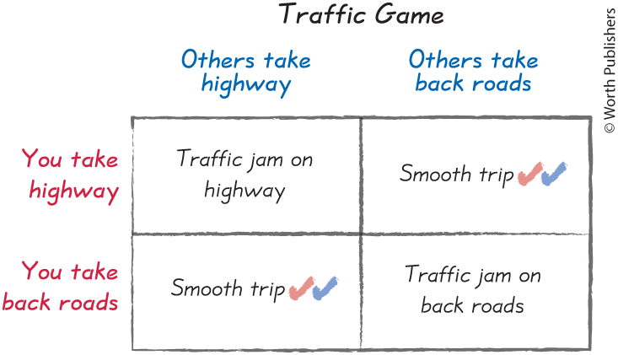
Another anti-coordination game: Traffic Jams
To avoid traffic, you wan to choose the route that other drivers don’t pick:
If they take the highway, you want to take the backroads.
If they take the backroads, then you want to take the highway.
Problem: Multiple equilibria
They take highways, and I don’t.
They take backroads, and I don’t.
But how do we coordinate our decisions so that everyone can avoid a traffic jam?
© Worth Publishers

Slide 39
Good and bad equilibria
So far…
We saw situations in which any of the possible equilibria would be a good outcome.
Just solve the coordination problem to get to one.
Now…
Situations in which there’s a good and a bad equilibrium.
Need to solve the coordination problem
AND prevent the bad equilibrium from occurring.

Slide 40
Coordination games: Good and bad equilibria
 | Others withdraw | Others keep money in the bank
You withdraw your money | Bank run: We race to get our money out first. | You don’t earn interest. Others definitely lose their savings.
You keep your money in the bank | You definitely lose your savings.. Others don’t earn interest.. | Stability: We both earn interest.
Bank Runs: If too many people want to withdraw their money from the bank at the same time, the bank won’t have enough money to hand over (the bank lends most of their money out).
A bank run can occur when everyone believes a bank run will occur.
Bad equilibrium: If you believe everyone else will withdraw, then you should race to bank to withdraw your savings before the bank vault is empty.
Good equilibrium: all savers are happy keeping their money in the bank earning interest.
Notes:
Teacher Tip:
During the pandemic we saw this kind of “bank run” on toilet paper.
People believed that many other people were going to buy all the toilet paper, so they responded by stocking up on toilet paper.
A bad equilibrium with toilet paper shortages occurred because everyone overbought toilet paper thinking that everyone else was going to overbuy toilet paper.

Slide 41
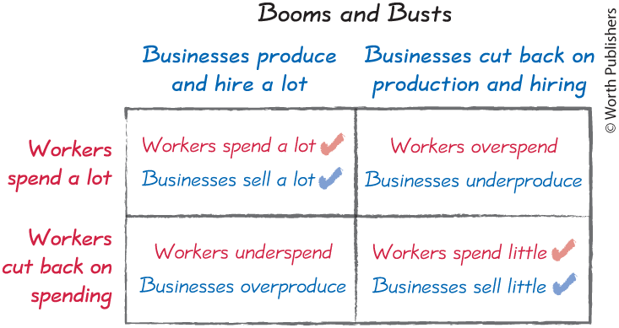
Good and Bad equilibria: Booms and Busts
Boom economy: Good equilibrium
If firms hire a lot, workers can afford to spend a a lot.
If works are spending a lot, then firms can afford to hire a lot.
Bust economy: Bad equilibrium
Firms aren’t hiring, so workers don’t spend.
Workers aren’t spending, so firms can’t afford to hire.
How do we coordinate on the GOOD equilibrium?
Want to avoid all other outcomes.
Solution: Governments can stimulate the economy to try and raise worker and business confidence.
© Worth Publishers

Slide 42
Solving coordination problems
Solution 1: Communication
Works when all players want the same thing (no opposing incentives).
Solution 2: Focal points, culture, and norms
Focal point: a cue from outside a game that helps you coordinate on a specific equilibrium.
Example: When should we meet for lunch? → Noon is a common lunch time in the U.S.
Example: Should we bow or shake hands as a greeting?
Solution 3: Laws and regulations
Can enforce coordination.
Example: Which side of the road should we drive on: left or right?

Slide 43
Can you and your classmate coordinate successfully?
If you and your classmate can pick the same number without first discussing your choice with your partner, then you win the game!
1 | 2
3 | 4
1 | 7
30 | 13
Notes:
Teacher tip:
Ask to see if any student pairs want to try and play the game?
You can play multiple rounds of the game using both (or just one) table of numbers.
If the student pair successfully pick the same number, then ask what ‘outside cue” they were using to coordinate their decision.
Did they know the other person’s favorite color or number?
Are they both fans of Taylor Swift (famously fond of the number 13)?

Slide 44
Key take-aways: Multiple equilibria and the problem of coordination
In coordination and anti-coordination you want to make the choice that complements the choice of the other player.
Coordination is difficult because there is more than one equilibrium.
Solving the coordination problem
Communication
Focal points, culture, and norms
Laws and regulations

Slide 45
Chapter 18
How to Think Strategically
The Prisoner’s Dilemma and the Challenge of Cooperation
Multiple Equilibria and the Problem of Coordination
Advanced Strategy: First and Second Mover Advantages
Advanced Strategy: Repeated Games and Punishments
Make your move when it’s most advantageous:
Games that play out over time.
Game Tree
First- and Second-mover advantage

Slide 46
Introducing advanced strategy
Our focus so far…
Simultaneous games: you make your choice without knowing what the other player has chosen.
As if you are choosing at the same time (like ‘rock-paper-scissors’).
Now we focus on…
Sequential games: you can see your rival’s action before choosing yours (or vice versa).
Games that play out over time (like chess or ‘tic-tac-toe’).
Order of the moves matter.
May yield a first-mover advantage, or a second-mover advantage.

Slide 47
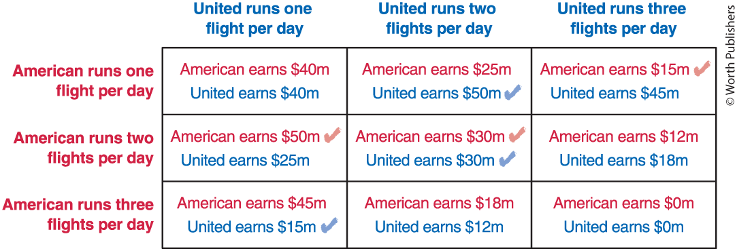
Airline scheduling as a simultaneous game
American and United are trying to decide how many Chicago to D.C. flights to schedule per day.
© Worth Publishers
Notes:
Teacher Tip:
POST this slide FOR STUDENTS – this slide does NOT include the best response checkmarks.
Have students work through steps 1-4 of good decision making to identify the simultaneous game Nash equilibrium.

Slide 48
Airline scheduling as a simultaneous game
American and United are trying to decide how many Chicago to D.C. flights to schedule per day.
© Worth Publishers
Notes:
Teacher Tip:
USE this slide IN CLASS when presenting the answers – this slide includes the best response checkmarks.
Have students work through steps 1-4 of good decision making to identify the simultaneous game Nash equilibrium.

Slide 49
Airline scheduling as a sequential game
What happens if American can move first, and they choose to run three flights per day?
What is United’s best response?
By moving first, American shifts the equilibrium outcome so American earns $45m instead of $30m.
First-mover advantage!
© Worth Publishers

Slide 50
First-mover advantage
First-mover advantage: the strategic gain from an anticipatory action that can force a rival to respond less aggressively.
Airline scheduling example:
American’s aggressive choice forced United to adapt and respond less aggressively.
American needs to credibly commit to running three flights per day (not just announce its choice).
Take concrete actions that will make any other choice costly.
Invest in new jets, rent extra gates → anything to show commitment to running three flights per day.

Slide 51
Using game tree logic
Game tree: shows how a game plays out over time, with the first move forming the trunk, and then each subsequent choice branching out, so the final leaves show all possible outcomes.
© Worth Publishers

Slide 52
Game Tree: Look forward and reason backward
Look forward:
In games that play out over time, you should look forward to anticipate the likely consequences of your choices.
Reason backward:
Start by analyzing the last period of the game.
Use this to figure out what will happen in the second-to-last period, and keep reasoning backward until you can see all the consequences that follow from today’s decision.
In short: Start from the end and reason backward.

Slide 53
Using game tree logic
For each “What if” branch, look forward:
What if American runs 1 flight?
Look forward to the last period.
United’s best response is to run 2 flights per day and earn $50m (and American earns $25m).
Pruning the tree: if an action is not a best response, then cross it out (it’s irrelevant).
If American runs 1 flight, we can prune the top and bottom branches.
© Worth Publishers

Slide 54
You Try! Keep pruning the tree
What if American runs 2 flights? What if American runs 3 flights?
What’s United’s best response? Which branches can be pruned?
Reason back one step closer to the base of tree:
Given the remaining branches and leaves, what choice will American make?
Run 3 flights and earn $45m.
Outcome: follow the highlighted path.
American runs 3 flights, and United runs 1 flight ($45m, $15m).
© Worth Publishers
Notes:
Teacher Tip:
POST this slide FOR STUDENTS to print. This slide excludes the pruned branches for the “2 flights” and “3 flights” branches. Have the students work through the other “What if” branches and prune branches for “What if American runs 2 flights” and “What if American runs 3 flights”.

Slide 55
You Try! Keep pruning the tree
What if American runs 2 flights? What if American runs 3 flights?
What’s United’s best response? Which branches can be pruned?
Reason back one step closer to the base of tree:
Given the remaining branches and leaves, what choice will American make?
Run 3 flights and earn $45m.
Outcome: follow the highlighted path.
American runs 3 flights, and United runs 1 flight ($45m, $15m).
© Worth Publishers
Notes:
Teacher Tip:
USE this slide IN CLASS when presenting the best responses and “pruning” for the other branches. Before revealing the answers, have the students work through the other “What if” branches and prune branches for “What if American runs 2 flights” and “What if American runs 3 flights”.

Slide 56
First-mover versus second-mover advantage
Moving early or late depends on the value of commitment versus flexibility.
Second-mover advantage: the strategic advantage that can follow from taking an action that adapts to your rival’s choice.
Flexibility to adapt your strategy in light of the choices made by the first mover.
Examples:
Pricing: as the second mover, you watch what your competitor does, and then you sell the same products at slightly lower prices.
Product-positioning: the second mover waits to see which part of the market remains underserved, and then positions to gain the largest customer base.
Cake cutting game: they cut, you pick.

Slide 57
Key take-aways: First and second mover advantages
A game tree shows how all possible outcomes can play out over time.
Think forward and reason backward.
Start by analyzing the last period, and reason back from there to assess the ripples of your decision today.
First-mover advantage
Credible commitment to aggressive action.
Second-mover advantage
Flexibility to adapt to other player’s choices.

Slide 58
Chapter 18
How to Think Strategically
The Prisoner’s Dilemma and the Challenge of Cooperation
Multiple Equilibria and the Problem of Coordination
Advanced Strategy: First and Second Mover Advantages
Advanced Strategy: Repeated Games and Punishments
Elicit cooperation by threatening punishment in repeated interactions:
Collusion in prisoner’s dilemma
Finitely repeated games
Indefinitely repeated games

Slide 59
Repeated games
Our focus so far…
One-shot games: a strategic interaction that occurs only once.
Never going to see or interact with the other player again.
Do not need to consider how today’s decision impacts how others will treat you in the future.
Now we focus on…
Repeated games: when you face the same strategic interaction with the same rivals and the same payoffs in successive periods.
You interact with them repeatedly, so the decision you make today will affect your future interactions.
Finitely repeated games: when you face the same strategic interaction a fixed number of times.
Indefinitely repeated games: when you face the same strategic interaction an unknown number of times.

Slide 60
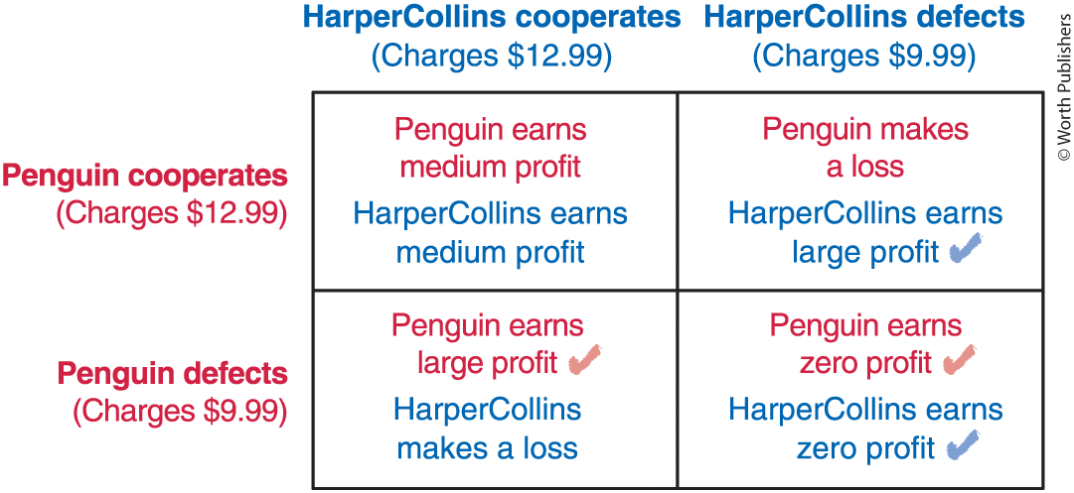
Collusion and the prisoner’s dilemma
In 2009, executives at several major publishers met over a series of private lunches, discussing how to stay profitable in the emerging e-book marketplace.
The deal: all charge the same high price for the bestselling e-books, $12.99 (instead of $9.99).
One-shot game outcome:
Both defect from the deal, thus failing to collude.
But in reality, all major publishers ended up colluding successfully!
Let’s explore!
Collusion: an agreement by rivals to not compete with each other, but to all charge high prices instead.
© Worth Publishers

Slide 61
Finitely repeated game
Suppose Penguin and HarperCollins though they would interact exactly three times.
Look forward and reason backward:
Final period: both players know they’ll never interact again.
Effectively face a one-shot prisoner’s dilemma → both choose to defect.
Second-to-last period: both players know their rival will defect in the next period.
Effectively face a one-shot prisoner’s dilemma → both choose to defect.
This incentive to defect continues as you roll back your analysis to earlier periods.
The outcome: when there’s a known final period, neither publisher will cooperate in any period.

Slide 62
Collusion and the prisoner’s dilemma: Indefinitely repeated game
If you don’t know when your interactions will end, then there’s no last period in which you know your rival will definitely be tempted to defect.
Can sustain cooperation!
Strategic plan: a list of instructions that describes exactly how to respond in any possible situation.
Might include a credible threat of punishment if your rival defects.
A sufficient threat could elicit cooperation in an indefinitely repeated prisoner’s dilemma.
Grim Trigger strategy:
If other other players have cooperated in all previous rounds, then you will cooperate.
If any player has defected in any previous round, then you’ll defect forever.

Slide 63
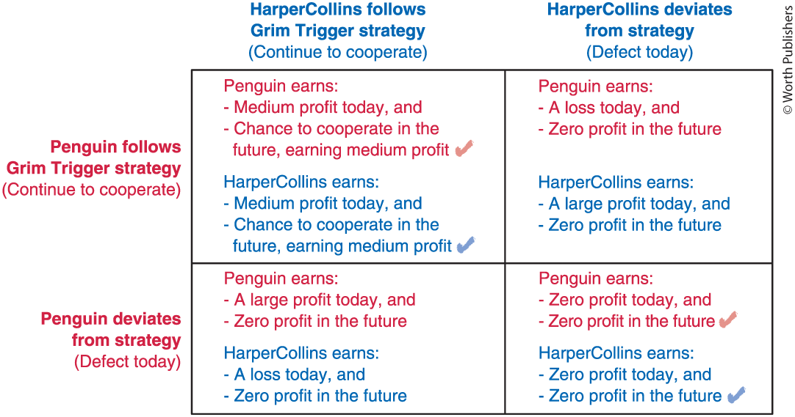
Collusion and the prisoner’s dilemma: Indefinitely repeated game
© Worth Publishers
Notes:
Teacher Tip:
First, walk student through the various payoffs to both Penguin and HarperCollins from each combination of choices.
Second, walk students through the best responses for both players.

Slide 64
Collusion and the prisoner’s dilemma: Indefinitely repeated game
Indefinitely repeated game outcomes:
Cooperate Outcome: As long as you and your rival value future profits enough, you’re better off cooperating.
Threat of punishment drives cooperation.
The loss of these future profits makes cooperating the better choice.
Defect Outcome: after either player defects, your rival continues to defect forever, so your best response is also to defect (and vice versa).
Reminder that cooperation is not guaranteed.
Key take-away: cooperation is possible as long as people continue to interact for an unknown period of time.
© Worth Publishers

Slide 65
Concept Check: Indefinitely repeated games
If CVS and Walgreens play this game for an indeterminant number of periods, and each use a Grim Trigger strategy, then is the Nash equilibrium (or equilibria)?
 | Walgreens charges a high price (cooperate) | Walgreens charges a low price (deviates)
CVS charges a high price (cooperate) | CVS earns $16 billion in profit today and in every future period. Walgreens earns $12 billion in profit today and in every future period. | CVS looses $8 billion in profit today, and $0 profit in every future period. Walgreens earns $18 billion today and earns $0 every future period.
CVS charges a low price (deviates) | CVS earns $20 billion in profit today, and $0 profit in every future period. Walgreens looses $5 billion today and earns $0 every future period. | CVS earns $0 billion in profit today, and in every future period. Walgreens earns $0 billion in profit today, and in every future period.
Notes:
Teacher Tip:
Click through the animations to reveal the best response check markets for each player.

Slide 66
Key take-aways: Repeated games and punishments
Repeated games
When you repeatedly interact with your rivals.
Account for how today’s decision will impact future interactions.
Indefinitely repeated games
When you face the same strategic interaction an unknown number of times.
Grim Trigger strategy
Punishes your rivals for not cooperating
Punishment drives cooperation
Indefinitely repeated play helps solve the Prisoner’s Dilemma.

Slide 67
Chapter 18
Four steps for making strategic decisions.
Temptation to take advantage undermines cooperation.
Want to make a choice that complements the choice of others, but multiple equilibria makes coordination difficult.
Game tree: look forward and reason backward.
Credible threat of punishment can elicit cooperation.
How to Think Strategically
The Prisoner’s Dilemma and the Challenge of Cooperation
Multiple Equilibria and the Problem of Coordination
Advanced Strategy: First and Second Mover Advantages
Advanced Strategy: Repeated Games and Punishments

