Slide 1



August 2026
Greater Oklahoma City
Monthly Market Report
Single Family Residences
Canadian, Cleveland, Grady, Lincoln, Logan, McClain, Oklahoma, Pottawatomie & Payne Counties
Provided By ChartMaster Services, LLC Exclusively for Keller Williams Realty
770.335.3102
JeromyTrask@kw.com

Slide 2

Terms of Use
These reports are created exclusively for Keller Williams Real
Estate offices and provide a competitive advantage for agents
in participating Keller Williams offices and should therefore be
used in a manner to protect that advantage.
Reports are provided by ChartMaster Services, LLC exclusively to
Keller Williams and should be treated as proprietary to those
offices contracting for the service, not for distribution or posting
to web sites in their entirety.
Reports, either whole or in part, can be used in consultations with clients and prospects during the normal conduct of business by real estate agents in offices contracting for the service.
Agents in contracting offices are also encouraged to use selected
charts in lead-generation activities to encourage prospective
clients to contact the agent for additional information.
Acceptance and use of this report shall constitute acceptance of
these terms.
2

Slide 3



Data
Producing timely reports means that transactions must be downloaded and analyzed before all have been entered into the MLSOK system. As a result, the transaction data and measurements in this report will increase when all have been entered. Since this is true in every report period these differences have always existed. When the next report is produced all closings from the previous period will have been entered and therefore the measurements will have changed to reflect more complete data. Transactions are often entered as much as 45 days after the end of a month, making it difficult to produce timely reporting without excluding some transactions.
ChartMaster statistics include Days on Market (DOM) and Original Listing Prices (OLP) for previous listing periods of unclosed listings even when the property was off the market for more than 30 days between listings. Normally, MLS data does not include those stats when a listing is Withdrawn or Expired and re-listed after a lapse of 30 days or more or is re-listed with a different company. Therefore, the median DOM and % S/OLP could be understated by not including all the information for all listing periods for a given property. As a result, our data attempts to include all relevant listing data.
ABOUT THIS REPORT
3

Slide 4
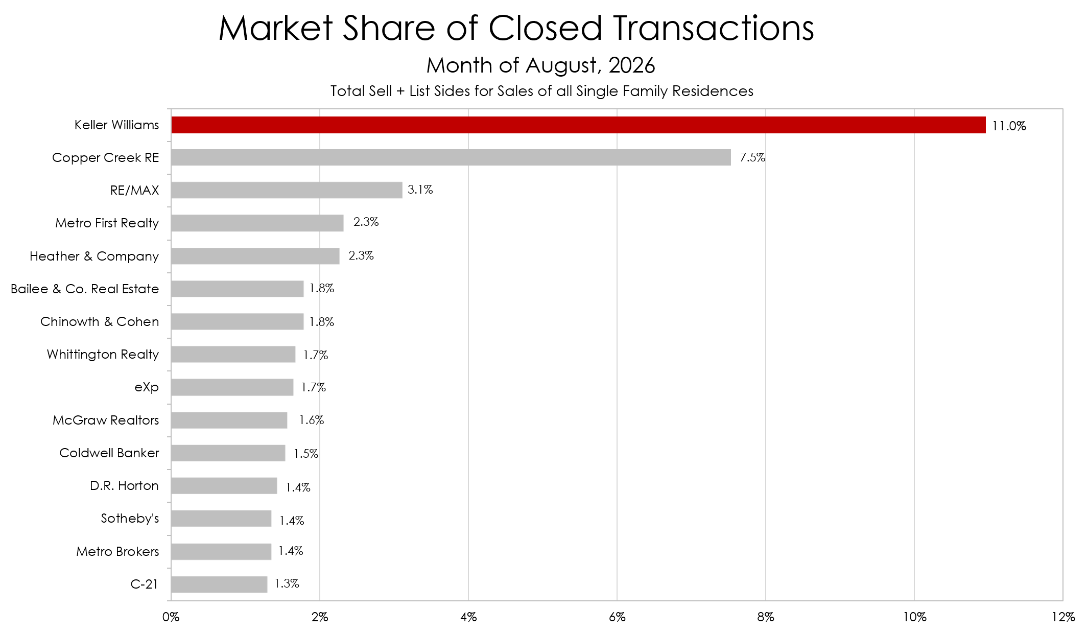
Keller Williams Realty is NUMBER 1 in total Market Share!
4

Slide 5



INTERACTIVE CHART INSTRUCTIONS: Slides 31, 32 & 42-47
Download the PowerPoint version to your computer. (Does not work with PDF or Google Slides.)
Open Downloaded File and in PowerPoint Normal Mode, double-click anywhere inside the Interactive Chart to open embedded Excel spreadsheet. (Google Sheets does not work.)
Choose desired Area from the dropdown boxes.
Click twice outside the Excel worksheet to return to PowerPoint mode.
If viewing PDF, click the underlined link below to be directed to the desired slide(s). Each slide has a button / link at the bottom left that will direct you back to the Table of Contents.
In PowerPoint, hover over underlined link below and hit Ctrl + Click to be directed to the desired slide(s). Each slide has a button / link at the bottom left that will direct you back to the Table of Contents.
Table of Contents
Instructions
Greater Oklahoma City Charts:
Shows the key metrics for the current month as well as comparisons to last month and the same month of the previous year. Slides 6-7
1-Year Trend & Sales vs. Rates:
Shows all the key metrics by month with a quick indicator of whether the metric is up or down year-over-year, plus a chart that shows the effects of interest rates on sales. Slides 8-9
Talking Points & PR Increments:
Quick summary of year over year comparisons for the key metrics and a 34-week price reduction increments chart. Slides 10-11
The Real Story – Game Board:
The Monthly Game Board identifies a one-year trend for key metrics associated with the four resulting “boxes” and the probability of landing in each one. Slide 12
County Charts:
Shows the key metrics for each county in the current month as well as comparisons to last month and the same month of the previous year. Slides 13-30
County Interactive Charts:
Compare all the key metrics with month over month & year over year changes plus an easy copy and paste graphic to keep your database current with Stats that Matter. Slides 31-32
County Comparisons:
Nine charts that show the key metrics broken down by county to allow for quick comparisons. Slides 33-41
Putting it All Together:
One of our most popular quarterly charts is now Interactive and highlights the most recent percentage of likely overpriced listings. Slide 42
City / Area Interactive Charts:
All Interactive charts are now available for 19 individual cities / areas of Greater Oklahoma City for an even more relevant conversation with clients. Slides 43-47
5

Slide 6
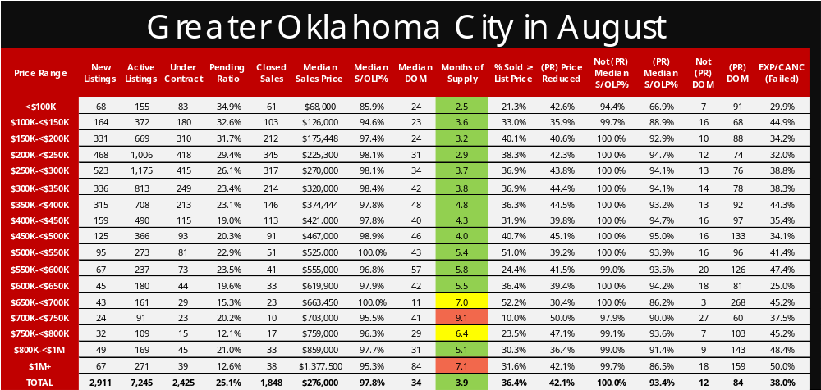
Back to Table of Contents
6

Slide 7
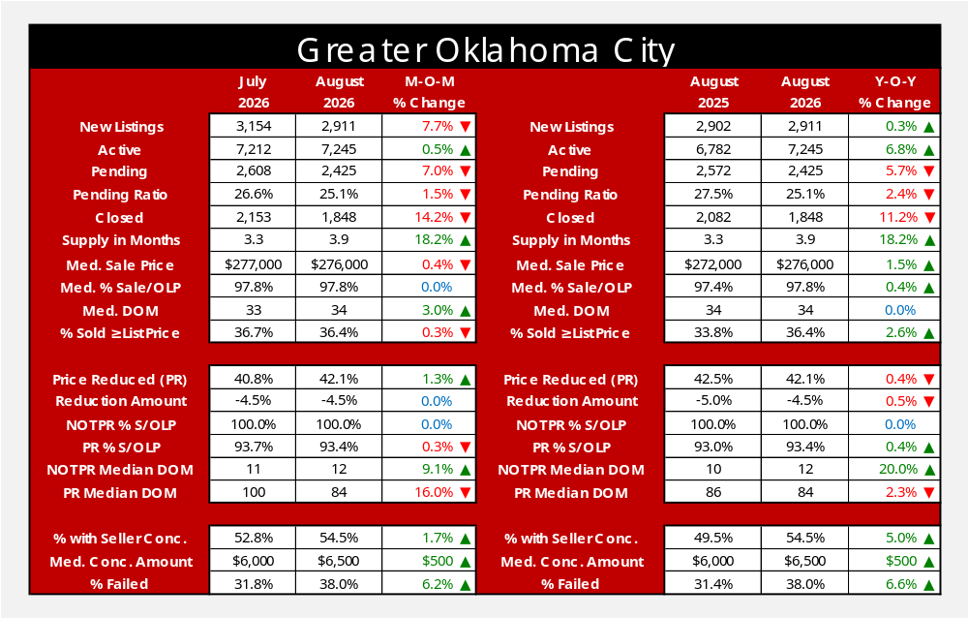
Back to Table of Contents
7

Slide 8
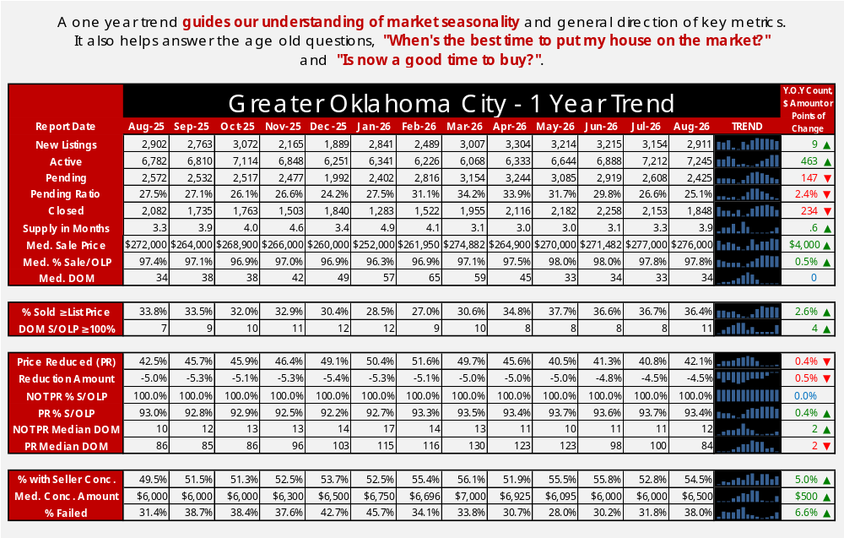
Back to Table of Contents
8

Slide 9
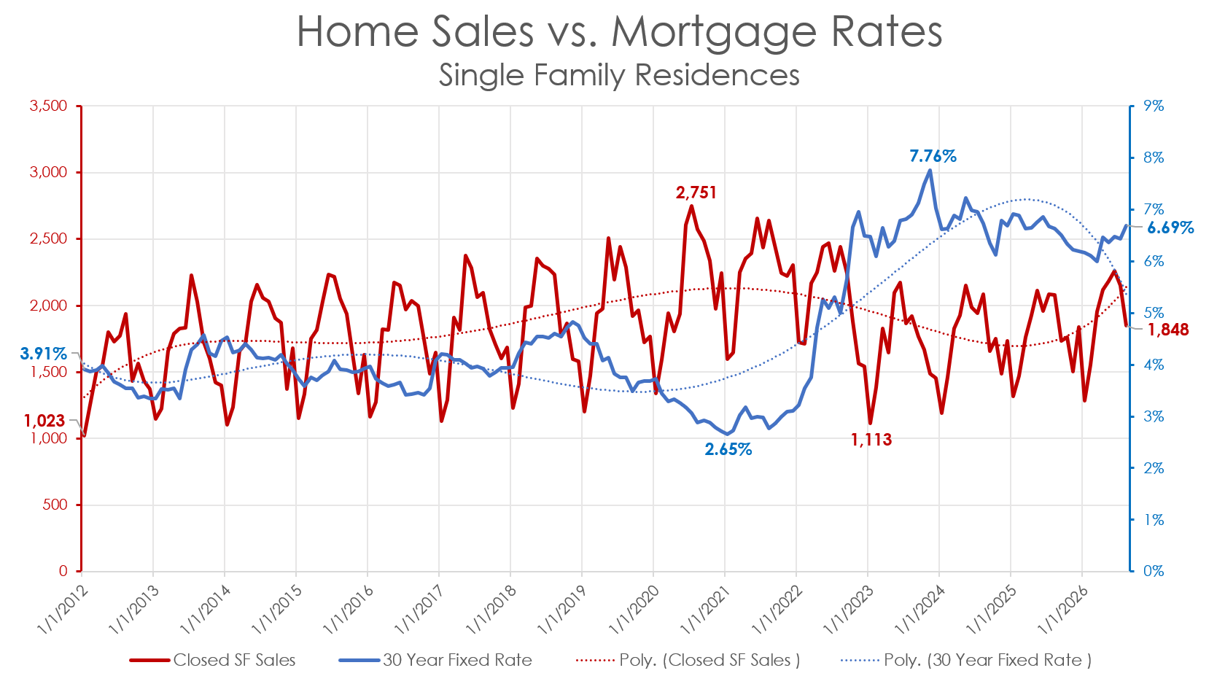
Back to Table of Contents
9

Slide 10
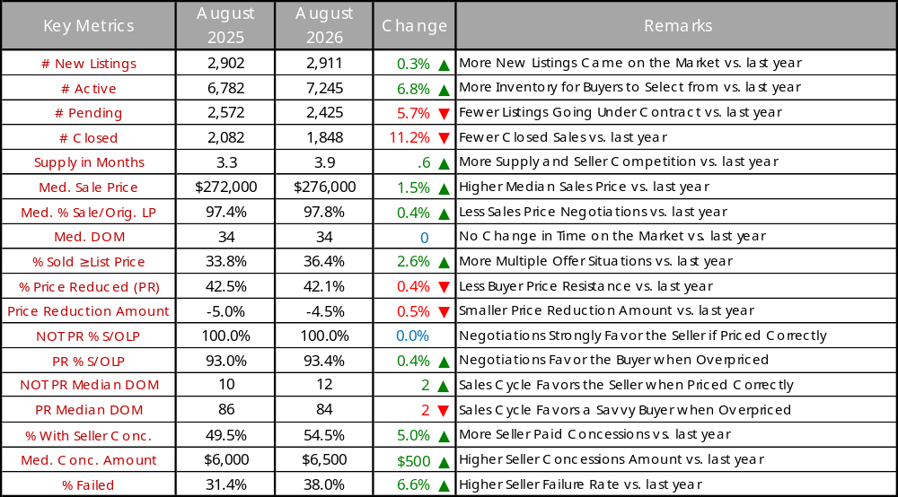
Key Metrics Talking Points
Back to Table of Contents
10

Slide 11
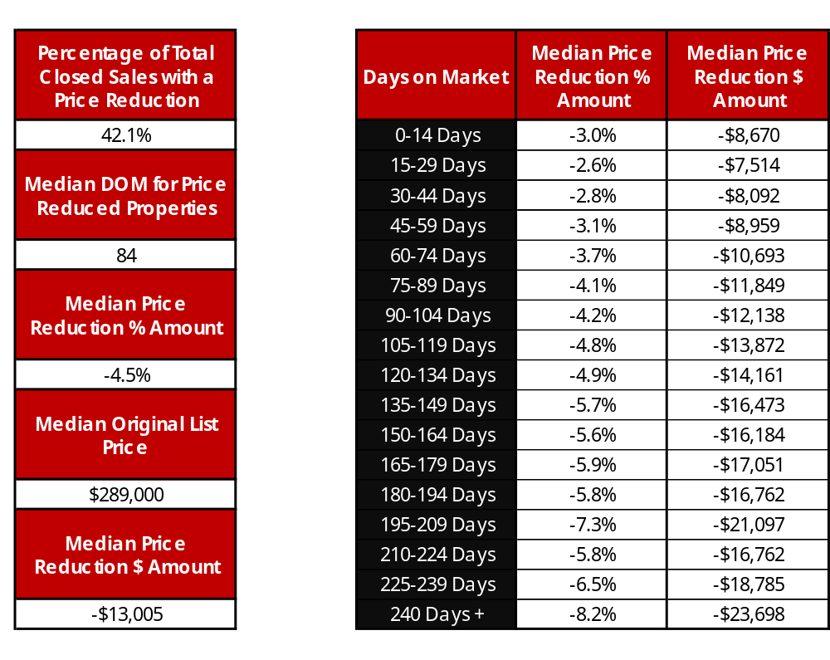
Price Reduction Increments
Back to Table of Contents
11

Slide 12
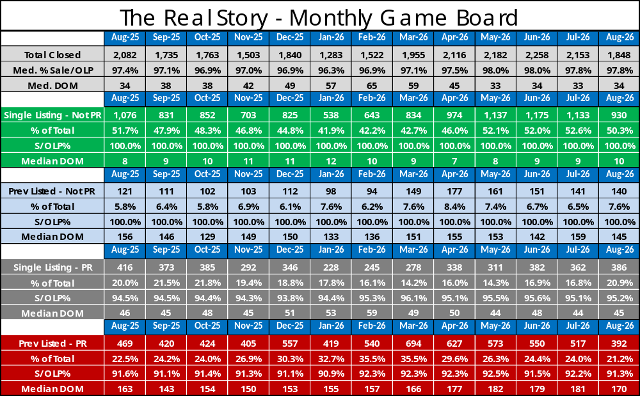
Back to Table of Contents
12

Slide 13
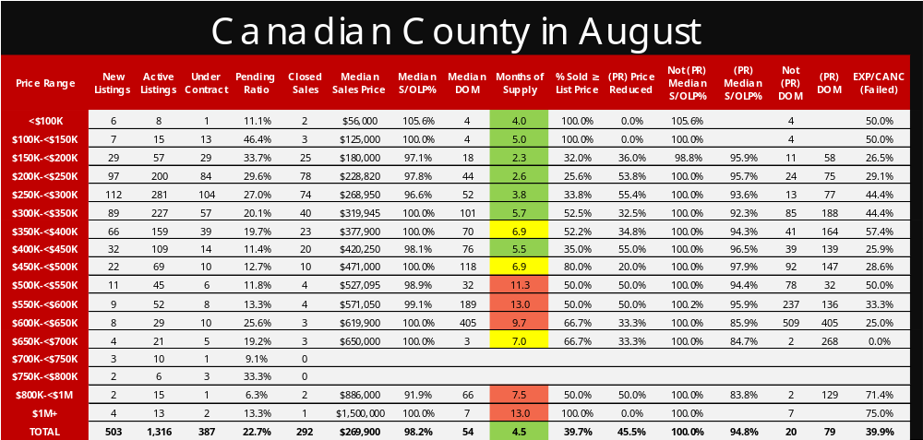
Back to Table of Contents
13

Slide 14
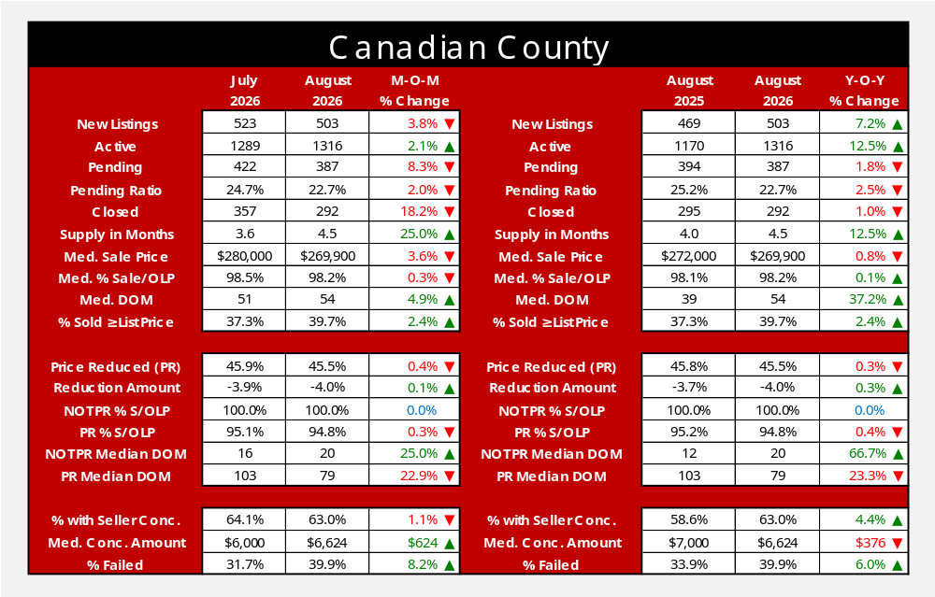
Back to Table of Contents
14

Slide 15
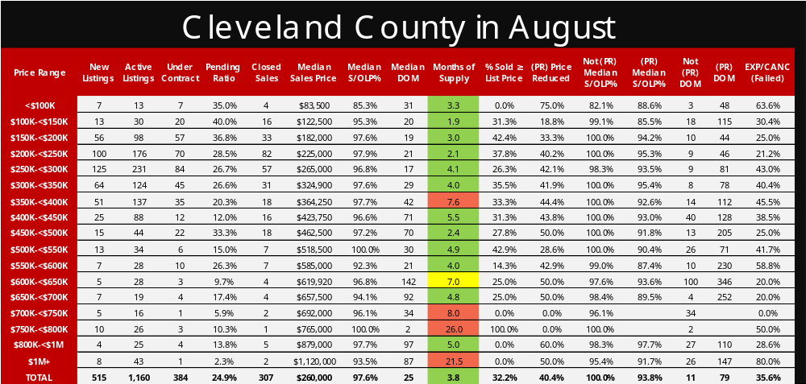
Back to Table of Contents
15

Slide 16

Back to Table of Contents
16

Slide 17
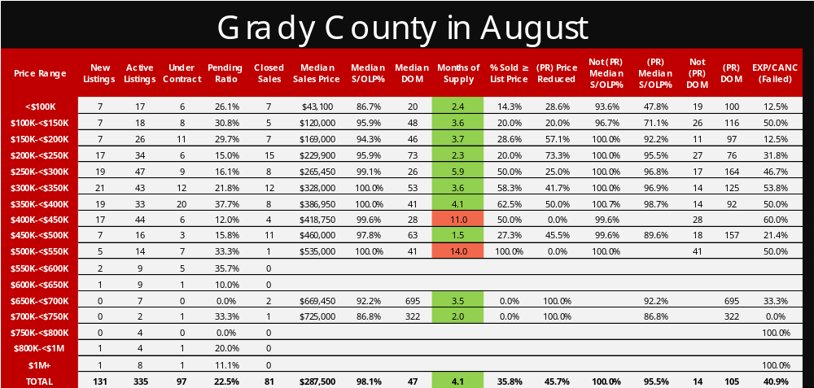
Back to Table of Contents
17

Slide 18
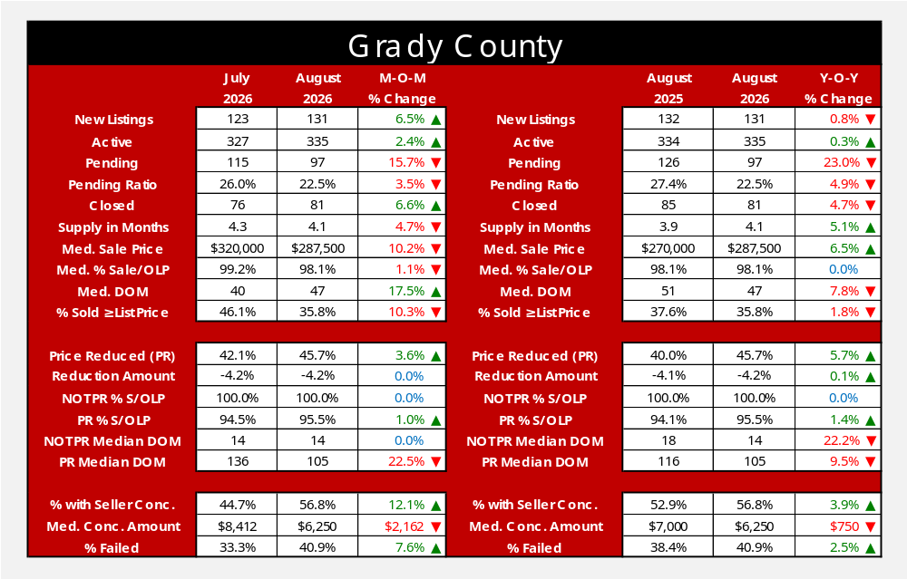
Back to Table of Contents
18

Slide 19
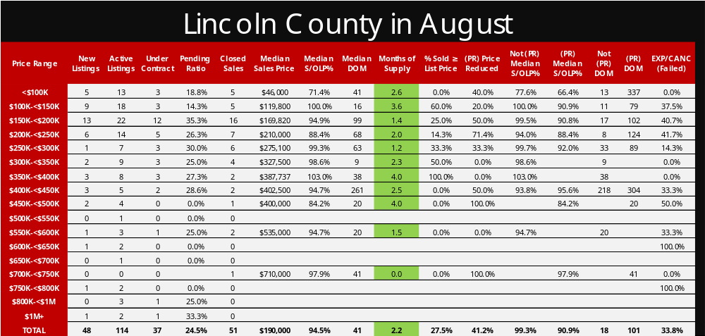
Back to Table of Contents
19

Slide 20

Back to Table of Contents
20

Slide 21
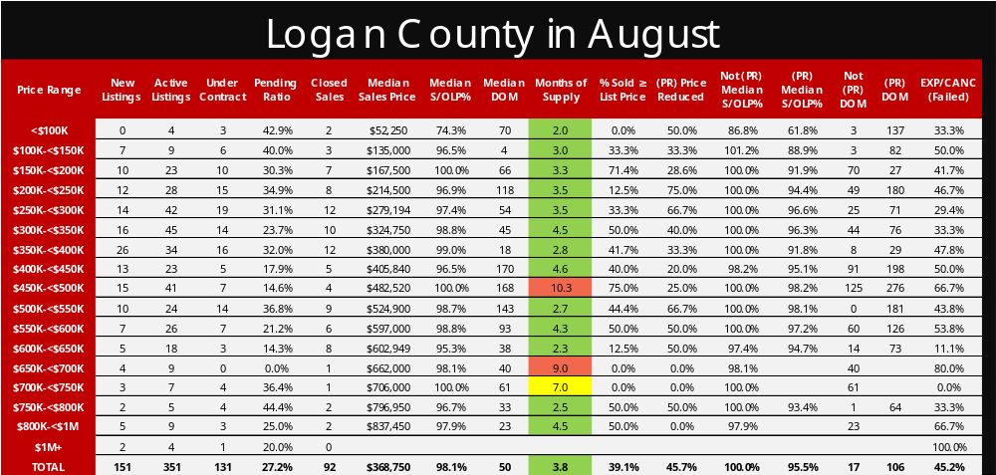
Back to Table of Contents
21

Slide 22

Back to Table of Contents
22

Slide 23
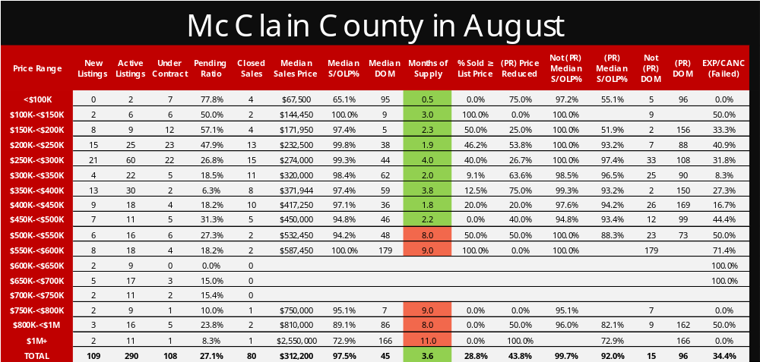
Back to Table of Contents
23

Slide 24

Back to Table of Contents
24

Slide 25
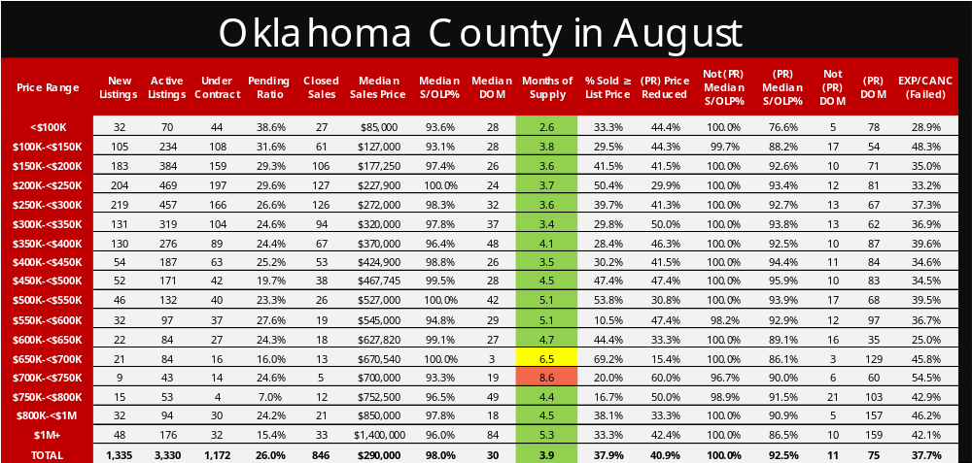
Back to Table of Contents
25

Slide 26
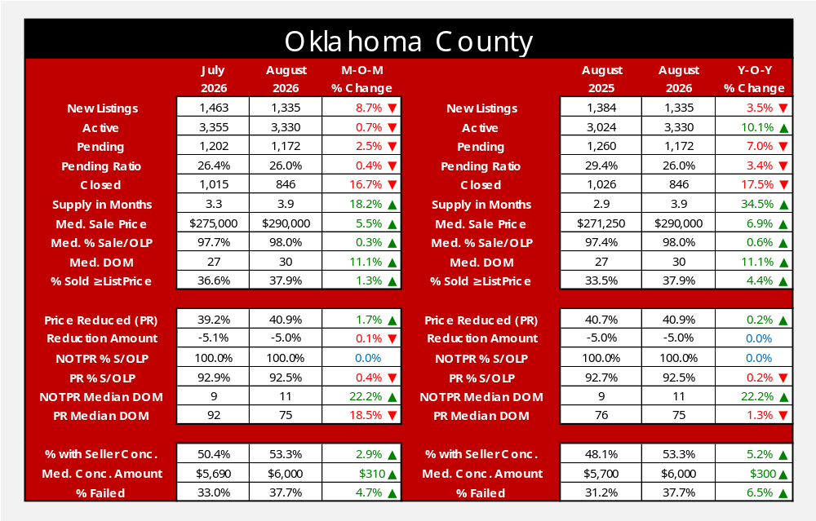
Back to Table of Contents
26

Slide 27
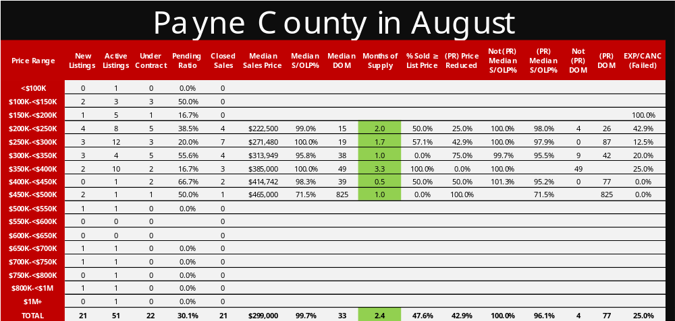
Back to Table of Contents
27

Slide 28

Back to Table of Contents
28

Slide 29
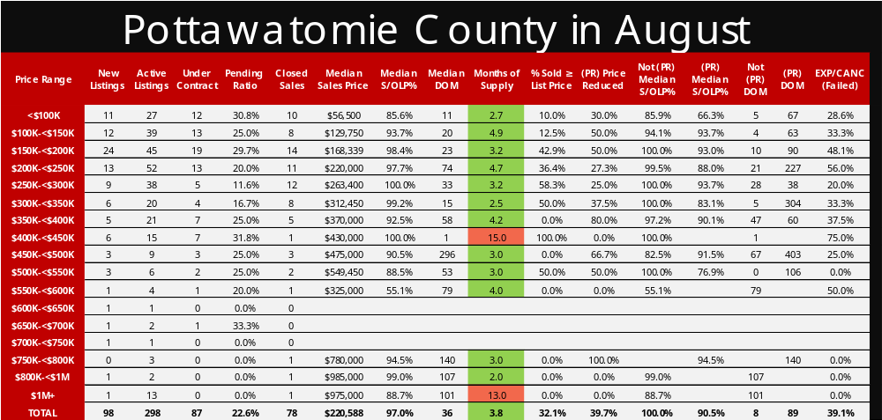
Back to Table of Contents
29

Slide 30

Back to Table of Contents
30

Slide 31
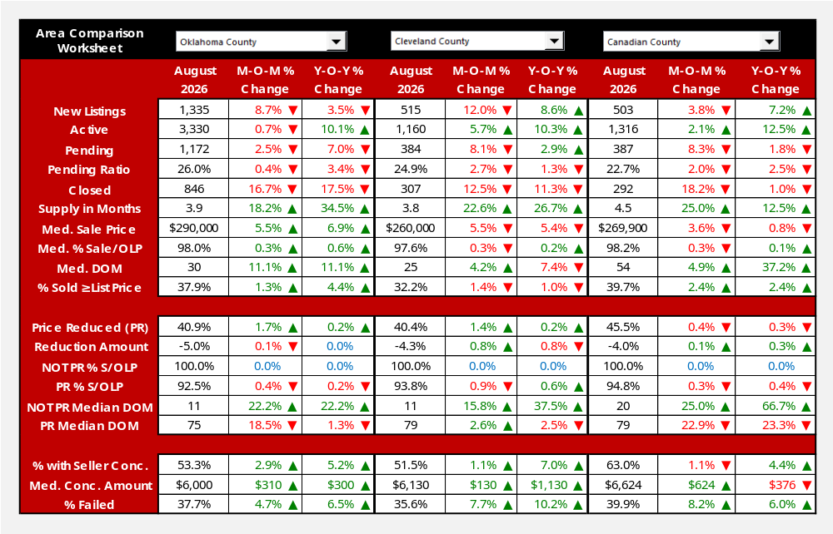
In PowerPoint Normal Mode, double-click anywhere inside the graphic to turn into Excel mode. Choose areas from dropdown and then click twice outside the Excel worksheet to return to PowerPoint mode.
Back to Table of Contents
31

Slide 32
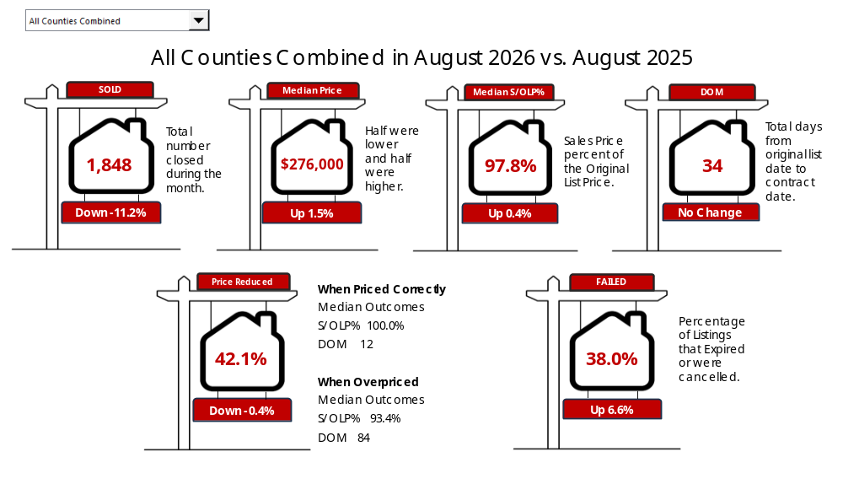
In PowerPoint Normal Mode, double-click anywhere inside the graphic to turn into Excel mode. Choose area from dropdown and then click twice outside the Excel worksheet to return to PowerPoint mode.
Back to Table of Contents
32

Slide 33
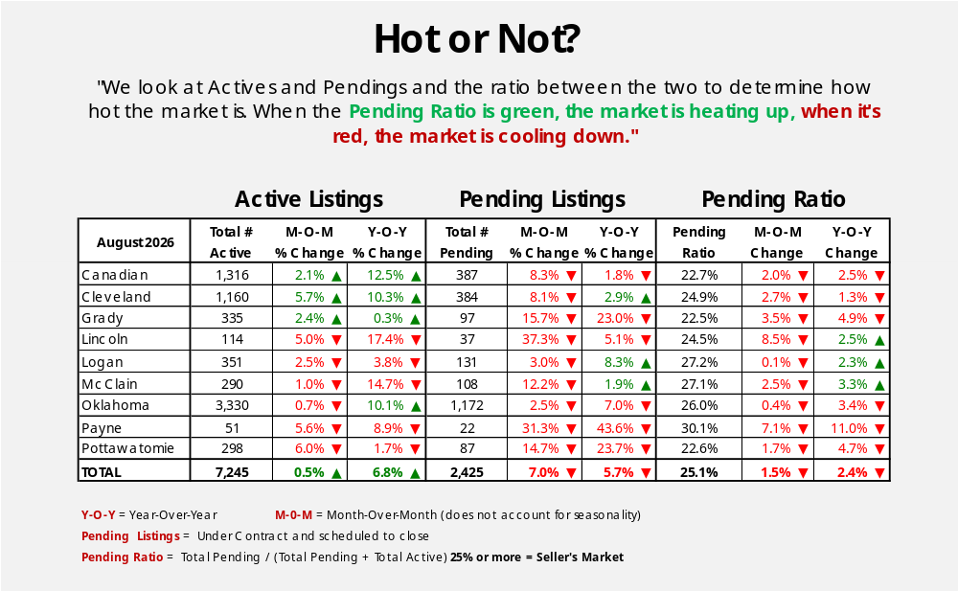
Back to Table of Contents
33

Slide 34
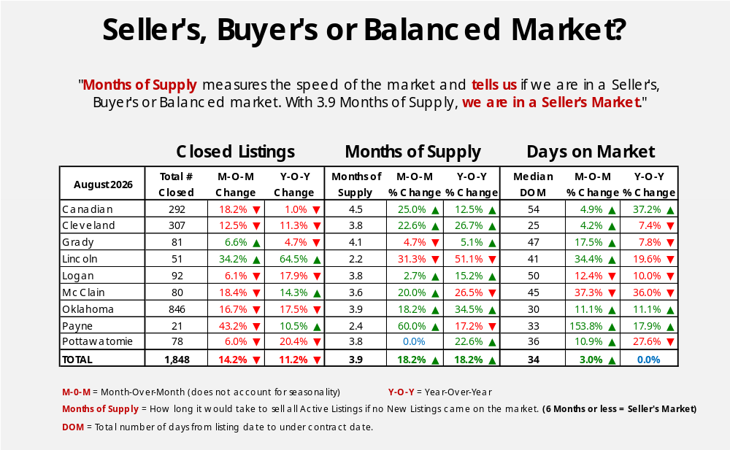
Back to Table of Contents
34

Slide 35
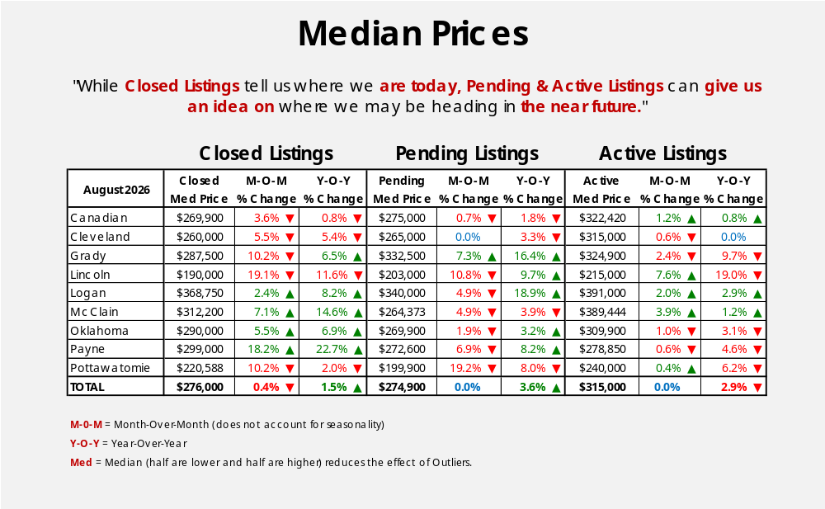
Back to Table of Contents
35

Slide 36
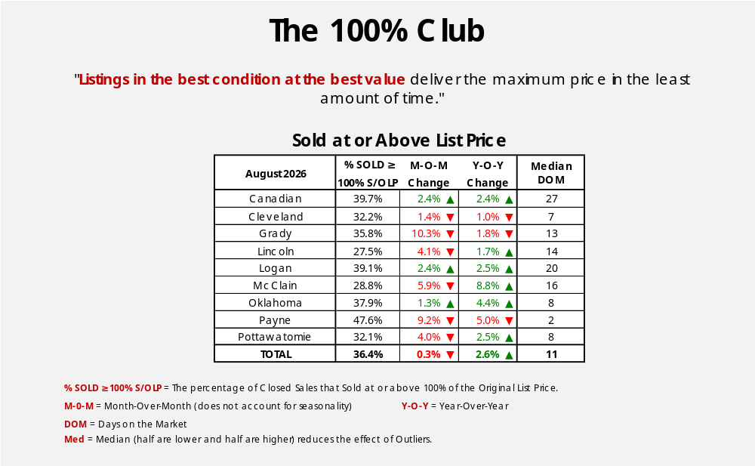
Back to Table of Contents
36

Slide 37
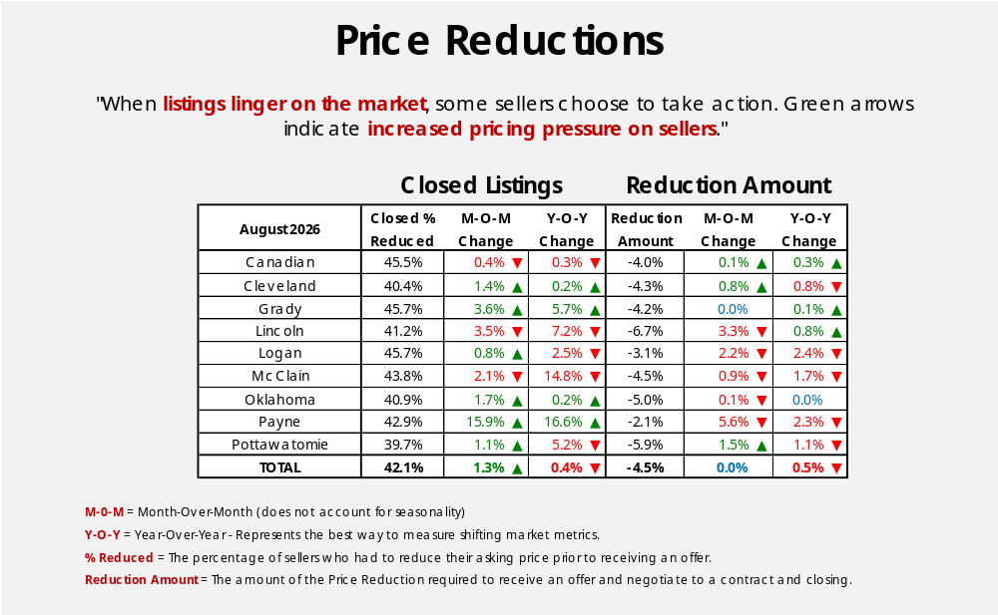
Back to Table of Contents
37

Slide 38
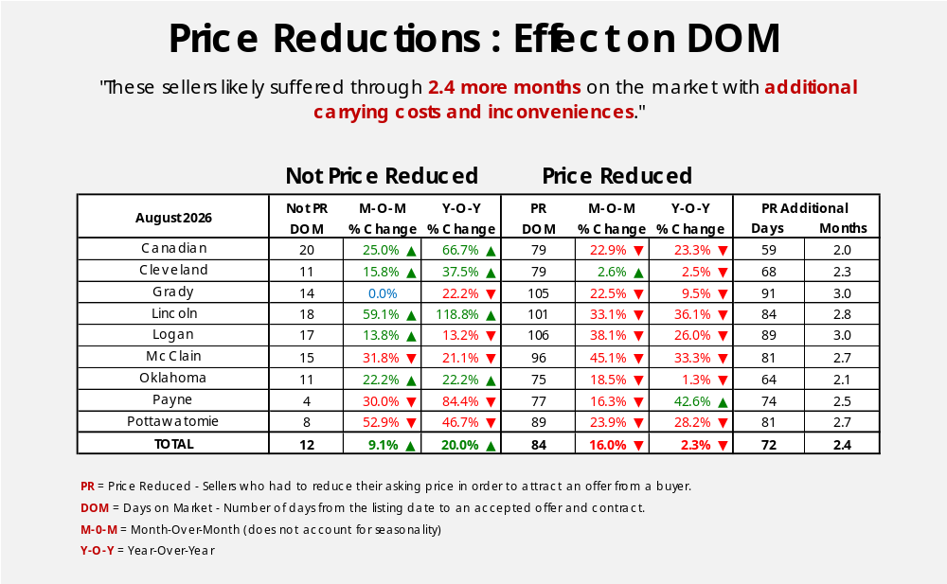
Back to Table of Contents
38

Slide 39
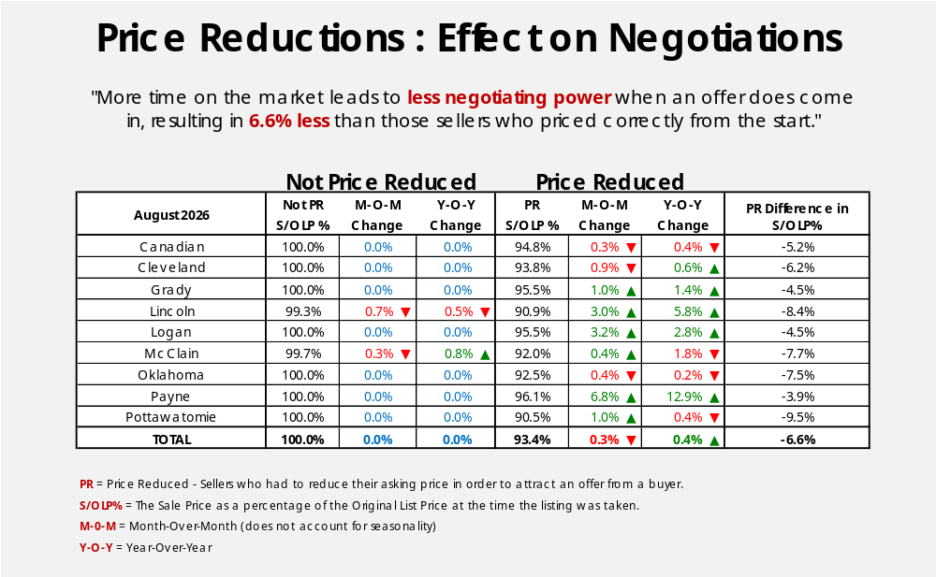
Back to Table of Contents
39

Slide 40
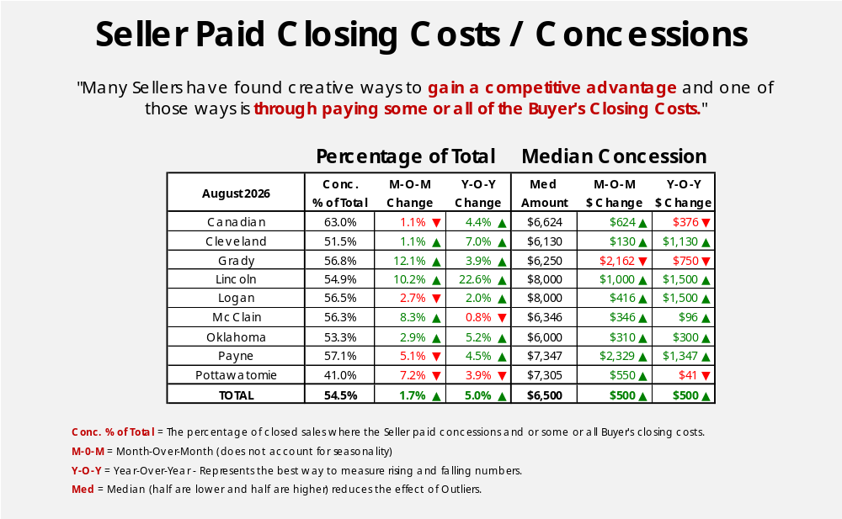
Back to Table of Contents
40

Slide 41
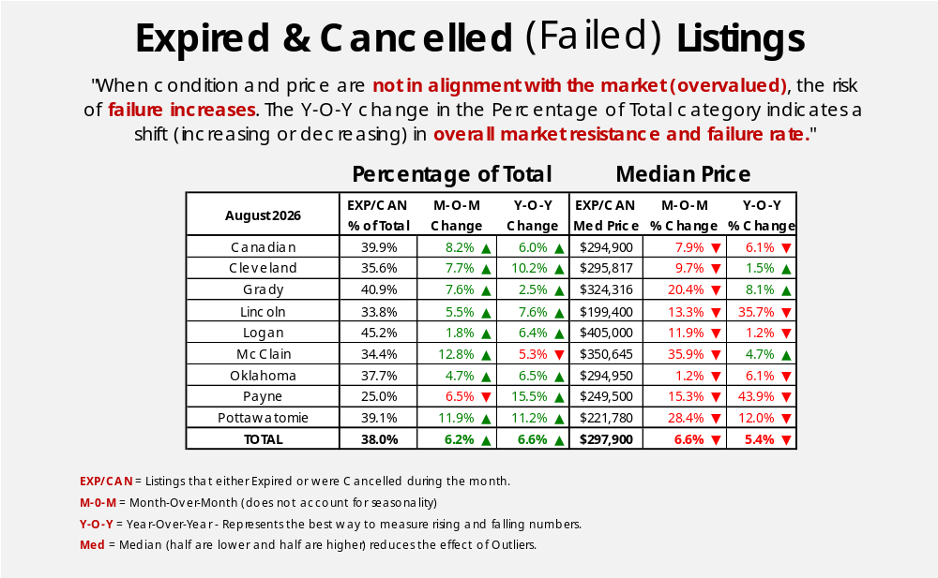
Back to Table of Contents
41

Slide 42
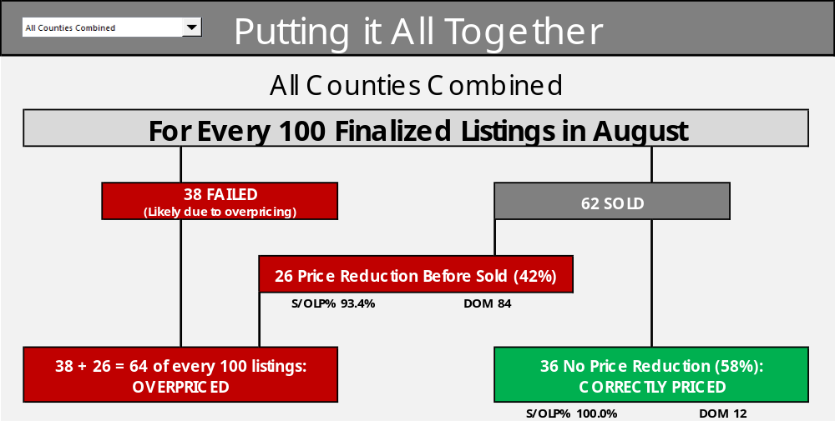
In PowerPoint Normal Mode, double-click anywhere inside the graphic to turn into Excel mode. Choose area from dropdown and then click twice outside the Excel worksheet to return to PowerPoint mode.
Back to Table of Contents
42

Slide 43
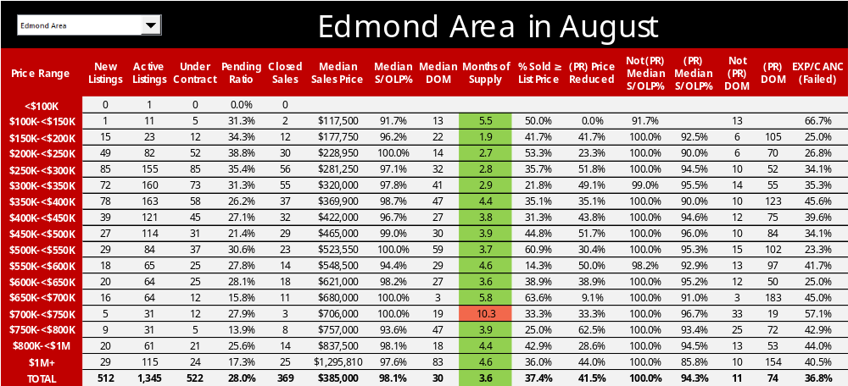
In PowerPoint Normal Mode, double-click anywhere inside the graphic to turn into Excel mode. Choose area from dropdown and then click twice outside the Excel worksheet to return to PowerPoint mode.
Back to Table of Contents
43

Slide 44
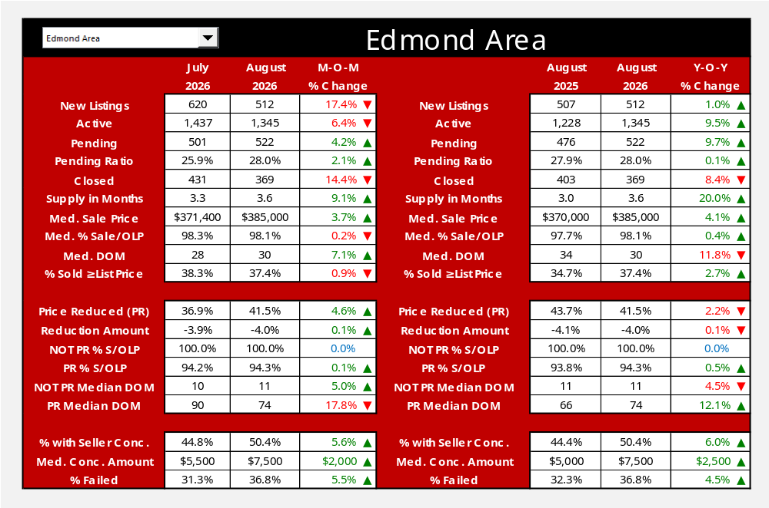
In PowerPoint Normal Mode, double-click anywhere inside the graphic to turn into Excel mode. Choose area from dropdown and then click twice outside the Excel worksheet to return to PowerPoint mode.
Back to Table of Contents
44

Slide 45
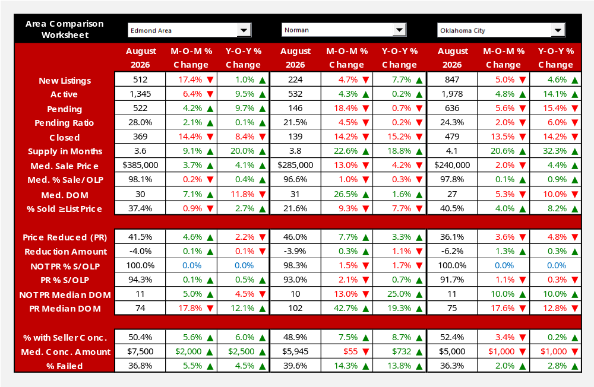
In PowerPoint Normal Mode, double-click anywhere inside the graphic to turn into Excel mode. Choose areas from dropdown and then click twice outside the Excel worksheet to return to PowerPoint mode.
Back to Table of Contents
45

Slide 46
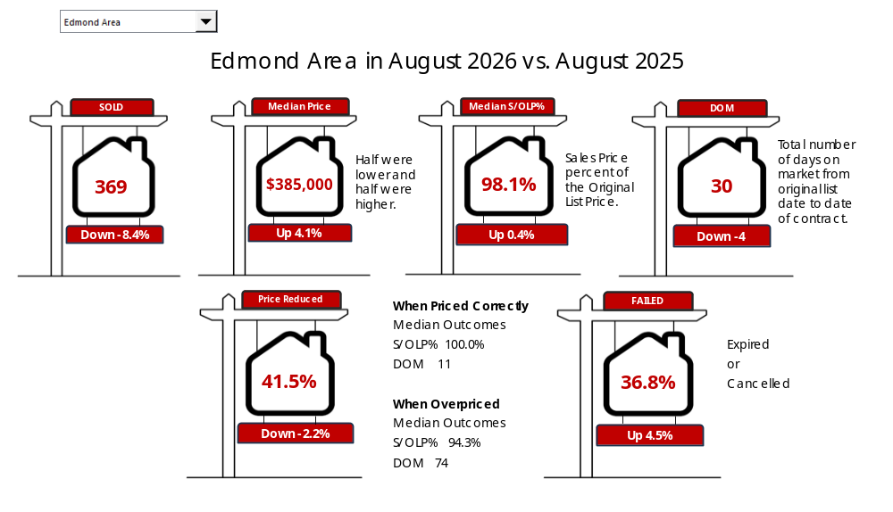
In PowerPoint Normal Mode, double-click anywhere inside the graphic to turn into Excel mode. Choose area from dropdown and then click twice outside the Excel worksheet to return to PowerPoint mode.
Back to Table of Contents
46

Slide 47
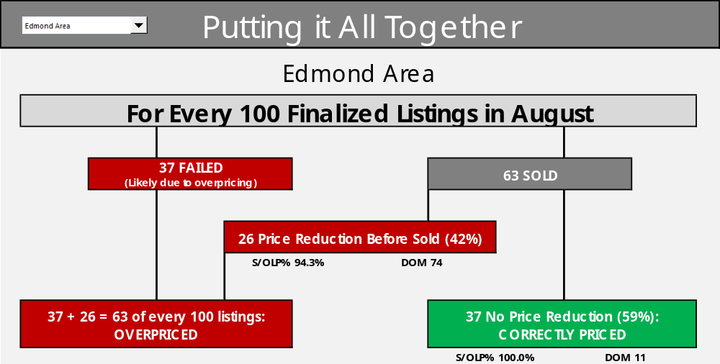
In PowerPoint Normal Mode, double-click anywhere inside the graphic to turn into Excel mode. Choose area from dropdown and then click twice outside the Excel worksheet to return to PowerPoint mode.
Back to Table of Contents
47

Slide 48

ABOUT THIS REPORT
Data
The source of all data contained herein is MLSOK listings data for
real estate transactions occurring in Selected Counties and does not necessarily represent all market activity for those Counties.
Analysis is performed by ChartMaster Services, LLC, an independent
data analysis firm which cannot and does not warrant the accuracy
or completeness of the data or its publications.
MLSOK neither guarantees nor is in any way responsible for its accuracy.
Accordingly, ChartMaster Services, LLC hereby disclaims any express
or implied warranties, including those of merchantability and/or fitness
for a particular purpose, and hereby notifies all readers and users that
any reliance upon the data, information, analysis or opinions contained
in any of our publications shall be at the reader’s own risk.
Back to Table of Contents
48

