Slide 1
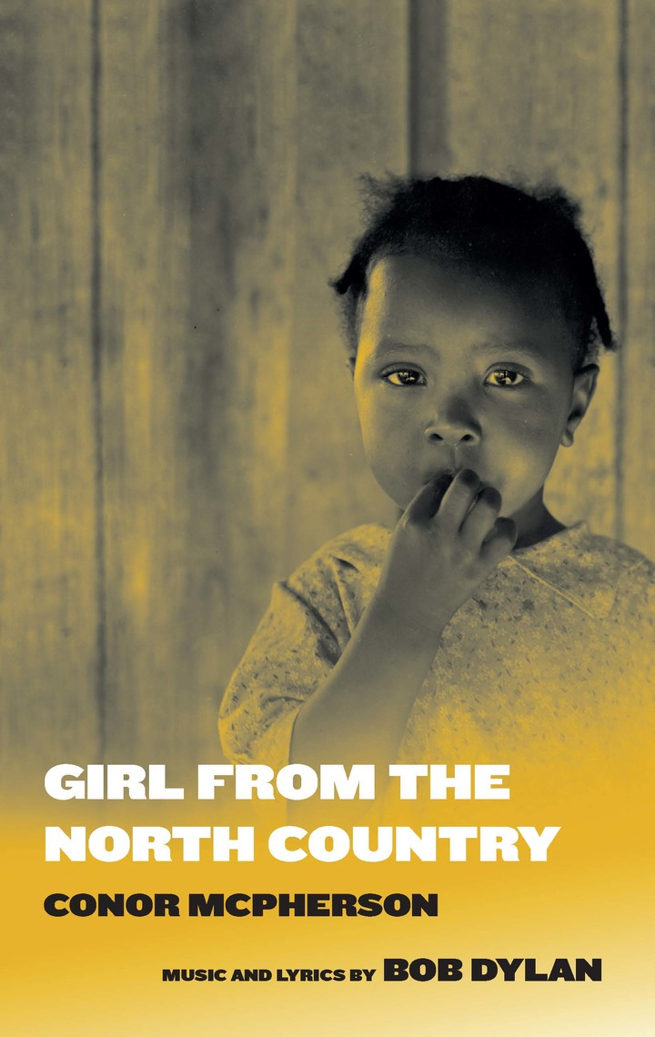
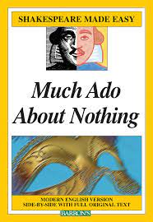
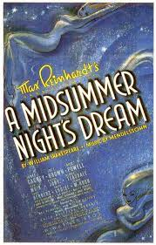
Copy and paste the relevant image.
You can also type the text if you prefer.

Slide 2
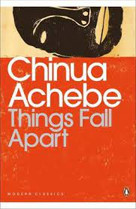
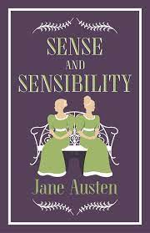
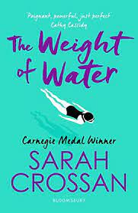
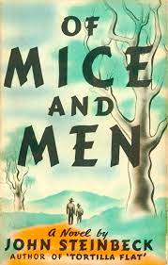
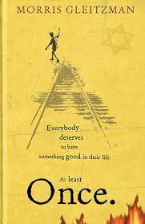
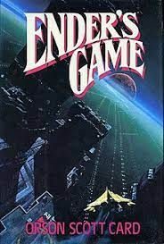
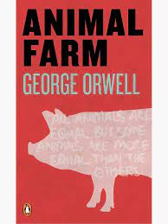
Copy and paste the relevant image.
You can also type the text if you prefer.

Slide 3
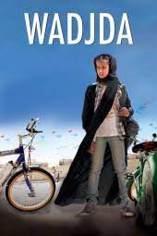
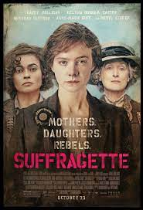
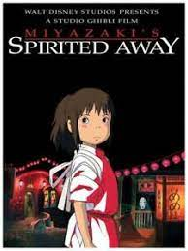
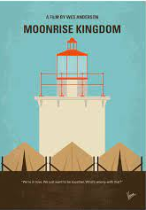
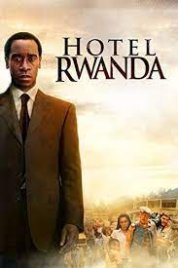
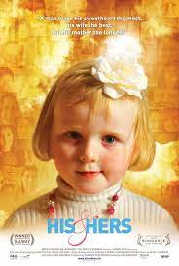
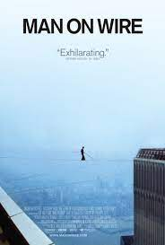
Copy and paste the relevant image.
You can also type the text if you prefer.

Slide 4
Considerations when reviewing chosen texts:
Gender balance
Positive role models
Representation of nationalities, cultures, socio-economic status
Is there a single story or multiple narratives?
Other...

Slide 5
Teacher Initials/Nickname: Example Teacher
Poetry
Dulce Et Decorum Est
Base Details
Count on Me
Mid Term Break
The Listeners
Someone you Loved
When You are Old
Thinking Out Loud
The Green Fields of France
Non-Literary
Biden Inauguration Speech
March for Our Lives, S. Rowley
Infographic: John Hopkins CSSE Covid 19 Cases
Short Story
The Lottery by Shirley Jackson
My Oedipus Complex by Frank O’Connor
The Sniper by Liam O’Flaherty
Short Film
The Crush
Yu Ming is Ainm Dom
Consider the following:
Gender balance
Positive role models
Representation of nationalities, cultures, socio-economic status
Is there a single story or multiple narratives?
Other...
Reflection:
Predominantly male voices in the texts.
Some positive role models
Perhaps more contemporary novels are needed next year.

Slide 6
Teacher Initials/Nickname:
Consider the following:
Gender balance
Positive role models
Representation of nationalities, cultures, socio-economic status
Is there a single story or multiple narratives?
Other...
Poetry
Non-Literary
Short Story
Short Film
Reflection:

Slide 7
Teacher Initials/Nickname:
Consider the following:
Gender balance
Positive role models
Representation of nationalities, cultures, socio-economic status
Is there a single story or multiple narratives?
Other...
Poetry
Non-Literary
Short Story
Short Film
Reflection:

Slide 8
Teacher Initials/Nickname:
Consider the following:
Gender balance
Positive role models
Representation of nationalities, cultures, socio-economic status
Is there a single story or multiple narratives?
Other...
Poetry
Non-Literary
Short Story
Short Film
Reflection:

Slide 9
Teacher Initials/Nickname:
Consider the following:
Gender balance
Positive role models
Representation of nationalities, cultures, socio-economic status
Is there a single story or multiple narratives?
Other...
Poetry
Non-Literary
Short Story
Short Film
Reflection:

Slide 10
Teacher Initials/Nickname:
Consider the following:
Gender balance
Positive role models
Representation of nationalities, cultures, socio-economic status
Is there a single story or multiple narratives?
Other...
Poetry
Non-Literary
Short Story
Short Film
Reflection:

Slide 11
Teacher Initials/Nickname:
Consider the following:
Gender balance
Positive role models
Representation of nationalities, cultures, socio-economic status
Is there a single story or multiple narratives?
Other...
Poetry
Non-Literary
Short Story
Short Film
Reflection:

Slide 12
Teacher Initials/Nickname:
Consider the following:
Gender balance
Positive role models
Representation of nationalities, cultures, socio-economic status
Is there a single story or multiple narratives?
Other...
Poetry
Non-Literary
Short Story
Short Film
Reflection:

Slide 13
Teacher Initials/Nickname:
Consider the following:
Gender balance
Positive role models
Representation of nationalities, cultures, socio-economic status
Is there a single story or multiple narratives?
Other...
Poetry
Non-Literary
Short Story
Short Film
Reflection:

Slide 14
Teacher Initials/Nickname:
Consider the following:
Gender balance
Positive role models
Representation of nationalities, cultures, socio-economic status
Is there a single story or multiple narratives?
Other...
Poetry
Non-Literary
Short Story
Short Film
Reflection:

Slide 15
Teacher Initials/Nickname:
Consider the following:
Gender balance
Positive role models
Representation of nationalities, cultures, socio-economic status
Is there a single story or multiple narratives?
Other...
Poetry
Non-Literary
Short Story
Short Film
Reflection:

Slide 16
Teacher Initials/Nickname:
Consider the following:
Gender balance
Positive role models
Representation of nationalities, cultures, socio-economic status
Is there a single story or multiple narratives?
Other...
Poetry
Non-Literary
Short Story
Short Film
Reflection:

