Slide 1

Let's
play!

Slide 2
Instructions
Take turns rolling the die. When you land on a square, you must do that fitness activity. The first person to complete the activities and reach the finish wins! Click on the video and then click pause to make the die stop on a number for you. To return to the main board game click the die on each slide. Click on the 30 second timer to start your fitness activity.

Slide 3
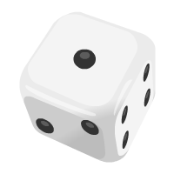
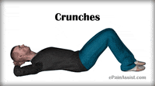
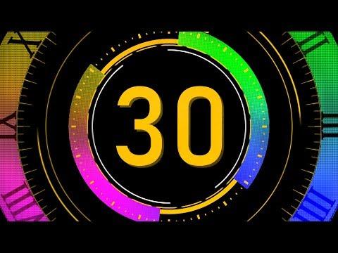
Activity 1
Do as many crunches as you can for 30 seconds
Backside

Slide 4
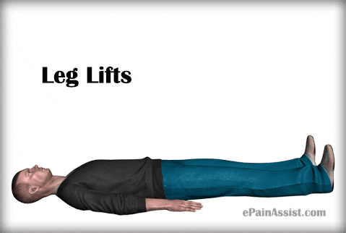
Activity 2
Do as many leg lifts as you can for 30 seconds
Backside

Slide 5
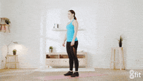
Activity 3
Do as many burpees as you can for 30 seconds
Backside

Slide 6

Activity 4
Do as many Supermans as you can for 30 seconds
Backside

Slide 7
#5
Free
Pass!
Backside

Slide 8
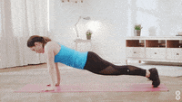
Activity 6
Do as many push ups as you can for 30 seconds
Backside

Slide 9
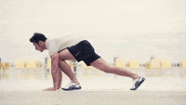
Activity 7
Do as many mountain climbers as you can for 30 seconds
Backside

Slide 10
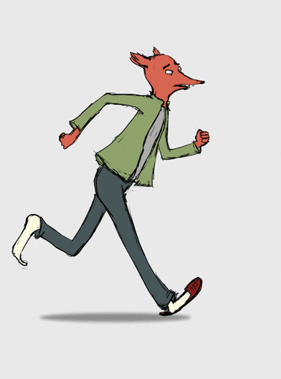
Activity 8
Run on the spot for 30 seconds
Backside

Slide 11

Activity 9
Do as many ski jumps as you can for 30 seconds
Backside

Slide 12
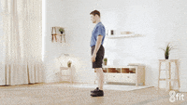
Activity 10
Do as many squats as you can for 30 seconds
Backside

Slide 13
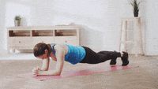
Activity 11
Do as many plank jumps as you can for 30 seconds
Backside

Slide 14
Activity 12
Free
Pass!
Backside

Slide 15

Activity 13
Do as many step back lunges as you can for 30 seconds
Backside

Slide 16
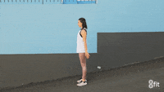
Activity 14
Do as many jump squats as you can for 30 seconds
Backside

Slide 17
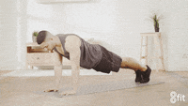
Activity 15
Hold a plank for 30 seconds
Backside

Slide 18
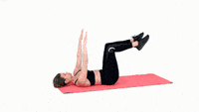
Activity 16
Do as many extensions as you can for 30 seconds
Backside

Slide 19
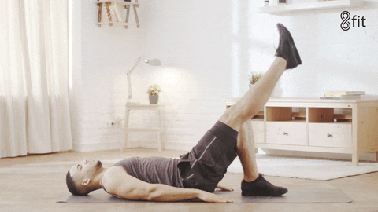
Activity 17
Do as many pelvic raises as you can for 30 seconds
Backside

Slide 20
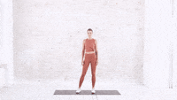
Activity 18
Do as many jump twists as you can for 30 seconds
Backside

Slide 21

Activity 19
Do as many bicycle kicks as you can for 30 seconds
Backside

Slide 22
Activity 20
Free
Pass!
Backside

Slide 23
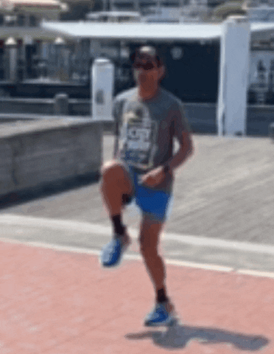
Activity 21
Do high knee running on the spot for 30 seconds
Backside

Slide 24
Yayyy!
You did it!

Slide 25
Special thanks to Alice Keeler for her Dice script

