Slide 1
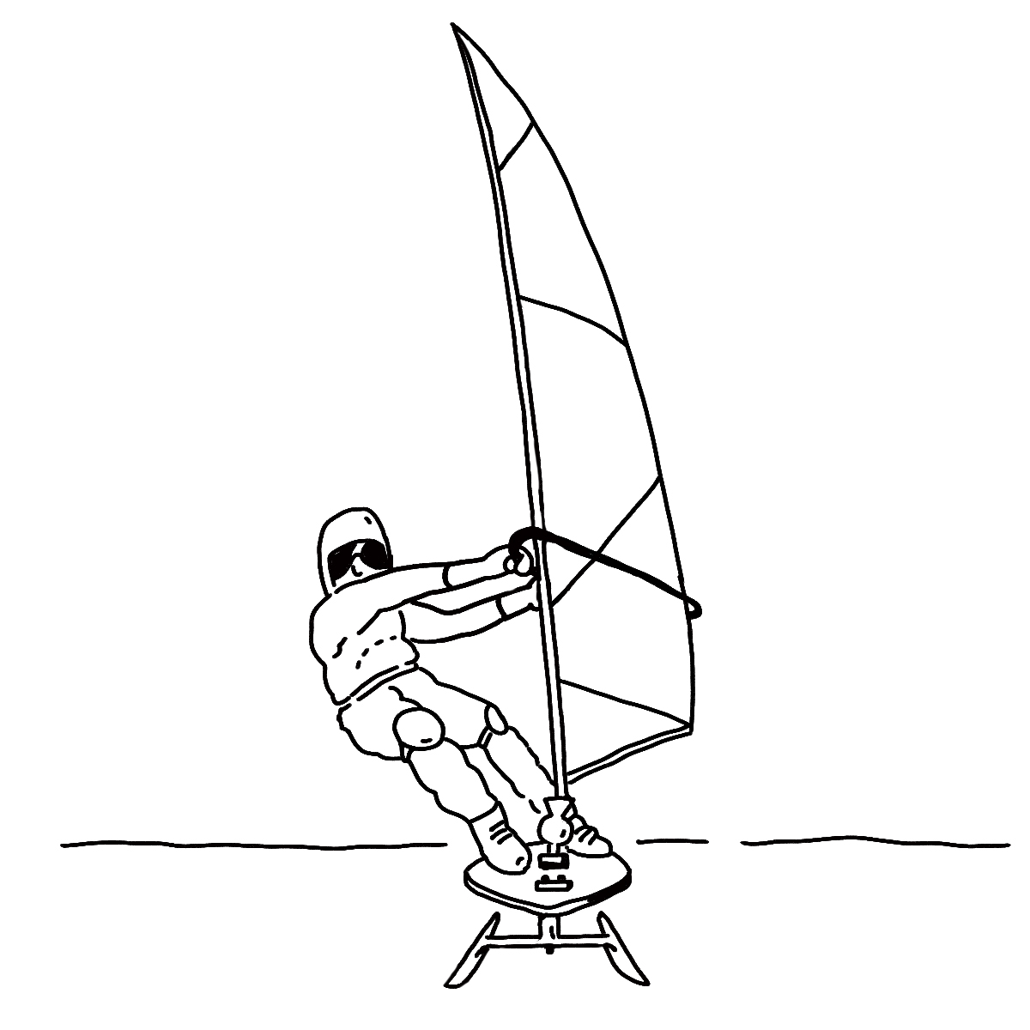
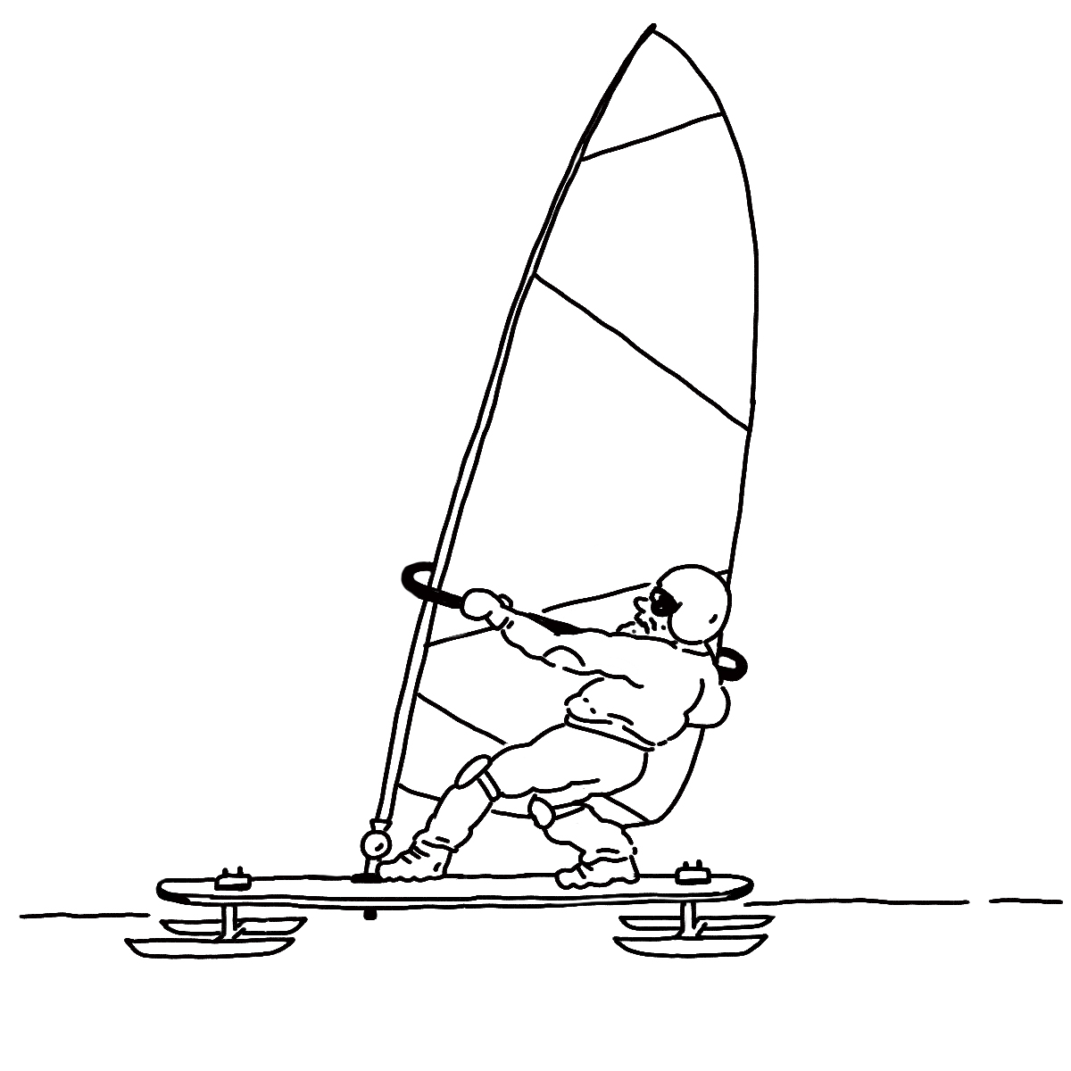

Ice Board
Directions:
Add labels to these drawings to explain how the ice board works.
Name: ______________________
Front View
Side View
Invisible Forces | Anchor Phenomenon

