Slide 1

The Granite Way
Professional Learning
Personalized Learning through Differentiated Instruction
November 6, 2019
Instructional/Student Learning Process
Expanded Instruction and Support
Notes:
Welcome to the Granite Way Professional Learning for School Year 2019-20.

Slide 2

Go to graniteway.org to follow along and access all current and previous materials

Slide 3
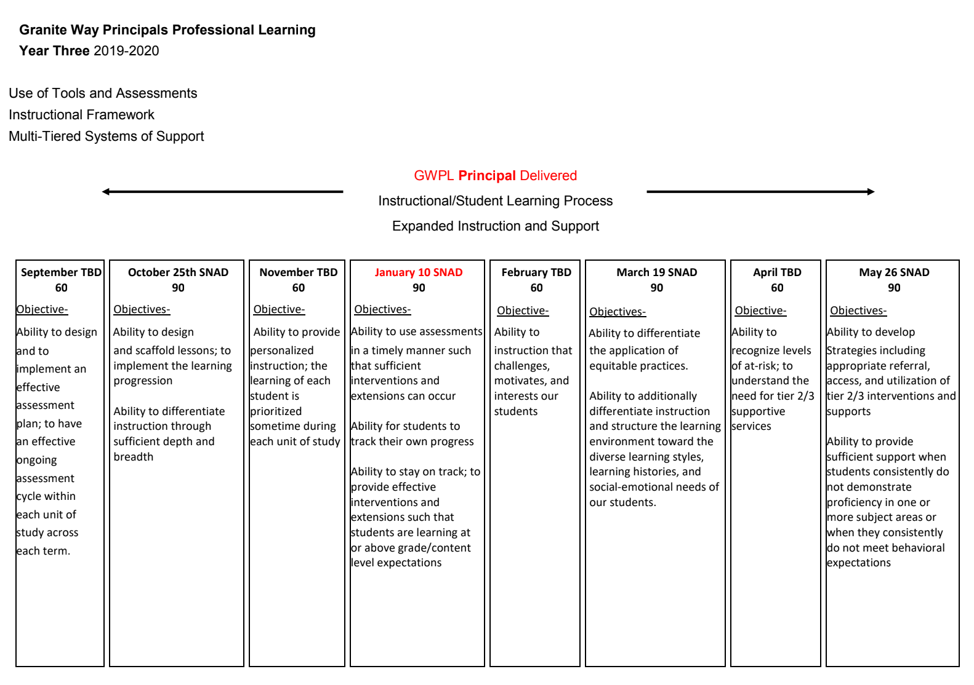
Notes:
30 second reminder. This is the schedule Principals will follow for their presentations.

Slide 4

Objectives
Content:
The ability to provide personalized learning opportunities through differentiated instruction.
Language:
Learners will discuss ways to differentiate their lessons to help all students access the rigor of the standard.
Notes:
1 minute. (Model the use of Language and Content Objectives)
Read individually or have a person in the group read it.

Slide 5
Admin Plan Self-Reflection
1. What went well in the GWPL on Scaffolding? What was impactful and valuable?
2. What problems did we experience? Why?
3. What can I plan better for in the next lesson upgrade GWPL?
Notes:
10 minutes. Connecting to last month’s GWPL, how did the “upgrade” a lesson with scaffolding go? First have individual reflection 2 minutes, then 5 minutes to discuss at their tables and 3 minutes for a whole group share out of “ah ha”

Slide 6
Lesson Plan Self Reflection
1. What went well in this lesson? Why?
2. What problems did I experience? Why?
3. Preparation and research – What scaffolding strategy did I incorporate?
4. Final thoughts? How did the class do? What should I change for next time? What did I learn from this experience that will help me in the future?
Notes:
10 minutes. Connecting to last month’s GWPL, how did the “upgrade” a lesson with scaffolding go? First have individual reflection 2 minutes, then 5 minutes to discuss at their tables and 3 minutes for a whole group share out of “ah ha”

Slide 7
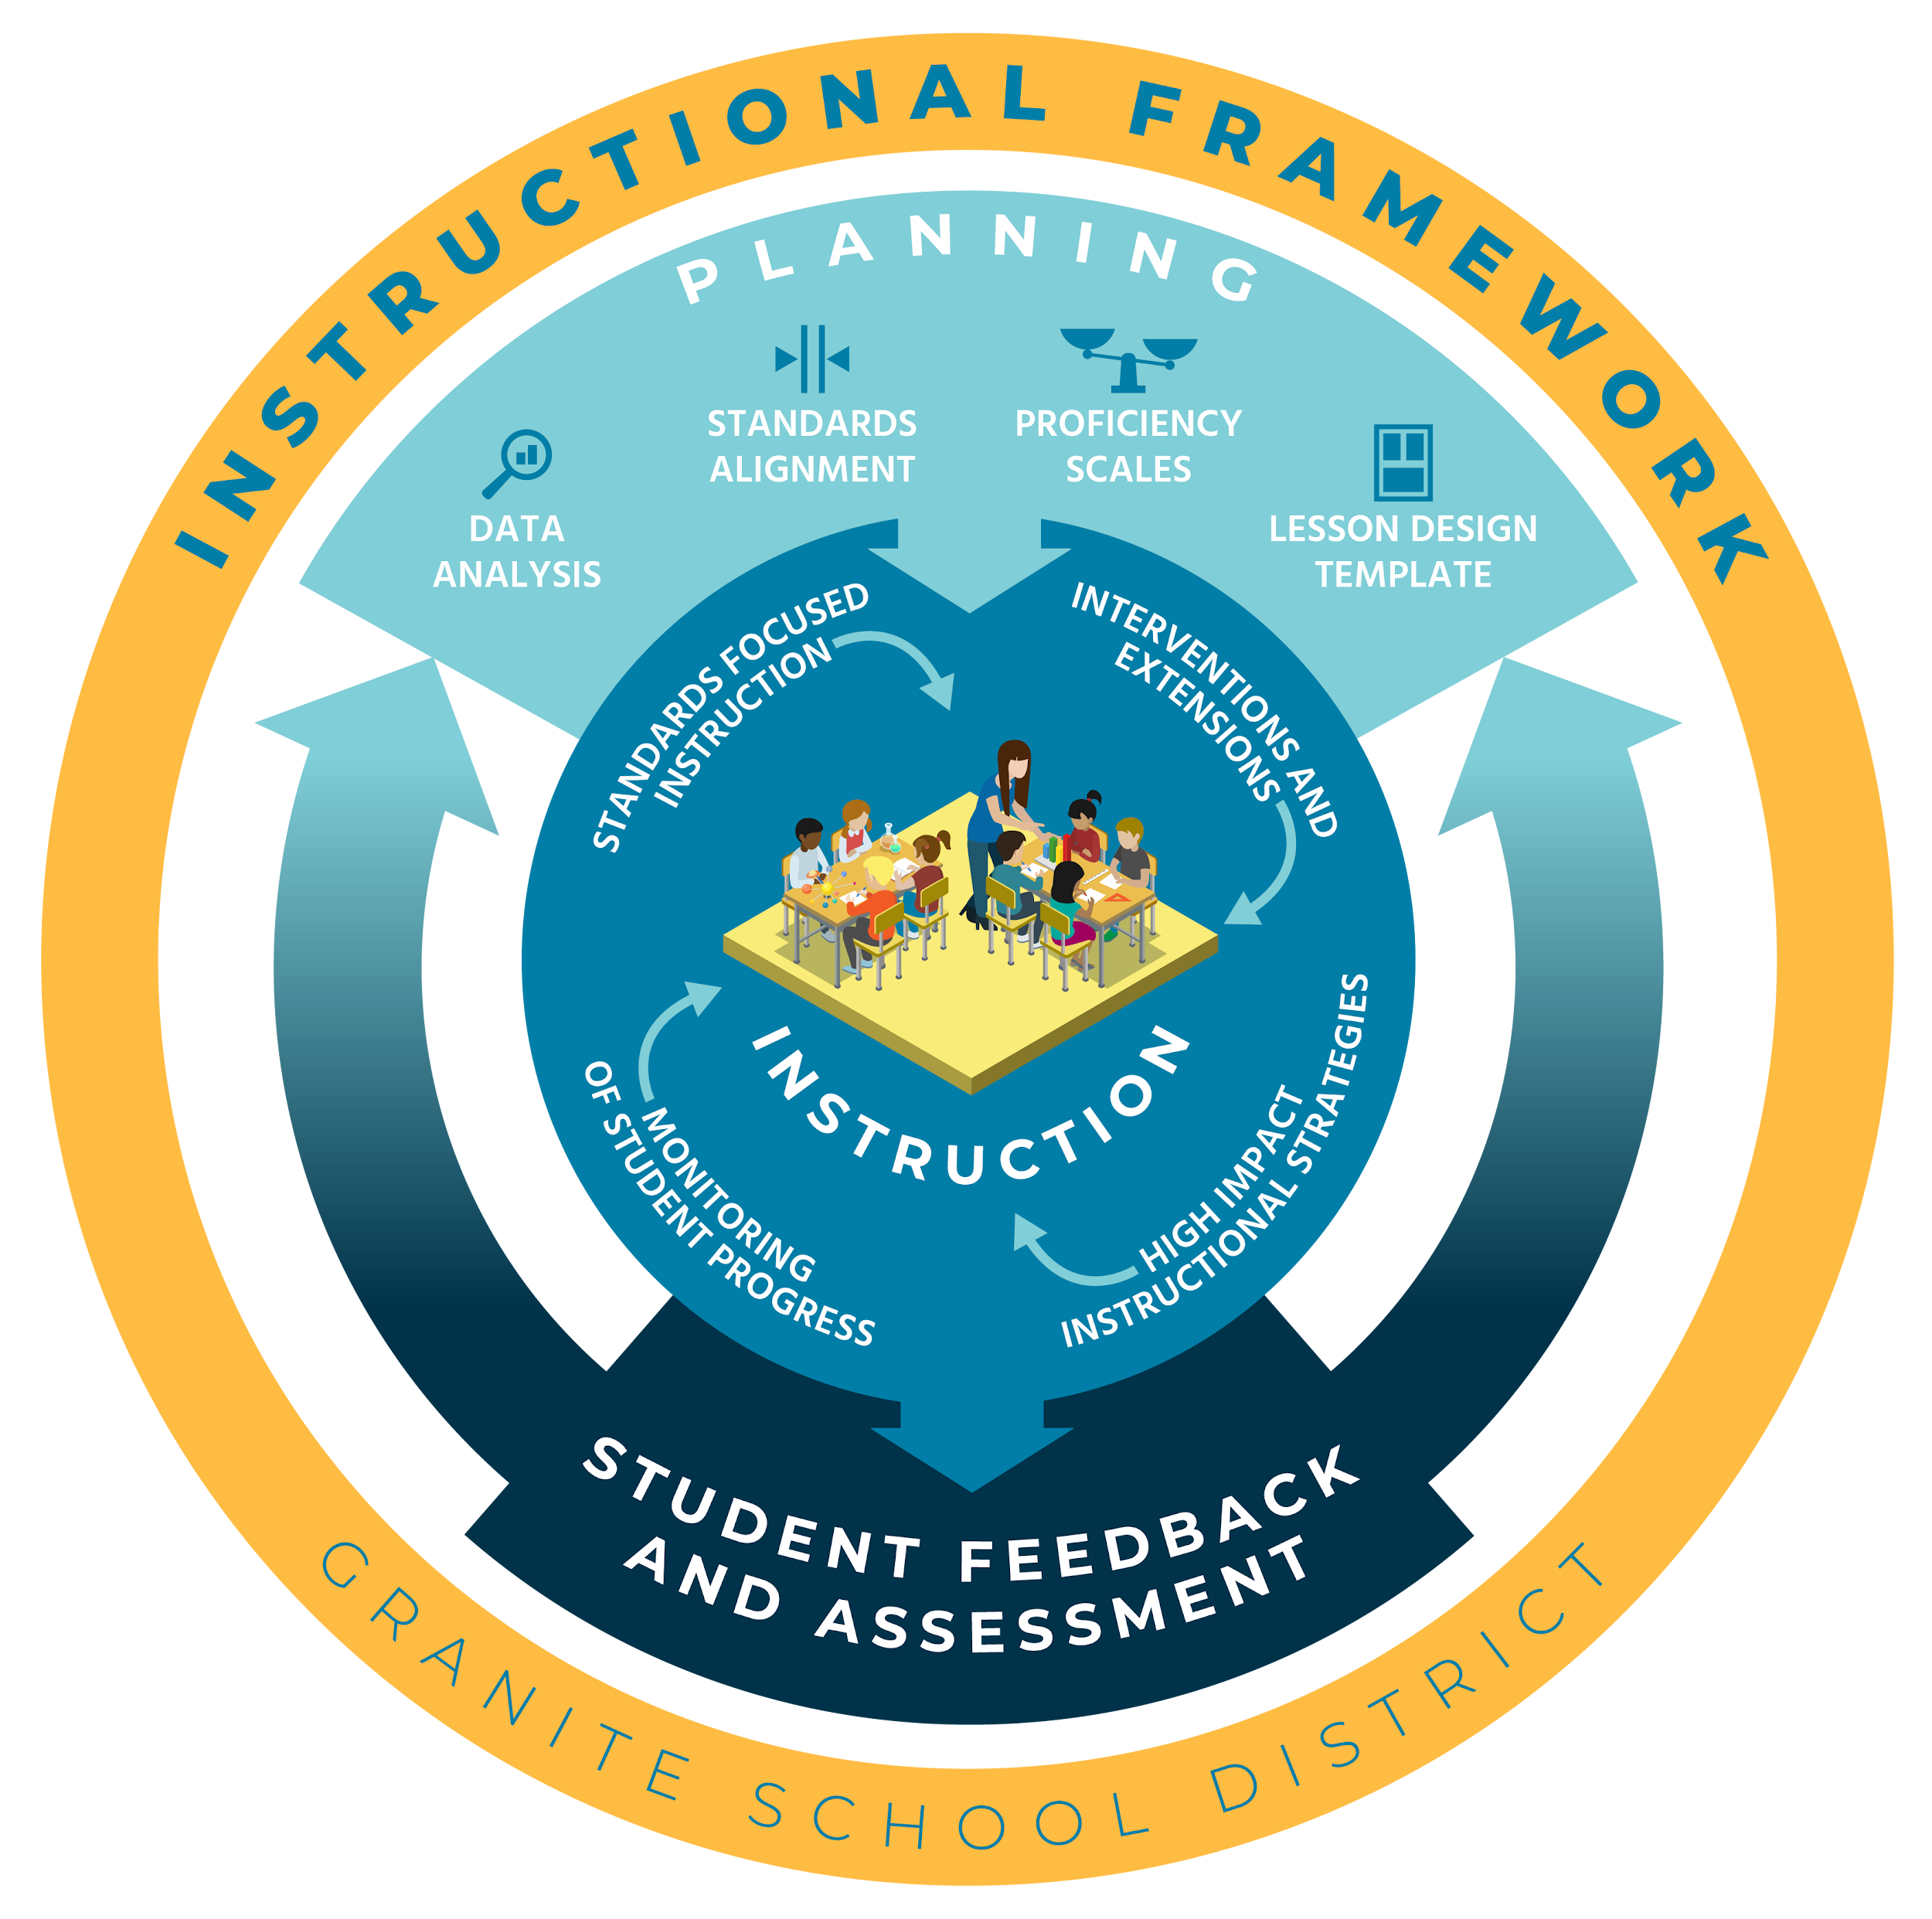
Instructional Framework
Notes:
1 minute: Part of the Granite Way includes the Instructional Framework we use. The Instructional Framework is comprised of multiple components

Slide 8
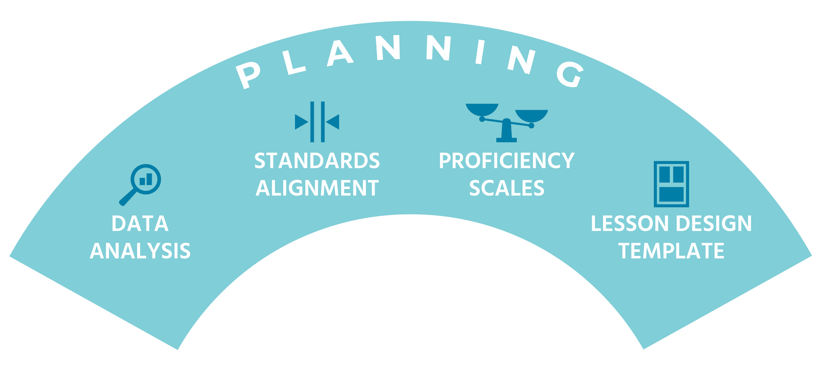
Planning
Data Analysis
Standard Alignment
Proficiency Scales
Lesson Design Template
Notes:
1 minute: In this month’s GWPL, we will focus on the Planning components, particularly using the info in the Lesson Design Template to plan for differentiation.

Slide 9
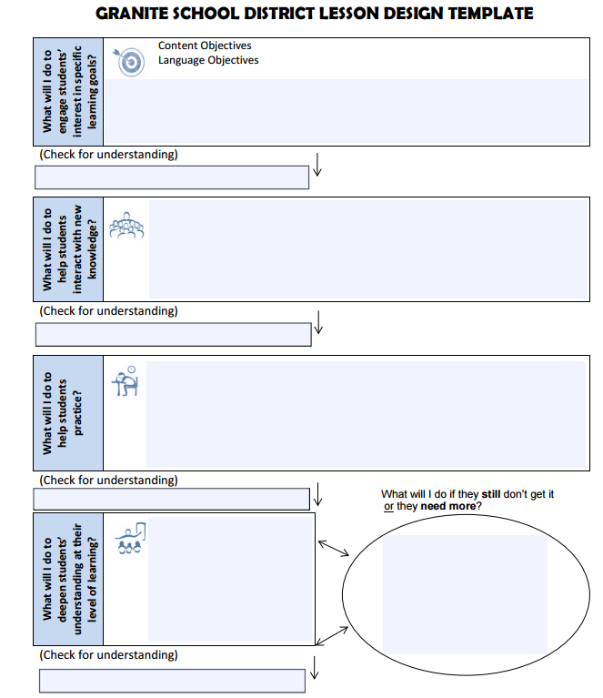
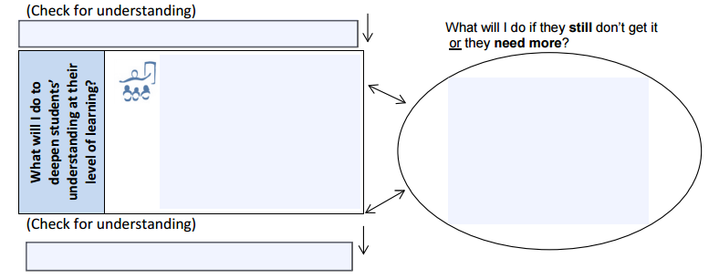
Remember the Granite Lesson Design Template?
Intervention
Extension
Notes:
3 minutes: Lesson Design Template is a visual cue that reminds us to include extensions and interventions as part of our planning to help differentiate for the learners. Interventions and extensions have always been an expectation. Our goal is to provide tools for implementing interventions and extensions.

Slide 10
Differentiation
is using data to tailor instruction to meet individual needs.
Teachers can differentiate through
Content
What students learn about and where they begin learning (e.g., topic, entry point)
Process
The ways we help students learn—through instruction and assessment
Product
The ways students demonstrate their learning—through assessment and evaluation
Learning Environment
Conditions for learning (e.g. quiet or busy, alone or with others)
according to student’s
Readiness
A student’s proximity to specified learning goals
Interest
Passions, affinities, kinships that motivate learning
Learning Profile
Preferred approaches to learning
Tomlinson, Carol Ann., and Marcia B. Imbeau. Leading and Managing a Differentiated Classroom. Hawker Brownlow Education, 2011.
Notes:
3 minutes: Explain the ways to differentiate according content, process, product and learning environment according to the students’ individual needs of readiness, interest, and learning profile. Using data is the first step in determining what kind of differentiation might be needed and then a teacher can determine how to proceed.

Slide 11

Notes:
6 minutes: Preface the video that this is a teacher sharing their experience with differentiation. In the video, the teacher talks about no effort or planning is needed “in the moment” of implementation, but some thought about what differentiation is, what he can live with and what his resources are were part of the planning he did. After the video-quick turn and talk about something that they saw that they might try or that resonated with them.

Slide 12
Differentiation Task
Use the Differentiation Planning Guide to reflect on the following questions:
What differentiation needs to be in place to help students move toward stronger understanding and independence of the standard being assessed?
Will I differentiate through content, process, product, or learning environment according to student’s readiness, interest, or learning profile?
Notes:
4 minutes: Instructions on how to access the module and use printed guide to upgrade a lesson using differentiation

Slide 13
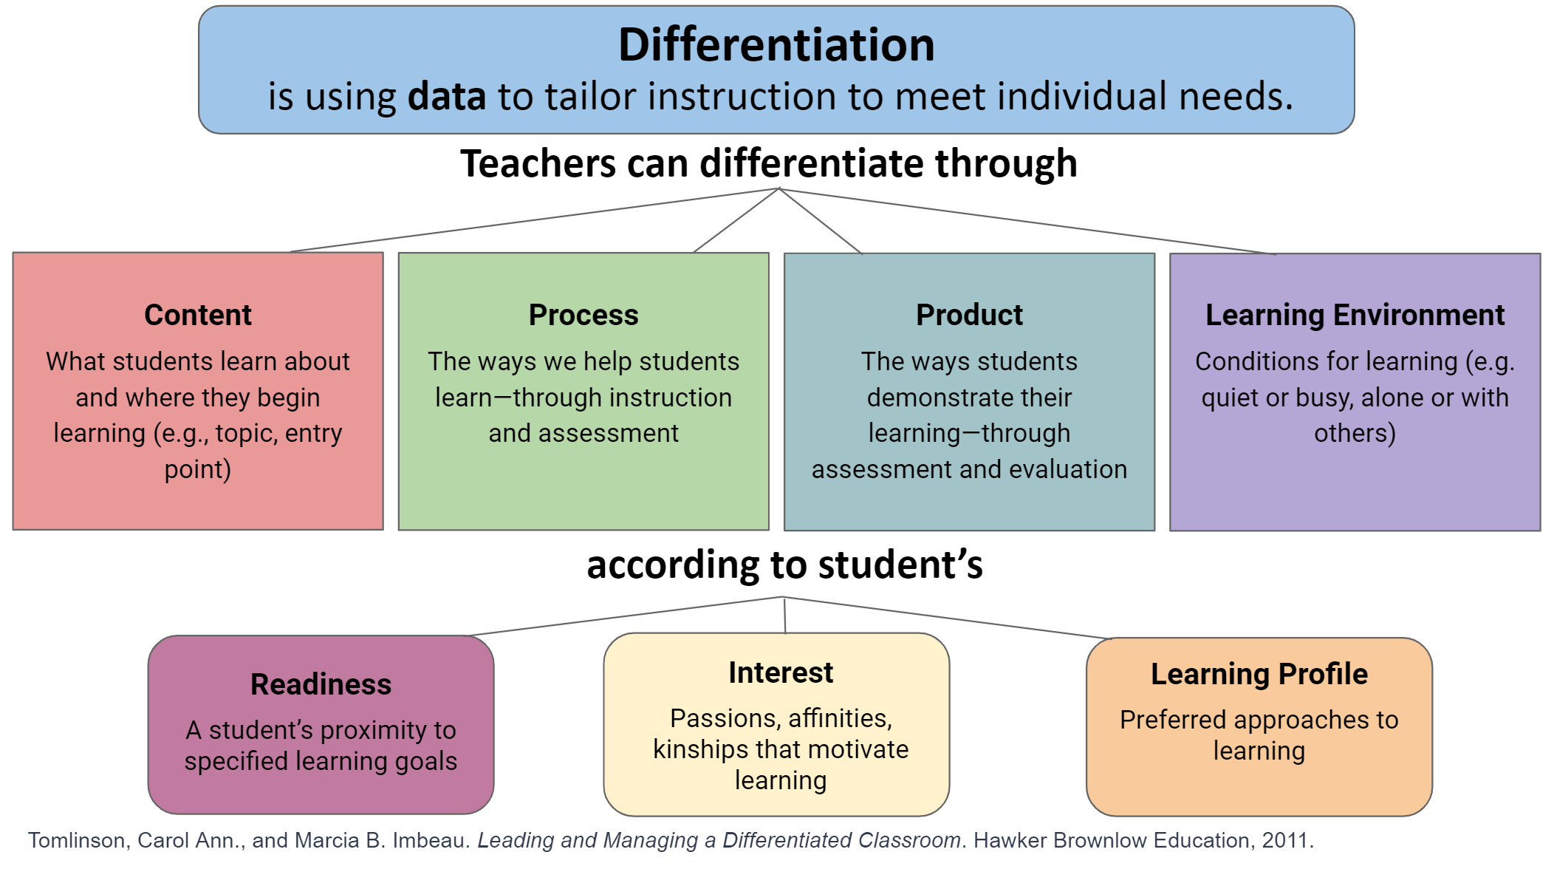
Teacher Learning Module - Differentiation
Directions: Pull up the link below to access the teacher learning module:
https://tinyurl.com/granite-differentiation
Notes:
24 minutes- stop every 8 minutes and share. This learning module will let teachers explore 4 different types of supports they can use to upgrade their lesson. The planning guide asks them to pick at least one from each category. They may not be able to incorporate every type into their lesson, but hopefully it will give them many ideas that they could use as they teach the standard. You can access the link through the presentation. When principals give the presentation to teachers, they can e-mail out the link or post it on the board. This module also provides a planning guide for PLCs and a differentiation checklist when upgrading their lesson, which is available through the pentagon shape. It may be helpful to go into the module and show them how it works. The home button in the bottom corner will return them to the main page. The first page of the module gives instructions.

Slide 14
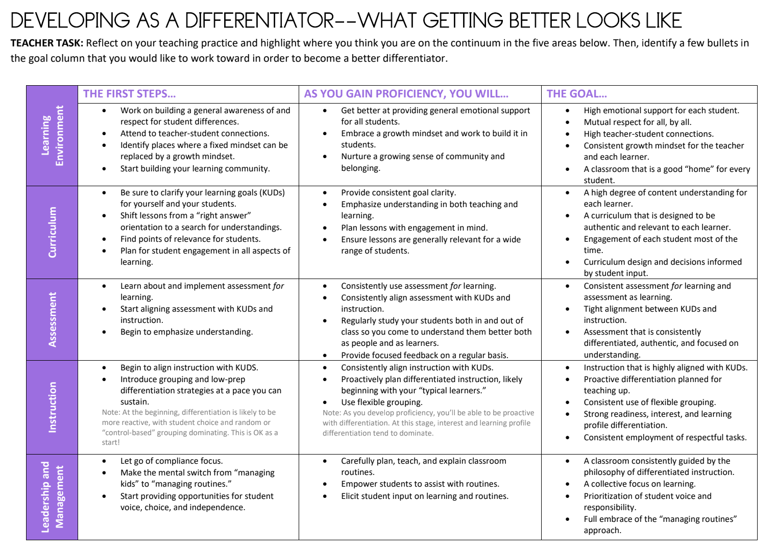
Rubric
Notes:
1 minute: In the printed materials is a self-reflection for an educator to determine where they are in the process of designing lessons that are differentiated and meet the needs of the variety of students we serve.

Slide 15
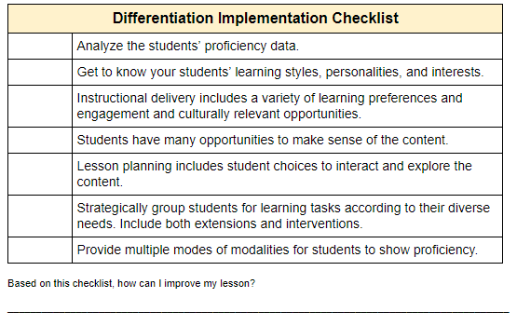
Planning for Differentiation
Differentiation Implementation Checklist
Notes:
5 minutes: Upgrading your lesson. Either using the lesson you used last month for adding scaffolding OR selecting a standard/lesson that you will be teaching in the future, go through the differentiation checklist to create an opportunities for differentiation. Make a plan for when you will be teaching this lesson prior to the next GWPL.

Slide 16

Survey
Please fill out the survey.
Graniteway.org

Slide 17
Possible video clip
https://www.edweek.org/ew/collections/differentiated-instruction-videos/index.html
Entry level differentiation strategies: https://www.youtube.com/watch?v=h7-D3gi2lL8&feature=youtu.be
Differentiation and ELL https://www.youtube.com/watch?v=9hekJsCOHLU&feature=youtu.be
Lesson planning that includes Differentiation: https://www.youtube.com/watch?v=rumHfC1XQtc&feature=youtu.be

