Slide 1


Free Template
Addiction
free presentation template

Slide 2

Free Template
Welcome
Welcome to the world of fantasy! Join us on a journey to explore the mystical creatures, enchanted lands, and magical wonders that exist beyond our reality. Discover the wonders and secrets of this exciting realm and unlock the power of imagination.

Slide 3

Free Template
01
Introduction
02
Types of Drugs
The Extraordinary Realm
Unicorn Sightings
03
Signs and Symptoms
04
Risk Factors and Causes
Wishes Granted
Spellcasting
05
Treatment and Recovery
06
Prevention and Education
Happily Ever After
Embrace the Fantasy
Table of Contents

Slide 4
Free Template
Introduction
Welcome to the Fantasy World, a realm of wonder and enchantment where anything is possible. Here, dragons breathe fire, unicorns prance through meadows, and rainbows shine brightly. This world is a place where wishes come true, where potions can be cursed and spells are cast. It's a place of treasure and adventure, where the impossible becomes possible. But the greatest treasure of all is the one that lies within.
The world of fantasy is a reflection of our deepest desires, our fondest dreams, and our wildest imaginations. It's a place where we can let go of the constraints of reality and explore the boundless possibilities of the human mind. In this introduction, we will delve into the mysteries of this realm, uncovering the magic and wonder that lies within. So come with us and let's embark on a journey through the Fantasy World.

Slide 5


Free Template
opioids
A record of the number of unicorns spotted in the fantasy realm and the beauty and mystery that surrounds these enchanting creatures.
Types of Drugs
hallucinogens
A closer look at the art of taming dragons and the brave adventurers who dare to take on these fearsome creatures.

Slide 6




Free Template
health problems
sleep disturbances
A record of the number of unicorns spotted in the fantasy realm and the beauty and mystery.
A closer look at the art of taming dragons and the brave adventurers who take on these creatures.
affection

Slide 7

Free Template
Fantasy is the gateway to the impossible, the land where the ordinary becomes extraordinary, and the impossible becomes possible. It is the realm of the imagination, where anything can happen and everything is possible.
The Dream Weaver
a quote of someone

Slide 8



Free Template
Signs and Symptoms
"The Art of Archery": Discover the intricacies of the Art of Archery as practiced by the graceful and elves.
"The Music of the Elves": Immerse yourself in the enchanting music of the elves, whose songs have the power to heal.
"The Life of an Elf": Learn about the customs and daily life of the elves, from their familial structure to their beliefs.

Slide 9
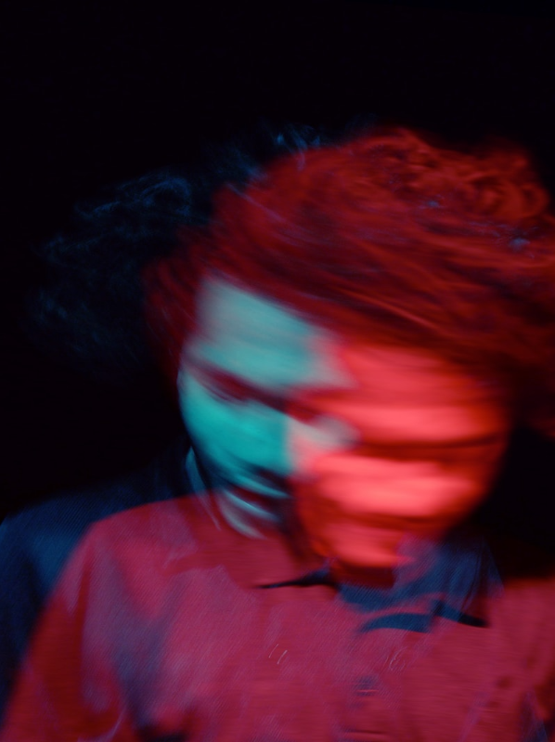
Free Template
changes in appearance
Physical signs
A guide to taming and caring for dragons in the realm of magic.
poor hygiene
Tips and tricks for spotting the elusive unicorns in their natural habitat.

Slide 10
Free Template
1
anxiety
Explore the lush, vibrant forest and uncover the mysteries.
Psychological sign
2
depression
Choose your own path through the forest, and see where it takes you.
paranoia
3
Encounter the mythical creatures that call the forest home.

Slide 11

Free Template
Risk Factors and Causes
Elegant inhabitants of enchanted forests, known for their mastery of magic and their close connection to nature. They possess an innate sense of harmony and balance, making them protectors of the natural world.

Slide 12
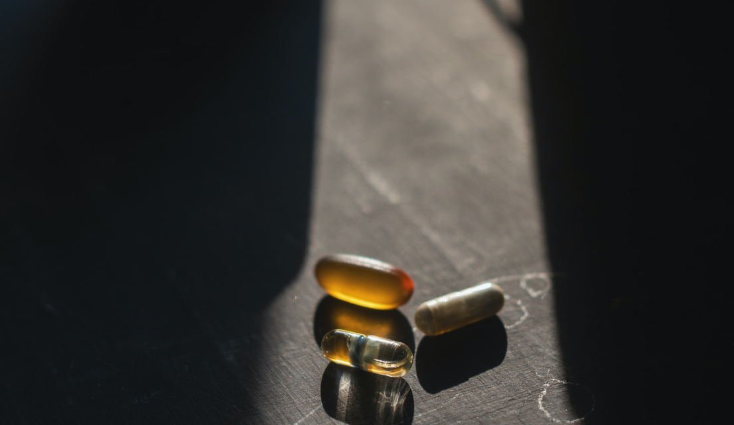
Free Template
Environmental factors may increase the risk of addiction

Slide 13




Free Template
family history
Environmental factors
trauma
peer pressure

Slide 14



Free Template
Behavioral factors
early drug use
poor coping skills
low esteem

Slide 15

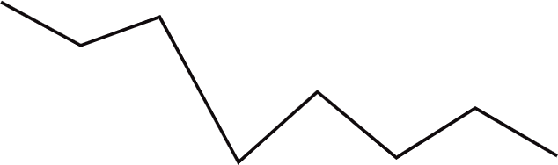

Free Template
100
90
80
70
60
50
40
30
20
10
0
Treatment and Recovery
1
2
3
4
5
6
7
8
Spellcasting Progress
A record of the number of spells cast per year

Slide 16


Free Template
Unicorn Sightings
A record of the number of unicorns spotted in the fantasy realm and the beauty and mystery that surrounds these enchanting creatures.
types of treatment
Unicorn Sightings
A record of the number of unicorns spotted in the fantasy realm and the beauty and mystery that surrounds these enchanting creatures.

Slide 17



Free Template
Success rates
12
10
A
8
6
B
C
4
2
0
2015
2016
2017
2018
2019
2020
2021

Slide 18
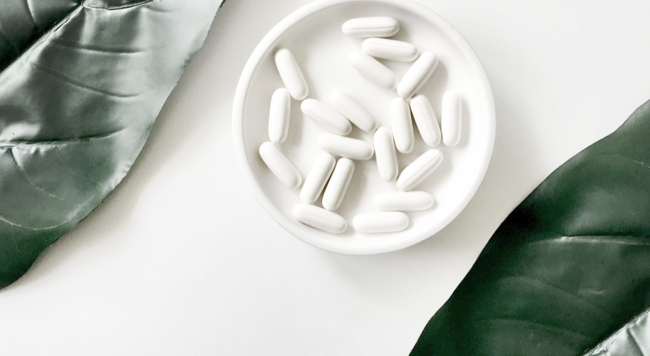
Free Template
Prevention and Education
  Immerse yourself in the world of magic and mystery
  Explore uncharted territories and fantastical lands
  Meet mythical creatures and legendary beings
  Uncover hidden treasures and secret treasures

Slide 19
Free Template
Dragons
Fire-breathing creatures that are often powerful and dangerous
Medieval-like Settings
Worlds with castles, knights, and feudal systems
Chosen One Trope
A hero chosen by destiny to save the world
Magic
An integral part of fantasy stories, can take many forms
The Best Curse
A curse that is unique, creative, and fits within the story
A variety of fantastical beings that inhabit the world
Resources for community
Unique Creatures

Slide 20
Free Template
Thank you for choosing EaTemp
We offer free and high-quality slides templates for your presentations. We appreciate you choosing us and hope our templates have been helpful.
As a new website, we rely on your support to grow, so please help us by sharing our site with your friends and colleagues.

