Slide 1
An introduction to dimensional analysis using basic properties of water
Notes:
This unit will review the dimensions and units that are commonly used for quantifying water in the environment. To provide examples of the meaning of these dimensions and the conversion of units, we will also review the properties of water that are critical to the shaping of the landscape and its ecosystems.

Slide 2
Physics of water
Water is matter.
What does this mean?
  Water has mass
  Water occupies space
How do we describe the amount of mass and volume objectively?
Notes:
Before we an start describing the unique physical properties of water, we have to establish some basic context for how we think about reality.
We can build from the basics starting with the most fundamental physical properties. Physical properties are broken down into a couple basic categories: Mass-energy and Space-time. Let’s start as simple as we can get, and just think about liquid water in a bucket.
Q: Water can be described as matter. Based on the definition of matter, what are the 2 properties we know the water in this bucket must have?
A: Water has mass and occupies a volume in space.
Mass and volume are things we can measure. Mass is measured as proportional to the gravitational force of the Earth on the water. This force is also known as the water’s weight. Volume can be measured in many ways.
So if we want to be able to talk to each other about how much mass or how much volume is associated with a given amount of water, then we have to make sure we are thinking in the same context. This is where we have to be sure we are thinking in the same reference frame, and properly defining the dimensions for mass and volume variables in that reference frame. This idea is the domain of dimensional analysis.

Slide 3
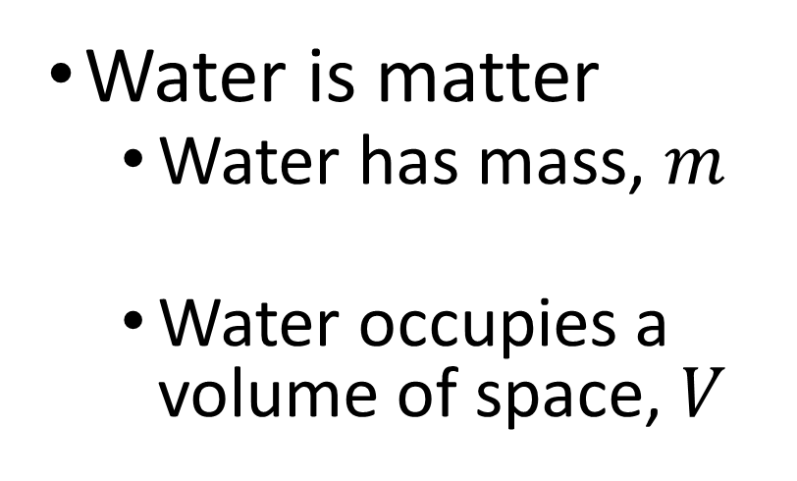
Dimensions of matter (in this case water)
Water is matter
  Water has mass, $m$
  Water occupies a volume of space, $V$
Mass [M]
[M]
Notes:
Dimensions of a given amount of water.
We can think about mass and volume in terms of dimensions.
Mass is straightforward, and is a dimension itself usually specified by a capital [M]. Dimensions are usually signified by square brackets.
Volume is a little different. We can break volume down into a simpler dimension in space, length. The length dimension is specified with a capital [L].
For our bucket of water, we can get to the dimensions of volume by thinking about how to calculate volume of a cylinder. The depth of the water in the bucket has dimensions of length. The plan area of the bucket is $πR^{2}$. Since R has dimension of [L], we know the dimensions of area are [L²]. Since the volume is the plan area of the bucket times the depth of water, we get a dimension of volume as [L³].

Slide 4
Dimensions of matter (in this case water)
  The fundamental dimension of space is the length of a line, abbreviated by [L]
Water is matter
  Water has mass, $m$
  Water occupies a volume of space, $V$
[L]
Mass [M]
[M]
Notes:
Dimensions of a given amount of water.
We can think about mass and volume in terms of dimensions.
Mass is straightforward, and is a dimension itself usually specified by a capital [M]. Dimensions are usually signified by square brackets.
Volume is a little different. We can break volume down into a simpler dimension in space, length. The length dimension is specified with a capital [L].
For our bucket of water, we can get to the dimensions of volume by thinking about how to calculate volume of a cylinder. The depth of the water in the bucket has dimensions of length. The plan area of the bucket is $πR^{2}$. Since R has dimension of [L], we know the dimensions of area are [L²]. Since the volume is the plan area of the bucket times the depth of water, we get a dimension of volume as [L³].

Slide 5
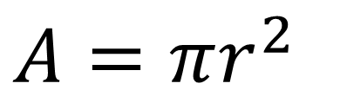
Dimensions of matter (in this case water)
$A=πr^{2}$
Water is matter
  Water has mass, $m$
  Water occupies a volume of space, $V$
[L]
Mass [M]
[M]
Notes:
Dimensions of a given amount of water.
We can think about mass and volume in terms of dimensions.
Mass is straightforward, and is a dimension itself usually specified by a capital [M]. Dimensions are usually signified by square brackets.
Volume is a little different. We can break volume down into a simpler dimension in space, length. The length dimension is specified with a capital [L].
For our bucket of water, we can get to the dimensions of volume by thinking about how to calculate volume of a cylinder. The depth of the water in the bucket has dimensions of length. The plan area of the bucket is $πR^{2}$. Since R has dimension of [L], we know the dimensions of area are [L²]. Since the volume is the plan area of the bucket times the depth of water, we get a dimension of volume as [L³].

Slide 6



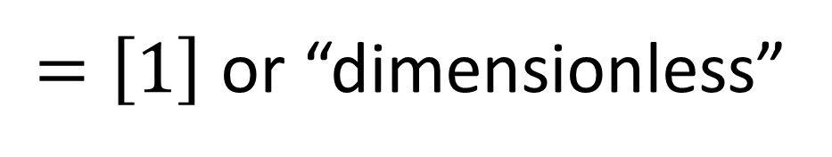


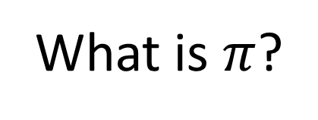
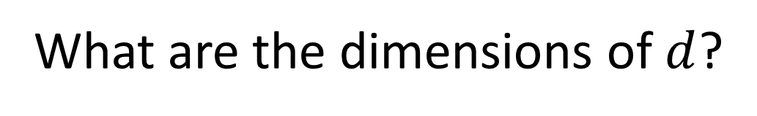


What are the dimensions of $π$?
What is $π$?
(Hint: it is a ratio that has something
to do with the geometry of a circle)
What are the dimensions of $c$?
$$c$$
What are the dimensions of $d$?
$$d$$
$$[L]$$
$$\frac{}{[L]}$$
$$π≡\frac{c}{d}$$
$=\left[1\right]$ or “dimensionless”

Slide 7
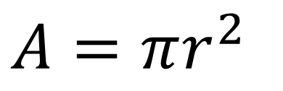
Dimensions of matter (in this case water)
$A=πr^{2}$
[1][?]²
[1][L]²
= [L²]
[L]
Water is matter
  Water has mass, $m$
  Water occupies a volume of space, $V$
[L]
Mass [M]
[M]
[L²][L] = [L³]
Notes:
Dimensions of a given amount of water.
We can think about mass and volume in terms of dimensions.
Mass is straightforward, and is a dimension itself usually specified by a capital [M]. Dimensions are usually signified by square brackets.
Volume is a little different. We can break volume down into a simpler dimension in space, length. The length dimension is specified with a capital [L].
For our bucket of water, we can get to the dimensions of volume by thinking about how to calculate volume of a cylinder. The depth of the water in the bucket has dimensions of length. The plan area of the bucket is $πR^{2}$. Since R has dimension of [L], we know the dimensions of area are [L²]. Since the volume is the plan area of the bucket times the depth of water, we get a dimension of volume as [L³].

Slide 8
Units
Variables have dimensions, numbers have units
  Dimensions define meaning, units provide a quantitative scale
Units are scaled by an arbitrary standard measurement
  Units define how much “1” (or unity) is for a given dimension
What are units of [L]?
  US Hydrologists have to be good at converting units
inches, feet, meters, kilometers, etc.
Notes:
Once we have defined the dimensionality of a variable, a value for that variable needs to be characterized on a scale we recognize. That scale is provided by some arbitrary standard measurement for a given dimension. We call that arbitrary standard measurement a “unit” then use it to scale all our measurements by some factor of that unit.
There is an international standard system of units called SI. However, as you are probably already aware, this is not the standard of units used by the US government. Therefore, the majority of jobs involving environmental science in the US are going to require strong skills in unit conversion.

Slide 9
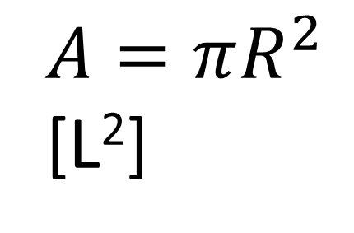
Units example
$A=πR^{2}$
[L²]
:cm²
acre or hectare?
Water is matter
  Water has mass, $m$
  Water occupies a volume of space, $V$
[L]
:cm
Mass [M]
[M]
:kg
:kg
[L³]
:cm³
gal or L?
Notes:
Units for a given amount of water.
Let’s go back to our bucket of water, and we can think about the units we might use to correspond to our dimensions.
We can think about the mass in kilograms. The kilogram is defined by the international prototype, a rod made of platinum iridium.
We can think about length in centimeters or one-hundredth of a meter. A meter is defined as the length travelled by light in a vacuum during a time interval of 1 / 299,792,458 sec.

Slide 10

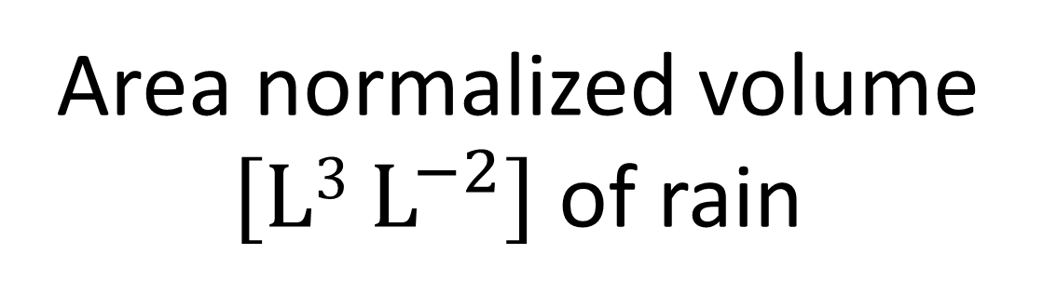
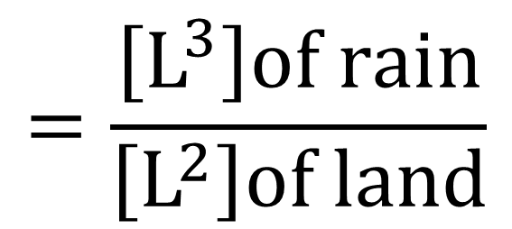
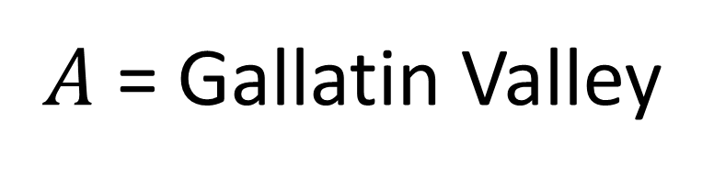
Dimensional thinking: How much rain is an “inch”?
$A$ = Gallatin Valley
$$=\frac{\left[L^{3}\right]of rain}{\left[L^{2}\right]of land}$$
$$\left[L\right]of rain$$
Area normalized volume $\left[L3 L^{−2}\right]$ of rain
Notes:
More about thinking dimensionally.
When you hear rainfall reported on the weather. What are the units? What are the dimensions? What does this amount of rain mean?
The dimensions of rainfall are usually given as a depth. Another way to think about depth is an area normalized volume.
For example, if we get 2 cm of rain on some area of land, you would multiply that area in cm² times the 2 cm of rain to come up with the total volume of water.
Later on, you will find out that we think about area normalized dimensions A LOT in watershed hydrology. Sometimes it is better not to cancel dimensions, even when you can.

Slide 11
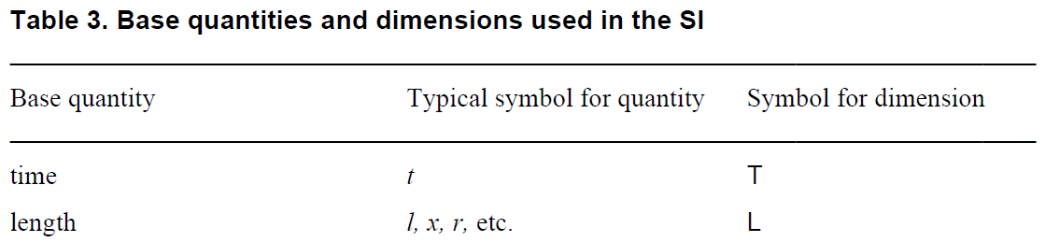
Fundamental dimensions
SI unit
second
meter
kilogram
Table from International System of Units Brochure 9th Edition 2019
Notes:
A more general application of dimensional analysis requires that we describe more properties of nature than just space.
Let’s work our way through the fundamental table of dimensions as suggested by the International System of Units, which we usually just abbreviate to SI units
A categorization and standardization of units across multiple cultures inherently requires dimensional thinking based on the most fundamental properties of nature we all understand
so it is logical that the basis for standardization of units is inherently built from a definition of fundamental dimensions
We’ve already talked about the fundamental dimension of length so I’ve already revealed that row from the table.
Many different variables may be used to represent length, as demonstrated by our use of x y and z to represent lengths in orthogonal cartesian directions
Ultimately, the goal of SI is to define a base unit for each fundamental dimension, so the base unit for length in the SI system is the meter.
As made famous by Einstein, characterizing movement in space inherently requires thinking about the dimension of time, which is symbolized with a capital T.
More often than not, time will be represented as a variable using a lower case t.
Time is one of those concepts that everybody understands abstractly, but the nature of time is very difficult to describe directly.
I like to think about time as the dimension of causality
One inarguable fact is that those of us operating in Earth’s gravitational field are all experiencing the same rate of cause and effect,
The concept of time allows us to agree on a common way to measure the pace of a resulting sequence of events.
Einstein famously showed that the fundamental rate of causality actually changes with your frame of reference,
but Earth-bound environmental scientists typically do not have to deal with meaningful variation in the pace of time in their calculations
The international community has agreed on the second as the base unit for the dimension of time
Speaking of gravity, another inarguable fact is that we all see the same effect of the stuff we call “matter” on spacetime
The degree of this effect is conceptualized as the dimension we call mass, which has a symbol of a capital M.
The magnitude of the effect of mass on spacetime is proportional to the magnitude of the apparent force we call gravity
though I think it is pretty well established at this point that gravity is actually a bending of spacetime that only has a similar effect as a force
The proportionality of mass with the effect of gravity gives us the ability to measure either based on the effect of the Earth’s mass on a given amount of matter
The international community has agreed that the base unit for mass should be the kilogram
While we often quantify an amount of matter relative to its gravitational effect, few scientists would argue against the idea that matter is made of bits of stuff we call molecules
So another way we talk about an amount of matter is by simply counting those bits, where the dimensions of this count are symbolized with a capital N
When we count in multiples of avogadros number, this count has units of moles, which is the international base unit for an amount of a substance
I would argue that counts are not limited to an “amount of a substance” and it is possible to have the dimension of count apply to conceptual entities as well
In terms of base dimensions, I am not sure “amount of substance” is a general enough descriptor for the concept of a count
But it provides a useful example
The need to predict the inarguable effects of matter on other nearby matter begins to highlight the need for dimensions related to energy.
As we will see later, Newton’s definition of energy does not require a fundamental dimension and can be derived only from the fundamental dimensions of Mass Length and Time
However, thinking about the thermodynamic energy content of matter starts to evoke notions of properties like temperature, based on the idea that we all fundamentally know the difference between stuff that is hot and stuff that is cold
The dimension of temperature is symbolized with a capital Greek letter theta, probably because a capital T was already taken by time.
Or perhaps because a capital Latin T used as a variable typically refers to temperature,
This potential confusion among symbols used for variables, dimensions, and units is why the best practice is to include square brackets around dimensions to differentiate them
The SI unit for temperature is a kelvin, where one Kelvin is conveniently the same difference in temperature as one Celsius degree
A couple more dimensions we will not focus on now include electrical current and light intensity.
The dimensions of current are symbolized with an I and the SI base unit is the ampere
We will talk later in the class about current being derived conceptually from a count of electrical charges per time
We will not be using light intensity in this class, but the dimensionality of J should not be confused with the unit of Joules of energy
Again, the square brackets help to differentiate a symbol that is used for different dimensions and units.
Luminous intensity is ultimately a type of angular energy flux with a base unit of candela that would be joules per steradian per second, where a steradian is kind of a 3-D version of an angle
There are nuances here regarding what constitutes a fundamental vs. a derived dimension
You might argue that current is actually a derived dimension and luminous intensity is almost certainly a derived dimension.
Ultimately the distinction between fundamental vs derived dimensions is not that critical as long as the element of nature being described is clear

Slide 12

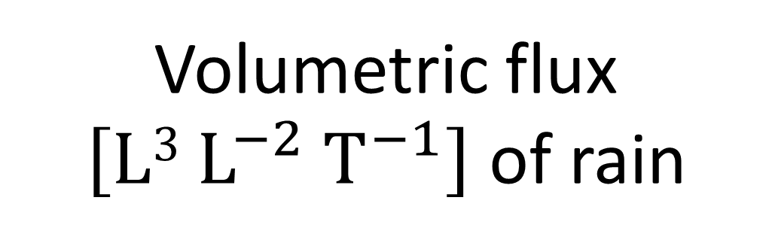
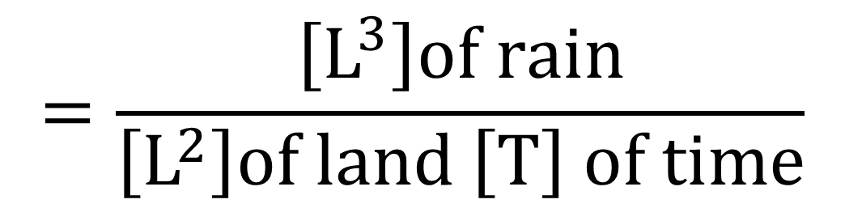
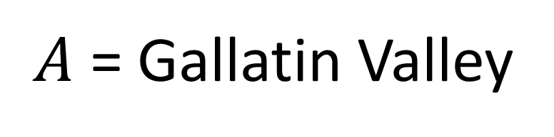
Dimensional thinking: What is an “inch per hour”?
$A$ = Gallatin Valley
$$\left[L T^{−1}\right]of rain$$
$$=\frac{\left[L^{3}\right]of rain}{\left[L^{2}\right]of land \left[T\right] of time}$$
Volumetric flux
$\left[L3 L^{−2} T^{−1}\right]$ of rain
Notes:
More about thinking dimensionally.
When you hear rainfall reported on the weather. What are the units? What are the dimensions? What does this amount of rain mean?
The dimensions of rainfall are usually given as a depth. Another way to think about depth is an area normalized volume.
For example, if we get 2 cm of rain on some area of land, you would multiply that area in cm² times the 2 cm of rain to come up with the total volume of water.
Later on, you will find out that we think about area normalized dimensions A LOT in watershed hydrology. Sometimes it is better not to cancel dimensions, even when you can.

Slide 13
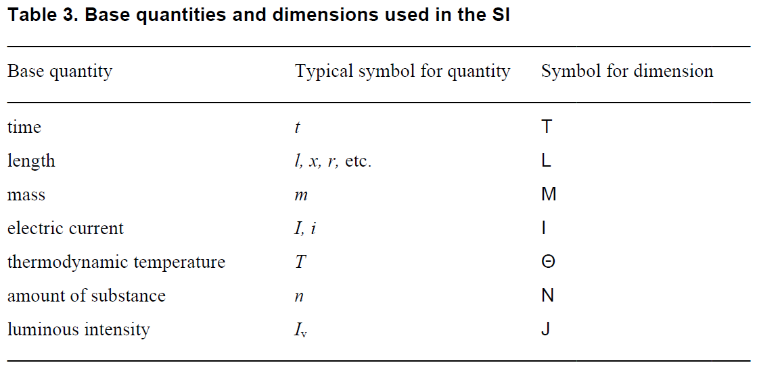
Fundamental dimensions
SI unit
[ ]
second
[ ]
meter
[ ]
kilogram
[ ]
ampere
[ ]
kelvin
or a count
[ ]
mole
[ ]
candela
Table from International System of Units Brochure 9th Edition 2019
Notes:
A more general application of dimensional analysis requires that we describe more properties of nature than just space.
Let’s work our way through the fundamental table of dimensions as suggested by the International System of Units, which we usually just abbreviate to SI units
A categorization and standardization of units across multiple cultures inherently requires dimensional thinking based on the most fundamental properties of nature we all understand
so it is logical that the basis for standardization of units is inherently built from a definition of fundamental dimensions
We’ve already talked about the fundamental dimension of length so I’ve already revealed that row from the table.
Many different variables may be used to represent length, as demonstrated by our use of x y and z to represent lengths in orthogonal cartesian directions
Ultimately, the goal of SI is to define a base unit for each fundamental dimension, so the base unit for length in the SI system is the meter.
As made famous by Einstein, characterizing movement in space inherently requires thinking about the dimension of time, which is symbolized with a capital T.
More often than not, time will be represented as a variable using a lower case t.
Time is one of those concepts that everybody understands abstractly, but the nature of time is very difficult to describe directly.
I like to think about time as the dimension of causality
One inarguable fact is that those of us operating in Earth’s gravitational field are all experiencing the same rate of cause and effect,
The concept of time allows us to agree on a common way to measure the pace of a resulting sequence of events.
Einstein famously showed that the fundamental rate of causality actually changes with your frame of reference,
but Earth-bound environmental scientists typically do not have to deal with meaningful variation in the pace of time in their calculations
The international community has agreed on the second as the base unit for the dimension of time
Speaking of gravity, another inarguable fact is that we all see the same effect of the stuff we call “matter” on spacetime
The degree of this effect is conceptualized as the dimension we call mass, which has a symbol of a capital M.
The magnitude of the effect of mass on spacetime is proportional to the magnitude of the apparent force we call gravity
though I think it is pretty well established at this point that gravity is actually a bending of spacetime that only has a similar effect as a force
The proportionality of mass with the effect of gravity gives us the ability to measure either based on the effect of the Earth’s mass on a given amount of matter
The international community has agreed that the base unit for mass should be the kilogram
While we often quantify an amount of matter relative to its gravitational effect, few scientists would argue against the idea that matter is made of bits of stuff we call molecules
So another way we talk about an amount of matter is by simply counting those bits, where the dimensions of this count are symbolized with a capital N
When we count in multiples of avogadros number, this count has units of moles, which is the international base unit for an amount of a substance
I would argue that counts are not limited to an “amount of a substance” and it is possible to have the dimension of count apply to conceptual entities as well
In terms of base dimensions, I am not sure “amount of substance” is a general enough descriptor for the concept of a count
But it provides a useful example
The need to predict the inarguable effects of matter on other nearby matter begins to highlight the need for dimensions related to energy.
As we will see later, Newton’s definition of energy does not require a fundamental dimension and can be derived only from the fundamental dimensions of Mass Length and Time
However, thinking about the thermodynamic energy content of matter starts to evoke notions of properties like temperature, based on the idea that we all fundamentally know the difference between stuff that is hot and stuff that is cold
The dimension of temperature is symbolized with a capital Greek letter theta, probably because a capital T was already taken by time.
Or perhaps because a capital Latin T used as a variable typically refers to temperature,
This potential confusion among symbols used for variables, dimensions, and units is why the best practice is to include square brackets around dimensions to differentiate them
The SI unit for temperature is a kelvin, where one Kelvin is conveniently the same difference in temperature as one Celsius degree
A couple more dimensions we will not focus on now include electrical current and light intensity.
The dimensions of current are symbolized with an I and the SI base unit is the ampere
We will talk later in the class about current being derived conceptually from a count of electrical charges per time
We will not be using light intensity in this class, but the dimensionality of J should not be confused with the unit of Joules of energy
Again, the square brackets help to differentiate a symbol that is used for different dimensions and units.
Luminous intensity is ultimately a type of angular energy flux with a base unit of candela that would be joules per steradian per second, where a steradian is kind of a 3-D version of an angle
There are nuances here regarding what constitutes a fundamental vs. a derived dimension
You might argue that current is actually a derived dimension and luminous intensity is almost certainly a derived dimension.
Ultimately the distinction between fundamental vs derived dimensions is not that critical as long as the element of nature being described is clear

Slide 14
Dimensional analysis: more examples of derived dimensions
  = [L T⁻¹]
Velocity
Acceleration
Force [F]
Energy [E]
  = change in distance [L] over time [T]
  = change in velocity [L T⁻¹] over time [T]
  = [L T⁻²]
  = mass [M] times acceleration [L T⁻²]
  = [M L T⁻²]
  = force [M L T⁻²] applied over a distance [L]
  = [M L² T⁻²]

Slide 15
Why care about dimensional analysis?
Will vastly improve understanding of applied mathematics
  Most important skill after algebra
Dramatically reduces the potential for mathematical errors
  Calculation error (i.e. carrying units through calculations)
  Derivation error
Huge emphasis on this in exams in this class!!!

Slide 16
Rules for formatting dimensions
(i.e. grounds for losing points on assignments)
Use capital letters with non-italicized fonts (e.g. [M] not [M] or [m])
Always put in square brackets (i.e. [L] not L or (L))
Use negative exponents rather than fractions
(e.g. a mass flux is [M L⁻² T⁻¹] not [M / L²T])
  Why? Less ambiguous order of operations
    [M/L²T] might be interpreted as [(M/L²)T] or [M/(L²T)]
    [M L⁻² T⁻¹] is unambiguously the same as [M/(L²T)]

Slide 17
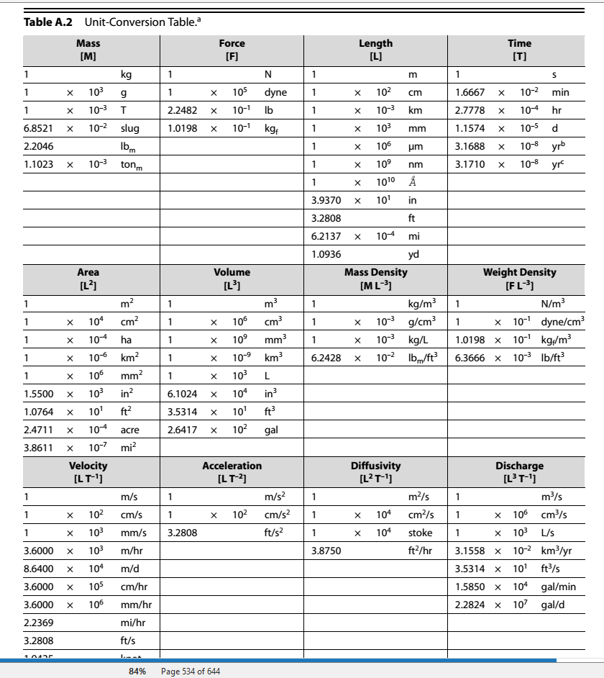
Appendix A in the textbook

Slide 18
Using the dimensionality of chemical properties of water to estimate volume
Notes:
This unit will review the dimensions and units that are commonly used for quantifying water in the environment. To provide examples of the meaning of these dimensions and the conversion of units, we will also review the properties of water that are critical to the shaping of the landscape and its ecosystems.

Slide 19
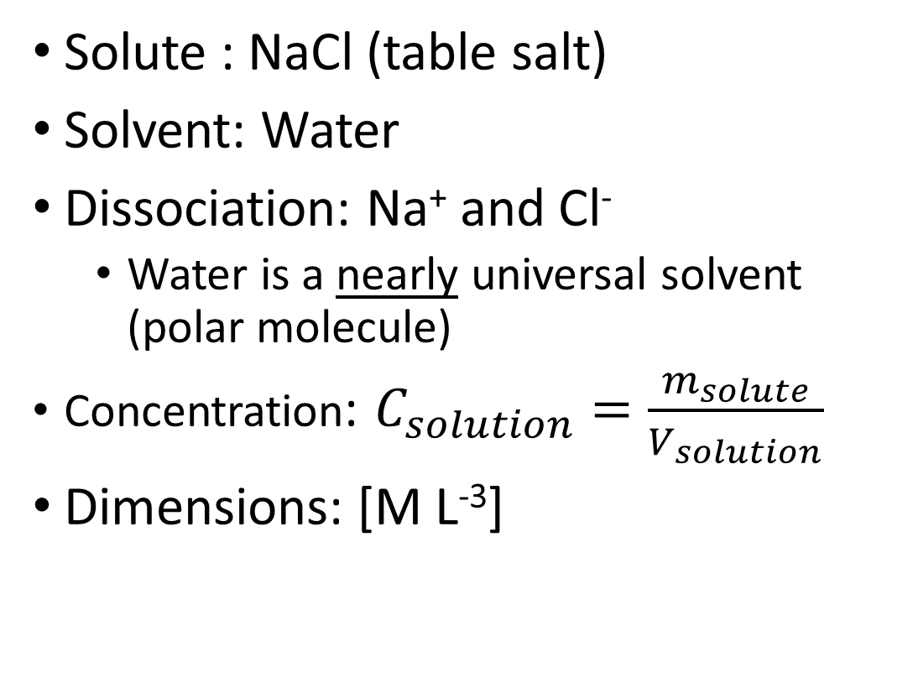
Chemistry of water: Solutions
Solute : NaCl (table salt)
Solvent: Water
Dissociation: Na⁺ and Cl⁻
  Water is a nearly universal solvent (polar molecule)
Concentration: $C_{solution}=\frac{m_{solute}}{V_{solution}}$
Dimensions: [M L⁻³]
Solute: [M]
NaCl
Solution NaCl in H₂O: [M L⁻³]
Na⁺
Na⁺
Cl⁻
Cl⁻
Careful! These volumes are not the necessarily the same.
Solvent H₂O: [L³]
Notes:
Chemistry: Solutions
Understanding the chemistry of water (also known as “aqueous chemistry”) all starts with understanding solutions and how to quantify them. One of the best indicators of where water has been, and for how long, is determining what is or isn’t dissolved in the water.
There is actually more than one mechanism of dissolution, but lets start with dissociation. Let’s start with a solute (salt), and added to our solvent (water). When you add table salt to water, what happens? What kind of bond is there between sodium and chloride in salt?
As it turns out, this bond is not very hard to break, especially in a polar solvent like water. Therefore NaCl will completely dissociate in water.
Water is particularly good at dissociating ions because of its polar nature. In fact, water can dissolve just about any molecule that has a charge. For this reason, it is sometimes referred to as a “universal” solvent. However, absolutes are almost never true, and this is no exception. Molecules with no charge tend to have little to no attraction to the polarity of water. The fact that they have much more cohesion with molecules of their own type than with water molecules makes them “immiscible” and they will not dissolve in water without additional chemical additives.
Later in the class, we will talk more about the chemical activity that occurs with solutes. But for right now, the important thing to remember is that all of the physical properties of water we have talked about so far CHANGE when solutes are added to the water.
For example, can anyone say why we sometimes put salt on roads or sidewalks in the winter?

Slide 20
Chemistry of water: Solutions
DIMENSIONS DON’T TELL YOU EVERYTHING!
Concentration might be provided in different dimensions (molarity is
[N L⁻³], molality is [N M⁻¹], percent by volume is [1], etc.)
[M L⁻³] is not always concentration. These are also the dimensions of density.
Mass of what and volume of what are critical context for interpretation
Solute: [M]
NaCl
Solution NaCl in H₂O: [M L⁻³]
Na⁺
Na⁺
Cl⁻
Cl⁻
Solvent H₂O: [L³]
Notes:
Chemistry: Solutions
Understanding the chemistry of water (also known as “aqueous chemistry”) all starts with understanding solutions and how to quantify them. One of the best indicators of where water has been, and for how long, is determining what is or isn’t dissolved in the water.
There is actually more than one mechanism of dissolution, but lets start with dissociation. Let’s start with a solute (salt), and added to our solvent (water). When you add table salt to water, what happens? What kind of bond is there between sodium and chloride in salt?
As it turns out, this bond is not very hard to break, especially in a polar solvent like water. Therefore NaCl will completely dissociate in water.
Water is particularly good at dissociating ions because of its polar nature. In fact, water can dissolve just about any molecule that has a charge. For this reason, it is sometimes referred to as a “universal” solvent. However, absolutes are almost never true, and this is no exception. Molecules with no charge tend to have little to no attraction to the polarity of water. The fact that they have much more cohesion with molecules of their own type than with water molecules makes them “immiscible” and they will not dissolve in water without additional chemical additives.
Later in the class, we will talk more about the chemical activity that occurs with solutes. But for right now, the important thing to remember is that all of the physical properties of water we have talked about so far CHANGE when solutes are added to the water.
For example, can anyone say why we sometimes put salt on roads or sidewalks in the winter?

Slide 21
Physics of water: Electrical conductivity
Solute: [M]
NaCl
Solutes change the physical properties of water, like electrical conductivity
Units: μS cm⁻¹
Varies with dissolved solids and temperature
Temperature-corrected (to 25 °C), or “specific” conductivity normalizes for the effects of temperature
Solution NaCl in H₂O: [M L⁻³]
Na⁺
Na⁺
Cl⁻
Cl⁻
Solvent H₂O: [L³]
Notes:
Chemistry: Solutions
For our next lab, we are especially interested in how salt affects a physical property we haven’t talked about yet. Electrical Conductivity.
Electrical conductivity is the ability to carry a current of electrons when a given voltage is applied. Particularly in NaCl solutions, the more salt there is, more electrons net movement of electrons through the solution. This is why NaCl is sometimes called an “electrolyte”.

Slide 22
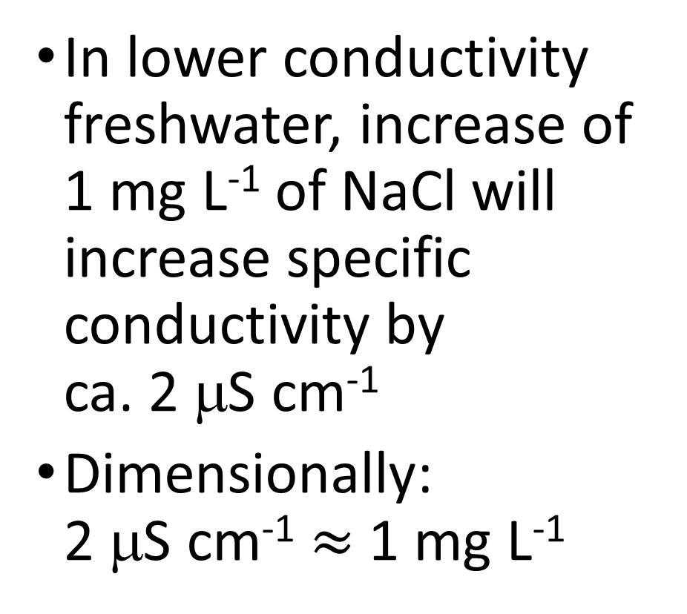
Relating electrical conductivity to solute concentration
Solute: [M]
NaCl
In lower conductivity freshwater, increase of 1 mg L⁻¹ of NaCl will increase specific conductivity by
ca. 2 μS cm⁻¹
Dimensionally:
2 μS cm⁻¹ $≈$ 1 mg L⁻¹
Solution NaCl in H₂O: [M L⁻³]
Na⁺
Na⁺
Cl⁻
Cl⁻
Solvent H₂O: [L³]
Notes:
Chemistry: Solutions
For our next lab, we are especially interested in how salt affects a physical property we haven’t talked about yet. Electrical Conductivity.
Electrical conductivity is the ability to carry a current of electrons when a given voltage is applied. Particularly in NaCl solutions, the more salt there is, more electrons net movement of electrons through the solution. This is why NaCl is sometimes called an “electrolyte”.

Slide 23
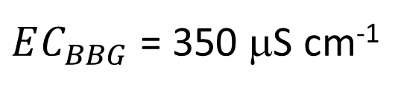
Measuring volume by dilution
$EC_{BBG}$ = 350 μS cm⁻¹
Conductivity
Meter
350 μS cm⁻¹
?
Notes:
Summarizes the calculations necessary to estimate the volume of water in a bucket by adding a known volume of salt to the bucket, dissolving the salt, and measuring the change in electrical conductivity before and after the salt is added.
$EC_{BBG}$ = Background electrical conductivity of water in the bucket (BEFORE adding salt)
$m_{NaCL}$ = Mass of salt added to the bucket
$EC_{BS}$ = Electrical conductivity of water in the bucket AFTER adding salt
$ΔEC$ = The change in EC (in this case increase) due to the addition of the salt to the water in the bucket

Slide 24
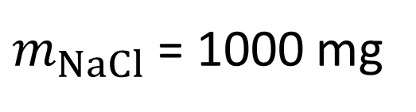
Measuring volume by dilution
$m_{NaCl}$ = 1000 mg
$EC_{BBG}$ = 350 μS cm⁻¹
NaCl
?
Notes:
Summarizes the calculations necessary to estimate the volume of water in a bucket by adding a known volume of salt to the bucket, dissolving the salt, and measuring the change in electrical conductivity before and after the salt is added.
$EC_{BBG}$ = Background electrical conductivity of water in the bucket (BEFORE adding salt)
$m_{NaCL}$ = Mass of salt added to the bucket
$EC_{BS}$ = Electrical conductivity of water in the bucket AFTER adding salt
$ΔEC$ = The change in EC (in this case increase) due to the addition of the salt to the water in the bucket

Slide 25
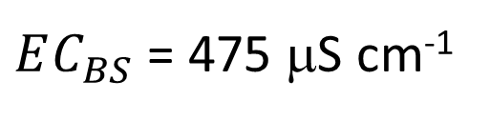
Measuring volume by dilution
$m_{NaCl}$ = 1000 mg
$EC_{BBG}$ = 350 μS cm⁻¹
$EC_{BS}$ = 475 μS cm⁻¹
Conductivity
Meter
475 μS cm⁻¹
?
Notes:
Summarizes the calculations necessary to estimate the volume of water in a bucket by adding a known volume of salt to the bucket, dissolving the salt, and measuring the change in electrical conductivity before and after the salt is added.
$EC_{BBG}$ = Background electrical conductivity of water in the bucket (BEFORE adding salt)
$m_{NaCL}$ = Mass of salt added to the bucket
$EC_{BS}$ = Electrical conductivity of water in the bucket AFTER adding salt
$ΔEC$ = The change in EC (in this case increase) due to the addition of the salt to the water in the bucket

Slide 26
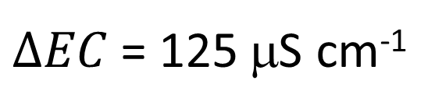
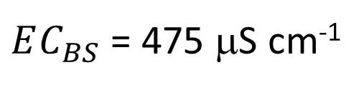
Measuring volume by dilution
$m_{NaCl}$ = 1000 mg
$EC_{BBG}$ = 350 μS cm⁻¹
$EC_{BS}$ = 475 μS cm⁻¹
$ΔEC$ = 125 μS cm⁻¹
Conductivity
Meter
475 μS cm⁻¹
?
Notes:
Summarizes the calculations necessary to estimate the volume of water in a bucket by adding a known volume of salt to the bucket, dissolving the salt, and measuring the change in electrical conductivity before and after the salt is added.
$EC_{BBG}$ = Background electrical conductivity of water in the bucket (BEFORE adding salt)
$m_{NaCL}$ = Mass of salt added to the bucket
$EC_{BS}$ = Electrical conductivity of water in the bucket AFTER adding salt
$ΔEC$ = The change in EC (in this case increase) due to the addition of the salt to the water in the bucket

Slide 27

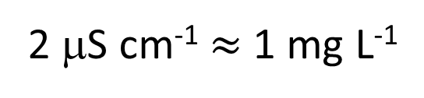
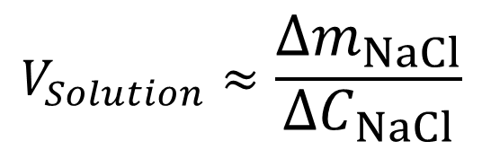
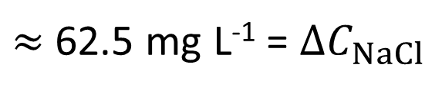
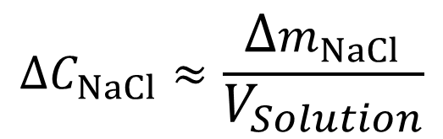
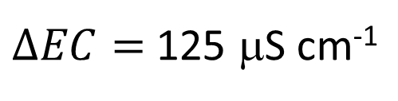
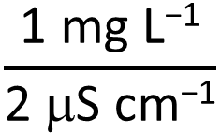
Measuring volume by dilution
$m_{NaCl}$ = 1000 mg
$EC_{BBG}$ = 350 μS cm⁻¹
Assuming salt is “conservative”
$EC_{BS}$ = 475 μS cm⁻¹
2 μS cm⁻¹ $≈$ 1 mg L⁻¹
$ΔEC$ = 125 μS cm⁻¹
$ΔEC=$ 125 μS cm⁻¹
$$\frac{\text{1 }\text{mg} \text{L}\text{−1}}{\text{2 }\text{m}\text{S} \text{cm}\text{−1}}$$
$≈$ 62.5 mg L⁻¹ = $ΔC_{NaCl}$
$$ΔC_{NaCl}≈\frac{Δm_{NaCl}}{V_{Solution}}$$
?
$$V_{Solution}≈\frac{Δm_{NaCl}}{{ΔC}_{NaCl}}$$
$$\text{= }\frac{\text{1000 }\text{mg} }{\text{62.5 }\text{mg} \text{L}\text{−1}}$$
16 L
= 16 L
Assuming solution volume is equal to original water volume (salt adds negligible volume)
Notes:
Summarizes the calculations necessary to estimate the volume of water in a bucket by adding a known volume of salt to the bucket, dissolving the salt, and measuring the change in electrical conductivity before and after the salt is added.
$EC_{BBG}$ = Background electrical conductivity of water in the bucket (BEFORE adding salt)
$m_{NaCL}$ = Mass of salt added to the bucket
$EC_{BS}$ = Electrical conductivity of water in the bucket AFTER adding salt
$ΔEC$ = The change in EC (in this case increase) due to the addition of the salt to the water in the bucket

