Slide 1
Disclaimer: The information in the following slides are a guide to assist in the Sales Tax Registration Process. At the end of the registration process there will be a submit button. Once submit is clicked the business has registered with the state and is obligated to the state filing frequencies, and if any, fees and penalties. Businesses should contact Sales Tax and More before hitting submit if questions arise, unfortunately your registration process will need to start over as states typically have a timeout period. There is a fee associated with the assistance of the registration. If the slides show information that is not consistent with what is shown on the website, please contact us we will correct this information as quickly as possible. Call Sales Tax and More at (972) 737-4559 or email info@salestaxandmore.com

Slide 2

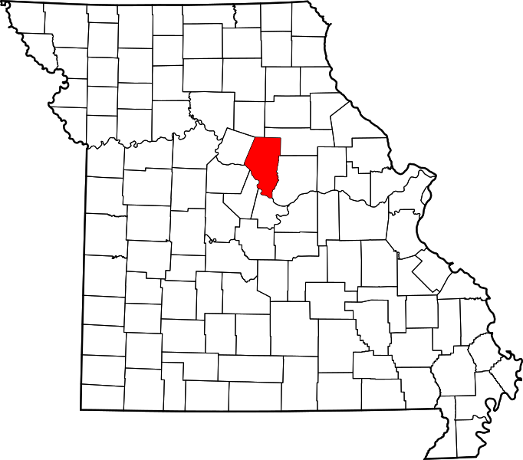

Missouri Sales Tax Registration Instructions
https://mytax.mo.gov/rptp/portal/home/!ut/p/z1/04_Sj9CPykssy0xPLMnMz0vMAfIjo8zijS0MnN09DIy83EODjQwc_R1DTcIcvYAsE_1wQgqigNIGOICjAVB_FCElBbkRBumOiooA7YFcLQ!!/dz/d5/L2dBISEvZ0FBIS9nQSEh/
Tax Type: Vendor Use Tax
https://www.salestaxandmore.com/

Slide 3
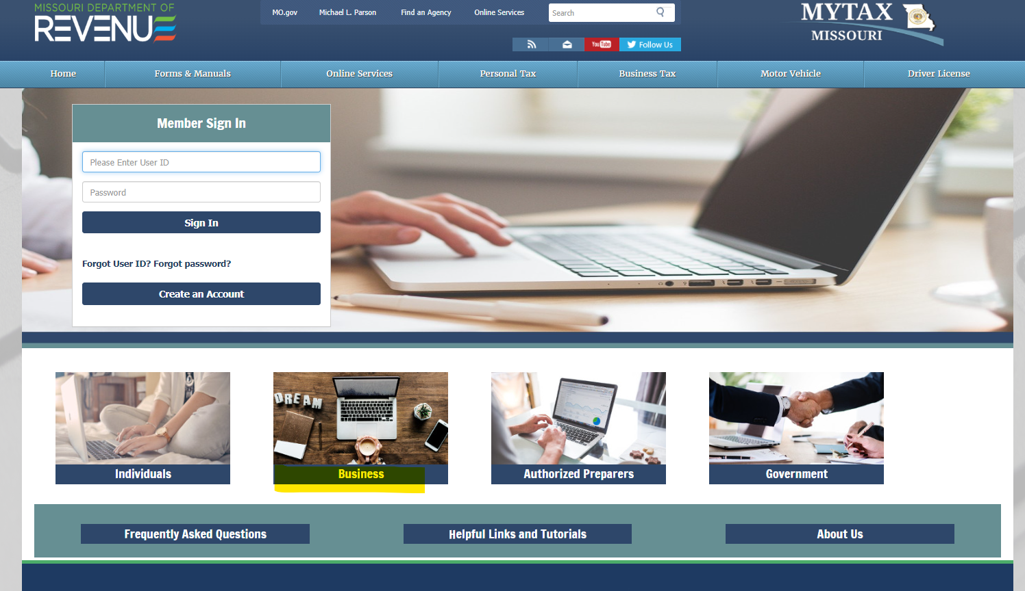
Sales Tax and More - MO Registration
Step 1, Click - Business
https://www.salestaxandmore.com/

Slide 4
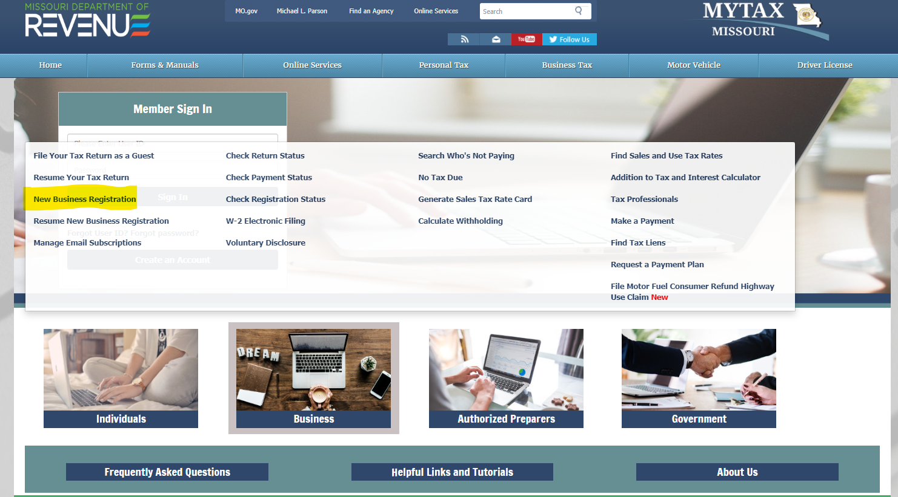
Sales Tax and More - MO Registration
Step 2
Pop up generates
Click - New Business Registration
https://www.salestaxandmore.com/

Slide 5
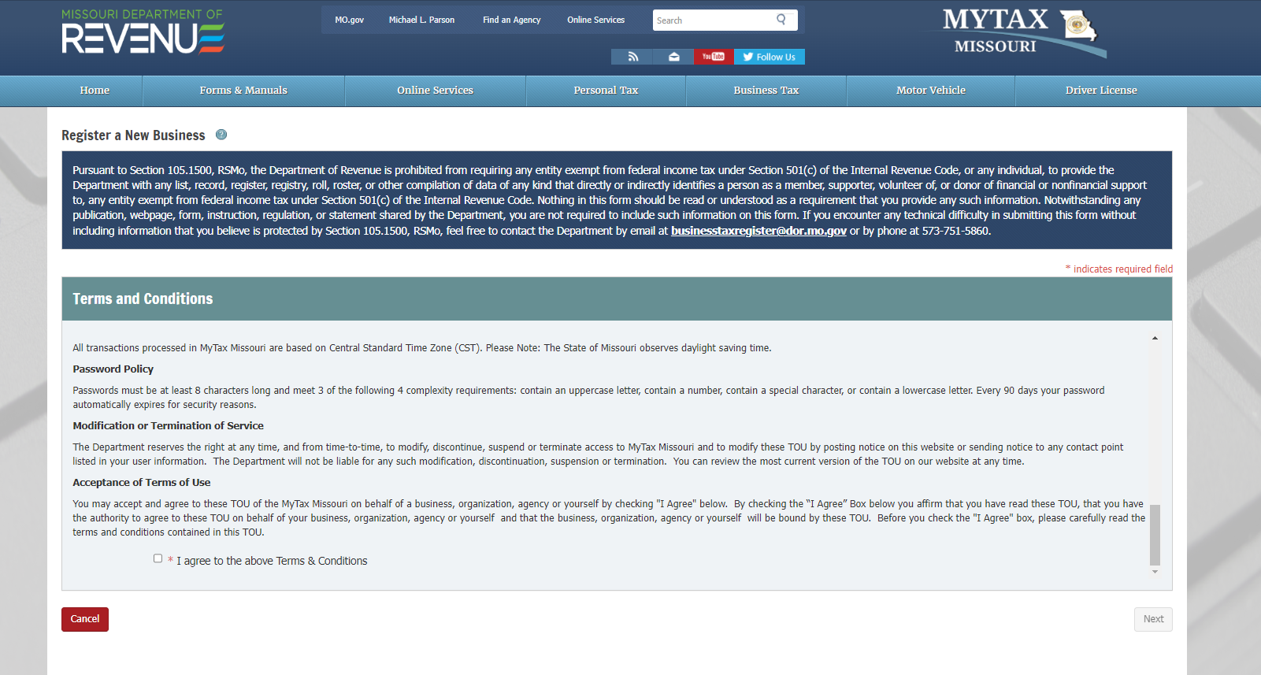
Sales Tax and More - MO Registration
Step 3
Scroll to bottom of page
Click - I agree
Click - Next
https://www.salestaxandmore.com/

Slide 6
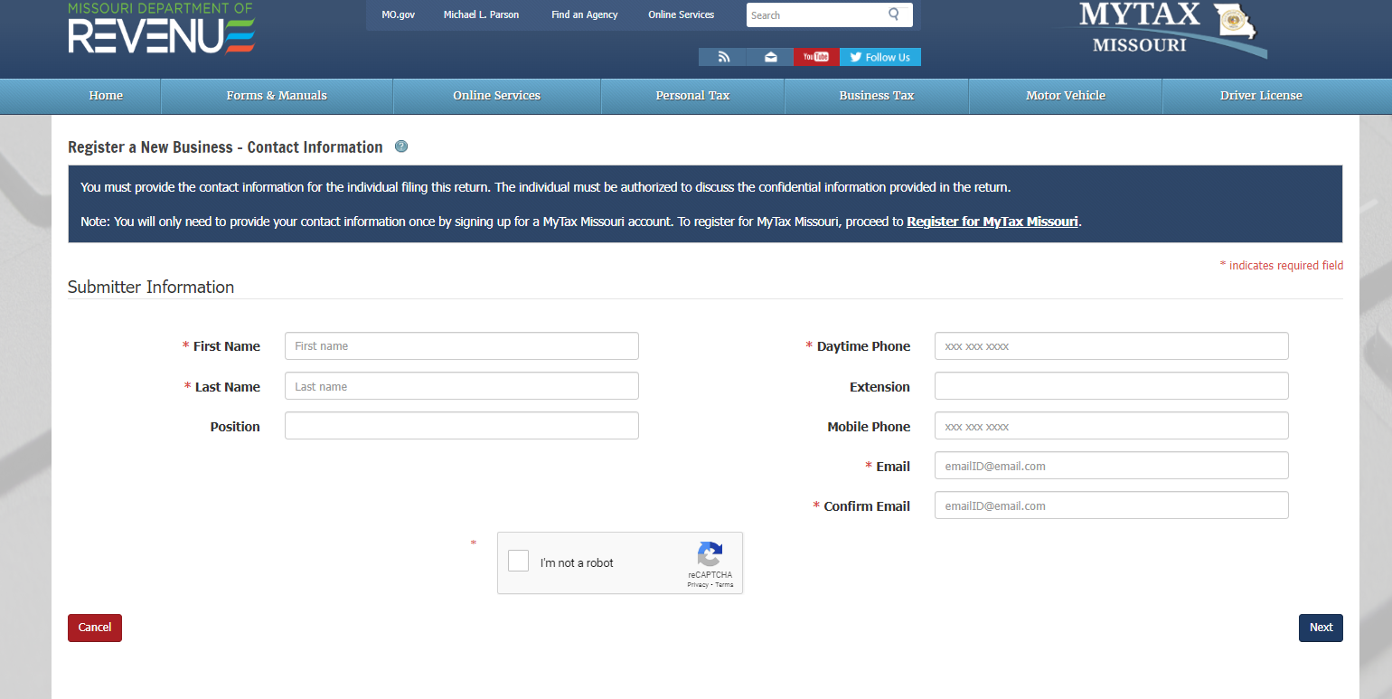
Sales Tax and More - MO Registration
Step 4
a) Type Name
b) Type Phone
c) Type Email (2x’s)
d) Click I am not a Robot
e) Click Next
https://www.salestaxandmore.com/

Slide 7
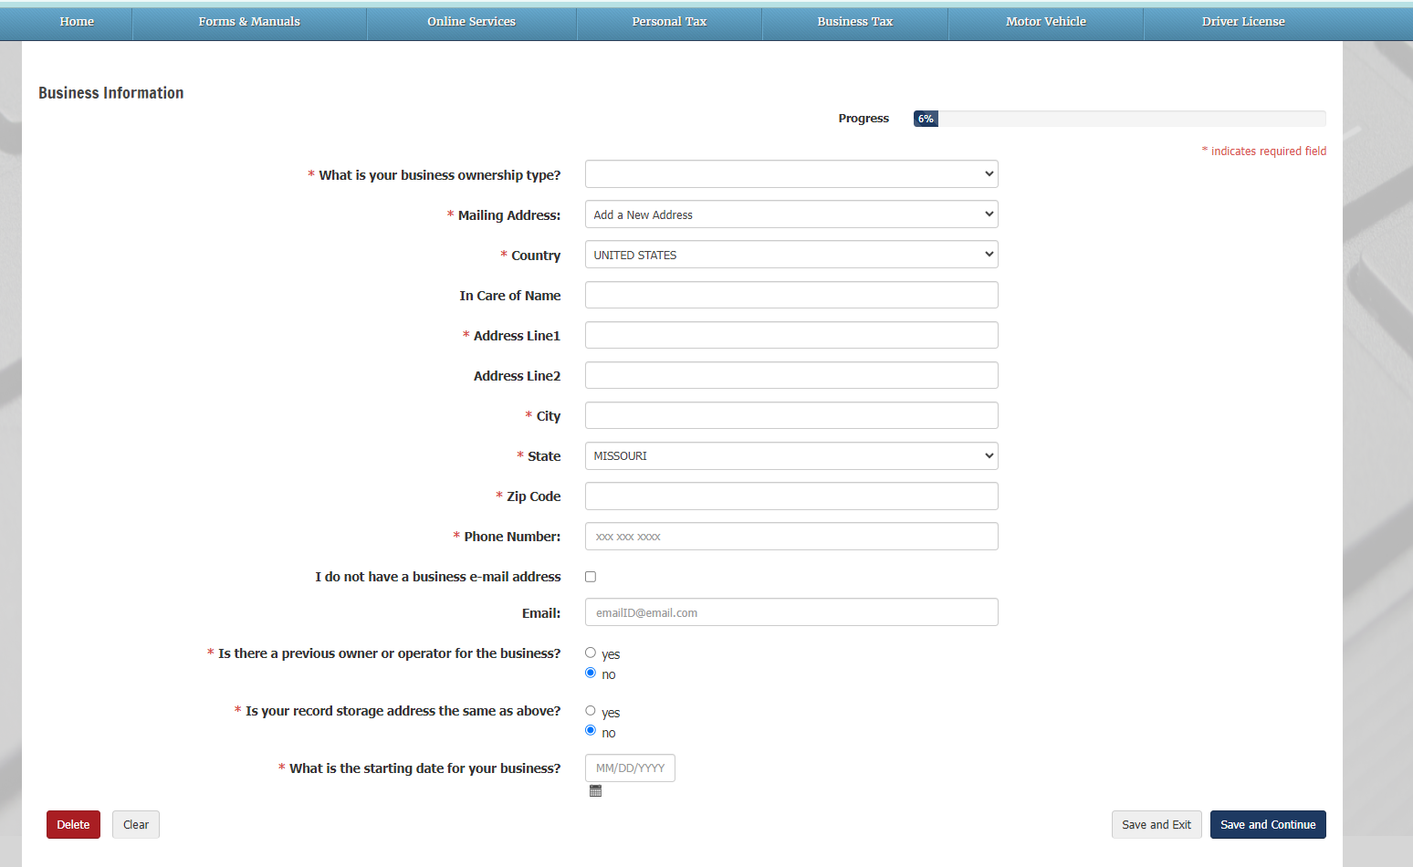
Sales Tax and More - MO Registration
Step 5
Drop down menu - Entity type
Type - Legal name of business
Type - Mailing address
Type - Phone #
Type - Email
Click - No, typically for the next 2 questions
Choose - Starting date for business
Click - Save & Continue
https://www.salestaxandmore.com/

Slide 8
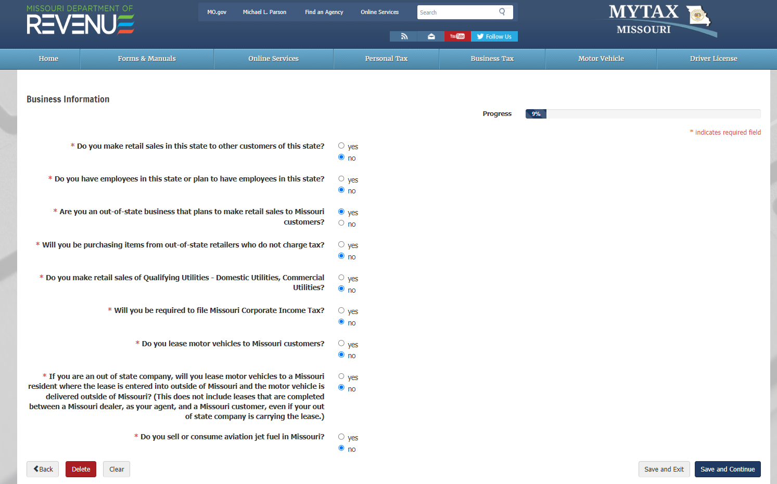
Sales Tax and More - MO Registration
Step 6
Click - No (typically)
Click - No (typically)
Click - Yes (typically)
Click - No (typically)
Click - No (typically)
Click - No (typically)
Click - No (typically)
Click - No (typically)
Click - No (typically)
Click - Save and continue
https://www.salestaxandmore.com/

Slide 9
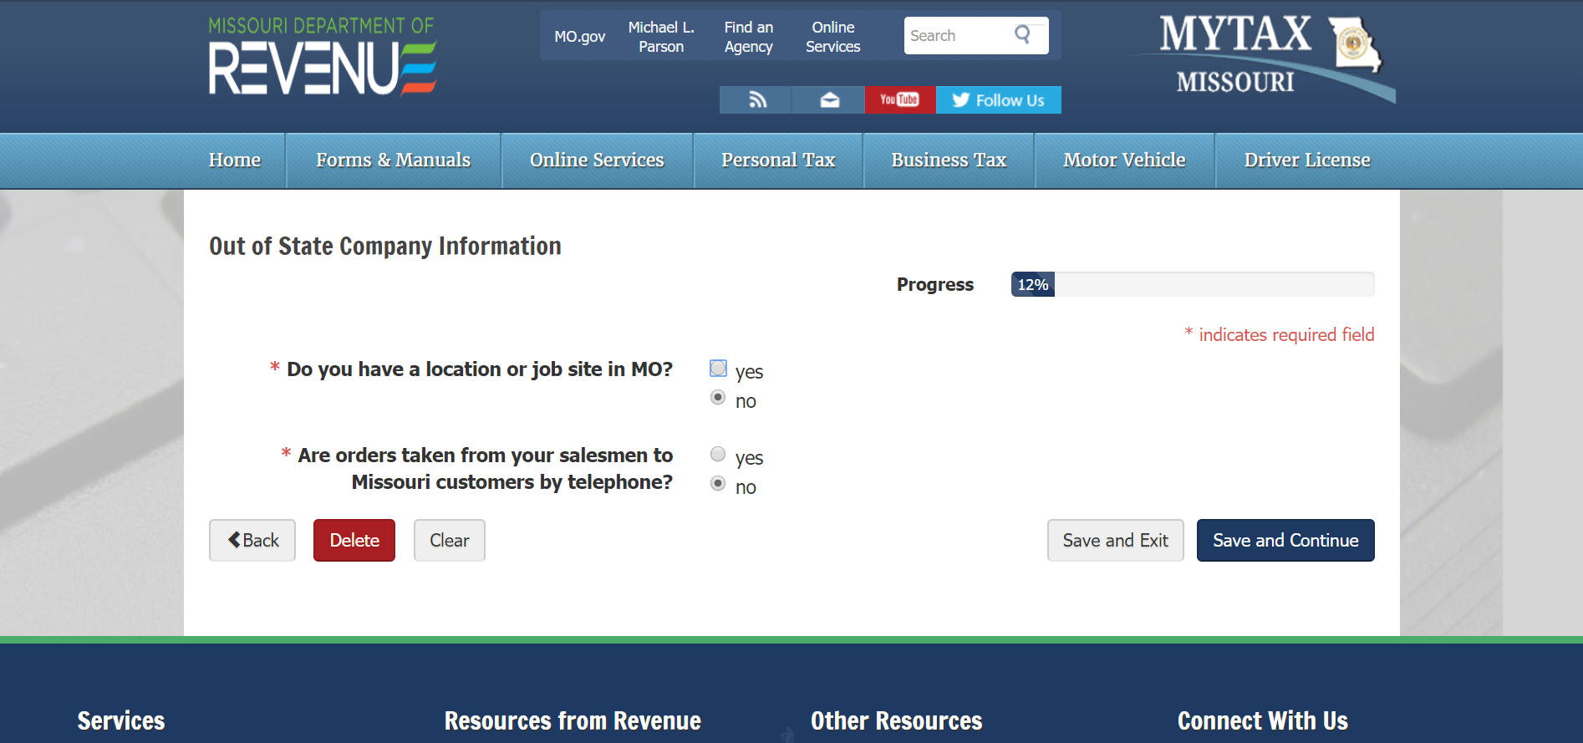
Sales Tax and More - MO Registration
Step 7
Click - No (typically)
Click - No (typically)
Click - Save and continue
https://www.salestaxandmore.com/

Slide 10
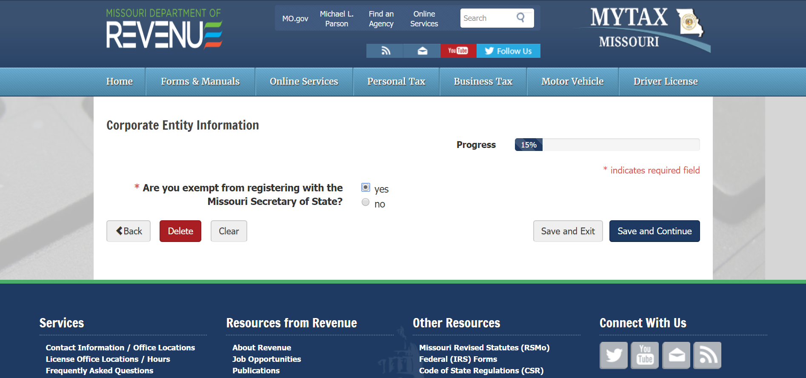
Sales Tax and More - MO Registration
Step 8
Click - Yes
Click - Save and continue
https://www.salestaxandmore.com/

Slide 11
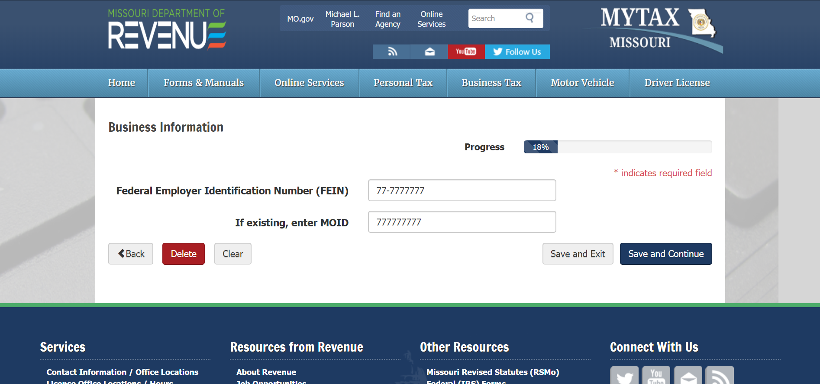
Sales Tax and More - MO Registration
Step 9
Type - FEIN
Skip - MOID, typically
Click - Save & continue
https://www.salestaxandmore.com/

Slide 12
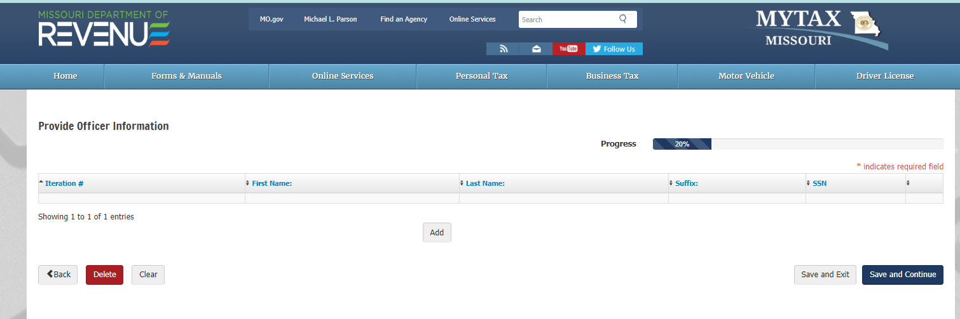
Sales Tax and More - MO Registration
Step 10
Click Add
https://www.salestaxandmore.com/

Slide 13
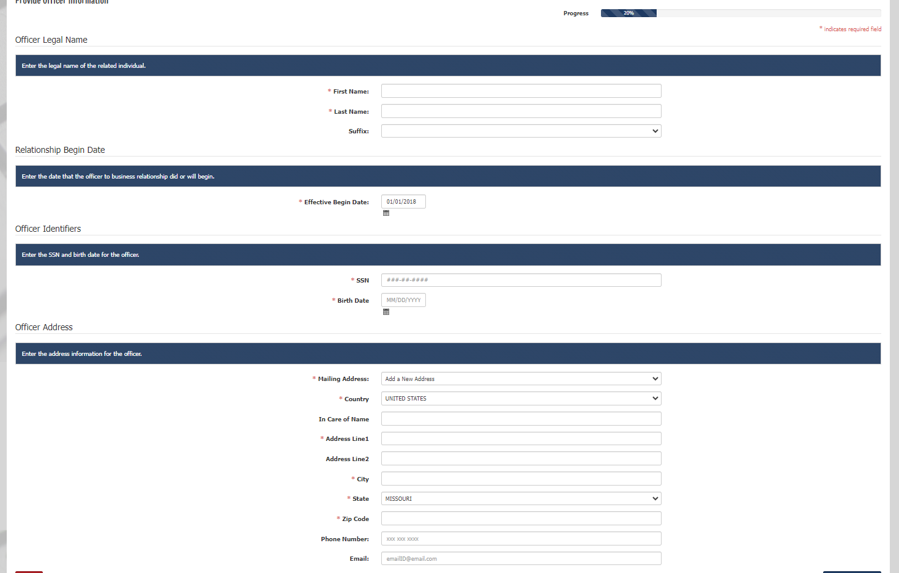
Sales Tax and More - MO Registration
Step 11
Type - Responsible party name
Type - Date Officer started at company
Type - Social security # of responsible party
Type - Date of birth of responsible party
Type - Mail address, phone #, and email address of responsible party
Click - Save and continue
https://www.salestaxandmore.com/

Slide 14
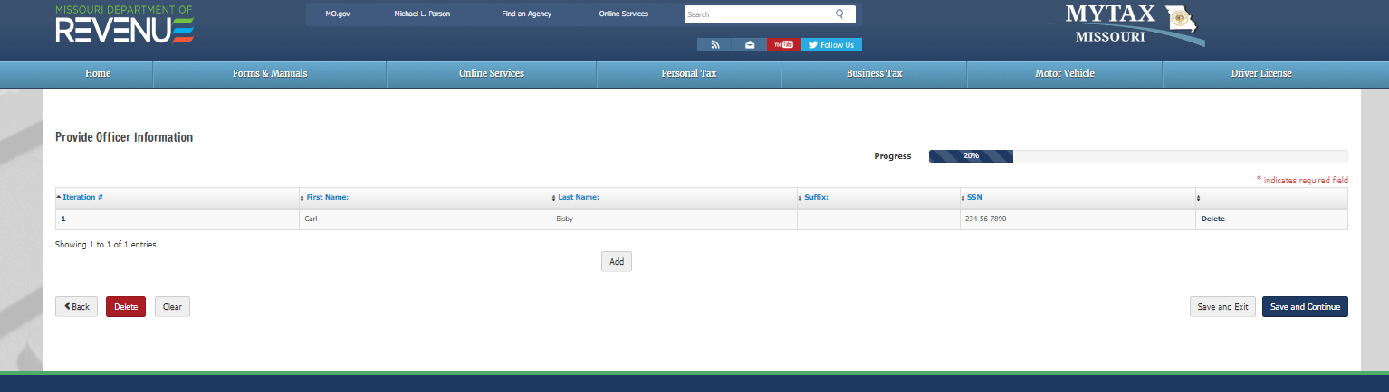
Sales Tax and More - MO Registration
Step 12
Review Information
Add more officers if needed
Click Save & Continue
https://www.salestaxandmore.com/

Slide 15
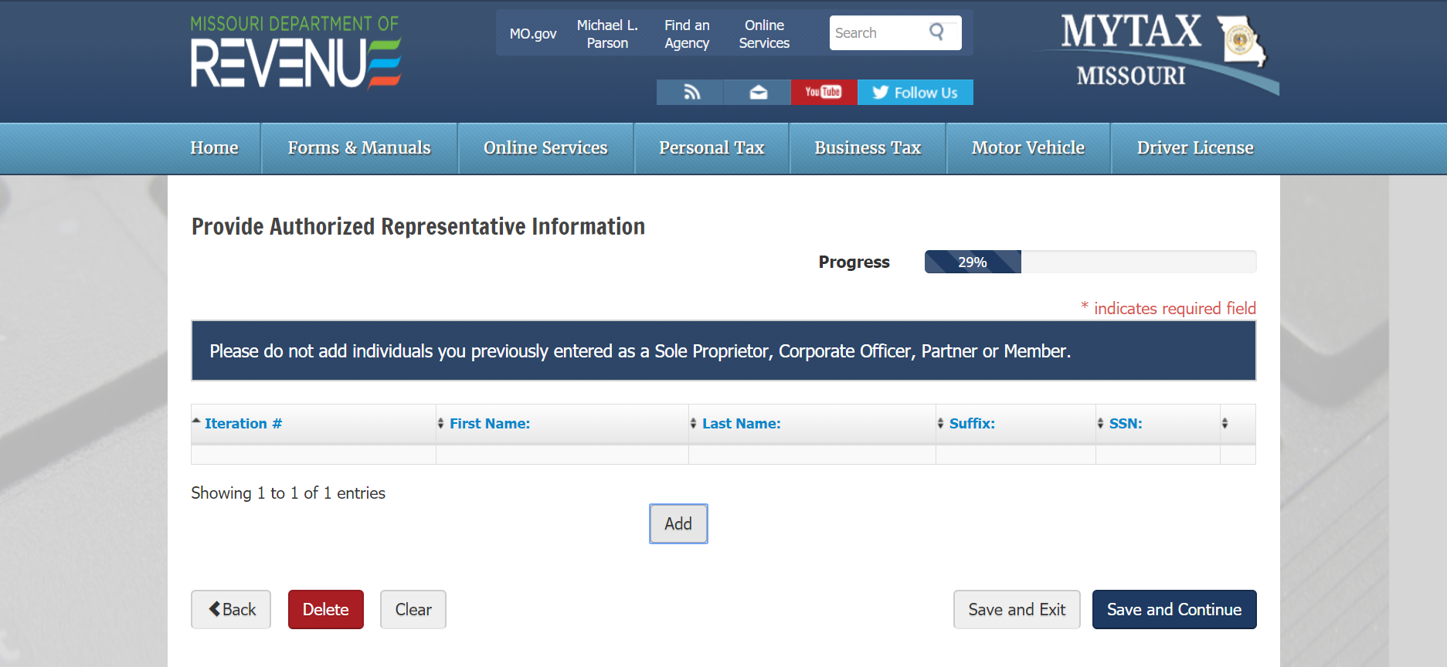
Sales Tax and More - MO Registration
Step 13
Click - Add to add an authorized representative
Once added
Click - Save and Continue
https://www.salestaxandmore.com/

Slide 16
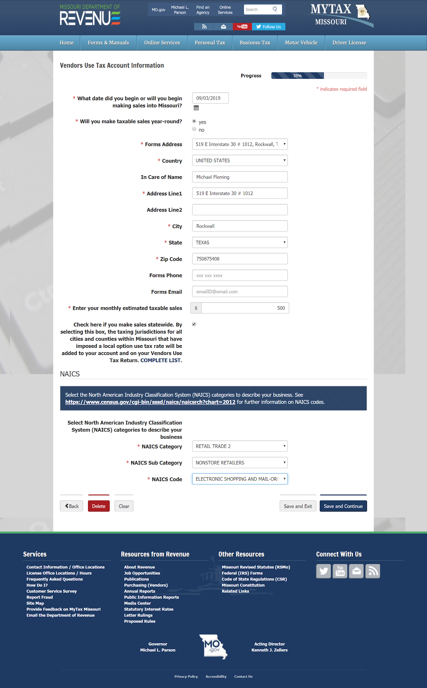
Sales Tax and More - MO Registration
Step 14
Type - Date sales begins in MO
Click - Yes, sales all year
Type or Drop down menu - Name, address where records are kept
Type - Monthly estimated sales, IF the estimated sales are over $500 MO will probably ask for a security deposit (they may use another term) it is similar to a security deposit when you rent an apartment, you pay a dollar amount to sit in the account, the dollar amount is determined by MO. If you close your sales tax account that dollar amount should usually be returned.
Drop down menu - NAICS, Retail trade 2
Drop down menu - Non store retailers
Drop down menu - Electronic shopping
Click - Save and continue
https://www.salestaxandmore.com/

Slide 17
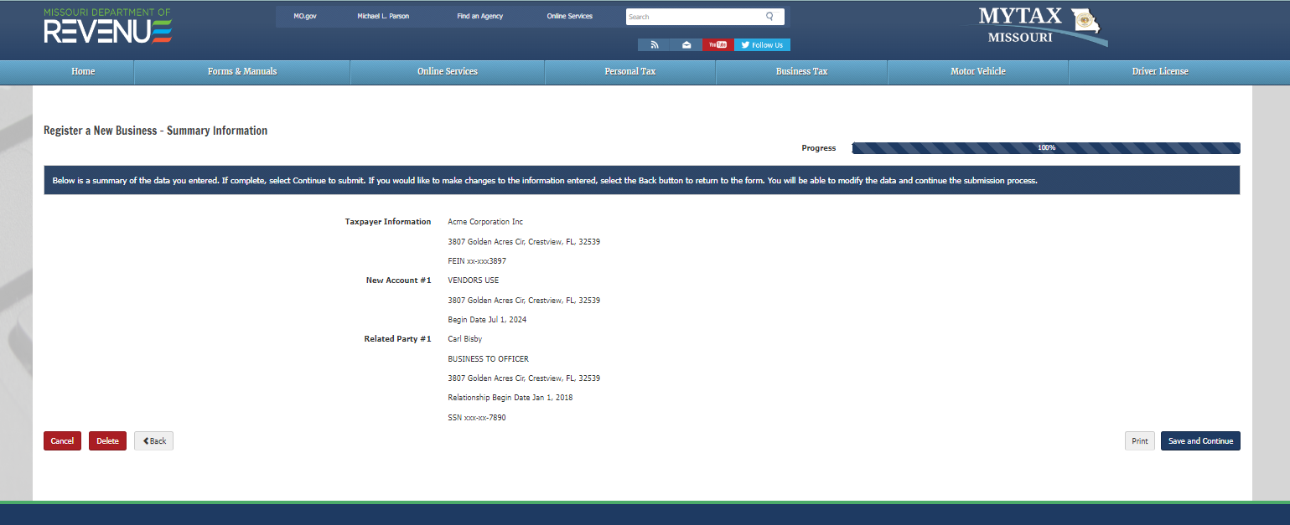
Sales Tax and More - MO Registration
Step 15
Review Information
Click - Save & Continue
https://www.salestaxandmore.com/

Slide 18
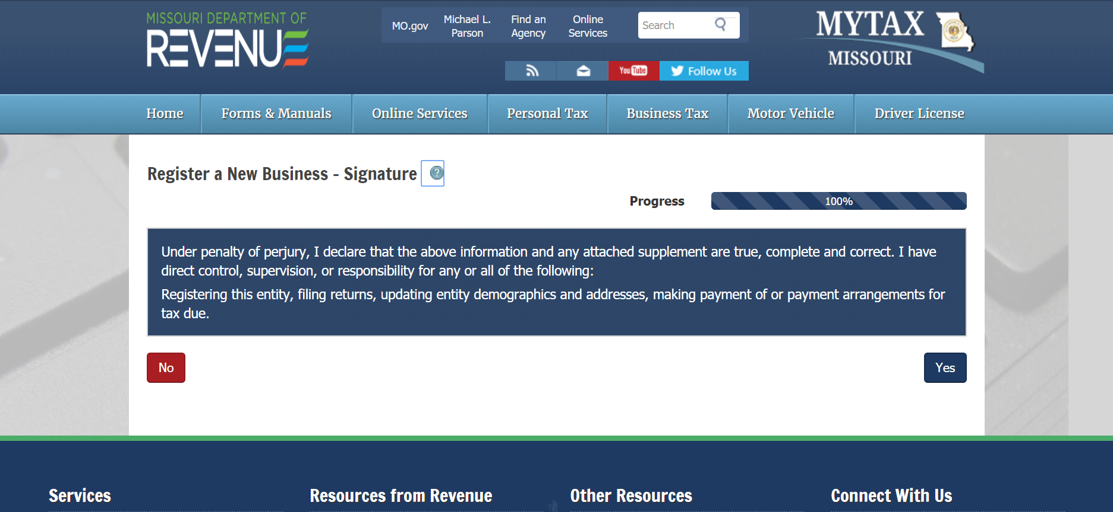
Sales Tax and More - MO Registration
Step 16
Read information
Click - Yes
https://www.salestaxandmore.com/

Slide 19
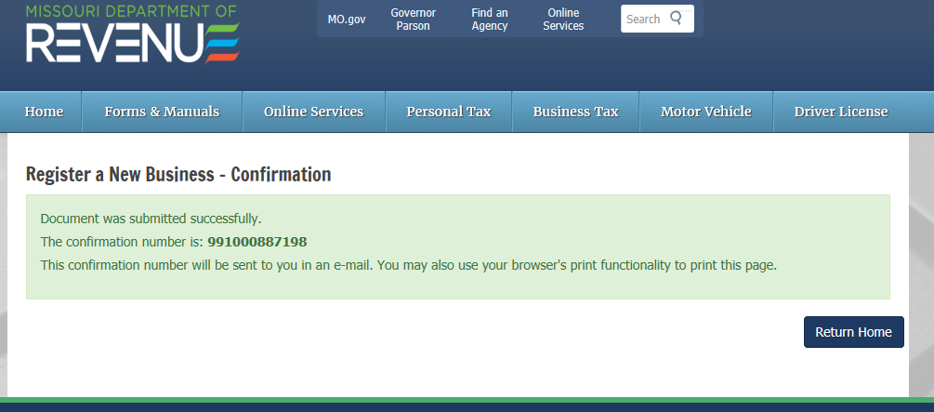
Sales Tax and More - MO Registration
Print this page and/or keep the email you will receive after this registration is complete. You will need the confirmation number to complete the online set up. You need to wait until you receive the permit number in the mail to complete the online setup. It may take a couple weeks to receive the notice.
Registration Complete. You now need to set up an online account in MO.
https://www.salestaxandmore.com/

