Slide 1

How to take care of monthly money
This session is aimed at Key Stage Three (recommended for Year 7)

Slide 2
Unit outline
Session 1 | Session 2 | Session 3 | Session 4 | Session 5 | Session 6
Spending decisions | How to budget | Getting a job | The impact of inflation | The critical consumer | Budgeting for a holiday

Slide 3
Having a respectful learning environment
We will listen to each other respectfully
We will avoid making judgements or assumptions about others
We will comment on what has been said, not the person who has said it
We won’t put anyone on the spot and we have the right to pass
We will not share personal stories or ask personal questions
If there is a question that you do not wish to ask aloud, you can write it on a Post-it Note which will be collected throughout the session and answered at the end
Notes:
Teacher delivery
Students should be invited to ask questions and they should be provided with an opportunity to ask questions anonymously. It is useful to have a question box or allocated space on the whiteboard for students to share questions.
It is suggested that students are provided with post-its or slips to write their questions on and as the teacher circulates throughout the lesson these questions can be collected and answers throughout the session or using an allocated ‘question time’ at the end of the session.
Students can be invited to respond to questions asked by their peers. If responses to questions are based on personal preference or opinion, the teacher should be clear to preface any answers with this.

Slide 4
Session 5:
The critical consumer
Notes:
See Money Matters lesson 5
https://natwest.mymoneysense.com/teachers/resources-8-12s/topic-8-what-affects-my-choices-about-money/lesson-plan/

Slide 5
By the end of the session, I will be able to:
Describe pressures that influence spending choices
Analyse what makes a persuasive advertisement

Slide 6

What is a critical consumer?
What are some of the questions that someone
might ask themselves before buying an item?
Do I need this item?
Why do I want this item?
How long will this item last?
Can I afford this item?

Slide 7

The critical consumer
A critical consumer is someone who thinks carefully before spending money.
Why is it important to be aware of pressures when making spending or saving choices?
By understanding different pressures, whether from other people or adverts, people can make more informed money choices and therefore better budgeting decisions.
Notes:
Teacher explanation
It’s easy to spend money on things we don’t really need or even particularly want because of compelling and engaging advertisements; or because we feel pressured into spending on something that someone else says is important. By understanding the different pressures, people can make more informed money choices and make better budgeting decisions.

Slide 8



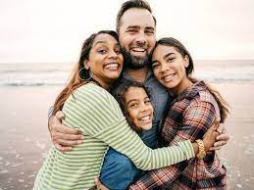
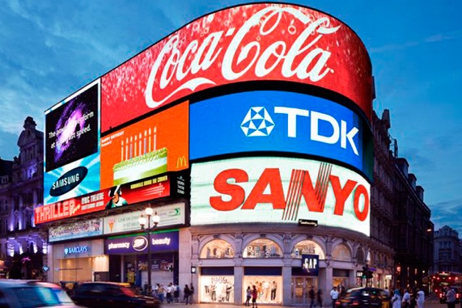
What and who influences people’s spending decisions?
Use the images to help you name different spending influences.
Are there any others you can think of?
Notes:
Teacher guidance notes
There are lots of pressures in our lives, whether from individuals or companies, that will influence our spending behaviours. Here are a few.

Slide 9
What and who influences people’s spending decisions?
Use the images to help you name different spending influences.
Are there any others you can think of?
Stretch: How might these influences affect spending decisions?
Cultural
Price tag and bargains
Friends and family
Company adverts
Influencers and social media

Slide 10
Let’s explore how a young person could be influenced to spend their money

Slide 11

Activity | How will Shivaughn spend the money?
In groups of four, you have 5 minutes to plan your arguments to persuade Shivaughn to spend the money in the way in which your character thinks is best.
Shivaughn will then decide how to spend their money and explain her choice.
Shivaughn
You have saved up £15 from helping your sister out at her shop and you are working out what to do with the money.
Shivaughn’s aunt
You want to encourage Shivaughn to save the money for the future.
Shivaughn’s best friend
You want Shivaugn to use it at a new Korean restaurant you have both wanted to check out together.
A Local charity
You are raising awareness and money for a local charity which is helping elderly people in the community.
New clothes shop
You recently came up with a new environmentally friendly clothes company and would like to sell more t-shirts. You offer a 3 for 2 deal where each t-shirt costs £7.50.
Why would Shivaughn's aunt say it is important to save?
What is the benefit of spending money at restaurants?
What is the benefit of supporting a local charity?
Why should Shivaughn be concerned about the environment or animal welfare?
Adapted from NatWest Moneysense resources
Additional activity: To buy or not to buy
Notes:
Delivery instructions
Alternative delivery method is to group students into 5, with each student taking a different character and feeding back to each other in small groups.
While circulating, ask students in their groups which influence was most convincing and why.

Slide 12
Persuade | How will Shivaughn spend the money?
AUNT
You could begin your sentences with:
We think Shivaughn should …
This would benefit her because…
Another reason why she should spend her money here is…
FRIEND
CHARITY
CLOTHES
SHOP

Slide 13

Vote | How will Shivaughn spend the money?
AUNT
FRIEND
CHARITY
CLOTHES
SHOP
What other factors could make the customer spend their money in a different way?

Slide 14
By the end of the session, I will be able to:
Describe pressures that influence spending choices
Analyse what makes a persuasive advertisement

Slide 15


Why do companies advertise?
Partner work
Watch the Just Eat advertisement. Then answer the following questions in pairs.
What is this advert trying to do?
How does it try to influence viewers?
How is this advertisement effective?
Video | Did Somebody Say - Just Eat ft. Snoop Dogg (Official Video)

Slide 16

Advertising techniques
Companies will use lots of advertising techniques to encourage people to buy their products.
Advertising techniques are ways to convince or influence people to buy a product or service.

Slide 17
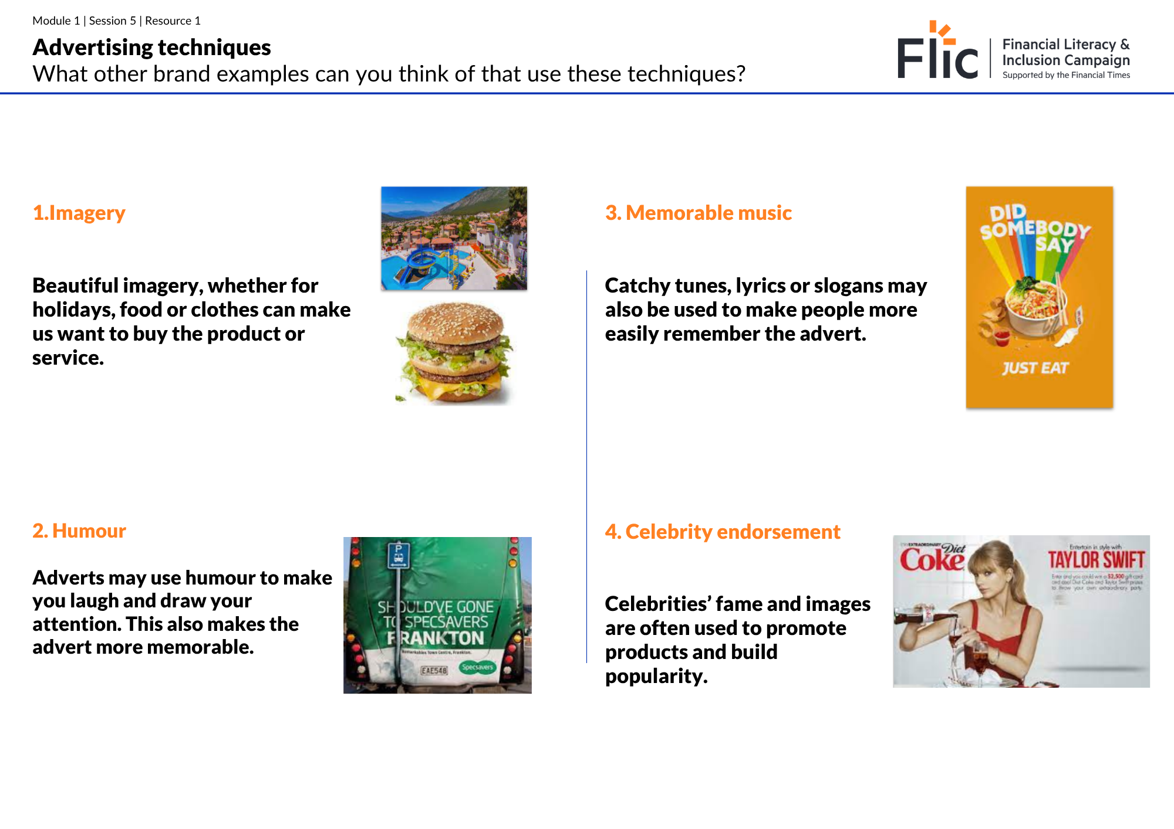
Activity
Read through the advertising techniques listed one by one. Give examples of brands that you’ve seen use these techniques.
Stretch - can you think of any other advertising techniques not mentioned?
Resource 1- Advertising techniques
Notes:
Delivery instruction
Students use the worksheet to consider other brands that use similar advertising techniques. The techniques are then listed slide by slide for teacher referral. Students can also use mini whiteboards to give examples as the teacher goes through the slides.
Equally if teacher circulation provides adequate feedback, the following 8 slides can be skipped through.

Slide 18

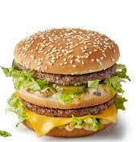
1. Imagery
Beautiful imagery, whether for holidays, food or clothes can make us want to buy the product or service.
What other examples can you think of?
Notes:
Delivery instruction
For each example, ask students to come up with other real world examples.
Make worksheet.
to what extent to these techniques influence young people?
which do you think are most powerful and why?
stretch - can you think of examples where these have been used?

Slide 19
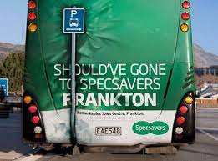
2. Humour
Adverts may use humour to make you laugh and draw your attention. This also makes the advert more memorable.
What other examples can you think of?
Notes:
Delivery instruction
For each example, ask students to come up with other real world examples.

Slide 20

3. Memorable music
Catchy tunes, lyrics or slogans may also be used to make people more easily remember the advert.
What other examples can you think of?
Notes:
Delivery instruction
For each example, ask students to come up with other real world examples.

Slide 21
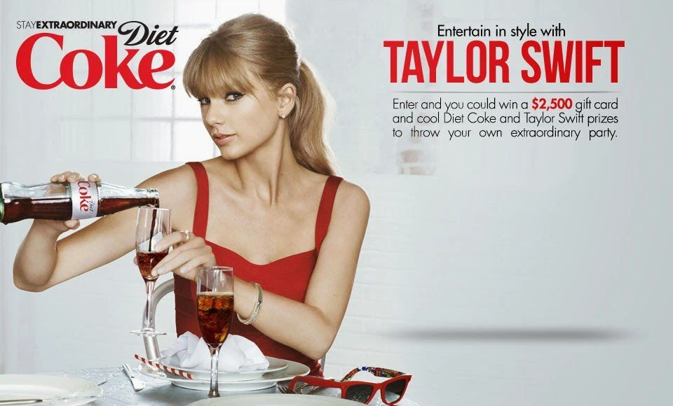
4. Celebrity endorsement
Celebrities’ fame and images are often used to promote products and build popularity.
What other examples can you think of?
Notes:
Delivery instruction
For each example, ask students to come up with other real world examples.

Slide 22

5. Data and facts
Brands may use statistics, data or scientific facts to make people trust the brand more, and make their product more appealing.
What other examples can you think of?
Notes:
Note that there may be others

Slide 23
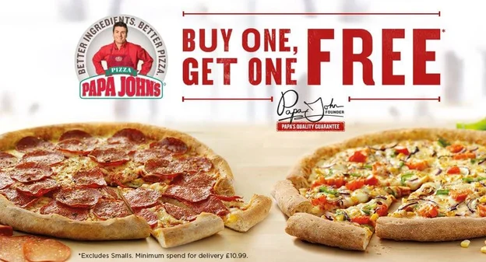
6. Discounts and offers
Discounts and offers can make people feel like they’re getting a great deal and so shouldn’t miss out.
What other examples can you think of?

Slide 24
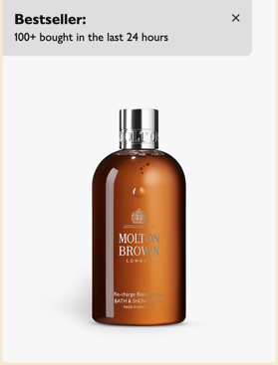
7. Social proof
Using the power of the crowds is a powerful way to make the customer more assured about the product.
What other examples can you think of?
Notes:
Additional context
Lots of e-commerce companies use social proof and it has shown that it increases revenue for the businesses.

Slide 25
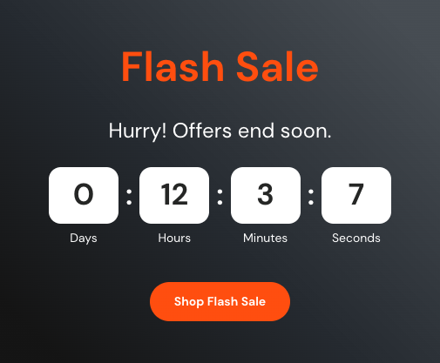
8. Countdown timers
These tell the customer that there is a limited time to buy the product - this is known as scarcity. Companies add a sense of urgency to encourage spending.
What other examples can you think of?
Notes:
Additional context
Lots of e-commerce companies use social proof and it has shown that it increases revenue for the businesses.

Slide 26

Optional | Did the advert make you buy it?
Video | Did the advert make you buy it?

Slide 27

Discussion
Which techniques are most persuasive?
Can you think of any other advertising techniques?
Can you think of examples when advertising techniques are used in combination with one other?
Notes:
Delivery instruction
Students to write answers down in their notebooks.
Additional context
Other advertising techniques may include personalisation (e.g. welcome back ‘name’) and emotional appeal (e.g. charity adverts).

Slide 28
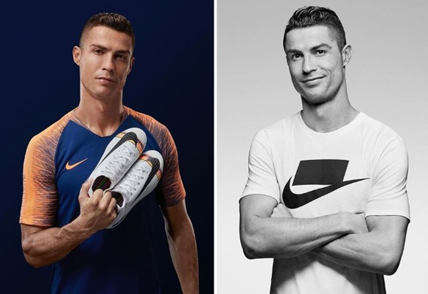
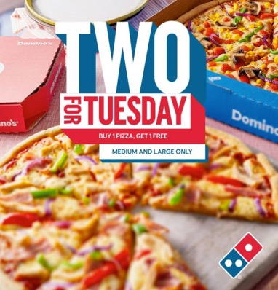
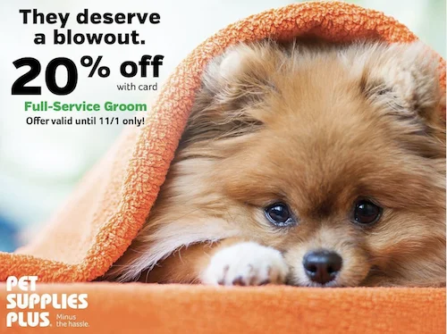
What makes an advert persuasive?
Look at the three adverts
Discuss with your partner which advert is most persuasive and why.
Write your answers in full sentences, using your new knowledge of different types of advertising techniques.
Advert 1
Advert 2
Advert 3
Notes:
Remember that when we choose a product there will be lots of other similar products available on the market. Some may even be better, or better value!
Adverts try to influence us to buy their products.
Teacher prompt questions
Why did you choose that advert? What Advertising techniques were used?
Is the product something that you need or want to spend your money on?
Is there a cost saving if you buy one vs the other?
Might we sometimes want to go for the more expensive option?

Slide 29

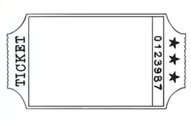
Time to advise | Exit ticket
Write a social media post (max 150 words) explaining how best Shivaughn can be a critical consumer.
Your post should include:
Pressures she needs to be aware of
Different types of advertising techniques companies use to try and persuade people
Tips to make better spending decisions
Notes:
Adaptation:
Shivaughn needs to be aware that…
Companies use advertising to make us buy their products - for example…
One thing that Shivaughn should start doing:
One thing that Shivaughn should stop doing:

Slide 30
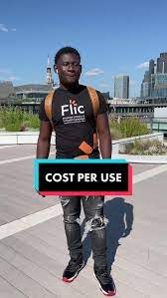
Optional | Tips to make better spending decisions
Watch Poku’s video on cost per use. What other tips and tools can be used to make better buying decisions?
Differentiate between wants and needs
Consider cost per use
Be aware of external influences and decide what’s most important to you
Recognise advertising techniques when looking at products and decide whether you really want/need that product or have been convinced by a good advert
Consider the price of the item and whether the same product can be bought at a lower price
Consider how ethical or environmental the product is and whether it fits with your values
Wait 24 hours between thinking about a product and making the purchase!
Notes:
Prompt questions
What can we learn from Poku about making better buying decisions?
What other tools can we use or questions can we ask to help us make informed spending decisions?
Teacher explanation
Before making a purchase, it’s important to consider how long the item will last and how many times the item will be used. That way we can be more discerning/ savvy when it comes to purchase decisions.
Encourage students to use learning from the entire unit. Responses can be found on the following slide (listed below). Students may have others not listed.
Differentiating between wants and needs
Considering cost per use
Consider external influences and decide what’s most important to you
Recognise advertising techniques when looking at products and decide whether you really want/need that product or have been convinced by a good advertisement
Consider the price of the item and whether the same product can be bought at a lower price

Slide 31
By the end of the session, I will be able to:
Explore pressures that influence spending choices
Analyse what makes a persuasive advertisement

Slide 32
Any questions?
?

Slide 33



Services available for people who have concerns about their personal finances
Citizens Advice – Debt and Money – This resource contains links to advice on a number of topics, including financial difficulties, cost of living and communicating with creditors.
National Debtline – Debt and Money – a debt advice charity run by the Money Advice Trust, offering a free and confidential debt advice service.
Childline Helpline
0800 1111
At school, you can speak with an adult you trust.
This could be your form tutor, head of year or the school’s safeguarding officer.

Slide 34
Links to learn more!
Articles to extend learning
Please visit the FLIC Learning Hub for further resources
‘What can you learn from the most persuasive adverts’ (BBC Psychology, 2020)
‘8 highly successful advert campaigns’ (Investopedia, 2022)
‘How social media impacts consumer buying’ (Forbes, 2022)
Tricks of the trade | How online customer journeys create consumer harm and what to do about it (Citizens Advice)

Slide 35
Optional home learning activity

Slide 36


Create a persuasive advert for a product for peers in your year group
What key features will make your product appealing to consumers?
What is a catchy strapline to add?
Which celebrity would be a good match for your product?
What data and facts would show this product is of value?
In what ways are the materials of the product environmentally or socially friendly?
Are there any other advertising techniques that you can use?
Notes:
Delivery instruction
Stretch - ask students to have a more specific audience in mind for their advert. They should describe this audience such as vegetarians, music loves, environmentally conscious consumers etc.

Slide 37
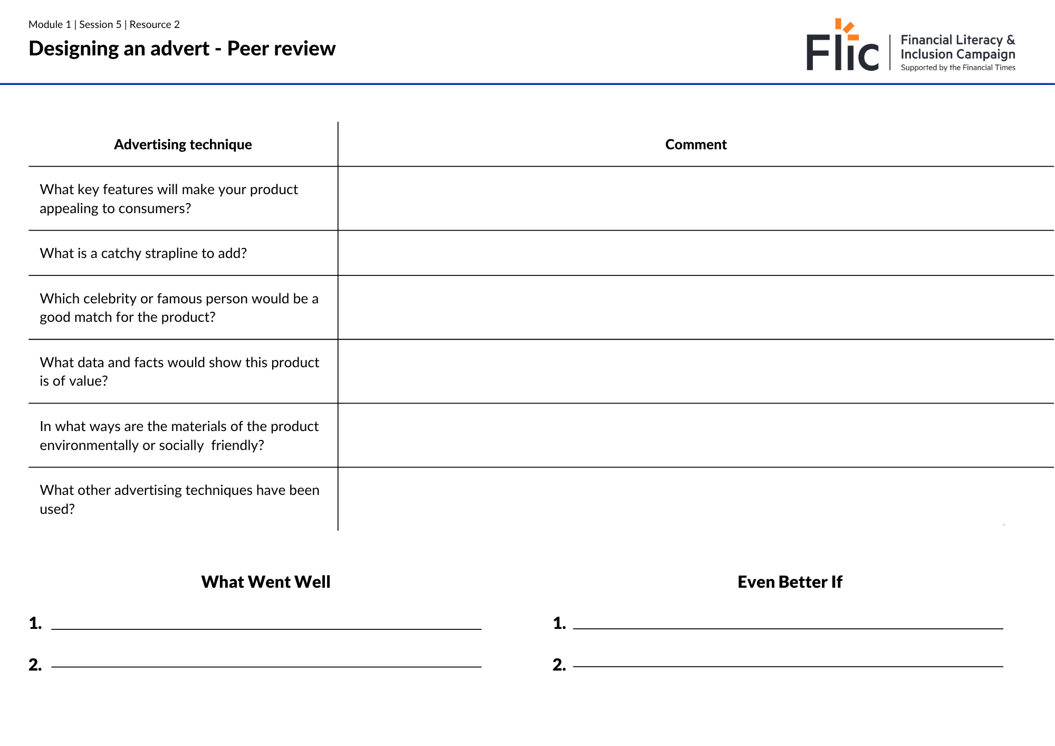
Peer review
Your job is to review the advert and use the criteria to assess the advert, writing 2 points on WWW (what went well) and 2 EBIs (even better ifs).
Stretch - describe the kind of person or groups of people that the advert would appeal to.
Resource 1: Peer review criteria
Notes:
Delivery instruction
Pairs to switch adverts and complete the table, commenting on each criteria. THen students use full sentences to comment on the positives and ways to improve.

