Slide 1





Conclusion
FREE PRESENTATION TEMPLATE

Slide 2





Conclusion
Introduction
01
02
Encounters
The Extraordinary Realm
Unicorn Sightings
Wonders
03
04
Magic
Wishes Granted
Spellcasting
Adventure
05
06
Conclusion
Happily Ever After
Embrace the Fantasy

Slide 3







Conclusion
Unicorn Sightings
Dragon Taming
A record of the number of unicorns spotted in the fantasy realm and the beauty and mystery.
A closer look at the art of taming dragons and the brave adventurers who dare to take on these fearsome creatures.
Dragon Taming
Unicorn Sightings
A closer look at the art of taming dragons and the brave adventurers who dare to take on these fearsome creatures.
A record of the number of unicorns spotted in the fantasy realm and the beauty and mystery.

Slide 4





Conclusion
Unicorn Sightings
Dragon Taming
A record of the number of unicorns spotted in the fantasy realm and the beauty and mystery. A record of the number of unicorns spotted.
A closer look at the art of taming dragons and the brave adventurers who dare to take on these fearsome creatures.
Dragon Taming
Unicorn Sightings
A closer look at the art of taming dragons and the brave adventurers who dare to take on these fearsome creatures.
A record of the number of unicorns spotted in the fantasy realm and the beauty and mystery. A record of the number of unicorns spotted.

Slide 5








Conclusion
Unicorn Sightings
Dragon Taming
A record of the number of unicorns spotted in the fantasy realm and the beauty and mystery. A record of the number of unicorns spotted.
A closer look at the art of taming dragons and the brave adventurers who dare to take on these fearsome creatures.
Dragon Taming
Unicorn Sightings
A closer look at the art of taming dragons and the brave adventurers who dare to take on these fearsome creatures.
A record of the number of unicorns spotted in the fantasy realm and the beauty and mystery. A record of the number of unicorns spotted.

Slide 6



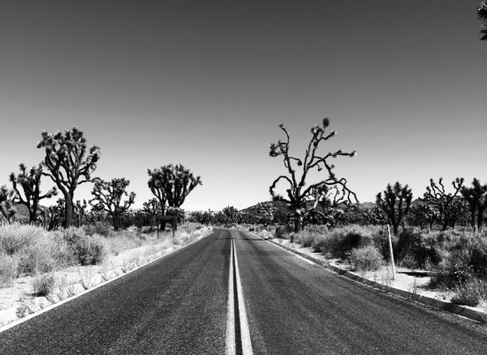

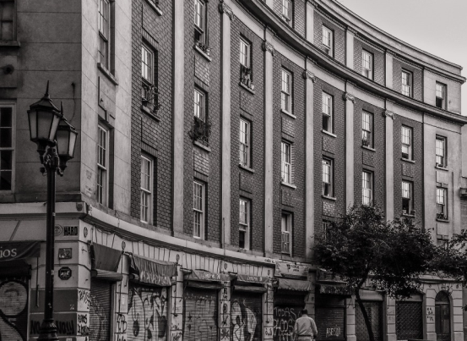
Conclusion
Unicorn Sightings
Dragon Taming
Unicorn Sightings
A record of the number of unicorns spotted in the fantasy realm and the beauty and mystery.
A closer look at the art of taming dragons and the brave adventurers who take on these creatures.
A record of the number of unicorns spotted in the fantasy realm and the beauty and mystery.

Slide 7





Conclusion
Unicorn Sightings
Dragon Taming
Unicorn Sightings
Dragon Taming
A record of the number of unicorns spotted in the fantasy realm and the beauty and mystery.
A closer look at the art of taming dragons and the brave adventurers who take on these creatures.
A record of the number of unicorns spotted in the fantasy realm and the beauty and mystery.
A closer look at the art of taming dragons and the brave adventurers who take on these creatures.

Slide 8




Conclusion
Basic
Elite
Legendary
  Access to the entry-level dungeons.
  A limited number of quests and battles per month.
  Ability to form a small party with fellow adventurers.
  Access to the intermediate and advanced dungeons.
  A greater number of quests and battles
  Ability to form larger parties with fellow adventurers.
  Access to the most challenging dungeons and encounters.
  Unlimited quests and battles per month.
  The ability to form the largest parties with fellow adventurers.

Slide 9


Conclusion
Dragon Taming Technique
A guide to taming and caring for dragons in the realm of magic.
The Art of Unicorn Sighting
Tips and tricks for spotting the elusive unicorns in their natural habitat.

Slide 10

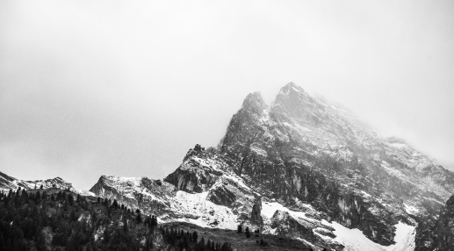
Conclusion
1
Discover the secrets
2
Find your own path
Explore the lush, vibrant forest and uncover the mysteries that lie within.
Choose your own path through the forest, and see where it takes you.
Meet the creatures
Uncover the magic
3
4
Encounter the mythical creatures that call the forest home, from talking animals to fairies.
Learn about the powerful magic that pervades the forest and how it affects all who enter.

Slide 11



Conclusion
Spellcasting Competition
Treasure
Hunt
Great
Adventure
A significant event in the history of the fantasy realm, in which the greatest spellcasters of the fantasy realm.
A significant event in the history of the fantasy realm, in which a massive and awesome treasure hunt was organized.
A notable year in the history of the fantasy realm, in which a large number of adventurers set out to explore.

Slide 12





Conclusion
1
2
3
4
Eclipse
Eclipse
Eclipse
Eclipse
Rare event causes unpredictable magic.
Rare event causes unpredictable magic.
Rare event causes unpredictable magic.
Rare event causes unpredictable magic.
Quest
Quest
Quest
Quest
Adventurers seek immortal artifact.
Adventurers seek immortal artifact.
Adventurers seek immortal artifact.
Adventurers seek immortal artifact.

Slide 13


1
2
Eclipse
Obtain
Rare event causes unpredictable magic.
Humans acquire Crystal
Quest
Foundation
Adventurers seek immortal artifact.
Shimmering City established
Conclusion
3
4
War
Invasion
Kingdoms clash in conflict.
Kingdom attacked by monsters.
Transformation
Betrayal
Peasant discovers magical powers.
Queen's advisor revealed as spy.

Slide 14


Conclusion
1
2
Eclipse
Obtain
Rare event causes magic.
Humans acquire Crystal
Quest
Foundation
Adventurers seek immortal artifact.
Shimmering City established
3
4
War
Invasion
Kingdoms clash in conflict.
Kingdom attacked by monsters.
Transformation
Betrayal
Peasant discovers magical powers.
Queen's advisor revealed as spy.

Slide 15





Conclusion
Strengths
Weaknesses
Rare event causes unpredictable magic.
1
2
Rare event causes unpredictable magic.
3
4
Opportunities
Threats
Rare event causes unpredictable magic.
Rare event causes unpredictable magic.

Slide 16
Conclusion
April
May
June
July
Eclipse, quest for artifact, volcano disaster
Shimmering City, conquest, Unicorn Crystal
War, curse from artifact, magic discovery
Kingdom invaded, betrayal, hero's festival
Eclipse
Obtain
War
Invasion
Rare event causes unpredictable magic.
Humans acquire Crystal
Kingdoms clash in.
Kingdom attacked.
Foundation
Transformation
Betrayal
Quest
Shimmering City established
Peasant discovers magical powers.
Queen's advisor revealed as spy.
Adventurers seek immortal artifact.
Rise
Intrigue
Festival
Disaster
City expands, conquers neighbors.
Plot to assassinate leader uncovered.
Grand celebration in hero's honor.
Volcano destroys city.

Slide 17
Thank you for choosing EaTemp
We offer free and high-quality slides templates for your presentations. We appreciate you choosing us and hope our templates have been helpful.
As a new website, we rely on your support to grow, so please help us by sharing our site with your friends and colleagues.
Credit | Image: Unsplash

