Slide 1



Horoscope
Powerpoint Presentation
www.freepptbackgrounds.net

Slide 2
Powerpoint
Web Design
Content
Keynote
Development

Slide 3

PART 01
POWERPOİNT
This is your presentation title This is your presentation title This is your presentation title

Slide 4

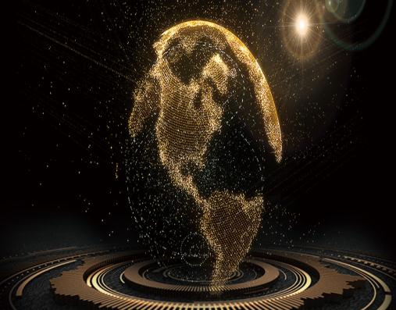
Powerpoint
Make
Think
Easy to change colors, photos and Text.
I hope and I believe that this Template will your Time,
Check
Make
Get a modern PowerPoint Presentation
Easy to change colors, photos and Text.
Think
Check
I hope and I believe that this Template will your Time,
Get a modern PowerPoint Presentation
Meet our Team
Get a modern PowerPoint Presentation that is beautifully designed.

Slide 5
Powerpoint
Web
It is a very sad thing that nowadays there is so little useless information.
4
Solutions
3
We certainly do not forget you as soon as you forget us.
Overview
We certainly do not forget you as soon as you forget us.
2
Design
1
It is a very sad thing that nowadays there is so little useless information.

Slide 6
Powerpoint
Infographics
The time is now, the
place is here.
Devices
We certainly do not
forget you as soon
Overview
It is a very sad thing that nowadays there
is so little useless information.。
Speakers Introduction
Cerenomy
I believe that people
would be alive
Devices
We certainly do not
forget you as soon 。

Slide 7
Powerpoint
Break Time
I feel very strongly that change is good because it
Opening
Genius hath electric power which earth can never tame.
Speakers
Introduction
I feel very strongly that change is good because it stirs up the system.
Genius hath electric power which earth can never tame.

Slide 8
PART 02
WEB DESİGN
This is your presentation title This is your presentation title This is your presentation title

Slide 9


Web Design
Free Time
Speakers
Woe be to him that reads but one book.
A large income is the best recipe for happiness I ever heard of.
Vision
Free Time
A large income is the best recipe for happiness I ever heard of.
Woe be to him that reads but one book.

Slide 10
Web Design
Mission
Vision
A torn jacket is soon mended; but hard words bruise the heart of a child.
A torn jacket is soon mended; but hard words bruise the heart of a child.
Vision
Mission
A large income is the best recipe for happiness I ever heard of.
A large income is the best recipe for happiness I ever heard of.

Slide 11
Web Design
Our Values
To see what is in front of one's nose
needs a constant struggle.
Home
Woe be to him that reads but
one book.
About us
Woe be to him that reads but one book.
Our Values
经验积累，革新技术提
高效率，更好完成任务
Egg
A torn jacket is soon mended; but hard words
bruise the heart of a child.。

Slide 12
Web Design
01
One
Take calculated risks. That is quite different
Two
There is only one difference between a
02
03
Three
Take calculated risks. That is quite different from being rash.
Four
04
There is only one difference between a madman and me. I am not mad.

Slide 13
Web Design
Case
I'm convinced that about half of what
Shield
There is only one difference
between a madm
Time
I'm convinced that about half of what
Safety
When you feel in your gut what you are and then
dynamically pursue it - don't back
About
There is only one difference between a
madman and me. I am not mad.

Slide 14
PART 03
KEYNOTE
This is your presentation title This is your presentation title This is your presentation title

Slide 15

Keynote
Forum
There is only one difference between a madman and me. I am not mad. There is only one difference between a madman and me. I am not mad.



01
02
03
Services
Timeline
Future
Take calculated risks. That is quite different from being rash.
There is only one difference between a madman and me. I
Take calculated risks. That is quite different from being rash.

Slide 16




Keynote
Pricing
Genius hath electric power which earth can never tame.
Be Champion
I feel very strongly that change is good because it stirs up the system.
Dice
I feel very strongly that change is good because it stirs up the system.
Peek
A large income is the best recipe for happiness I ever heard of.

Slide 17


Keynote
Infographics
When you feel in your gut what you are and then dynamically pursue it - don't back down and don't give up - then you're going to mystify a lot of folks.

Slide 18
Keynote

Pack
Skiing consists of wearing $3,000 worth of clothes and equipment and driving 200 miles in the snow in order


Free
When you feel in your gut what you are and then

Home
Skiing consists of wearing $3,000 worth of clothes and equipment and driving 200 miles in the snow in order

Slide 19
Keynote




01
02
03
Opening
When you feel in your gut what
you are and then dynamically
Speakers
Pursue it - don't back
down and don't give up
- then you're going to
mystify a lot of folks.
Cerenomy
Skiing consists o
f wearing $3,000 worth

Slide 20
PART 04
DEVELOPMENT
This is your presentation title This is your presentation title This is your presentation title

Slide 21
Development
Values
I feel very strongly
that change is


Free

Free Time
A large income is the best recipe for
happiness I ever heard of.
Value

Time
Woe be to him that read
but one book.
Time

Slide 22
Development
A large income is the best recipe for happiness I ever heard of.
Forum
Woe be to him that reads but one book.
Woe be to him that reads but one book.
About us
Woe be to him that reads but one book.

Slide 23

Development
01
02
03



Services
Home
Challange
Your heart are always with you.
You can’t change what’s
People who touch

Slide 24
Development
Pricing
Always give your best never worry for results.
Our Values
Education is the most powerful weapon which
Forum
Future
God sometimes removes people from your life
God sometimes removes people from your life
Break Time
Timeline
Always give your best never worry for results.
Education is the most powerful weapon which

Slide 25
Thank You !
Horoscope Powerpoint Presentation
www.freepptbackgrounds.net

