Slide 1


COLLECTIVE BEHAVIOUR AND PROTEST

Slide 2

In this chapter we will study
• Mobs – meaning, nature and effects.
• riots – meaning, nature and effects.
• different forms of collective behavior.
• Women’s Self-Help Groups

Slide 3
❖ Man is a social animal, and hence always lives in groups, communities and societies. When he is a member of a group
❖ he behaves in a manner totally different from the way he behaves when he is alone
❖ This kind of behavior is called ‘collective behavior’.

Slide 4
❖ Human behavior coming under the scope of collective behavior includes mobs, rumors, propaganda, public opinion, revolution, social movements etc.

Slide 5

Mob:
‘Assembly of people around a common interest without any expectation or planning is called a mob”.
❖ The mob is a temporary assembly of people which responds to a particular provocation.
❖ For ex: a group of people assembled near a theatre to buy tickets, an assembly of people around an accident scene. Etc.

Slide 6

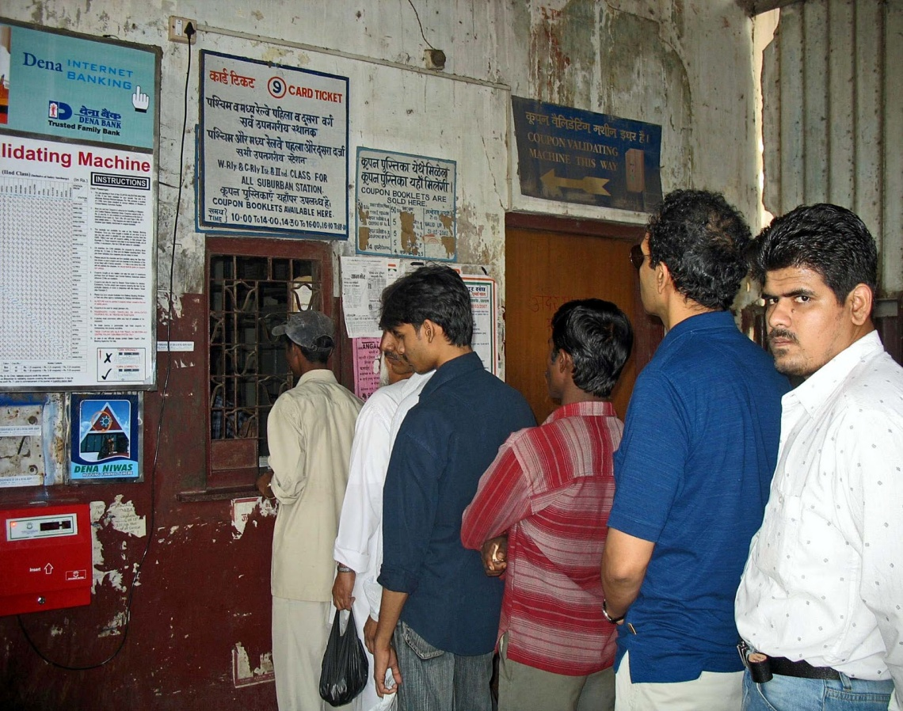

Slide 7
❖ Mob is a temporary assembly of people. In this, people assemble at a specific place.
❖ Members of a mob are influenced very easily by mutual feelings, opinions and acts.
❖ There is a possibility of display of suppressed feelings.
❖ Sometimes such displays assume violent form

Slide 8
Influence of mob.
❖ Uncontrolled acts of the members of a mob often indicate the shortcomings of the society.
❖ Sometimes, they express the frustration towards the working of social organizations

Slide 9
❖ They represent the people’s dissatisfaction about the government’s projects, attitude and specific programs.
❖ It becomes necessary to use police force, security forces, military help etc

Slide 10

Riots:
❖ Violent and destructive nature of mob behavior is called riot.
❖ When riots become uncontrollable and harmful, they lead to destruction

Slide 11
Nature of Riots
❖ The minimum level of unity seen in a mob
❖ Those involved in riots go on destroying everything in their way
❖ Creation of chaos is the intention of rioters.
❖ Large scale loss of property and lives

Slide 12
❖ Do not have any particular aim or cause for the destruction they cause.
❖ Serious challenges for law and order.
❖ Communal clashes, communal fights, group clashes are the some examples of riots.
❖ Riots occur more in towns and cities

Slide 13
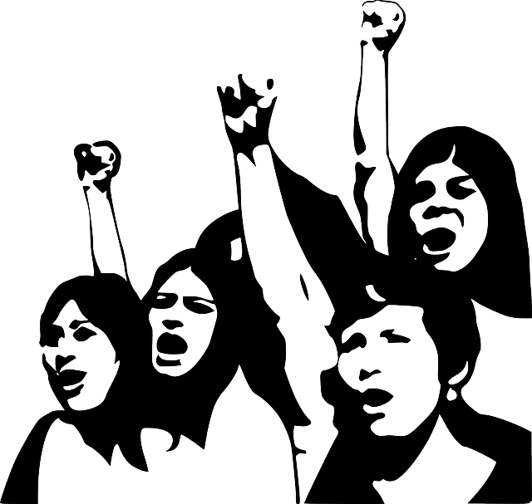
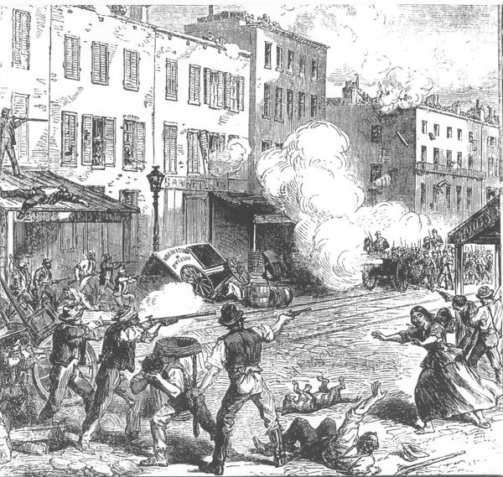


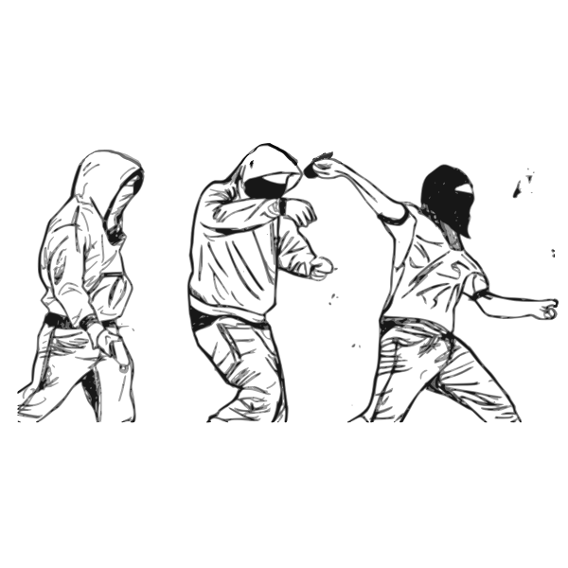

Slide 14
❖ Provoking circumstances, individuals’ uncontrolled behavior, uncivilized behavior, criminal intent of people,
❖ Riotous mindset is the main causes for riots.
❖ Riots do not continue for a long time.
❖ Riots can be controlled by the presence of mind of the officials, by police and security forces and law.

Slide 15
Environmental movements
❖ When collective behavior is organized and directed towards a specific goal, and aims to bring about social change, it is called a Movement.
❖ The soil, air, water and biosphere around us getting polluted with toxins and chemicals is called environmental pollution.

Slide 16
Pollution posing a serious problem
❖ The pressure on the environment where human beings are living is progressively increasing
❖ Developed and developing nations exploit the natural resources in an aggressive manner.
❖ Developed nations are destroying the environment for the purpose of their luxurious life.

Slide 17
❖ Many nations in the world are exerting enormous pressure on the environment
❖ the unbridled growth of cities, proliferation of industries, technological progress,
❖ Expansion of transport system etc. are destroying the forests and polluting the environment. Consequently, pollution is posing a serious problem

Slide 18
Chipko movement 1974
❖ Leadership of Shri Sunderlal Bahuguna and Shri Chandiprasad Bhatt.
❖ The government gave permission to chop down certain trees in Tehri Garhwal district of Uttar Pradesh

Slide 19
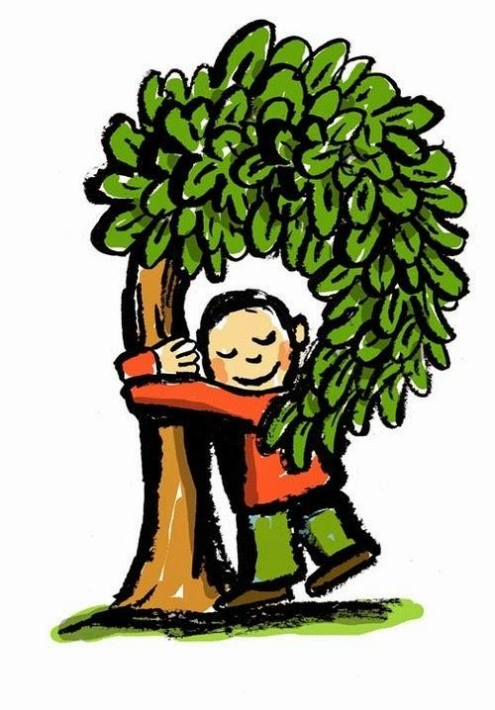
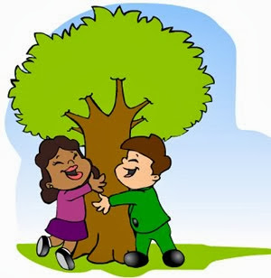
❖ The people there realized that there will be loss of trees, and their environment will be destroyed.
❖ they hugged the trees and halted their destruction

Slide 20
❖ This movement took place in 1973
❖ As a result, the permission given to chop down the trees was withdrawn

Slide 21
Appiko movement 1983
In 1983, the farmers of Salyani village in Uttara Kannada district of Karnataka began the ‘Appiko’ movement.
❖ When the contractors came to cut down trees in Kelase forest, in order to stop them, the farmers hugged the trees and protested

Slide 22
❖ The purpose of the farmers’ protest was to stop smuggling of trees, and develop awareness among the common people about the importance of growing trees and the importance of environment

Slide 23
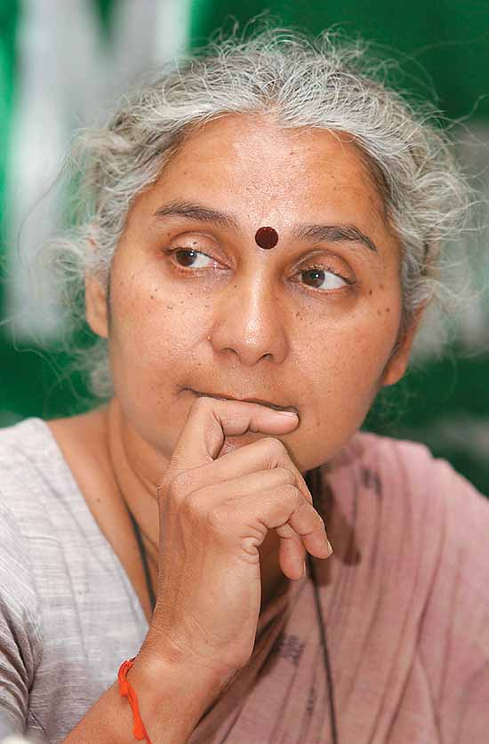
Narmada movement
❖ An agitation was launched against the construction of a dam across the Narmada river under Sardar Sarovar Project in Gujarat.
❖ The leaders of this movement were environmental activists Medha Patkar and Baba Amte

Slide 24
Reason:
with the construction of the dam, there would be large scale destruction of forests, damage to the environment and threat to many animal species

Slide 25
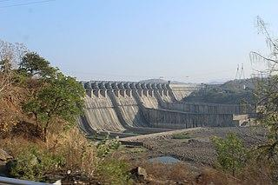
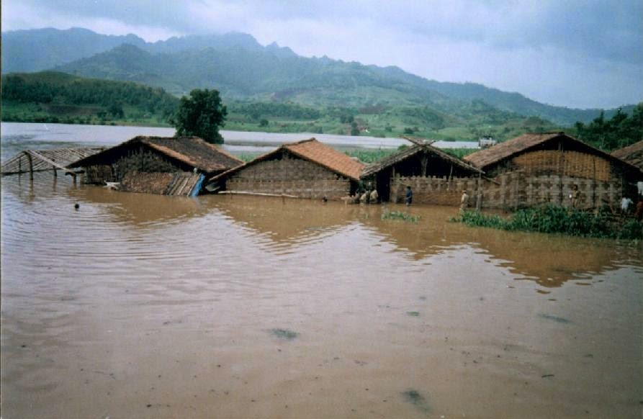
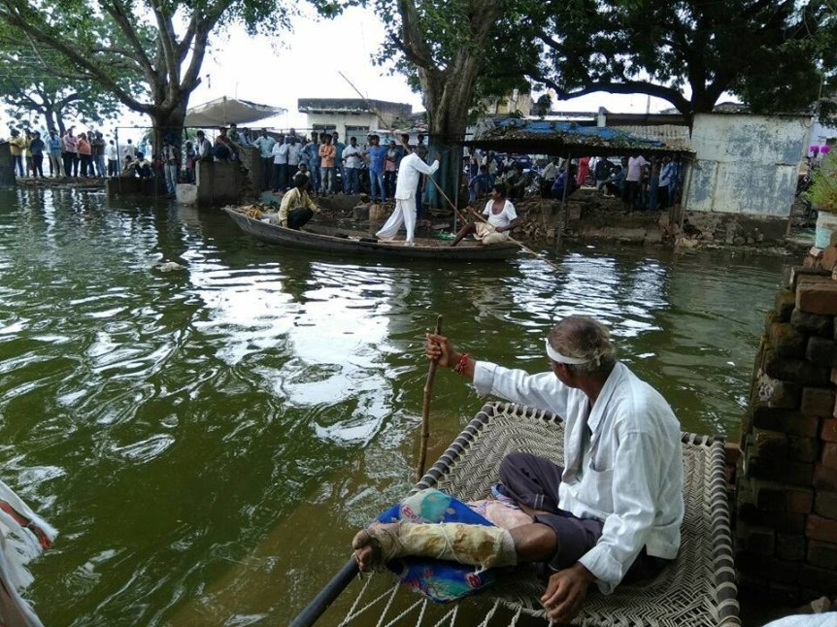
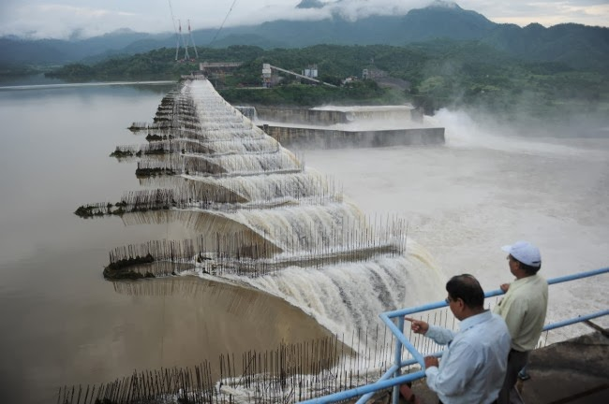

Slide 26
Silent valley movement
❖ The environment and many animal species came under threat when a dam was planned to be constructed in the Silent Valley in Palghat taluk of Kerala

Slide 27
❖ In order to stop the construction, the Kerala Sahitya Parishad and wild-life enthusiasts agitated against it.
❖ This movement was successful in protecting many forms of flora and fauna

Slide 28
Movement against MRPL
❖ Environmentalists protested against the ‘Mangalore Refineries and Petrochemicals Limited’ (MRPL)in Mangalore in Karnataka
❖ Reason: the chemicals fumes from the proposed oil refinery would destroy the environment

Slide 29
Agitation against Kaiga
❖ Dr.Shivaram Karanth and other intellectuals carried out a movement against the Nuclear Power Generation Center proposed to be set up in Kaiga in Karnataka.

Slide 30
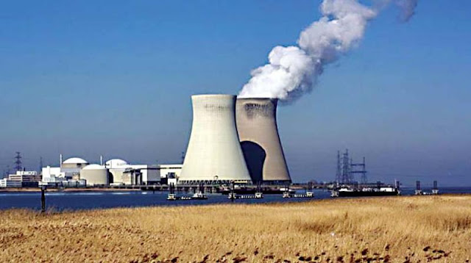
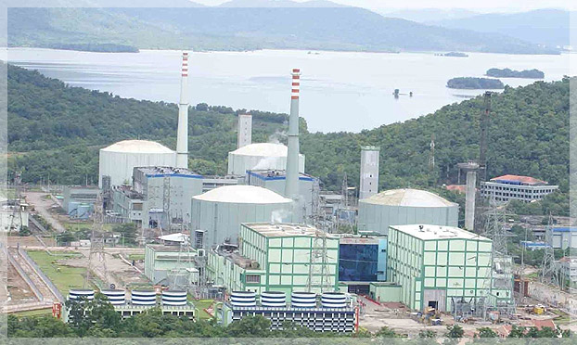
Reason:
the nuclear power generation center would cause loss of forest cover, and the radiation from the center would pollute the environment, thus endangering the survival of various animal species of the area.

Slide 31
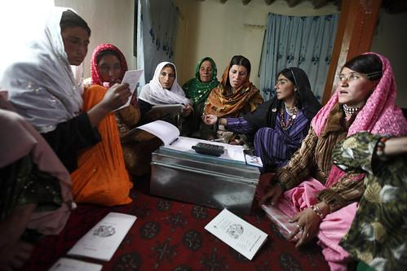
Women’s Movements
Alcohol Prohibition Movement
Alcohol Prohibition Movements are organised by the women against alcoholism which has created havoc and hardship in the life of the poor
Women Self Help Group
These groups empower women economically and socially. In addition to that self-help groups play an important role in providing them with equal rights opportunities and powers.

Slide 32
Farmer’s Movement
Farmers protests which started through the refusal of taxes, against economic crisis
D. Devaraj Arus
implemented many laws, for the empowerment of the socially weaker section of the society,
abolishion of bounded labour
free the tenents from the cluches of land lords

Slide 33
The peasant rebellion at Naaragunda in 1980
leadership of Pro. M.D. Nanjundaswamy
he established the Karnataka State farmers association
rebellion against the government’s tyranny and it was in favor of farmers

Slide 34
Labour Movements
to uphold the dignity of labourers and to protect the interests of labourers are called labour movements.
opposing capitalist exploitations.

Slide 35
Anti - Untouchability Movement
The anti untouchability movement is the people’s movement against the attack on dalits
It was started in the 19th century by Jyoti Rao Phule of Maharashtra in 1917.
Periyar Ramaswamy started the self-respect movement

Slide 36
Dr. B.R. Ambedkar’s thought and struggle the anti-untouchability movement
advocated the rights for socially oppressed
He started the magazine ‘Mookanayaka’
huge movement against the practice of untouchability
Ambedkar’s thought and struggle the anti-untouchability movement took on an intense form

Slide 37

Thank you
Prepared by:
Praveen Banakar

