Slide 1


Environmental Health: Structural Approaches to Road Safety
Johns Hopkins Center for Injury Research and Policy
Diné College

Slide 2
How this lecture fits into the course
This lecture builds on content in an Environmental Health course by discussing the environmental and structural approach to road safety in the Safe System Approach
that aims to prevent motor vehicle and pedestrian
fatalities.

Slide 3
What is one word that describes roads on the Navajo Nation?
Notes:
One Word Popcorn: Ask the question, “What is one word that describes roads on the Navajo Nation?” Invite participants take turns unmuting and quickly saying their word. You as the facilitator could call on names, or you can have the current speaker call on the next person. This way, everyone participates briefly, and it sets a quick rhythm.

Slide 4
Learning Objectives
In this lecture you will learn an introduction to injury prevention:
Define injury
Describe how injury compares with other leading causes of death
Describe injury epidemiology for both intentional and unintentional injuries.
Notes:
Define injury and/or violence and describe the concepts of intentionality and mechanism as they relate to injury and/or violence.
Describe how injury and/or violence compare with other leading causes of morbidity and mortality and with regard to burdens on the population (e.g. incidence, cost, years of potential life lost, etc.)
Explain how injuries and/or violence are preventable.
Describe the disparity in the risks of injury and/or violence (e.g. differences by age, gender, race, ethnicity, education, location, access to economic resources, access to health care services, sexual orientation, creed, community norms, and the environment).
Describe the influence of a variety of factors (including age, gender, race, ethnicity, education, access to economic resources, sexual orientation, creed, community norms, access to health care services, and the environment) on injury and/or violence prevention.

Slide 5
Part 1: Injury 101
Play Recorded Lecture
(youtube link)

Slide 6
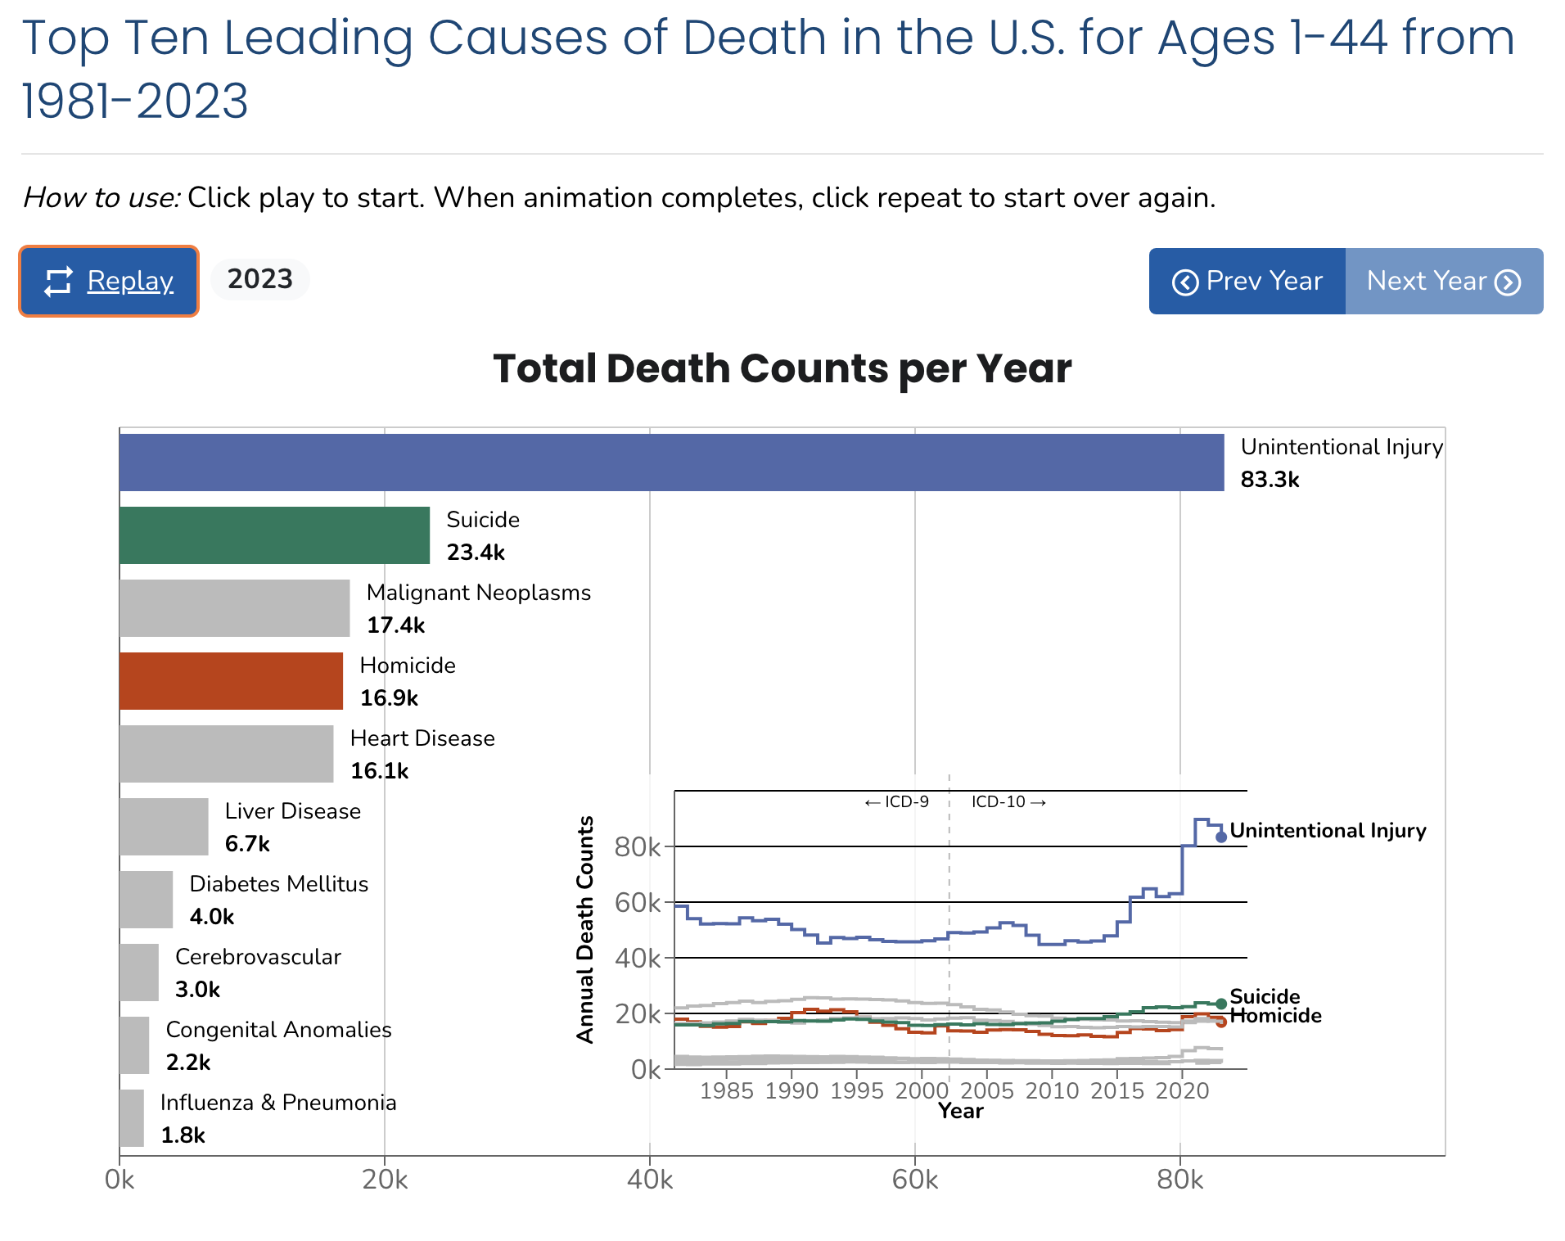
Link to animation: https://wisqars.cdc.gov/animated-leading-causes/
Notes:
Optional activity if there is time. Description in Facilitator Guide.

Slide 7
Part 2: Structural Approaches to Road Safety
Learning Objectives
After this lecture, you will be able to:
Describe the role of design in the Safe System Approach.
Describe some of the guiding principles of the Safe System Approach.
Identify how crash investigations can help injury prevention.
Identify some Safe System design implementations.

Slide 8
Part 2: Structural Approaches to Road Safety: A Safe Systems Approach
Play Recorded Lecture
(youtube link)

Slide 9

DISCUSSION QUESTIONS
What caught your attention in the lecture today?
What Safe System approaches do you think would work to address road safety concerns you have in your communities?
From your perspective, what barriers do you foresee in implementing Safe System approaches?
Notes:
If the class will be going into different break out rooms, post the questions in the chat before initiating the breakout rooms. Inform the facilitators the time allowed and if there will be a person to give a summary of the small group discussion.

