Slide 1
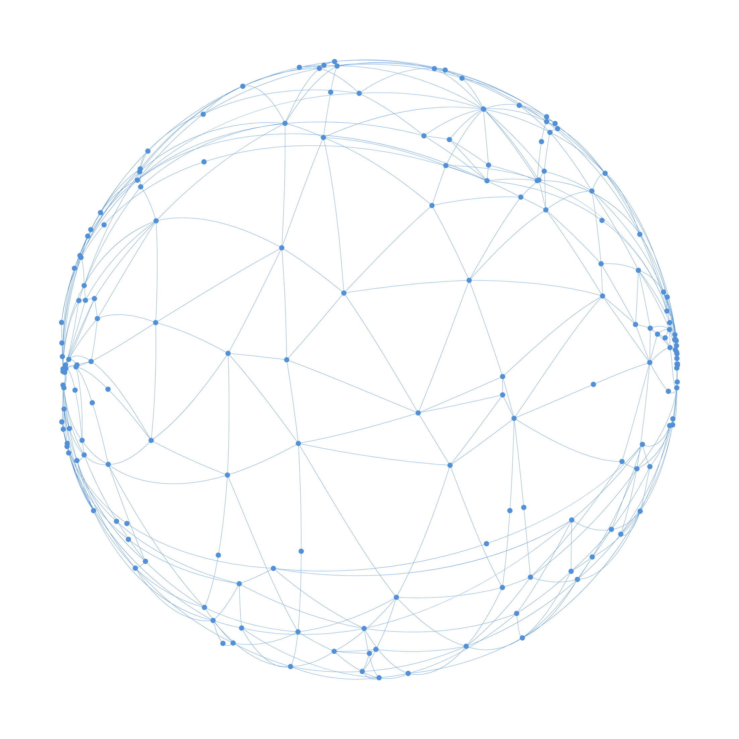
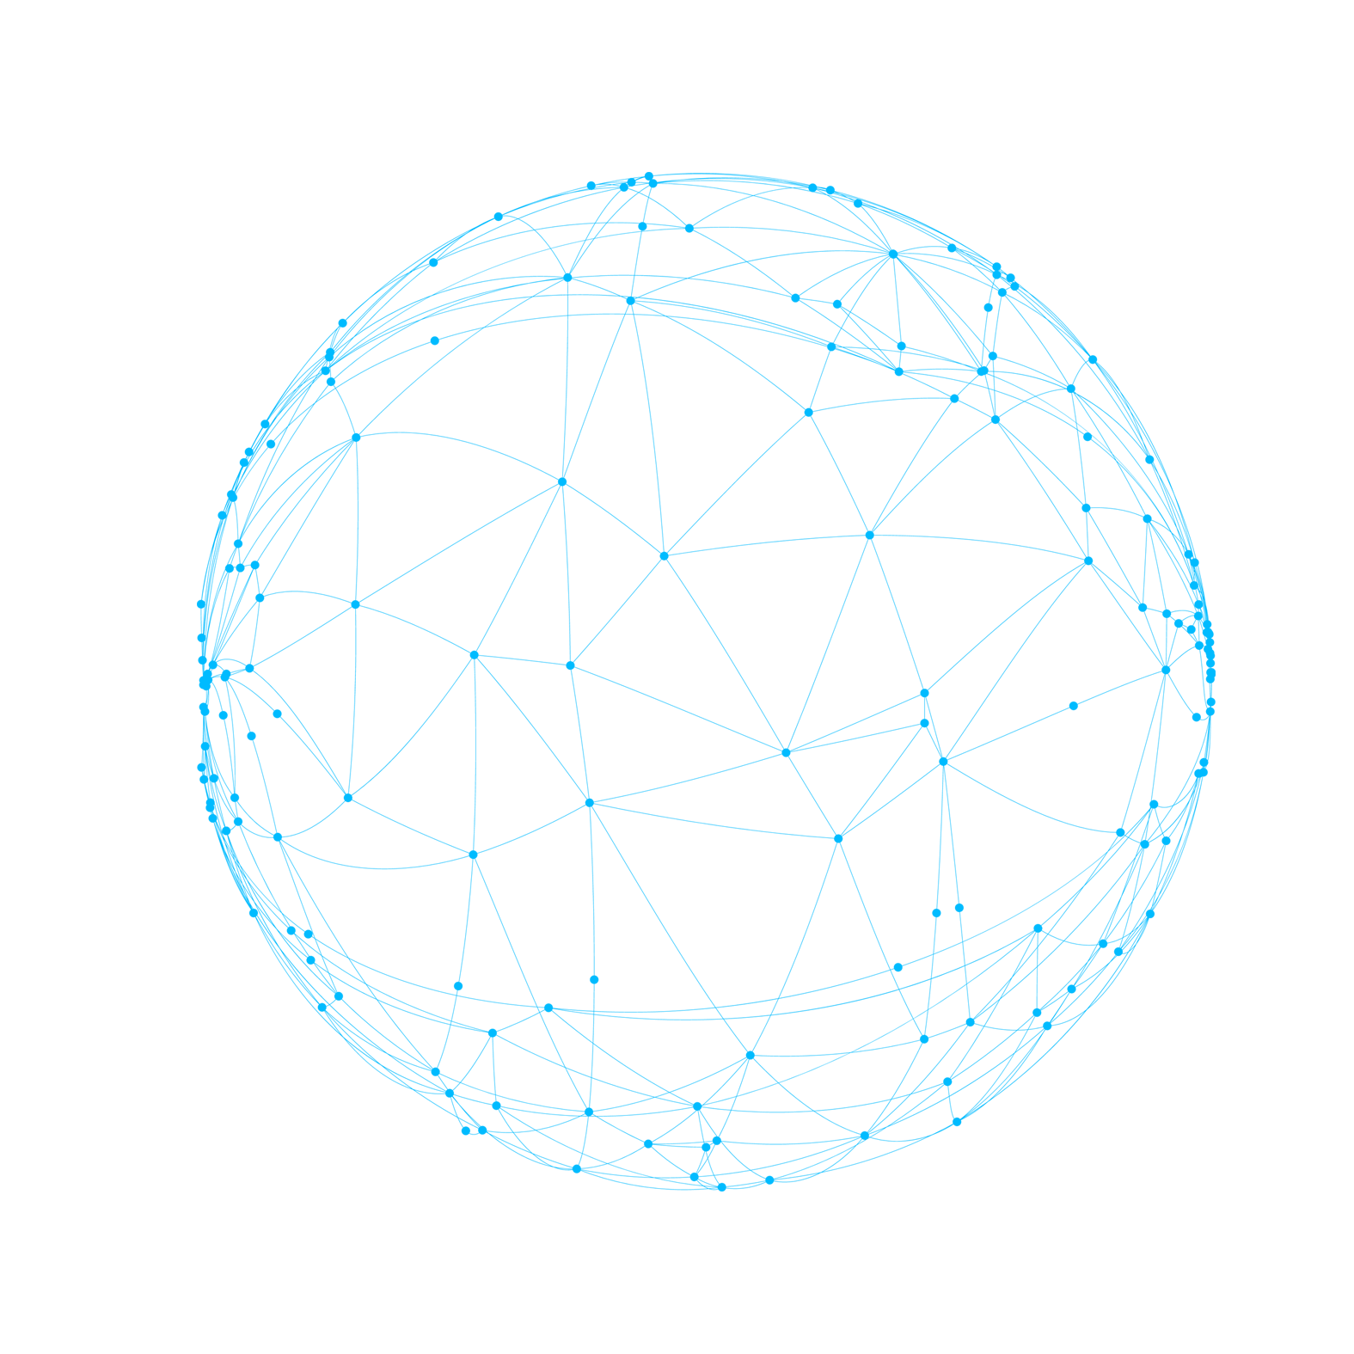







LOGO
SUCCESS STORY
PRESENTATION TEMPLATE

Slide 2



CONTENTS
01
SPRING
CLICK TO ADD CAPTION TEXT
02
SUMMER
CLICK TO ADD CAPTION TEXT

Slide 3

03
AUTUMN
CLICK TO ADD CAPTION TEXT
04
WINTER
CLICK TO ADD CAPTION TEXT
We use well-known development methodologies to create a customized approach for each of the projects. This allows us to achieve high quality outcomes and full transparency towards.

Slide 4

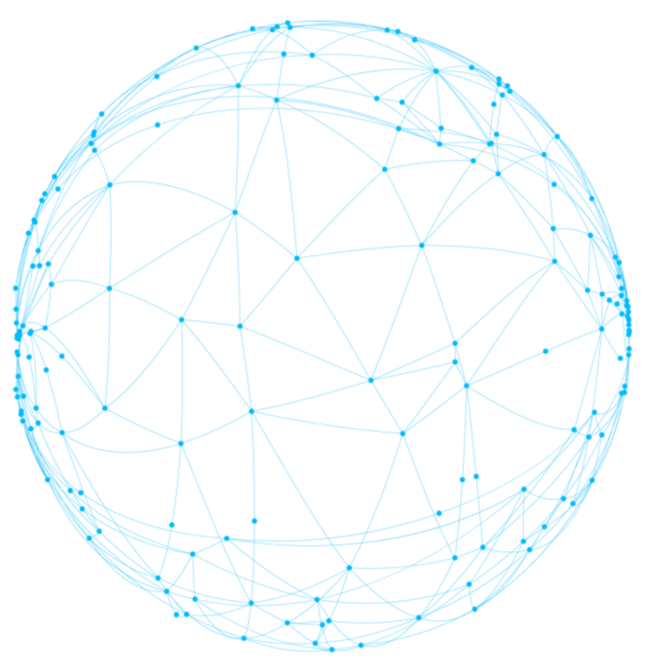
Text here...
01
Text here...
Text here...
SPRING
Text here...
Text here...
Text here...

Slide 5
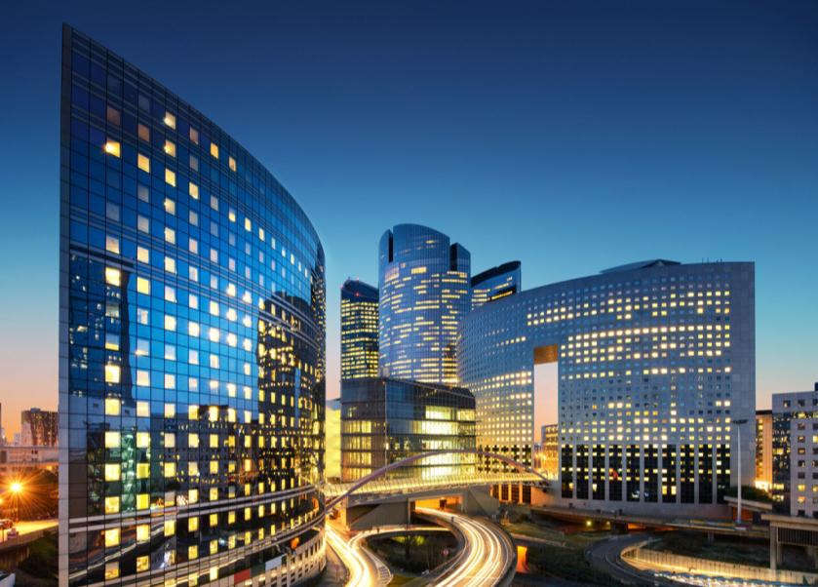

TITLE HERE
TITLE HERE
We use well-known development methodologies to create a customized approach for each of the projects. This allows us to achieve high quality outcomes and full transparency towards.
We use well-known development methodologies to create a customized approach for each of the projects. This allows us to achieve high quality outcomes and full transparency towards.

Slide 6
TITLE HERE
201X.XX
We hope that this template will return to you as a time, money and reputation.
201X.XX
We hope that this template will return to you as a time, money and reputation.
We hope that this template will return to you as a time, money and reputation.
201X.XX
We hope that this template will return to you as a time, money and reputation.
We hope that this template will return to you as a time, money and reputation.
201X.XX
201X.XX
201X.XX
We hope that this template will return to you as a time, money and reputation.

Slide 7
TITLE HERE
STEP HERE
STEP HERE
Go ahead and replace it with your own text.
STEP HERE
STEP HERE
Go ahead and replace it with your own text.
STEP HERE
Go ahead and replace it with your own text.
STEP HERE
STEP HERE
Go ahead and replace it with your own text.
STEP HERE
STEP HERE
Go ahead and replace it with your own text.

Slide 8

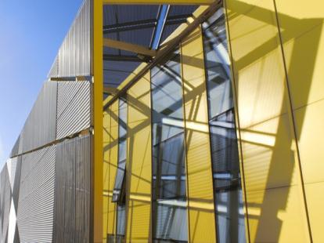


TITLE HERE
STAGE HERE
STAGE HERE
STAGE HERE
STAGE HERE
Go ahead and replace it with your own text.
Go ahead and replace it with your own text.
Go ahead and replace it with your own text.
Go ahead and replace it with your own text.

Slide 9




TITLE HERE
TITLE HERE
TITLE HERE
Go ahead and replace it with your own text.
Go ahead and replace it with your own text.
TITLE HERE
TITLE HERE
Go ahead and replace it with your own text.
Go ahead and replace it with your own text.

Slide 10
TITLE HERE
STEP HERE
04
A complex idea can be conveyed with just a single still image, namely making it possible to absorb large amounts of data quickly.
STEP HERE
03
A complex idea can be conveyed with just a single still image, namely making it possible to absorb large amounts of data quickly.
STEP HERE
02
A complex idea can be conveyed with just a single still image, namely making it possible to absorb large amounts of data quickly.
STEP HERE
01
A complex idea can be conveyed with just a single still image, namely making it possible to absorb large amounts of data quickly.

Slide 11
Text here...
02
Text here...
Text here...
SUMMER
Text here...
Text here...

Slide 12
TITLE HERE
01
STAGE HERE
A complex idea can be conveyed with just a single still image, namely making it possible to absorb large amounts of data quickly.
STAGE HERE
02
A complex idea can be conveyed with just a single still image, namely making it possible to absorb large amounts of data quickly.
03
STAGE HERE
A complex idea can be conveyed with just a single still image, namely making it possible to absorb large amounts of data quickly.
STAGE HERE
04
A complex idea can be conveyed with just a single still image, namely making it possible to absorb large amounts of data quickly.

Slide 13
TITLE HERE
OPTION HERE
OPTION HERE
OPTION HERE
OPTION HERE
OPTION HERE
A complex idea can be conveyed with just a single still image, namely making it possible to absorb large amounts of data quickly.
A complex idea can be conveyed with just a single still image, namely making it possible to absorb large amounts of data quickly.
A complex idea can be conveyed with just a single still image, namely making it possible to absorb large amounts of data quickly.
A complex idea can be conveyed with just a single still image, namely making it possible to absorb large amounts of data quickly.

Slide 14
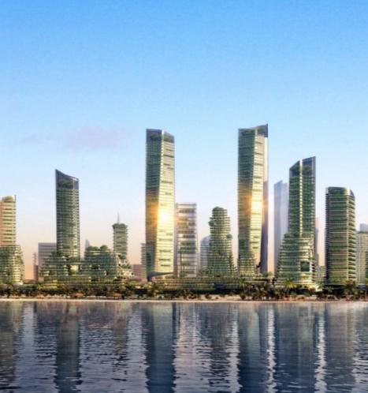
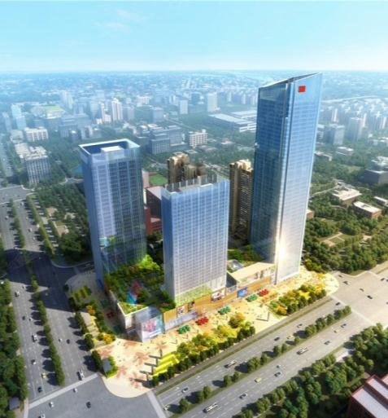
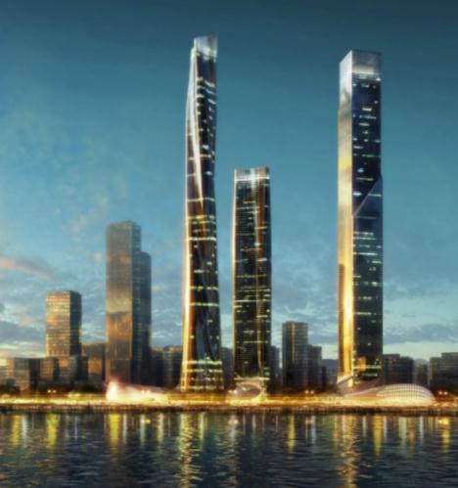
TITLE HERE
1
2
3
TITLE HERE
TITLE HERE
TITLE HERE
A complex idea can be conveyed with just a single still image, namely making it possible to absorb large amounts of data quickly.
A complex idea can be conveyed with just a single still image, namely making it possible to absorb large amounts of data quickly.
A complex idea can be conveyed with just a single still image, namely making it possible to absorb large amounts of data quickly.

Slide 15
TITLE HERE
STEP HERE
A complex idea can be conveyed with just a single still image, namely making it possible to absorb large amounts of data quickly.

Slide 16
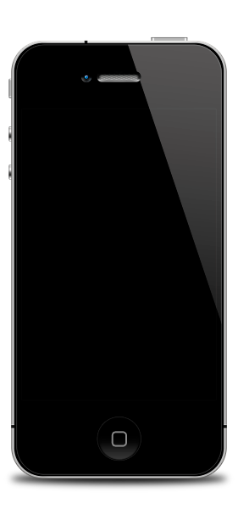

TITLE HERE
STAGE HERE
STAGE HERE
A complex idea can be conveyed with just a single still image, namely making it possible to absorb large amounts of data quickly. A complex idea can be conveyed with just a single still image, namely making it possible to absorb large amounts of data quickly.
A complex idea can be conveyed with just a single still image, namely making it possible to absorb large amounts of data quickly. A complex idea can be conveyed with just a single still image, namely making it possible to absorb large amounts of data quickly.
STAGE HERE
STAGE HERE
A complex idea can be conveyed with just a single still image, namely making it possible to absorb large amounts of data quickly.
A complex idea can be conveyed with just a single still image, namely making it possible to absorb large amounts of data quickly.

Slide 17
Text here...
03
Text here...
Text here...
AUTUMN
Text here...
Text here...

Slide 18

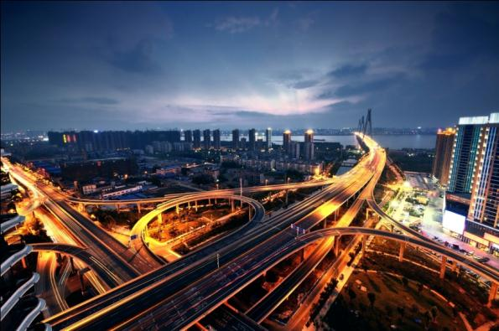

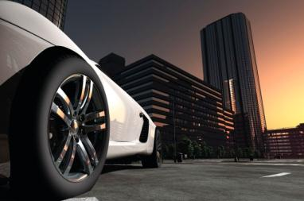

TITLE HERE
OPTION HERE
OPTION HERE
Go ahead and replace it with your own text.
OPTION HERE
Go ahead and replace it with your own text.
Go ahead and replace it with your own text.

Slide 19
TITLE HERE
TITLE HERE
TITLE HERE
We hope that this template will return to you as a time, money and reputation.
We hope that this template will return to you as a time, money and reputation.
TITLE HERE
TITLE HERE
We hope that this template will return to you as a time, money and reputation.
We hope that this template will return to you as a time, money and reputation.
TITLE HERE
TITLE HERE
We hope that this template will return to you as a time, money and reputation.
We hope that this template will return to you as a time, money and reputation.

Slide 20
TITLE HERE
01
02
03
04
05
STEP HERE
STEP HERE
STEP HERE
STEP HERE
STEP HERE
A complex idea can be conveyed with just a single still image, namely making it possible to absorb large amounts of data quickly.
A complex idea can be conveyed with just a single still image, namely making it possible to absorb large amounts of data quickly.
A complex idea can be conveyed with just a single still image, namely making it possible to absorb large amounts of data quickly.
A complex idea can be conveyed with just a single still image, namely making it possible to absorb large amounts of data quickly.
A complex idea can be conveyed with just a single still image, namely making it possible to absorb large amounts of data quickly.

Slide 21



TITLE HERE
01
02
03
STAGE HERE
STAGE HERE
STAGE HERE
A complex idea can be conveyed with just a single still image, namely making it possible to absorb large amounts of data quickly.
A complex idea can be conveyed with just a single still image, namely making it possible to absorb large amounts of data quickly.
A complex idea can be conveyed with just a single still image, namely making it possible to absorb large amounts of data quickly.

Slide 22




TITLE HERE
OPTION HERE
OPTION HERE
OPTION HERE
OPTION HERE
A complex idea can be conveyed with just a single still image, namely making it possible to absorb large amounts of data quickly.

Slide 23
Text here...
04
Text here...
Text here...
WINTER
Text here...
Text here...

Slide 24
TITLE HERE
TITLE HERE
TITLE HERE
A complex idea can be conveyed with just a single still image, namely making it possible to absorb large amounts of data quickly.
A complex idea can be conveyed with just a single still image, namely making it possible to absorb large amounts of data quickly.
TITLE HERE
TITLE HERE
A complex idea can be conveyed with just a single still image, namely making it possible to absorb large amounts of data quickly.
A complex idea can be conveyed with just a single still image, namely making it possible to absorb large amounts of data quickly.
TITLE HERE
TITLE HERE
A complex idea can be conveyed with just a single still image, namely making it possible to absorb large amounts of data quickly.
A complex idea can be conveyed with just a single still image, namely making it possible to absorb large amounts of data quickly.
55
70
85
40
60
80
A complex idea can be conveyed with just a single still image, namely making it possible to absorb large amounts of data quickly. A complex idea can be conveyed with just a single still image, namely making it possible to absorb large amounts of data quickly. A complex idea can be conveyed with just a single still image, namely making it possible to absorb large amounts of data quickly.

Slide 25
TITLE HERE
70%
STEP HERE
80%
70%
80%
A complex idea can be conveyed with just a single still image, namely making it possible to absorb large amounts of data quickly. A complex idea can be conveyed with just a single still image, namely making it possible to absorb large amounts of data quickly.
70%
90%
A complex idea can be conveyed with just a single still image, namely making it possible to absorb large amounts of data quickly. A complex idea can be conveyed with just a single still image, namely making it possible to absorb large amounts of data quickly.
50%
80%
DATA
DATA
DATA
DATA
DATA

Slide 26


TITLE HERE
01
STAGE HERE
A complex idea can be conveyed with just a single still image, namely making it possible to absorb large amounts of data quickly.
02
STAGE HERE
A complex idea can be conveyed with just a single still image, namely making it possible to absorb large amounts of data quickly.
03
STAGE HERE
A complex idea can be conveyed with just a single still image, namely making it possible to absorb large amounts of data quickly.
04
STAGE HERE
A complex idea can be conveyed with just a single still image, namely making it possible to absorb large amounts of data quickly.
05
STAGE HERE
A complex idea can be conveyed with just a single still image, namely making it possible to absorb large amounts of data quickly.
06
STAGE HERE
A complex idea can be conveyed with just a single still image, namely making it possible to absorb large amounts of data quickly.

Slide 27
TITLE HERE
OPTION HERE
OPTION HERE
A complex idea can be conveyed with just a single still image, namely making it possible to absorb large amounts of data quickly.
A complex idea can be conveyed with just a single still image, namely making it possible to absorb large amounts of data quickly.
01
02
OPTION HERE
OPTION HERE
A complex idea can be conveyed with just a single still image, namely making it possible to absorb large amounts of data quickly.
A complex idea can be conveyed with just a single still image, namely making it possible to absorb large amounts of data quickly.
03
04
27

Slide 28
TITLE HERE
201X
STAGE HERE
Go ahead and replace
it with your own text.
201X
STAGE HERE
Go ahead and replace
it with your own text.
201X
STAGE HERE
Go ahead and replace
it with your own text.
201X
STAGE HERE
Go ahead and replace
it with your own text.
201X
STAGE HERE
Go ahead and replace
it with your own text.

Slide 29
LOGO
THANK YOU!
Powered by Freepptbackgrounds.net

