Slide 1



Phonics: m as in map
Colour the boxes that have the letter m and practise making the sound.
a
m
t
p
m
m
n
m
i
d
© State of New South Wales (Department of Education), 2023. Except for the Department of Education logo, other logos and trademark-protected material, this resource is licensed under the Creative Commons Attribution 4.0 International Licence

Slide 2

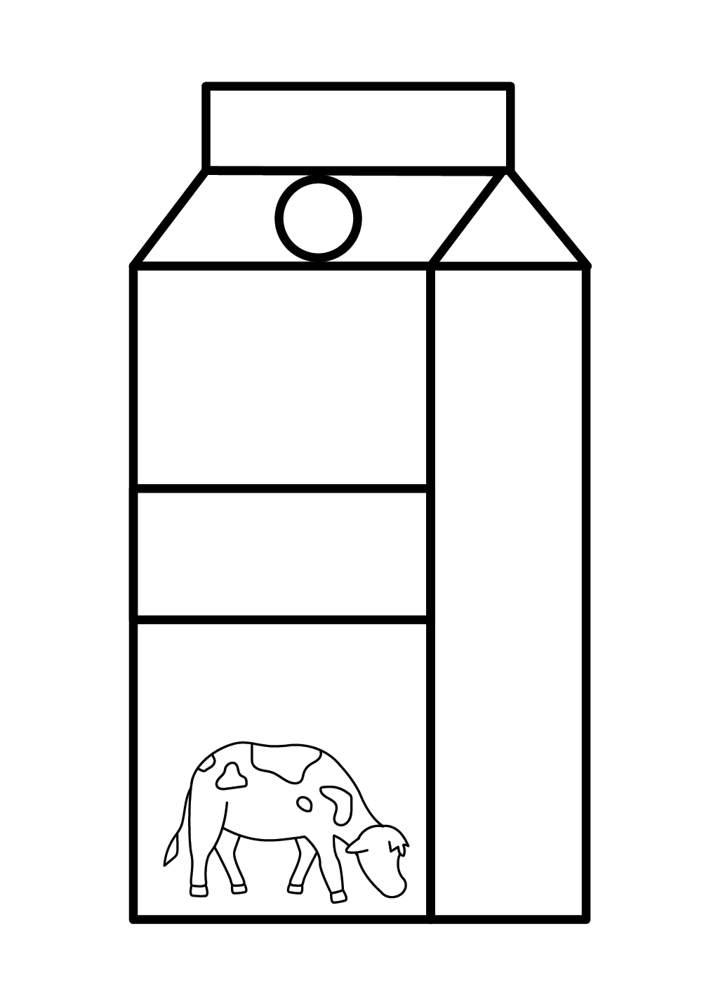


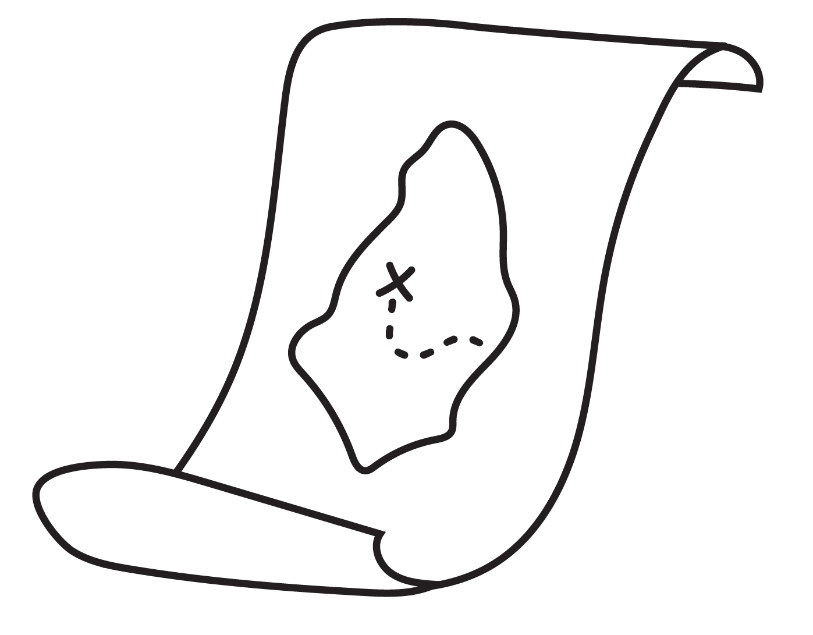
Phonics: m as in map
What sound does each object start with? Colour the letter that matches the sound.
Milk
a
m
s
t
d
m
p
m
i
m
s
n
© State of New South Wales (Department of Education), 2023. Except for the Department of Education logo, other logos and trademark-protected material, this resource is licensed under the Creative Commons Attribution 4.0 International Licence

Slide 3

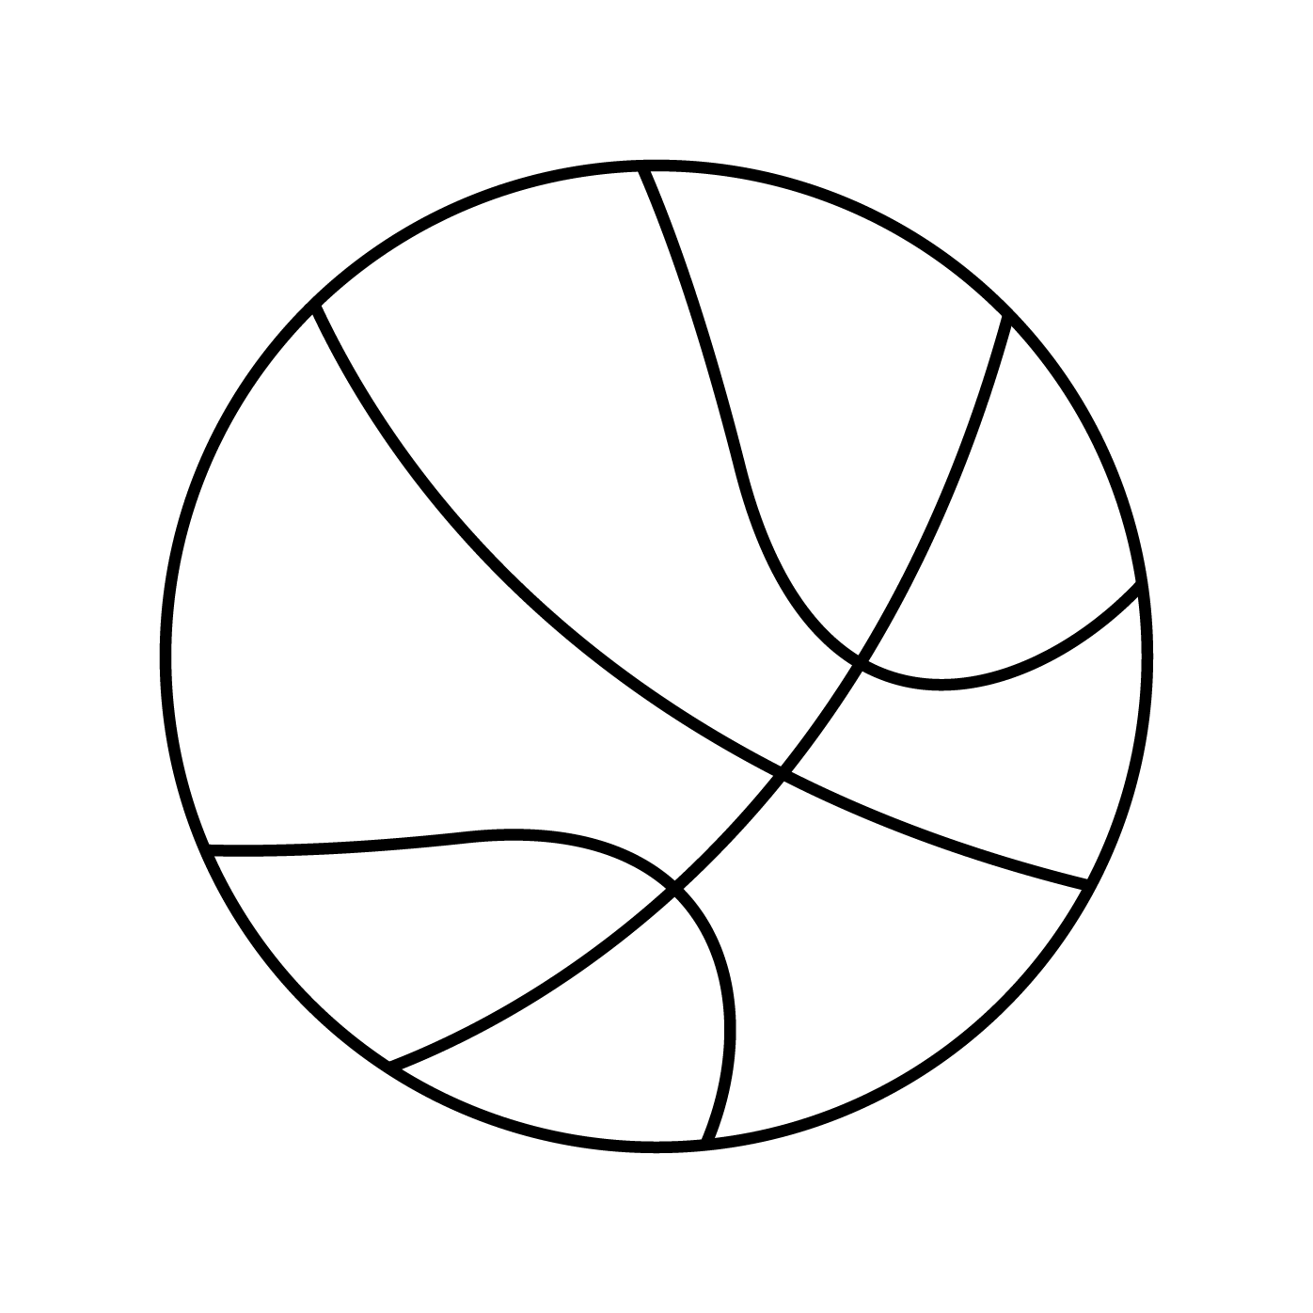


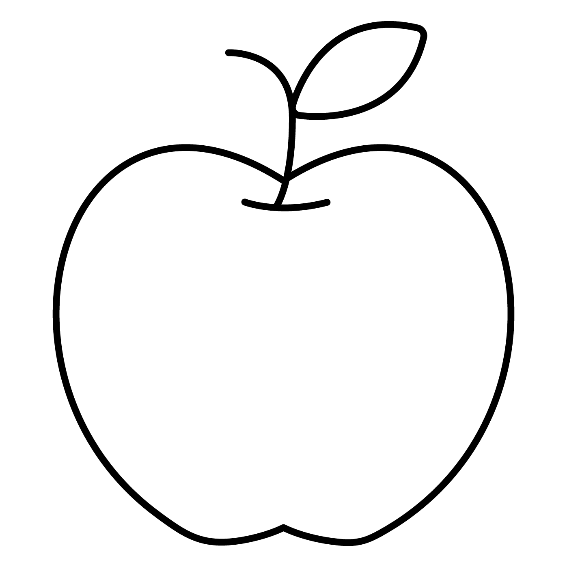



Phonics: m as in map
Colour the pictures that begin with the m sound.
m
Draw your own pictures that start with the m sound.
© State of New South Wales (Department of Education), 2023. Except for the Department of Education logo, other logos and trademark-protected material, this resource is licensed under the Creative Commons Attribution 4.0 International Licence

