Slide 1


Anchor Layer Teacher Guide
A curriculum companion for Anchor Layer users
Grade K
Weather Patterns
Unit Web Link • Pacing Guide • Other Units

Slide 2
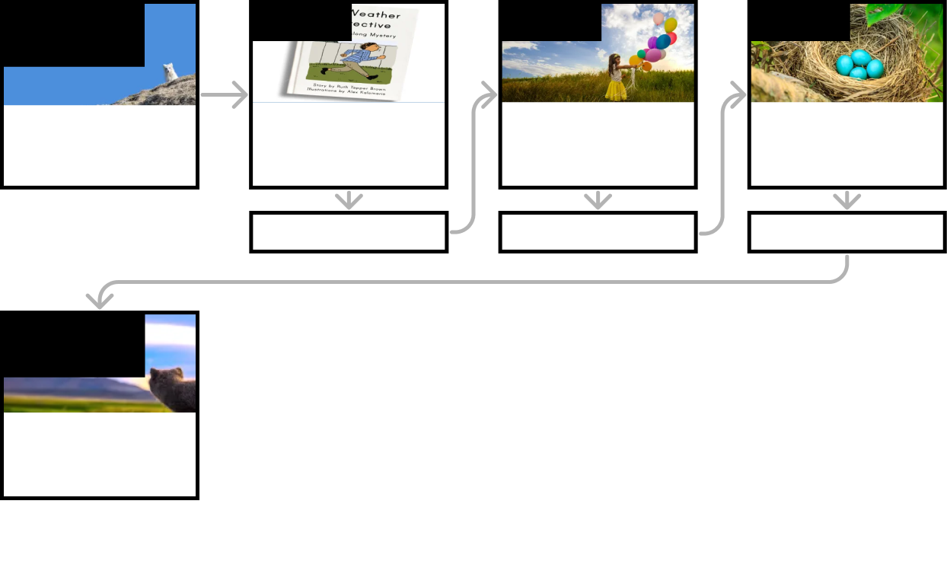
Weather Patterns • Grade K
Anchor Layer Teacher Guide
Unit Summary
In this unit, students gather evidence in order to identify daily and seasonal weather patterns. They use those patterns to explain mysteries like why you might lose your jacket during the day or why birds lay their eggs at certain times of the year.
Performance Expectations | Science & Engineering Practices | Disciplinary Core Ideas | Crosscutting Concepts
• K-ESS2-1. Use and share observations of local weather conditions to describe patterns over time. • K-ESS2-2. Construct an argument supported by evidence for how plants & animals (including humans) can change the environment to meet their needs. | • Obtaining, Evaluating, and Communicating Information • Asking Questions and Defining Problems • Analyzing and Interpreting Data • Engaging in Argument from Evidence • Developing and Using Models | • ESS2.E: Biogeology • ESS2.D: Weather and Climate | • Systems and System Models • Patterns • Structure and Function
Anchor Phenomenon
Lesson 1
Lesson 2
Lesson 3
Seasonal Weather Patterns
Furry Foxes
Daily Weather Patterns
How do you know what to wear for the weather?
Wind & Storms
What will the weather be like on your birthday?
Animals Changing Their Environment
Why do birds lay their eggs in the spring?
Anchor Connection
Anchor Connection
Anchor Connection
Performance Task
Seasonal Weather Patterns
What’s the weather like for the arctic foxes?
‹#›

Slide 3
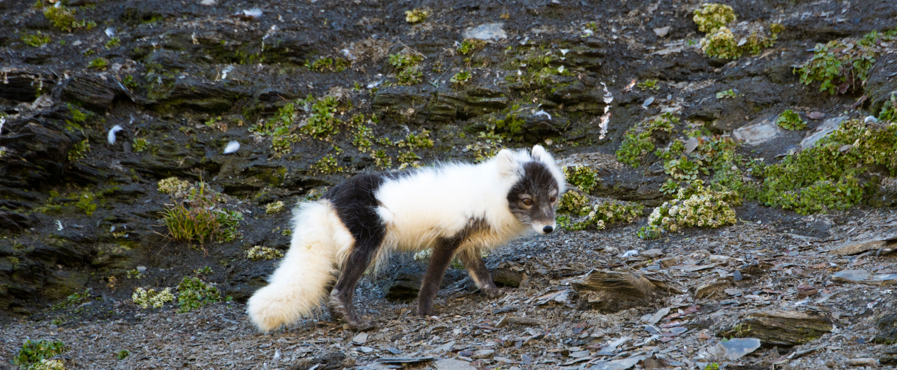
Weather Patterns • Grade K
Anchor Layer Teacher Guide
Anchor Phenomenon Background
Why do arctic foxes have fur that changes so much?
On most days, the temperature on Earth follows a predictable pattern. The temperature is coolest in
the morning just before sunrise and then warms throughout the day. When the Sun sets, the
temperature begins to drop again, and the pattern repeats during the following day. Animals do many
different things to handle these daily temperature changes, such as huddling with others when cold
or seeking shade when they are hot.
There are much longer seasonal weather patterns, too. Throughout all four seasons on Earth,
different animals respond to the different seasons in different ways.
Some animals exhibit behavioral changes, such as birds building nests and laying eggs in the spring
instead of the summer. Other animals physically change along with the changes in weather. Arctic
foxes are one example of this. Throughout the fall, they grow a long, thick coat, which helps insulate
them from the cold of winter. And throughout the spring, that coat slowly falls out, leaving them with a
much thinner coat that helps them moderate their body temperature during the summer.
There are other benefits to the white coat of winter, such as helping the fox to blend in with its
surroundings. However, this unit is focused primarily on weather, and therefore the content about the
arctic foxes is focused primarily on how their coat helps them to regulate their body temperature.
‹#›

Slide 4
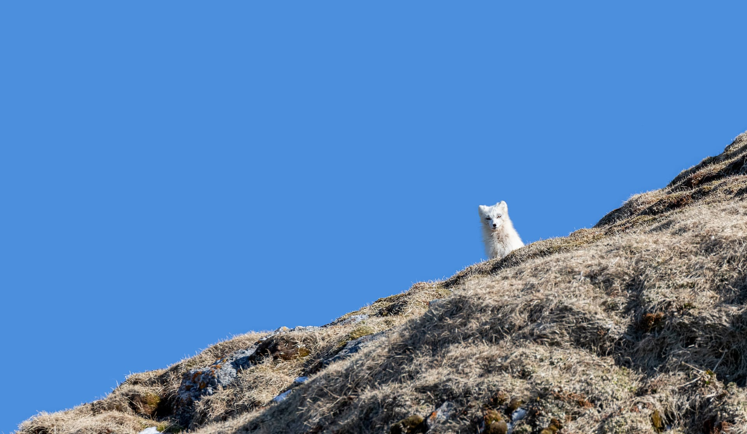
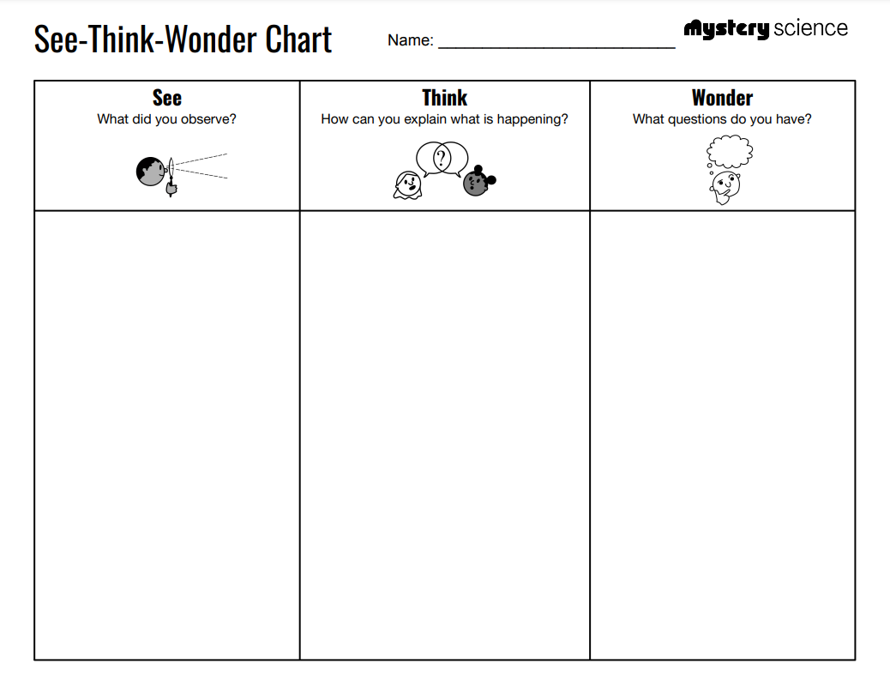
Weather Patterns • Grade K
Anchor Layer Teacher Guide
Anchor Phenomenon: Furry Foxes
Seasonal Weather Patterns
Anchor Phenomenon Lesson Overview
Note: This lesson is part of this unit’s Anchor Layer. If you have the Anchor Layer turned on, we recommend teaching all of the lessons in this unit in order.
The anchor phenomenon for this unit is the amazing cycle of changes an arctic fox's fur undergoes throughout the annual cycle of seasonal weather.
During the introduction, students generate observations and questions about the phenomenon and create a list of possible explanations for the phenomenon. Students will use these initial ideas to track how their understanding grows throughout the unit.
Anchor Phenomenon 15 mins
Guided Inquiry 20 mins
Student Work Samples & Notes
Students will gather clues during and after each lesson in this unit to help them improve their understanding and explanations. It is important to encourage students to recognize that even if they don't know the perfect answer yet, they are going to learn a lot throughout the unit and will have an opportunity to revisit the phenomenon over time.
The fox looks different colors
The fox is fluffy sometimes but not always
There is snow on the ground
There is grass on the ground
I think the arctic fox is changing colors
I think the weather is different
Why does the fox change colors?
Why is the fox puffy sometimes but not always?
Why is there snow on the ground?
‹#›

Slide 5


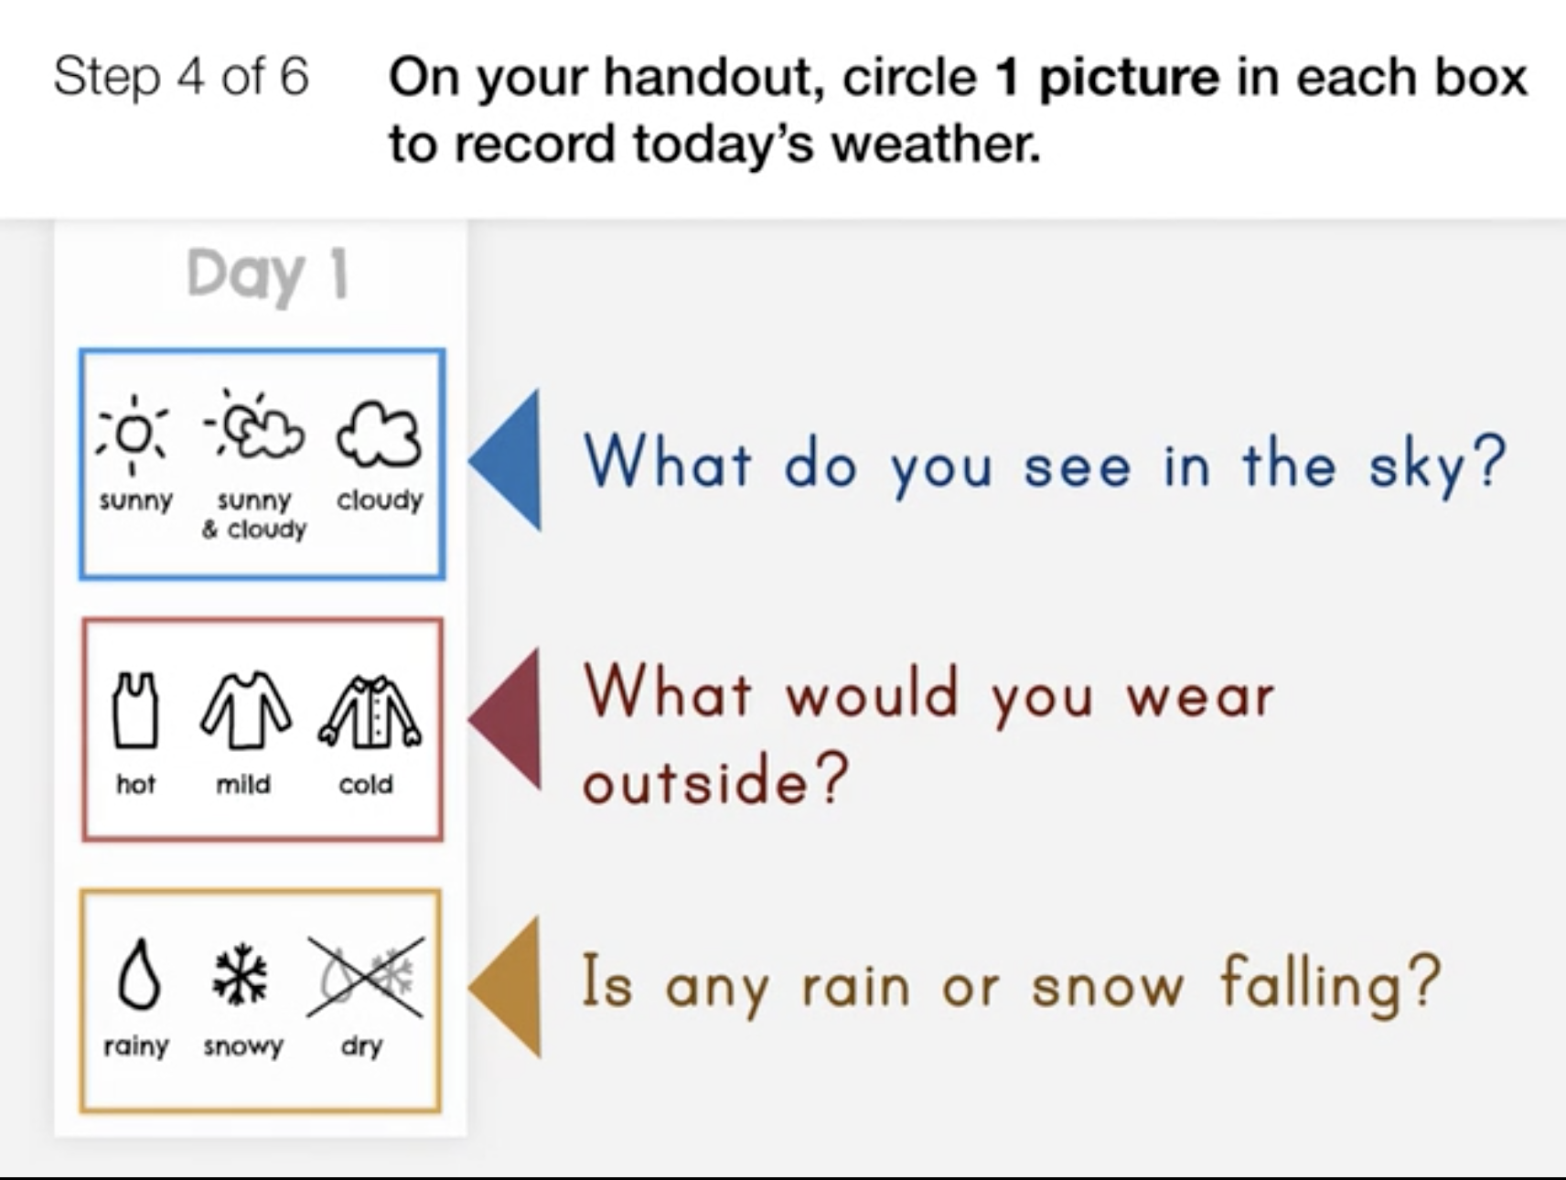
Weather Patterns • Grade K
Anchor Layer Teacher Guide
Lesson 1: How do you know what to wear for the weather?
Daily Weather Patterns (pg 1 of 2)
Overview
In this Read-Along lesson, students listen to an illustrated digital storybook with student participation. If you would prefer to read the book aloud yourself, you can switch to the non-narrated version. In the story, Kevin becomes a weather detective to figure out why he keeps losing his warm clothes.
In the activity, Weather Window, students track the weather over four days.
Anchor Connection on Next Page
Digital Book (W/Audio) 20 mins
Hands-On Activity 25 mins
Anchor Connection 15 mins
Assessment 20 mins
Activity Notes
Students will record the weather each day for four days using the Weather Window worksheet.
Think about:
What time of day do you want students to check the weather? Ideally, it should be about the same time each day.
How many days do you want students to check the weather? The worksheet has space to record weather for 4 days. If you want students to continue beyond 4 days, use the second page of the worksheet with blank day numbers that can be filled in.
‹#›

Slide 6
Weather Patterns • Grade K
Anchor Layer Teacher Guide
Lesson 1: How do you know what to wear for the weather?
Daily Weather Patterns (pg 2 of 2)
Anchor Connection
In this lesson, students gathered observations of the relationship between the clothes that people choose to wear and the temperature of the weather. In colder weather, people wear more puffy clothing. The arctic fox doesn’t wear clothes, but it does have a fur coat that is more puffy when the weather is cold.
Students revisit the See-Think-Wonder chart that they worked on during the Anchor Phenomenon. They should understand the foxes have more puffy fur when the weather is cold, and less puffy fur when the weather is hot. This is similar to how people change their clothes in different weather.
Connecting Storyline Question
How do the foxes know what the weather will be like each year?
Digital Book (W/Audio) 20 mins
Hands-On Activity 25 mins
Anchor Connection 15 mins
Assessment 20 mins
‹#›

Slide 7

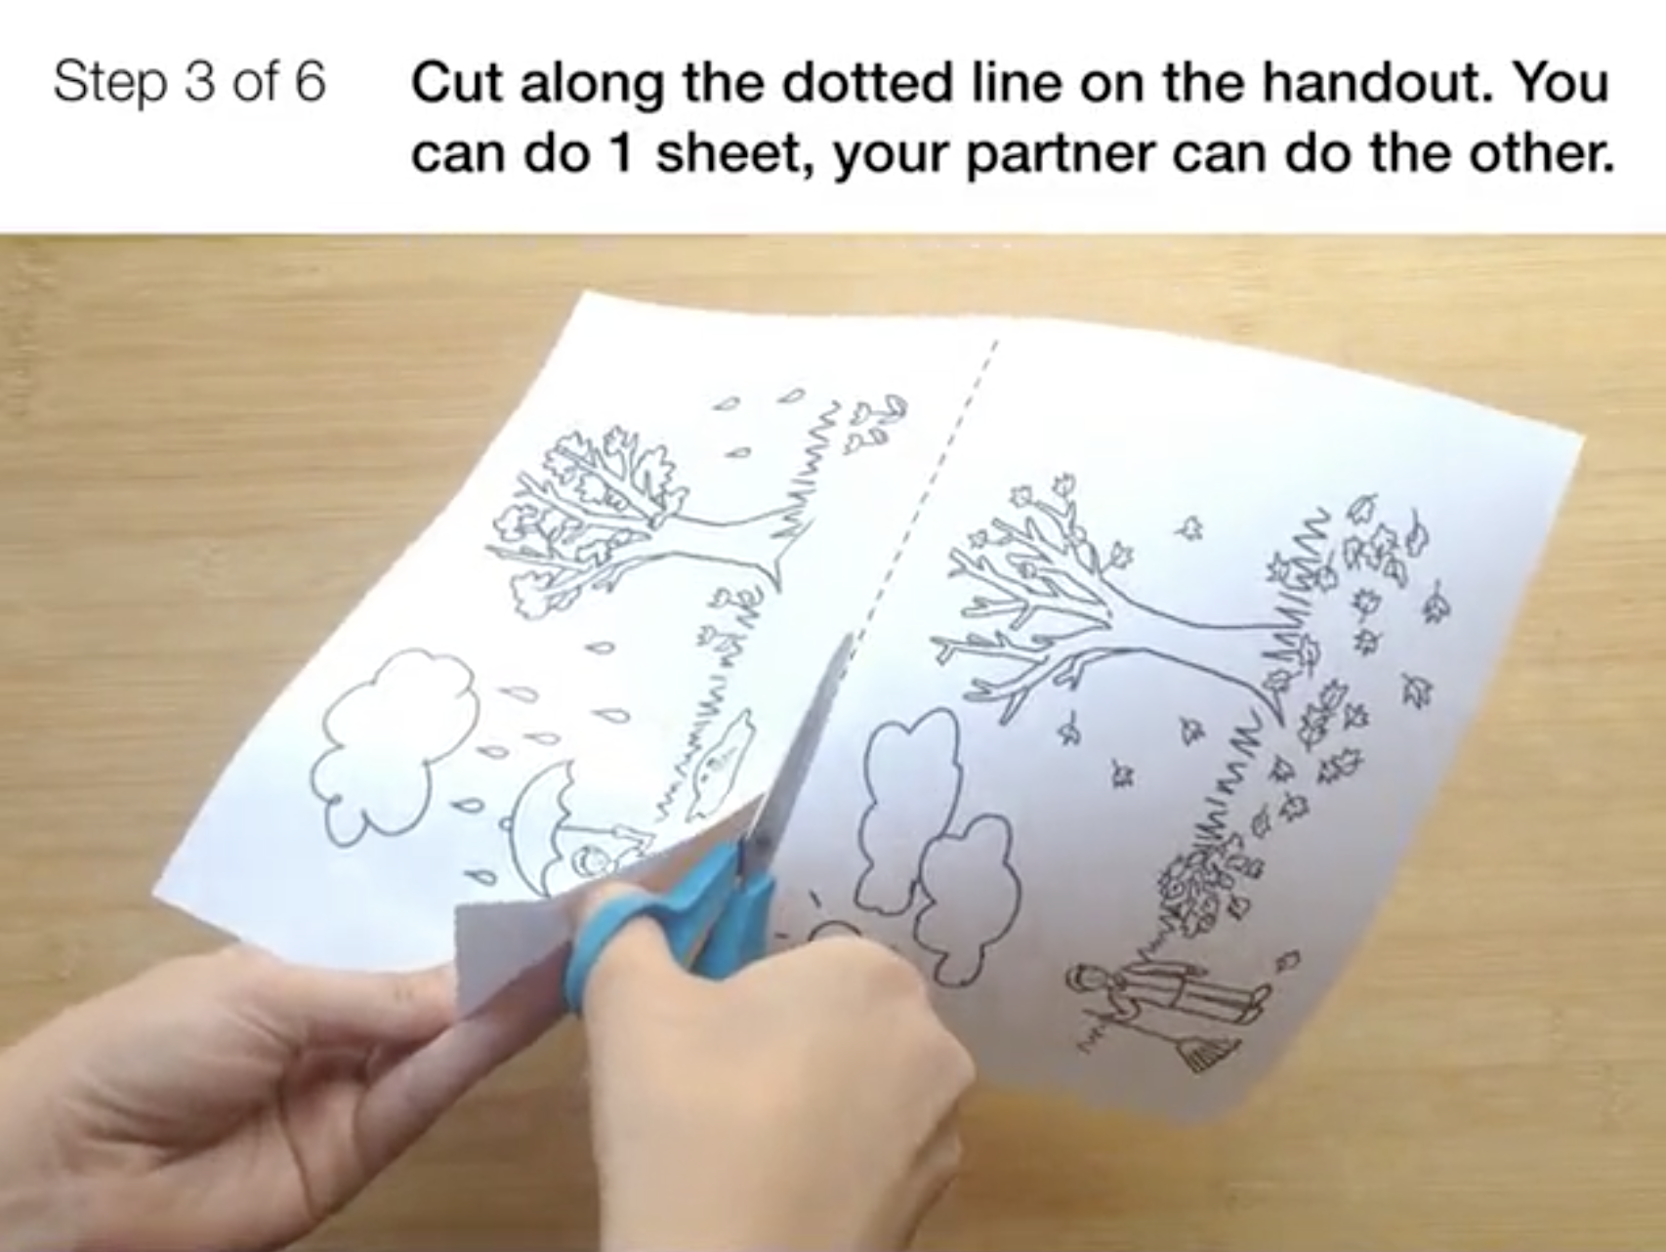
Weather Patterns • Grade K
Anchor Layer Teacher Guide
Lesson 2: What will the weather be like on your birthday?
Seasonal Weather Patterns (pg 1 of 2)
Overview
In this lesson, students use observations of the four classic seasons to spot patterns and thereby determine the seasons’ order.
In the activity, Circle of Seasons, students make observations of the four classic seasons of the temperate zone: snowy winter, warm spring, hot summer, and cool autumn with colorful leaves. Students spot patterns and determine the order of the seasons.
Anchor Connection on Next Page
Exploration 5 mins
Hands-On Activity 30 mins
Wrap-Up 5 mins
Anchor Connection 15 mins
Assessment 20 mins
Activity Notes
We suggest students work in pairs. If you live somewhere that doesn't experience four seasons, we strongly recommend extending this lesson and discussing the seasonal changes where you live. You can print out a blank “Circle of Seasons” chart and fill this out with your students so that it matches the seasonal weather patterns where you live.
‹#›

Slide 8
Weather Patterns • Grade K
Anchor Layer Teacher Guide
Lesson 2: What will the weather be like on your birthday?
Seasonal Weather Patterns (pg 2 of 2)
Anchor Connection
In this lesson, students created a model of the seasonal changes in weather that take place over the course of a year. By looking at the ground in the pictures of the arctic foxes, we can find clues about how the weather changes over the seasons in the places where the arctic foxes live.
Students revisit the See-Think-Wonder chart that they worked on during the Anchor Phenomenon. They should understand that foxes have fur that changes between seasons. The puffy fur falls out each spring, and it grows back each fall.
Connecting Storyline Question
Why do the foxes change in the same way every year?
Exploration 5 mins
Hands-On Activity 30 mins
Wrap-Up 5 mins
Anchor Connection 15 mins
Assessment 20 mins
‹#›

Slide 9
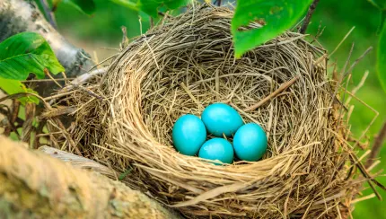
Weather Patterns • Grade K
Anchor Layer Teacher Guide
Lesson 3: Why do birds lay eggs in the spring?
Animals Changing Their Environment
Overview
In this lesson, students learn why spring is the best time for babies to be born.
In the activity, Build A Bird Nest, students make a model of a bird nest and notice how birds can change their environment to meet their needs when they build their nests.
Anchor Connection
In this lesson, students observed how animals do different things to adjust to different temperatures at different times of year. Arctic foxes also do different things at different times of year: they grow and shed their coat as
temperatures get colder or warmer.
Students revisit the See-Think-Wonder chart that they worked on during the Anchor Phenomenon. They should understand that the seasons change in a predictable pattern every year. This is why the fox’s fur changes in a predictable pattern, too.
Connecting Storyline Question
Which kind of weather do the foxes have the most?
Exploration 10 mins
Hands-On Activity 30 mins
Anchor Connection 15 mins
Assessment 20 mins
Activity Notes
We suggest students work in pairs. We also suggest encouraging students to modify the materials you provide -- tearing and crumpling them to make them fit in their nest. That’s what birds do, after all!
‹#›

Slide 10
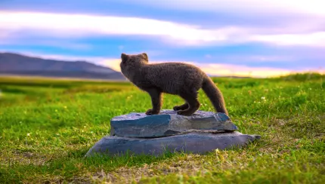
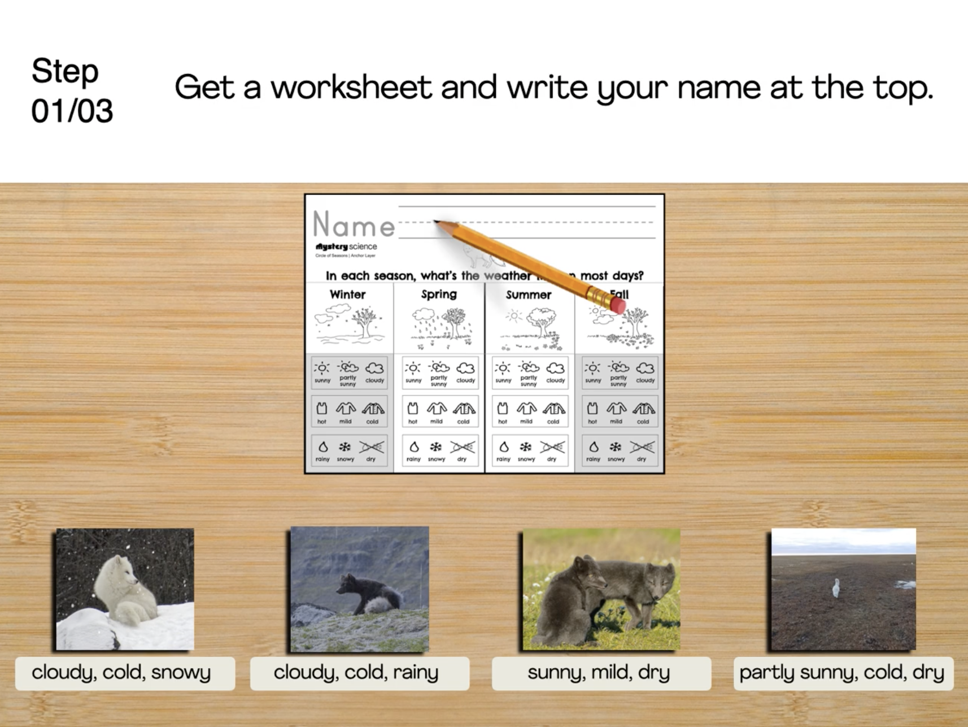
Weather Patterns • Grade K
Anchor Layer Teacher Guide
Performance Task: What’s the weather like for the arctic foxes?
Seasonal Weather Patterns
Overview
In this performance task, students use observations of weather conditions in the areas where arctic foxes live to identify patterns over time.
After a brief review of the unit, students observe and describe different kinds of weather that the foxes experience. Then, they analyze data about the weather to identify seasonal patterns.
Unit Review 15 mins
Hands-On Activity 30 mins
Performance Task Notes
Students can work as a class, in small groups, or individually. Each student will need one copy of the What's the weather? Worksheet.
With your students, begin the lesson. It begins with a brief unit review. Then, move through the activity. The activity includes a step-by-step guide and discussion questions throughout.
Crosscutting Concepts
Patterns: All living things are affected by the weather in the places where they live. The weather changes in short and long-term patterns, and animals respond by exhibiting short and long-term patterns of their own. Over the course of a single day, animals might huddle together at night for warmth, while seeking shade during the heat of the day. Patterns such as this one repeat on a daily basis. On the other hand, long-term seasonal changes can affect when animals lay eggs or how their feathers or fur shed and are grown again and again, each year.
‹#›

