Slide 1
Education is a Public Health Problem: How Behavior Analysis Can Help
Ronnie Detrich
Wing Institute
Southeastern Association for Behavior Analysis, 2017

Slide 2
Goals for Today
Describe long term impact of education.
Discuss relevance of public health model of prevention to education.
Consider how behavior analysis can contribute to educational outcomes.

Slide 3

Notes:
I graduated from high school in 1965. It was the dawning of the age of aquarius.

Slide 4
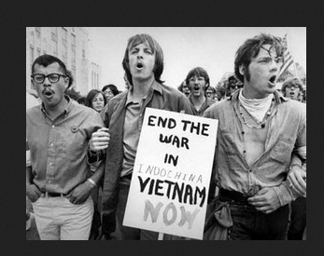
We failed
Notes:
Many in my generation thought we would end war.

Slide 5
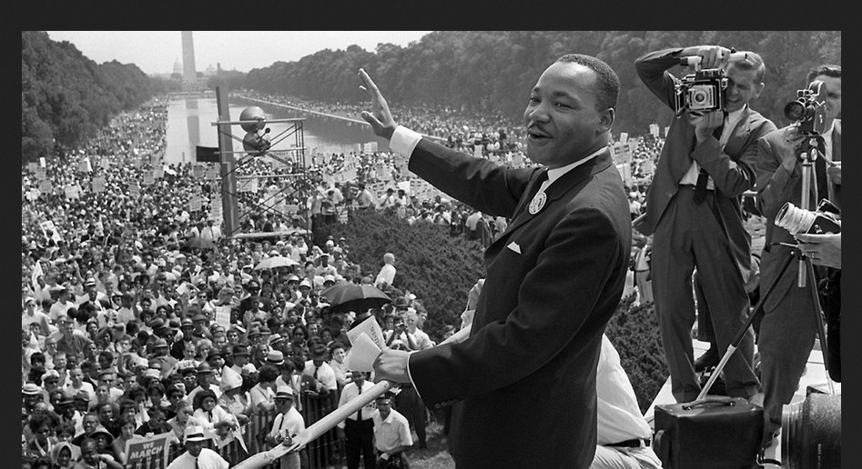
We didn’t
Notes:
End racism.

Slide 6
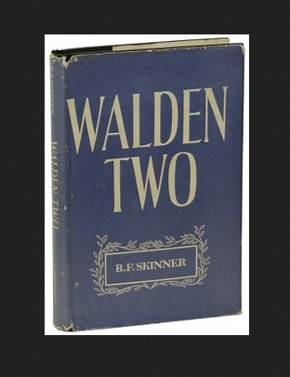
Notes:
As part of achieving peace, love, and understanding many of us were reading utopian literature.
I was fortunate enough to come across Walden 2 and a new way of thinking about communities

Slide 7
Better Living through Behaviorism
Notes:
No movement can survive without a rallying cry. Better living through behaviorism became a cause and a movement for a few of us. And it fits nicely on a bumper sticker.

Slide 8
Applied Behavior Analysis as Agent for Change
“applied research is constrained to examining behaviors which are socially important, rather than convenient for study. It also implies, very frequently, the study of those behaviors is in their usual social settings, rather than in a "laboratory" setting.”
Baer, Wolf, and Risley (1968)
Notes:
In 1968 BWR gave us a framework for defining our work.

Slide 9
Education as a Context for Improving Individual Lives and Society
Notes:
My own career trajectory was such that I kept ending up working in school settings. Let’s consider educational settings as a socially important setting.

Slide 10
Public Schools as Socially Important Setting
Approximately 50 million students
About 6 million in special education
How many are instructional casualties?
3 million teachers
Many are under prepared.
Notes:
A high quality education impacts an entire generation. That is by definition socially important. Ultimately, the entire society has a stake in the quality of public education

Slide 11
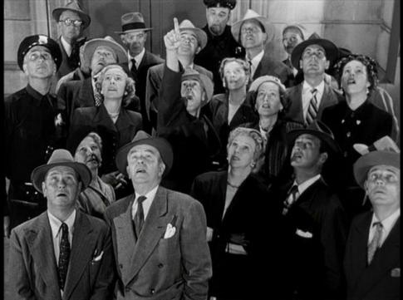
October 1957
USSR launched Sputnik.
U. S. Education quickly blamed.
Modern reform efforts began.
Notes:
The launch of Sputnik was the beginning of the modern school reform efforts and has continued unabated for 60 years.

Slide 12
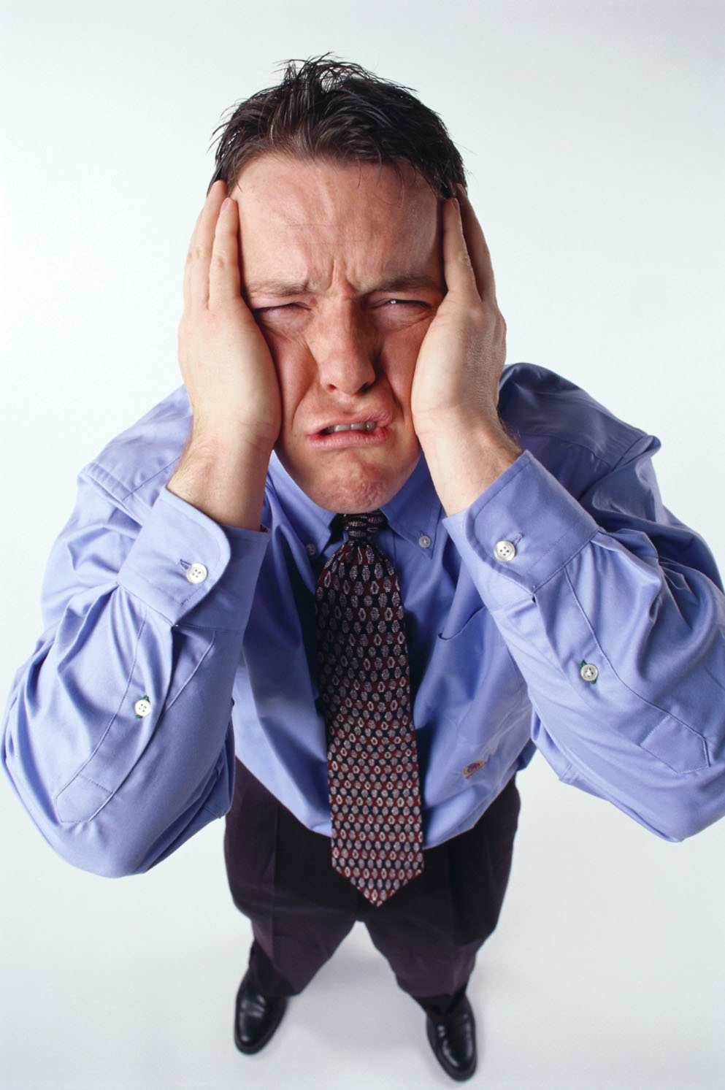
1983 A Nation at Risk
American students not performing well.
Education quickly blamed.
The Nations Report Card created.

Slide 13

1994 Goals 2000
All students will start school ready to learn.
High school graduation rate ≥ 90%.
All students in grades 4, 8, & 12 will demonstrate competency in challenging subjects.
Notes:
Specified goals to be achieved by 2000.
We didn’t accomplish them.

Slide 14
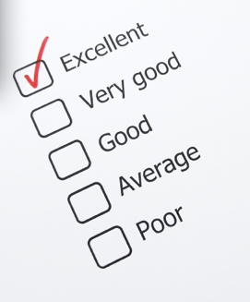
2001 No Child Left Behind
By 2014 every student will be at grade level.
Instructional methods will be scientifically based.
Educators will be held accountable for outcomes.
Notes:
All of these reform efforts established goals but did not provide mechanisms for achieving them.
Lets look at what we have achieved through all of these reform efforts.

Slide 15
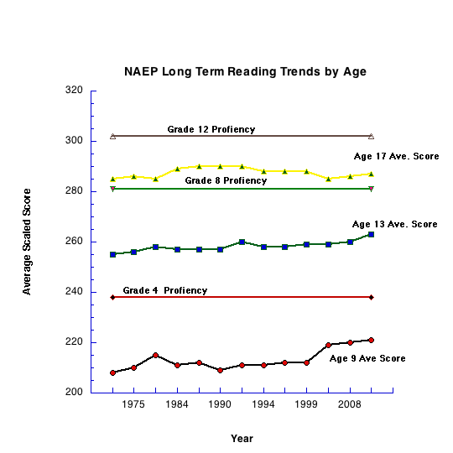
1983
A Nation
at Risk
1994
Goals 2000
2001
No Child
Left Behind

Slide 16
Consider This
Probability of remaining an average reader in 4th grade when an average reader in 1st grade=.87.
Probability of remaining a poor reader at the end of 4th grade when a poor reader at the end of 1st grade=.88.
If not a competent reader by 4th grade chance of catching up is .06.
Juell, 1988
Notes:
It is clear that we need effective reading instruction from the beginning of a child’s educational career.

Slide 17
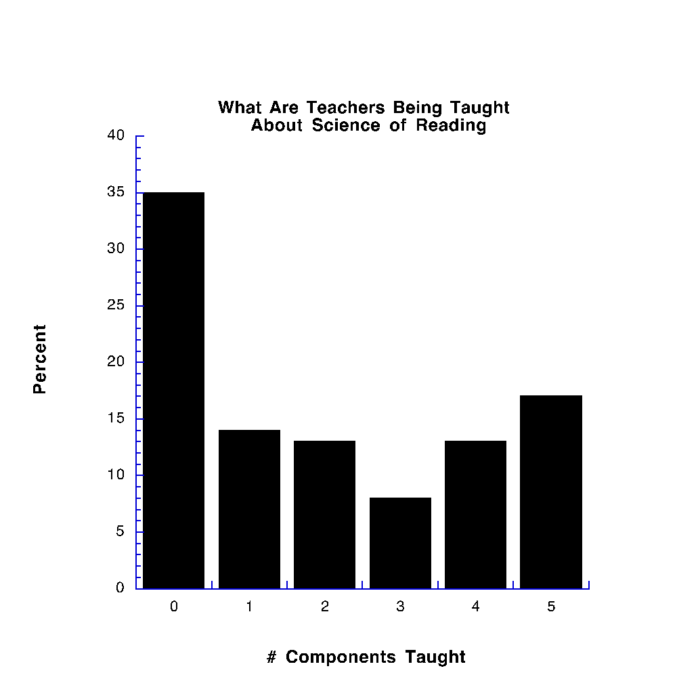
50% of Teacher Prep programs taught no more than one component of scientifically based reading
Walsh, Glaser, & Wilcox, 2006
Notes:
Phonemic awareness
Fluency
Comprehension
Vocabulary
Alphabetic principle

Slide 18
Consequences of Educational Attainment

Slide 19
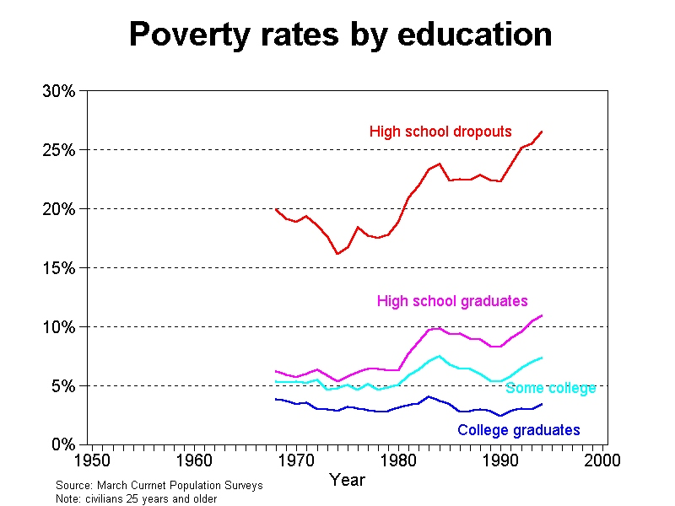
University of Maryland, Department of Sociology
Notes:
Biglan Nuture Effect documented the pervasive impact of poverty
High school diploma cuts poverty rate in half. Graduating from college cut poverty rate compared to graduating from HS by2/3. These are not trivial effects.

Slide 20
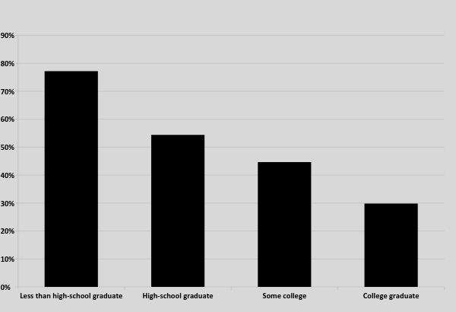
Percent of Adults, Ages 25-74 Years, in Less Than Very Good Health
REACHING AMERICA'S HEALTH POTENTIAL: A STATE-BY-STATE LOOK AT ADULT HEALTH Commission to Build a Healthier America May 2009 U.S. Census Data: American Community Survey (2007) U.S. Census Data: Behavioral Risk Factor Surveillance System Survey Data (2005-2007)

Slide 21
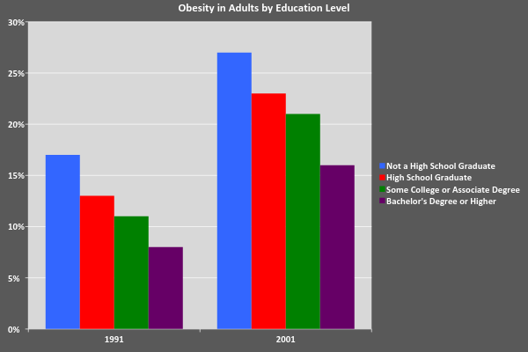
SOURCE:
Department of Health and Human Services (2003)

Slide 22
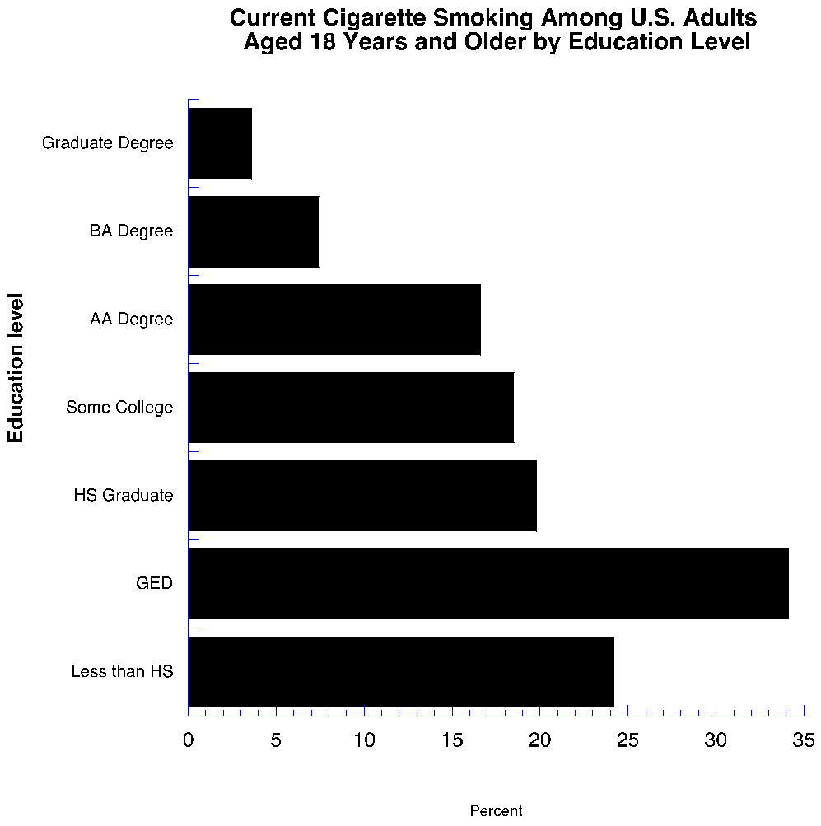

Slide 23
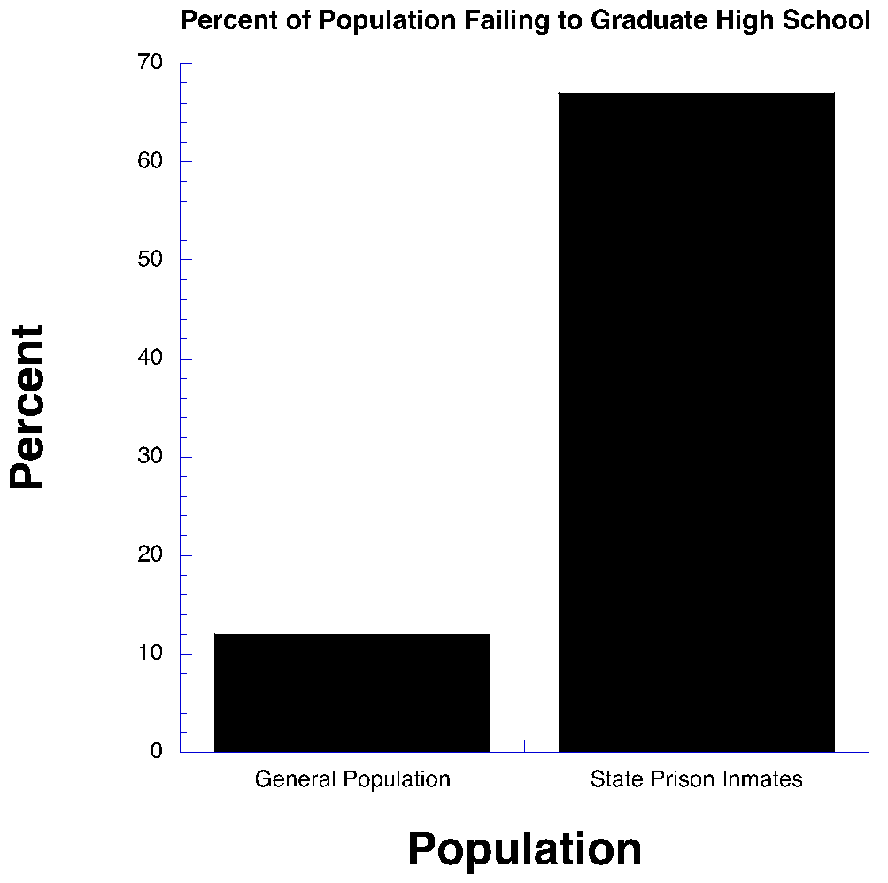
Notes:
Education a powerful crime reduction strategy

Slide 24
Education is the civil rights issue of our generation.
Arne Duncan Secretary of Education 2009

Slide 25
Education as a Public Health Issue
Notes:
Education clearly related to a wide variety of social ills
Education is an alterable variable.
It may be productive to consider education in the frameworks of the public health model of prevention.

Slide 26
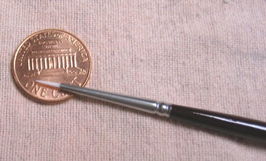



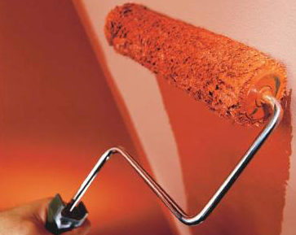

A Prevention Model for Education
Academic Systems
Behavioral Systems
Intensive, Individual Interventions
Individual Students
Assessment-based
High Intensity
Intensive, Individual Interventions
Individual Students
Assessment-based
Intense, durable procedures
1-5%
1-5%
Targeted Group Interventions
Some students (at-risk)
High efficiency
Rapid response
5-10%
5-10%
Targeted Group Interventions
Some students (at-risk)
High efficiency
Rapid response
Universal Interventions
All students
Preventive, proactive
80-90%
80-90%
Universal Interventions
All settings, all students
Preventive, proactive
Notes:
The core of these frameworks is a multi-tiered model of prevention. These frameworks have been productively applied to education by colleagues working in SWPBIS and RtI.

Slide 27
Where Do Behavior Analysts Allocate Their Time?
Notes:
K-12 classroom
Usual setting for student
Implemented by existing school resources
These choices were made because they represent the real test of the usability of our interventions

Slide 28
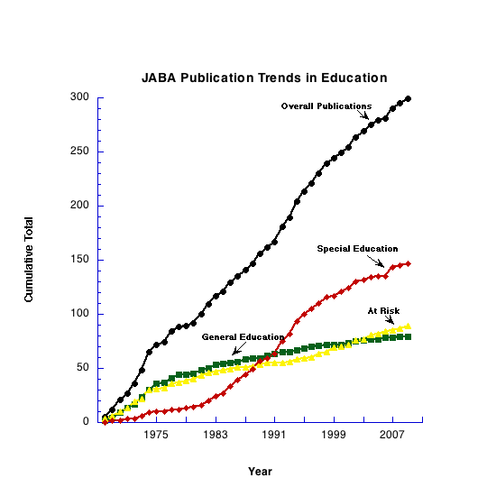
Notes:
Overall= 7/year
SPED= 3/year
At risk= 1.5/year
Gen Ed=1.5/year

Slide 29
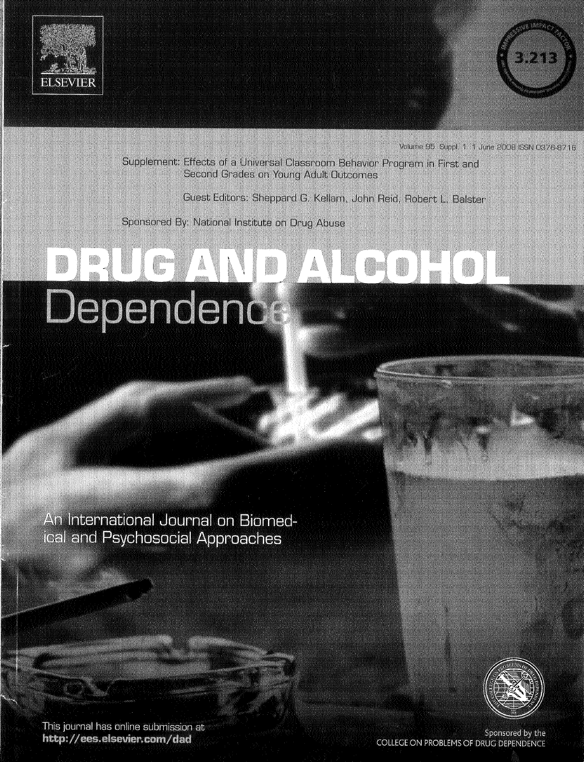
Notes:
Dennis Embry suggests GBG could be behavioral vaccine

Slide 30
Good Behavior Game as Universal Prevention
Series of effectiveness studies by Kellam et al. examining it as a prevention program:
Special issue of Drug and Alcohol Dependence (2008)
If exposed to GBG in 1st and 2nd grade then reduced risk for young adults of:
drug/alcohol abuse
smoking
anti-social personality disorder
subsequent use of school-based services
suicidal ideation and attempts
All studies were RCTs.

Slide 31
Good Behavior Game
First study: fourth grade classroom
(Barrish, Saunders, Wolf, 1969)
Subsequent replications across:
Settings (The Sudan, library, sheltered workshop)
Students (general education, special education, 2nd grade, 5th grade, 6th grade, adults with developmental disabilities)
Behaviors (on-task, off-task, disruptive, work productivity)
All studies were single subject designs.

Slide 32
What Can We Do to Make a Difference?
We have developed powerful instructional and behavior improvement methods.
These methods have not been widely adopted.
How do we get science of behavior into the classroom?
Notes:
Behavior analysis in education has long been a boutique enterprise.
The goal is to take it scales of social importance.

Slide 33
Some Recommendations
Re-think dissemination.

Slide 34
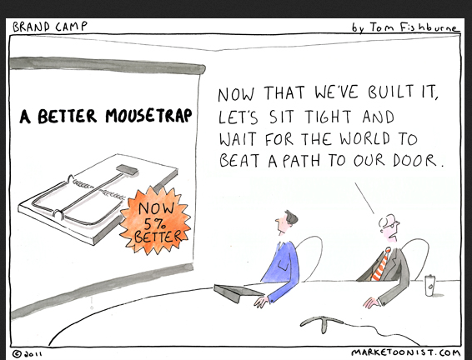
Re-thinking Dissemination
Notes:
We built a better mousetrap and the world didn’t beat a path to our door. After 50 years, perhaps it is time to try another way-active dissemination and focus on those skills related to solving wicked problems. Behavior analysis is a wonderful technology for changing behavior but we need to improve our methods of social influence.

Slide 35
Common Practice
“However, it is at least a fair presumption that behavioral applications, when effective, can sometimes lead to social approval and adoption.”
Baer, Wolf, & Risley, 1968
Passive
Not Often Enough

Slide 36
A Better Mousetrap in Not Enough:
Scurvy in the British Royal Navy
John Lind again experimentally demonstrated the effectiveness of citrus in preventing scurvy.
James Lancaster first experiment demonstrating how to prevent scurvy.
British Navy adopted policy to have citrus on all ships in the Royal Navy.
1601
1747
1795
Notes:
Even simple solutions can take a long time to be adopted if they don’t fit the prevailing values and norms of the receiving system.

Slide 37

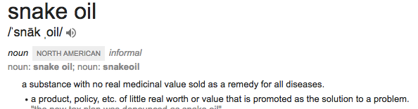

Notes:
No evidence of effectiveness-some evidence of harm. For years the most adopted drug education program.
Average expenditures on DARE-%1.3 Billion in 2014
How did it get so widely disseminated first without evidence and then evidence suggesting it was ineffective? We should study the dissemination process to understand.

Slide 38
Re-thinking Dissemination
Purpose of dissemination: change behavior of an individual or a group.
Dissemination is often described topographically.
Activity without accomplishment
Functional perspective: dissemination requires a program or practice actually be adopted.

Slide 39
Dissemination as an Influence Strategy
Speaker-listener relation.
Listener shapes speaker behavior.
Effective speaking influences behavior of listener.
Dissemination is about audience variables.
Effective speaker knows the audience.

Slide 40
Re-thinking Dissemination: Behavior Analyst as Cultural Anthropologist
Effective dissemination requires understanding the targeted audience.
Schools are a specific culture with their own values and norms.
School decision-makers do not typically read primary research literature.
What influences decisions?
Notes:
Decisions are choices-we know something about choice

Slide 41
Adoption as Choice
“It has been said that man is a rational animal. All my life I have been searching for evidence which could support this.” Bertrand Russell
Notes:
We often act as if choosing is rational in spite of decades of evidence to the contrary.
The organism is always right. “I taught them but they didn’t learn.”

Slide 42
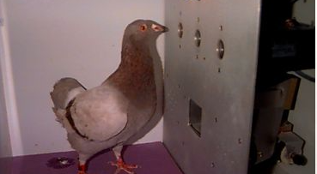
Choice in a Chamber
Notes:
We know a lot about choosing under these conditions. Allocation of responding matches rate of reinforcement. Most of the important variables are controlled and known.
Even so we rarely get perfect matching. Position bias can influence response allocation.
In equation describing generalized matching law-variable to account for bias R₀

Slide 43

Choice in the Wild
Reading
Mastery
F & P
Guided Reading
Rewards
Language!
Soar to Success
What variables influence choice?
Is it all R_{o}?
Notes:
We know far less about choosing under these conditions.
We know very little about variables that influence choices in the wild.
Variables such as history and bias are unknown.
Effectiveness data are only one of many variables to influence choice and not among the most important for most school administrators.

Slide 44


Slide 45
Diffusion of Innovation Rogers, Diffusion of Innovation, 2003
Diffusion of innovation is a social process, even more than a technical matter.
The adoption rate of innovation is a function of its compatibility with the values, beliefs, and past experiences of the individuals in the social system.

Slide 46
Principles for Effective Diffusion: Improving the Odds (Rogers, 2003)
Innovation has to solve a problem that is important for the “client.”
Innovation must have relative advantage over current practice.
It is necessary to gain support of the opinion leaders if adoption is to reach critical mass and become self-sustaining.
Innovation must be compatible with existing values, experiences and needs of the community.
Notes:
Behavior analysis is the science of social influence. We behavior analysts often sell the science rather than solutions. We are enamored by the science and want to spread the word. The educator is motivated by aversive stimulation from problems-we should be promoting solutions that provide relief. The motivating variables for the behavior analyst and the educator are very different. The one that is important is the person we are trying to influence.
Sounds like matching.
To influence a culture we must be seen as credible. Often the researcher or outside consultant does not have credibility. Someone in the system can more effectively promote or discourage adoption of a particular practice.

Slide 47
Lessons Learned in the Wild
Data are rarely sufficient to influence decisions.
It can be argued that Catherine Maurice had a great impact on dissemination of ABA than all of the published studies.
Powerful, emotional story told by parent to an audience of parents.

Slide 48
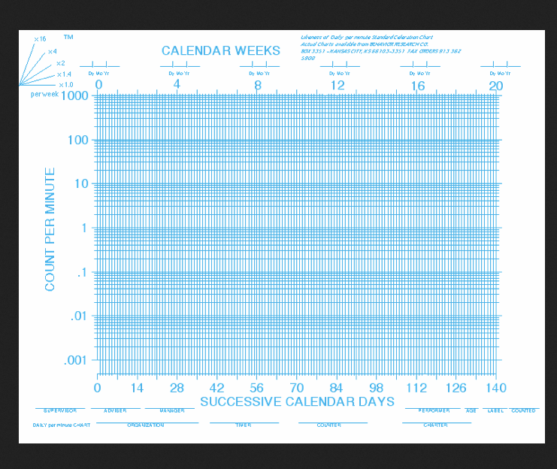
This may distract from the story you are trying to tell. Consider the audience.
Notes:
This is an elegant and precise way to display data but one must be able to read this charts. When presenting to school administrator/policy makers who are pressed for time-looking at data in this way increases the response effort for the administrator and makes them less interested in listening to me. In SD, I ran an educational and residential program for children with autism. We charted everything on SCC. Presenting to one family, I spent 30 minutes going over their child’s progress. At the end, the Dad asked-is my son getting better.

Slide 49
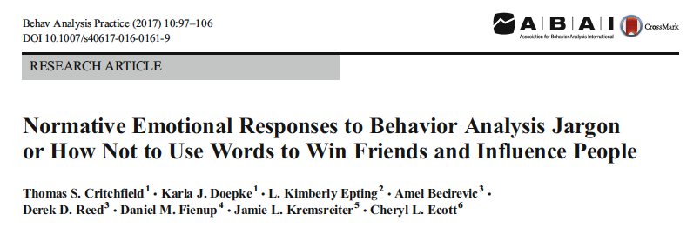
Words Matter: Behavioral Jargon
May Impede Dissemination
1:15 Ratio strongly positive: strongly negative
60% Behavior analytic terms rated unpleasant
28% Rated as strongly motivating
Taken together suggest motivated to avoid
Notes:
Ratio strongly positive to strongly negative 1:15
60% of words rated unpleasant
28% rated as strongly motivating
Taken together with unpleasant rating may suggest motivated to avoid.

Slide 50
Transforming Language
Positive reinforcement = Praise
Praise = Acknowledgment
Acknowledgment = Positive Reinforcement
Question is: Will recommending “acknowledgment” result in more reinforcement for students than recommending “positive reinforcement?”

Slide 51
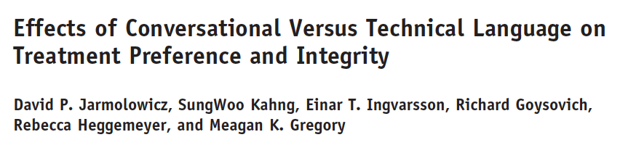
Notes:
Assessed direct care staff understanding of plan and quality of implementation as function of language used.
Conversational language increased understanding

Slide 52
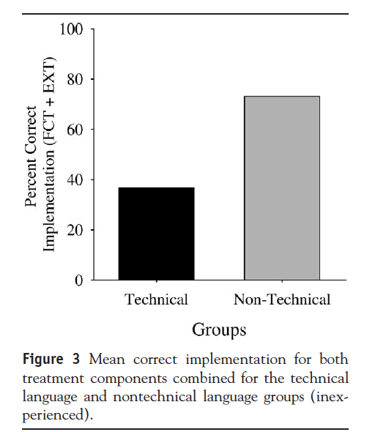
Notes:
Just about doubled the integrity of implementation. Increasing the probability students receive benefit from intervention.

Slide 53

Notes:
If you saw this one evening what would you call it? Sunset is the most common answer but not technically correct. I doubt that astrophysicist take exception.

Slide 54
Changing the Trend: Words Matter
Dominant Paradigm
Behavioral Education
Child Centered
Educate the whole child
Discovery learning
The art of teaching
Teacher directed
Build skill repertoires
“Drill and Kill”
Technology of teaching
Notes:
Must attend to audience variables

Slide 55
Some Recommendations
Re-think dissemination
Manualize interventions.
Public school administrators are interested in packages rather than principles.
Behavior analysis built into package.
With 3 million teachers as audience packages more efficient.
Consistent with technological dimension of applied behavior analysis (Baer, Wolfe, & Risley, 1968).
Notes:
Public school administrators are interested in packages not principles.
We can’t train 3 million teachers to be behavior analysts but we can teach them to implement a manualized program.

Slide 56
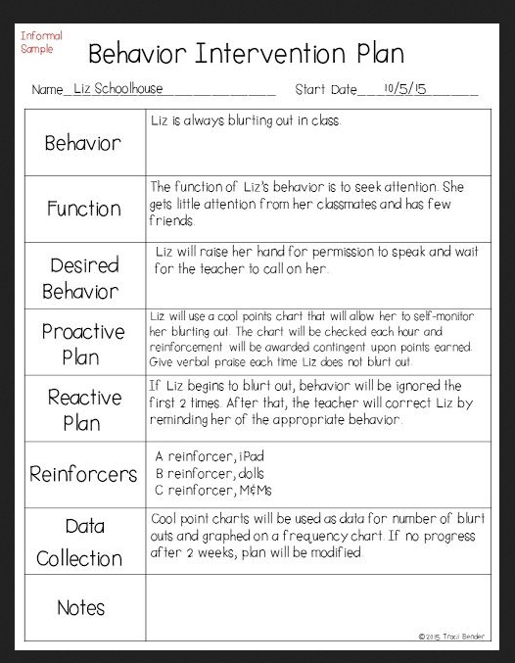
Notes:
BIP is manualized package for individual student. I’m willing to bet that manuals that are based on our science of behavior and carefully evaluated procedures will be effective when the individuals are unknown and uncounted will be effective for a large % of the population

Slide 57
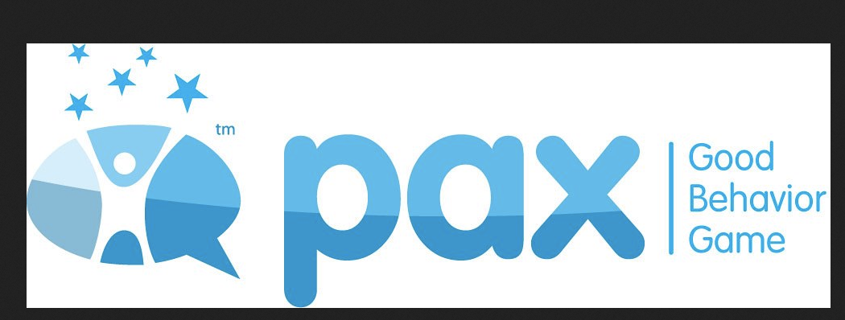
A Manualized Version of the Good Behavior Game
Notes:
Dennis Embry

Slide 58


Slide 59
Some Recommendations
Re-think dissemination.
Manualize interventions.
Link immediate outcomes to general outcome measures.

Slide 60
Linking Immediate Outcomes to General Outcomes
Society concerned with outcomes such as academic achievement, bullying, substance abuse.
BA well developed technology for changing behavior.
Focus has been on more discrete units of behavior
Move from “cult of behavior” to focus on worthy accomplishments (Gilbert, 1996).
Some behaviors have more impact than others on behavioral/developmental trajectory.
What are the long term benefits of behavioral intervention?
Notes:
We have data about EIBI for children with autism.
Can we replicate with other populations and/or behavior?

Slide 61
General Outcome Measures
Baer, Wolf, & Risley (1968) discussing effective as a dimension of applied behavior analysis:
“…an increase in those children from D- to C might well be judged an important success by an audience which thinks that C work is a great deal different than D work, especially if C students are much less likely to become drop-outs than D- students.”
Notes:
BWR focus on general outcome=dropouts.

Slide 62

Meaningful Differences
Size of vocabulary at 3 yrs predicts performance in 3rd grade.
Parents language style predicts child’s language development at 9yrs.
Inspired the 30 million word project.

Slide 63
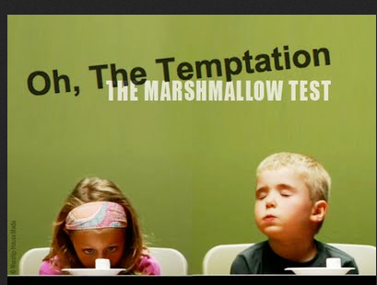

Slide 64
Effects of Managing Delay: At age 27-32
Self Control Children:
Lower BMI
Better sense of self-worth
Coped better with stress and frustration
Impulsive children:
Struggled more in stressful situations
More trouble paying attention
Lower SAT scores
Higher BMI
More likely to have substance problems.
Notes:
We could manualize a program for teach tolerance for delay of reinforcement. Package it as character education. Get science into public schools.

Slide 65
Some Recommendations
Re-think dissemination
Manualize interventions.
Link immediate outcomes to general outcome measures.
Ask populations questions.

Slide 66
Ask Population Questions
Decision makers are concerned with actuarial questions.
“How big a bang will I get for my buck?”
We should begin to conduct RCTs.
RCTs are well suited to answer actuarial questions.
If we have robust interventions, they will fare well with RCT.
Notes:
SSD are great for identifying functional relations. They are not great designs for answering population questions.

Slide 67
Having an Impact
Sidman, The Behavior Analyst, 2006:
“To make the general contributions of which our science is capable, behavior analysts will have to use methods of wider generality, in the sense they affect many people at the same time- or within a short time, without our being concerned about any particular members of the relevant population.”

Slide 68
Is Better Living Through Behaviorism Possible?
The stakes are high for our society.
Changing the system is long term, “messy,” and requires persistence in the face of massive resistance.
If we change a part of the system and there is no backlash we have not done anything important.

Slide 69
Realizing the Potential of Behavior Analysis in Education
Contextualist/pragmatic perspective.
Behave in ways that make everyone else look good.
Lead from behind.

Slide 70
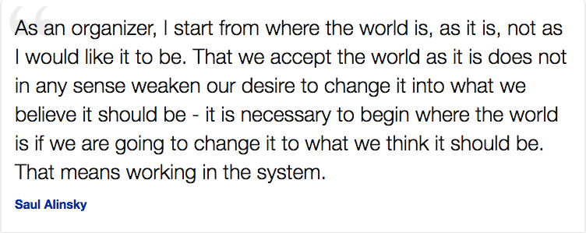
Shaping
Notes:
We have a term for this: Shaping-requires interaction with the learner.
Get involved. Become school leaders, get elected to school boards, become policy advisor to legislators.
All of these people speak differently than we do. That is not a problem. Be effective not right.

Slide 71
Thank you
Copies may be obtained at winginstitute.org

