Slide 1
Liver Cancer
Case Study
Here is where your presentation begins

Slide 2
Content of this template
This is a slide structure based on a case study presentation
You can delete this slide when you’re done editing the presentation
Fonts | To view this template correctly in PowerPoint, download and install the fonts we used
Used and alternative resources | An assortment of graphic resources that are suitable for use in this presentation
Thanks slide | You must keep it so that proper credits for our design are given
Colors | All the colors used in this presentation
Infographic resources | These can be used in the template, and their size and color can be edited
Customizable icons | They are sorted by theme so you can use them in all kinds of presentations
For more info:
You can visit our sister projects:
FREEPIK | FLATICON | STORYSET | WEPIK | VIDEVO

Slide 3
Table of contents
01
02
03
04
05
The patient
Discussion
You can describe the topic of the section here
You can describe the topic of the section here
Diagnosis
Treatment
Patient monitoring
You can describe the topic of the section here
You can describe the topic of the section here
You can describe the topic of the section here

Slide 4
—Someone Famous
“This is a quote, words full of wisdom that someone important said and can make the reader get inspired.”

Slide 5
Introduction
Neptune is the farthest planet from the Sun. It's also the fourth-largest planet by diameter in the Solar System

Slide 6
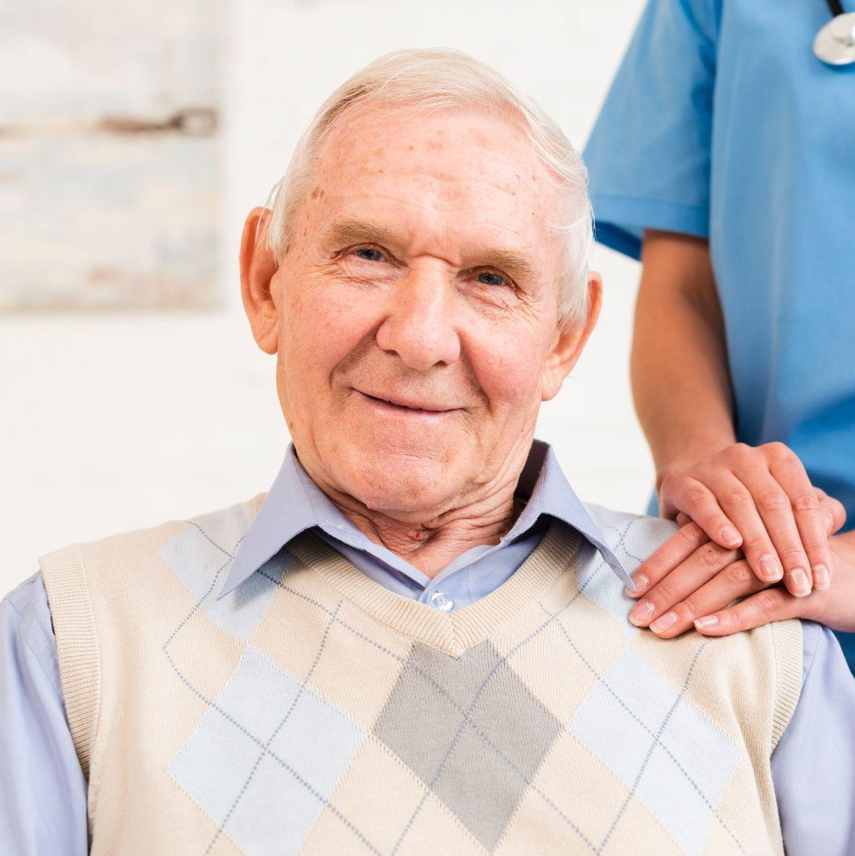
Patient medical history
2014 | Neptune is an ice giant
2016 | Mercury is very small
2018 | Venus is a hot planet
2020 | Pluto is a dwarf planet
2022 | Mars is a cold planet
Weight
80 kg
Name:
Height
John Doe
1.80 m
Age:
Smoker:
75 years
No
Allergies:
Drinker:
None
Occasionally

Slide 7
01
The patient
You can enter a subtitle here if you need it

Slide 8
Identifying information
Jupiter
Mars
Venus
Jupiter is a gas giant and the biggest planet in the Solar System
Mars is actually a cold place and it's full of iron oxide dust
Venus has a beautiful name and is the second planet from the Sun

Slide 9
Awesome words

Slide 10
Symptoms
Weight loss
Mars is full of iron oxide dust
Loss of appetite
Earth is the planet with life
Nausea and vomiting
Jupiter is the biggest planet
General weakness
Saturn is the ringed planet

Slide 11
Physical examination
Bilirubin test
Blood test
Jupiter doesn’t have a solid surface
Saturn was named after a Roman god
Albumin test
Prothrombin test
Despite being cold, Mars is actually a cold place
Venus has extremely high temperatures

Slide 12

A picture is worth a thousand words

Slide 13
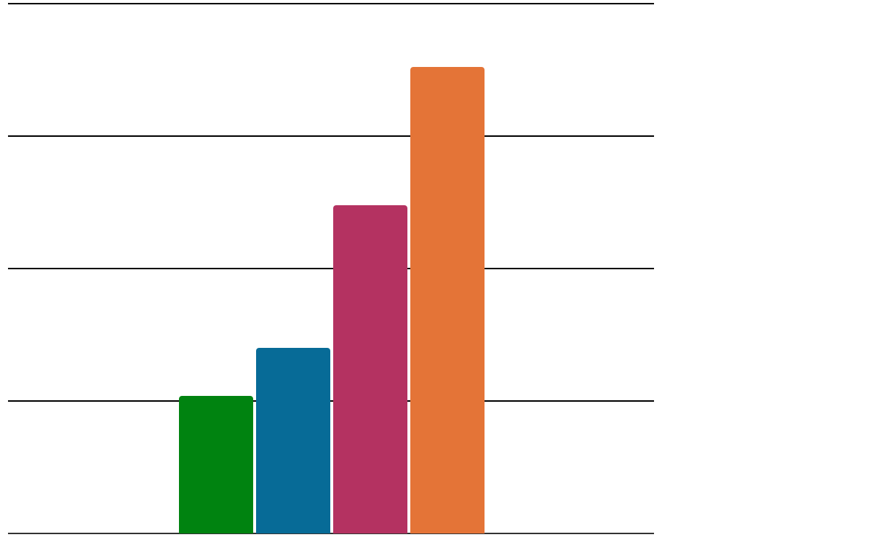
Findings
100%
26%
35%
1-20 y/o
21-40 y/o
75%
Jupiter is the biggest planet
Saturn was named after a Roman god
50%
62%
88%
25%
41-60 y/o
61-80 y/o
Mars is actually a cold place
Venus has a very beautiful name
0%
Follow the link in the graph to modify its data and then paste the new one here. For more info, click here

Slide 14
Discussion
John Doe
Susan Bones
“Venus has a beautiful name”
“Earth is the planet where we all live on”
Jim Timmy
Jenna Hill
“Mercury is the smallest planet”
“Mars is full of iron oxide dust”

Slide 15
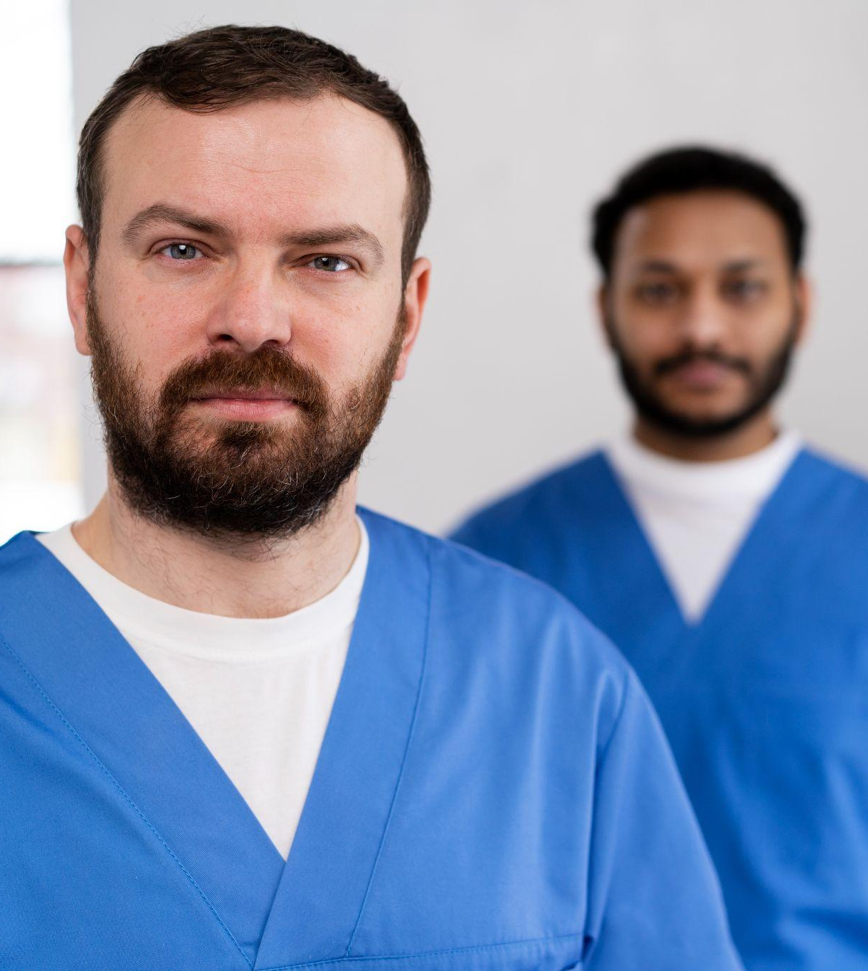
A picture always reinforces the concept
Images reveal large amounts of data, so remember: use an image instead of a long text. Your audience will appreciate it

Slide 16
Discussion summary
Do you know what helps you make your point clear?
Lists like this one:
They’re simple
You can organize your ideas clearly
You’ll never forget to buy milk!
And the most important thing: the audience won’t miss the point of your presentation

Slide 17
Comparison
 | 1-2 months | 3-6 months | 7-12 months
Stage 1 | Neptune is very far away from the Sun | Venus is the second planet from the Sun | Mars is actually a very cold place
Stage 2 | Jupiter is the biggest planet of them all | Saturn is a gas giant and has rings | Ceres is in the main asteroid belt
Stage 3 | Earth is the third planet from the Sun | The Moon is Earth’s only satellite | Pluto is considered a dwarf planet

Slide 18
75%
53%
15%
Of liver cancer is caused by alcohol
Of liver cancer is caused by overweight
Of the cases are hereditary

Slide 19
World similar cases
Symptom 1
Venus
It’s the second planet from the Sun
Symptom 2
Saturn
Saturn is a gas giant and has rings

Slide 20
Diagnosis
Biopsy
Venus is the second planet from the Sun
Computerized tomography
Earth is the planet with life
Magnetic resonance imaging
Mars is full of iron oxide dust

Slide 21
Treatment
Ablation
Immunotherapy
Neptune is very far away from the Sun
Despite being red, Mars is actually a cold place
Embolization
Chemotherapy
Saturn was named after a Roman god
Earth is the third planet from the Sun
Targeted therapy
Radiation therapy
Jupiter is a gas giant and the biggest planet
Venus is the second planet from the Sun

Slide 22
Patient monitoring
Week 1
Week 2
Week 3
Week 4
Mercury
Venus
Neptune
Jupiter
Mercury is a small planet
Venus has a beautiful name
Neptune is far away from us
Jupiter is the biggest planet

Slide 23
Contraindications & indications
Despite being red, Mars is actually a cold place full of iron oxide dust
Saturn is composed mostly of hydrogen and helium
Neptune is the farthest planet from the Sun
Jupiter is the biggest planet in the Solar System
Earth is the third planet from the Sun and where we all live on

Slide 24
Post prevention
Regular exercise
Limited alcohol
Mercury is the closest planet to the Sun
Venus is the second planet from the Sun
Weight control
Reduce risks
Jupiter is a gas giant and the biggest planet
Neptune is the farthest planet from the Sun
Healthy diet
Avoid infections
Earth is the only planet that harbors life
Saturn was named after a Roman god

Slide 25
Case timeline
Venus has a beautiful name
Jupiter is the biggest planet
Day 1
Day 3
Mars is actually a cold place
Day 2
Earth is where we all live together
Day 4

Slide 26


Our team
John Doe
Jenna Bones
You can speak a bit about this person here
You can speak a bit about this person here

Slide 27
40,000
Patients die each year worldwide from liver cancer

Slide 28
Conclusions
Mercury is the closest planet to the Sun and the smallest one in the Solar System—it’s only a bit larger than the Moon. The planet’s name has nothing to do with the liquid metal, since Mercury was named after a Roman god

Slide 29
References
AUTHOR. (YEAR). Title of the publication. Publisher
AUTHOR. (YEAR). Title of the publication. Publisher
AUTHOR. (YEAR). Title of the publication. Publisher
AUTHOR. (YEAR). Title of the publication. Publisher
AUTHOR. (YEAR). Title of the publication. Publisher
AUTHOR. (YEAR). Title of the publication. Publisher
AUTHOR. (YEAR). Title of the publication. Publisher
AUTHOR. (YEAR). Title of the publication. Publisher

Slide 30
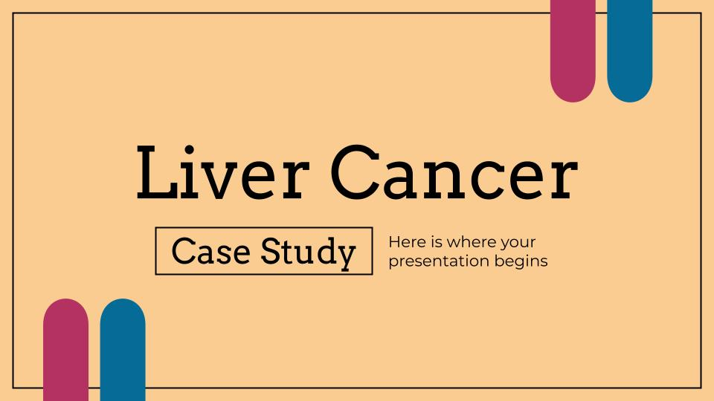
Multimedia
You can replace the image on the screen with your own work. Just right-click on them and select “Replace image”

Slide 31
Thanks!
Do you have any questions?
youremail@freepik.com
+91 620 421 838
yourwebsite.com
Please keep this slide for attribution

Slide 32
Alternative resources
Here’s an assortment of alternative resources whose style fits the one of this template:
Vectors:
Hand drawn flat design fatty liver illustration
Cancer types flat icons

Slide 33
Resources
Did you like the resources on this template? Get them for free at our other websites:
Vectors:
Hand drawn flat design fatty liver illustration
Human anatomy internal organs layout
Photos:
Caregiver holding old man's shoulder
Old man and woman sitting on yellow sofa with nurse
Nurses getting ready for work day
Medium shot doctor with crossed arms
Medium shot smiley doctor with coat

