Slide 1
Solving problems with more than one answer
Mrs Sund

Slide 2
Key principles
This box is to indicate to the teacher (user) that stage of the instructional cycle. It won’t be visible in a recorded lesson, but is there for teachers who download the slides for their own use.
The ‘I do’ phase involves the explanation - indicates where a teacher would be explaining a concept.
Moving from ‘I do’ to ‘We do’ involves modelling - indicates that the teacher is demonstrating a skill or modelling a process.
Check for Understanding - Questions posed to check whether students have understood and to inform next steps.
‘You do’ - Practice - indicates places where students will attempt questions independently.
I
W
I do
We do
CfU
Check for
Understanding
Y
You do

Slide 3







Engagement icons
This icon is to indicate to the teacher (user) a suggested engagement norm. It won’t be visible in a recorded lesson, but is there for teachers who download the slides for their own use.
Whiteboards
All students respond to the teacher’s question, showing their responses at the same time.
Turn and talk
Students discuss with the person next to them.
Cold call
The teacher asks a question, gives wait time, then calls on individual students to respond.
Choral response
Students respond orally all together.
In your book
Students respond to a prompt in their exercise book or booklet.
Thumbs up, thumbs down
Students indicate whether they agree or disagree with a statement, or whether something is an examples or non-example.

Slide 4


In this lesson, you will need:
Worksheet, exercise book or paper
Pencil

Slide 5
Learning intentions: Mathematics, Stage 1a
Mathematicians solve problems and communicate their thinking.
Mathematicians communicate their thinking with words,
symbols, or pictures.
Mathematicians solve problems using concrete materials.
Addition problems can be solved using advanced count-by-one strategies.

Slide 6


Solving problems with more than one answer
How many ways can we place the 10 fish into 2 bowls?
W
Credit: Pixabay

Slide 7
Solving problems with more than one answer
How many ways can we place the 10 fish into 2 bowls?
W
Credit: Pixabay

Slide 8
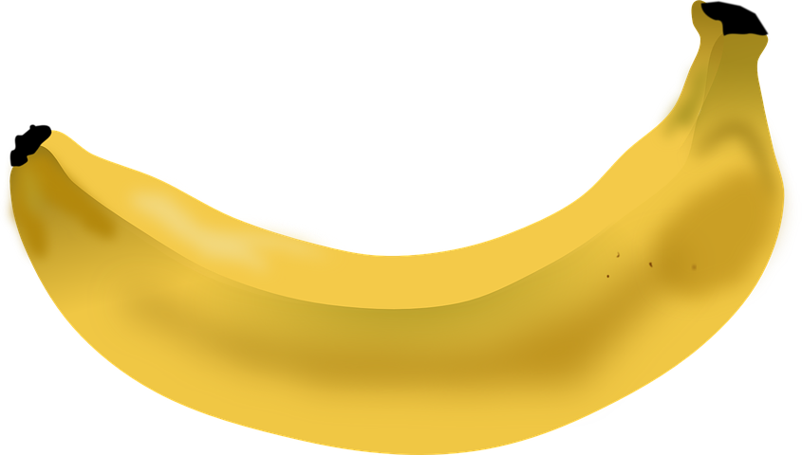
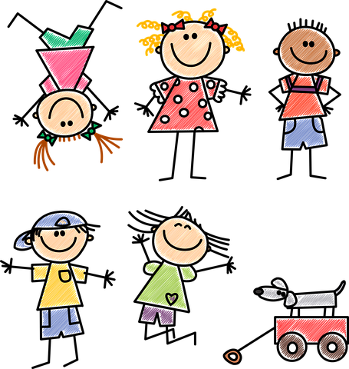
Solving problems with more than one answer
How many ways can you share 9 bananas between 3 children?
Y
Credit: Pixabay
Notes:
It doesn’t have to be fair sharing, so not everyone needs the same amount.

Slide 9
Y
Independent practice

Slide 10
Lesson review
We have been learning about:
Mathematics in our everyday lives
Solving Problems
Where we see maths everyday
How mathematical items help us solve problems
Using visual representations of objects
Problems with one or more answers

