Slide 1

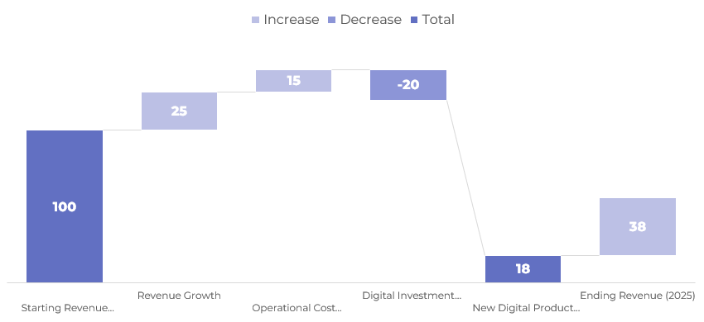
Heat Map of Digital Transformation Priorities and Business Impact Levels
A Waterfall Breakdown of Revenue Gains, Cost Savings, and Investment Costs
Key Takeaway
This waterfall chart visually outlines how various components of a digital transformation strategy contribute to overall business performance. Starting from a baseline revenue of $100M in 2021, the chart shows incremental gains from revenue growth and operational savings, offsets from digital investments, and additional contributions from new digital product sales — resulting in a net financial gain of $38M by 2025.
(Net Gain)
01
Introduction
A Waterfall Breakdown of Revenue Gains, Cost Savings, and Investment Costs

