Slide 1


Teacher Coaching:
The Missing Link in Teacher Development
Randy Keyworth
Notes:
Two issues
What we mean by culture
Lots of information in a very short time

Slide 2
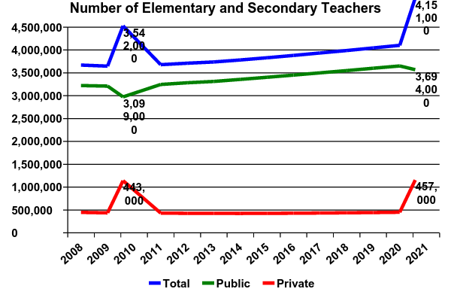
The K-12 Education Universe (2010 – 2020)
STUDENT GROWTH
% Growth Over
Year # Prev. 5 years
Fall 2010 49,484,181 .3 %
Fall 2015 50,773,300 2.3 %
\
Fall 2020 52,688,000 3.8 %
TEACHER GROWTH

Slide 3
PROJECTIONS FOR NEW TEACHERS
(2010-2020)
Growth 609,000
Retirement 1,875,000
Attrition 1,950,000
TOTAL 4,434,000
Researchers estimate a need to hire between
2.9 and 5.1 million full-time teachers
between 2008 and 2020 (Aaronson & Meckel, 2008)

Slide 4
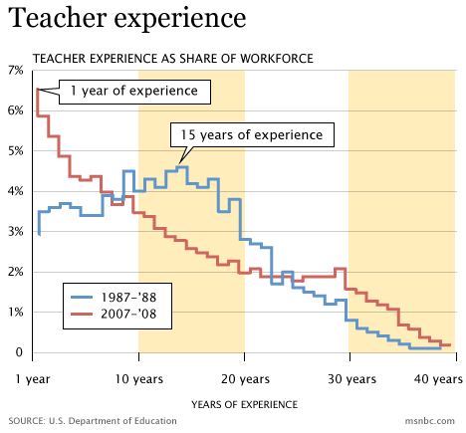
% TEACHERS BY EXPERIENCE LEVEL
During the 1987–88
school year, the most common experience level, was fifteen years;
by 2008,
it was
one year.

Slide 5
Perfect Storm
Need to provide effective training and support for millions of new teachers:
New teachers entering the field
Current teachers with little experience

Slide 6
Teacher
Professional Development
Infrastructure

Slide 7
Teacher Professional Development Infrastructure
PRE-SERVICE professional development occurs before the individual’s first job
teacher training programs: course work
student teaching
IN-SERVICE professional development occurs after the individual’s first job begins
induction: intensive training during first year(s) of of teaching
ongoing: workshops & conferences
continuing education (CEUs)
advanced degrees
peer collaboration (mentoring, etc.)
Notes:
OUTCOMES & PROCESS

Slide 8
PRE-SERVICE Metrics
Teacher Preparation Programs
Number of institutions (2011): 1,434
Number of programs (2011): 2,054
Number of students enrolled: 724,173
Number of new teacher graduates (BA): 235,138
Traditional programs 89%
Alternative (IHE) 6%
Alternative (non-IHE) 5%
Dollars spent: $ 20.4 Billion
Number of years 4-5 years
Notes:
OUTCOMES & PROCESS

Slide 9
IN-SERVICE Metrics
3.5 million teachers
ACTIVITY % TEACHERS COSTS
Induction 82 % $ 2 Billion
Advanced 60% with MAs $ 15 Billion (salary)
Degrees 35% enrolled $ 6 Billion (university)
Professional Development 95% $ 18-25 Billion
(workshops, conferences) ($ 4–8,000 / teacher)
Total Professional Development Costs (Pre- and In-service):
$ 61 – 68 Billion
Notes:
OUTCOMES & PROCESS

Slide 10
Teacher Professional Development Goals
Overall goals of teacher professional development
• improve student outcomes
• acquisition of effective teaching skills
    • increase teacher motivation, satisfaction & retention

Slide 11
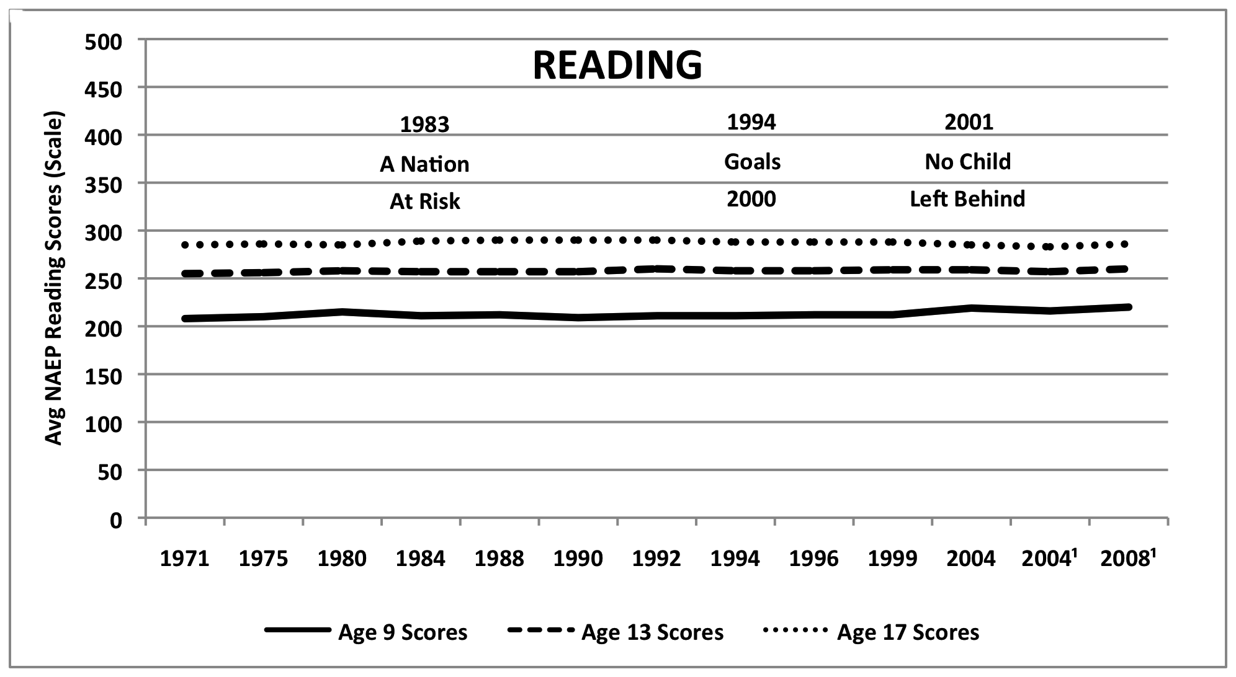
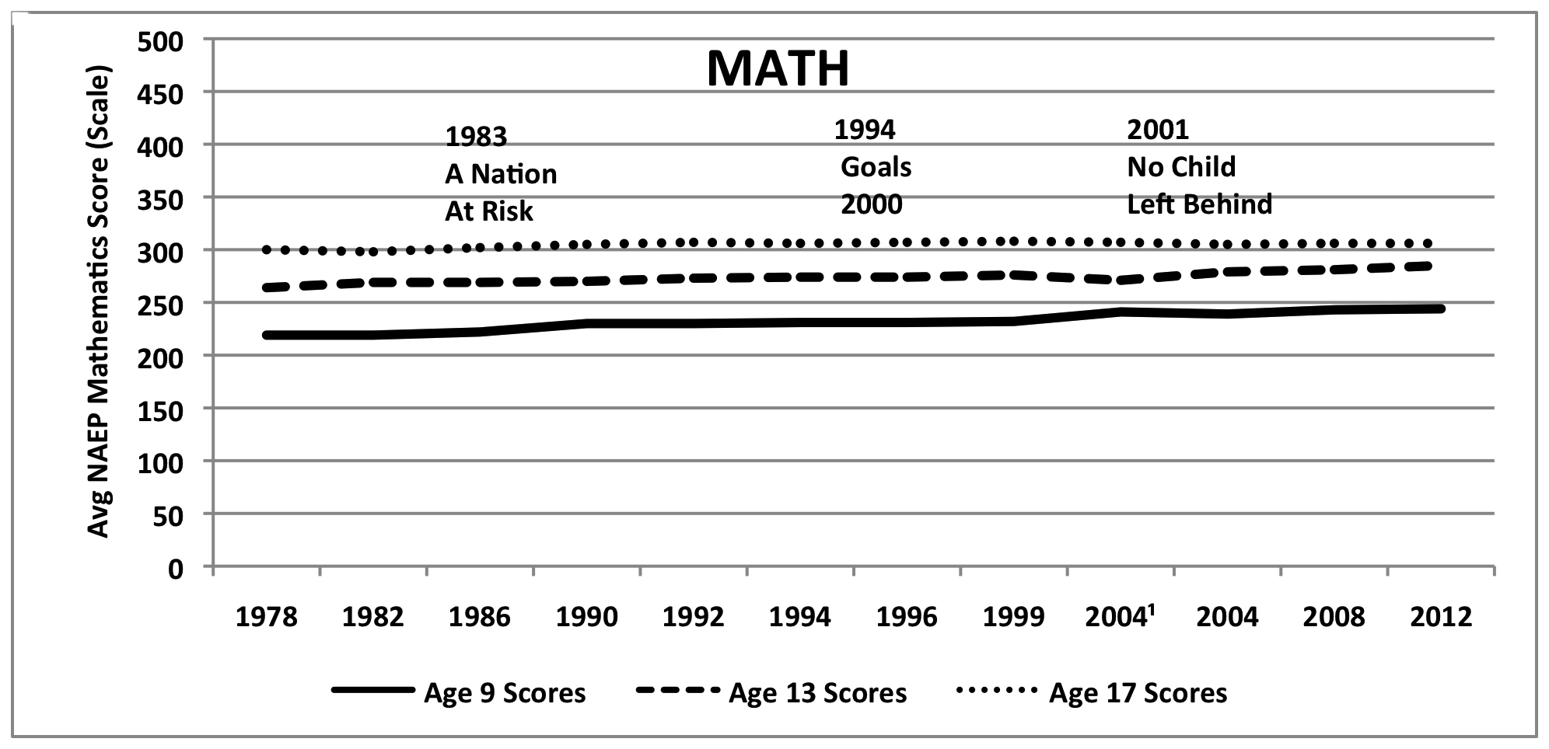
STUDENT OUTCOMES: Professional Development
2011 NAEP Reading
At or above proficiency
4th Grade = 35%
8th Grade = 36%
12th Grade = 38% *
2011 NAEP Math
At or above proficiency
4th Grade = 42%
8th Grade = 36%
12th Grade = 26% *
National Assessment
of Educational
Progress (NAEP)
Notes:
OUTCOMES & PROCESS

Slide 12
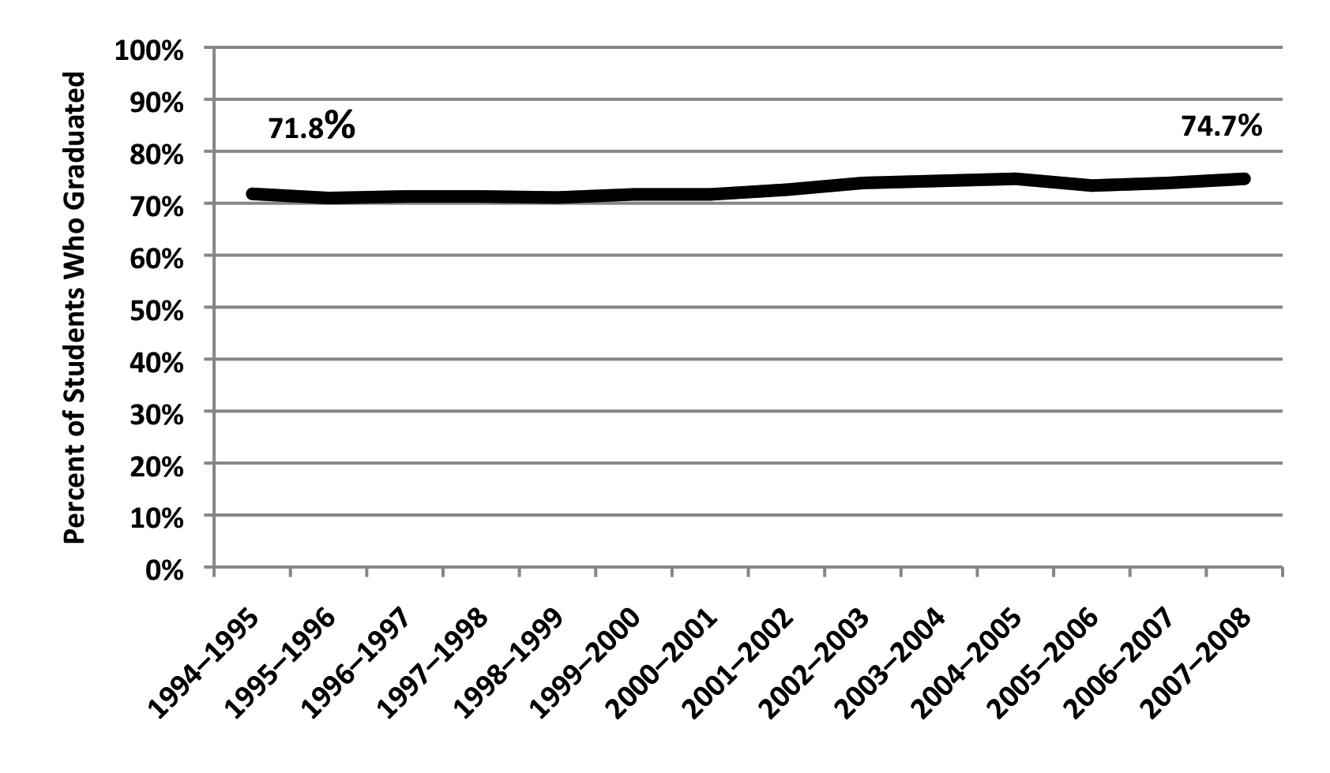
STUDENT OUTCOMES: Professional Development
High School Graduation Rates

Slide 13
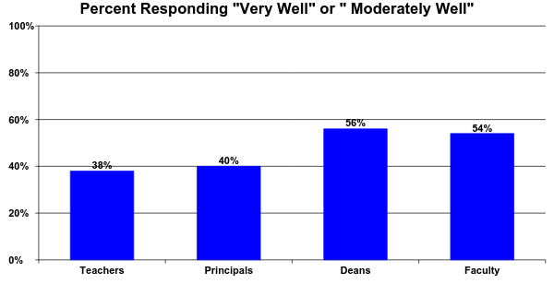
TEACHING SKILLS: Pre-Service
How Well do Schools of Education Prepare Teachers?
  Levine (2006)
Notes:
Very well to moderately well

Slide 14
TEACHING SKILLS: Induction
Institute of Education Sciences Study (2008-2010)
What is the impact of comprehensive induction services?
After one year? After two years?
impact on teacher’s classroom practices
no statistically positive impact
2. impact on student achievement
no statistically positive impact
3. impact on teacher retention
no statistically positive impact
4. impact on composition of the district’s teaching
workforce
no statistically positive impact

Slide 15
TEACHING SKILLS: Advanced Degrees
Evidence suggests that teachers with masters’ degrees do not demonstrate an instructional advantage over those without.
Kane, et al. (2006), Aaronson, et al. (2002), Hanushek, et al. (1998)
90 percent of the Master’s Degrees held by teachers come from education programs that tend to be unrelated to or unconcerned with instructional efficacy
National Center for Education Statistics
(2003-04 Schools and Staffing Survey)

Slide 16
TEACHING SKILLS: Workshops
“one-day workshops are intellectually superficial, disconnected from deep issues of curriculum and learning, fragmented and noncumulative”
Ball & Cohen (1999)

Slide 17
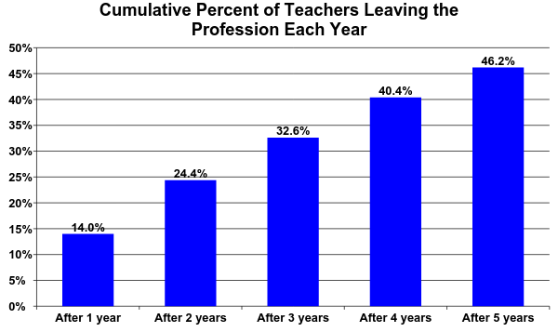
TEACHER RETENTION: Professional Development
Ingersoll, R. (2003)

Slide 18
Teacher Professional Development Goals
Overall goals of teacher professional development
• improve student outcomes
• acquisition of effective teaching skills
    • increase teacher motivation, satisfaction & retention
NO
NO
NO
WHAT ARE WE MISSING?

Slide 19
WHAT ARE WE MISSING?
We are not teaching teachers the right skills:
classroom management
instruction delivery
formative assessment & data based decision making
soft skills
We are not teaching teachers effectively:
    teacher coaching

Slide 20
TEACHING SKILLS: CLASSROOM MANAGEMENT
IMPORTANCE
Classroom management continues to be one of the greatest challenges new teachers face Jones (2005)
Over forty percent of surveyed new teachers reported feeling they were “not at all prepared” or “only somewhat prepared” to handle a range of classroom management or discipline situations Coggshall et al. (2012)
Classroom management was identified as “the top problem” by teachers The New Teacher Project (2013)

Slide 21
TEACHING SKILLS: CLASSROOM MANAGEMENT
CRITICAL COMPONENTS
three authoritative research summaries examining over 150 studies over six decades (Simonsen et al. 2008, Oliver et al. 2011, IES 2008)
RULES
ROUTINES
PRAISE
MISBEHAVIOR
ENGAGEMENT
National Council on Teacher Quality (2013)

Slide 22
TEACHING SKILLS: CLASSROOM MANAGEMENT
Average program dedicates lass than half of one course on topic (out of 10-15 courses)
Most programs only addressed 2-3 of critical components. Only 16 % addressed all five components
Only 17% of teacher training programs included classroom management in their clinical coursework
Fifty percent of programs ask candidates to develop their own “personal philosophy of classroom management”
National Council on Teacher Quality (2013)

Slide 23
WHAT DO WE KNOW: FORMATIVE ASSESSMENT & DATA-BASED DECISION MAKING
CRITICAL COMPONENTS:
Assessment literacy:
the taxonomy of assessment (formative vs. summative,
norm-referenced, criterion-referenced)
Analytic Skills:
collect, dissect, describe and display data
Instructional Decision Making:
using data to make effective decisions about teaching strategies
National Council on Teacher Quality (2012)
Notes:
OUTCOMES & PROCESS

Slide 24
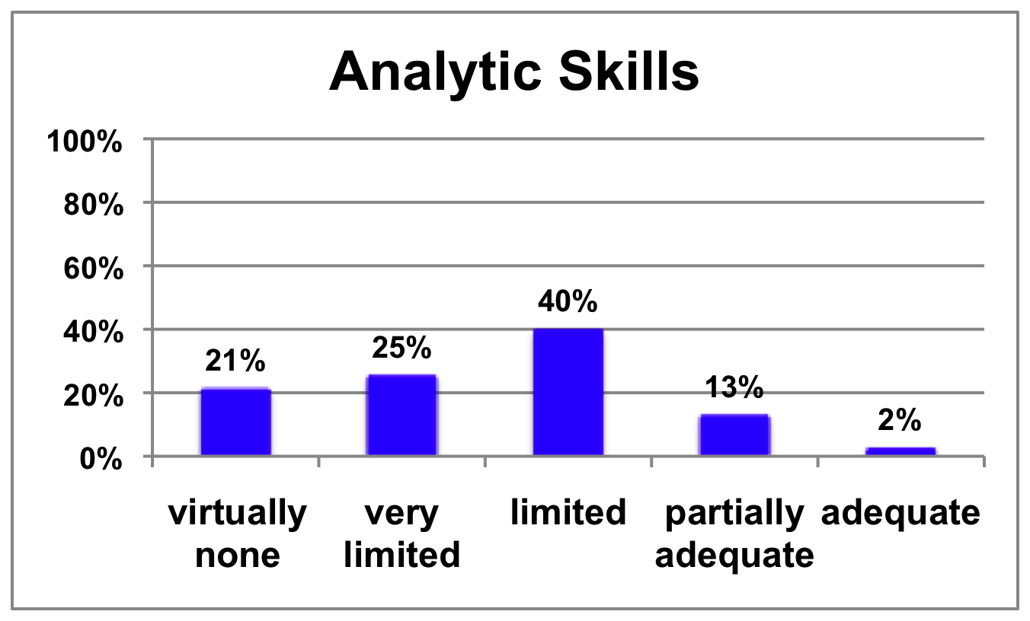
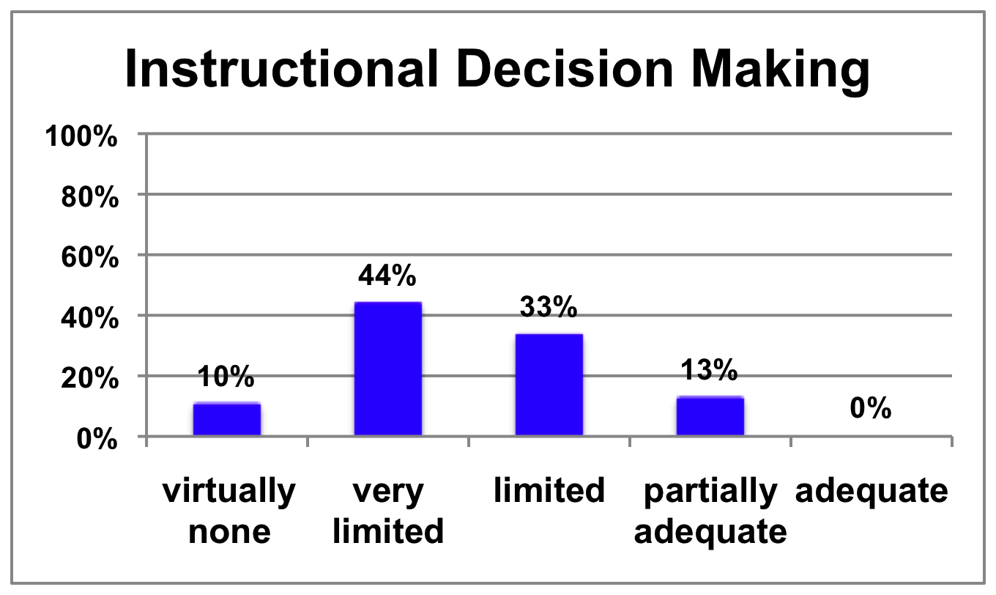
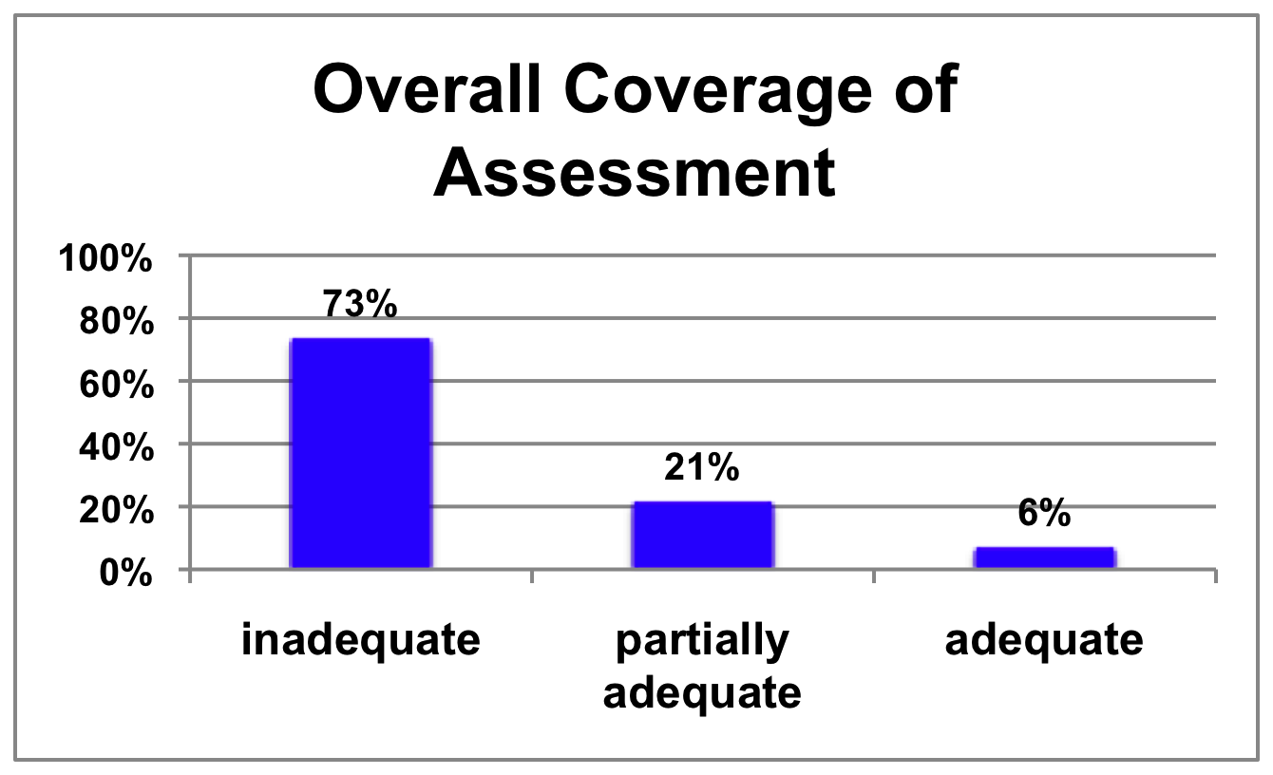
TEACHING SKILLS: FORMATIVE ASSESSMENT
National Council on Teacher Quality (2012)
Notes:
OUTCOMES & PROCESS

Slide 25
INSTRUCTION TEACHING SKILLS: READING
National Reading Panel (2000)
overwhelming evidence that effective reading instruction includes explicit and systematic teaching of:
CRITICAL COMPONENTS:
Phonemic awareness
Phonics
Fluency
Vocabulary
Comprehension
National Council on Teacher Quality (2012)

Slide 26
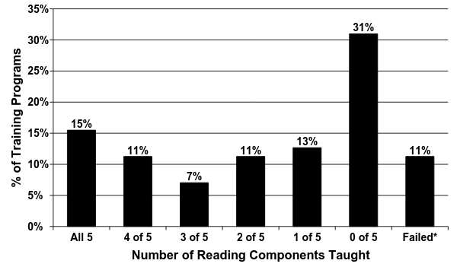
INSTRUCTION TEACHING SKILLS: READING
National Council on Teacher Quality (2011)
Notes:
OUTCOMES & PROCESS

Slide 27
TEACHING TEACHERS: STUDENT TEACHING
Critical Standards:
Should last no less than 10 weeks.
Teacher prep program selects cooperating teacher
Cooperating teacher must have at least three years of experience
Cooperating teacher must have capacity to have a positive impact on student learning
Cooperating teacher must have capacity to mentor an adult
National Council on Teacher Quality (2011)
Notes:
OUTCOMES & PROCESS

Slide 28
TEACHING TEACHERS: STUDENT TEACHING
Cooperating Teacher Requirements
82% require some number of years experience (usually three)
  38% require cooperating teachers to possess the qualities of a good mentor
28% require cooperating teachers to be effective instructors
The role of teacher preparation programs in choosing cooperating teachers
  7% have appropriate role (selecting / monitoring cooperating teacher)
41% have a nominal role
52% have no role
Student Teaching in the United States NCTQ
Notes:
OUTCOMES & PROCESS

Slide 29
TEACHING TEACHERS: STUDENT TEACHING
The number of observations, visits, evaluations by cooperating teachers
48% require visit at least 5 times (every two to three weeks)
some requiring as few as 2 observations over the course of a semester
30% fail to require cooperating teacher to meet with the teacher and give written feedback
Student Teaching in the United States NCTQ
Notes:
OUTCOMES & PROCESS

Slide 30
TEACHING SKILLS: STUDENT TEACHING
Performance of All Institutions on Five Critical Standards
7% model programs
18% good
49% weak
25% poor
National Council on Teacher Quality (2011)
Notes:
OUTCOMES & PROCESS

Slide 31
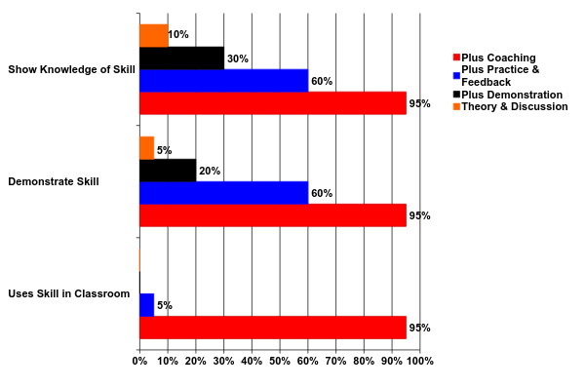
TEACHING TEACHERS: COACHING
Joyce & Showers , 2002
Notes:
OUTCOMES & PROCESS

Slide 32
COACHING PRACTICE ELEMENTS
1. ADDRESSES IMMEDIATE ISSUES
Focus is on authentic concrete, everyday challenges faced by teachers with real students in real classrooms
Elmore (2006)
2. ACTIVE ENGAGEMENT
Process encourages teachers participation and collaboration in the learning process, feedback, and problem solving
Gordon (2004)
Notes:
OUTCOMES & PROCESS

Slide 33
COACHING PRACTICE ELEMENTS
3. SUBJECT CONTENT
Training is evidence-based and related state standards for courses and translating those standards into curriculum, lesson plans, student learning Jacobs (2004)
Not just focused on curriculum content but on the teaching and learning of content.
Blank & de las Alas (2009)
4. TEACHING SKILLS
Training focuses on evidence-based, classroom teaching practices. Blank & de las, Alas (2009)
Notes:
OUTCOMES & PROCESS

Slide 34
COACHING PRACTICE ELEMENTS
5. MODELING (IN-CLASS)
Training uses guided practice to model lesson in the teacher’s classroom with that teacher’s students (I do, we do, you do)
Teachers more likely to try practices that have been modeled for them in professional development settings.
Snow-Renner et al. (2005)
6. OBSERVATION (IN-CLASS)
Trainer observes teacher’s performance at a level of frequency and specificity necessary to support and sustain skill acquisition
Notes:
OUTCOMES & PROCESS

Slide 35
COACHING PRACTICE ELEMENTS
7. FREQUENT FEEDBACK (ON PRACTICE)
Feedback is given in a frequent, constructive, data-based, problem solving manner that encourages teacher collaboration
Cooper (2004)
8. TRAINER SKILLS
Trainers, instructors, coaches…have experience and expertise in social influence, teaching, and consultation (instruction, modeling, observation, feedback, etc.)
National Staff Development Council (2001)
Notes:
OUTCOMES & PROCESS

Slide 36
COACHING PRACTICE ELEMENTS
9. ONGOING FEEDBACK & SUPPORT
Systems are in place to providing ongoing feedback and problem solving on student / teacher performance.
Yoon (2007)
Notes:
OUTCOMES & PROCESS

Slide 37
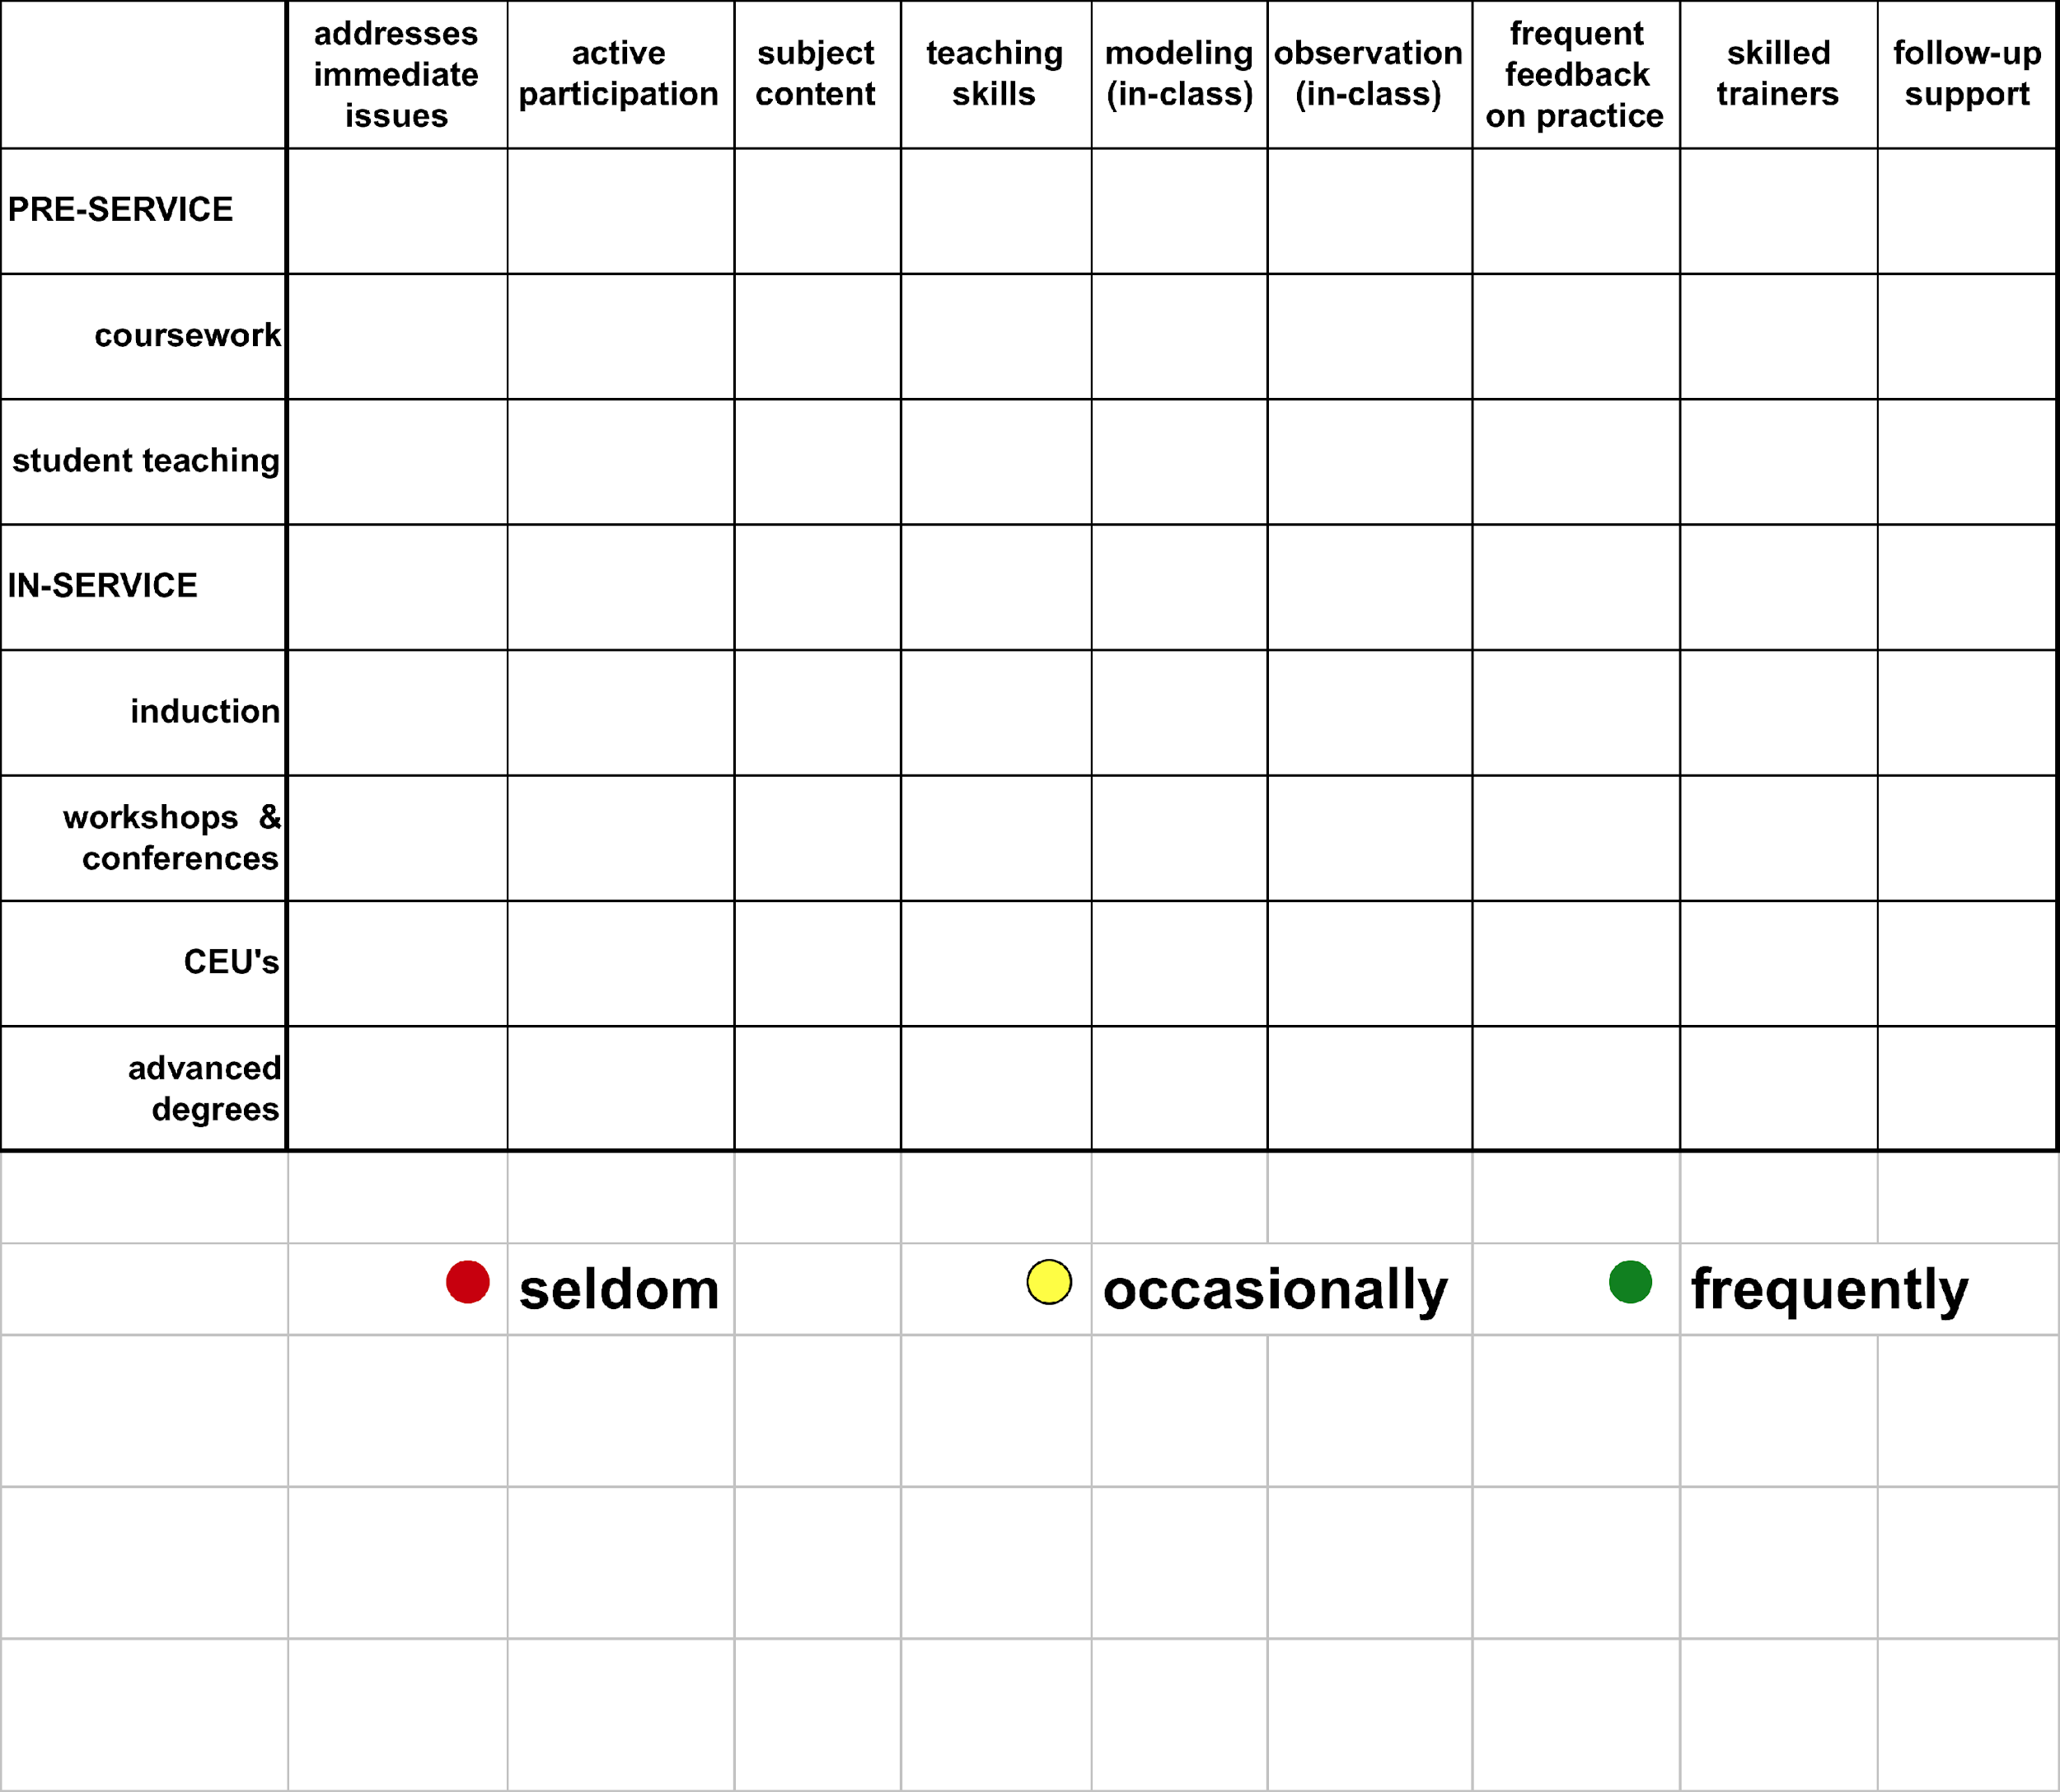
Teacher Professional Development re:
Coaching Practice Elements

Slide 38
Teachers are only as effective as
they know how to be.

