Slide 1

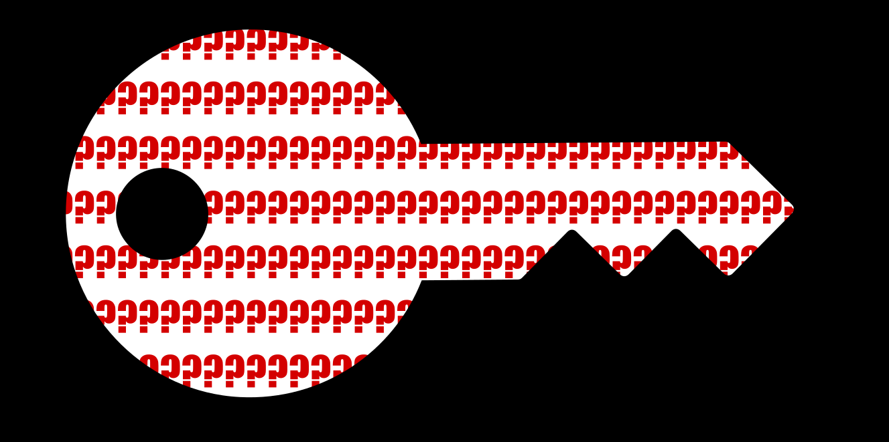


Context is key
Are my people really using hate speech? > SEL > Context is key

Slide 2
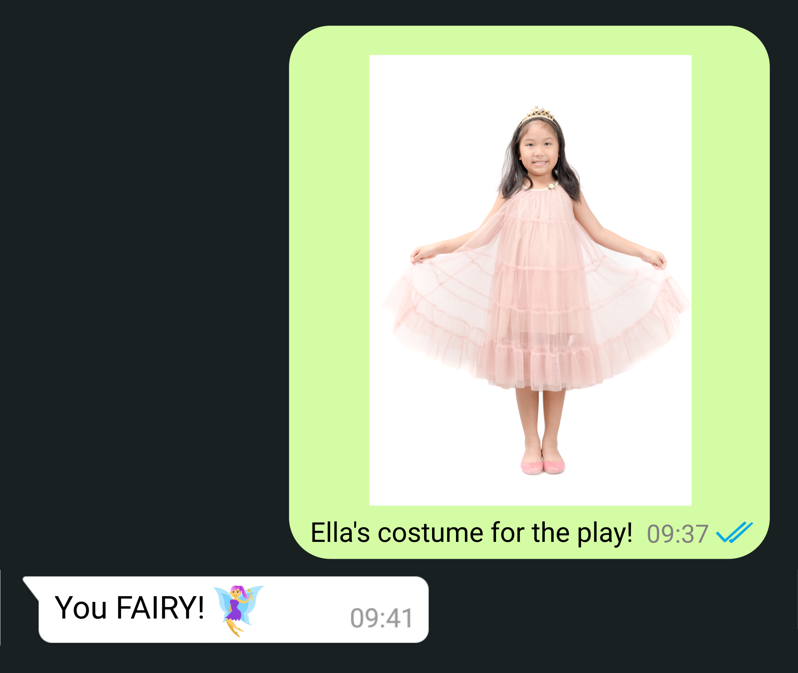
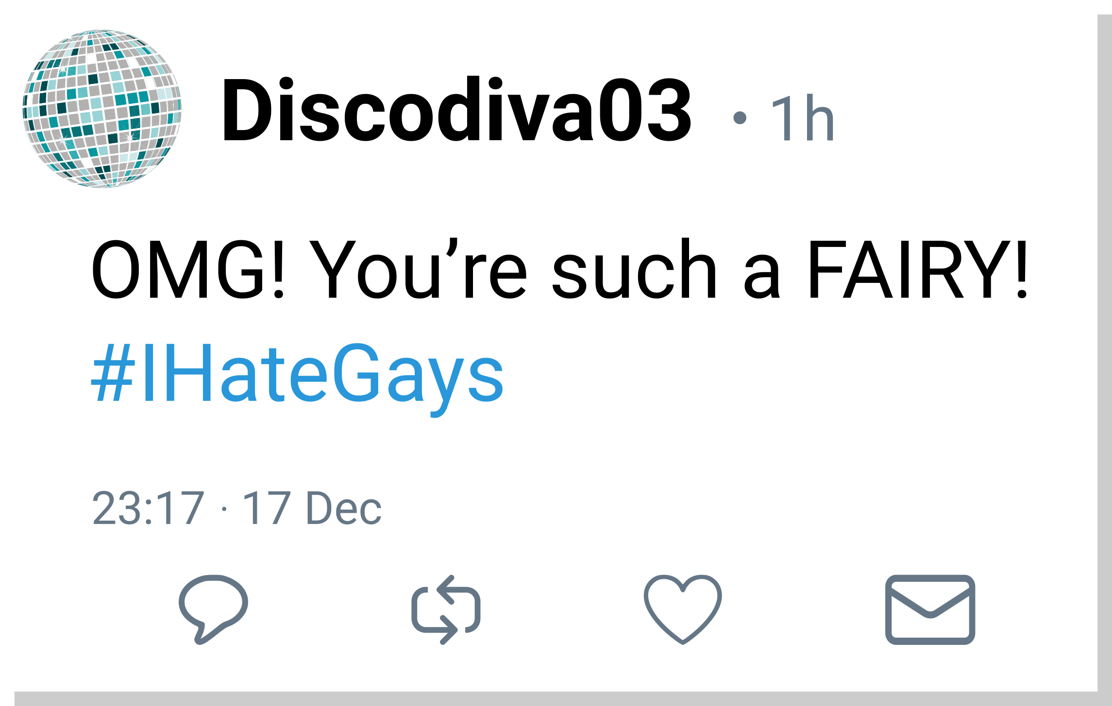
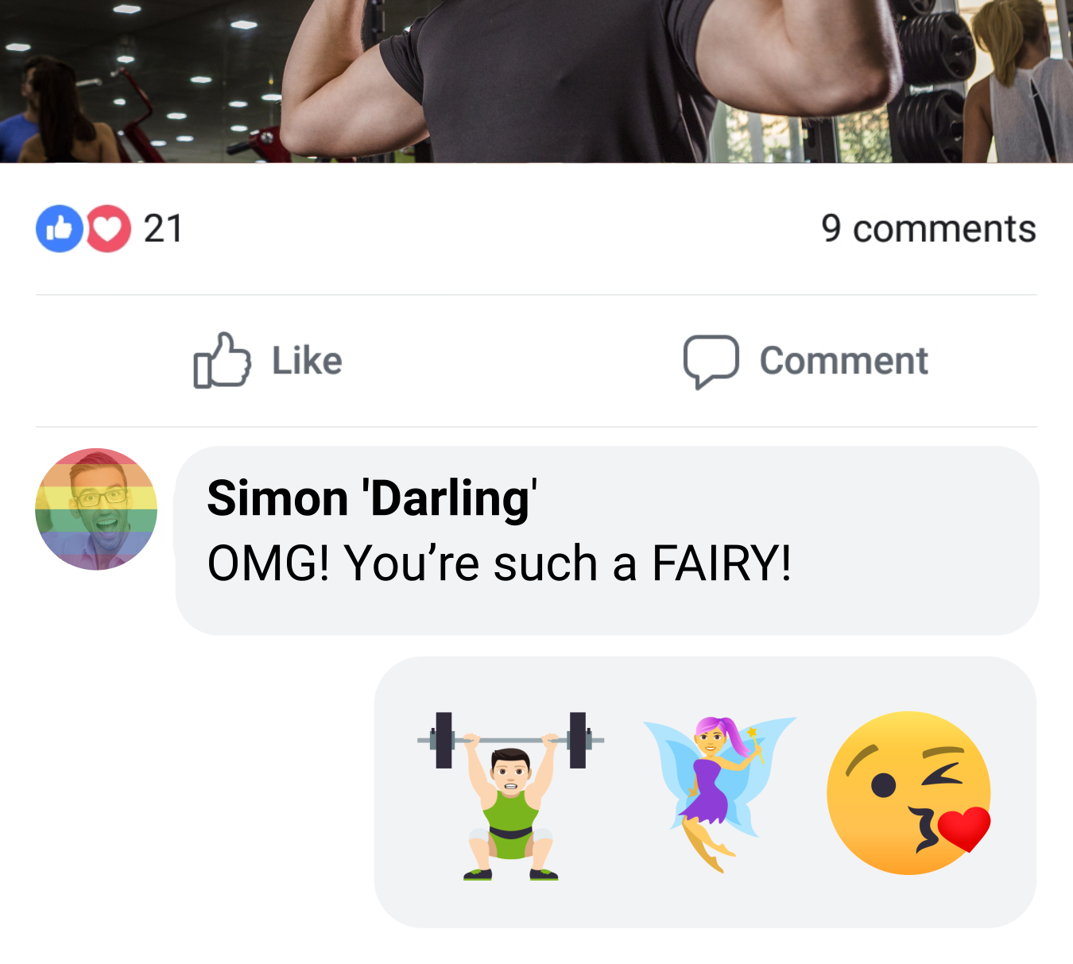

Slide 3
Said in a private message to the sender’s child who had just found out they are the fairy in this year’s holiday performance.
Said on Twitter by a straight woman in response to a well-known gay personality’s message about their new styling session.
Said on a Facebook post by another gay man in response to a gay friend's announcement that they just bench-lifted over 100kg. In this context, fairy means ‘Fairy-power’ or strength

Slide 4
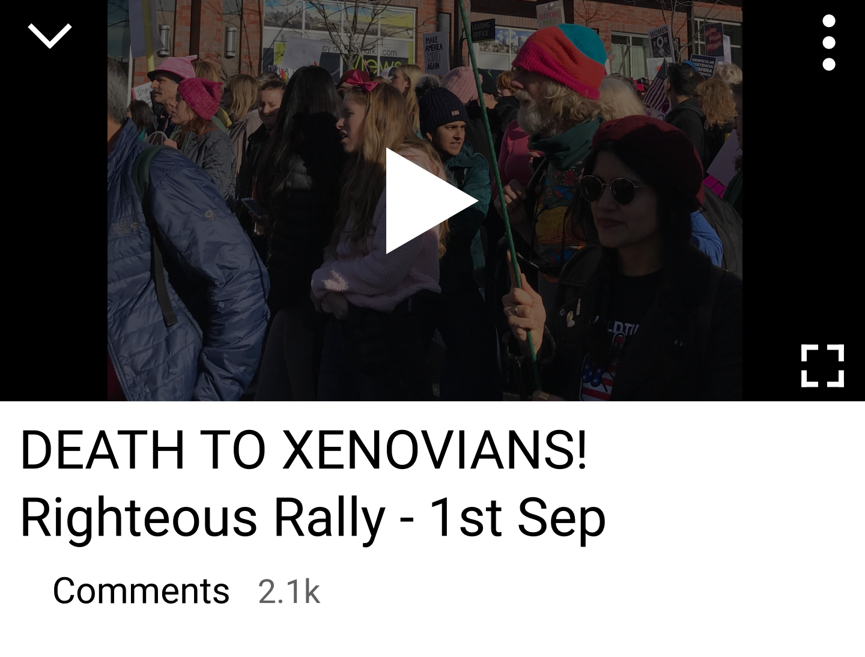
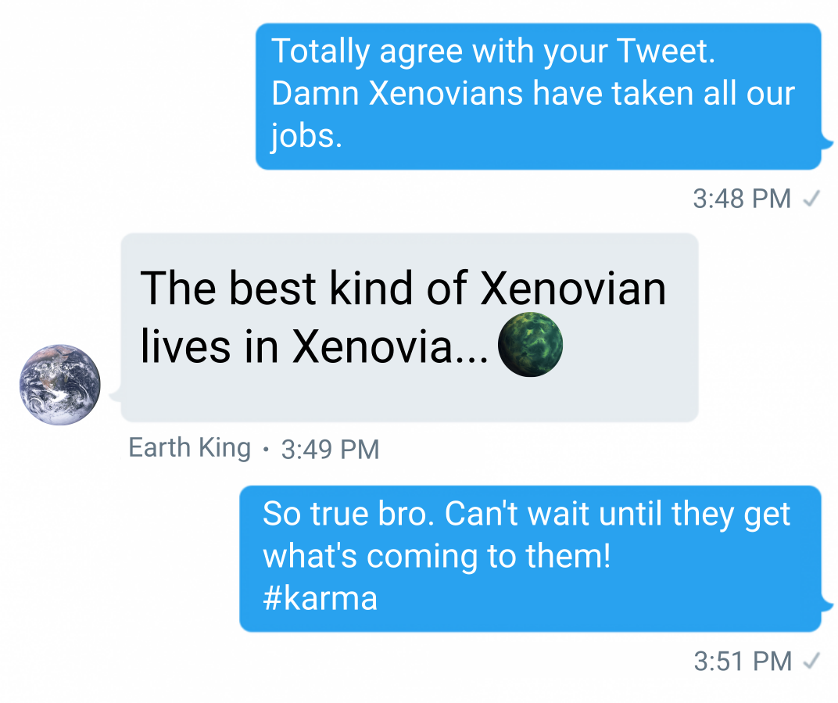
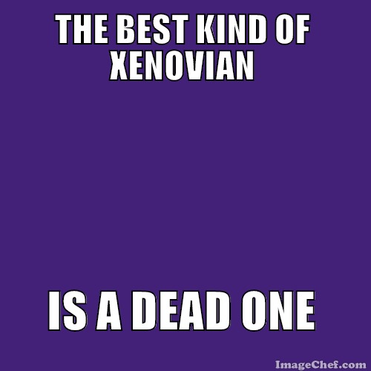

Slide 5
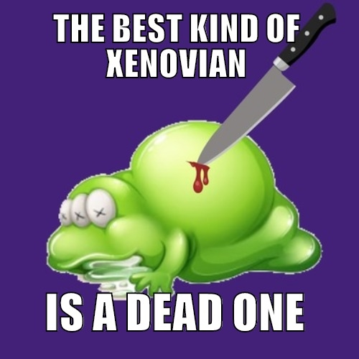
Chanted at a rally, captured in a video and shared on multiple platforms with #deathtoxenovians becoming one of the trending hashtags.
This meme text was written over an image of a xenovia with a cartoon knife to their neck. It was widely shared on a number of message boards and eventually on public social media.
Shared in a private message between two friends on Twitter in response to a negative Tweet about Xenovians taking all ‘our’ jobs .

Slide 6
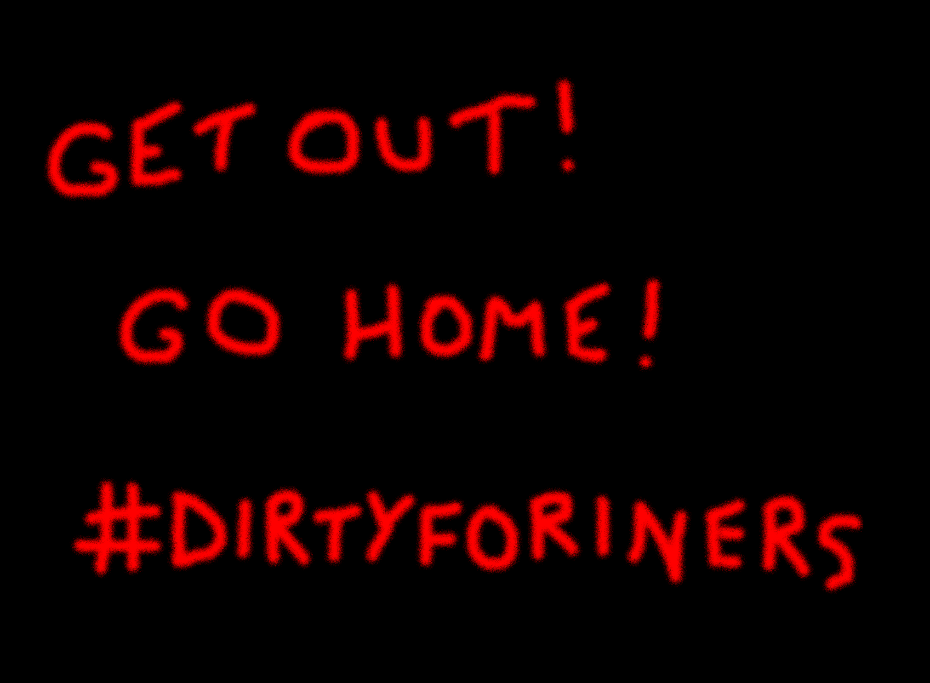

GET OUT!
GO HOME!

Slide 7
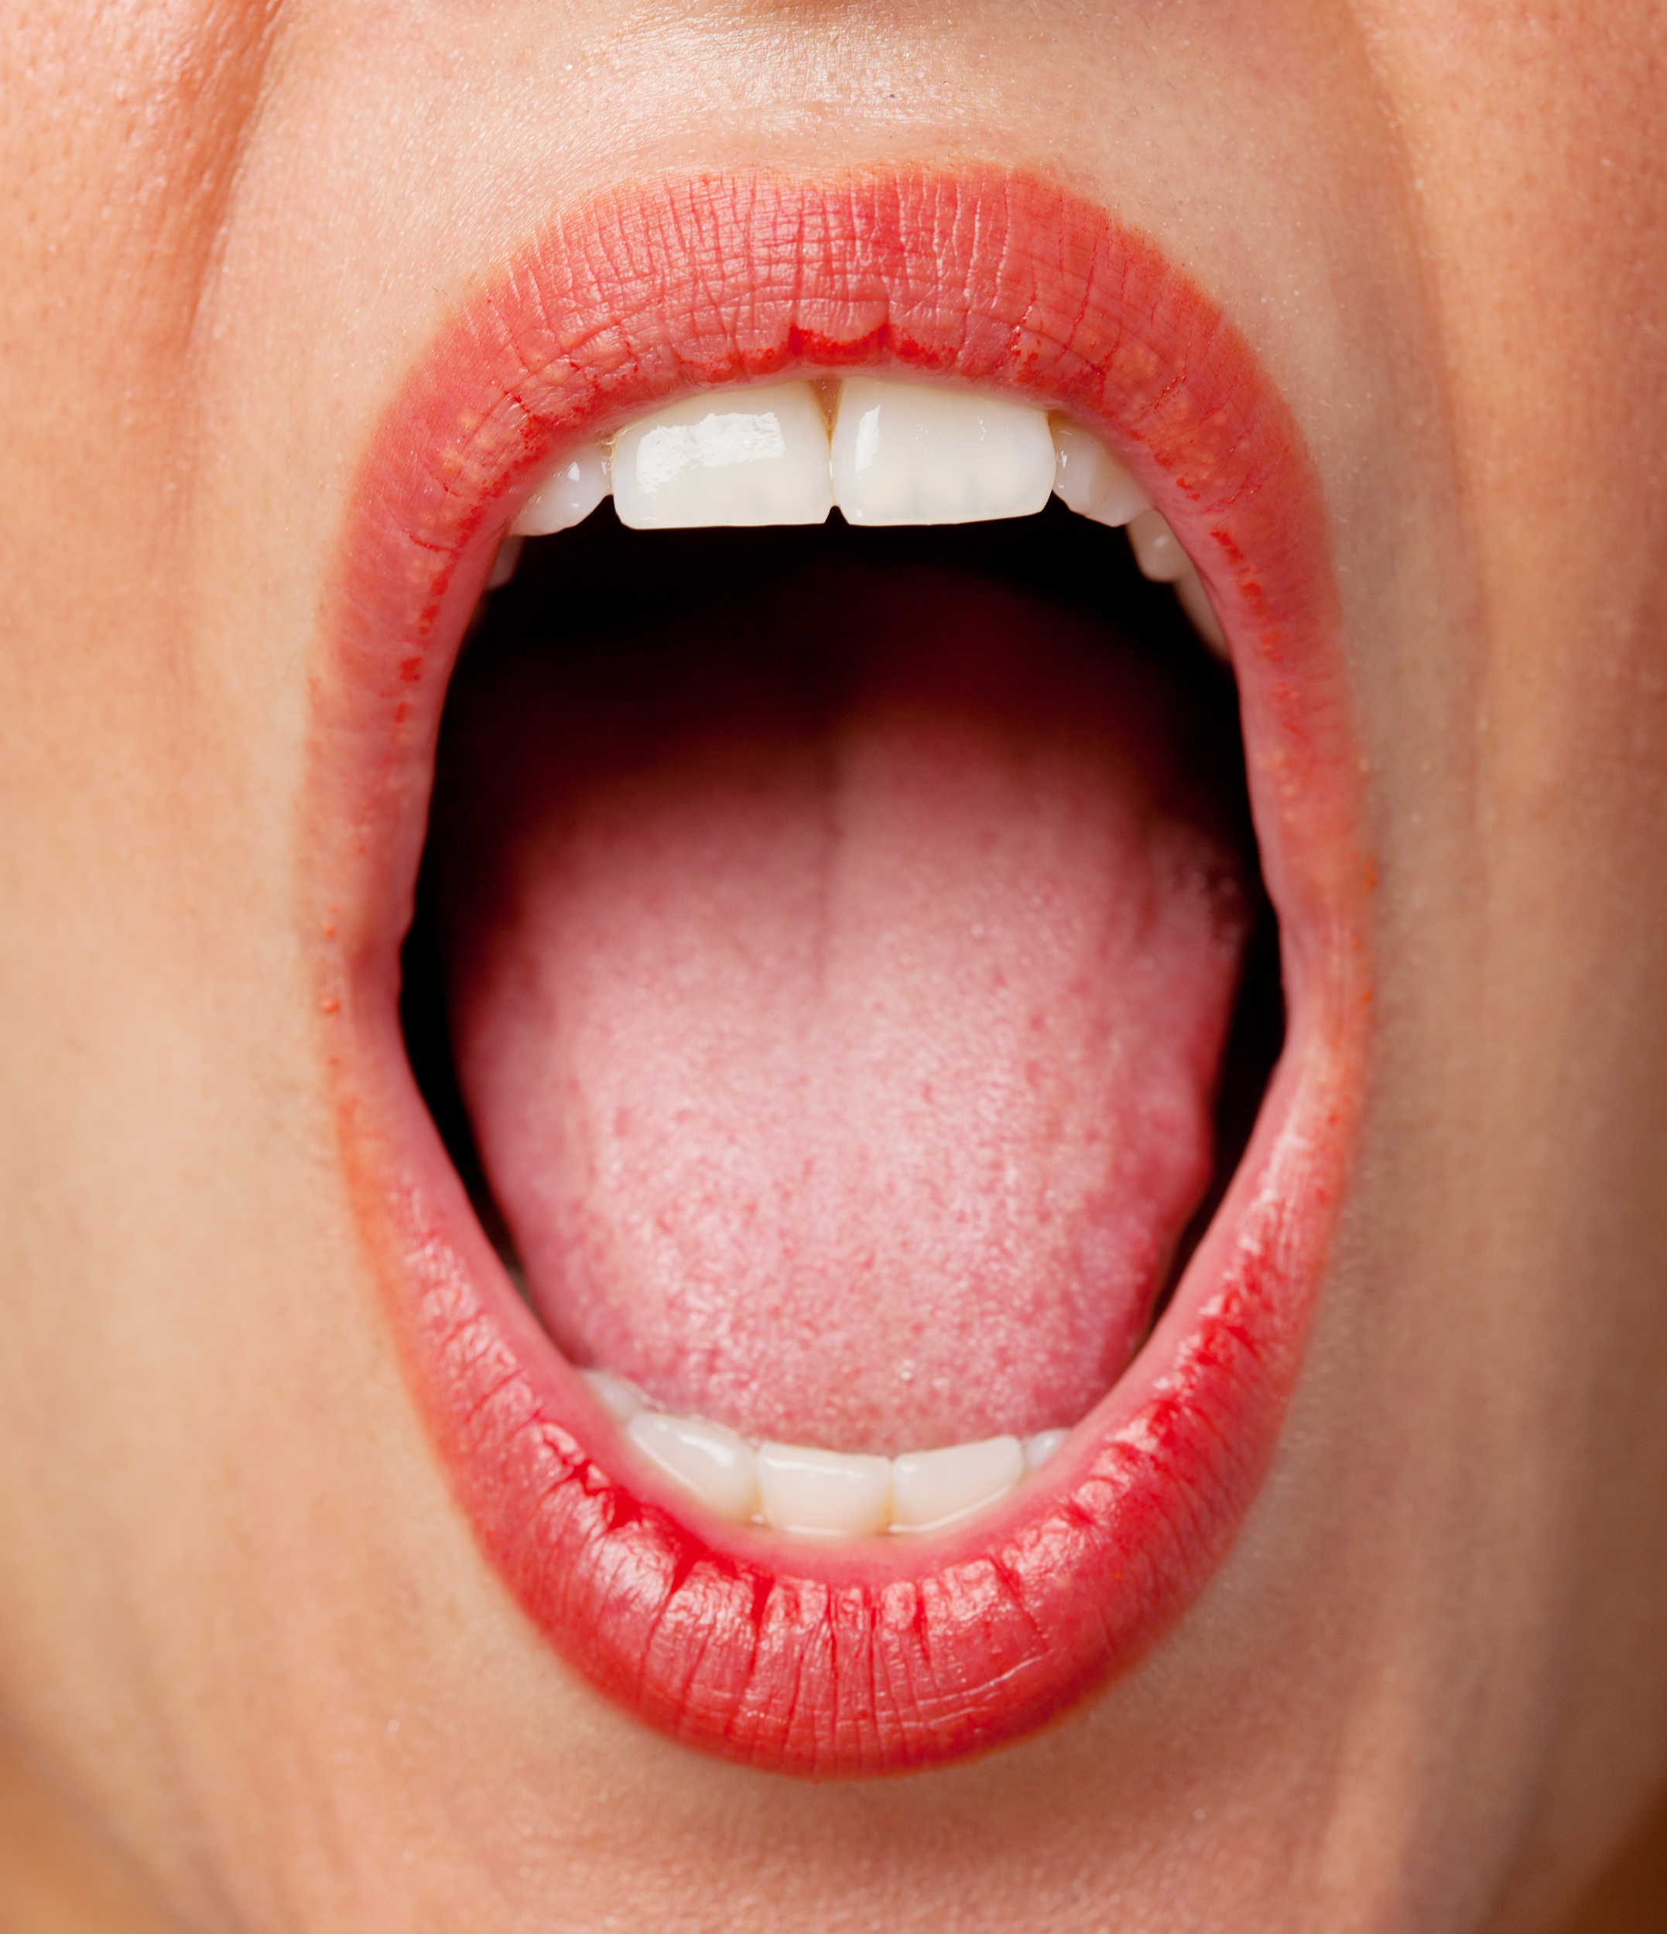
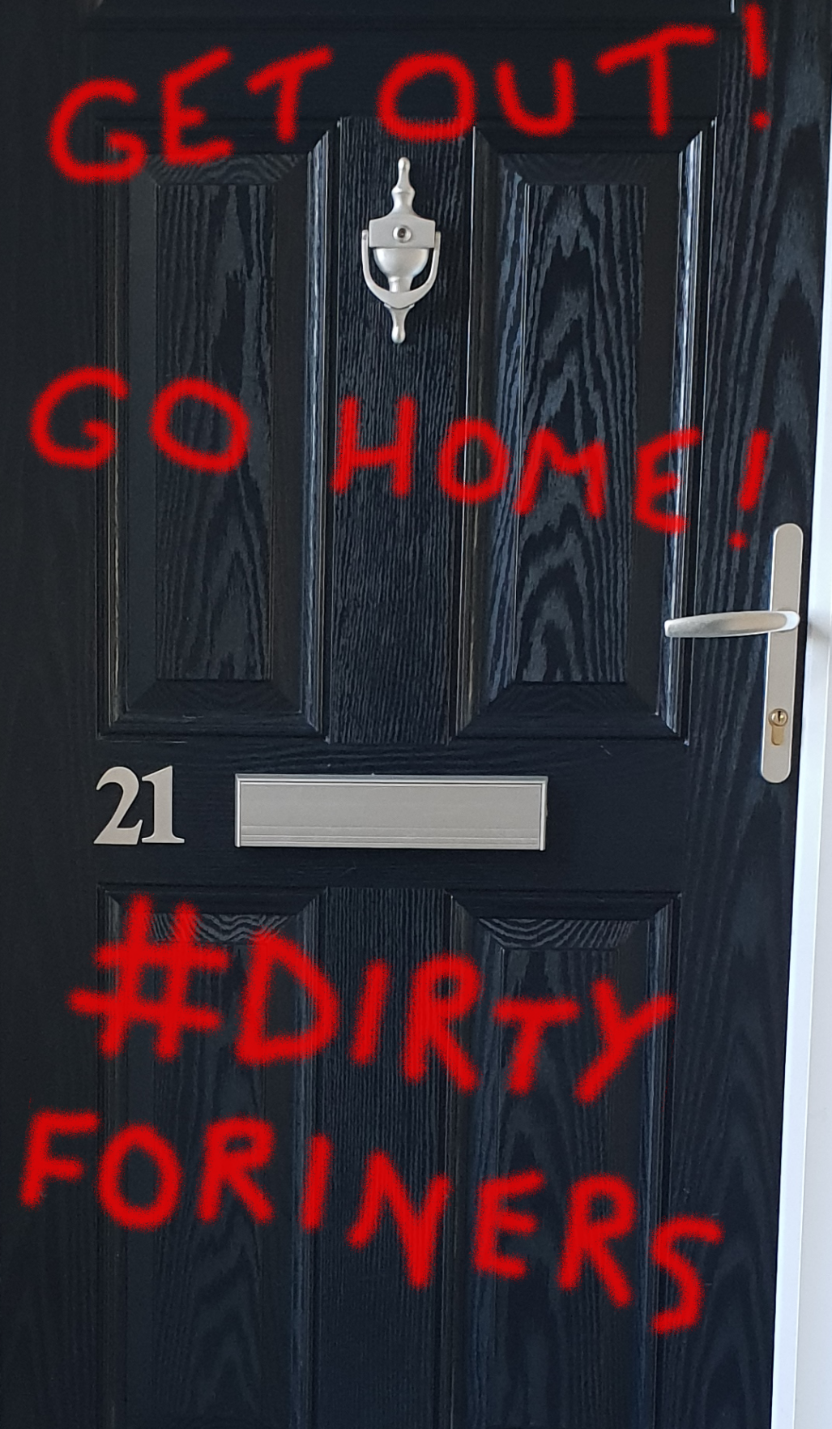
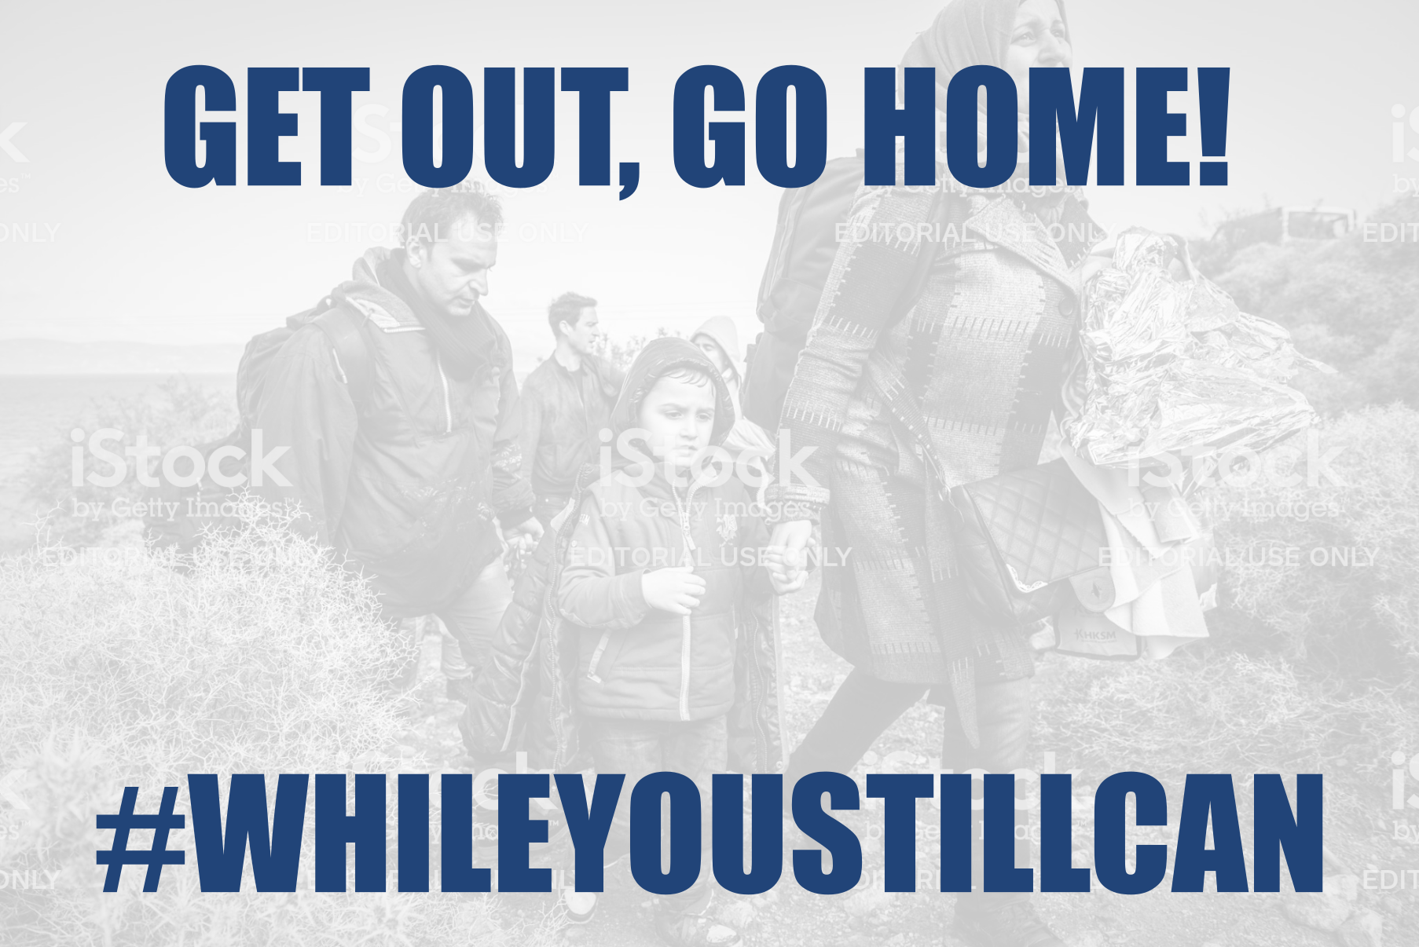
GET OUT!
GO HOME!
Spoken by a bar owner at the end of the night, trying to get everyone out of the bar so it can close.
Sprayed on the door of a newly arrived refugee family from Syria.
The text on an image of a refugee family from Syria, shared widely on social networks.

Slide 8
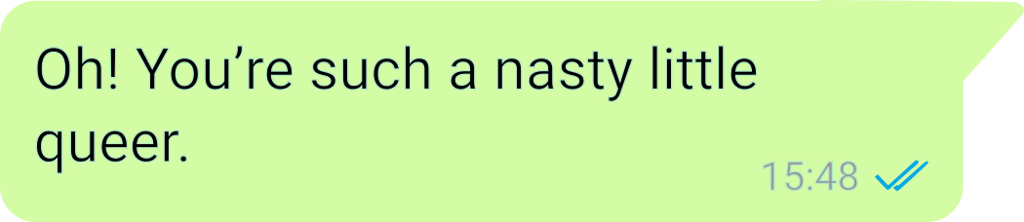
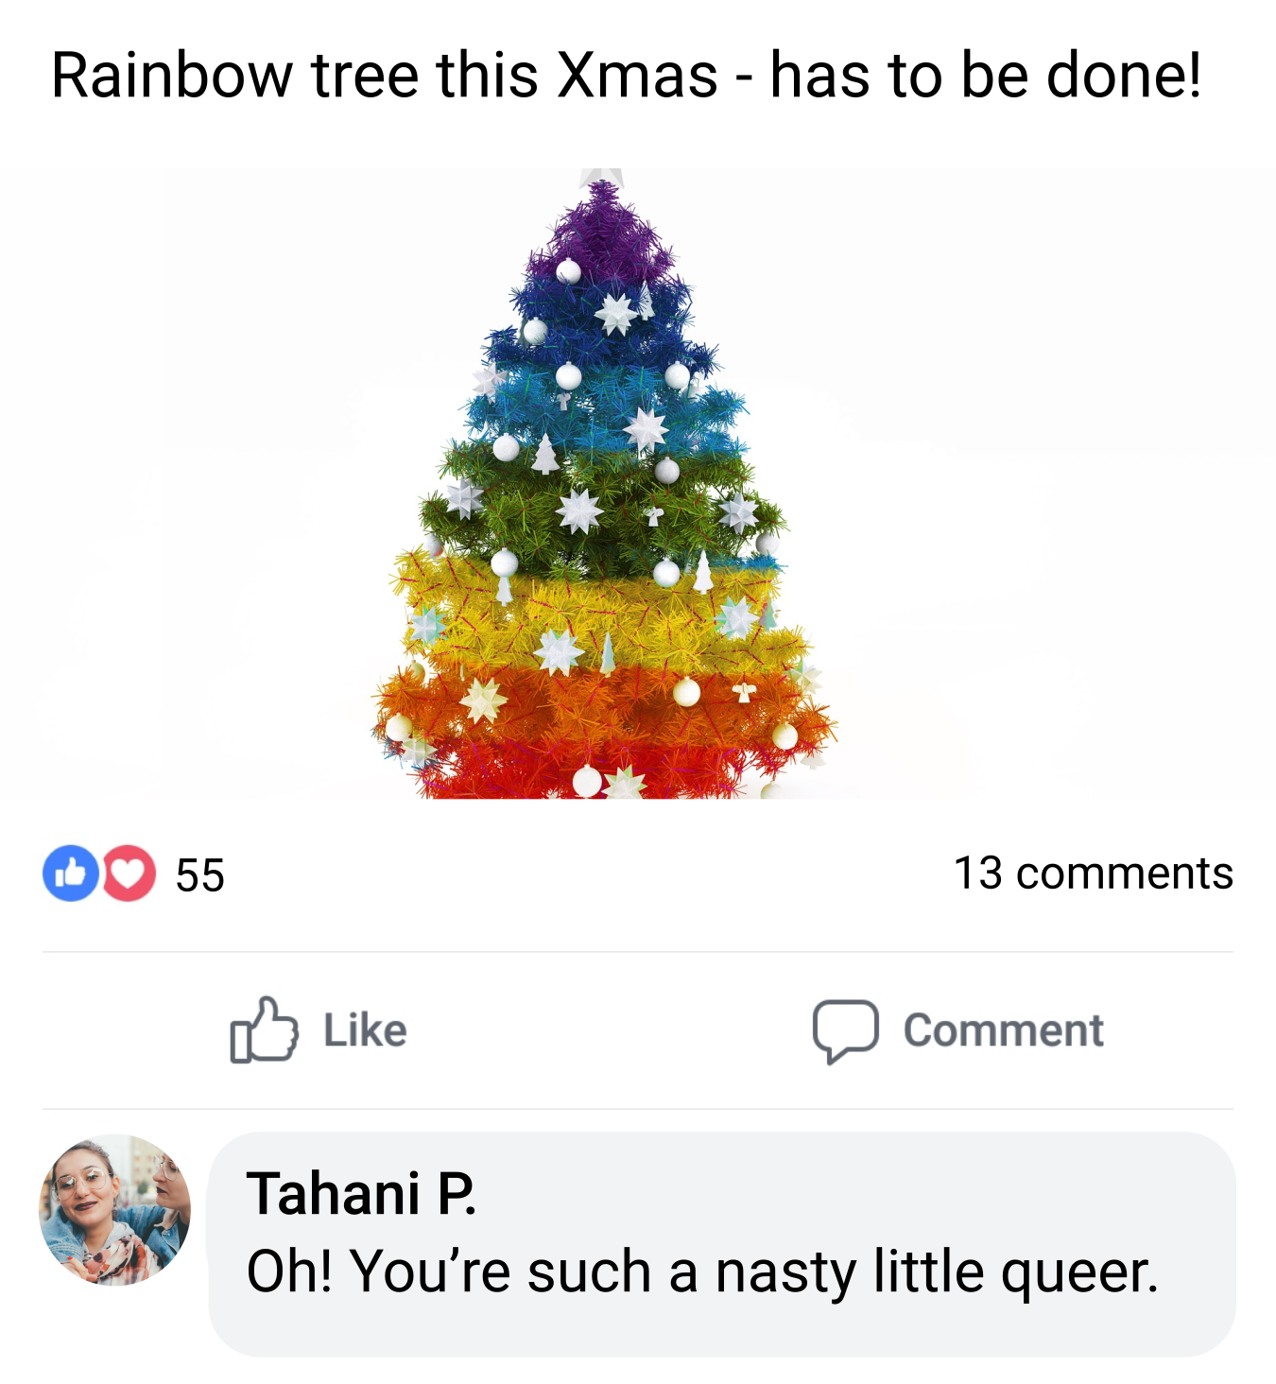
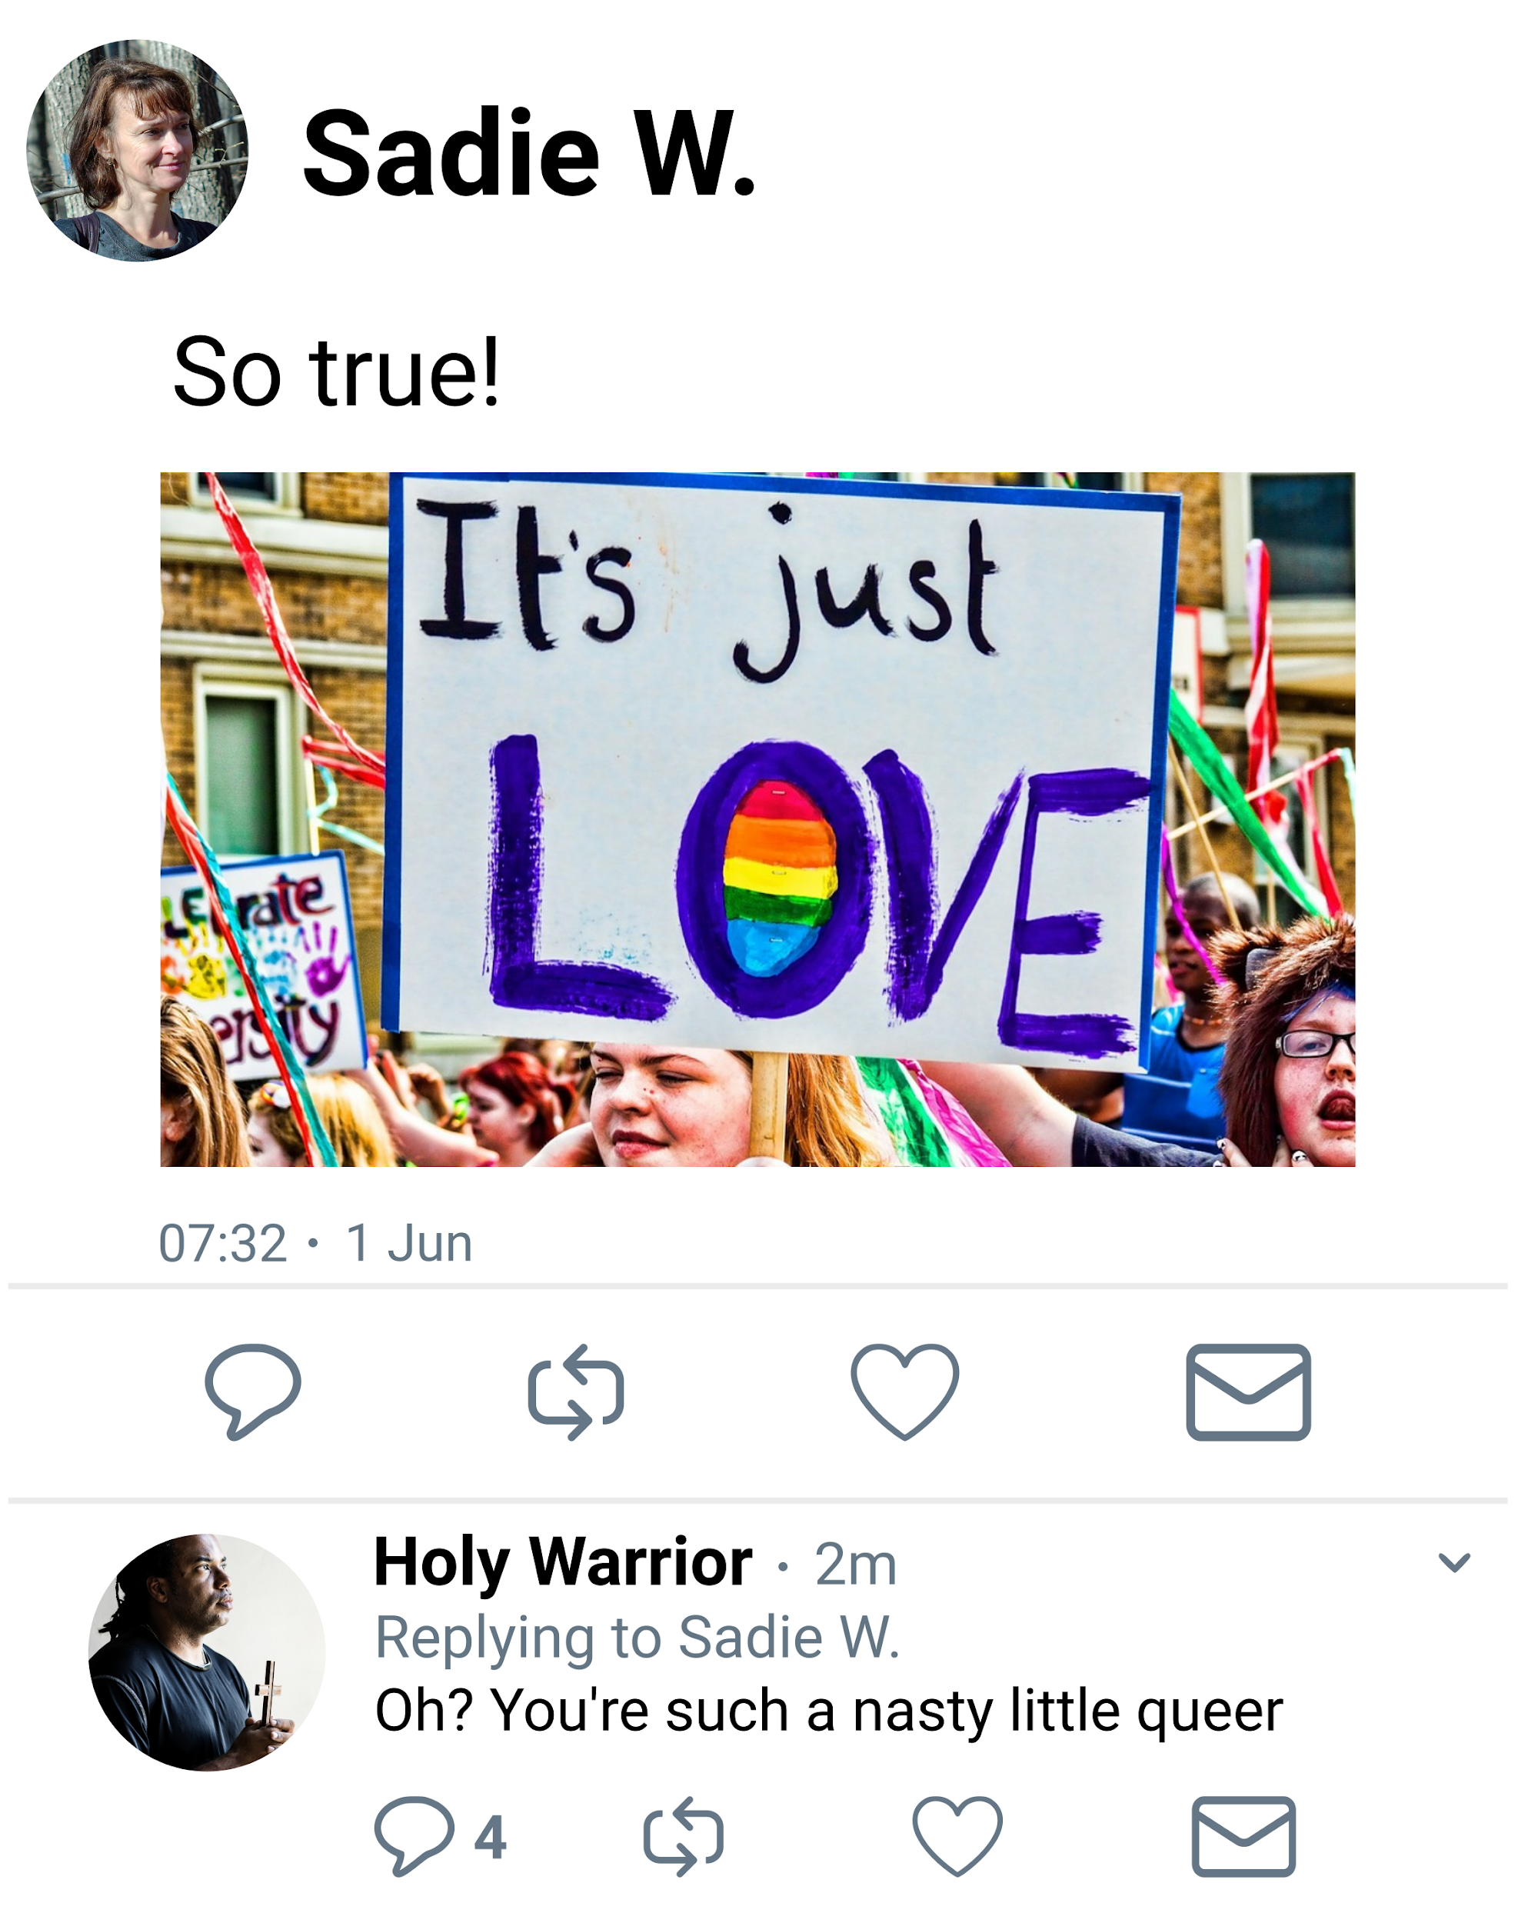

Slide 9
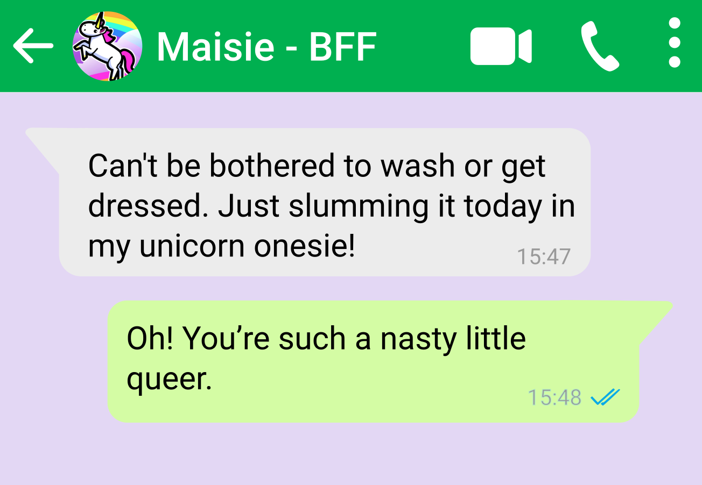
Written in a private message between two gay women.
Written in a public message from a straight man to a gay woman.
Written in a public message between two gay women.

Slide 10
Which factors did you consider when judging the context?
E.g.
Use of other words/language in the message
The identity of the author of the message
Relationship between author and recipient(s)
The method in which the message was shared (e.g. private message vs. public social media post)
Images/visual cues
Any other factors that influenced perception of the message

Slide 11








www.hackinghate.eu
#SELMA_eu

