Slide 1

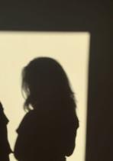
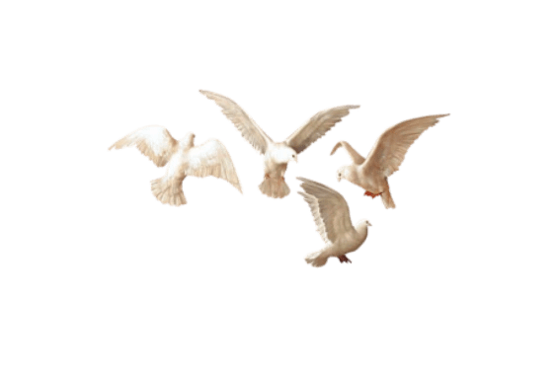

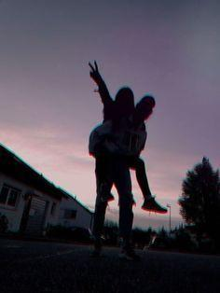
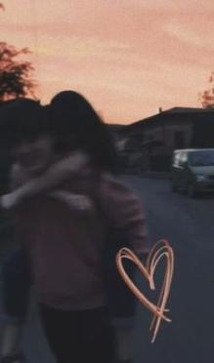


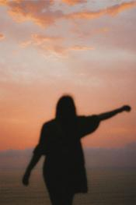


AESTETIC
PHOTOGRAPHY
Free Template

Slide 2
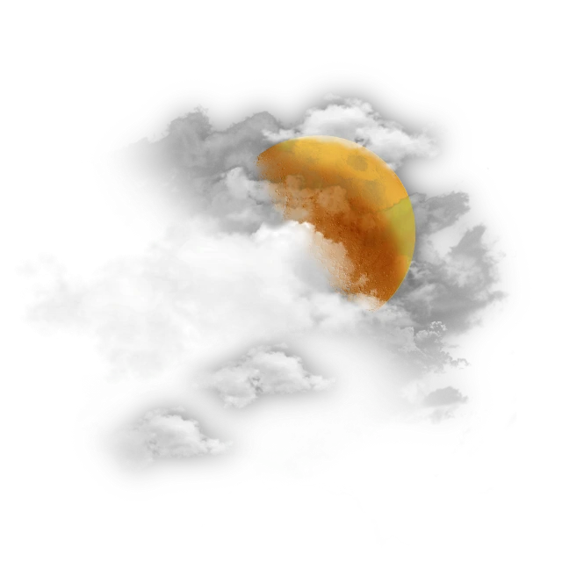
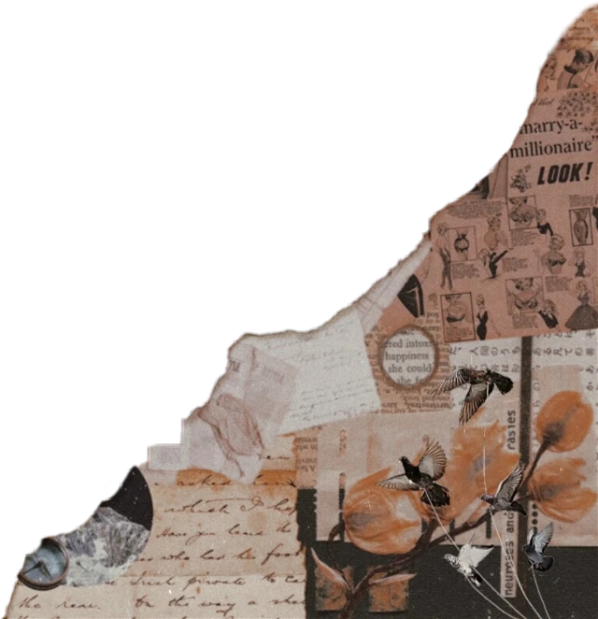
Contents of This Template
Here’s what you’ll find in this template:
A slide structure based on a thesis defense, which you can easily adapt to your needs. For more info on how to edit the template, please visit School or read our FAQs.
An assortment of pictures and illustrations that are suitable for use in the presentation can be found in the alternative resources slide.
A thanks slide, which you must keep so that proper credits for our design are given.
A resources slide, where you’ll find links to all the elements used in the template.
Instructions for use.

Slide 3
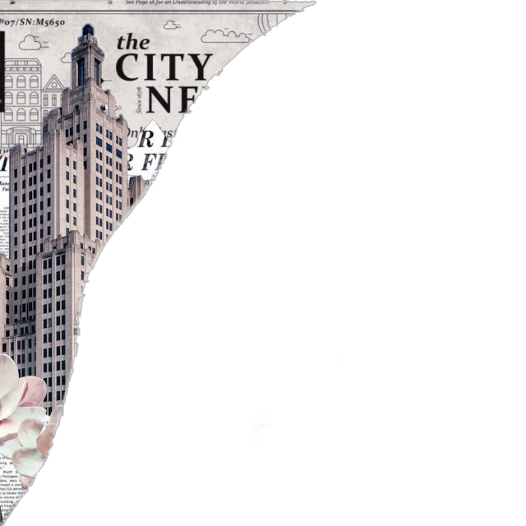
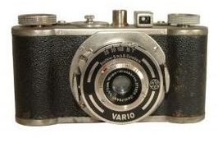

Table of Contents
01.
Objectives
02.
Methodology
Here you could describe the topic of the section
Here you could describe the topic of the section

Slide 4
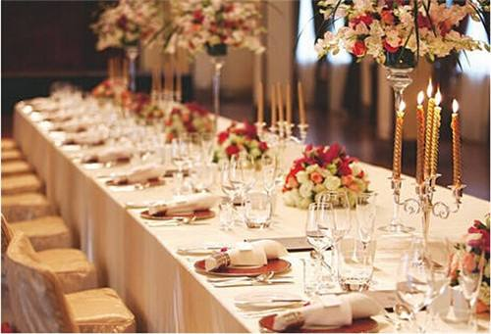
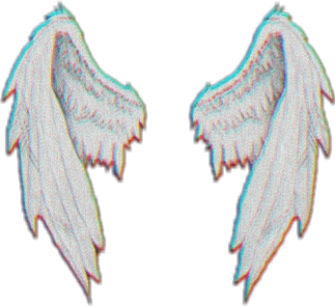
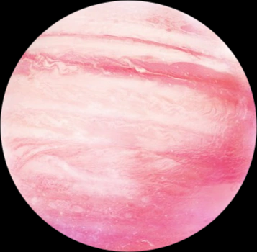
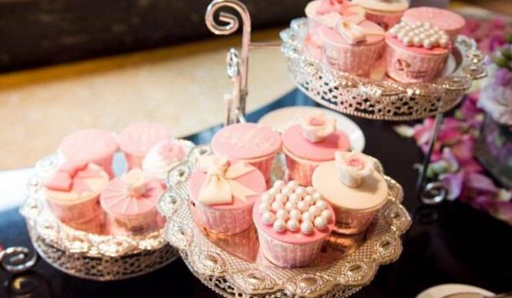
Title of the Thesis
Introduction
Venus has a beautiful name and is the second planet in the Solar System. It’s terribly hot—even hotter than Mercury—and its atmosphere is extremely poisonous

Slide 5
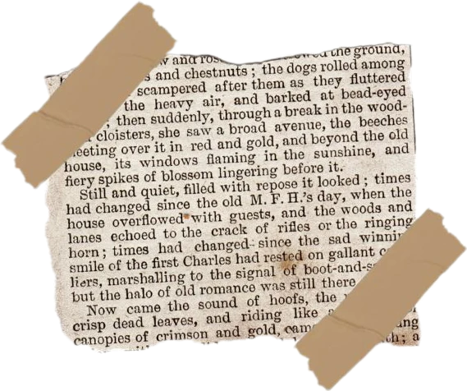

Table of Contents
03.
Results
Here you could describe the topic of the section
04.
Conclusions
Here you could describe the topic of the section

Slide 6
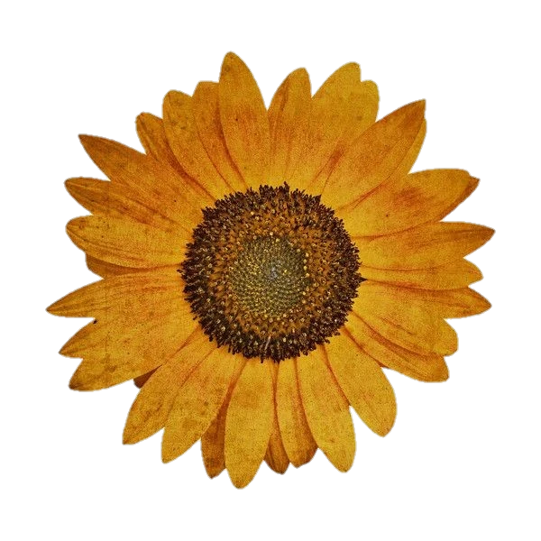
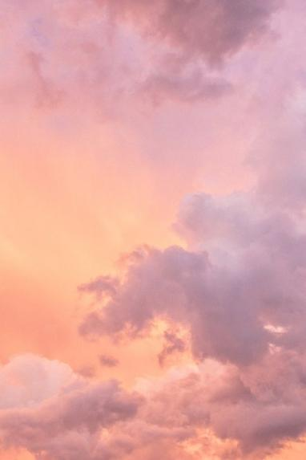
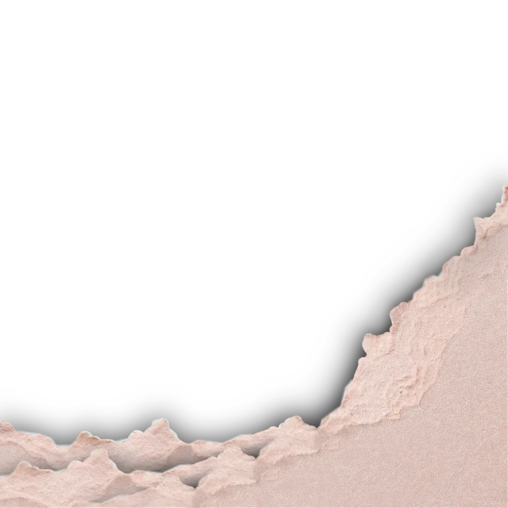
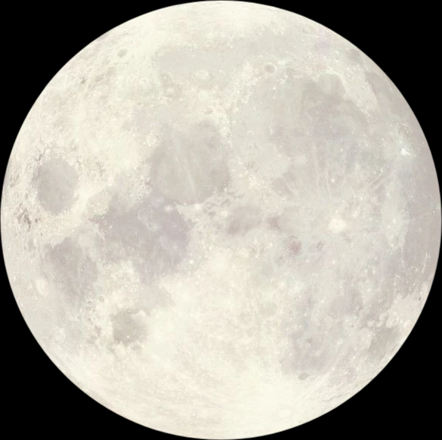

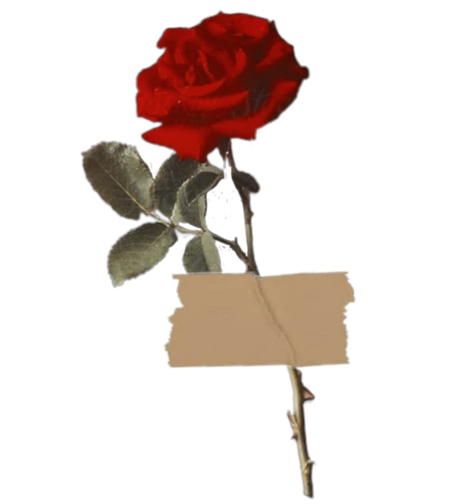
01
About
You could enter a subtitle here if you need it

Slide 7


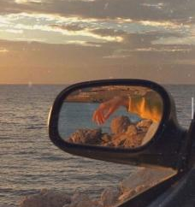
Methodology
Analysis
Neptune is very far away from Earth
Comparison
Jupiter is the biggest planet of them all

Slide 8
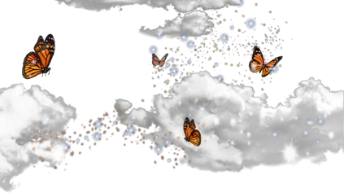
“This is a quote, words full of wisdom that someone important said and can make the reader get inspired.”
“This is a quote, words full of wisdom that someone important said and can make the reader get inspired.”
—Someone Famous

Slide 9
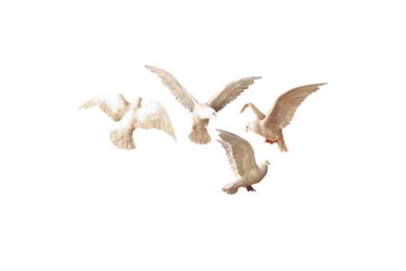

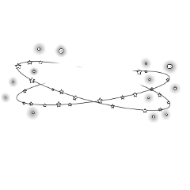
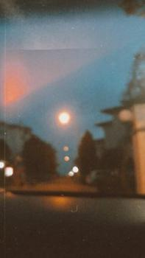


Study Objectives
Mercury
Venus
Mercury is the closest planet to the Sun and the smallest of them all
Venus has a beautiful name and is the second planet from the Sun

Slide 10
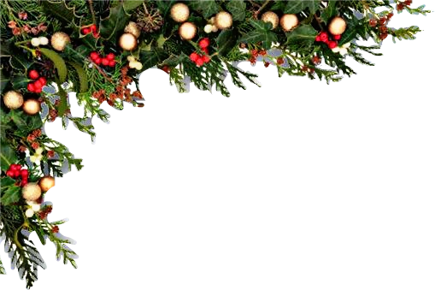
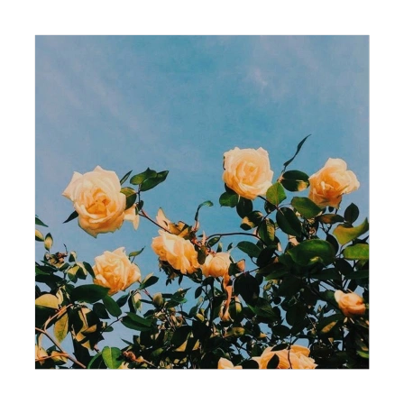
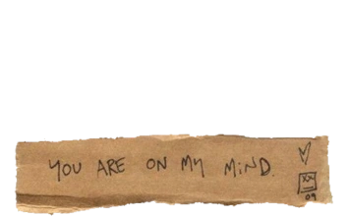
This Is a Map
Venus
Venus is the second planet from the Sun
Mercury
Mercury is the smallest planet
Earth
Earth is the only planet with life

Slide 11

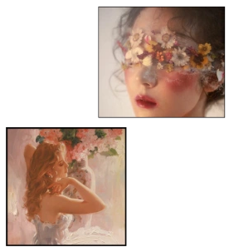
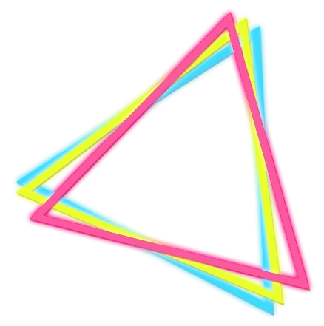
Introduction
Title of the Thesis
Venus has a beautiful name and is the second planet in the Solar System. It’s terribly hot—even hotter than Mercury—and its atmosphere is extremely poisonous

Slide 12
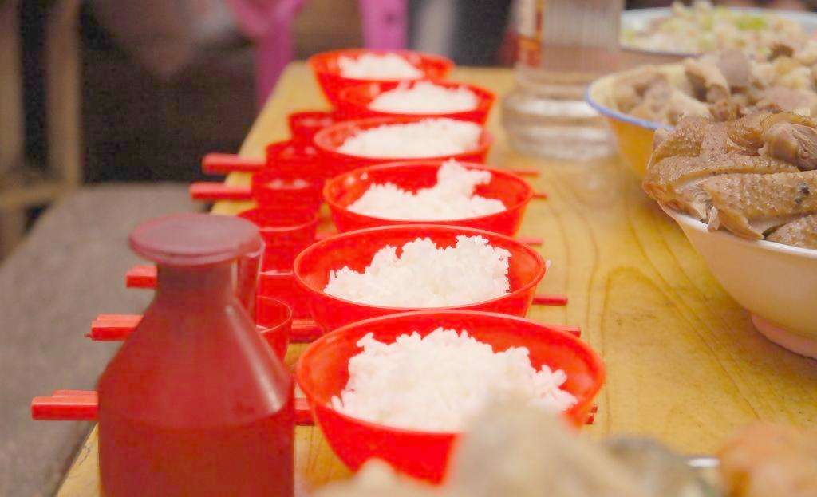
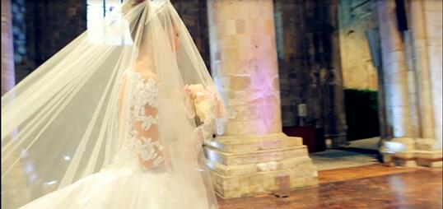
Objectives
Table of Contents
01.
Here you could describe the topic of the section
02.
Methodology
Here you could describe the topic of the section

Slide 13


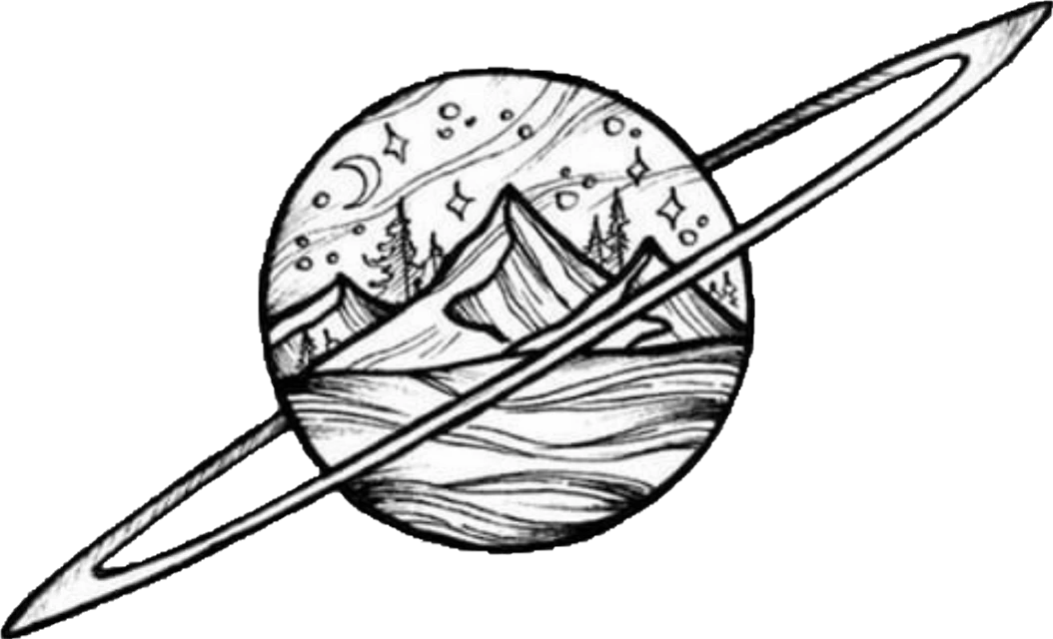
Methodology
Research
Data Study
Venus is the second planet from the Sun
Despite being red, Mars is a cold place

Slide 14
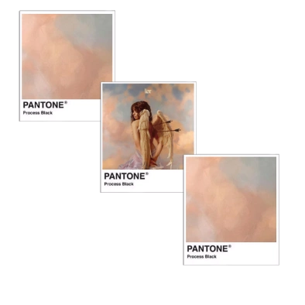
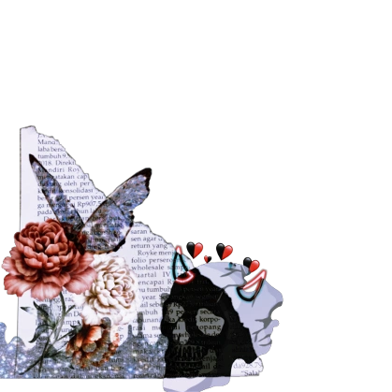

Literature Review
Theory 01
Mercury is the closest planet to the Sun and the smallest of them all

Slide 15


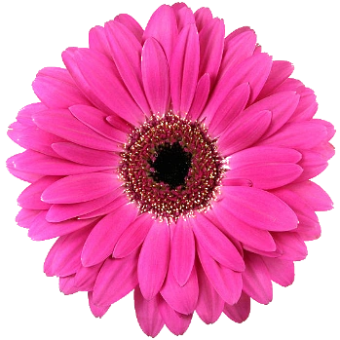
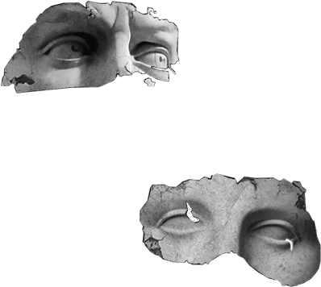
Bibliographic References
AUTHOR (YEAR): Title of the publication. Publisher
AUTHOR (YEAR): Title of the publication. Publisher
AUTHOR (YEAR): Title of the publication. Publisher
AUTHOR (YEAR): Title of the publication. Publisher
AUTHOR (YEAR): Title of the publication. Publisher
AUTHOR (YEAR): Title of the publication. Publisher

Slide 16
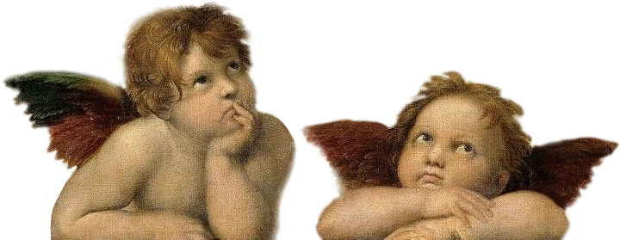
Mercury
Secondary Objectives
Venus
Earth
Mercury is the closest planet to the Sun
Venus has a beautiful name and is the second planet
Earth is the third planet from the Sun

Slide 17

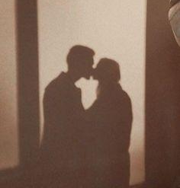
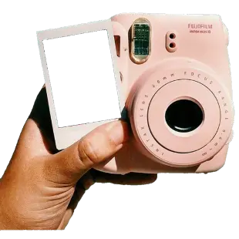
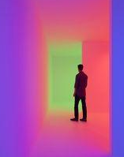
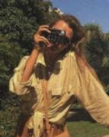
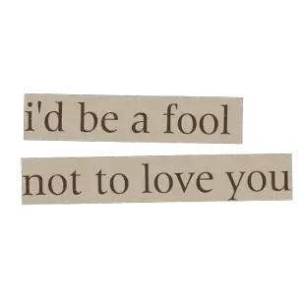
Awesome
PHOTO

Slide 18
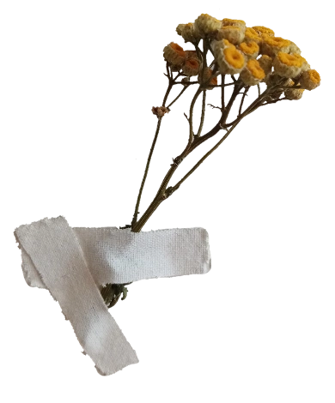
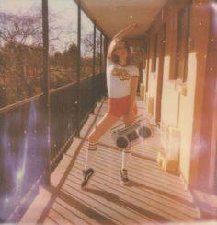
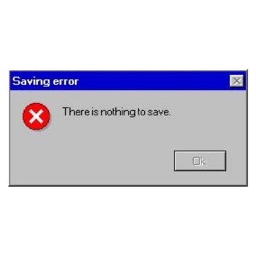
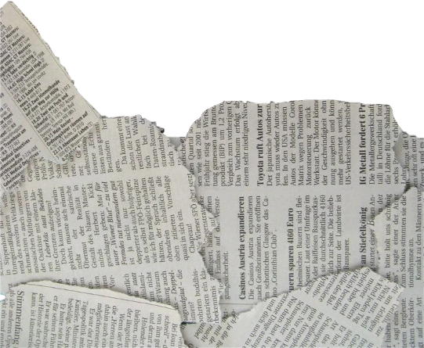
Your Work
You can replace the image on the screen with your own work. Just delete this one, add yours and center it properly

Slide 19

Resources
Vectors
Glasses with books for literacy day
International literacy day with lots of books
International literacy day celebration
Photos
Glasses on old books in library
Old books on library table
Ink pen on opened old notebook

Slide 20
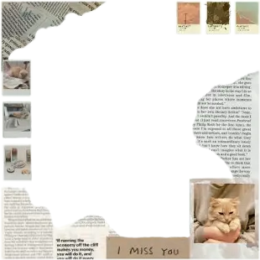
AESTATIC FREE
Schedule
1st Phase
2nd Phase
1st Week
Mo
Tu
We
Th
Fr
Sa
Su
2nd Week
Mo
Tu
We
Th
Fr
Sa
Su
3rd Phase
4th Phase

Slide 21
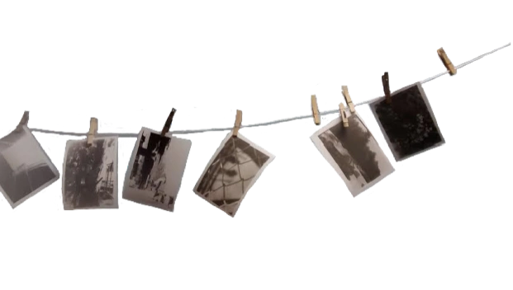
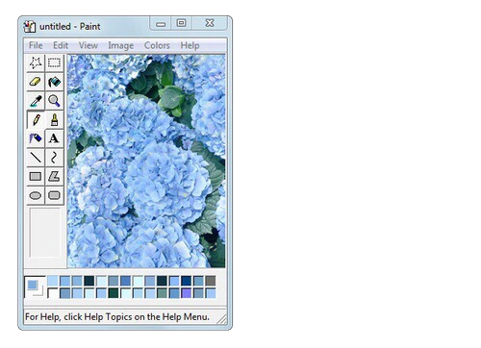
1,927
Big numbers catch your audience's attention

Slide 22

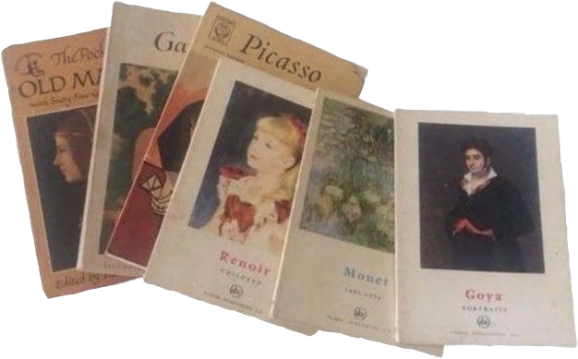
Table
 | Test 1 | Test 2 | Test 3 | Test 4
Indicator 1
Indicator 2
Indicator 3
Indicator 4

Slide 23


Timeline
Mercury
Mars
Mercury is the closest planet to the Sun
Now
Mars is actually a very cold place
Venus
1927
2027
Venus is the second planet from the Sun

Slide 24



A Picture Always Reinforces the Concept
Images reveal large amounts of data, so remember: Use an image instead of a long text

Slide 25

Contenido
Presentation
Presentation
Get a modern PowerPoint Presentation that is beautifully designed.
Get a modern PowerPoint Presentation that is beautifully designed.
2019
2021
2018
2020
2022
Presentation
Presentation
Presentation
Get a modern PowerPoint Presentation that is beautifully designed.
Get a modern PowerPoint Presentation that is beautifully designed.
Get a modern PowerPoint Presentation that is beautifully designed.

Slide 26





Important Percentages
33.5%
26.7%
18.2%
Mercury is the closest planet to the Sun
Despite being red, Mars is a cold place
Saturn is the ringed one and a gas giant

Slide 27





Contenido
Text Here
You can simply impress your audience and add a unique zing and appeal to your Presentations.

Slide 28
Alternative Resources
Vectors
Hand drawn international literacy day
International literacy day with stack of books
International literacy day draw
Photos
Bunch of old books
Pile of books on blue background
Smoke over antique notebook and ink pen

Slide 29


Thanks
Please keep this slide
for attribution

