Slide 1
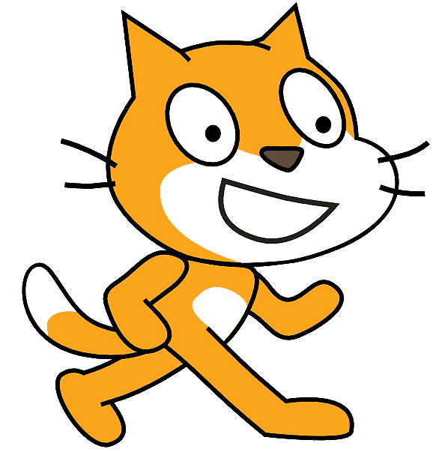


Using Scratch, present at least one concrete action you can take to help achieve the Responsible Consumption and Production goal.
To take on this challenge, you will need
to follow certain criteria.
Content of the animation or game
Your animation or game should include the following elements :
 | at least one concrete action you can take
 | at least two backdrops
 | at least two sprites
 | at least one sound or audio recording
 | at least one dialogue between two sprites
 | one interaction (ex.: question) with the user
RÉCIT document made available, with exception, according to the terms of the Creative Commons 4.0 License.

Slide 2

Content of your Scratch program
Your program should include the following elements :
 | motion blocks to animate your sprites
 | at least one sensing block (ex.: to ask a question to the user)
 | at least one conditional statement
 | at least one loop
 | at least two different event blocks
 | an animation between 2 and 4 minutes
Elements related to publication
To publish your project, you should:
 | have a meaningful title followed by Kreocode 2023 (e.g.: Game About Recycling - Kreocode 2023)
 | use images, photos or sounds that are copyright free (no photo or personal information of students)
 | cite any sources used in the space reserved for Notes and Credits
 | pay close attention to your use of language
 | indicate how to start your program in the Instructions section (if it does not start with the green flag)
 | shart the project (* once your project is complete)
RÉCIT document made available, with exception, according to the terms of the Creative Commons 4.0 License.

