Slide 1

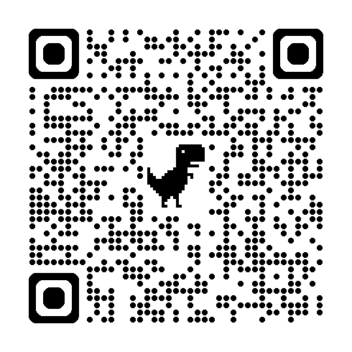
Cultural Responsiveness in Addressing Behavior
Please Scan the QR Code and Complete the Form to Record Your Session Attendance
Self-Starter in Your Packet
Never
Always
Digital Handouts: tinyurl.com/GranitePL2024CRAB
Notes:
5 minutes
Place handouts on the table near the door for people to pick up as they come in (or hand them out as people come in).
CR Addressing Behavior Handouts
Welcome - begin with the self-starter in your packet of handouts.
Think about these statements as we go about the presentation. We will revisit them at the end of the presentation with an exit ticket.

Slide 2


Agenda
Identity Markers Activity
A Model for Reframing Classroom Management:
Understand and Distinguish Behavior
Rethink Control and Power Dynamics
Be Proactive Instead of Reactive
Respond to the Child, not the Behavior
Wrap up
Notes:
30 seconds

Slide 3

Shared Norms - Community Agreements
Stay engaged
Speak your truth
Listen for understanding
Experience discomfort and stay curious
Expect and accept non-closure
Maintain confidentiality
Withhold judgment (no blame, no shame, no guilt)
“What’s said here, stays here.
What’s learned here, leaves here.”
Do you think there are any that aren’t covered here?
Notes:
1 minute
Take a minute and read through these Community Agreements. Are there any that aren’t covered?
Remember “What’s said here, stays here, what’s learned here, leaves here.” We will take the learning with us. We might hear a personal story that moves us but we don’t need to share someone else’s story as our own. We are part of something bigger and we are committed to our collective impact.

Slide 4

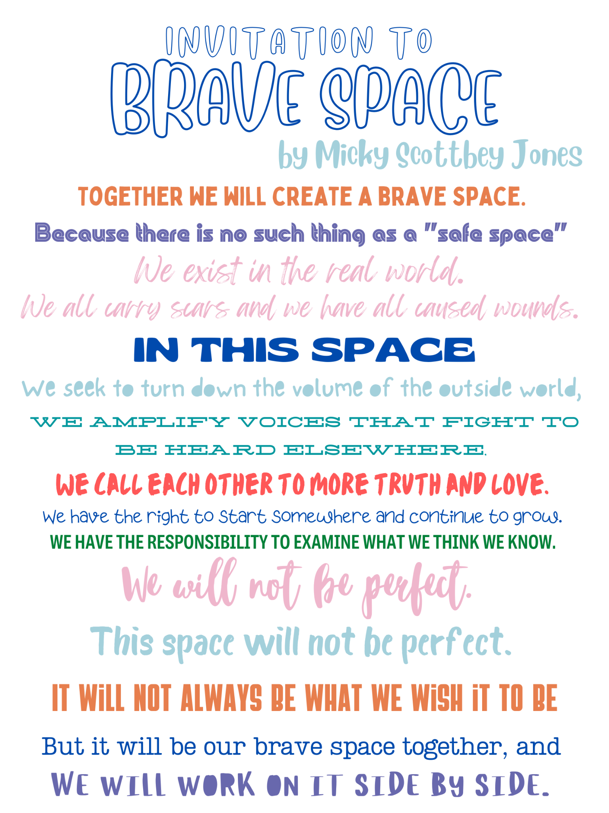
Invitation to a Brave Space
Together we will create brave space
Because there is no such thing as a “safe space”
We exist in the real world
We all carry scars and we have all caused wounds.
IN THIS SPACE
We seek to turn down the volume of the outside world.
We amplify voices that fight to be heard elsewhere,
We call each other to more truth and love
We have the right to start somewhere and continue to grow.
We have the responsibility to examine what we think we know.
We will not be perfect.
It will not always be what we wish it to be
But it will be our brave space together,
And we will work on it side by side.
Micky Scottbey Jones
Brave Space Printable
Notes:
1 minute
I wanted to start by inviting you to this brave space. We know that equity is a bit of a hot topic, especially right now. The idea of equity is not going anywhere. Looking at the last section of the poem - We will not be perfect. But we will work together, side-by-side. We’re going to be talking about ourselves and our identities. Remember we are not here to judge each other, but to support each other.

Slide 5
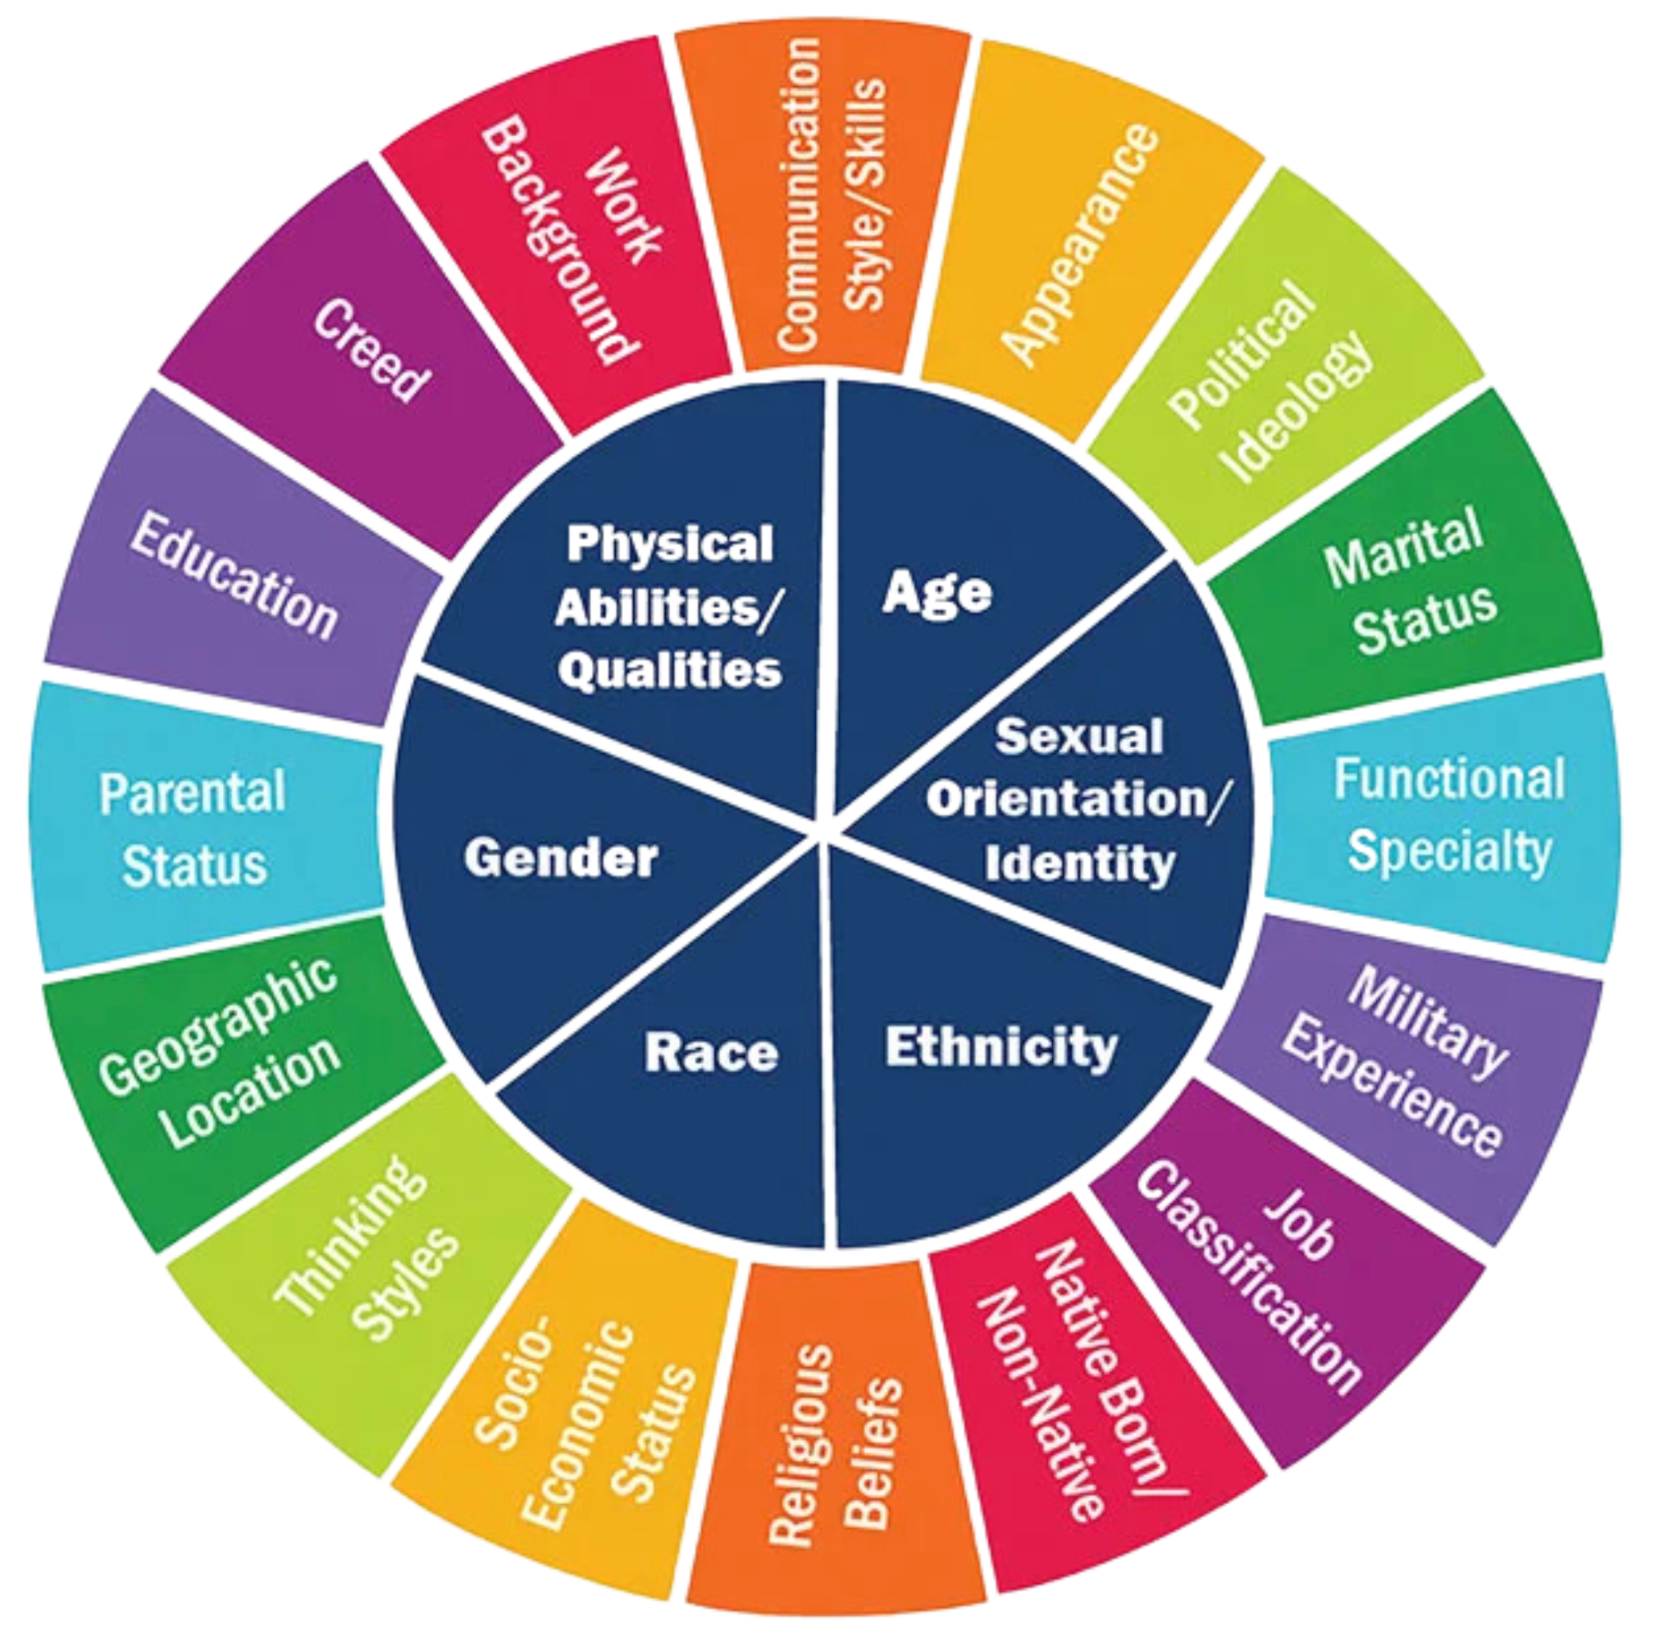
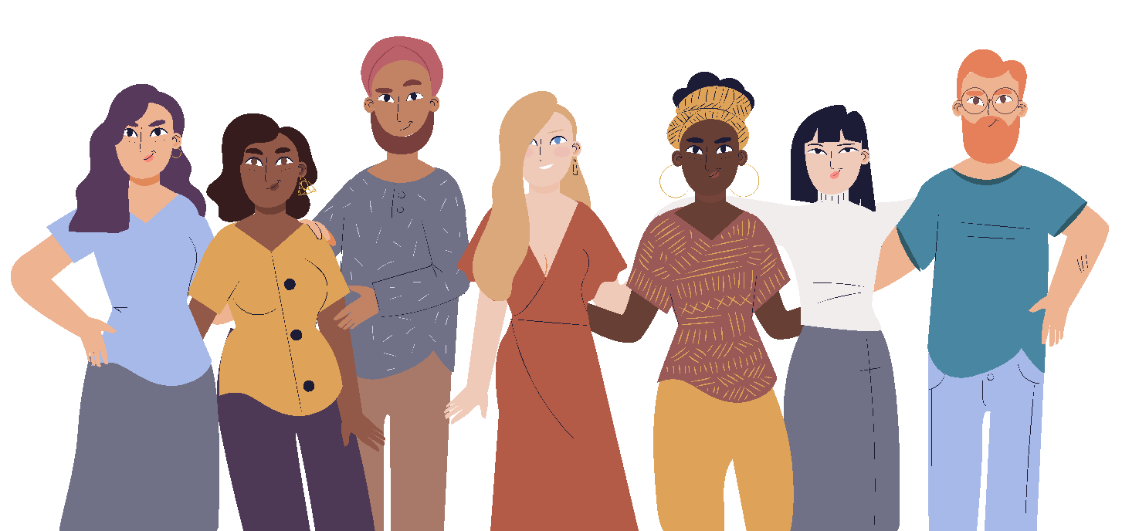
Identity Wheel
What’s your story?
What’s our connection?
Digital Handouts: tinyurl.com/GranitePL2024CRAB
Notes:
7 minutes
CR Addressing Behavior Handouts
Open your handout packet to the Identity Wheel. On this page you’ll see the Identity Wheel as well as several Identity Markers. In the middle of the wheel are markers that are easy to see. They are the things that people notice about you first. The outer wheel are all of the factors that aren’t so obvious.
Take 3-5 minutes to look at the handout. Read through the examples of identity markers in the table as well as those on the identity wheel. On the next two pages put marks in the boxes for the identity markers that answer that question. We have left some space, feel free to add any identity markers that you feel might have been missed. We will only spend about 3-5 minutes to activate background knowledge. We know that these questions could change and take a lifetime to answer :)

Slide 6

Reflect
When you look at your three most important identity markers, which specific life experiences made those so prominent?
What impact have your top identity markers had on your life?
Have any of your identity markers felt more salient or relevant during other periods of your life? How so?
Do your closest friends share aspects of your identity? In which way(s)?
What have you learned about yourself from this activity?
Digital Handouts: tinyurl.com/GranitePL2024CRAB
Notes:
7 minutes
Talking Points: We know that you probably didn’t have enough time to completely finish filling out the table and looking at your identity markers. We hope that this activity has given you some food for thought and that you will continue to reflect on your identity and how it influences your perspectives and connections with others. Let’s take five minutes to silently reflect on these questions. You may take notes on the handout if you choose.
---
After giving time to sit with and reflect on these questions, ask if there are any volunteers who feel comfortable sharing about their reflections. Share out stories and connections as people are willing.
---
Your identity, likes and dislikes, pet peeves and tolerances will all contribute to your classroom culture. Today we will talk about how we can be authentic and make our classrooms a place where all students can thrive. Let’s take a look at some common undesired behaviors in our Granite School District Classrooms. -->

Slide 7
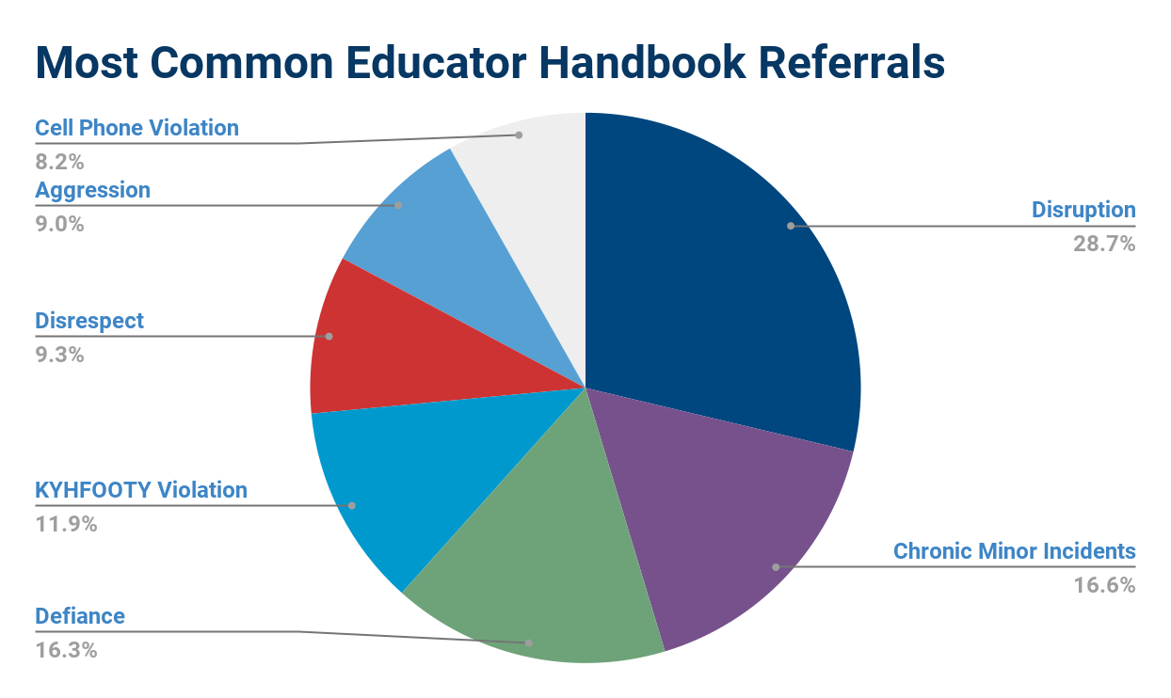

Notes:
1 minute
We know that teachers are seeing an increase in undesired behaviors. This graphic shows 7 of the most common referrals in Granite DIstrict’s Educator Handbook. These are not the only behaviors we see in the classroom but they are the most commonly reported behaviors.
Thumbs Up/Thumbs Down: Do you think that these behaviors have the potential to escalate into more serious violations?
Those of you who have classroom experience, raise your hand if you would rather deal with these minor behaviors than the escalated behaviors. In today’s presentation we want to show you some ways of addressing these minor behaviors before they become major.

Slide 8
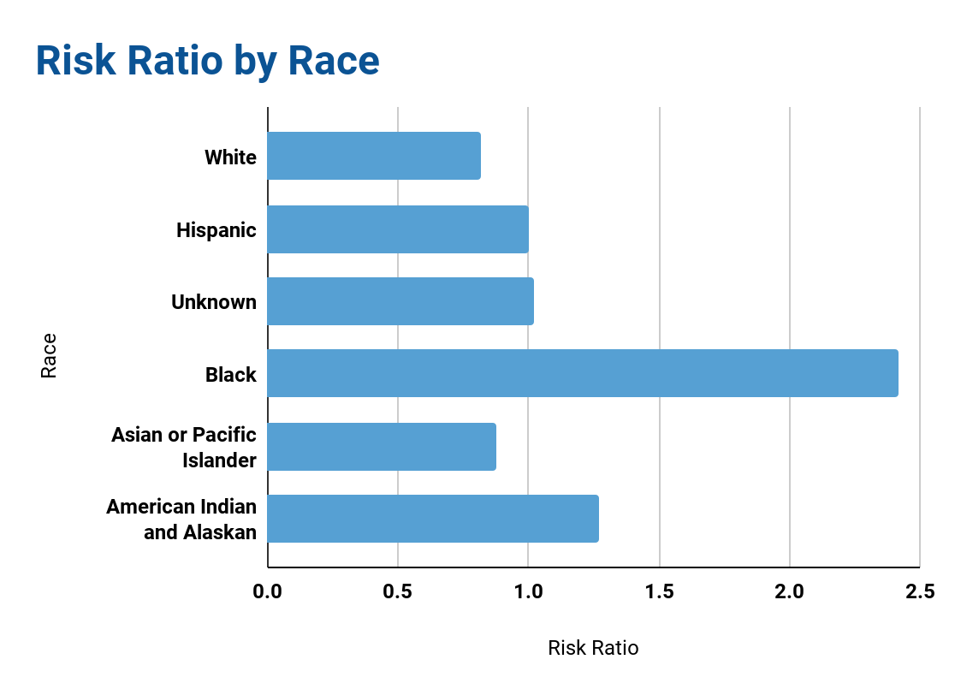
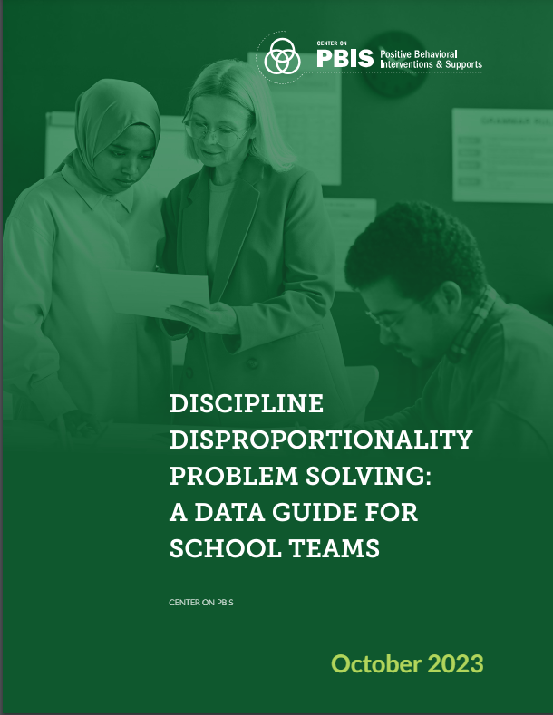
Based on 2023-2024 Educators Handbook Data
For more information on Risk Ratio:
1.0 means that students in that group receive their “fair share” of Educators Handbook referrals.
Notes:
2 minutes
Going back to the identity markers, one of the markers that we can look at is race.
We can look at whether students are disproportionately affected by disciplinary actions by using risk ratio. If you want more information on risk ratio, the document linked on the slide goes over how it is calculated. If a population has a risk ratio of 1, that means that it aligns with the risk ratio of the overall population. A risk ratio of more than 1.0 indicates that members of a population are at a higher risk for disciplinary action than the overall population.
Turn and Talk: Looking at this graph, what do you notice? What do you wonder? Take one minute and talk with your neighbor about the graph.

Slide 9
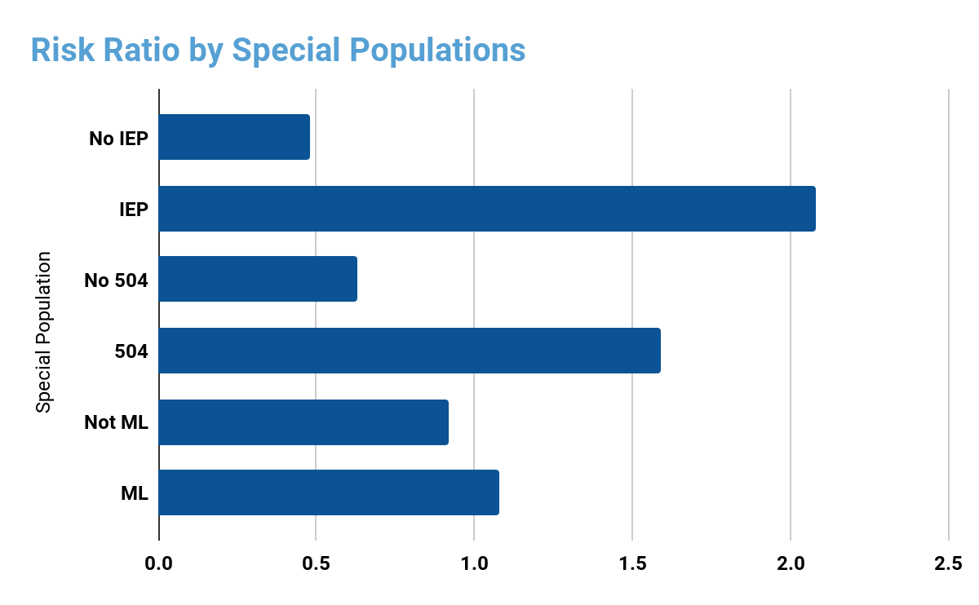
Based on 2023-2024 Educators Handbook Data
For more information on Risk Ratio:
*ML = Multilingual Learner
1.0 means that students in that group receive their “fair share” of Educators Handbook referrals.
Notes:
1 minute
Race is only one of many identity markers that we look at when we think about disproportionate discipline. This graph uses the same risk ratio measurement based on special populations. Students with an IEP vs. students without. Students with a 504 vs. those without. And ML students vs. non-ML students. Remember that some students may be in more than one of these categories.
Turn and Talk: What do you notice about the graph? What do you wonder? Take one minute and talk with your neighbor about the graph.

Slide 10
Adaptation of
existing systems to better meet the needs, values, and strengths of students,
families, communities.
Language
Visual Representations
Relevance
Instructional Methods
Voice and Choice
Co-creation of Systems
What is Cultural Responsiveness?
Notes:
1 minute
As reflected in the Educator’s Handbook data, our current systems are not meeting the needs of all our students. By meeting our students needs, we make our jobs easier in the long run because it will decrease discipline issues. Cultural responsiveness works to adapt our existing systems in order to better meet the needs of all of our students. Some things that we can adapt or implement to better meet our students’ needs are in the bullet points.

Slide 11
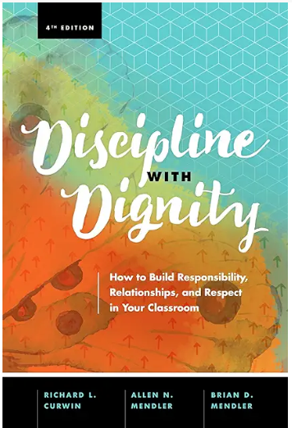
Discipline with Dignity
Discipline is an important part of the job and every educator must be prepared to accept that reality.
Students always deserve to be treated with dignity.
School is for all students, not just the good ones.
Embracing the journey makes the ride easier.
Good discipline requires short-term solutions without sacrificing the long term goals.
Effective discipline has its own DNA (discussion, negotiation, agreement).
Starting fresh every day keeps optimism intact.
Learning how to get along with others, to solve problems and make responsible choices
Notes:
2 minutes
As we are working with our students, one thing we need to do is discipline while maintaining their dignity. The book Discipline with Dignity has some great information. These are some of the core principles in Discipline with Dignity. We will be using several sources in our presentation today, this book is one of them.
Take a moment to read through them. Turn and talk with a neighbor: Which ones are easy for you to embrace? Which ones give you some hesitation?

Slide 12

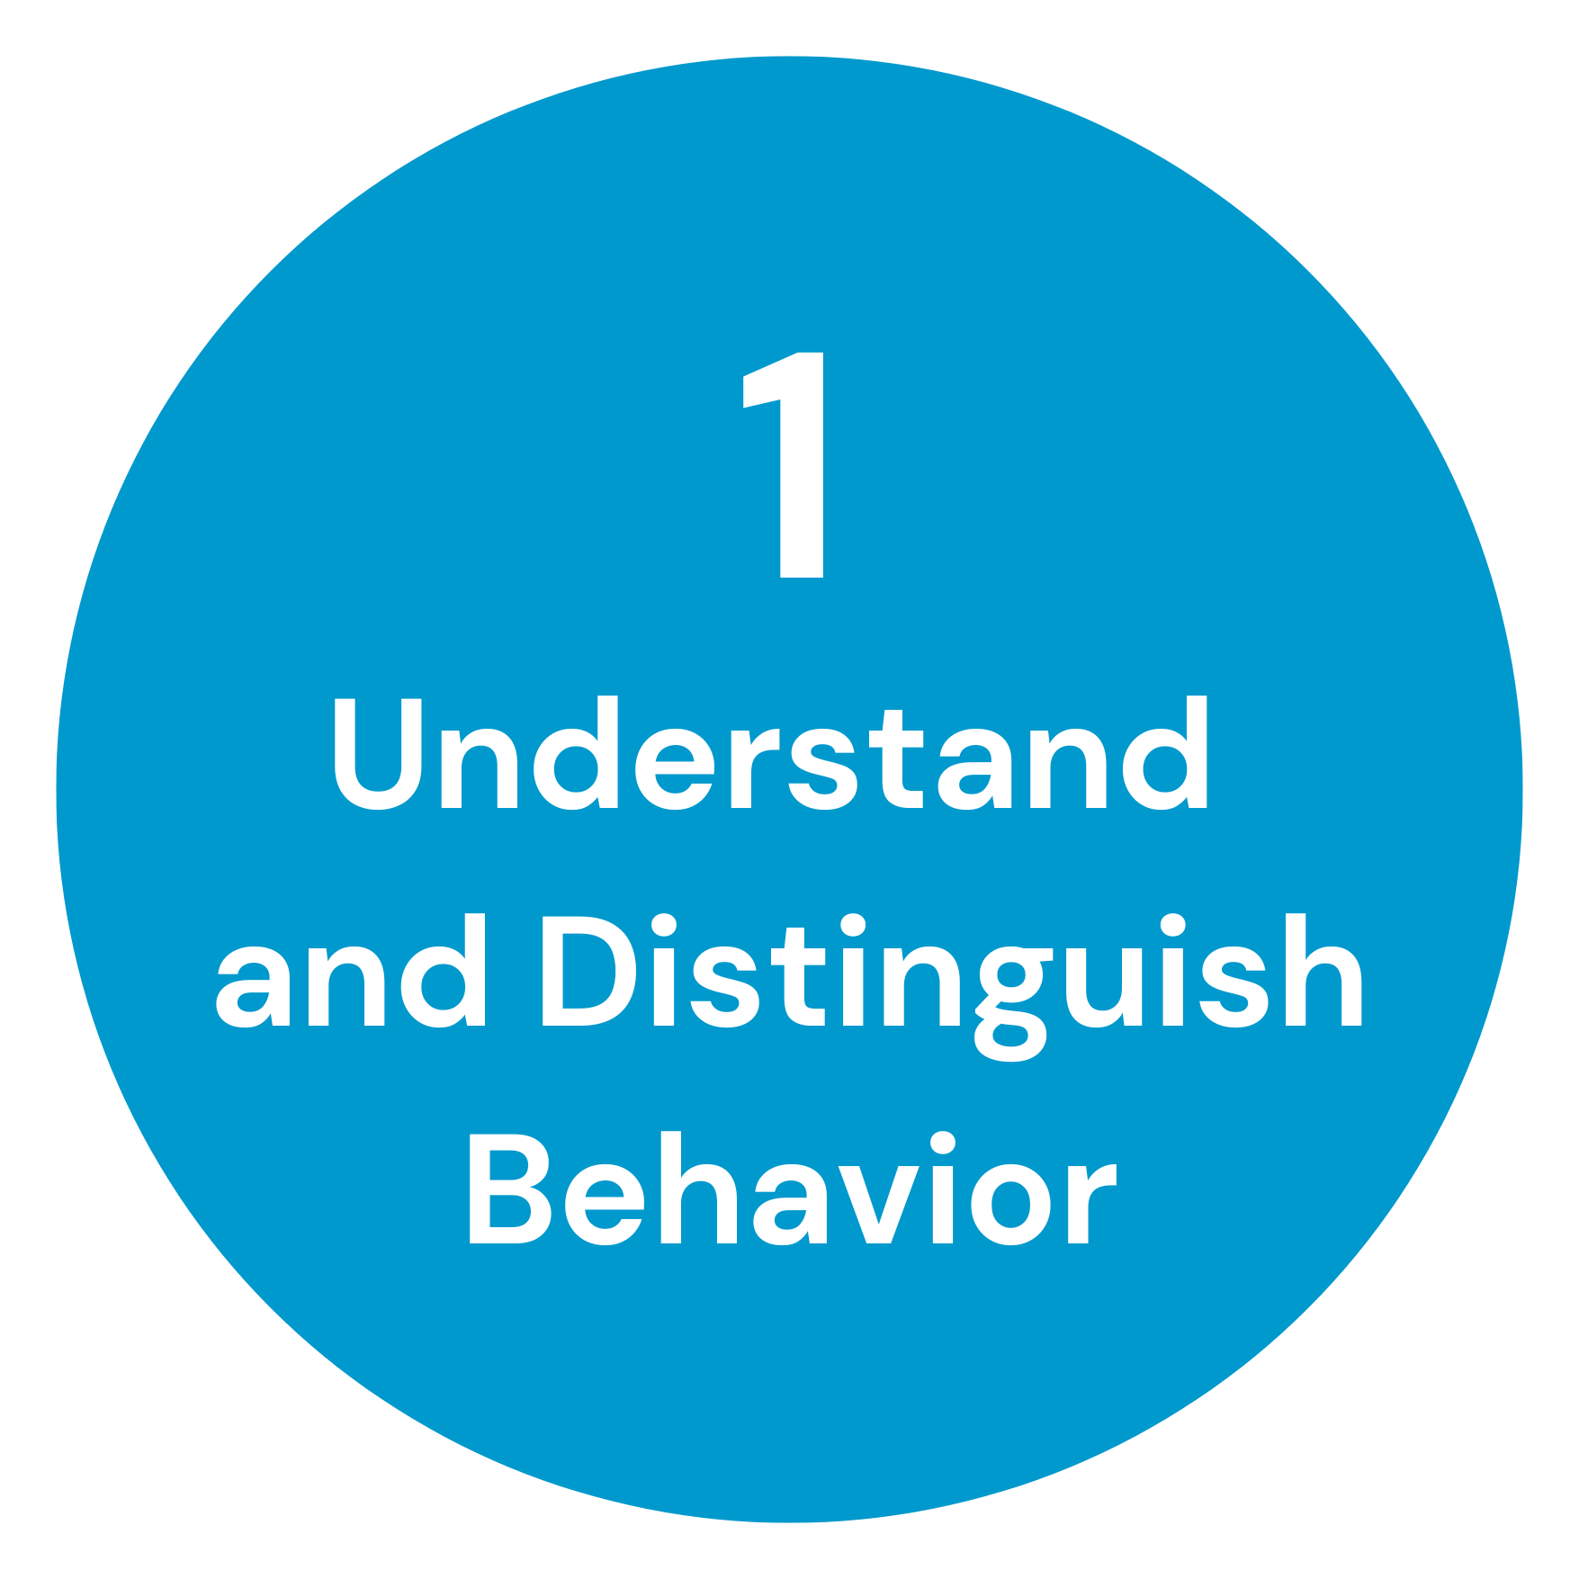
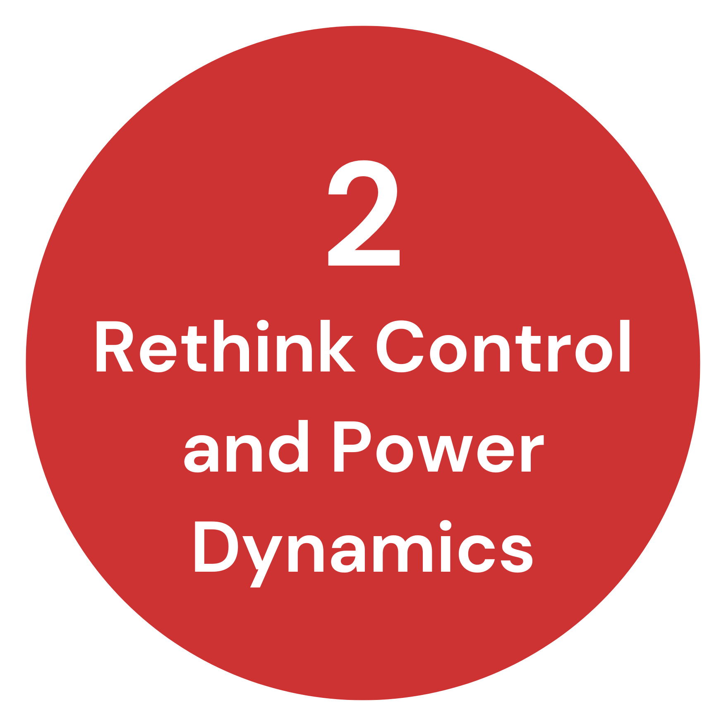
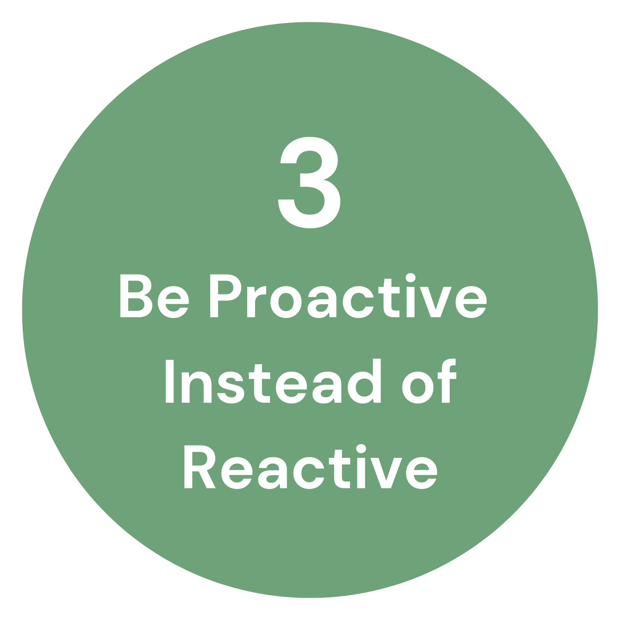
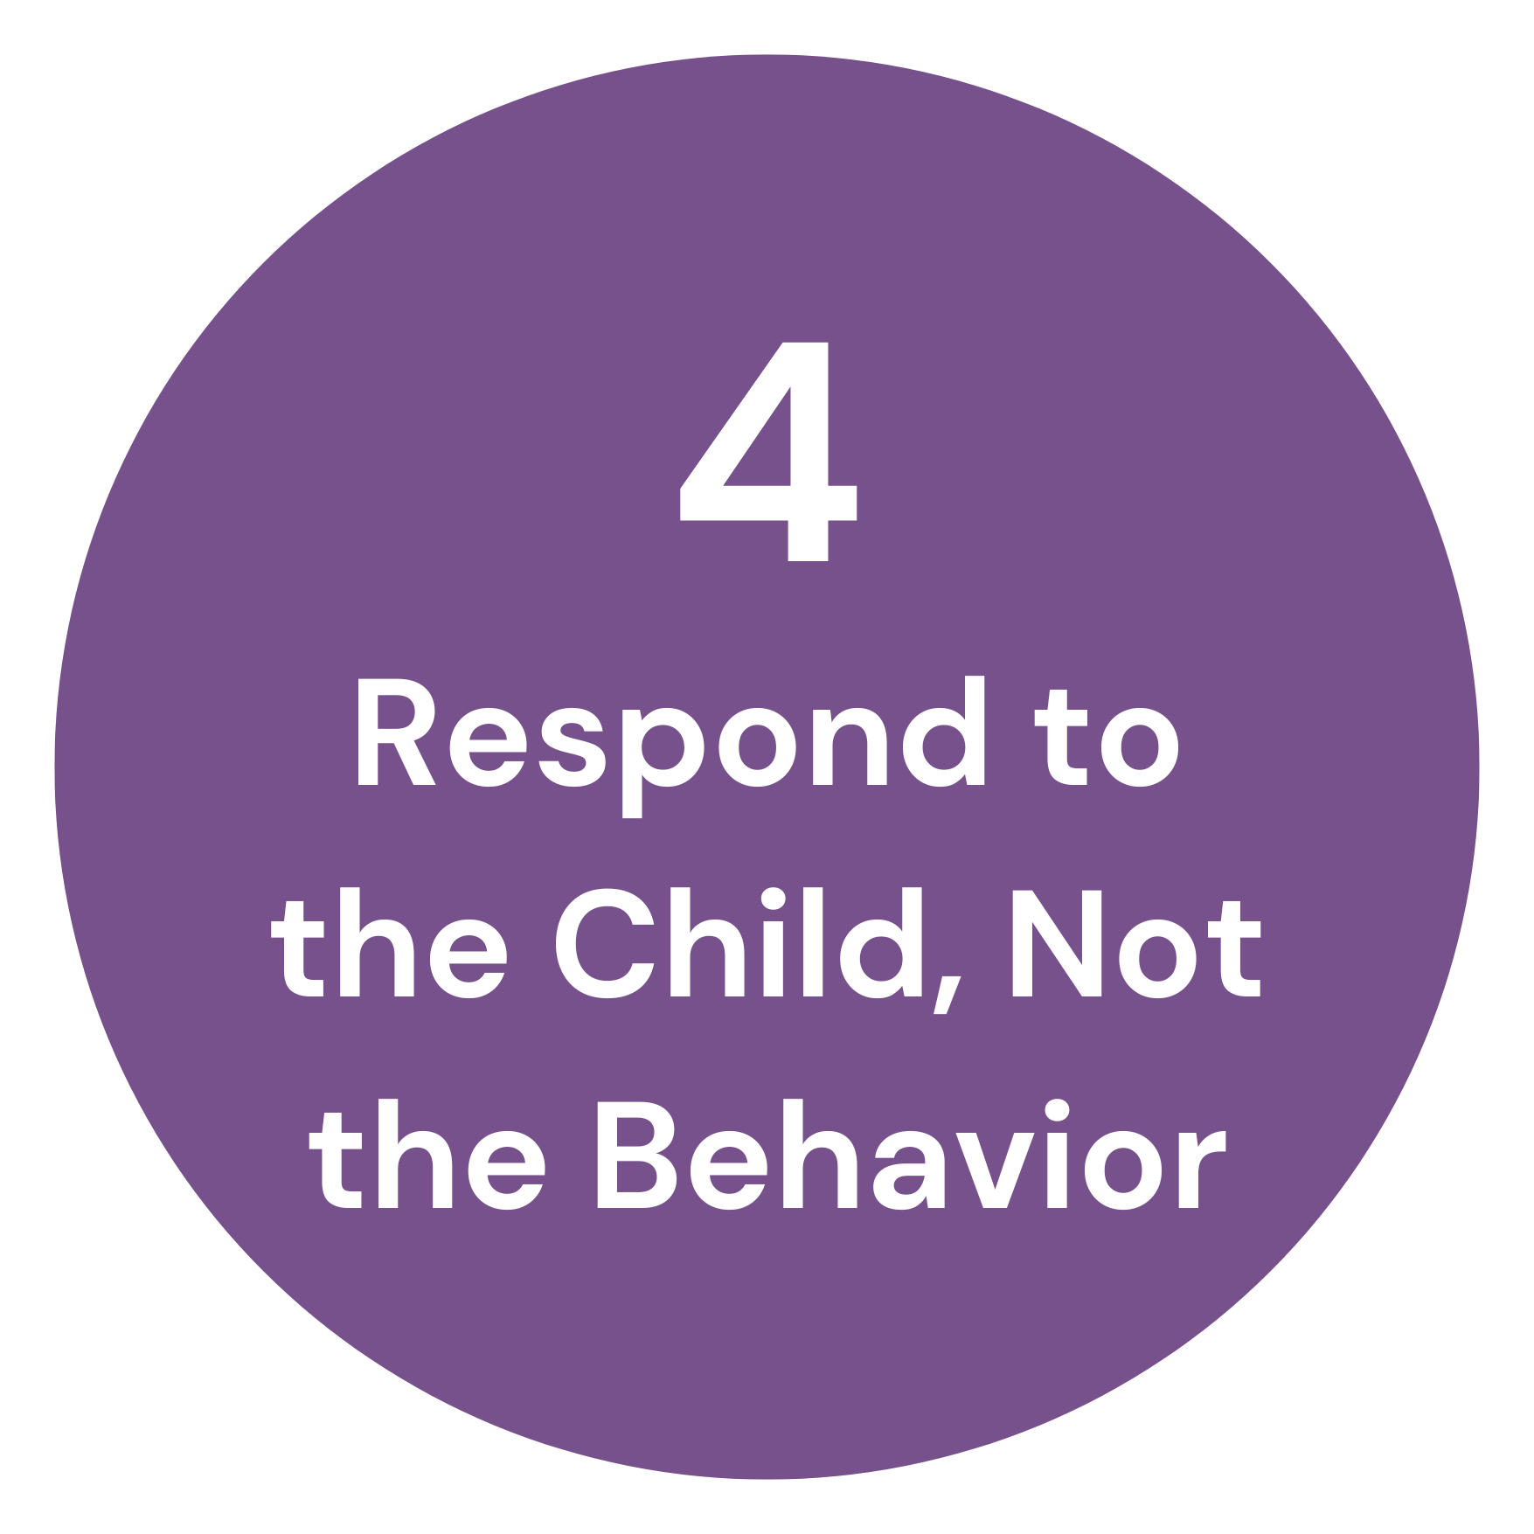
A Model for Reframing Classroom Management
Establish Expectations
All Areas
All Staff and Students
Explicitly Teach Expectations
All Areas
All Staff and Students
Reinforce Expectations
All Areas
All Staff and Students
Correct Behavioral Errors
All Areas
All Staff and Students
4 Pillars of PBIS
Reframing Classroom Management - A Toolkit for Educators
Notes:
2 minutes
You’ve probably seen the 4 pillars of PBIS before. (Go over the 4 pillars briefly). We can also think about discipline using the framework from Reframing Classroom Management from Learning for Justice.
Whole Group Discussion (1 minutes):
Where do the four pillars of PBIS fit into the circles representing the reframing of classroom management? Are there overlaps?
Silently Reflect for a moment (1 min or less): What are YOUR strengths and weaknesses in these areas?
Reframing Classroom Management - A Toolkit for Educators

Slide 13




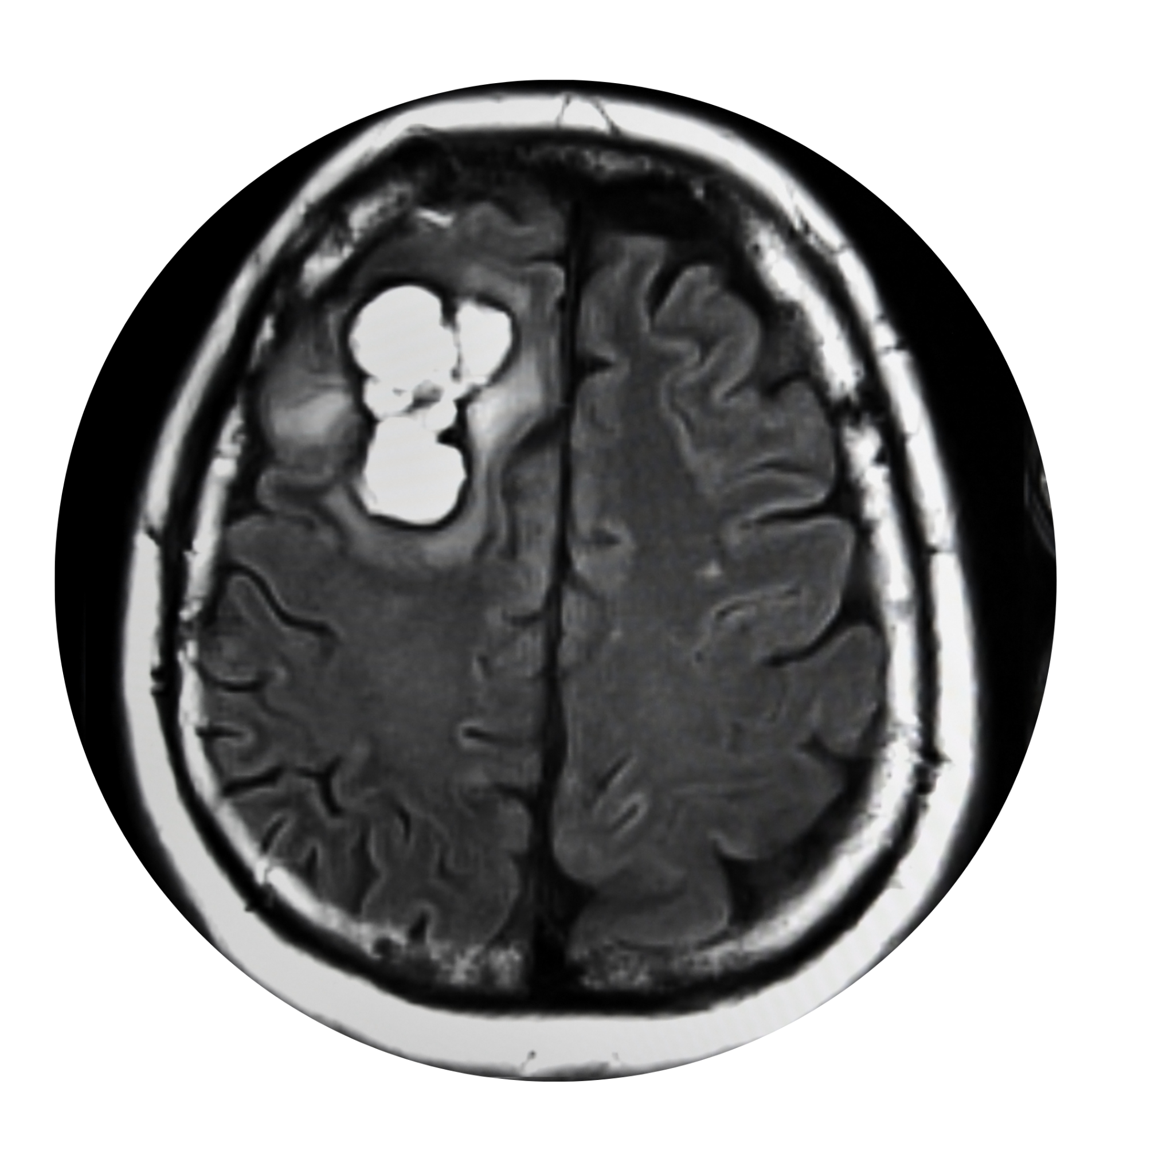

What a Headache!
Notes:
4 minutes
Let’s look at an example why it’s important to take underlying causes into account when making decisions. Two people went to the same doctor complaining of a headache. One of the patients simply had eye strain and was prescribed glasses. (click again to show the bottom row of pictures) The other patient was diagnosed with a brain tumor and was referred to a surgeon. Both patients received the treatments that was reflective of their needs and were able to recover from it.
Whole group discussion: The patients did not receive equal treatment, is this unfair? What would have happened if both patients were treated the same way? If the doctor assumed that both patients had eye strain? A tumor? (Should these questions be an animation that pops up after the example is given?)
Education is a lot like medicine. Sometimes the same symptom will require radically different treatments.

Slide 14
Behavior is communication.
Determining the reason for the behavior is essential in addressing the behavior.
Common Behaviors:
  Disrespect
  Disruption
  Disregard
We have to de-personalize student behavior.
Moving from “How can I control these behaviors?” to “How do I understand these behaviors?”
Focus on prevention rather than punishment.
Notes:
1 minute
The first circle in Reframing Classroom Management is to understand and distinguish behavior. This means that we as educators should be able to understand where a student’s behavior is coming from and distinguish what the underlying cause for that behavior is. We are going to go deeper into it but for now, take a minute to read some of the important points along the side.

Slide 15
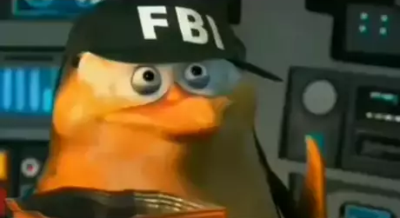
All Behavior Communicates a Need
Appropriate behavior is generally achieved when students:
Feel connected to the teacher, one another, and the curriculum
Believe that success is attainable with reasonable effort
Feel respected by being heard; feel teachers strongly care about them
Are given responsibility, especially in helping other students
Look forward to sanctioned moments of joy and laughter every day
Believe that what is taught is relevant to something they care about
“Can you help determine the function of behavior?”
Me (Function of Behavior Investigator):
Let’s find that function!
Notes:
4 minutes
When we look at students who exhibit the most pro-social behavior we see some of the same aspects over and over. Students have certain needs that when they aren’t met, will sometimes manifest as misbehavior. Our actions can either feed into that misbehavior or help mitigate those needs.
This is a list of characteristics of students who tend to show the most desirable behavior.
Think-Pair-Share: Do you see any of factors that may provide a particular challenge to students who are newcomers and/or refugees? What about other populations of students?

Slide 16
Basic Needs that Contribute to Behavior
Identity - Find time to notice how students feel about themselves and connect with those feelings | Attention - Call more often on students who need attention, greet them at the door, smile at them when walking around the classroom | Connection - Pay attention to the connections students make. Resolve conflicts with the students in ways that don’t alienate them. Help them connect with positive groups
Competence - Stress effort as the primary measure of success | Control - Give more genuine choices (not threats) | Fun - Find ways to add an element of fun to your lessons
Notes:
1 minutes
These are some of the common needs that all humans have. When these are not met, they can lead to undesired behavior.

Slide 17
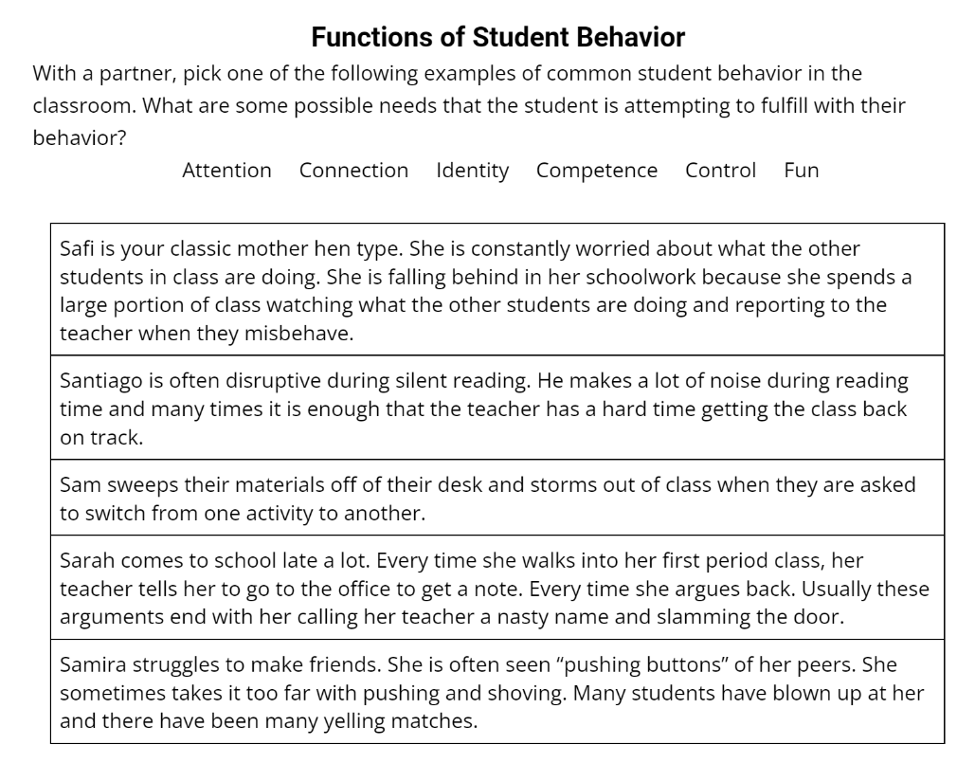
Which needs could be contributing to these behaviors?
Attention
Connection
Identity
Competence
Control
Fun
Digital Handouts: tinyurl.com/GranitePL2024CRAB
Notes:
3 minutes
Remember, the same behavior can have multiple needs contributing to it. Sometimes it will take time to figure out what need your student is trying to fulfill.
Handout Activity:
With a partner, Pick one of the scenarios in your handout, read through the scenario and decide which need(s) that student is attempting to fulfill. What are some possible needs that the student is attempting to fulfill with their behavior?
Popcorn Call Out:
Pick a couple of scenarios, have the audience call out the answers.

Slide 18
Identity and Connection
A student’s connection with their own identity
A teacher’s understanding of their students’ identities
Students’ identities reflected in the classroom and curriculum
Notes:
3 minutes
Every human being has an identity that is made up of many of these markers. Identity has a huge impact on our classroom and our students. Ask yourself these questions as you get to know your new students this year: How connected are your students to their own identities? How much do you understand about your students’ identities? What assumptions do you make about your students’ identities that may be different from reality? Are your students’ identities reflected in your classroom all year long?
Think about some students with whom you have had the “best/easiest relationships” and some with whom you had the “most challenging relationships” Are there any patterns you can identify? Are there some similarities in visible group identification for the best/easiest vs most challenging? It’s not true for everyone, but most people find it is easier to build relationships with students that share their own background, common interests, common appreciations of art, culture, etc. Do you know more about the internal identity markers of students with whom you had easier relationships with?
My Example - (insert your own example/personal story on your paper notes or you can use Ashley’s)
Ashley’s Example - For example, I taught 9th grade English. I always felt like it was easier to relate and build relationships with girls than boys. I sometimes had a hard time relating with the boys and “understanding” why they acted the way that they did.

Slide 19
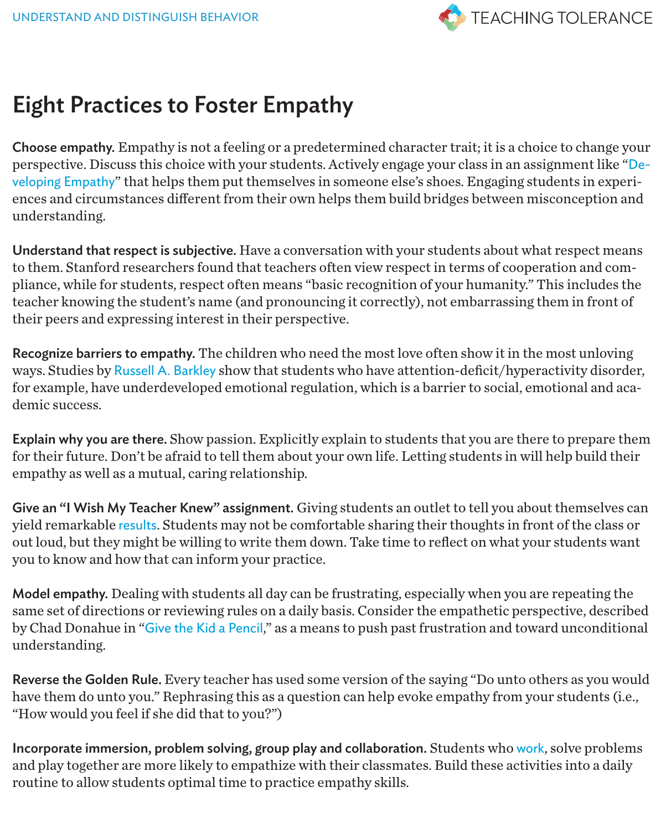
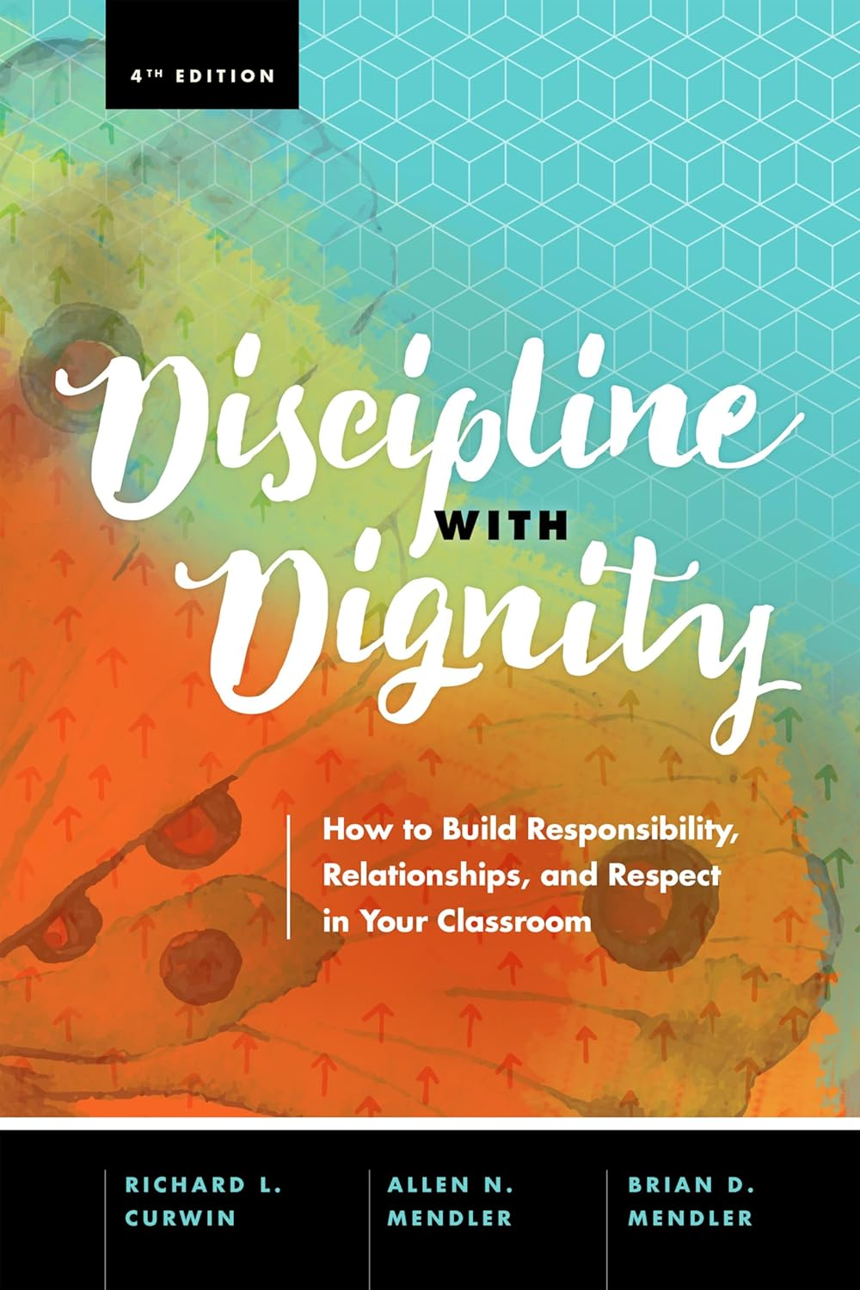
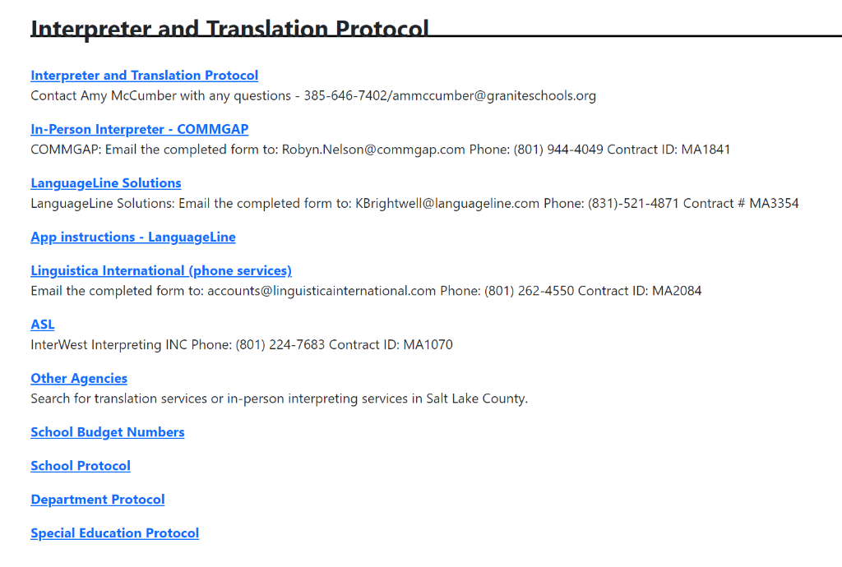
Resources
Eight Practices to Foster Empathy
Interpreter and Translation
Information on the
Educational Equity Intranet
Reframing Classroom Management
A Toolkit for Educators
Notes:
30 seconds
If you are interested in further reading about understanding and distinguishing behavior, this slide has some links to some resources that go more in depth with this.

Slide 20
Everyone experiences
bad days. This includes students.
Unbalanced power dynamics and the assumption that all students are the same
can make the term management problematic.
We need to be realistic in our expectations, look at the whole child and their circumstances, and the messages their behavior is sending.
Notes:
1 minute
(Have participants take 30 seconds to read through this slide) It is important, as you are thinking about your classroom culture to really think about how you will approach power and control in your classroom. As you are planning for the upcoming year, ask yourself: Are your students active participants in your classroom and its culture or are they passive spectators?

Slide 21
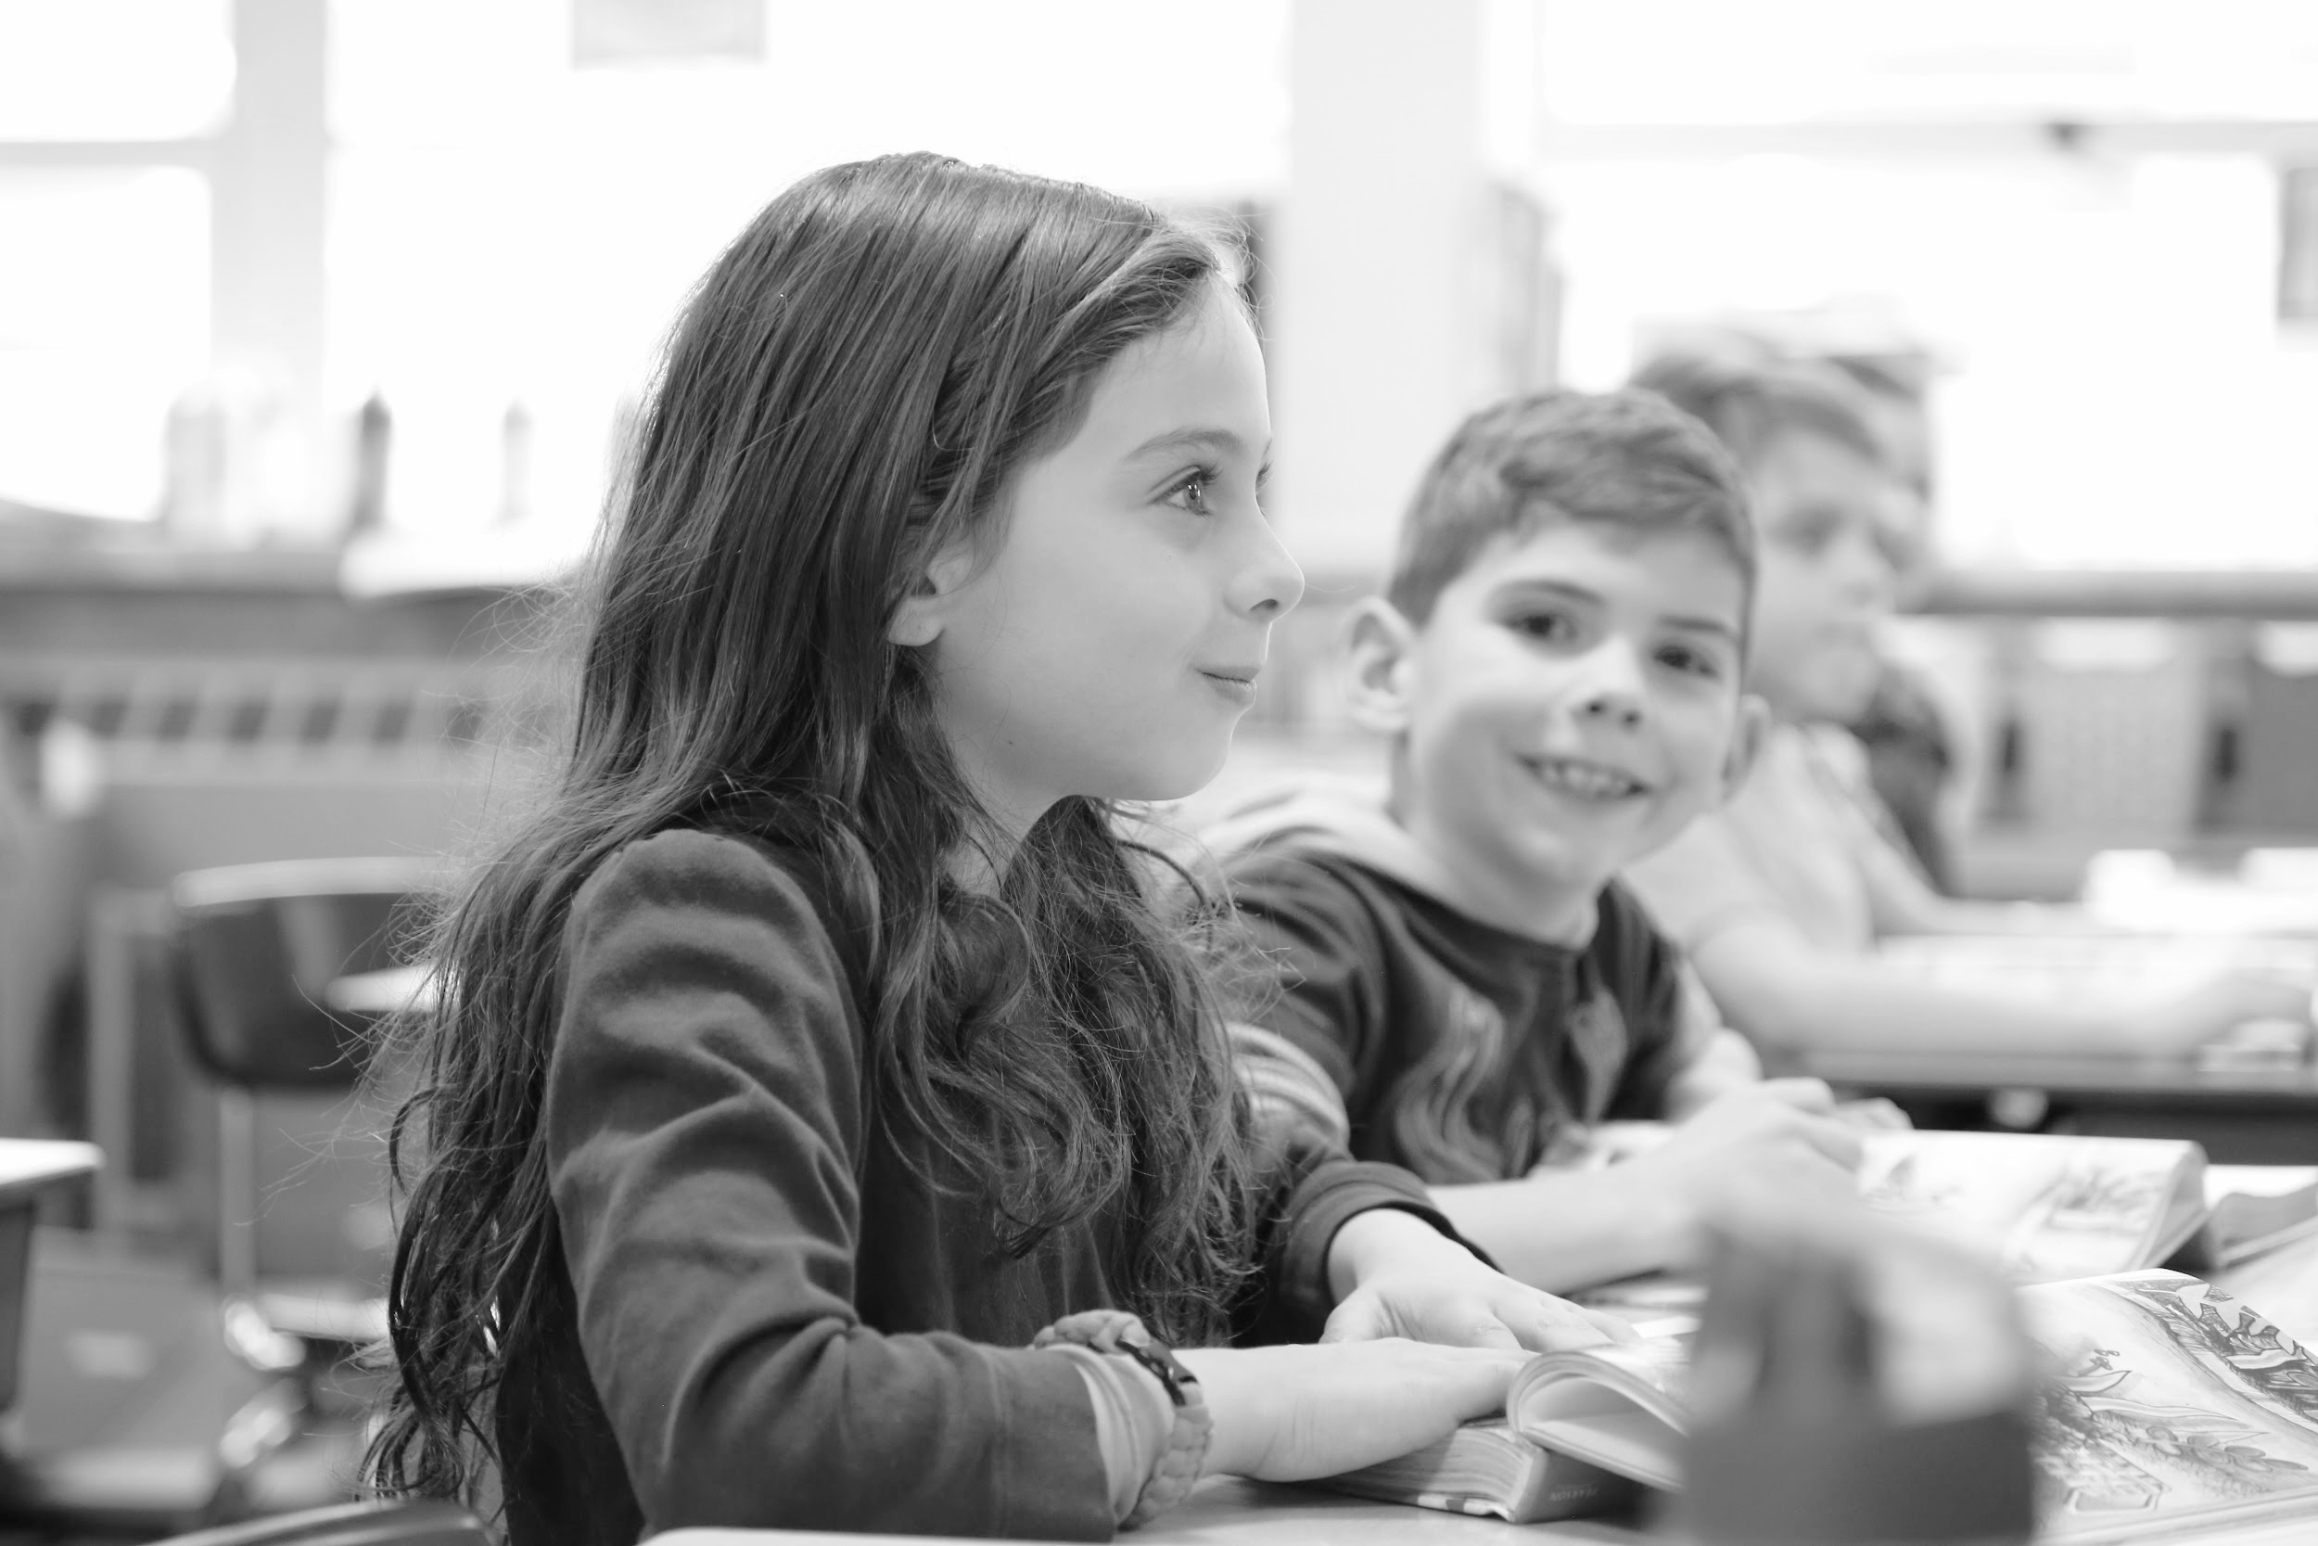
Responsibility vs. Obedience
Notes:
2 minutes
Turn and talk- What is the difference between responsibility and obedience? Do we want responsible students? Obedient students? A bit of both?

Slide 22
Responsibility or Obedience?
Responsibility
Obedience
Students are empowered to be active decision makers
Students are provided choices daily in class
Students feel genuine ownership of their classroom
Students are given space to make mistakes and then are guided on how to grow from them
Students have provided their input in classroom rules and expectations
Teachers clearly express their reasoning when providing student feedback, so students can effectively process that information
Teachers make the majority of decisions without student input
Students are usually provided choices as a result of good behavior
Students feel that the classroom environment is teacher-centered
Students feel micromanaged to not make mistakes and have no tools on how to cope when they make them
Classroom rules and expectations were displayed before the students’ first day
Students simply react to teacher feedback, rather than think it through because no teacher reasoning is shared
Notes:
3 minutes
Let’s look at some characteristics of a classroom that teaches responsibility vs. one that teaches obedience. Take a few moments to read over this slide.
Whole group discussion (2 minutes) Thinking back to the basic needs that we talked about previously; identity, attention, connection competence, control, and fun. Which type of classroom do you think will work towards meeting those needs? Are there any challenges you can see to focusing on teaching responsibility over obedience?

Slide 23
Threat vs. Choice
Threat
Increases adrenaline and cortisol levels
Fight-flight-freeze becomes arguments, temper-tantrums, name-calling withdrawal, and passive-aggressive behavior
The teacher is the one with control
The correct choice is already decided before being offered
A punishment is always part of a threat
Do what I want you to do, or you will be hurt in some way
Choice
Set boundaries while offering movement (decision making and control)
Limits define the parameters of control
The student has some control within limits
Both options are equally as valid, there is no right or wrong answer.
Punishment is not part of the choices
Notes:
3 minutes
One thing that helps to reframe our thinking about power in the classroom is looking at the types of language we are using. Students who are threatened into obedience may obey for the short term in order to avoid an unpleasant outcome. However, with repeated use, the threats will lose their effectiveness and disempower our students. One way to mitigate this is to offer choice, however, it is important to realize that threats sometimes get disguised as choices.
Take a moment to read over the characteristics of threats and choices.
Notice that choices do not necessarily mean that the student gets to make the rules completely. There are boundaries and limits, they are just able to make choices within those boundaries and limits.

Slide 24

Threat or Choice?
Threat!
The student doesn’t really have a choice. There is one correct option and a punishment.
Do your homework or I’ll call your parents.
Notes:
30 seconds
Slides 27-31 are the quotes from the activity. Go over them quickly to clarify which are threats and which are choices.
What happens when the student knows that their parents aren’t at home?

Slide 25

Threat or Choice?
Choice!
The student is being asked to do something and the expectation is that they will do it. However, the way it is done is left up to the student. Either option is valid and there is no punishment for picking one over the other.
Would you prefer to do it yourself or pick a friend to help?
Notes:
30 seconds
Slides 27-31 are the quotes from the activity. Go over them quickly to clarify which are threats and which are choices.

Slide 26
Threat or Choice?
Choice!
The student is being asked to apologize and is expected to do so. The way the apology gets to the other student isn’t important, so the student has a choice.
Would you rather apologize face-to-face or in writing?
Notes:
30 seconds
Slides 27-31 are the quotes from the activity. Go over them quickly to clarify which are threats and which are choices.

Slide 27
Threat or Choice?
Threat!
There is a clear correct choice. The punishment is embedded in with the options.
Will you stop calling people names or are you going to stay after school with me?
Notes:
30 seconds
Slides 27-31 are the quotes from the activity. Go over them quickly to clarify which are threats and which are choices.

Slide 28
Threat or Choice?
Choice!
The student will be leaving Sarah alone. The choice is what she will do instead of pester Sarah.
I need you to leave Sarah alone at the painting center. Would you rather go to the lego center or to the puzzle center?
Notes:
1 minute
Slides 27-31 are the quotes from the activity. Go over them quickly to clarify which are threats and which are choices.
Looking at some of these examples. Let’s think about an ML student who is still working on grasping social language. Is it possible for them to miss the subtext in the threats disguised as choices? If you ask a student who doesn’t have a lot of experience with subtext if they would rather do their schoolwork or leave the classroom, they may misunderstand and answer (truthfully) that they would rather leave the classroom.

Slide 29
Leverage vs. Persuasion
Leverage
Using power to get what we want from someone else
Relies on threats, punishments, and bribes
Only effective if the student likes what is offered more than the gratification achieved by the behavior or if the punishments are bad enough to interrupt whatever fulfillment they get from the undesired behavior
Does not rely on student/teacher relationships
Persuasion
Helping students see how the proposed change is in their best interest
Relies on listening to what the child is seeking through the inappropriate behavior
Relies on logic, emotion, and connection
Enhances someone’s awareness of how the consequences of the current behavior leads to unwanted feelings
Notes:
2 minutes
As we are thinking about power dynamics in the classroom, it is also important to understand the difference between leverage and persuasion. Look at the difference between the two. Which do you think contributes to fulfilling the needs we have spoken about previously? (Attention, Connection, Identity, Competence, Control, Fun)
Like threats, leverage can lead to short term success in modifying student behavior; however, it does tend to lead to breakdowns in relationships.

Slide 30
Leverage or Persuasion?
Leverage
You have the power to take away a student’s recess and are using that to get what you want.
What if the student doesn’t like recess? What if they would rather goof off now than go to recess later anyway?
If you don’t get your work done, you will have to do it during recess.
Notes:
30 seconds
Slides 33-36 go along with the activity. Go over them quickly.

Slide 31
Leverage or Persuasion?
Leverage
You have the power to remove a student from the room and are threatening to use it.
What if the student wants to leave class?
If you keep slamming your books and yelling, you will have to leave the room.
Notes:
30 seconds
Slides 33-36 go along with the activity. Go over them quickly.

Slide 32
Leverage or Persuasion?
Persuasion
This isn’t a power play. You are explaining to the student why it is in their best interest to change their behavior.
This teacher already knows that they dislike being nagged and is telling them how to avoid that outcome.
Not only will you make a lot more money as a highschool graduate than as a dropout, but if you change your behavior, you are less likely to get nagged and picked at, which you hate.
Notes:
30 seconds
Slides 33-36 go along with the activity. Go over them quickly.

Slide 33
Leverage or Persuasion?
Persuasion
The teacher is acknowledging the student’s feelings and connecting to them. The goal is to help the student find a better outlet to express his anger.
Expressing your anger by slamming books and yelling creates a problem for you, even if the teacher is being unfair. Would you like to look at some other ways to express your feelings that most teachers would find more respectful?
Notes:
30 seconds
Slides 33-36 go along with the activity. Go over them quickly.
One thing to notice is that persuasion takes more time and more thought. You have to know your students and they have to know that you are on their side.

Slide 34
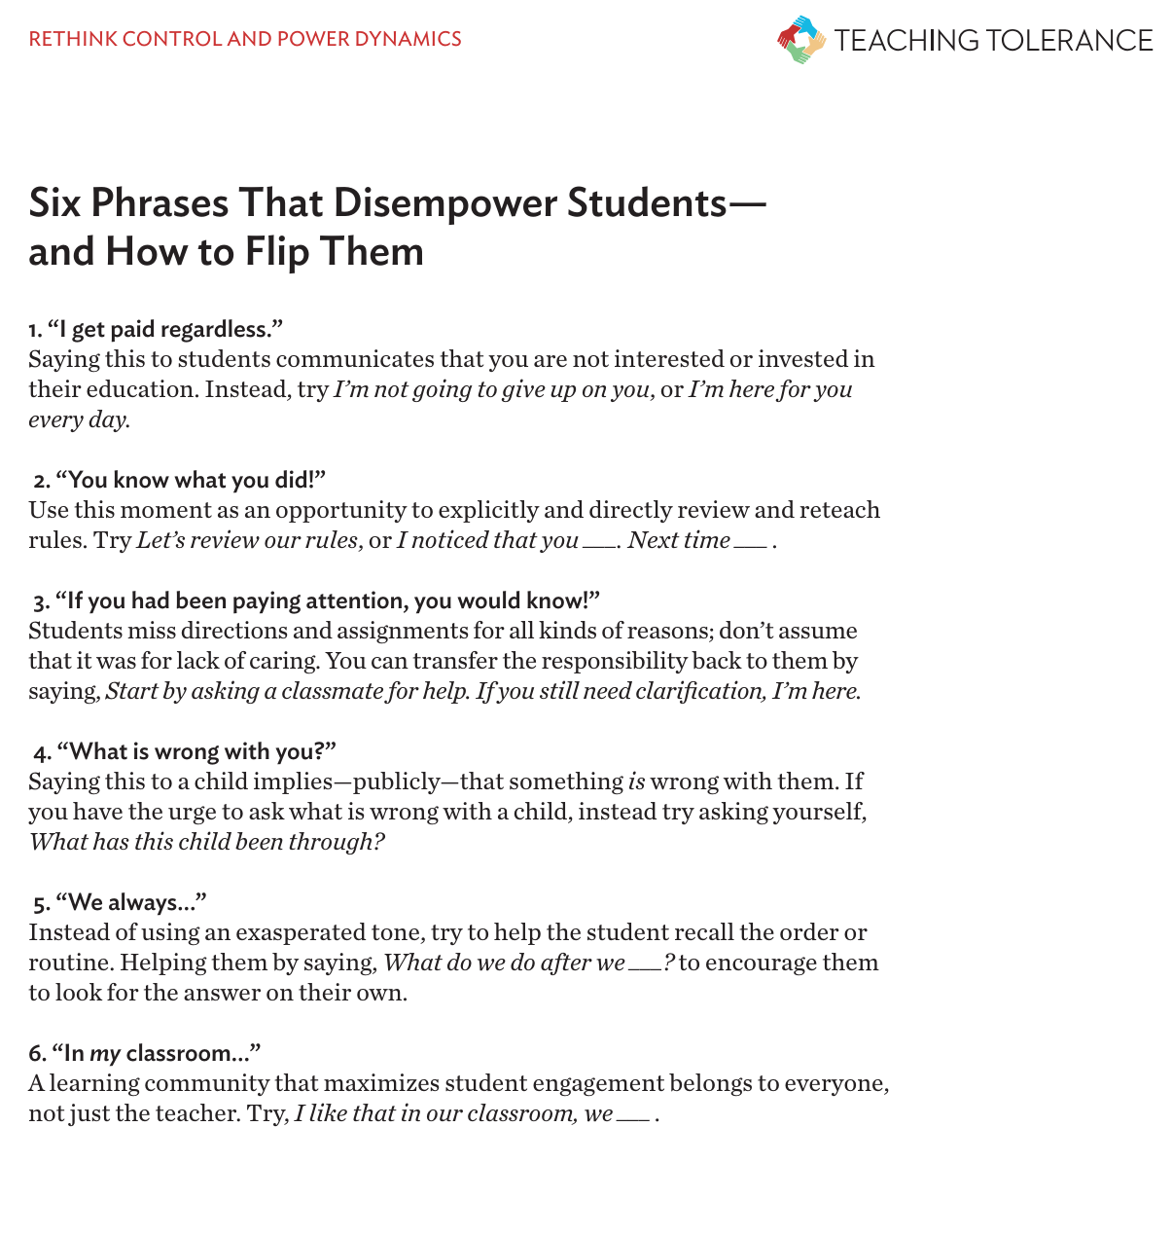
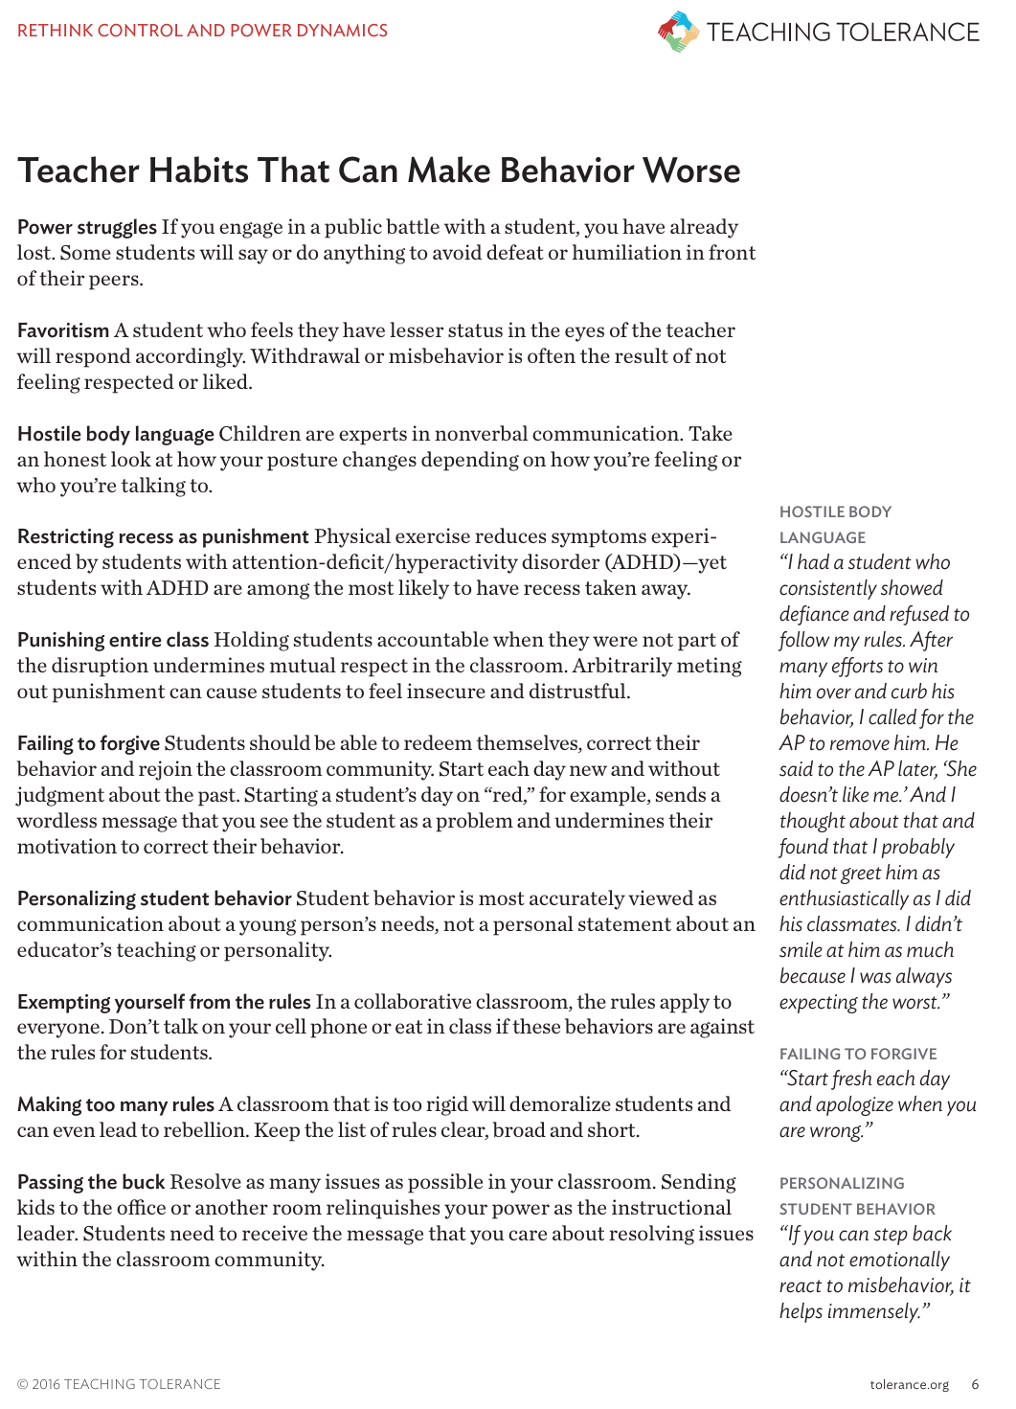
Resources
Six Phrases That Disempower Students -- and How to Flip Them
Teacher Habits That Can Make Behavior Worse
Reframing Classroom Management
A Toolkit for Educators
Notes:
30 seconds
If you would like more information on rethinking control and power in your classroom, we have some resources linked here.

Slide 35
Ties strongly to PBIS practices
Reactive management strategies elevate teacher stress and off-task student behaviors
There is a need to teach classroom behaviors just like academic content, which allows students to become self-disciplined and self-directed
Proactive behavior steps include:
  building relationships
  with students
  fostering engagement
  greeting students
Notes:
2 minutes
Most of your work establishing a classroom climate should be done proactively rather than reactively. The best way to stop discipline problems is to prevent them. Make sure that your students are meeting their needs for identity, connection, fun, attention, control, and competence. As you are thinking about the upcoming year, it is important to plan ways to teach and reteach your classroom expectations in a way that all of your students can understand. Take a moment to read over the points on this slide.
Whole Group - What are some ways that you can build relationships with your students?

Slide 36
Self-Reflection
Explicitly Teach Expectations
All Areas
All Staff and Students
How do you teach your expectations? With what frequency do you have planned reteaching?
How are you adapting your classroom system to better meet your students’ needs, values, strengths, and cultural/family background?
What is your current
teaching practice?
Notes:
1 minute
Let’s think about your current practice. How do you teach your expectations to your students? When do you reteach them? Do you reteach regularly or only when problems arise? How are you making sure that ML students, newcomers, refugees, etc. are able to understand your classroom expectations? In the following slides we will discuss some ideas to ensure all students understand the expectations.

Slide 37
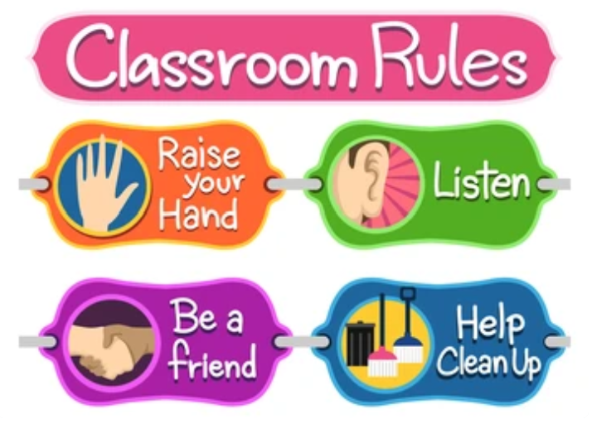
Providing Equity in Setting Expectations
Be explicit
in your expectations.
Use images.
Use gestures.
Have students role play.
Model the expectations.
Be open to student identity.
It is important to set high expectations from the beginning. How do we help all of our students understand those expectations?
Notes:
1 minute
It isn’t enough to just go over your expectations once and verbally. You must plan for the needs of your diverse learners. These are some examples of ways to make expectations accessible to all students regardless of language or familiarity with US schools. (Highlight the bullet points on the side).

Slide 38
Why Reteach Often?
Students Forget!
Other Supports for Teaching Behavior Expectations
New students won’t receive the initial teaching that everyone gets at the beginning of the year.
School expectations in other countries may have been completely different (the amount of student talking, engagement strategies, what engagement looks like, etc).
Use non-verbal cues
Have consistent procedures
  when and where to get supplies, which graphic organizers you use, note taking
Use visuals
Use sentence stems
Provide word banks
Teach academic vocabulary explicitly
Notes:
1 minute
Reteaching our expectations not only decreases misbehavior, it also increases equity for our students. It is important to have a plan for teaching and reteaching expectations.
If time allows you can go deeper by discussing these examples:
The following examples are ways that you can build the reteaching of expectations into your practice.
Plan lessons where expectations review includes students’ real-life experiences, cultural strengths, and values.
Teachers can examine expectations and reflect on the use of dominant cultural values that may need explicit teaching for students from other cultures. Those expectations can be clarified by using the rationale and having a plan for explicitly teaching them to all students. For instance, explaining that we raise our hand and wait to be called on so that everyone can have a turn to be heard. In some cultures students are expected to not participate orally in class. Older students may be able to work in groups to provide some clarity to their peers.
Provide opportunities for students to articulate what their expectations are at home and discuss similarities and differences

Slide 39

“Why is it Better?” Activity
Why?
Helps students see the value in desirable behaviors.
Increases student buy in.
Implement the Activity
Prepare a list of certain behaviors covered by procedures and rules.
Ask students individually or collectively why they think it’s better to do those things than to not do them.
Examples
Why is it better to…
do your homework?
help another student?
help clean up your things?
admit when you’re wrong?
share with your friends?
be on time to class?
tell the truth about what you do?
Notes:
1 minute
Students do best when they can convince themselves to do something. One way to help them with this is to ask them at the beginning of the year (and throughout) why it is better for them to do certain things. It is important to emphasize that you want to hear their reasons not the reasons they think you want to hear.
This can be done in a variety of ways, as a whole group discussion, think-pair-share, journal entries, bell work etc.

Slide 40
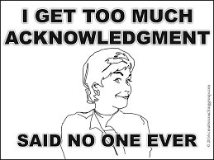
Reinforcing Expectations: Equity Strategies for Acknowledging Pro-Social Behavior
Reinforce Expectations
All Areas
All Staff and Students
Equity in Evidence-Based Practices
Providing students with equitable access to established Evidence- Based Practices
Increase Equity in Praise
Assess and increase equity
in use with students
Behavior-Specific Praise
Opportunities to Respond
Cultural Responsiveness
Adaptation of existing systems to better meet the needs, values, and strengths of students, families, communities.
Increase Cultural Responsiveness
Get to Know You Activities
Praise Preference Assessment
Planned Praise
Non-Contingent
Acknowledgement
Notes:
30 seconds
The following slides will detail four practices that you can use in your classroom to acknowledge pro-social behaviors. They are practices that can be used with all students to increase equity.
Source: Equitable Classroom Acknowledgement Systems - Recorded Webinar

Slide 41

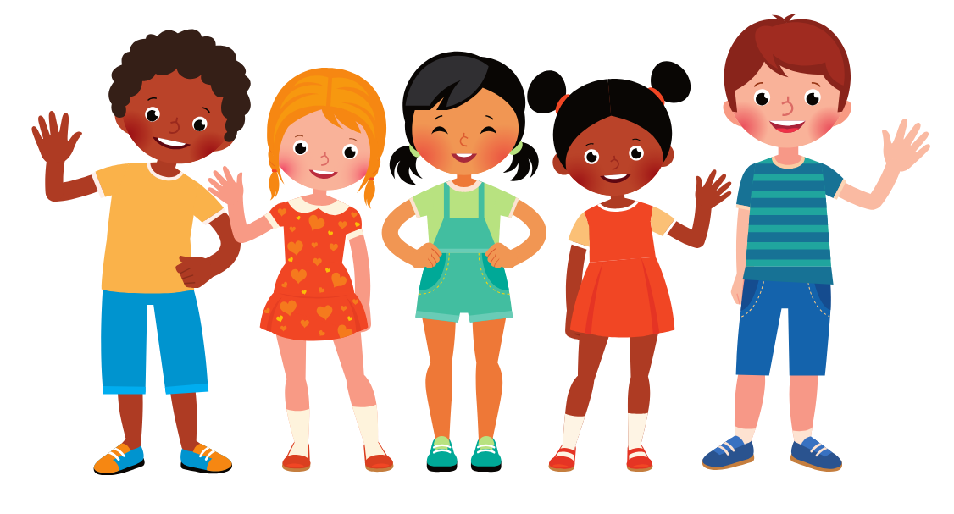
Increase Cultural Responsiveness: Get To Know You Activities
Why?
Getting to Know You activities are easy and useful exercises to understand student perspectives and foster connections that are critical to learning.
Knowing and referring to students’ personal lives may help them feel acknowledged and can improve their academic learning; especially when relevant examples are incorporated into academic instruction.
Implement the Activity
Have students, parents, or both complete a Getting to Know You worksheet
Have students interview each other and staff members.
Ask a question each day or each week when students arrive or during morning meetings or circle time.
Let students present about themselves to the class.
Include ongoing Getting to Know you activities throughout the year.
Use the information in daily interactions with students.
Notes:
1 minute
Many teachers give students getting-to-know-you surveys at the beginning of the year. It is important to use the information gathered from those surveys as ways to connect with their students. Also, getting to know you activities should happen all year long.
ELLevation has Get to Know you Activities highlighted on their strategies page. Show ELLevation strategies section.
Examples:
Getting to know students- index card/ seating chart,
While writing assessments - including students names or things they like - lambos and ferraris, Taylor Swift & Travis Kelce

Slide 42
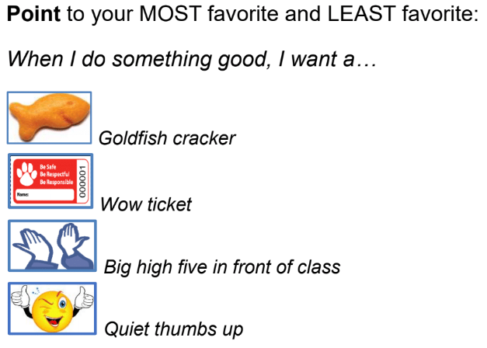
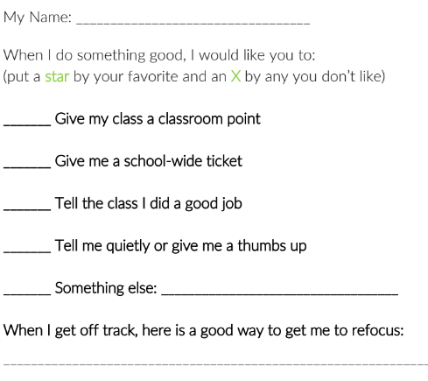
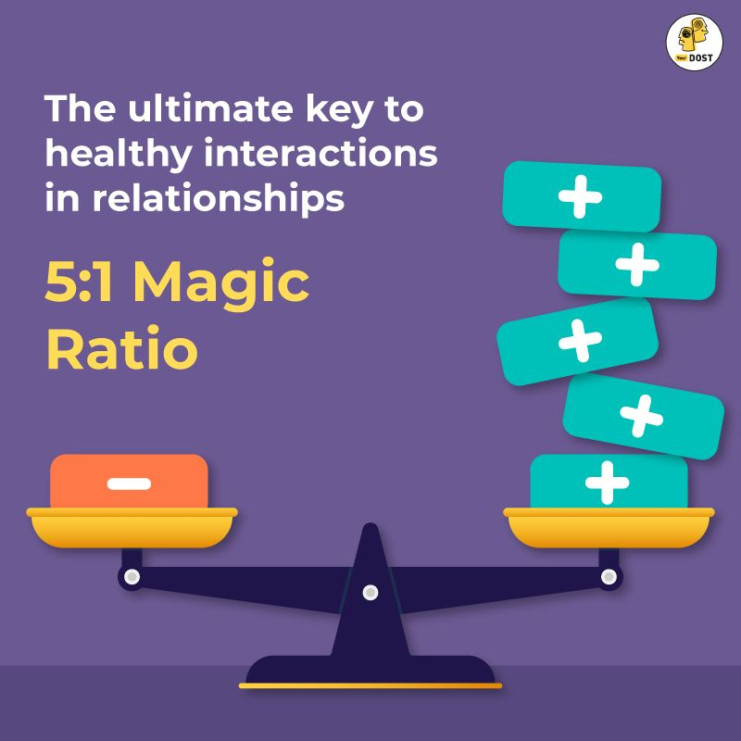
Increase Cultural Responsiveness: Praise Preference Assessment
Why?
Increases student acquisition and
use of prosocial behavior
Decreases use of teacher reprimands
Supports students from diverse backgrounds
Implement the Activity
Class-wide surveys
Individual student interview
School-wide surveys
Review individual responses
and tailor praise.
Review class-wide responses
to adjust overall approach.
Notes:
1 minute
Not all students respond to the same type of praise in the same way. One student may thrive on public praise while that may make another student uncomfortable. A praise preference assessment is a great way to tease out what types of praise work best for your students. There are many ways they can be done with the whole class or with individual students. You can ask students to rank choices or do a “would you rather” type activity.
To think about:
Use pictures instead of text
1:1 interviews with student to learn about likes/dislikes
Ask parents/caregivers about what student prefers
Ask students to rate the options (circle, cross out, rate from 1-5, etc.)

Slide 43
Increase Cultural Responsiveness: Planned Praise
Planned praise is a strategy used to acknowledge a student or group of students for whom student-adult relationships could be improved. It involves brainstorming a set of possible praise statements ahead of time and using them deliberately increase positive interactions.
Positive Specific Feedback (e.g., praise) is a powerful tool to improve behavior and build positive relationships. Because it's
so effective, it is important to:
(a) use it with all students,
(b) identify students who need more
positive interactions, and
(c) use specific strategies to increase
positive feedback.
Planned praise is such strategy to ensure underpraised
students have access to this evidence-based practice.
Notes:
Planned praise is a way to deliberately increase praise for our students who tend to get missed when we give praise or for students who need some extra positive feedback (those students who it’s difficult to catch meeting expectations). It involves spending some time brainstorming about our students and planning specific times and ways to praise them.
Planned Praise PPT: https://www.dropbox.com/s/cn48y2s98re7mm5/2.%20PP%20PPT.pptx?dl=0
Select times when:
Students are most likely to show their strengths
Students might need additional encouragement (e.g., before difficult activity)
It is easy to remember to provide praise statements (e.g., beginning of lesson)
Use the praise statements consistently, especially at first to build the relationship (e.g., at least once a day for 10 days)
Think about newcomers - how might it need to look different?

Slide 44
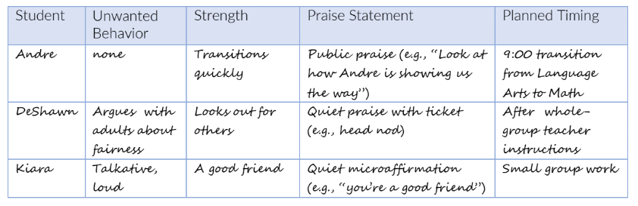
Increase Cultural Responsiveness: Planned Praise
Tips for Success:
Start off using planned praise during a routine that already runs smoothly
Use a praise preferences assessment to identify preferred praise statements
Consider writing praise statements on a seating chart and use it to tally
Use a system to help prompt you to use planned praise, such as a phone reminder or visual signal (e.g., poster, sticker, note in lesson plan)
Notes:
1 minute
This is one example of a planned praise sheet. You don’t have to use one that is this in depth. You could use sticky notes in your plan book. The important thing is that we are trying to increase the ratio of positive to negative interactions with our students. Our goal is to have 5 positive interactions to every 1 negative interaction. In order to facilitate this ratio, it is sometimes helpful to take a step back and plan specific times during the day when you can praise students.

Slide 45

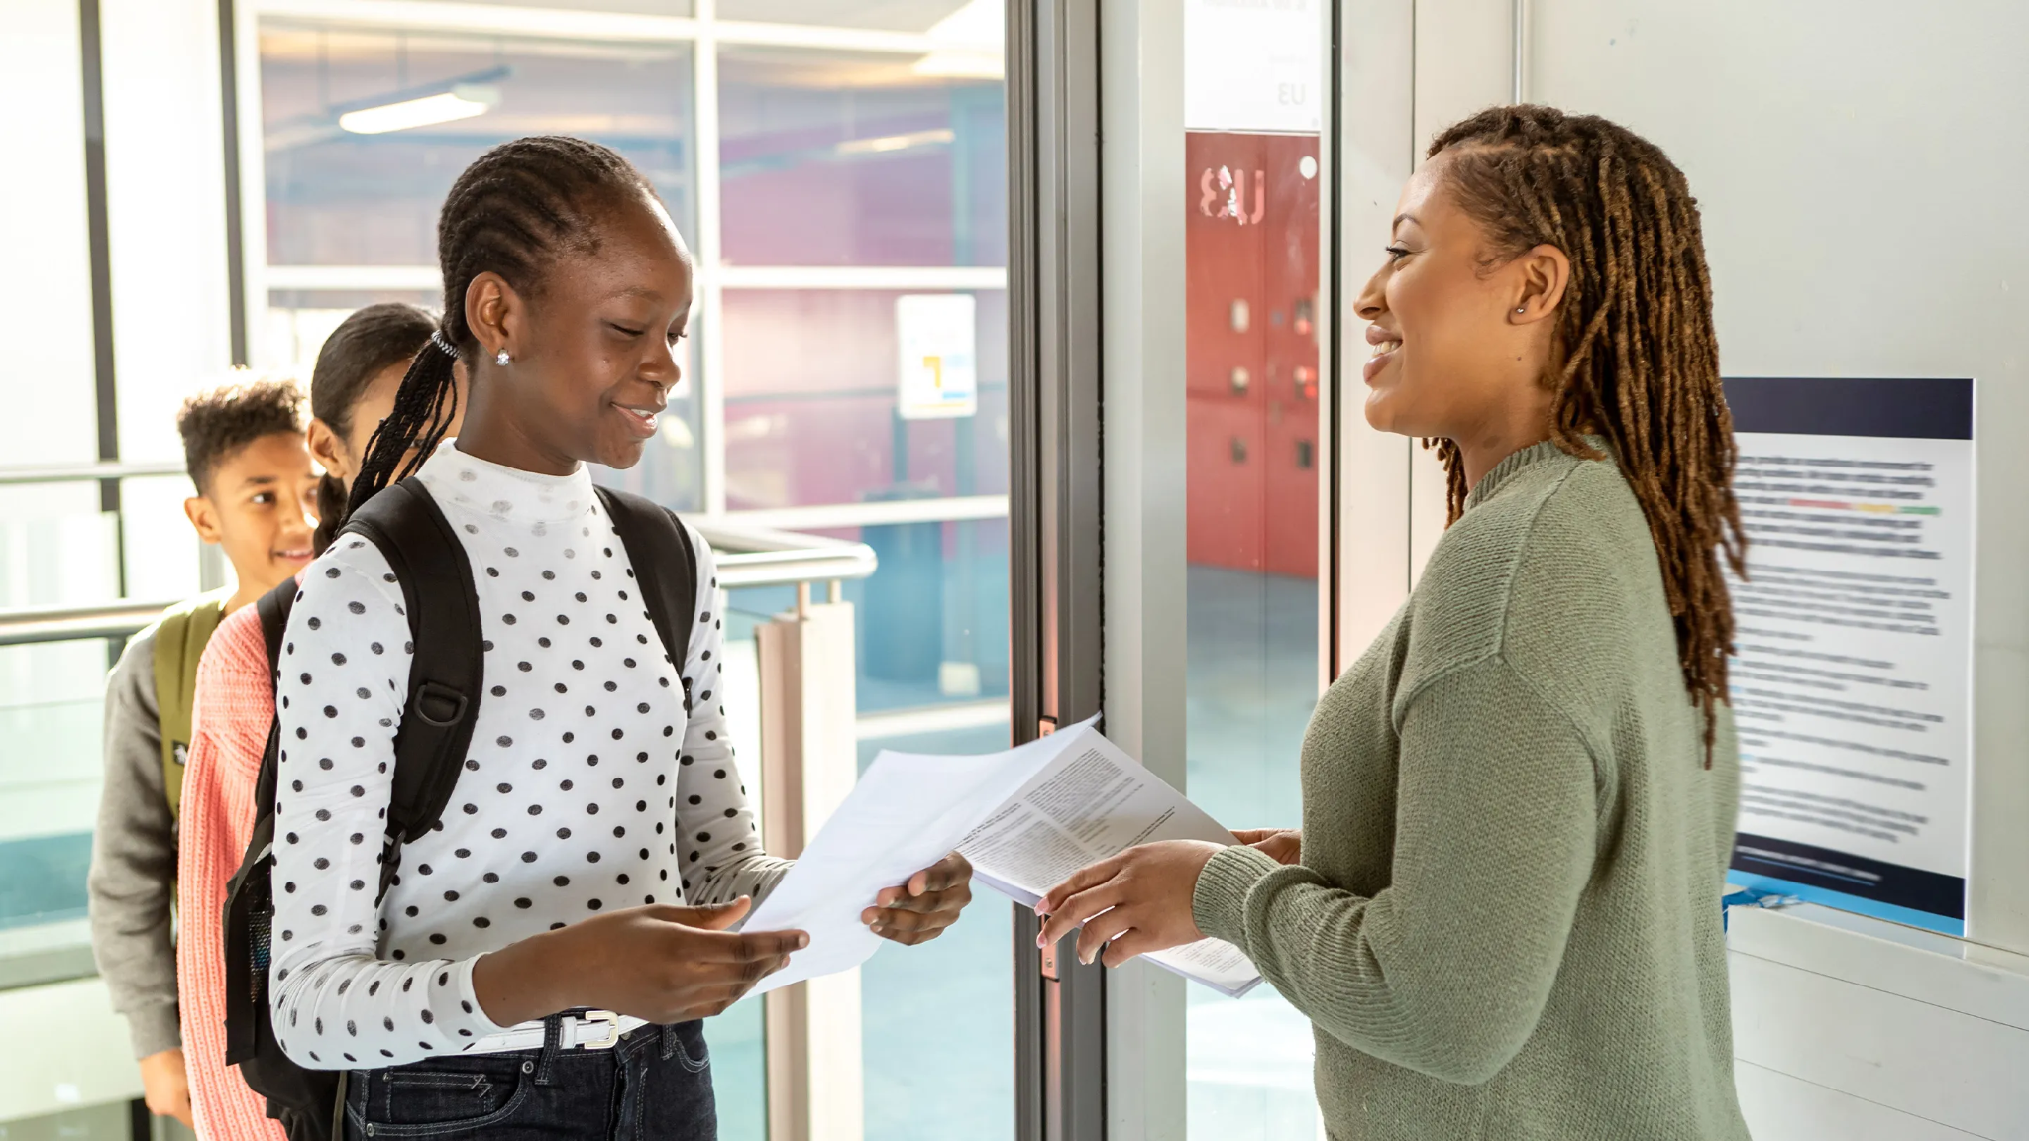
Non-Contingent Praise
Shout Outs or Appreciations
A whole-class activity in which students acknowledge peers/class for their actions, efforts and gestures.
Positive Greetings
Stand at the door as students
arrive and:
Greet them by name
Say something positive or neutral
Direct to the first activity

Slide 46
Six Things Teachers Can Do to Prevent Discipline Problems
1. Make connecting with students a top priority
2. Know and express yourself - warts and all
3. Make success a daily goal for each student
4. Make your classroom a motivating place
5. Teach responsibility and caring
6. Establish formal discipline procedures (a “social contract”)
Digital Handouts: tinyurl.com/GranitePL2024CRAB
Notes:
2 minutes
These are six things that you can do to prevent discipline problems in your classroom.
Turn and Talk -Which ones do you think will be easy? Difficult?
More specific tips for each are available in the handout for you to review later.

Slide 47

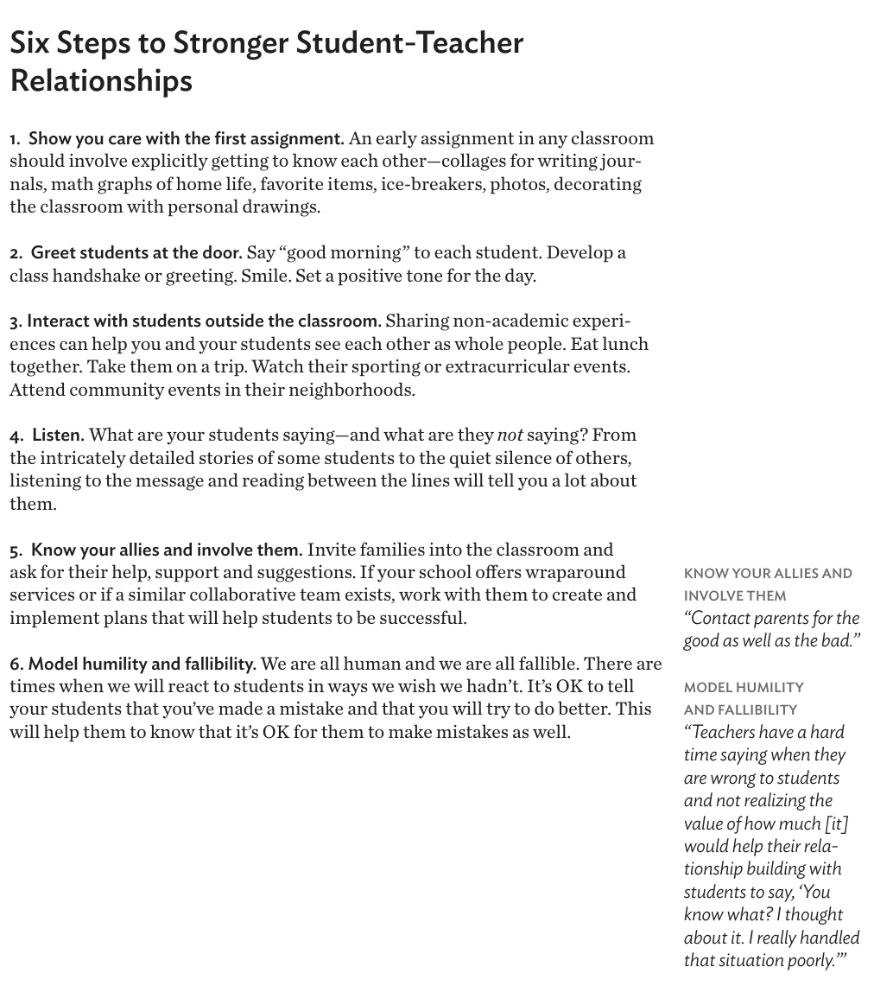
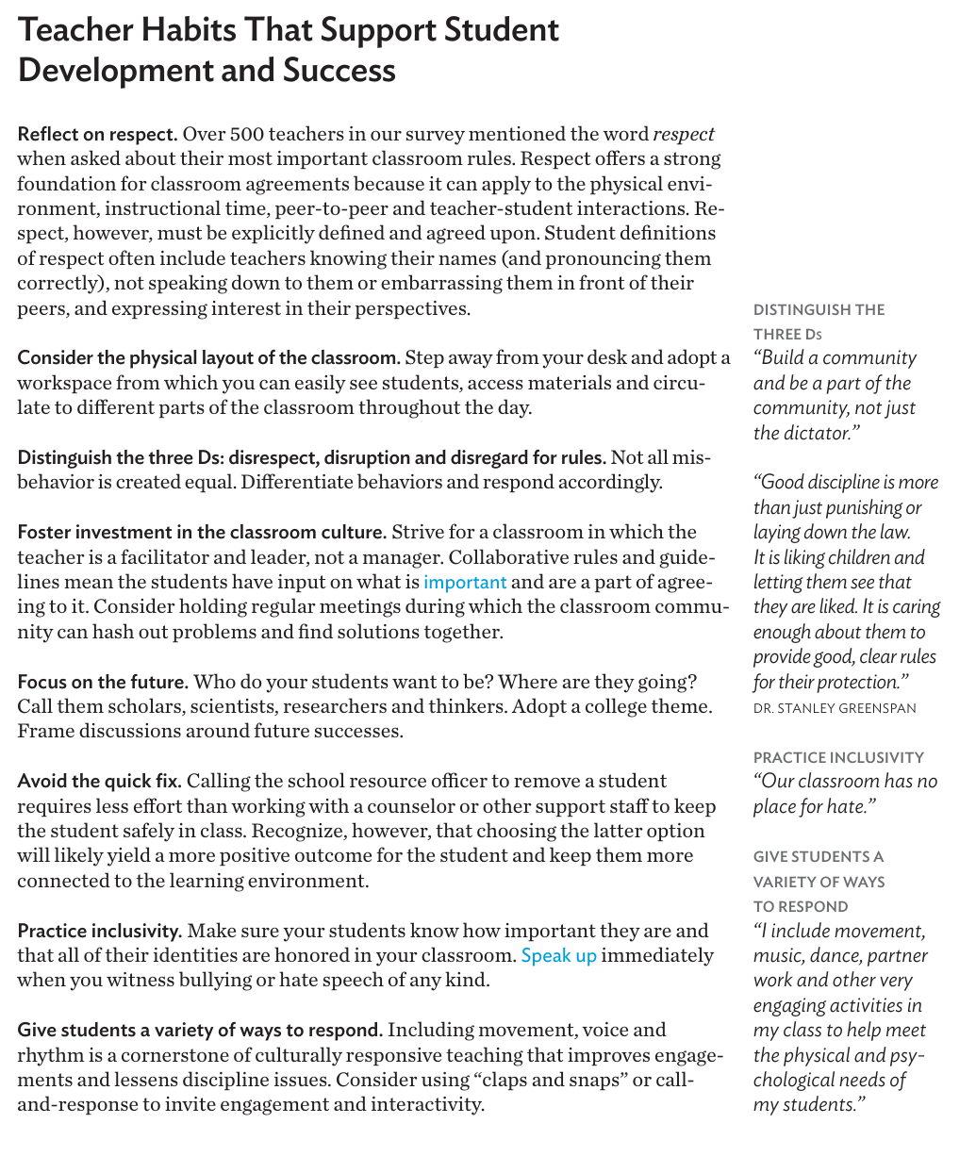



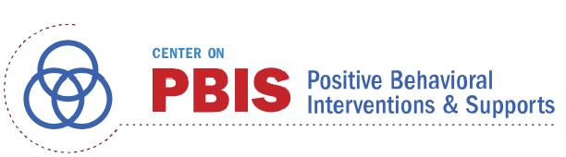
Resources
Strategies
11 Activities for building sociocultural
competence to use with students
4 Modules - Building Sociocultural
Competence
Six Steps to Stronger Student-Teacher Relationships
Teacher Habits That Support Student Development
and Success
Reframing Classroom Management
A Toolkit for Educators
Equitable Classroom Acknowledgement Systems - Recorded Webinar
Notes:
30 seconds
Here are some resources for proactive strategies.
ELLevation
Flashlight360
Teacher Habits that Support Student Development and Success
Six Steps to Stronger Student-Teacher Relationships

Slide 48
Responsive classroom management honors the whole child, respects their identities and experiences, and acknowledges their critical role in the classroom community.
Decode behavior rather than focus on power and control.
Punitive classroom management does not address the underlying and unexpressed needs of the child.
Be the thermostat not the thermometer. (Set the climate rather than react to it)
Notes:
1 minute
Our students are whole human beings, with thoughts, feelings, needs, desires, dreams, past experiences etc. They do not come to us as blank slates. Because of this we cannot react to all of our students in the same manner. If a student is misbehaving we should respond to the human being whose needs aren’t being met. It is difficult sometimes but it is important to remember that every human (including our students) deserves dignity and respect. It’s easy to show this when everything is running smoothly but when things go south, how do we react to our students who are misbehaving? Do we treat them with dignity?
Thermostat - acts/regulates
Thermometer - acted upon

Slide 49
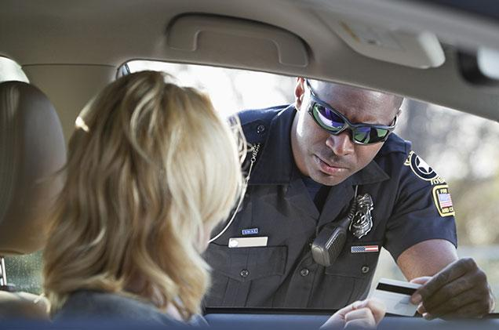
Punishment
Is it worth it?
What did you think?
“I should be a better driver.”
“I should really watch
more carefully for cops.”
Notes:
30 seconds
Think about the last time you were pulled over. Did you think that from now on you would be a better driver or did you think that from now on you will keep a better eye out for cops? Did a ticket help you learn to be a better driver or just inconvenience you. Was the punishment of a ticket effective?

Slide 50
Punishment
Punishment is meant to:
Inflict pain (mental or physical) when a student does something wrong so that the student associates pain with that behavior
Send a message to all students. When students see their classmates get punished, they fear the same might happen to them.
Give the teacher the ability to control students.
Give the teacher the feeling of being in control, whether or not that control is real.
Is it worth it?
Notes:
1 minute
Take a look at the objectives of punishments. The most positive result of punishment is how quickly it works in the short term. However, over the long term it will break trust and take responsibility away from the students. Control is taken away from the students and given to the person administering the punishment.
Does using punishment (inflicting pain, mental or physical) treat students with the dignity that every student deserves? Remember that consequences are different from punishments.

Slide 51
Types of Effective Consequences
Consequences that are altruistic - “Pushing Samantha to be first in line was hurtful.
Please think about something nice you can do for her and tell me before lunch.”
Consequences that teach - “Lets practice calmly walking into class with voices lower.”
Consequences that offer choices - “There are at least three ways to avoid unpleasant
confrontations: walk away, say you see their point and respectfully disagree, or make it clear you will not
engage in nasty talk. Which works best for you?”
Consequences that transform punishments - “Kelley, we are headed for a major
disagreement. Please take a break in Mrs. Prague’s class and come back when you are ready to learn. Please
do not be long. This lesson is too important for you to miss and we will miss you.”
Consequences that plan - “What specifically will you do first when Casey looks at you again?
What will you do next?”
Consequences that are based on logic - “The cafeteria is a mess and our Custodian
could use your help with the cleaning.” (After one student throws food at another).
Consequences that involve parents - “Thank you for coming to discuss your daughter.
I think she is hurting her future in school and I hope we can find a way to help her together.”
Notes:
2 minutes
Take a look at the types of effective consequences. Consequences can be a much more dignified way to respond to the damage caused by misbehavior. Consequences usually should be related to righting the wrong that was done. For example, in the first quote, the student shoved Samantha and hurt her. Having the offending student sit a lunch detention does not do Samantha any good or repair the harm done to her.
Consequences should be used to repair harm and teach students the proper way to behave, not solely inflict pain or misery on a student. They should also be related to the undesired behavior that was exhibited. This maintains the dignity of both the student and, if applicable, the victim.

Slide 52
Ask yourself:
What have I tried before when this happened? Did it help? Were there negative results?
Is it more important that the student feel bad about what they did or that they change their behavior?
What haven’t I tried that might work?
Who can I ask if I am out of ideas?
Everyday Behaviors
Most behaviors we see are minor infractions that require quick interventions.
Talking when another student is talking
Not sitting when asked
Slamming a door
Using an unauthorized electronic device
Disrupting the lesson by humming, tapping, etc.
Not doing homework or in-class assignments
Horseplay
How you respond to these
behaviors can either increase
student misbehavior or decrease it.
Notes:
1 minute
We as teachers will mostly deal with minor behavior issues. These are not behaviors we want to spend a lot of time and energy on until they become chronic. However, we need to deal with them early so that they do not become chronic.
Ask yourselves these questions when these behaviors come up:
What did I try before when this happened? Did it ever help? Were there negative results?
Which is more important - that the student feel bad about what he did or that he change his behavior?
What haven’t I tried that might work?
Who can I ask if I am out of ideas?
On the following slides are some interventions that you can try.

Slide 53
Two-Step Intervention
Stabilize the student and situation
Repair the damage done
Common Stabilizers
Privacy - discussing the behavior in a private setting rather than publicly.
Proximity - be aware of cultural differences and do not invade personal space
Distraction - talk with an individual student while other students are heavily engaged in group or partner work
Cruising - walk around the classroom as you are teaching
Perseverance - once you have asked a student to do something, do not move away until they have done it
Lower shields and start fresh - wait to address behavior until shields are lowered
The terminator - “I’ll be back.”
Reframing - Is the student stubborn or persistent?
Things to Keep in Mind
Stabilizing is not excusing behavior, it will be dealt with at a later, more appropriate time.
Show students you are willing to listen to their side of the story
Guess the motive for misbehavior.
Deflect arguing by agreeing
Respond unexpectedly
Try hard not to criticize, lecture, scold, blame, or argue.
Avoid embarrassing or attacking a students’ dignity
Notes:
If running low on time, say that the next few slides have strategies to try and they can look at them later. Skip to slide 67.
1 minute
One way to handle minor misbehavior in classes is to use a two step intervention. First you stabilize the student and then you repair any damage done. Stabilizing the student means waiting to address the behavior until there are not as many threats to the student’s needs. For example, loudly telling a student to sit down may cause them to become defensive and feel the need to stand their ground. A better solution is to use one of the common stabilizers such as cruising by the student and quietly reminding them to sit down.

Slide 54

Strategies for Students Who Chronically Misbehave
Exploratory Questions
Meant to be asked when things are stable, to promote reflection and insight. They may also lead to a plan.
Examples include:
What can you tell me about the behavior that upset you so much?
Do you know why we have a rule about…?
Can you stop (behavior) when you want to stop?
Can you stop (behavior) when you are asked to stop?
What do you think would happen if everyone…?
If you were in charge, what would you do if someone kept breaking the rule? How do you think that would help?
Teaching and Practicing Key Social Skills
Students may not be taught our cultural norms or social skills at home and need explicit instruction on:
Greeting others
Making a request
Getting someone’s attention
Accepting criticism
Disagreeing
Self calming
Thinking before
acting
“I” statements
Notes:
1 minute
As students’ behavior becomes more chronic, more intensive interventions may be needed. The first line of defense is a conversation with the student at an appropriate time. It is important to make sure that neither you nor the student are escalated during this conversation so the appropriate time may be much later.
Students who are chronically misbehaving may also benefit from some explicit instruction in social skills.

Slide 55
Positive Student Confrontation
The coach describes the problem, process and his or her role.
The coach encourages both the teacher and student to share feelings of dislike, resentment, anger, or frustration. Ask each side to paraphrase the other’s statements.
The teacher and student share appreciations.
The teacher and student make demands.
The teacher and student negotiate a solution.
Agreement is reached, put in writing and signed by the teacher and the student.
Evaluation responsibilities are established.
A follow-up meeting is scheduled.
Mediation process with teacher, student, and
neutral third party
Notes:
1 minute
If a student is really struggling with their behavior a positive student confrontation may be warranted. This is a strategy where the teacher and student both sit down with a neutral third party. It gives them both the opportunity to air grievances, share appreciations, and make demands. The goal is to come out with an agreement that both the teacher and the student can agree on and follow up plan. This tool can also be modified to use between students who are in conflict with each other.

Slide 56
Family Intervention
Meet with parent(s) without the student to come to an agreement about working as a team first. Then bring the student into the conversation.
Be certain that the problem is a lack of effort.
Agree together on a concrete goal that is measurable and can be reached in a short amount of time.
Establish positive and negative consequences for failing to reach the goal.
Consider making the plan a written contract.
Decide how you will monitor the student’s progress.
Collaborative effort among school personnel, parents, and the student.
Notes:
1 minute
Sometimes your best tool is the student’s family. If behavior is a chronic issue for a student, you might want to call a meeting with the student’s parents or guardians. Again, the goal is to leave with a written agreement that both the teacher and the student follow as well as steps for follow up.
Family’s of ML students should be provided with a translator who is not the student or a family member of the student.

Slide 57
Two Minute Intervention
Spend two minutes talking conversationally with a target student for 10 consecutive days. Make the conversation informal. Do not talk about academics, performance, or behavior.
Talk about a topic that is interesting to that student. If you don’t know the student’s interests or they are reluctant to share, talk about your interests and end your share with “How about you?”
At the beginning, be prepared to do most if not all, of the talking.
Be prepared for initial rejection, especially with older students.
Don’t lie. Don’t pretend to know, care about, or do anything that you don’t want.
Work with one student at a time.
A way to spend two minutes per day to really get to know a student who you have a hard time connecting with.
Notes:
1 minute
Oftentimes the students who are the hardest to connect with are the ones who really need to feel connected to their teacher. This two minute intervention helps you connect with students over the course of 10 days. Remember that it may take them a while to warm up and really talk but when they see that you are genuinely making an effort to connect, most students will come around.

Slide 58
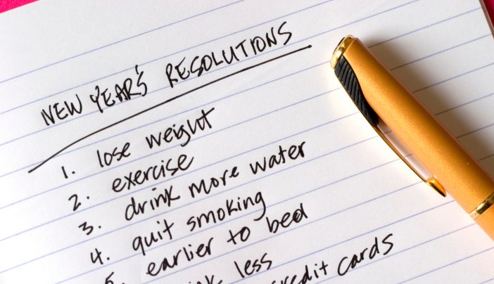
More than 1 Year
6%
New Year's Resolutions
1 Month
8%
4 Months
13%
9 Months
2%
2 Months
22%
6 Months
5%
12 Months
1%
The average New Year’s Resolution lasts 3.75 months.
Notes:
1 minute
Raise your hand if you have ever tried to change anything about yourself (big or little).
Raise your hand if you were able to stick with it for an hour, a day, a week, a month, a year.
If it is this difficult for an adult to stick with a change they want to, How difficult do you think it is for a student, who does not necessarily want to change, to stick with it. Remember that change for our students can be a long and winding road with ups and downs. It is important that our students know that we believe in them and are willing to help them be successful.

Slide 59
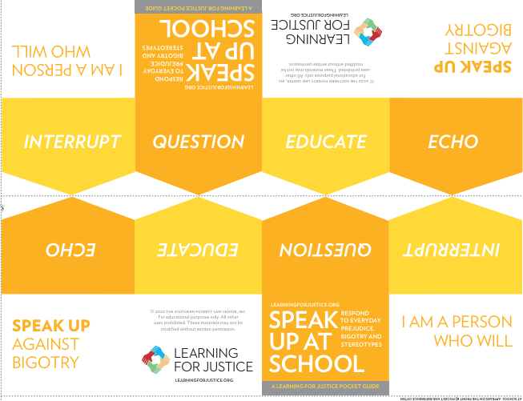
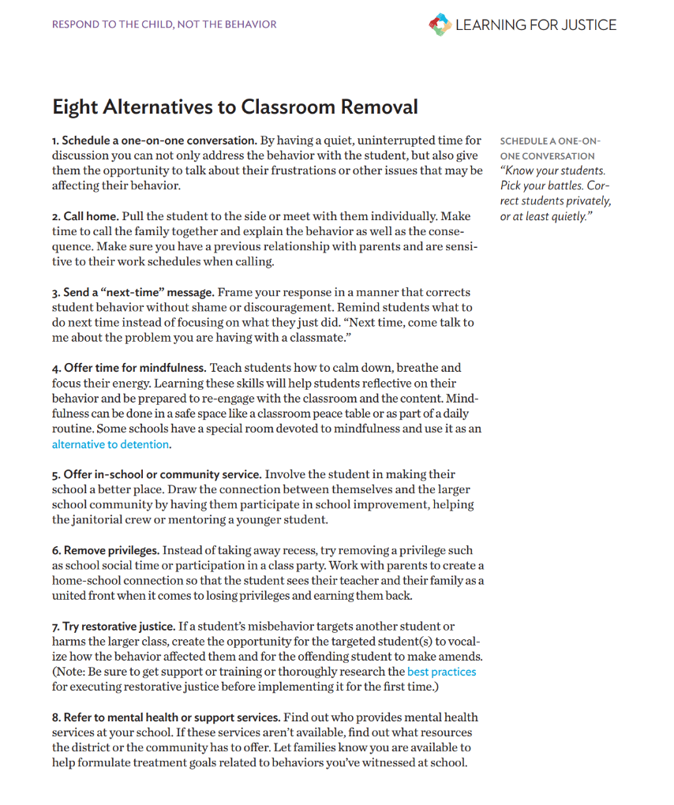
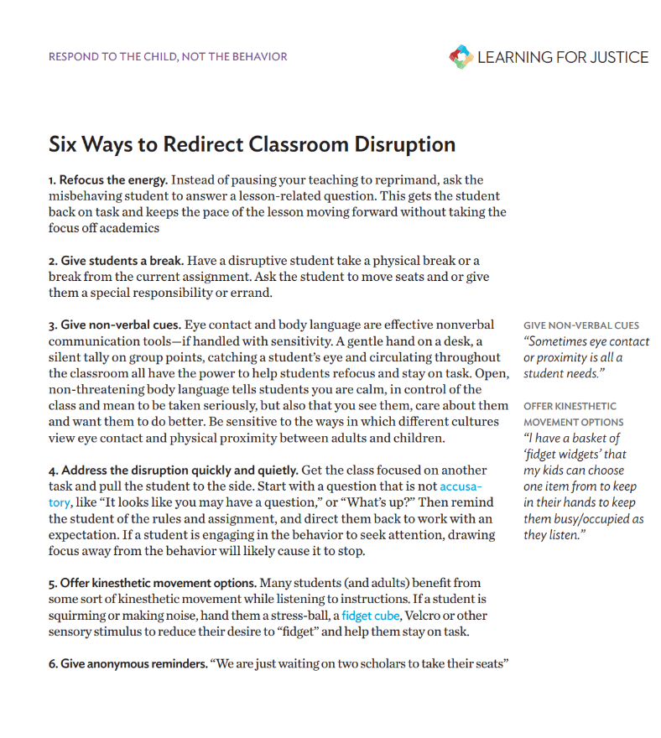
Resources
Six Ways to
Redirect Classroom Disruption
Eight Alternatives to Classroom Removal
Reframing
Classroom Management
A Toolkit for Educators
Speak Up at School Pocket Guide
Notes:
30 seconds
Here are some resources for responding to the student rather than the behavior.

Slide 60
What is Cultural Responsiveness?
Adaptation of existing systems to better meet the needs, values, and strengths of students, families, communities.
Language
Visual Representations
Relevance
Instructional Methods
Voice and Choice
Co-creation of Systems
Notes:
1 minute
As reflected in the Educator’s Handbook data, our current systems are not meeting the needs of all our students. By meeting our students needs, we make our jobs easier in the long run because it will decrease discipline issues. Cultural responsiveness works to adapt our existing systems in order to better meet the needs of all of our students. Some things that we can adapt or implement to better meet our students’ needs are in the bullet points.

Slide 61
District Support
Educational Equity
Teacher Specialists
Refugee/ Newcomer Liaisons
Family and Community Engagement
Family Connectors
Help is available!
Notes:
30 seconds
The Ed. Equity team is here to help you. Don’t hesitate to reach out if you have questions or need assistance.

