Slide 1
Microsoft Teams Operator Connect
- Admin Guide -
October, 2024

Slide 2
Version Control (March, 2024)
Items | Slide No. | Change Description
Caller ID | 38 | Randomize Caller ID

Slide 3
Prerequisites
Setup Guide
MS Teams Features

Slide 4
Prerequisites

Slide 5

Prerequisites <Microsoft Teams>
For MS Teams configuration, you will need the following Licenses:
Microsoft Licenses for Operator Connect
Global Admin access on your Office 365 tenant
Note: Teams Admin access is also sufficient as an alternative to Global Admin access
Global Admin Account
Microsoft Licenses

Slide 6
Prerequisites <Microsoft Teams>
Common Area Phone
Microsoft 365 Business Basic + Teams Phone Standard add-on
Microsoft 365 Business Standard + Teams Phone Standard add-on
Microsoft 365 Business Premium + Teams Phone Standard add-on
Microsoft E5
Office 365 E5
Office 365 A5 for faculty
Office 365 A5 for students
Microsoft 365 A5 for faculty
Microsoft 365 A5 for students
Microsoft E3 + Teams Phone Standard add-on
Microsoft F3 + Teams Phone Standard add-on
Microsoft 365 A1 + Teams Phone Standard add-on
Microsoft 365 A3 for faculty + Teams Phone Standard add-on
Microsoft 365 A3 for students + Teams Phone Standard add-on
Office 365 E1 + Teams Phone Standard add-on
Office 365 E3 + Teams Phone Standard add-on
Office 365 F3 + Teams Phone Standard add-on
Office 365 Education E1 for Faculty + Teams Phone Standard add-on
Office 365 Education E3 for Faculty + Teams Phone Standard add-on
Office 365 (Plan G1) for Government + Teams Phone Standard add-on
Office 365 (Plan G3) for Government + Teams Phone Standard add-on
Add us as the Operator - Configure Operator Connect - Microsoft Teams | Microsoft Docs, under “Enable an operator”
Provide us Microsoft tenant ID. - Find Tenant ID, Object ID, and partner association details in Azure Marketplace | Microsoft Docs
Make sure the MS Teams users are in Teams Only coexistence mode
Fill in your Emergency Address under Location in Microsoft Teams Admin Center
Each MS Teams user needs to have either one of these licenses:
Note:
To see an updated list of license requirements please see the Microsoft site.
Notes:
Customer need to complete

Slide 7

Prerequisites <CPaaS Provider>
For CPaaS portal configuration, you will need the following Licenses:
Phone System Base License
Add-on Licenses:
  Microsoft Teams Operator Connect (used for MS Teams Call Service)
  Microsoft Teams Operator Connect Resource Account (used for MS Teams Auto Attendant & Call Queues)
  Number License (used for choosing numbers for the organization)
Phone System Base License
Microsoft Teams Operator Connect
Microsoft Teams Operator Connect Resource Account
Number License

Slide 8
Setup Guide

Slide 9
Setup Guide <Overview>
Provide us your Microsoft Tenant ID
Assign Licenses to CPaaS users on CPaaS portal
Upload CPaaS numbers to Microsoft Teams Admin portal
Assign CPaaS numbers to your Microsoft users on Microsoft Teams Admin portal
Configure general settings for CPaaS users on CPaaS portal
Open Microsoft Teams Apps > Enjoy your call
***All steps must be done by Customer Admins (Global Admin or Teams Admin)

Slide 10
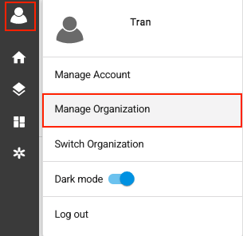
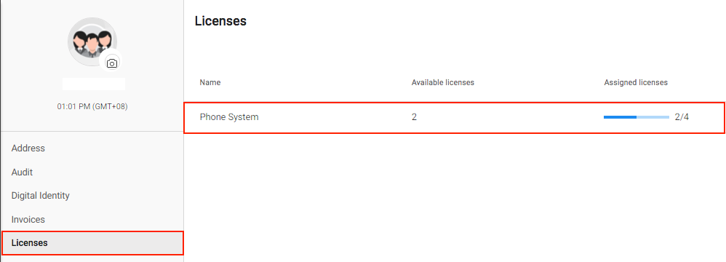

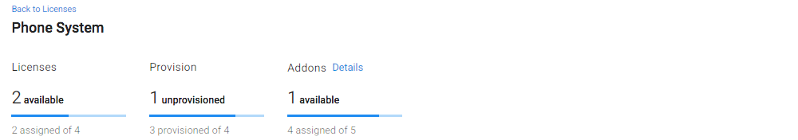
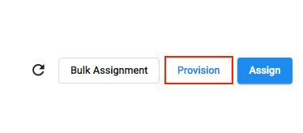
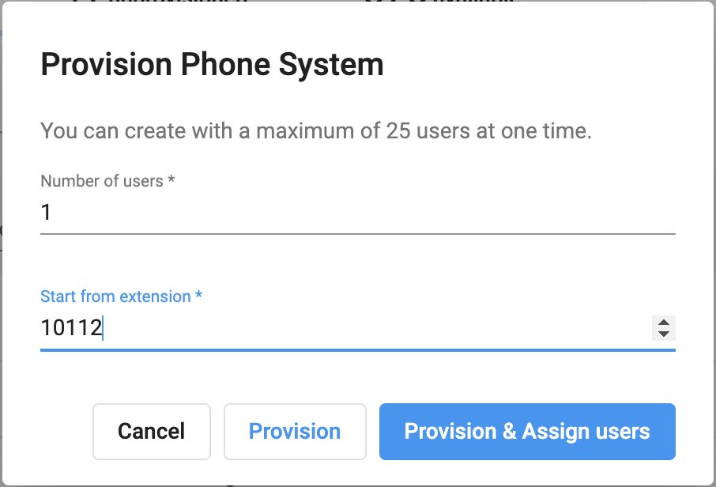
Setup Guide <Assign CPaaS License to Users>
Manual Configuration
  Provision Phone System Base License
Go to Manage Organization > Select Licenses tab
Go to Phone System > click Provision
Input:
  Number of Users to be created
  Extension Number Key
Provision & Assign users

Slide 11
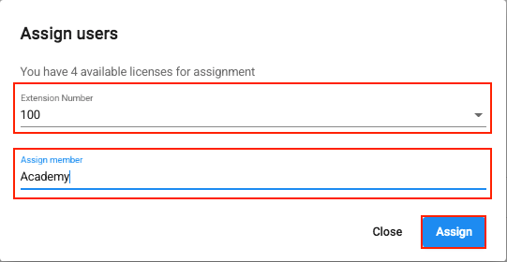
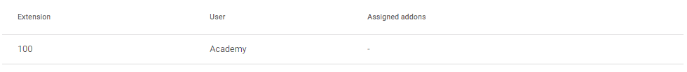
Setup Guide <Assign CPaaS License to Users>
Manual Configuration
b. Assign User
Select:
  Extension Number
  Member to assign
Assign

Slide 12
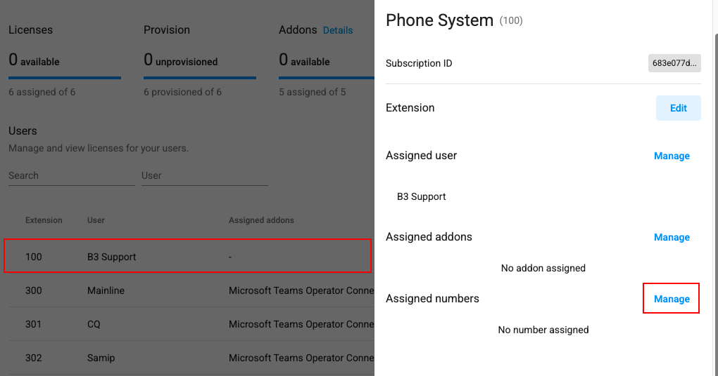
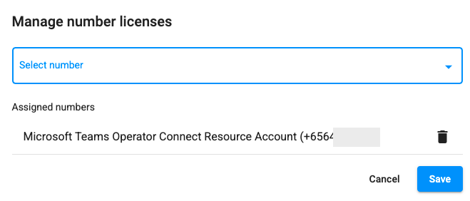
Setup Guide <Assign CPaaS License to Users>
Manual Configuration
c. Assign Addon License
Select the extension that you would like to assign
At Assigned addons, choose Manage > select the purchased addons (if any)
At Assigned Numbers, choose Manage > Select a Operator Connect license with a number
Save

Slide 13
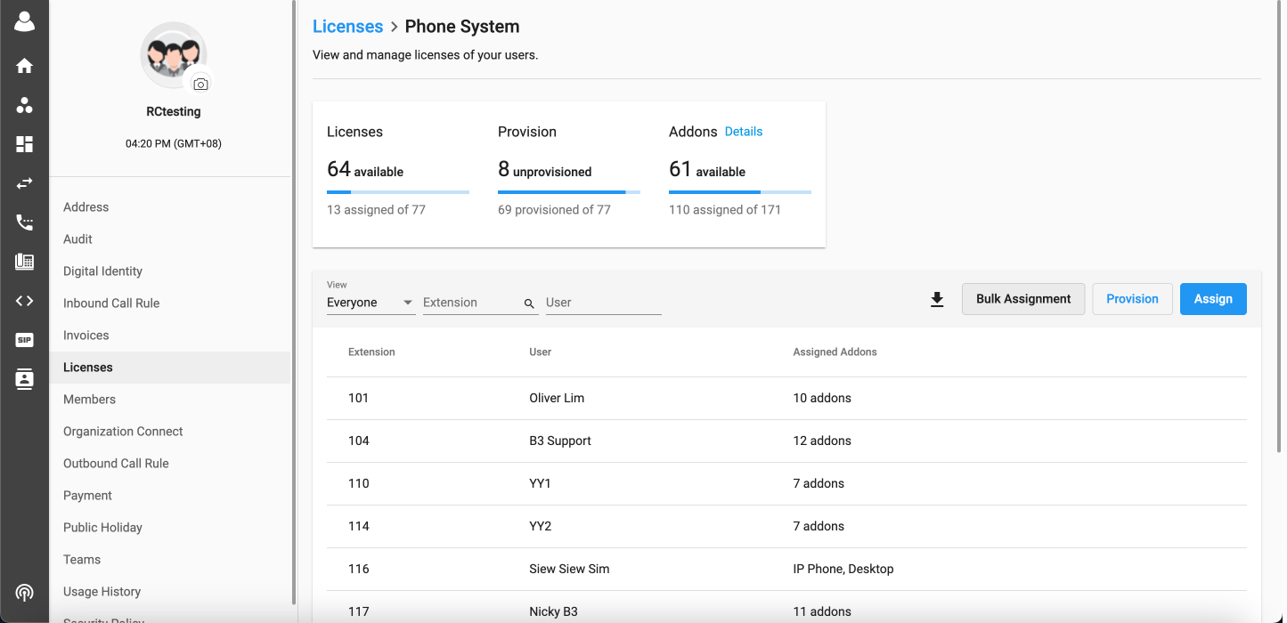
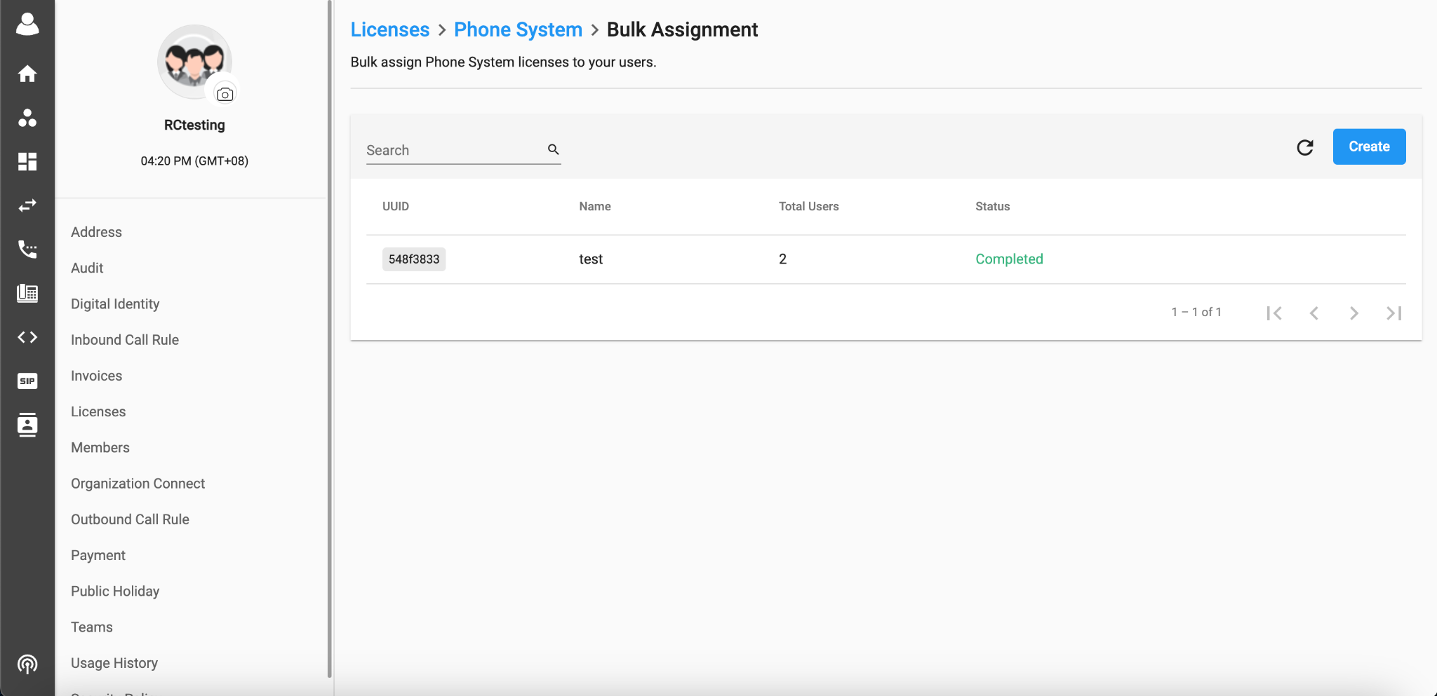
Setup Guide <Assign CPaaS License to Users>
B. Bulk Assignment
Background:
This feature will allow:
Mass provision and assign add-on licenses for many Users.
Main page:
Direction:
On Licenses > Phone System, clicking the Bulk Assignment button will navigate to the new page - BULK ASSIGNMENT.

Slide 14
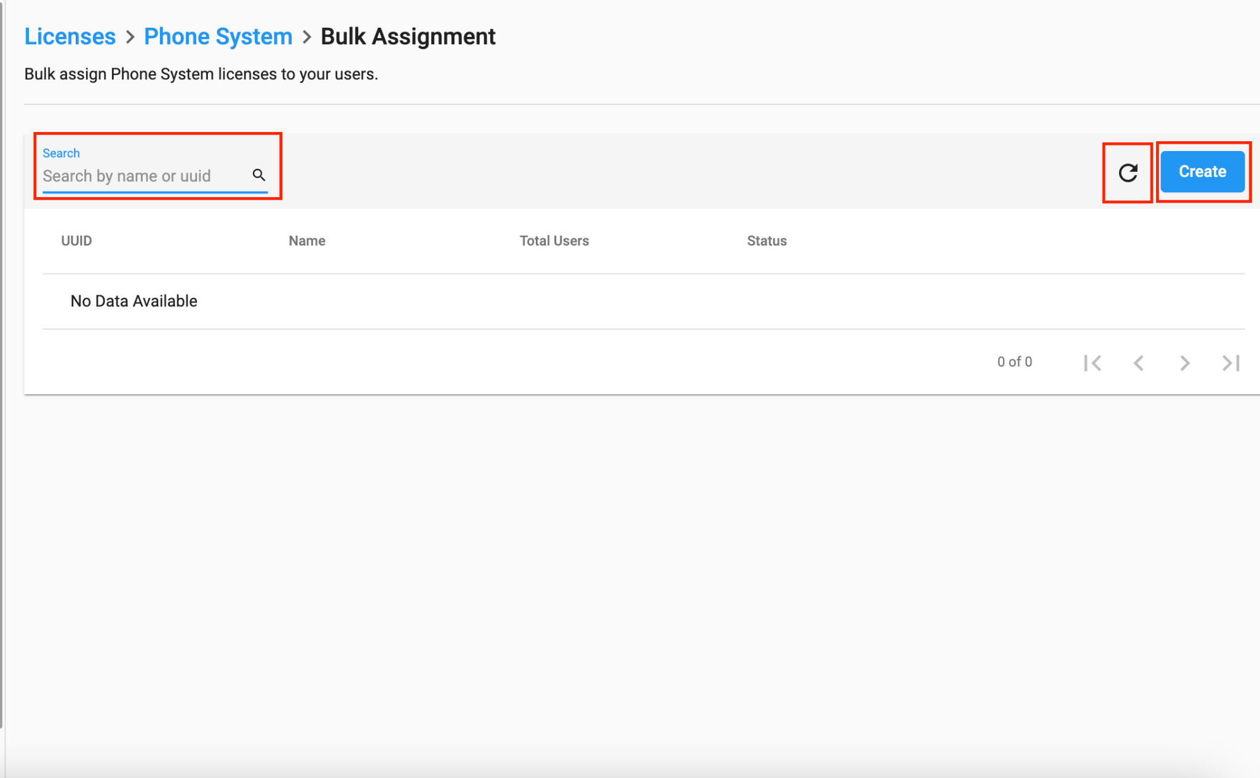
Setup Guide <Assign CPaaS License to Users>
B. Bulk Assignment (UI explanation)
Top Bar:
Search bar (User can search by Name or UUID)
Refresh button (to refresh the page)
Create button (to create a Bulk assignment template)
Columns Details:
UUID (UUID of template created)
Name (Name of the template which user specified during creation)
Total users (Total number of users added in the template)
Status (Status of the template i.e, draft, in progress, completed)

Slide 15
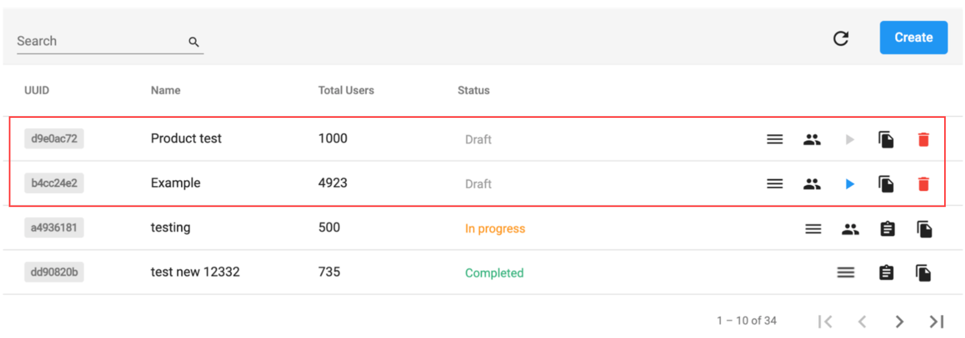
Setup Guide <Assign CPaaS License to Users>
B. Bulk Assignment
When the template is in Draft: (users have 5 options)
Licenses: Show the name and Add on licenses, users can edit and save at this point
Users: show the user's details for the assignment
Assign: start icon
Disabled (Grey): If the user list is blank, cannot start the assignment
Enabled (Blue): Start the assignment process
Duplicate
Delete

Slide 16
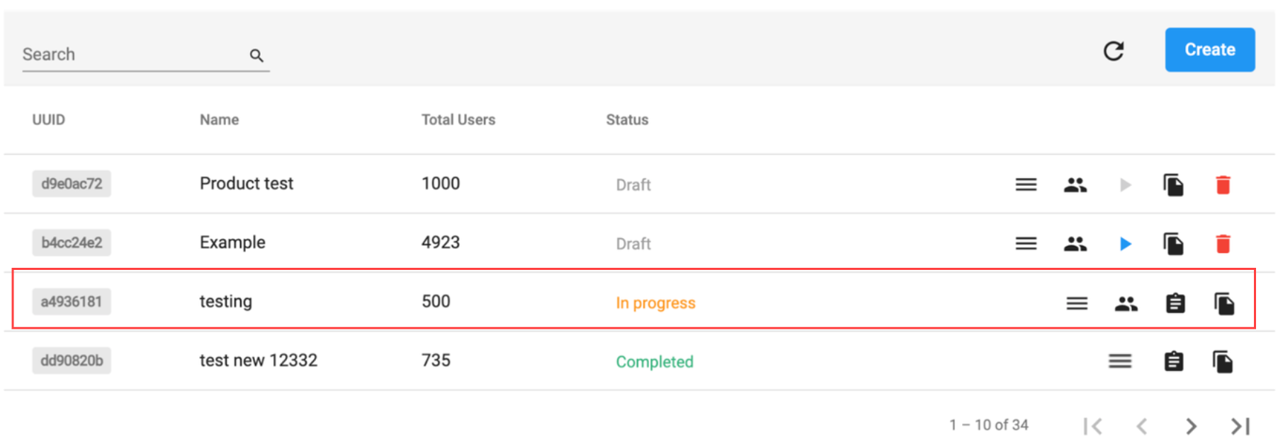
Setup Guide <Assign CPaaS License to Users>
B. Bulk Assignment
When the template is In Progress: (Users have 4 options)
Licenses (view only)
Users (view only)
Report (When user clicks Report, it will navigate to a new Page - Report)
Duplicate

Slide 17
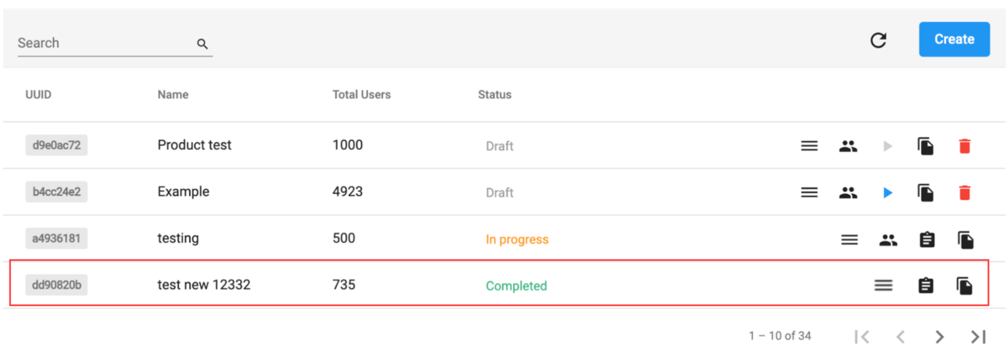
Setup Guide <Assign CPaaS License to Users>
B. Bulk Assignment
When the template is Completed: (Users have 3 options)
Licenses (view only)
Report (When user clicks Report, it will navigate to a new Page - Report
Duplicate

Slide 18
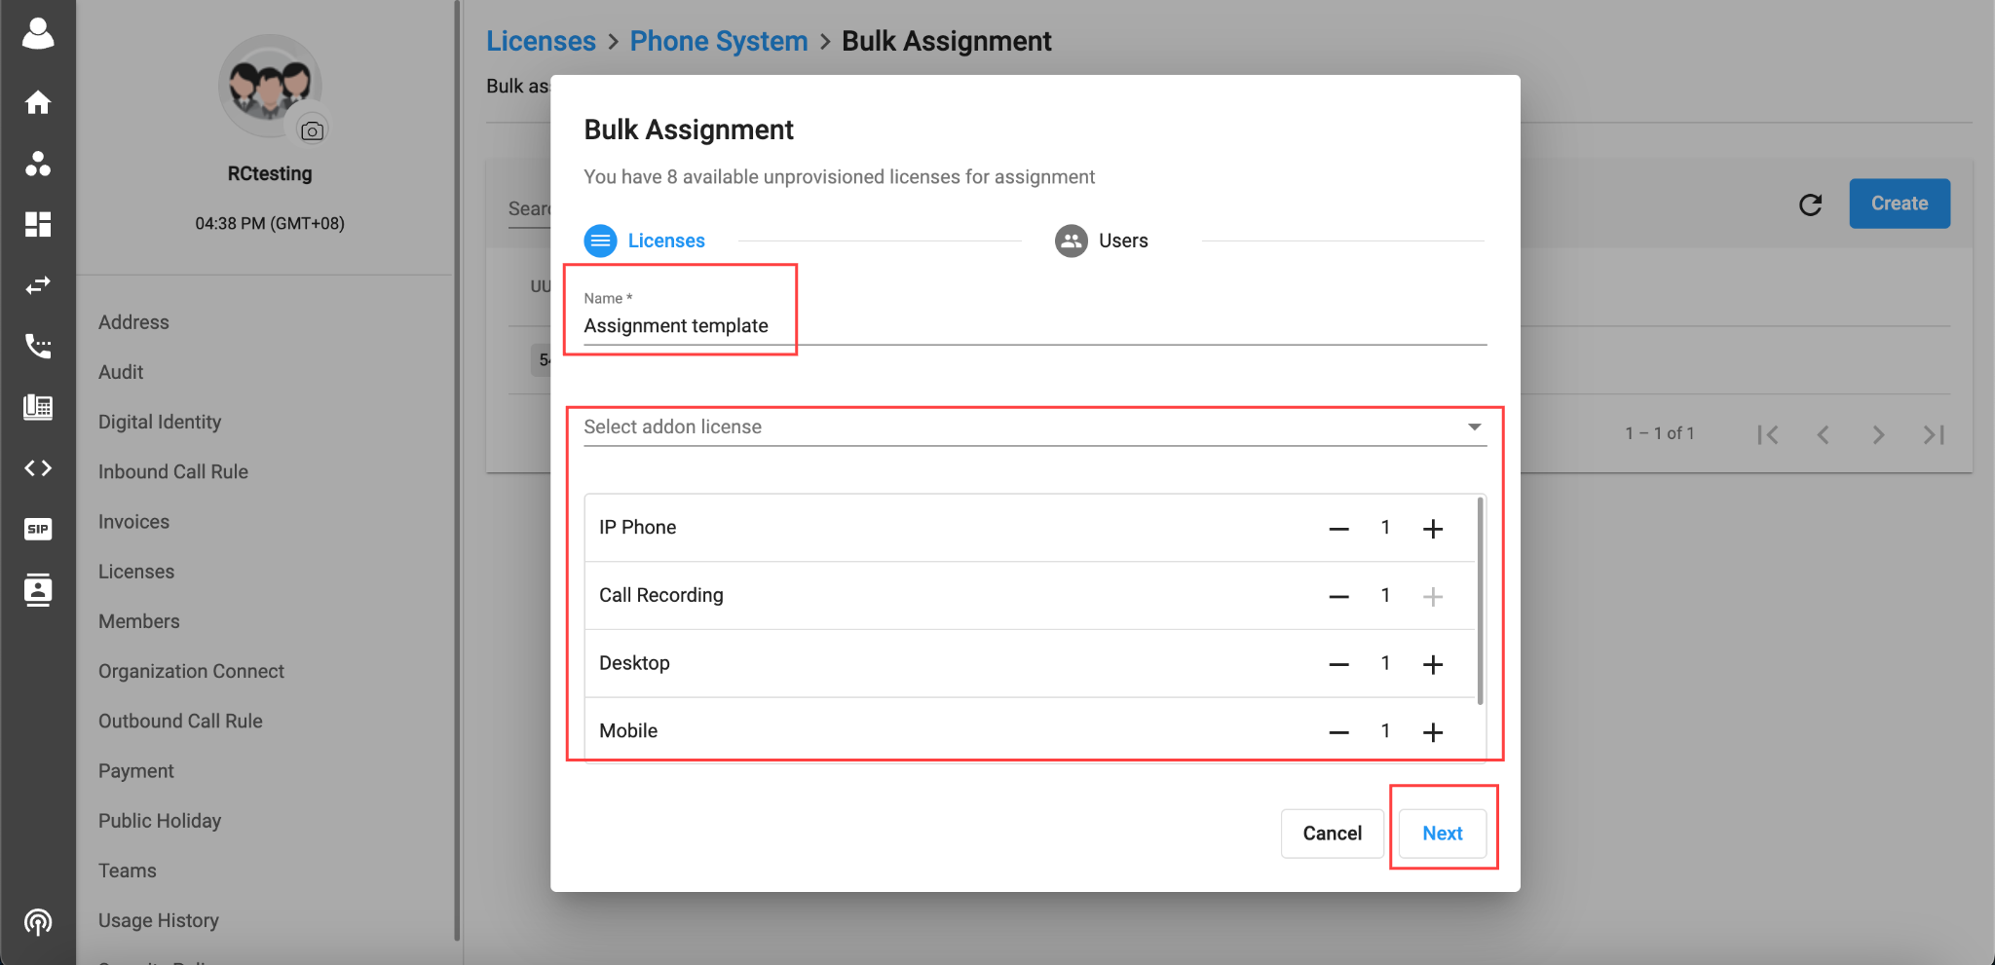
Setup Guide <Assign CPaaS License to Users>
B. Bulk Assignment
When users click Create button, a new window will pop up:
Fill in the Name
Select Add on licenses you want to add from here
Click Next

Slide 19
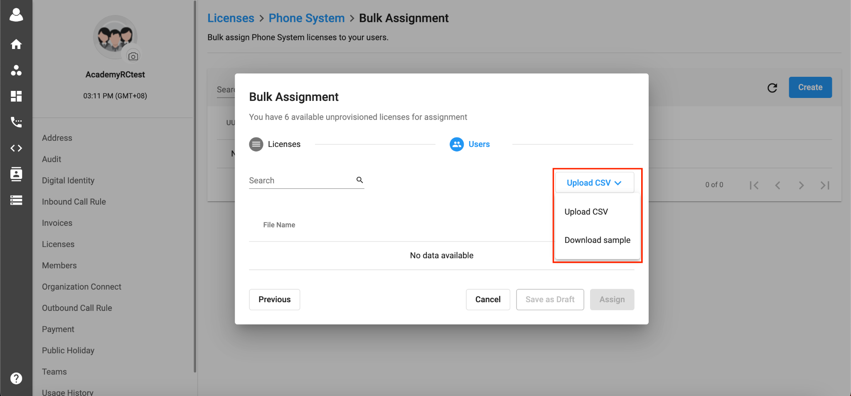
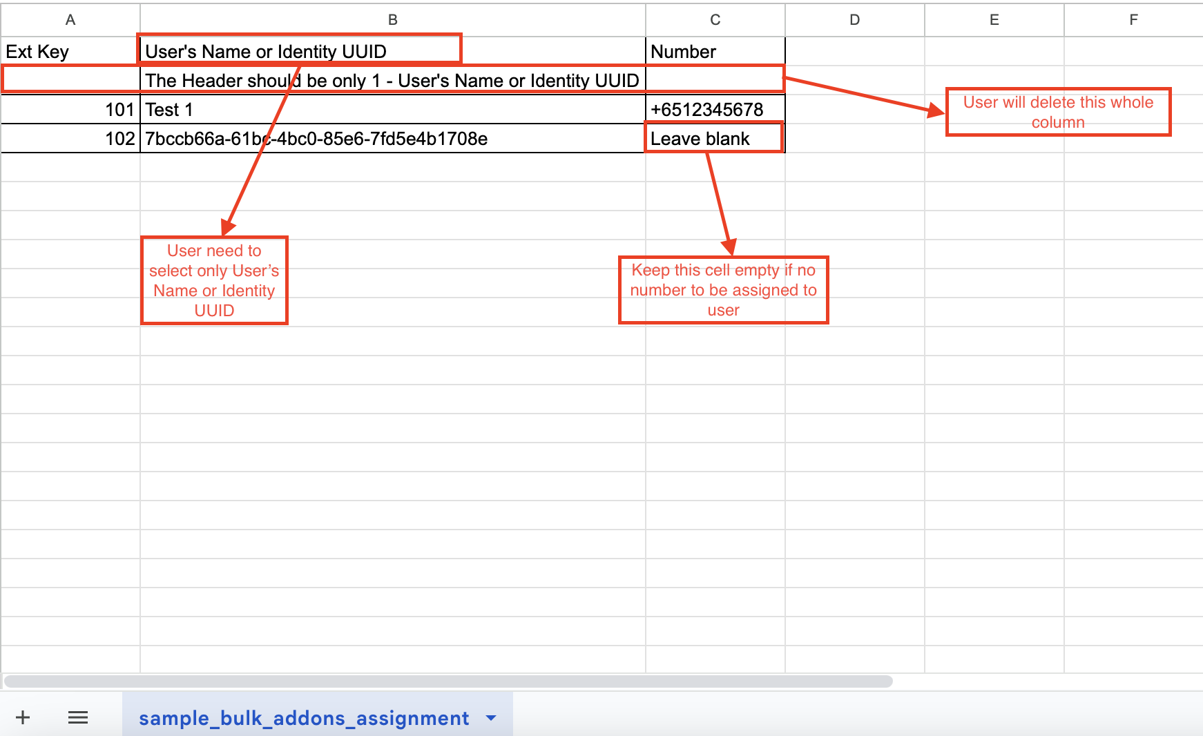
Setup Guide <Assign CPaaS License to Users>
B. Bulk Assignment
Click on the dropdown menu to Download the Sample file.
The sample file downloaded needs editing on the user's side.

Slide 20
Setup Guide <Assign CPaaS License to Users>
B. Bulk Assignment
There are two sample files which can be created:
File with User's name
File with Identity UUID
Ext Key | User's Name | Number
101 | Tony | +6512345678
102 | Jane
Ext Key | Identity UUID | Number
101 | 652d2f57-6e3b-4170-8bf9-4f1e98c88b56 | +6512345678
102 | 7bccb66a-61bc-4bc0-85e6-7fd5e4b1708e
Note:
Ext Key
Obligatory
Cannot leave it blank
Extension key is Unique cannot be duplicated
Format: Numeric, from 3 to 5 Digits
The Ext key is newly created for the unprovision Phone System Base License
User's Name or Identity UUID
Obligatory
Cannot leave it blank
User can input either user’s name or identity UUID in the CSV file
CSV only accepts one type for the entire file, either UUID or name. Mixing is not allowed to ensure consistency
Limitation for the uploaded Users in CSV file is 15,000 Users. No limitation for number of CSV files uploaded but must be under limitation 15,000 Users
Format: UUID or String
Number
Optional
If there is no number → The extension does not have Assigned Number
If there is number → The extension has Assigned Number
Maximum: 1 Number
Format: Numeric or Blank
Note: Size Limit for the CSV file is 5 MB

Slide 21
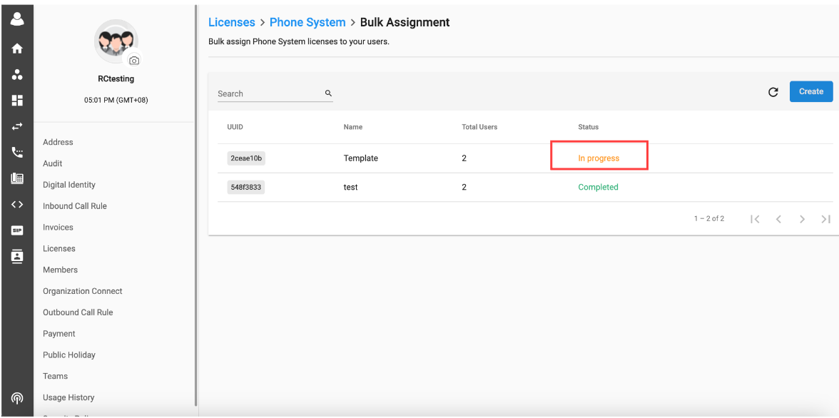
Setup Guide <Assign CPaaS License to Users>
B. Bulk Assignment
After clicking Assign, users wait for a while to complete the assignment progress.

Slide 22
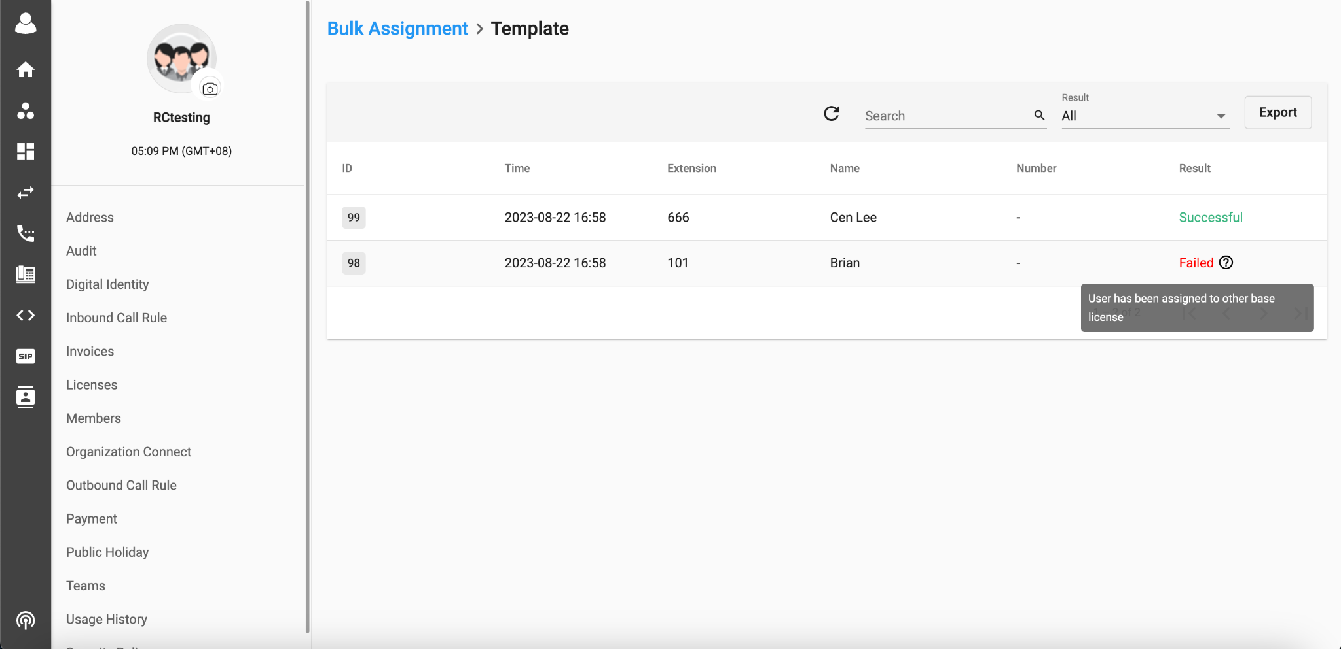
Setup Guide <Assign CPaaS License to Users>
B. Bulk Assignment
After completing the assignment, users click Report to see the result of the assignment progress and export the report.
Note: In order to assign successfully
The organization must have sufficient available unprovisioned Phone System licenses for assignment
The organization must have sufficient available addon licenses for assignment
User’s status must be unassigned

Slide 23
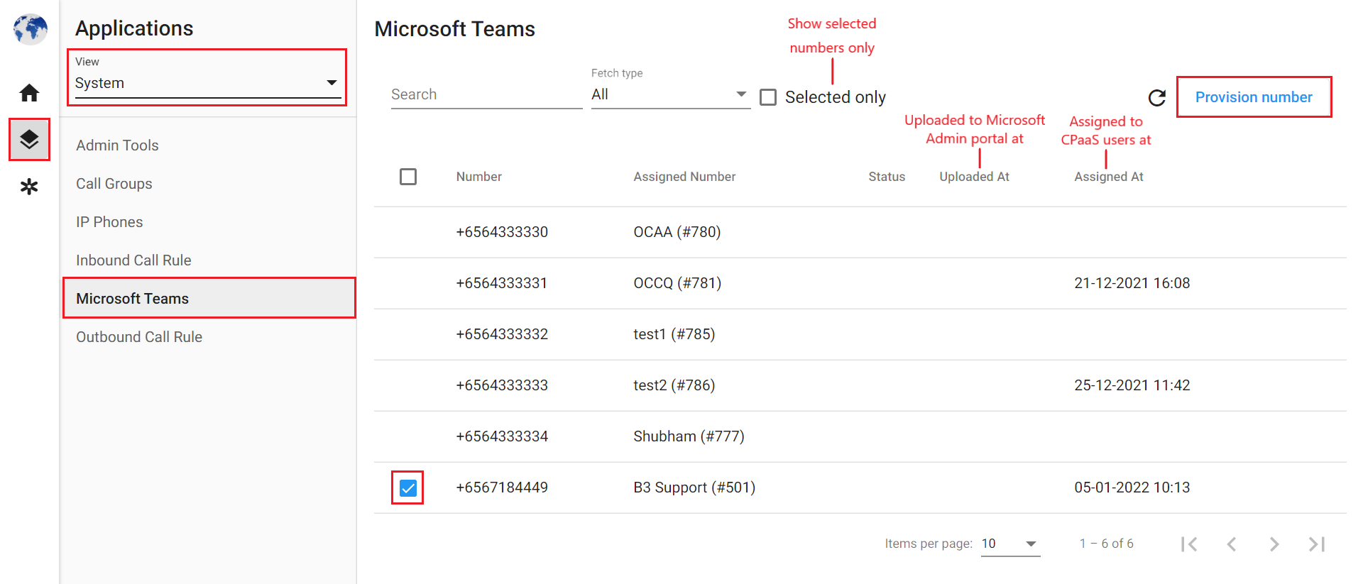

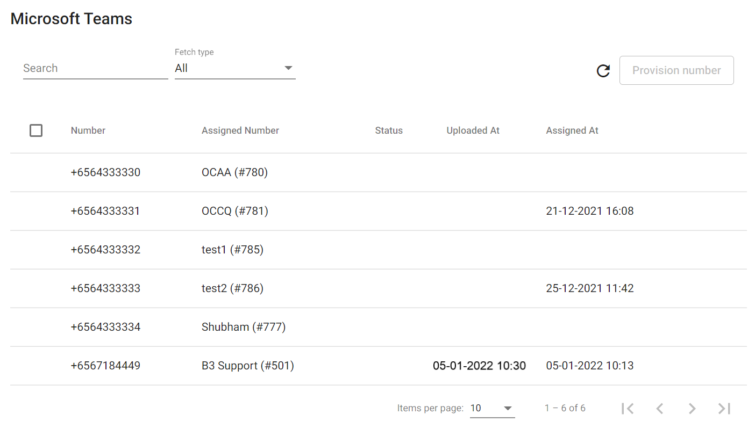
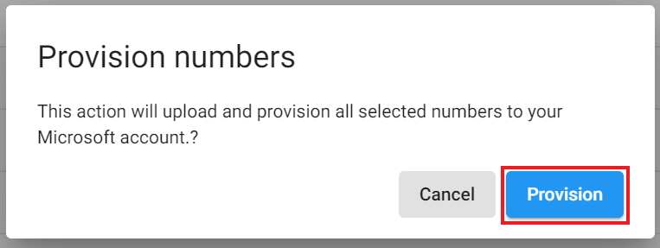

Setup Guide <Upload CPaaS Numbers>
Go to Application Settings > View: System > Microsoft Teams
Tick the CPaaS phone numbers you want to upload to Microsoft Teams Admin portal > click Provision Number

Slide 24
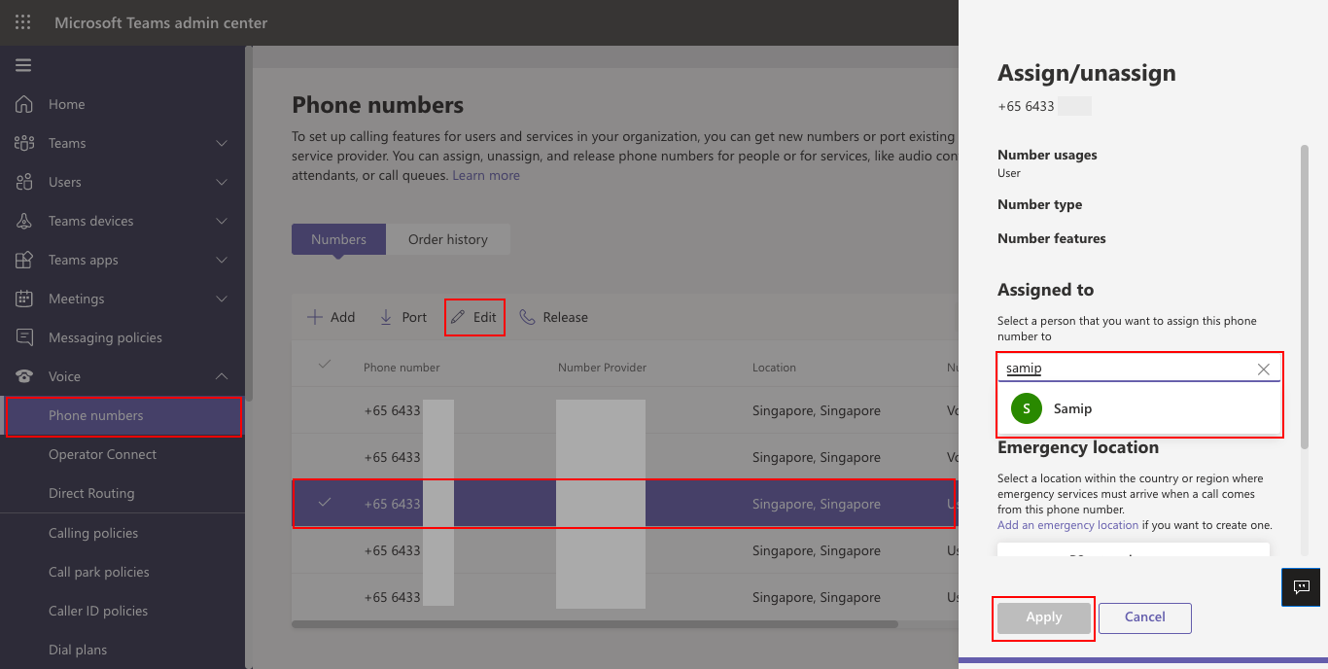
Setup Guide <Assign CPaaS Numbers to Microsoft users>
Go to Microsoft Teams Admin Portal > Voice > Phone numbers
Click on the phone number you want to assign > Edit > find the user > Apply

Slide 25
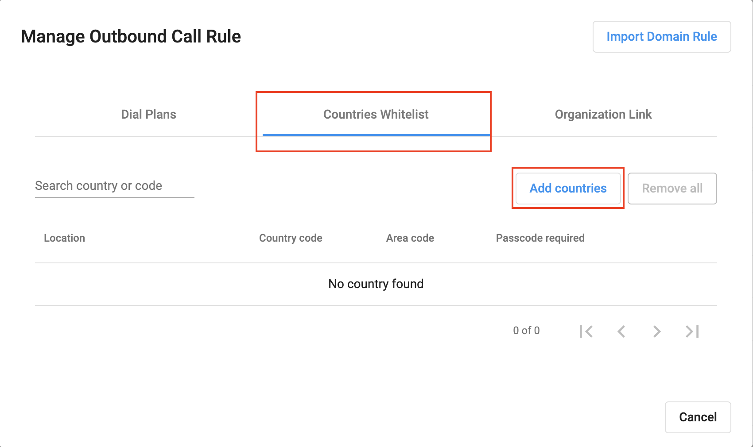
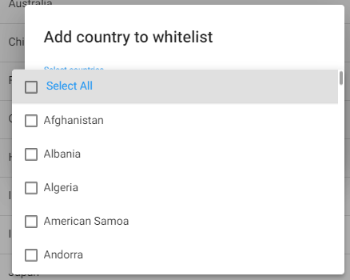
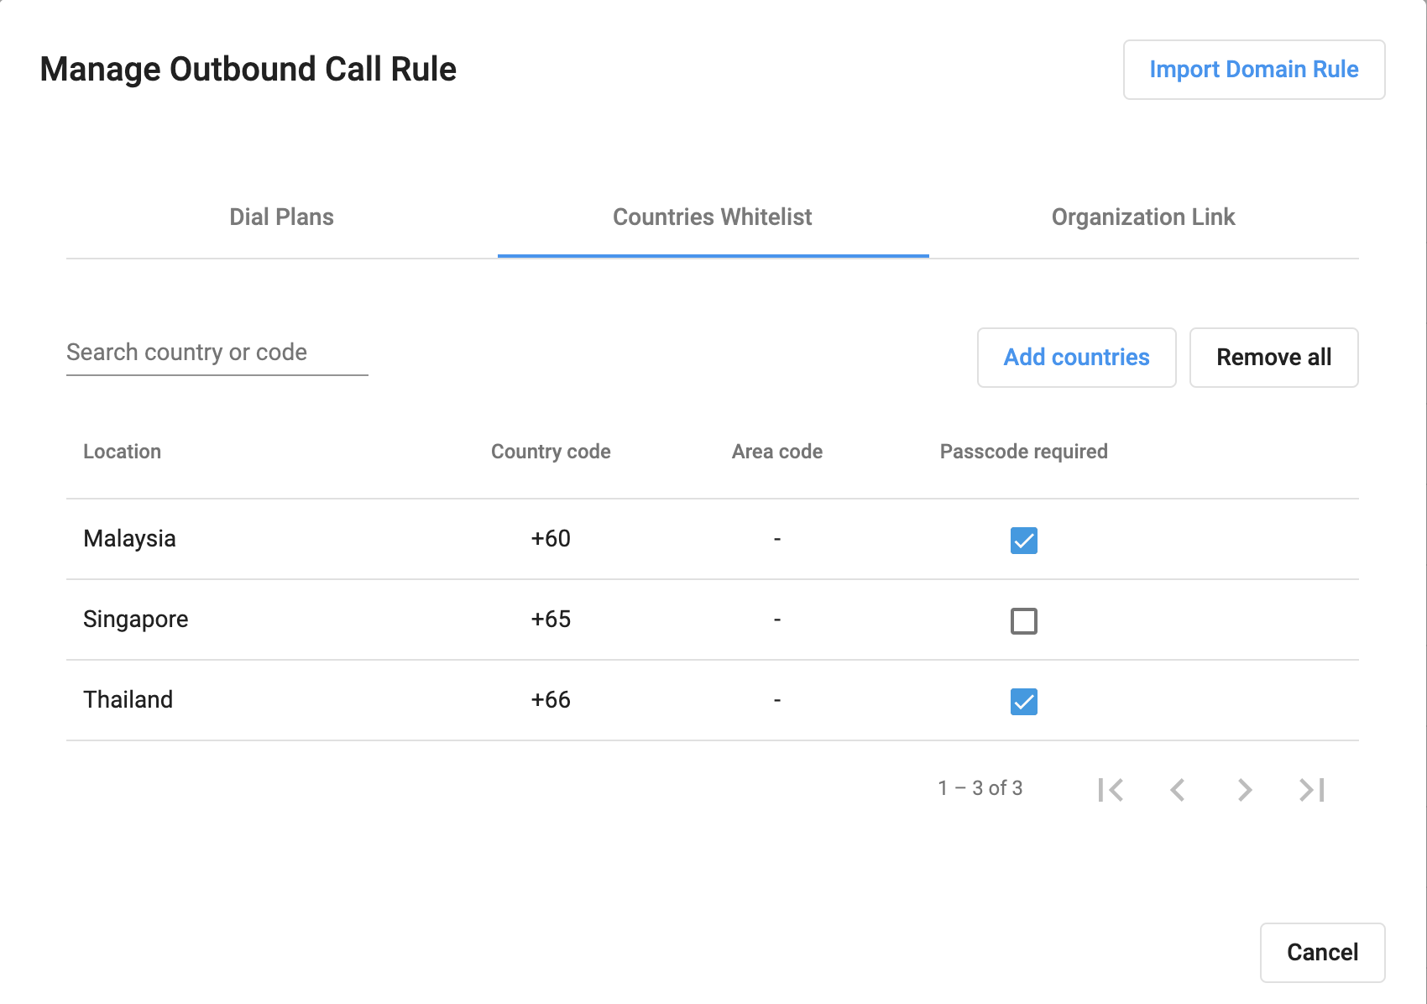
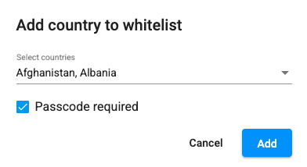
System Configuration <Manage Organizations>
Outbound Call Rule:
Country Whitelist
  User can select the list of countries they can call to.
  Passcode required: if checked, users need to key in their passcode in order to call to these countries.
Go to Manage Organization
Select Outbound Call Rule
You can manages Dial Plans, Countries Whitelist and Organization Connect Patterns for your organization.

Slide 26
Setup Guide <Configure General Settings for CPaaS>
CPaaS System Configuration

Slide 27
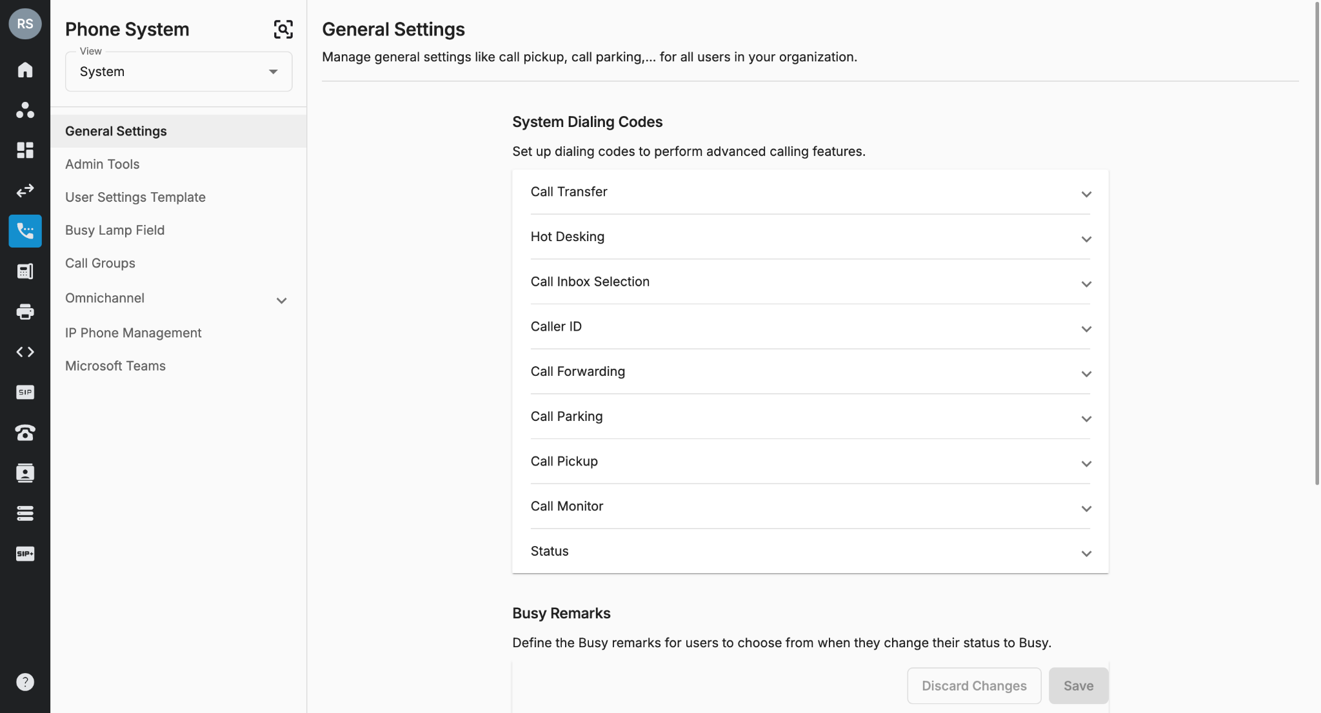
System Configuration <General Settings> (Optional)
General Settings is where the Owner/Admins configure the below information for the Organization:
Call Pickup
Call Parking

Slide 28
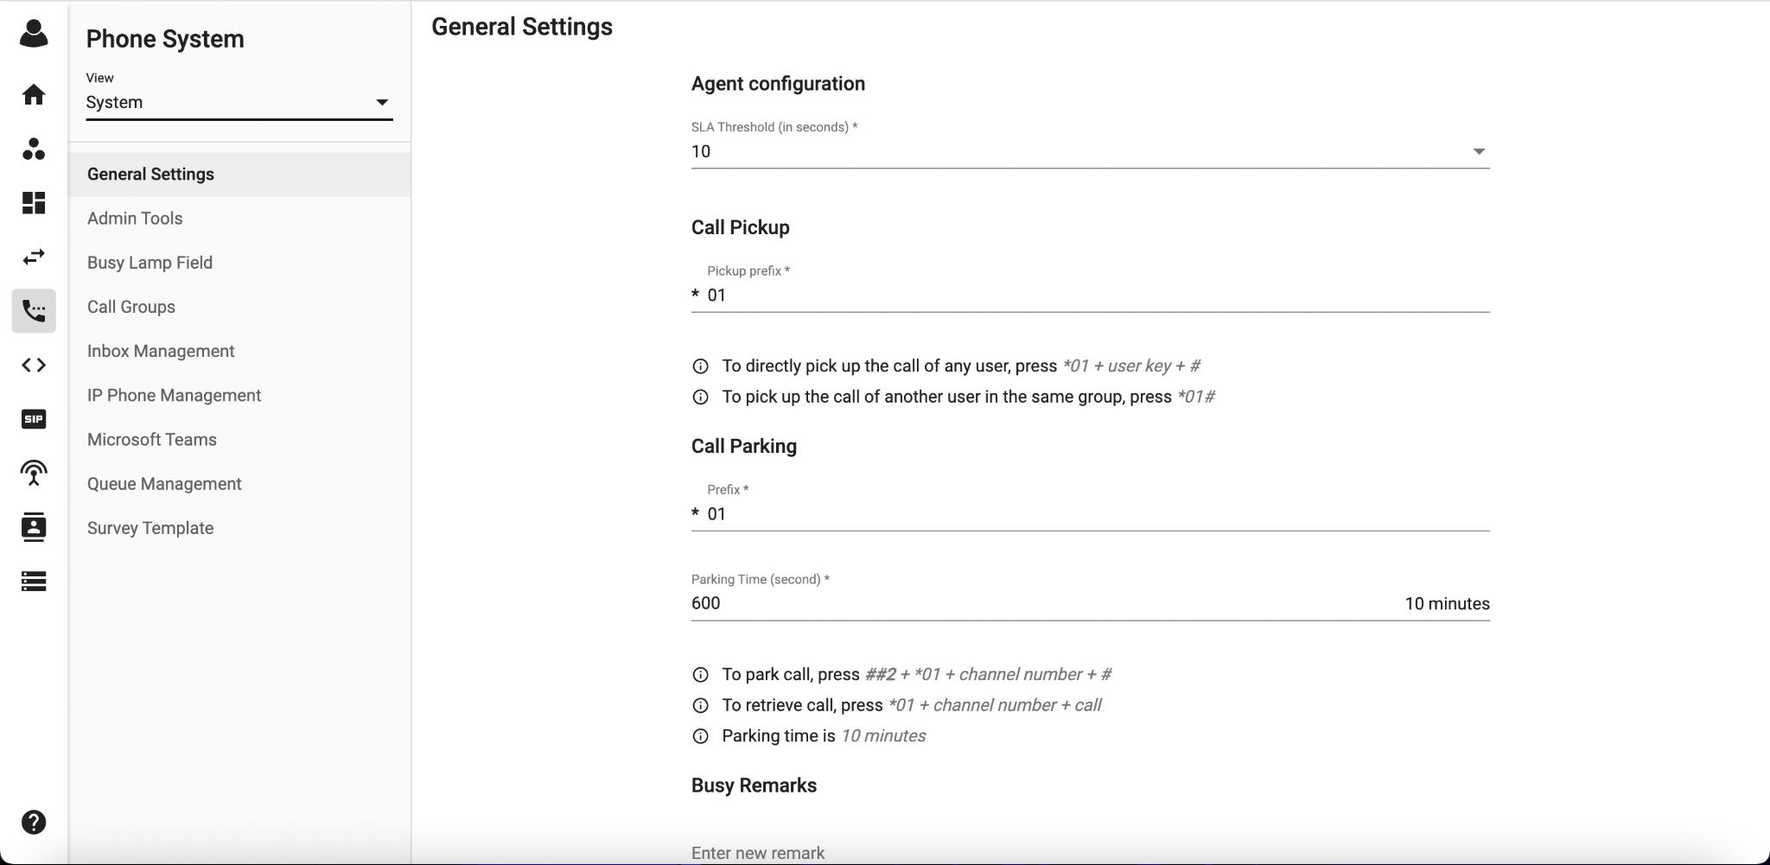
System Configuration <General Settings> (Optional)
Call Pickup
Owner/Admins can create a pickup prefix for the organization so that users can pick up calls of any other extensions.
To directly pick up the call of any extension, press: Pickup prefix + user key + #
  Example:
    The pickup prefix is *10
    Pick up the call that is ringing at Ext 201, press *10201#
To pick up the call of another extension in the same group, press: Pickup prefix + #
  Example:
    The pickup prefix is *10
    Ext 202 & Ext 203 are in the same Group
    Ext 202 wants to pick up the call ringing at Ext 201, press *10#

Slide 29
System Configuration <General Settings> (Optional)
Call Parking
Call Park is a feature that allows users to:
Place an incoming call on hold at a specific parking location (a fictional extension)
Pick up the call on a different phone.
Let another person can pick it up on a different phone
To park or retrieve a call, press: *Parking Prefix + channel number + #
Example:
The parking prefix is *10
Ext 202 parks the call at Channel 1
Ext 203 wants to retrieve the call, press *101#
During the Parking time, the caller will hear the on-hold music.
*Channel Number:
It is a fictional extension that allows you to park the call.
The range will be from 1 to 99.
The system allows you to park 99 calls at the same time. However, each channel only can handle 1 call at a time.
If the user tries to park the caller in a busy room (which have another caller), then the system will play an announcement to the user: "This room is unavailable, please try another room."
Note
The digit limit for call parking prefix is between 1 to 4 digits.

Slide 30
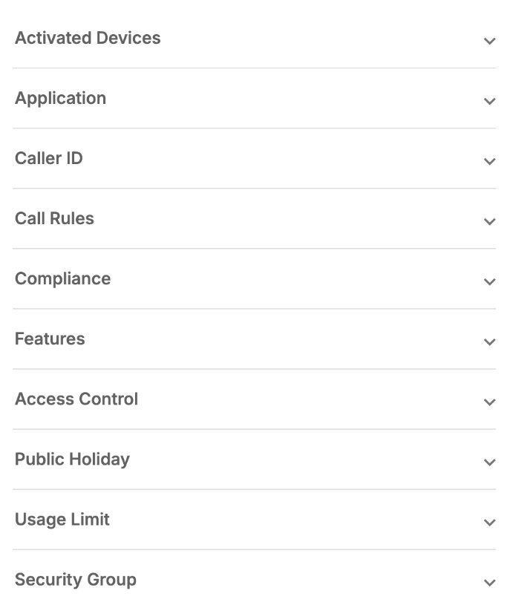
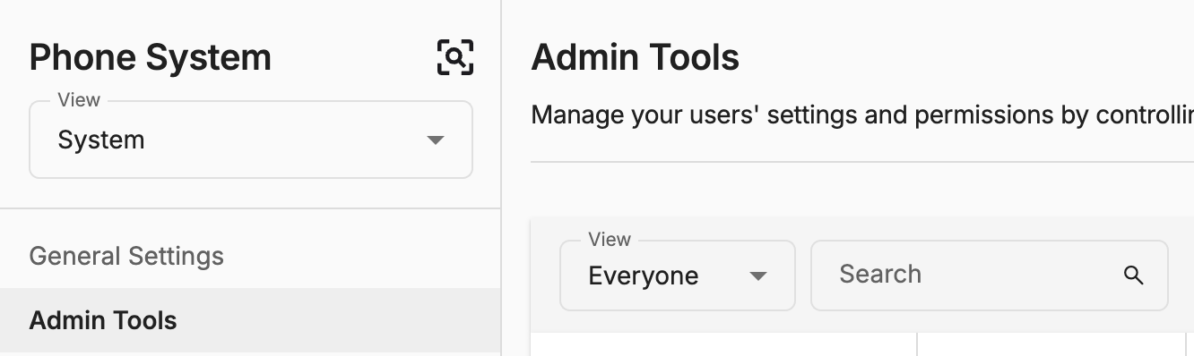
System Configuration <Admin Tools>(Compulsory)
Admin Tools page is where Owner/Admins can manage the user’s configurations:
Manual Configuration
Activated Devices
Application
Caller ID
  Caller ID When Forwarding
  Caller ID when Transferring
  Private Caller ID
  Auto Attendant Numbers
Call rules
  Inbound Call Rule - Users have the option to choose “None” as their inbound call rule.
  Outbound Call Rule
  Passcode
Features (Call Waiting, Debug Mode, Android Background)
Organization Connects
Access Control (Call Recording, DNC)
Public Holiday

Slide 31
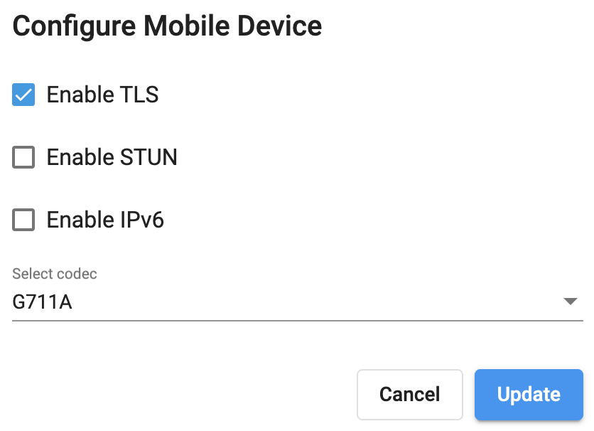
System Configuration <Admin Tools> (Compulsory)
Activated Devices:
TLS:
  Secure SIP protects SIP messages by encrypting them over a TLS (Transport Layer Security) channel using a security certificate. Secure RTP (Real-time Transport Protocol) provides encryption, message authentication, integrity, and attack protection to the RTP data stream.
STUN:
  A STUN (Session Traversal of User Datagram Protocol [UDP] through Network Address Translators [NATs]) server allows NAT clients (i.e. IP Phones behind a firewall) to set up phone calls to a VoIP provider hosted outside of the local network.
  The STUN server allows clients to find out their public address, the type of NAT they are behind and the Internet side port associated by the NAT with a particular local port. This information is used to set up UDP communication between the client and the VoIP provider to establish a call.
IPV6 (applicable for Desktop, Mobile):
  Internet Protocol version 6 (IPv6) is the most recent version of the Internet Protocol (IP), the communications protocol that provides an identification and location system for computers on networks and routes traffic across the Internet.
  Most of our clients will use IPV4, however, if you utilize IPV6 (check with your internet provider for this information), please enable IPV6 for your Desktop and Mobile devices to make it work.
Codecs:
  Standards that encode and decode sound into data streams for transmission in the internet environment.
  Users can now update codecs for each device
  Codec list includes:
    G711A
    G711U
    Opus
*Note: If the user has multiple mobile or desktop devices, a change will be applied to all of the devices that have the same type.
IP Phone - View SIP Credentials:
  Owner/Admins can use this feature to view SIP Credentials and manually connect SIP with users’ IP Phones.
  If users use these brands, Owner/Admins can also use the auto-provisioning functionality to connect SIP with users’ devices.

Slide 32
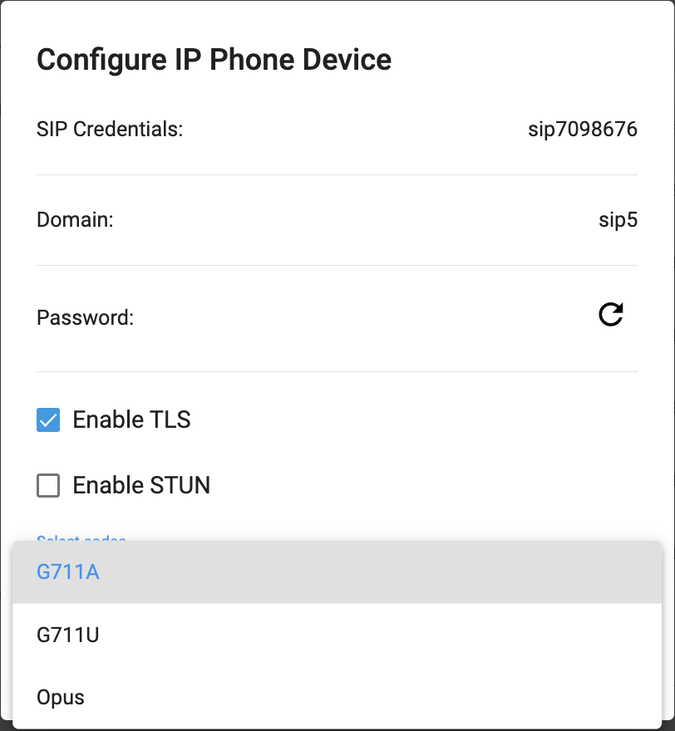
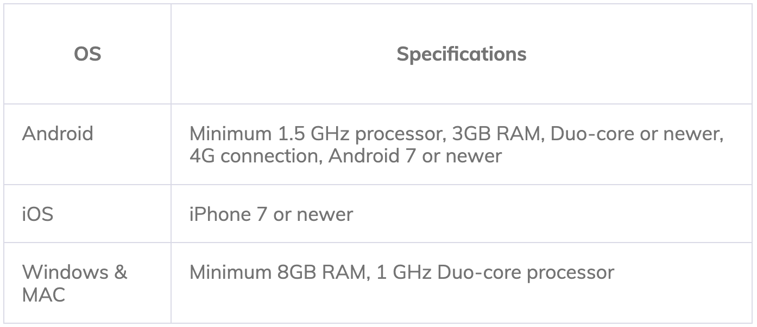
System Configuration <Admin Tools>
Activated Devices:
Codecs:
  Standards that encode and decode sound into data streams for transmission in the internet environment.
  Users can now update codecs for each device
  Codec list includes:
    G711A
    G711U
    Opus
*Note: If the user has multiple mobile or desktop devices, a change will be applied to all of the devices that have the same type.
IP Phone - View SIP Credentials:
  Owner/Admins can use this feature to view SIP Credentials and manually connect SIP with users’ IP Phones.
  If users use these brands, Owner/Admins can also use the auto-provisioning functionality to connect SIP with users’ devices.
Note: (OPUS minimum requirement)

Slide 33
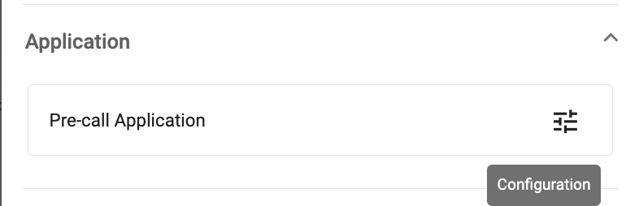
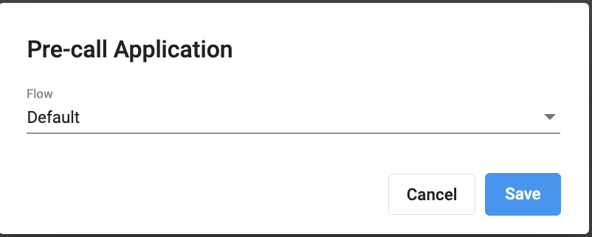
System Configuration <Admin Tools>
Application:
This feature allows Owner and PS Admins to set up multiple Extensions at 1 time.

Slide 34
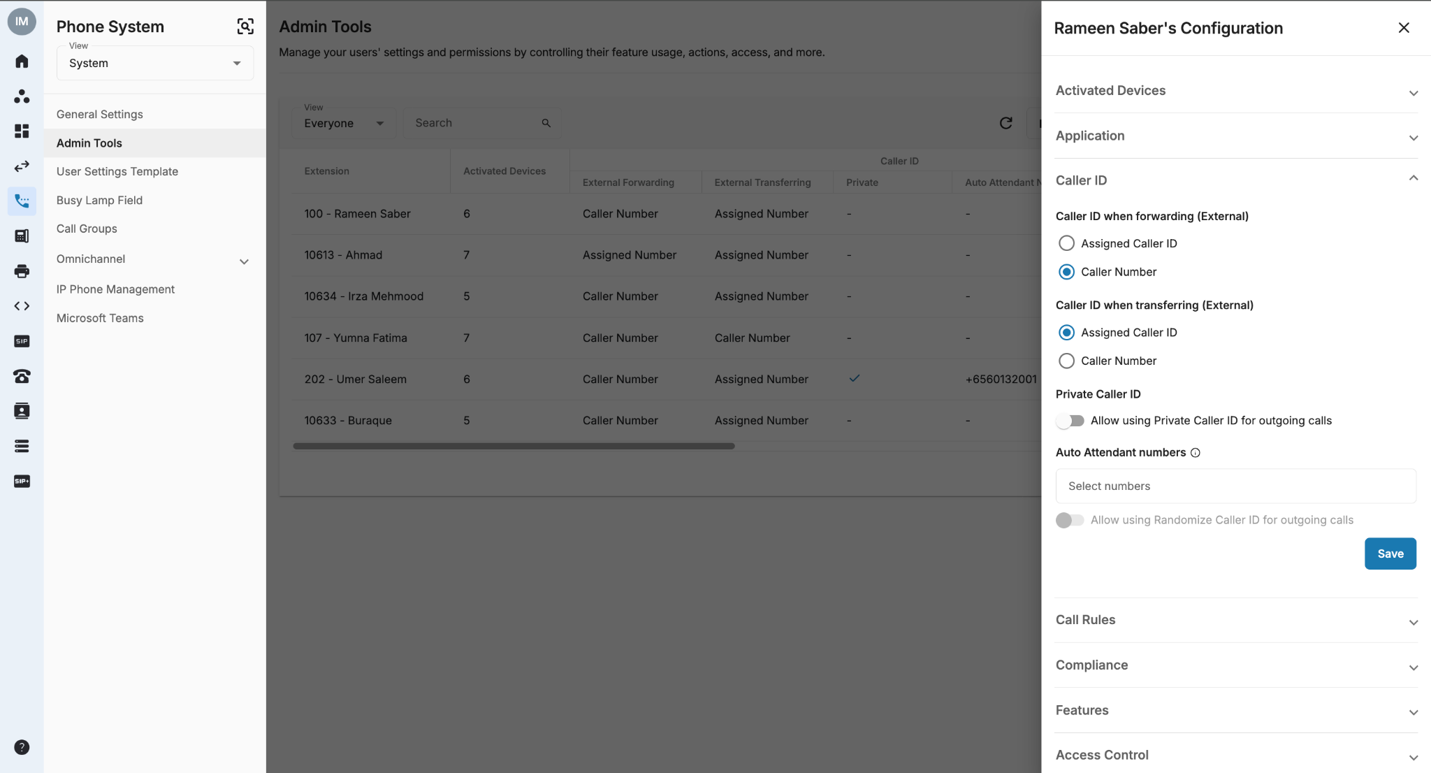
System Configuration <Admin Tools>
Caller ID when Forwarding:
Owner/Admins can determine which Caller ID will be displayed on the transferred/forwarded destination for the users.
For external transfer Caller ID:
  Assigned Number: extension assigned Caller ID.
  Caller Number: original caller number.

Slide 35
System Configuration <Admin Tools>
Caller ID when Transferring:
Owner/Admins can determine which Caller ID will be displayed on the transferred destination for the users.
For external transfer Caller ID:
  Assigned Number: extension assigned Caller ID.
  Caller Number: original caller number.

Slide 36
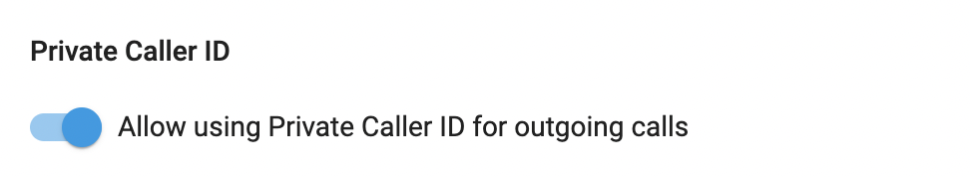
System Configuration <Admin Tools>
Private Caller ID:
Allow users to choose Private as their Caller ID when making Outbound Calls

Slide 37
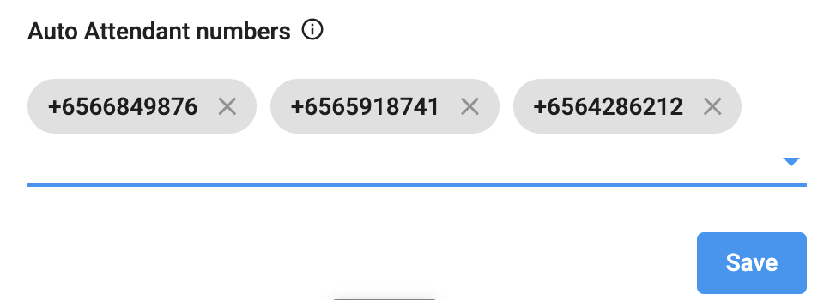
System Configuration <Admin Tools>
Auto Attendant Numbers:
Allow users to choose the assigned auto-attendant numbers as their caller ID when making outbound calls.

Slide 38
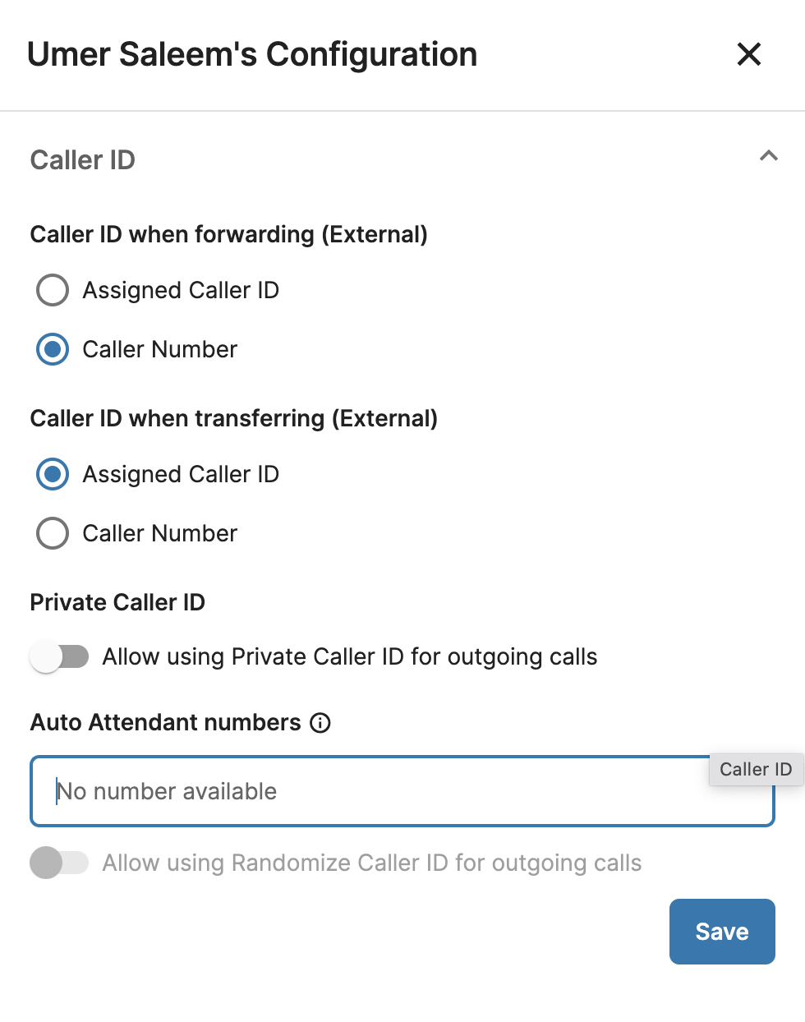
System Configuration <Admin Tools>
Randomize Caller ID:
This feature allows you to randomize the selected Auto Attendant numbers as caller IDs. This will apply to the following scenarios:
Normal Outgoing Calls (Extension directly makes Outgoing Calls)
Caller ID when Transferring externally - Assigned Caller ID
Caller ID when Forwarding externally - Assigned Caller ID
Campaign Outbound Contact Center - Respective Extension Caller ID

Slide 39
System Configuration <Admin Tools>
Randomize Caller ID:
Due to regulations in several countries, 1 Caller ID cannot be displayed simultaneously (1 Caller ID cannot be used in 2 or more calls at the same time), So,
When a Phone-System-Extension initiates a call, the system will automatically assign the next available Caller ID from the pool in a Round-robin method.
Once all Caller IDs have been used, the system will loop back the first Caller ID in the pool.
Limitations:
If the total of Auto Attendant numbers in the Pool are less than the total Phone System Extensions in the Organization, system will not allow to set randomize Caller ID feature.
If the total of Auto Attendant numbers in the Pool are greater than the total Phone System Extensions in the Organization, system will allow to set randomize Caller ID.

Slide 40
System Configuration <Admin Tools>
Randomize Caller ID:
Example:
Prerequisites:
Caller ID Pool: N1, N2, N3, N4, N5
Extensions: 100,101, 102, 103
Phone System Admin enabled these 5 numbers as Caller ID Randomize for these 4 extensions.
Round | Ext. 100 | Ext. 101 | Ext. 102 | Ext. 103 | Caller ID Pool
1 | N1 | - | - | - | N2, N3, N4, N5
2 | - | N2 | - | - | N1, N3, N4, N5
3 | - | - | N3 | - | N1, N2, N4, N5
4 | - | - | - | N4 | N1, N2, N3, N5
5 | N5 | - | - | - | N1, N2, N3, N4,
6 | - | N1 | - | - | N2, N3, N4, N5

Slide 41
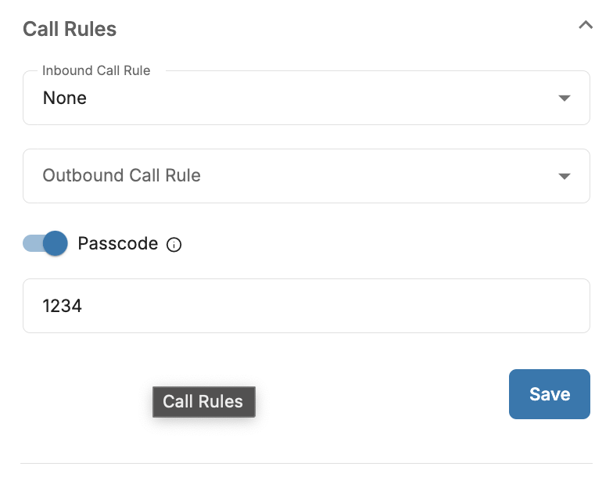
System Configuration <Admin Tools>
Call Rules:
Owner/Admins can assign created Inbound Call Rule & Outbound Call Rule to users.
Inbound Call Rule
  Users have the option to choose “None” as their inbound call rule
Outbound Call Rule
Passcode
  A chain of digits that users have to press when the call to a specific destination.

Slide 42
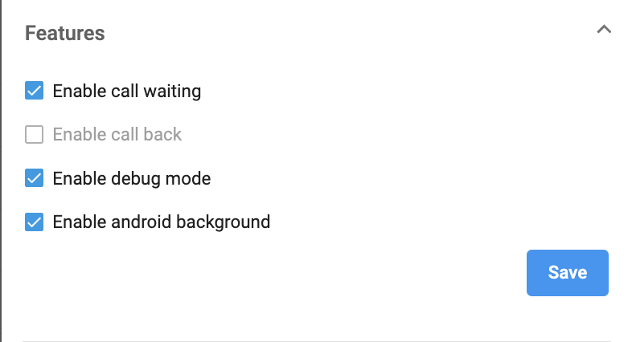
System Configuration <Admin Tools>
Features:
Call Waiting:
This feature helps users to be notified that another caller is trying to get through their line while they are currently engaged on a call.
Users are able to choose whether to accept/reject the new call or keep talking on the line.
When there are incoming calls ringing directly to the Extension’s devices, the system will check the followings:
Call States:
Free
Others: Dialing, Talking, Holding
Call Waiting:
Disabled: 1 Concurrent Call
Enabled: 2 Concurrent Calls
In case the incoming call reaches the Concurrent call limit of the Extension (3rd call), the call will drop and show status as “Failed”.

Slide 43
System Configuration <Admin Tools>
Features:
Call Back:
This feature supports Auto Callback feature for 1 specific use case when a user is busy on another line so that every call will be handled.
Call flow:
Direct incoming call to Phone System Extension, who is talking with another
This extension enabled the callback feature.
For the incoming call to that extension that cannot be handled, the caller will hear a message: “Hi, I'm currently busy. Please press 1 to request a call back, or press 2 to end the call. Thank you.”
Press 1 or 2 to request a callback or end the call.
  1 = After the extension is free → The System will trigger a Call back.
  2 = The call will end as a Missed Call
Note:
Phone system extension can only enable either call waiting or call back. These two features cannot work at the same time.

Slide 44
System Configuration <Admin Tools>
Features:
Debug Mode:
If this mode is turned on, users using Mobile and Desktop App will be able to submit app logs whenever they face problems with the apps. This will help our technical team identify the issue faster.
Android Background:
This option allows the Admin/Owner to hide the android background icon on the mobile app.
  For existing users its enabled by default.
  For new users its disabled by default.
Please note that the user must refresh the app after enabling/disabling android background. .

Slide 45
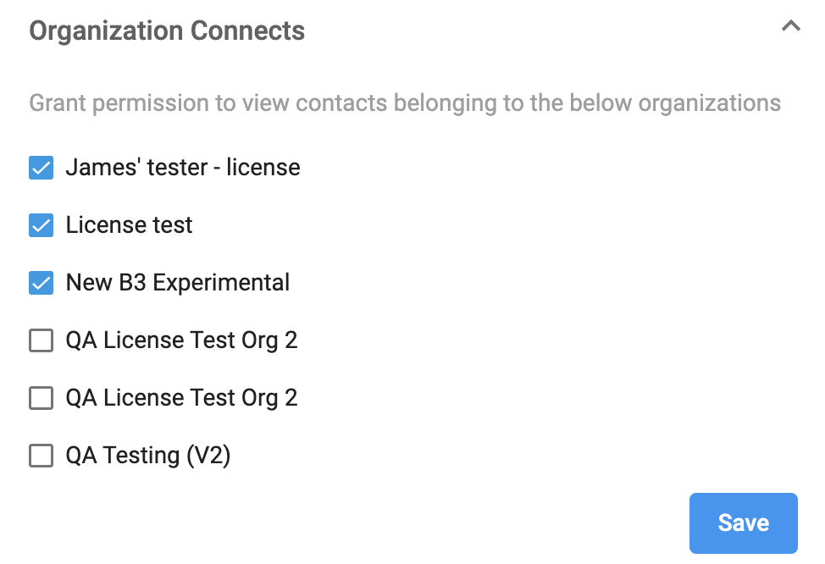
System Configuration <Admin Tools>
Organization connects:
Grant permission for users to view contacts belonging to the connected organizations.

Slide 46
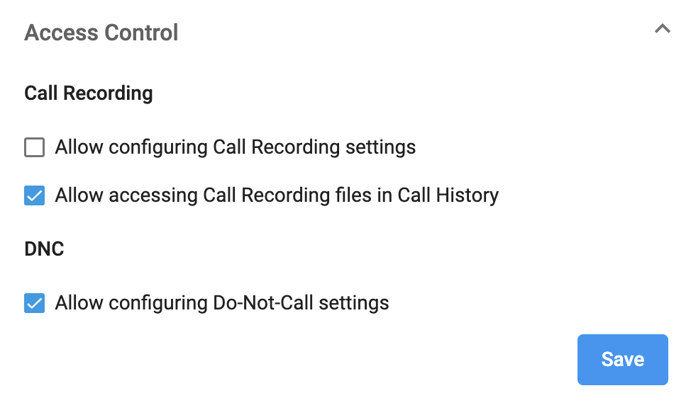
System Configuration <Admin Tools>
Access Control:
Call Recording:
Allow users to configure the Call Recording settings by themselves.
Allow users to access their own Call Recording files..

Slide 47
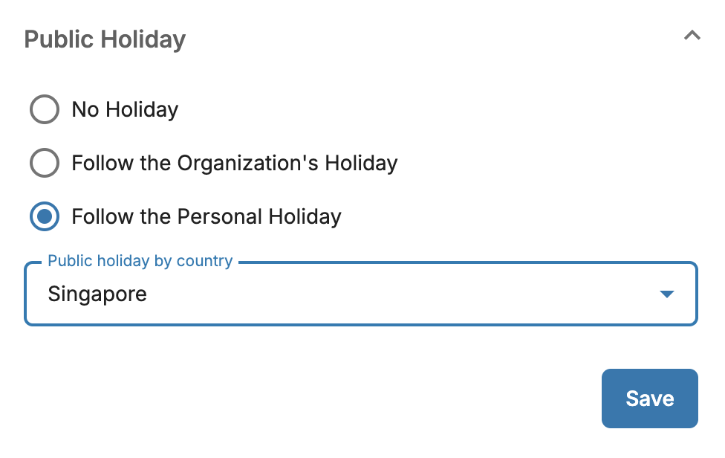
System Configuration <Admin Tools>
Public Holiday:
Allow User to select Public Holiday at User level & Organization level:
No Holiday: Not follow any Public and Customized Holidays If users choose this option, they won’t have any Public Holidays to follow.
Follow the Organization’s Holiday: Applicable for both Public and Customized Holidays.This extension will follow Organization's Public Holiday
Follow the Personal Holiday: Select a Public Holiday by Country If users choose this option, they are allowed to select the Public Holiday of a specific country.

Slide 48
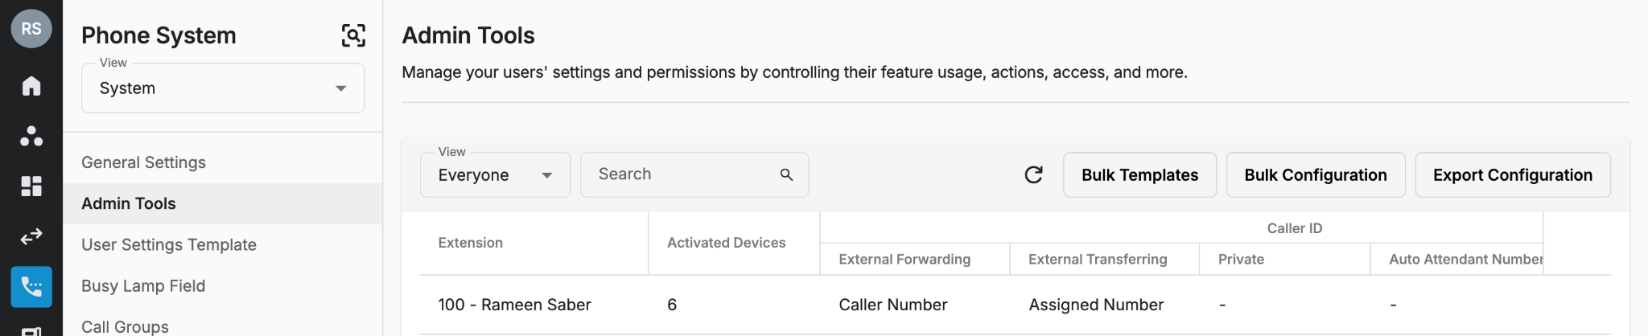
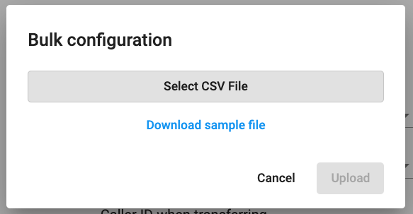
System Configuration <Admin Tools>
Bulk Configuration
Owner/Admins can do bulk configuration for the users:
Click Bulk Configuration > Download sample file > Fill in the information > Select the file > Upload

Slide 49
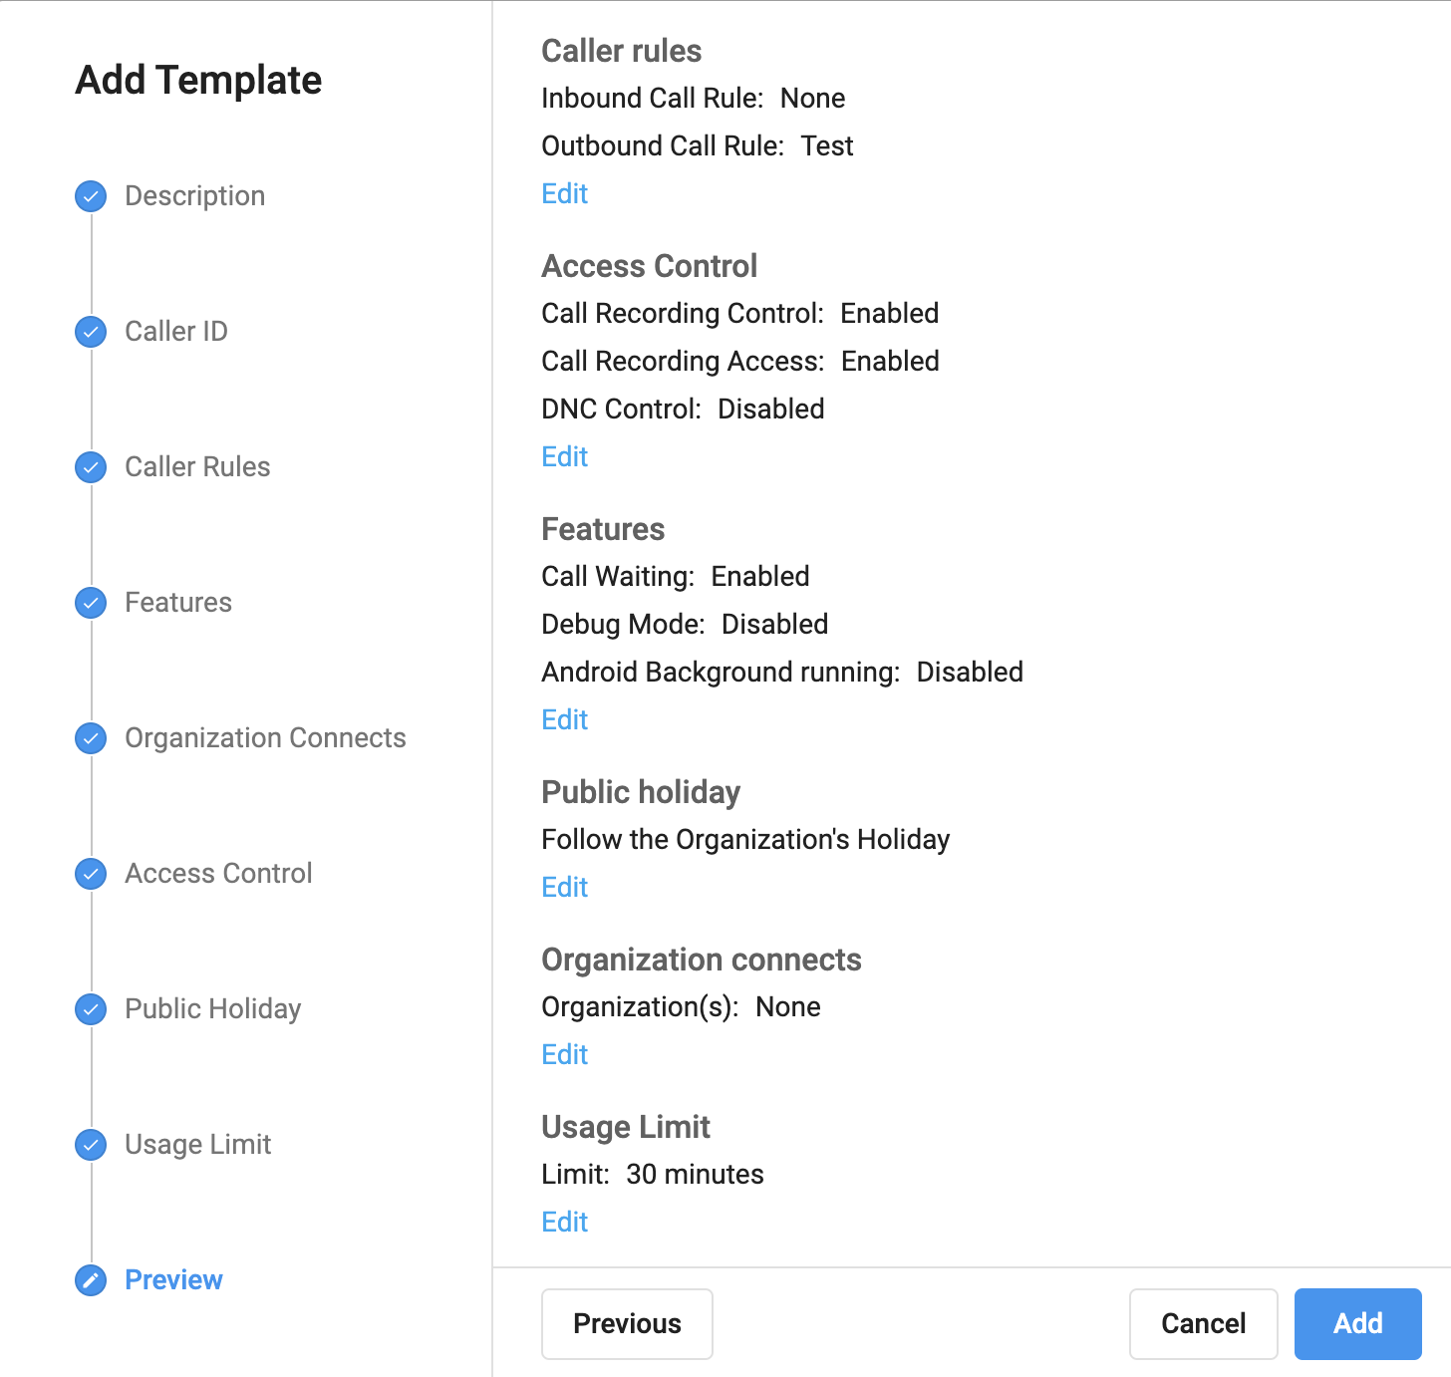
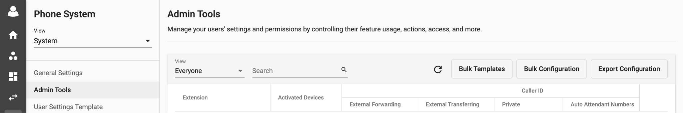
System Configuration <Admin Tools>
Bulk Templates
Bulk templates can be created and saved for Bulk configuration.
Create a Bulk Template
Click on Bulk Template < Add Template
Give template a Name
Set up the settings:
  Caller ID
  Call Rules
  Features
  Organization Connects
  Access Control
  Public Holiday
  Usage Limit
Review template in Preview Section and Add

Slide 50

System Configuration <Admin Tools>
Bulk Templates
Bulk templates can be created and saved for Bulk configuration.
Manage Templates
Owner/Admins can manage their templates. They can:
  Add new template
  View an existing template
  Delete a Template

Slide 51

System Configuration <Admin Tools>
Bulk Templates
Bulk templates can be created and saved for Bulk configuration.
Apply Bulk Template
Create a CSV file according to the format in the screenshot.
Select Bulk Configuration< Select the File
Upload
Note:
Extension: Extension key of users
Passcode:
  If fill in the Passcode number = Enable Passcode
  If not fill in the Passcode number = Disable Passcode
Template UUID:
Go to [Manage Templates]
Copy UUID

Slide 52
Setup Guide <Configure General Settings for CPaaS>
CPaaS User Configuration

Slide 53

Settings (Overview)
This page gives the overview of the current User’s settings as well as their current status.
Directory Name, Extension Number & Assigned Numbers are managed in the Licenses tab by the Owner/Admins.
To change user status, follow this instruction.
Current work status is displayed based on User’s Working Hours.
Current inbound call actions is displayed based on User’s Inbound Call.

Slide 54

Settings (Overview)
Users can manually change their status by going to Homepage > Click on a User’s current status > change to Available / Busy / Away / Offline.
  If the users log out their account or do not access the portal, their status will be automatically changed to Offline. Once they login again, the system will restore their last status.
  Apart from Offline, other statuses will not be changed unless the users take an action.

Slide 55

Settings (Call Forwarding)
Go to Call Forwarding to manage User’s Forward List.
Ring Mode:
Ring All: All available numbers/extensions in the Forward List are rung simultaneously.
  Total Ring Time: from 5 to 60 seconds
Sequential: Each number/extension is rung in order, one after the other, starting from the first extension in the list each time.
  Ring time per forwarding number: from 15 to 90 seconds.
Please Note:
The total limit for forwarding numbers is five numbers or extensions. The forwarding list can only contain one call group.
System will auto count when users enter the numbers/groups/extensions.
When the limit is reached, you cannot add more users to the list.

Slide 56

Setting (Call Recordings)
Call Recordings page is where users who have Call Recording License can configure Call Recording settings.
Toggle on/off to choose either record incoming/outgoing calls or both.
For outgoing calls, owner/admins can choose one of the following actions:
Record all: Automatically records all outgoing calls.
Ask to record: Before initiating the call, user is asked which call they wish to record.
  Message: “Please press 0 to disable call recording, press 1 to apply call recording.”
(Only appears if users have Call Recording License and the Admins allow to self-configure).
Please Note:
Limitation for the number of characters for TTS message are 2000 characters
Error will only appear on the UI when users enter more characters than the limit.
Apply button will be disabled when the character limit is exceeded.

Slide 57

Settings (Delegate <Boss-Secretary>) (Optional)
This function allows other people to answer and make calls on User’s behalf. Calls can be automatically forwarded to User’s delegates (setting up in Inbound Call page). Delegates can transfer back to their Boss by using Transfer function on their devices.
Go to Delegate tab to manage User’s Delegation List.
Ring Mode:
  Ring All: All available delegates in the Delegation List are rung simultaneously.
  Sequential: Each delegate is rung in order, one after the other, starting from the first delegate in the list each time.
Notes:
Only users within the organization can be added to the Delegation List.
A user cannot be delegated if they are delegating to others.
A user cannot delegate or be delegated when being in a Call Group (created by the Owner/Admins).
In the case of Delegation List:
  If any of the extensions miss the call, it will not trigger its own Unanswered or Busy Flow and the call will be simply dropped.
  The working hour of the delegates in the list will be ignored.
The total limit for Delegate numbers are 5 numbers.
System will auto count when users enter the numbers.
When the limit is reached, you cannot add more user to the list.

Slide 58

Settings (Delegate <Boss-Secretary>) (Optional)
The Delegate tab also shows the information of the Boss and his/her status in case the Secretary would like to transfer the call to the Boss.
***Notes:
Call History on the portal:
Boss will see that the call is delegated.
Secretary will see the call as a normal incoming call.
Admin Tools:
Show SIP credential for Delegate to:
Register on IP Phone
Receive and make calls using the Boss's Caller ID
Secretary’s Mobile App View:
If the Boss diverts all his/her incoming calls to the Secretary, when there is an incoming call to the Boss:
The system will display the Caller ID of the caller (not her Boss's Caller ID) on the Secretary's device. Besides, if the Secretary uses mobile app, the Boss's extension number will be displayed on the screen so the Secretary knows that this call is diverted from the Boss.
Secretary

Slide 59

Settings <Devices>
In case users have multiple activated devices, Owner/Admins can decide which devices to be rung when calls come in by going to Devices tab. Users can also select Primary Device.
Primary Device
Users can choose a Primary Device from the drop-down menu.
Primary Device is the only device that will be rung for Contact Center extension and if the user is added to a call group
Ring Mode:
Ring All: All ticked devices are rung simultaneously.
  Total ring time (second) at all devices.
Sequential: Each device is rung in order, one after the other, starting from the first extension in the list each time.
  Ring time (second) per device.
The current supported devices include:
MS Teams
Please note:
The default Primary Device will be the first selected device in the devices list.
However, for existing Extensions, the default Primary Device will be as configured.

Slide 60

Settings (Inbound Call) (Compulsory)
Users can configure their Inbound Call settings for different scenarios.
When users are Available in Working Hours, they can choose to:
Ring Devices: ring users’ available devices
Ring Delegates: forward all incoming calls to users’ delegates
Ring Forwarding List: forward all incoming calls to users’ forwarding list

Slide 61



Settings <Inbound Call>
Working Hours - Busy/Away/Offline:
Owner/Admins can trigger the below actions:
  Simply Hang Up the incoming call
  Ring Devices
  Ring Delegates
  Ring Forwarding List to the Forward List
  Play Message
    Supports TTS (text-to-speech) or MP3 file upload.
    The message box is currently limited to 450 characters.
    Multiple language and accent options to choose from.
    Customizable pitch: the degree of highness or lowness of a tone; from 0 (lowest) to 9 (highest).
    Customizable speech rate: the speed; from 0 (slowest) to 9 (fastest).
    Gender of the voice options.
  Record Voicemail
    Limitation: 1 minute/voicemail
Please Note:
Limitation for the number of characters for TTS message are 2000 characters
Error will only appear on the UI when users enter more characters than the limit.
Apply button will be disabled when the character limit is exceeded.

Slide 62

Settings <Inbound Call>
Non-Working Hours:
Owner/Admins can trigger the below actions:
  Simply Hang Up the incoming call
  Ring Devices
  Ring Delegates
  Ring Forwarding List to the Forward List
  Play Message
    Supports TTS (text-to-speech) or MP3 file upload.
    The message box is currently limited to 450 characters.
    Multiple language and accent options to choose from.
    Customizable pitch: the degree of highness or lowness of a tone; from 0 (lowest) to 9 (highest).
    Customizable speech rate: the speed; from 0 (slowest) to 9 (fastest).
    Gender of the voice options.
  Record Voicemail
    Limitation: 1 minute/voicemail

Slide 63

Settings <Inbound Call>
Public Holidays:
Owner/Admins can trigger the below actions:
  Simply Hang Up the incoming call
  Ring Devices
  Ring Delegates
  Ring Forwarding List to the Forward List
  Play Message
    Supports TTS (text-to-speech) or MP3 file upload.
    The message box is currently limited to 450 characters.
    Multiple language and accent options to choose from.
    Customizable pitch: the degree of highness or lowness of a tone; from 0 (lowest) to 9 (highest).
    Customizable speech rate: the speed; from 0 (slowest) to 9 (fastest).
    Gender of the voice options.
  Record Voicemail
    Limitation: 1 minute/voicemail

Slide 64

Setting (Inbound Call Filter) (Optional)
This function defines what action will be taken when an incoming call is made to the Users’ assigned number according to the Caller ID.
First Rules: By default, the Inbound Call Filter comes with two default rules that can be adjusted but cannot be removed:
  Allow internal call to directly Ring Devices: If this option is disabled, internal calls will follow User’s Inbound Call settings and Working Hours. If enabled, all internal calls will go directly to the User’s devices regardless of their Inbound Call settings and Working Hours.
  Block Call with Private Caller ID

Slide 65


Setting (Inbound Call Filter) (Optional)
This function defines what action will be taken when an incoming call is made to the User's assigned number according to the Caller ID.
Custom Inbound Call Filter: In order to add a custom inbound call filter rule, follow the steps below:
  Go to the Inbound Call Filter tab, click Add
  Choose Match Pattern type
  Starts with
  Exact match
  Click on Add and select the Action
Available Actions
Block all calls (To block all incoming calls except the ones on the list)
Block specific calls (To block specific numbers on the list)
Ring Devices (For specific numbers in the list)
Ring Delegates (For specific numbers in the list)
Ring Forwarding List (For specific numbers in the list)
*Note: Filtering is done by the FIRST match. The system will stop checking the remaining rules if the Caller ID matches the first rule.

Slide 66

Configuration <Inbound Missed Calls>
Owner/Admins can configure Inbound Missed Calls settings for the users for different scenarios.
Reject
Unanswered
Owner/Admins can trigger the below actions:
  Ring Delegates
  Ring Forwarding List to the Forward List
  Play Message
  Record Voicemail
  Simply Hang Up the incoming call
Please Note:
Limitation for the number of characters for TTS message are 2000 characters
Error will only appear on the UI when users enter more characters than the limit.
Apply button will be disabled when the character limit is exceeded.

Slide 67

Settings (Music On Hold) (Optional)
In this tab, users can replace default music on hold with their own.
Note:
After uploading an MP3 file, you can either click Upload New to upload a new file or click Revert to go back to the default music.

Slide 68

Settings (Outbound Call) (Compulsory)
Outbound Call is where users can modify their Caller ID - DNC/Consent action and Speed Dial.
Caller ID can be changed from Desktop/Mobile app.
  Caller ID can be:
    Private (if Admins allow to use)
    Identity:
      Users’ assigned numbers
      Users’ registered numbers
    Delegation: Their Boss’s numbers
    Organization: CPaaS Auto-Attendant numbers
    Call Group: numbers of the groups that users are in.

Slide 69


Settings (Outbound Call) (Compulsory)
Speed Dial: allows users to place a call by pressing a reduced number of keys.
  This function is particularly useful for phone users who dial certain numbers on a regular basis.
  Key requires from 1 to 2 digits
  Phone number requires the E.164 standard format
Please Note
If the System detects an incorrect number format it will show the following error: * Number format must be <+><country code><area code><phone number>

Slide 70

Settings (Working Hours) (Compulsory)
In this section, users can set their own Working Hours appropriately.
During non-working hours, actions to be taken can be customised in the Inbound Call tab.
Turn toggle ON/OFF for working days
Set the same time for all days
Revert to 24 hours of working hours
Add multiple working hours within a day
Inbound Call tab

Slide 71

Setup Guide <Start Using>
Open the Microsoft Teams Desktop application or Mobile application > Enjoy your call.
Outbound call to normal phone numbers
Receive inbound call from your mobile / fixed line numbers on MS Teams App

Slide 72





Communication Hub <Call History>
The Call History in Communication Hub is a place where keeps the records of all call transactions within the Organization. It will provide:
  Basic details - Call Directions (Incoming/Outgoing calls), Phone Numbers, Extension Numbers, Date & Time, etc.
  Advanced details - Call Result, Call Metadata, Call Journey, Call Recording, Voicemail, etc.
Data in Call History will be stored up to 1 year since the date the call is created.
It takes a few mins (max: 5 mins) for the data to appear on the portal after the call ends. Longer call duration will require longer processing time.
The SLA of call recording uploading on Unified History is 24 hours.

Slide 73

Communication Hub <Call History>
Call History Design:
The call transaction is divided into 2 levels:
Main Call Transaction
Call Leg Transaction
Main Call Transaction
It contains every basic information about a call that a user with minimum experience about call flows can still understand, including:
TXN UUID: TXN UUID stands for the Universal Unique Identifier of the Transaction.
  It is copyable
  It is capable to search in the searching box.
Type
Time
Caller
To
Talk / Total Duration
Result

Slide 74


Communication Hub <Call History>
Call History Design:
The call transaction is divided into 2 levels:
Main Call Transaction
Call Leg Transaction
Main Call Transaction
It contains every basic information about a call that a user with minimum experience about call flows can still understand, including:
TXN UUID
Type: Type of the call, can be:
  Incoming: Calls come from outside B3 system
  Outgoing: Calls are initialized inside B3 system
  Forwarding: Calls come from outside B3 then are forwarded to another endpoint
Time
Caller
To
Talk / Total Duration
Result

Slide 75
Communication Hub <Call History>
Call History Design:
The call transaction is divided into 2 levels:
Main Call Transaction
Call Leg Transaction
Main Call Transaction
It contains every basic information about a call that a user with minimum experience about call flows can still understand, including:
TXN UUID
Type
Time: The time when the call started.
Caller
To
Talk / Total Duration
Result

Slide 76

Communication Hub <Call History>
Main Call Transaction
It contains every basic information about a call that a user with minimum experience about call flows can still understand, including:
TXN UUID
Type
Time
Caller: The party who initializes the call, it can be from:
  Phone Number (External Call)
  Extension (Internal Call), including:
    Extension Key
    Extension Label
    Extension Device
      IP Phone
      Mobile
      Desktop
      Web Phone
To
Talk / Total Duration
Result
Call History Design:
The call transaction is divided into 2 levels:
Main Call Transaction
Call Leg Transaction

Slide 77

Communication Hub <Call History>
Main Call Transaction
It contains every basic information about a call that a user with minimum experience about call flows can still understand, including:
TXN UUID
Type
Time
Caller
To: The party who FIRST answers the call. As 1 call can have lots of participants who join to answer the caller, the system will pick the first participant who answered the call to display in the To column.
  It can be to:
    Phone Number (Called Party Number)
    Extension
      Extension Key
      Extension Label
      Extension Device
        IP Phone
        Mobile
        Desktop
        Web Phone
        MSISDN/SIM
    Sip Username
    User Origin Inputs (Outbound Only) - The digits input by user when making outbound call.
Talk / Total Duration
Result
Call History Design:
The call transaction is divided into 2 levels:
Main Call Transaction
Call Leg Transaction

Slide 78

Communication Hub <Call History>
Main Call Transaction
It contains every basic information about a call that a user with minimum experience about call flows can still understand, including:
TXN UUID
Type
Time
Caller
To
Talk / Total Duration
  Total Duration = Call End Time - Call Start Time
  Total Duration = Call End Time - First Answer Time (Detected by the Leg Transaction)
Result
Call History Design:
The call transaction is divided into 2 levels:
Main Call Transaction
Call Leg Transaction

Slide 79

Communication Hub <Call History>
Main Call Transaction
It contains every basic information about a call that a user with minimum experience about call flows can still understand, including:
TXN UUID
Type
Time
Caller
To
Talk / Total Duration
Result: Results of the call, values list:
  Answered
  Unanswered
  Busy
  Cancel
  Blocked
  Failed
Call History Design:
The call transaction is divided into 2 levels:
Main Call Transaction
Call Leg Transaction

Slide 80
Communication Hub <Call History>
Result | Call Type | Determination Method
Answered | Incoming | The incoming call was successfully connected to destination party such as: An Auto-Attendant tree An automation bot User’s devices (IP Phone, mobile, desktop, etc…) and the party picked up
 | Outgoing | The outgoing call was successfully connected to the destination
 | Forwarding | The incoming call was successfully forwarded to the external destination
Unanswered | Incoming | The incoming call was successfully connected to the user’s devices (IP Phone, mobile, desktop, etc…). Caller waited until reaching the total ring time configured by the user => the call was hung up by the system.
 | Outgoing | The caller was successfully connected to the system and the destination party did not pick up the call
 | Forwarding | The caller was successfully connected to the system and the forwarded destination party did not pick up the call
Busy | Incoming | The destination party of the incoming call was on the another call or rejected it
 | Outgoing | The destination party of the outgoing call was on the another call or rejected it
 | Forwarding | The destination party of the forwarding call was on the another call or rejected it

Slide 81
Communication Hub <Call History>
Result | Call Type | Determination Method
Cancel | Incoming | The incoming call was successfully connected to the destination, but hung up before the agent picked up The incoming call was successfully connected to the destination but then the system received cancel request from agent’s device, telco provider,... before the agent picked up Non-working hour/Public Holiday, predefined Action = Hang Up.
 | Forwarding | The incoming call was successfully forwarded to the external destination but hung up before the forwarded destination picked up The incoming call successfully forwarded to the external destination but then the system received cancel request from agent’s app, telco provider,... before the agent picked up
 | Outgoing | The caller of the outgoing call cancelled the call before the destination picked up
Blocked | Incoming | The incoming call was blocked to connect to the users by their inbound call filter settings (reject anonymous calls or specific numbers).
 | Outgoing | The outgoing call was blocked to connect to destination party by consent (DNC) or the organization’s outbound call rule.
Failed | Incoming | System failed to connect the destination party of the incoming call.
 | Outgoing | System failed to connect the destination party of the outgoing call. There are some edge cases for the outgoing call to be marked as Failed, such as Internal Call is not allowed (enabled from the backend).
 | Forwarding | System failed to forward the incoming call to the destination party

Slide 82
Communication Hub <Call History>
Priority Order | Result
#1 | Answered
#2 | Unanswered
#3 | Busy
#4 | Cancel
#5 | Blocked
#6 | Failed
Call Status Favored Order for Main Call Transaction
When to apply this:
In call flows where the destination has multiple active devices (Mobile, Desktop, IP Phone…)
In call flows where there are multiple destinations

Slide 83


Communication Hub <Call History>
Leg Transaction Level
Contains detailed information about every participant who has ever joined a call.
Leg UUID: Leg UUID stands for the Universal Unique Identifier of the Call Leg Transaction
  It is copyable
  It is capable to search in the searching box.
Type
Start Time
End Time
Caller ID
Participant
Result
Call Recording / Voicemail
If a user chooses Ring All mode for Everyone view, all the legs (including Failed legs) for Ring All calls will be displayed.
A drop-down button next to the leg UUID will be displayed with tooltip: Show hidden rung devices. When users will click on it, it will show all the hidden rung devices.
When call legs are shown, a button next to the leg UUID will be shown with tooltip: Hide hidden rung devices. When users will click on it, it will hide all the hidden rung devices.

Slide 84
Communication Hub <Call History>
Leg Transaction Level
Contains detailed information about every participant who has ever joined a call.
Leg UUID
Type:
  The type of the call can be:
    Incoming: Calls come from outside the B3 system
    Outgoing: Calls initialized inside the B3 system
    Forwarding: Calls come from outside B3 then are forwarded to another endpoint.
Start Time
End Time
Caller ID
Participant
Result
Call Recording / Voicemail

Slide 85
Communication Hub <Call History>
Leg Transaction Level
Contains detailed information about every participant who has ever joined a call.
Leg UUID
Type
Start Time: Begin time mark of the Call Leg
End Time
Caller ID
Participant
Result
Call Recording / Voicemail

Slide 86
Communication Hub <Call History>
Leg Transaction Level
Contains detailed information about every participant who has ever joined a call.
Leg UUID
Type
Start Time
End Time: End time mark of the Call Leg
Caller ID
Participant
Result
Call Recording / Voicemail

Slide 87
Communication Hub <Call History>
Leg Transaction Level
Contains detailed information about every participant who has ever joined a call.
Leg UUID
Type
Start Time
End Time
Caller ID: The Caller ID that is displayed on participant devices.
Participant
Result
Call Recording / Voicemail

Slide 88
Communication Hub <Call History>
Leg Transaction Level
Contains detailed information about every participant who has ever joined a call.
Leg UUID
Type
Start Time
End Time
Caller ID
Participant: The Participant Endpoint information:
  It can be to:
    Phone Number (Called Party Number)
    Extension
      Extension Key
      Extension Label
      Extension Device
        IP Phone
        Mobile
        Desktop
        Web Phone
        MSISDN/SIM
    Sip Username
Result
Call Recording / Voicemail

Slide 89
Communication Hub <Call History>
Leg Transaction Level
Contains detailed information about every participant who has ever joined a call.
Leg UUID
Type
Start Time
End Time
Caller ID
Participant
Result: Results of the call, values list:
  Answered
  Unanswered
  Busy
  Cancel
  Blocked
  Failed
  Delegated: The call is delegated to someone else
Call Recording / Voicemail

Slide 90
Communication Hub <Call History>
Leg Transaction Level
Contains detailed information about every participant who has ever joined a call.
Leg UUID
Type
Start Time
End Time
Caller ID
Participant
Result
Call Recording / Voicemail
  Tied to the Call Leg transaction
  Played directly on Call History
  Downloaded
  *Note: Maximum duration of VoiceMail = 1 minute
  Call Recording disrupted indicator
    If a call recording file is not complete due to disruption caused by any technical reason, there will be an error icon (with a pop-up note) beside the download icon to indicate a disrupted call recording file.
    The user can still play / download the call recording file they if they have proper permission.

Slide 91


Communication Hub <Call History>
Call Metadata
Call Metadata is a place to display the advanced information related to call transactions.
Compliance: PDPC Information:
  Bypass Reason
  PDPC ID
  Action:
    Block
    Go through
Original Called Number
Auto Attendant
Contact Center
Flow
Participants

Slide 92

Communication Hub <Call History>
Call Metadata
Call Metadata is a place to display the advanced information related to call transactions.
Compliance
Original Called Number: The First Phone Number received the call when it reached the system.
Auto Attendant
Contact Center
Flow
Participants

Slide 93

Communication Hub <Call History>
Call Metadata
Call Metadata is a place to display the advanced information related to call transactions.
Compliance
Original Called Number
Auto Attendant: Call Journey Information:
  Auto Attendant Workflow Name
  Auto Attendant Call Journey
Contact Center
Flow
Participants

Slide 94

Communication Hub <Call History>
Call Metadata
Call Metadata is a place to display the advanced information related to call transactions.
Compliance
Original Called Number
Auto Attendant
Contact Center: Queue Name
Flow
Participants

Slide 95

Communication Hub <Call History>
Call Metadata
Call Metadata is a place to display the advanced information related to call transactions.
Compliance
Original Called Number
Auto Attendant
Contact Center
Flow: Execution Information:
  Flow UUID
  Flow Execution UUID
  Execution Time
Participants

Slide 96

Communication Hub <Call History>
Call Metadata
Call Metadata is a place to display the advanced information related to call transactions.
Compliance
Original Called Number
Auto Attendant
Contact Center
Flow
Participants: (For Contact Center)
  Agent Information:
    Extension Key
    Extension Label
  Agent Status:
    Available
    Busy
    Away
    Offline
  Agent Actions:
    Ring Devices
    Ring Delegates
    Forward Calls
    Play Message
    Record Voicemail
    Hangup
  Ex:
    #101 - Academy - Available - Ring Devices
    #102 - B3Networks - Busy - Hangup

Slide 97

Communication Hub <Call History>
Access Control
According to the privilege of the Admins, they can see the history as follow:
Personal View (Me): Personal View displays:
  Call Leg Transactions that tied to their identity UUID
  Recording Files that tied to their call leg transactions
Team View
Organization View (Everyone)

Slide 98

Communication Hub <Call History>
Access Control
According to the privilege of the Admins, they can see the history as follow:
Personal View (Me)
Team View: Team View displays:
  Call Transactions that tied to the Members of the Team
  Call Leg Transactions that tied to the Members of the Team
  Call Recording Files and Voicemails that tied to the Members of the Team
Organization View (Everyone)

Slide 99

Communication Hub <Call History>
Access Control
According to the privilege of the Admins, they can see the history as follow:
Personal View (Me)
Team View
Organization View (Everyone): Organization View displays:
  Call Transactions of the Organization
  Call Leg Transactions of the Organization
  Call Recording Files and Voicemails of the Organization

Slide 100
MS Teams Features

Slide 101
MS Teams Auto-Attendant & Call Queue
For more information regarding Auto-Attendant, please refer to this documents 📁
For more information regarding Call Queue, please refer to this documents 📁

Slide 102
MS Teams Call Parking
Introduction
Call park and retrieve is a feature that lets a user place a call on hold. When a call is parked, the service generates a unique code for call retrieval.
The user who parked the call or someone else can then use that code with a supported app or device to retrieve the call.
Common Scenarios
A receptionist parks a call for someone working in a factory. The receptionist then announces the call and the code number over the public address system. The user who the call is for can then pick up a Teams phone on the factory floor and enter the code to retrieve the call.
A user parks a call on a mobile device because the device battery is running out of power. The user can then enter the code to retrieve the call from a Teams desk phone.
A support representative parks a customer call and sends an announcement on a Teams channel for an expert to retrieve the call and help the customer. An expert enters the code in Teams clients to retrieve the call

Slide 103


MS Teams Call Parking
Configuration
Step 1: Create a new call park policy
In the left navigation of the Microsoft Teams admin center, go to Voice > Call park policies
On the Manage Policies tab, click Add
Give the policy a name, and then switch Allow call park to On
Change the range and park timeout as required
Save
Step 2: Assign the new call park policy which was created to the users

Slide 104


MS Teams Call Parking
Configuration
Step 1: Create a new call park policy
Step 2: Assign the new call park policy which was created to the users
In the left navigation of the Microsoft Teams admin center, go to Users > Manage user
On the Manage User tab, search for the user name
Assign users a new Call Park policy
Save

Slide 105


MS Teams Call Parking
Park a Call in MS Teams
To place a call on hold on one device and pick it up from another device, also known as parking a call, click More in your call window and select Call Park .
After you park the call, Teams will give you a unique code you can use to retrieve the call. If someone else is retrieving the call, copy the code and share it with them.
Retrieve a Parked Call in MS Teams
To retrieve a parked call, go to the speed dial tab, click Unpark, and enter the park code.
If no one picks up a parked call within 5 minutes, it’ll ring again.

