Slide 1




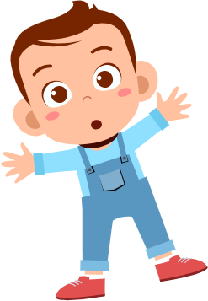

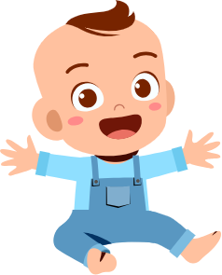
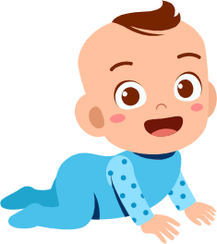
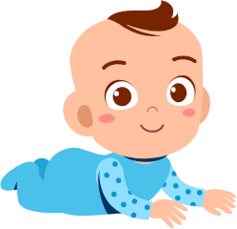
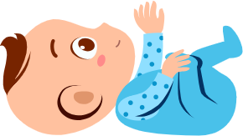
Child Development
FREE PRESENTATION TEMPLATE

Slide 2





Welcome
Welcome to the world of fantasy! Join us on a journey to explore the mystical creatures, enchanted lands, and magical wonders that exist beyond our reality. Discover the wonders and secrets of this exciting realm and unlock the power of imagination.

Slide 3
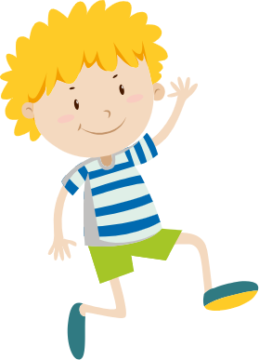

Table of Contents
Introduction
Physical Development
01
02
Introduce the concept of child development and why it's important.
Focus on physical milestones and importance of physical activity.
Cognitive Development
Social Development
03
04
Explore cognitive milestones and importance of cognitive stimulation.
Cover social and emotional milestones and importance of positive relationships.

Slide 4


Introduction
This section will introduce the concept of child development and explain why it is important to understand it. It will provide an overview of the presentation and set the stage for the subsequent sections.

Slide 5
What is child development?
Child development refers to the gradual and ongoing changes that occur in children's physical, cognitive, social, and emotional abilities from birth to adolescence. It is a complex process that is influenced by a combination of nature and nurture, with genetics and environment playing significant roles in shaping a child's development.
Understanding child development is important for parents, caregivers, and educators because it can help them provide appropriate support and stimulation for children's growth and development. By understanding the milestones and patterns of development, adults can create an environment that promotes positive outcomes and ensures that children are on track for success.

Slide 6






Why is child development important?
Roadmap
Concerns
It provides a roadmap for understanding the stages and patterns of development.
It helps identify potential developmental delays or concerns and seek appropriate support or intervention.
Creation
Potential
It informs the creation of developmentally appropriate activities, environments, and interactions.
It helps children reach their full potential and become healthy, well-adjusted, and successful adults.

Slide 7
Physical Development
Focus on the physical aspects of child development, including milestones and the importance of physical activity. Offer practical tips for promoting physical development.

Slide 8
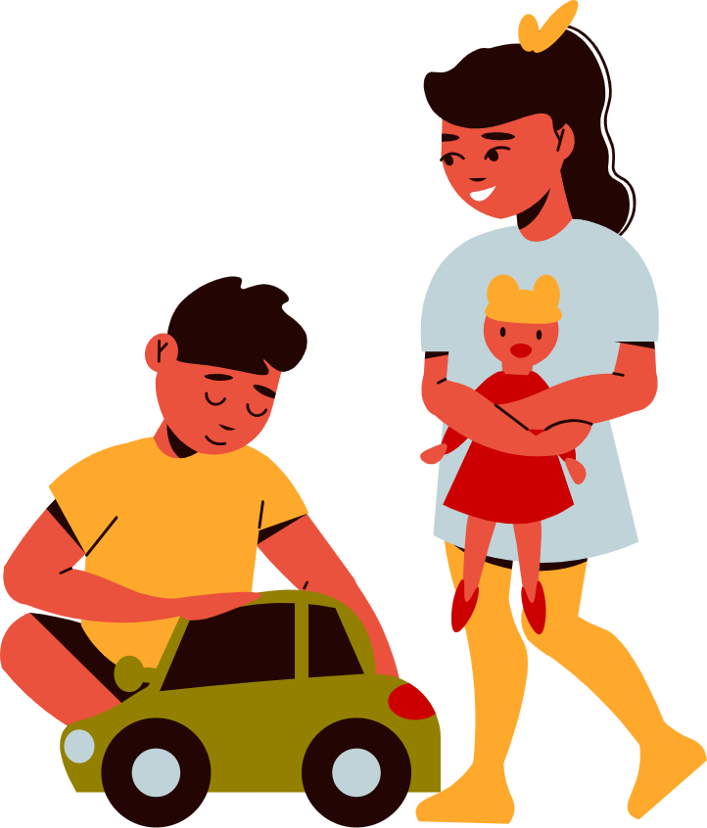
What is physical development
Physical development refers to the changes that occur in a child's body and physical abilities over time, including growth, motor skills, sensory abilities, and physical health. It is influenced by both genetic and environmental factors such as nutrition, exercise, and healthcare. Understanding physical development is crucial for ensuring that children receive appropriate support and opportunities to promote optimal growth and development.

Slide 9
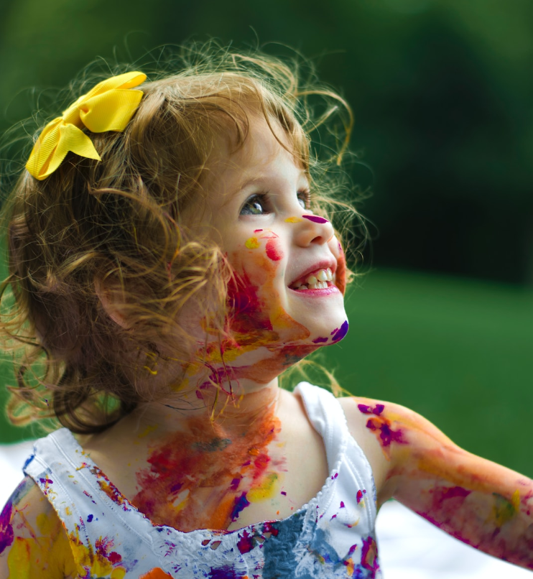

The greatest sign of success for a teacher is to be able to say, 'The children are now working as if I did not exist.
Maria Montessori

Slide 10





Milestones of physical development
9-15 months
5 years
Coordination, balance, and spatial awareness.
Sports, exercise, and physical play.
Crawling
Walking
Climbing
Motor skills
6-10 months
18-24 months
Helps develop strength and coordination.
Climb stairs, furniture, and other objects.

Slide 11
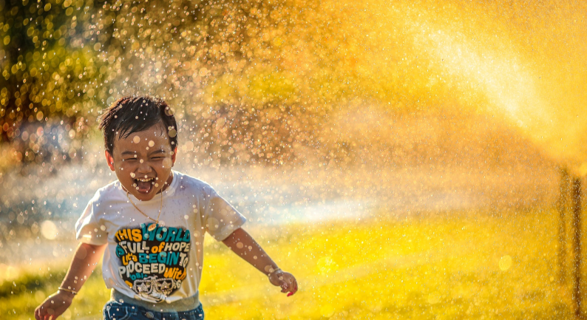
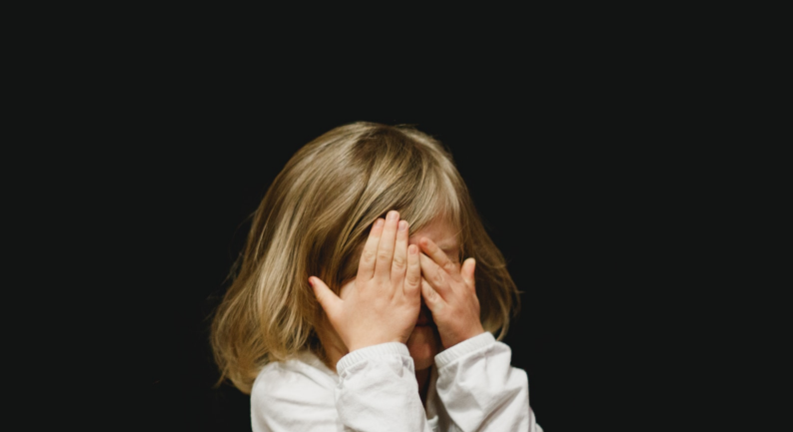
Importance of physical activity for children
Promotes physical health
Supports cognitive development
Regular physical activity helps children build strong bones, muscles, and cardiovascular systems.
Physical activity has been linked to improved cognitive function, memory, and academic performance.

Slide 12
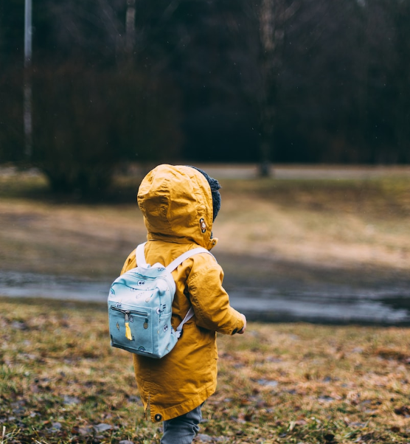
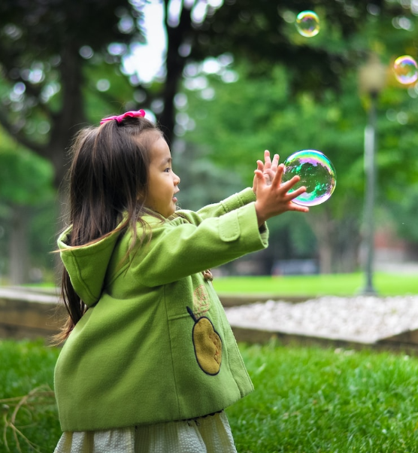
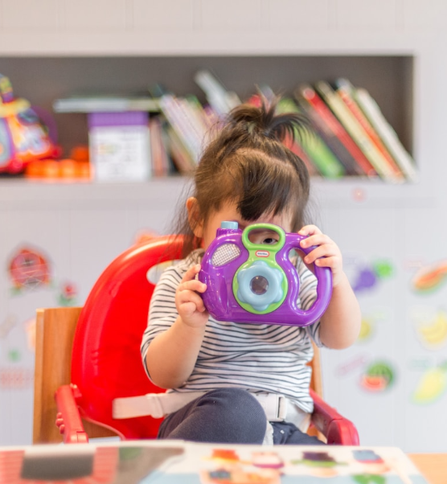

Boosts mental health
Fosters social skills
Encourages habits
Physical activity releases endorphins, which can improve mood and reduce symptoms of anxiety and depression.
Physical activity provides opportunities for children to interact with peers and learn social skills.
Establishing physical activity habits in childhood can help children develop a commitment to staying active/

Slide 13

Cognitive Development
This section will explore the cognitive aspects of child development, including major milestones and the importance of cognitive stimulation. It will offer practical tips for promoting cognitive development in children.

Slide 14
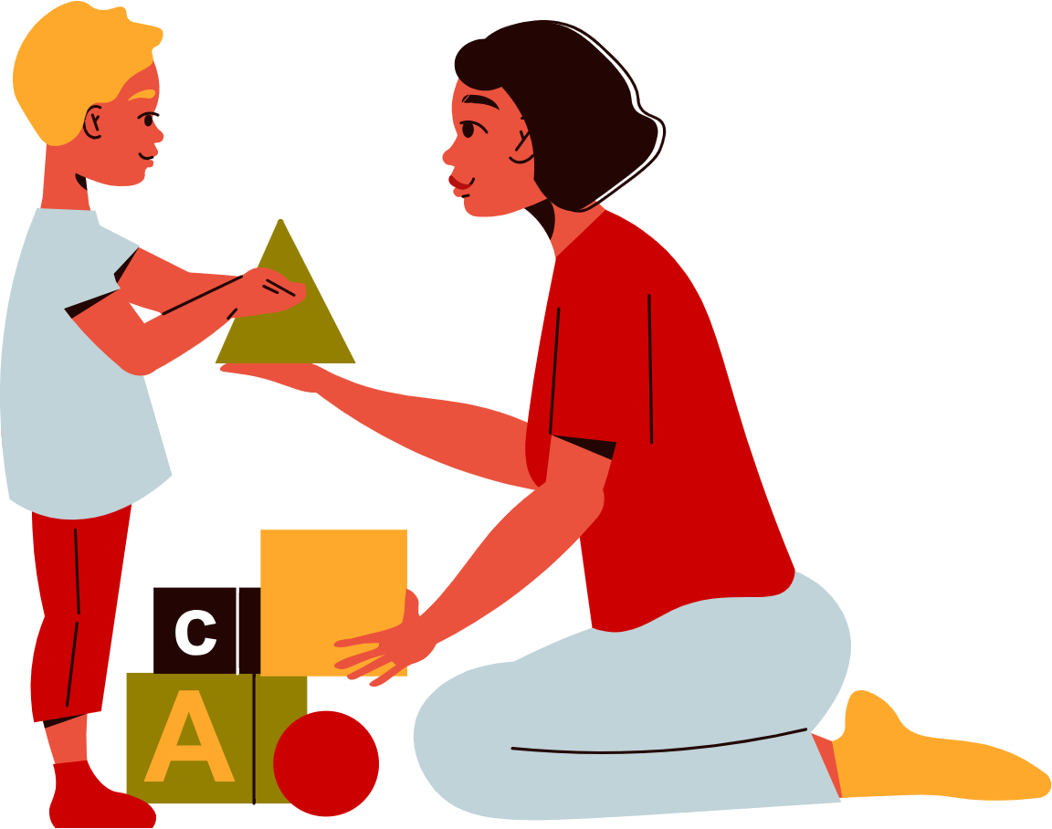

Understanding Cognitive Development
Cognitive development is the process by which children develop thinking and learning abilities.
Components of Cognitive Development
It includes language, memory, attention, perception, and other mental processes.

Slide 15

Milestones of cognitive development
Infancy
During the first year, infants develop the ability to recognize faces, track moving objects, and learn basic cause-and-effect relationships.
Toddlerhood
Toddlers begin to develop language skills, engage in symbolic play, and demonstrate a growing sense of independence and autonomy.
Early childhood
Children's language skills continue to develop, they begin to understand basic concepts such as numbers and time, and they develop
Children become more adept at problem-solving, their memory and attention skills improve, and they develop a better understanding of social norms and rules.
Middle childhood
Adolescents continue to refine their cognitive abilities, including their abstract thinking, reasoning, and decision-making skills, as they prepare for the transition to adulthood.
Adolescence

Slide 16






Importance of cognitive stimulation for children
Improves problem-solving skills
Enhances learning
Boosts academic achievement
Fosters creativity

Slide 17
Social Development
Cover the social and emotional aspects of child development, including milestones and the importance of positive relationships. Offer practical tips for promoting social and emotional development.

Slide 18

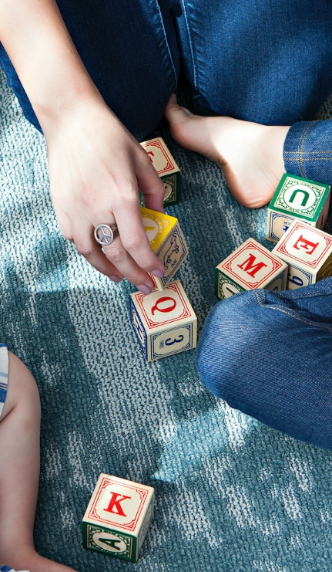
What is social and emotional development?
Social and emotional development refers to the changes that occur in children's ability to interact with others and manage their own emotions and behaviors. It includes developing social skills, such as communication, cooperation, and empathy, as well as emotional regulation, self-awareness, and self-esteem. Social and emotional development is a complex and ongoing process that is shaped by a child's environment, experiences, and relationships with others.

Slide 19




Milestones of social and emotional development
Attachment: Infants develop attachments to their primary caregivers during the first year of life. This attachment provides a sense of security and helps infants learn to regulate their emotions.
Empathy: Around the age of 2-3 years old, children begin to show signs of empathy, such as recognizing when others are upset or distressed and showing concern for their well-being.
Peer relationships: As children enter school, they begin to form friendships and navigate social hierarchies. This is time for developing social skills such as communication, cooperation.

Slide 20

Importance of positive relationships for children
Emotional support
Social skills
1
2
Children who have positive relationships with caring adults are more likely to feel emotionally supported.
Interacting with peers and adults helps children develop social skills such as communication, empathy.
Self-esteem
Resilience
3
4
Positive relationships can also help boost a child's self-esteem and sense of self-worth.
Children who have positive relationships with caring adults are more likely to develop resilience.

Slide 21
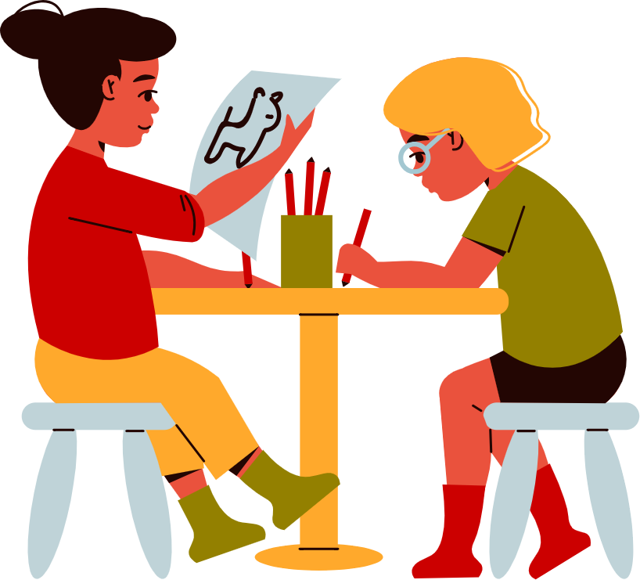





Thank you for choosing EaTemp
We offer free and high-quality slides templates for your presentations. We appreciate you choosing us and hope our templates have been helpful.
As a new website, we rely on your support to grow, so please help us by sharing our site with your friends and colleagues.
eatemp._
@eatemp
eatempofficial
@eatemp.official

