Slide 1
BALANCE YOGA
FREE TEMPLATES
Here is where your presentation begins

Slide 2
INTRODUCTION
You can give a brief description of the topic you want to talk about here.
For example, if you want to talk about Mercury, you can say that it’s the smallest planet in the entire Solar System

Slide 3
CONTENTS OF THIS TEMPLATE
2015
2015
Example Text : Get a modern PowerPoint Presentation that is beautifully designed.
Example Text : Get a modern PowerPoint Presentation that is beautifully designed.
2015
2015
2015
Example Text : Get a modern PowerPoint Presentation that is beautifully designed.
Example Text : Get a modern PowerPoint Presentation that is beautifully designed.
Example Text : Get a modern PowerPoint Presentation that is beautifully designed.

Slide 4
TABLE OF CONTENTS
01
Theory
lesson
03
Features
of the topic
02
Vinyasa
tips
04
Practical
exercise
You can describe the topic of the section here
You can describe the topic of the section here
You can describe the topic of the section here
You can describe the topic of the section here

Slide 5
Break Time

Slide 6
01
THEORY LESSON
You can enter a subtitle here
if you need it

Slide 7
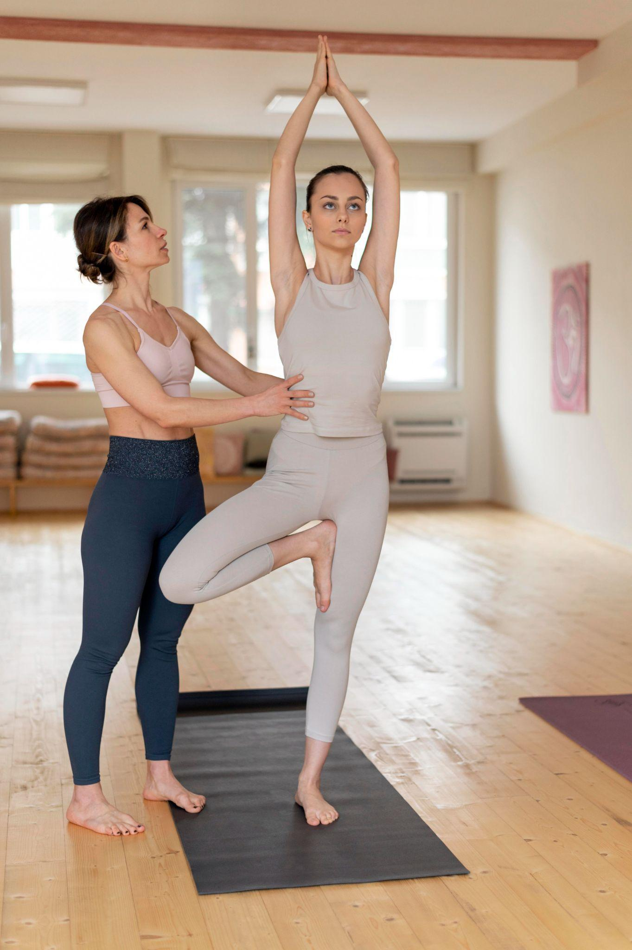
INTRODUCTION
Vinyasa comes from vi-, “variation” and nyasa, “to place”. It’s a way of expressing our feelings through external movements, based on:
Steadiness (Sthira)
Comfort (Sukha)
Smooth and Long Breathing (Prayatna Sithila)

Slide 8
UNDERSTANDING THE CONCEPTS
BREAST FREE
HOW TO TREAT IT?
Mercury is the closest planet to the Sun and the smallest one in the Solar System
Venus has a beautiful name and is the second planet from the Sun. It’s hot, even hotter than Mercury!

Slide 9
AWESOME WORDS

Slide 10
PRACTICAL
EXERCISE
Patience | Technique | Strength
Meditation 15 minutes | Study body postures 30 minutes | Stretch your muscles 10 minutes
Reading 1 hour | Try your favorite postures 30 minutes | Take a walk 1 hour
Mercury is the closest planet to the Sun and the smallest one in the Solar System—it’s only a bit larger than the Moon

Slide 11
STEPS FOR BREAST SELF EXAM
STAND UP
Earth is where we all live on
FEEL THEM
01
TURN
Mars is actually a cold place
Neptune is far away from us
05
02
CONTRACT
FEEL THEM
Jupiter is a gas giant
04
03
Saturn has several rings

Slide 12
TRADITIONAL YOGA VS. VINYASA YOGA
Traditional yoga
Vinyasa yoga
Venus has a beautiful name and is the second planet from the Sun. It’s terribly hot—even hotter than Mercury—and its atmosphere is extremely poisonous
Mercury is the closest planet to the Sun and the smallest one in the Solar System—it’s only a bit larger than the Moon. It was named after a Roman god

Slide 13
EXAMPLES OF STANDING POSTURES
Urdhva prasarita ekapadasana
Utthita
trikonasana
Ardha parsvakonasana
It’s the closest planet to the Sun and the smallest
Venus has a beautiful name and is the second planet
Despite being red, Mars is actually a cold place

Slide 14
AWARENESS & PATHOLOGY
CHECK YOURSELF
LET’S HELP OUT!
The Sun is the star at the center of the Solar System
Venus is the second planet from the Sun
TALK ABOUT IT!!
Mercury is the closest planet to the Sun

Slide 15
—S. Gawain
“Living in harmony with the universe is living full of joy,
love and abundance.”

Slide 16
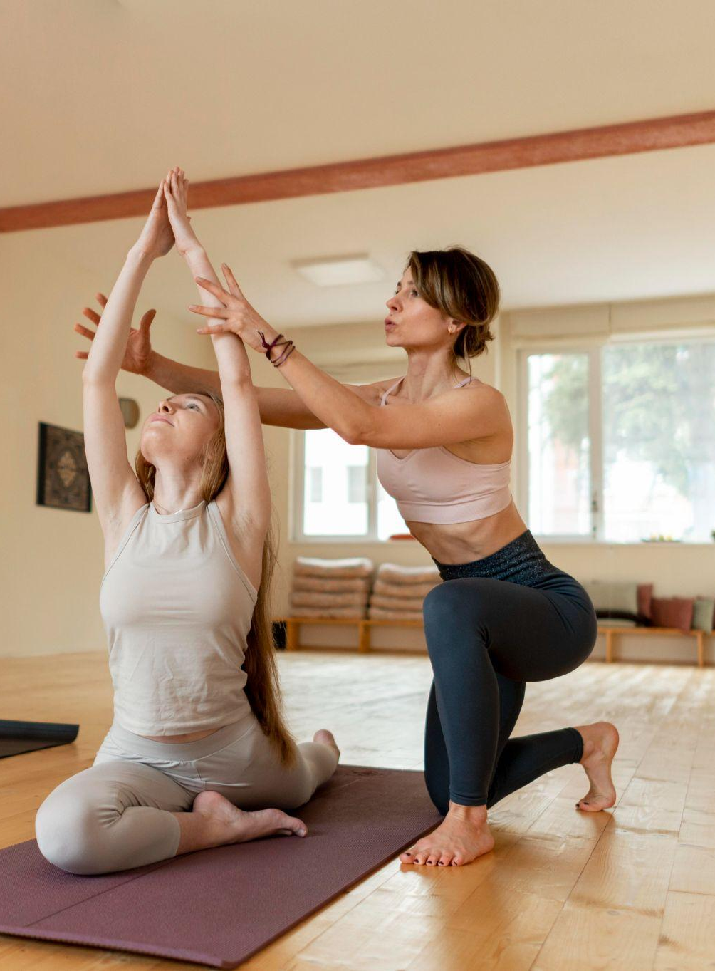
90 ′
Use the series as long as your practice does not last longer than 90 minutes

Slide 17
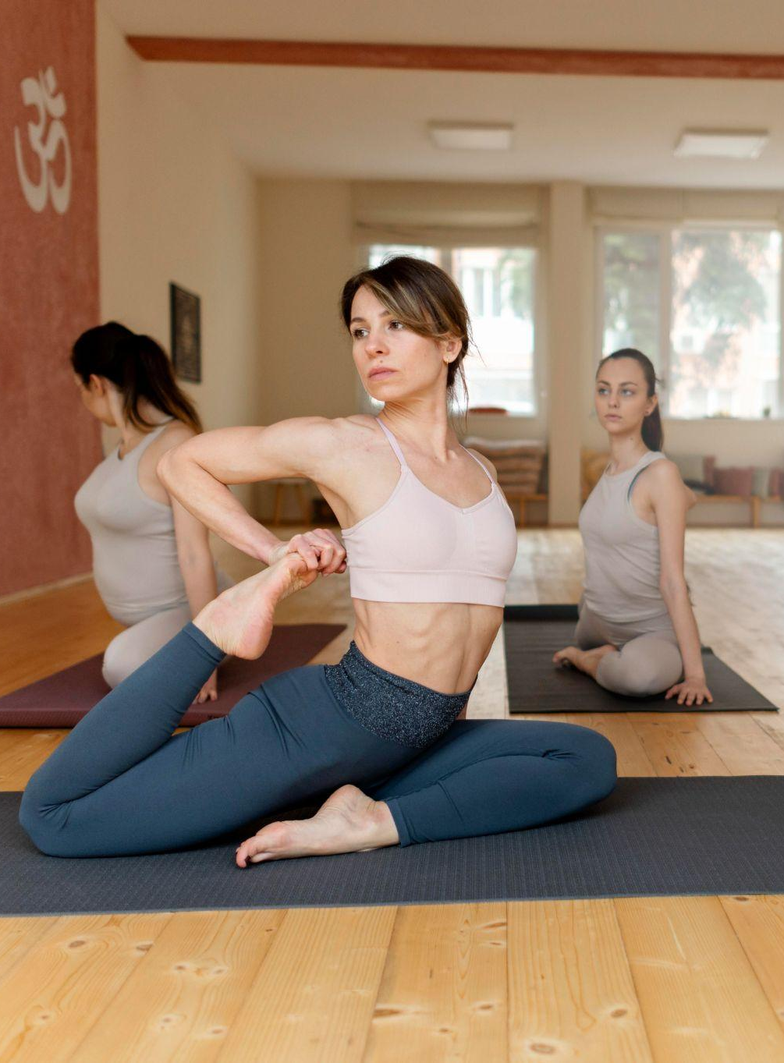
CHARACTERISTICS OF VINYASA FLOW YOGA
Steadiness
Prayatna Sithila
Sukh
Nyasa
Mercury is the closest planet to the Sun and the smallest
Jupiter is a gas giant and the biggest planet in the Solar System
Venus has a beautiful name and is the second planet from the Sun
Despite being red, Mars is a cold place. It’s full of iron oxide dust

Slide 18
AWARENESS & PATHOLOGY
CHECK YOURSELF
The Sun is the star at the center of the Solar System

Slide 19
RECOMMENDATIONS
Drink
water
Arrive
early
Release
tension
Grab
the accessories
Don't eat
before class
Focus on your breathing
Mars is actually
a very cold place
It’s the farthest planet from the Sun
Neptune is the farthest planet from the Sun
Mercury is the closest planet to the Sun
Saturn is the ringed
one and a gas giant
Jupiter is the biggest planet of them all

Slide 20
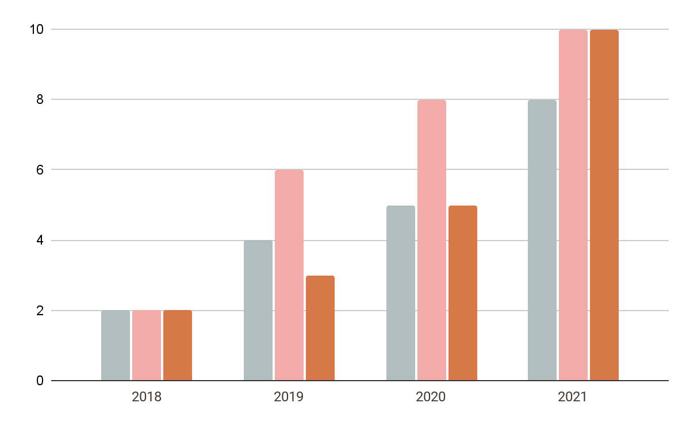
YOUR PROGRESS
Patience
Venus is the second planet from the Sun
Technique
Mercury is the closest planet to the Sun
Stretch
Despite being red, Mars is a very cold place
Follow the link in the graph to modify its data and then paste the new one here. For more info, click here

Slide 21
THIS CANCER AROUND THE WORLD
HIGH RELEVANCE
LOW RELEVANCE
Contents_Here
Contents_Here
Get a modern PowerPoint Presentation that is beautifully designed. I hope and I believe that this Template will your Time, Money and Reputation. Easy to change colors, photos.
Get a modern PowerPoint Presentation that is beautifully designed. I hope and I believe that this Template will your Time, Money and Reputation. Easy to change colors, photos.
Contents_Here
Contents_Here
Get a modern PowerPoint Presentation that is beautifully designed. I hope and I believe that this Template will your Time, Money and Reputation. Easy to change colors, photos.
Get a modern PowerPoint Presentation that is beautifully designed. I hope and I believe that this Template will your Time, Money and Reputation. Easy to change colors, photos.
LOW RELEVANCE
HIGH RELEVANCE

Slide 22
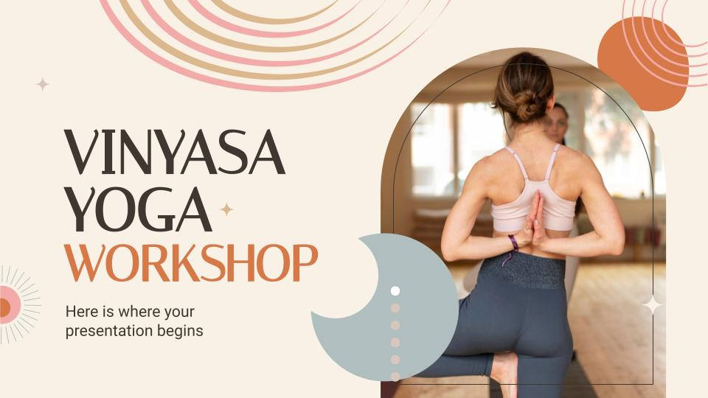
START WITH
ONLINE CLASSES
Mercury is the closest planet to the Sun and the smallest one in the Solar System—it’s only a bit larger than the Moon. The planet’s name has nothing to do with the liquid metal

Slide 23
PATIENT CARE
POSITIVE FOCUS
REST & SLEEP
Earth is the beautiful planet where we all live on
Jupiter is the biggest planet in the Solar System
EXERCISE
GROUP SUPPORT
Despite being red, Mars is actually a cold place
Saturn is a gas giant and has several rings

Slide 24
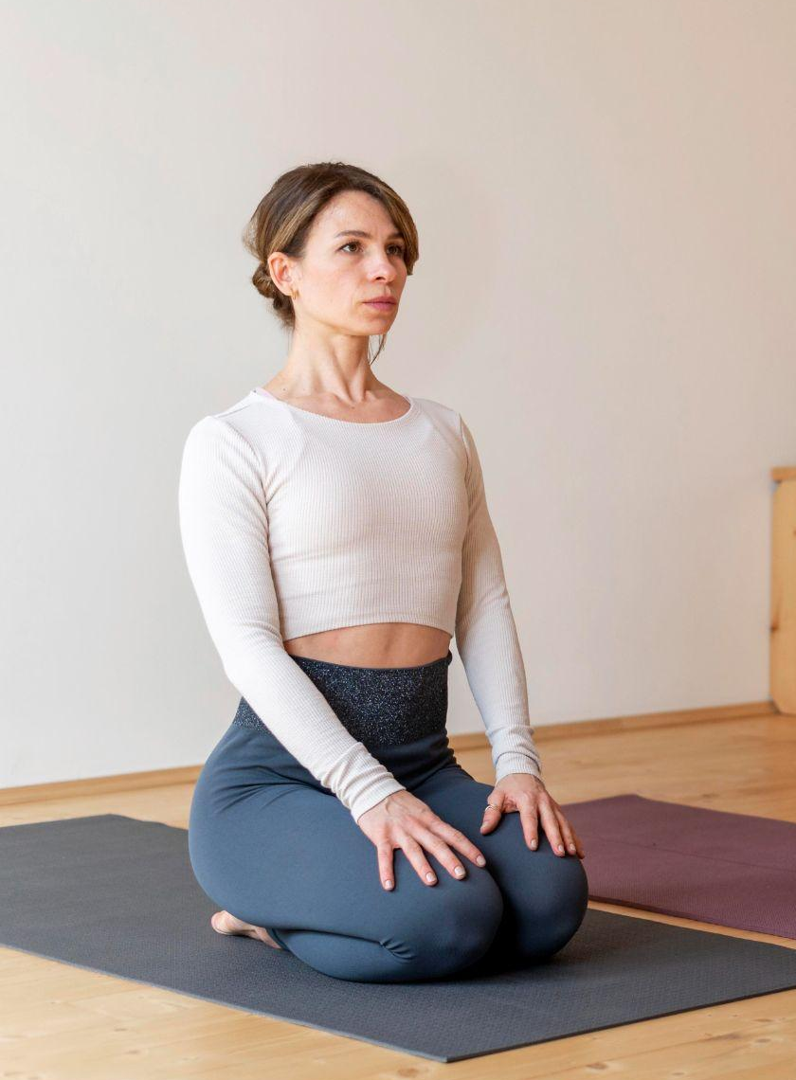
HOW TO PROGRESS IN VINYASA YOGA?
50%
30%
20%
Patience
Technique
Strength
Mars is actually
a very cold place
Jupiter is the biggest planet
It’s the closest planet to the Sun

Slide 25
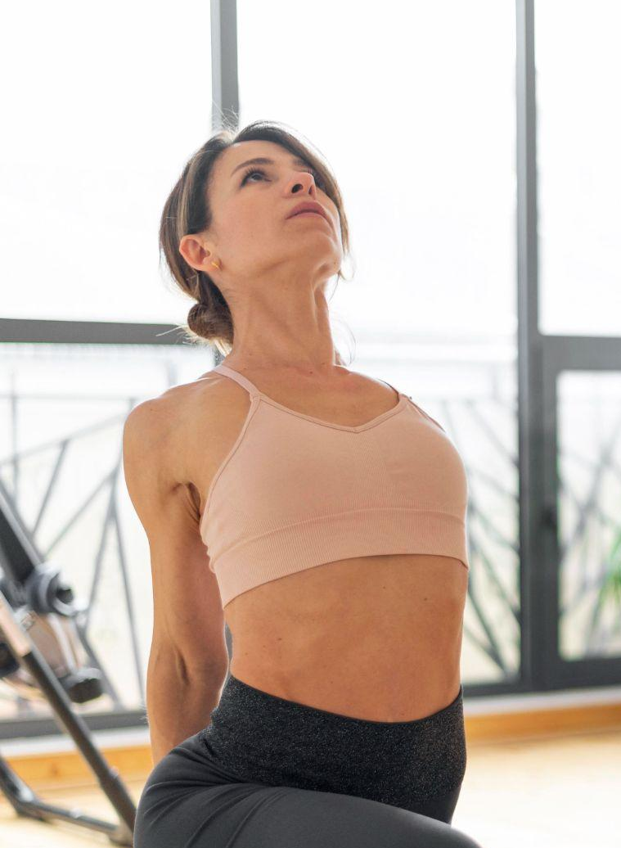
9h 55m 23s
333,000.000
386,000 km
Is Jupiter's rotation period
Earths is the Sun’s mass
Is the distance between Earth and the Moon

Slide 26
UNDERSTANDING THE CONCEPTS
BREAST CANCER
HOW TO TREAT IT?
Mercury is the closest planet to the Sun and the smallest one in the Solar System
Mercury is the closest planet to the Sun and the smallest one in the Solar System

Slide 27
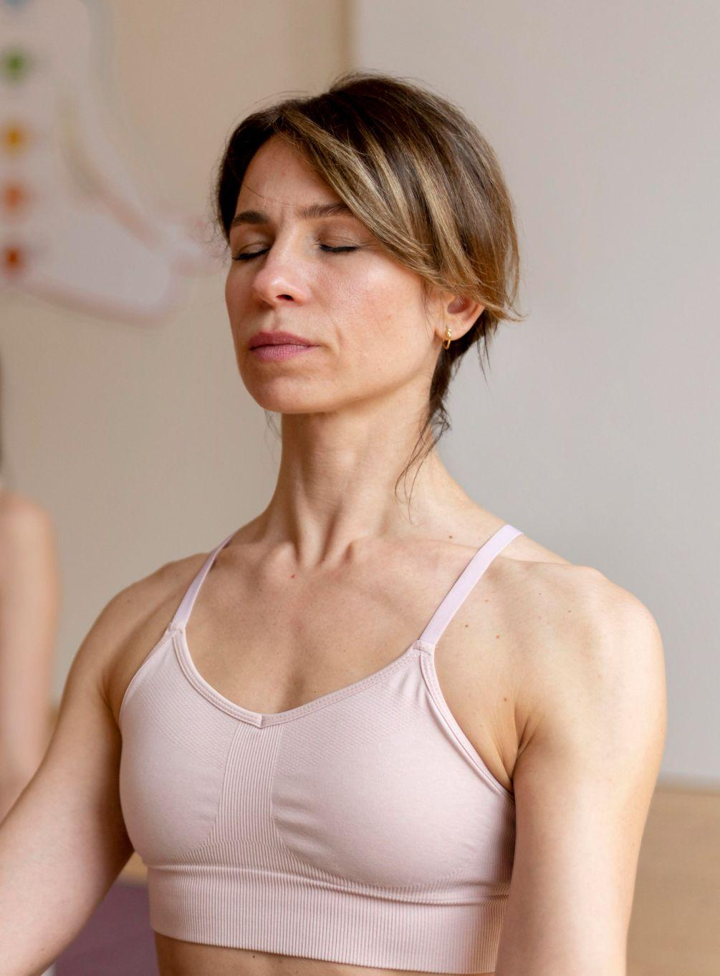
VINYASA YOGA BENEFITS
It can boost your mood
It can improve your mobility
It can give you a good cardio workout
It can enhance your core stability
It can strengthen your muscles
It may help you quit smoking

Slide 28
A PICTURE REINFORCES THE CONCEPT
Images reveal large amounts of data, so remember: use an image instead of a long text. Your audience will appreciate it

Slide 29
VINYASA YOGA IN THE WORLD
20%
30%
50%
Venus is the second planet from the Sun
Academies
Mercury is the closest planet
to the Sun
Jobs
Despite being red, Mars is a very cold place
Courses

Slide 30
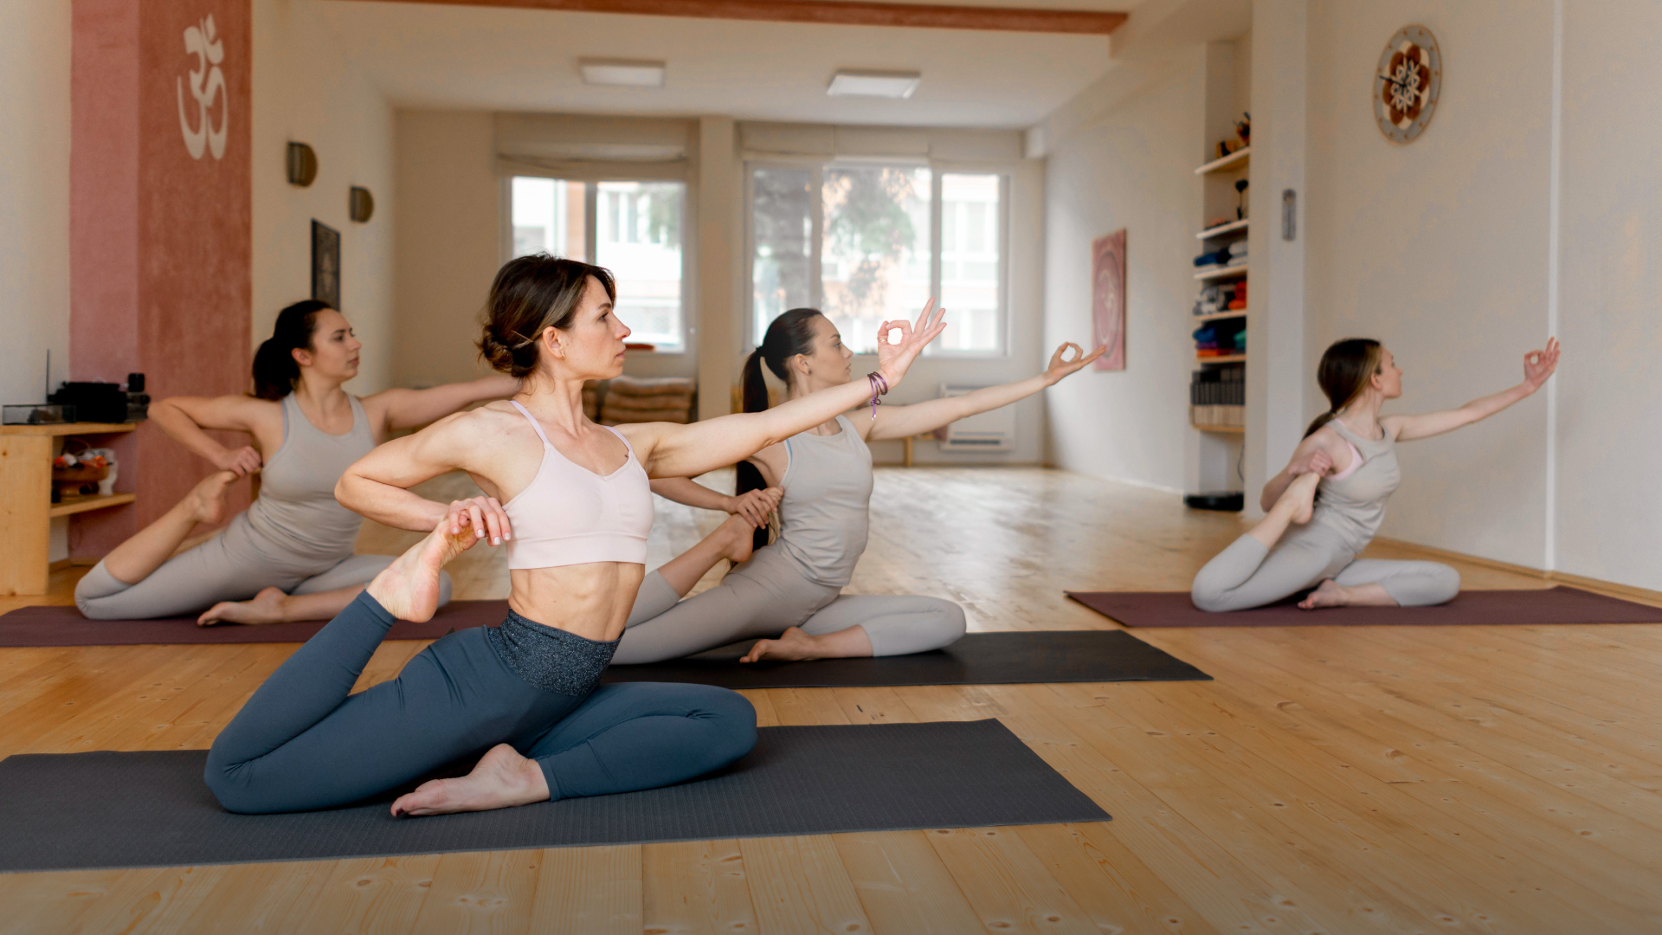
Vinyasa is synonymous with movement

Slide 31
DOCTOR’S NOTES
You can replace the image on the screen with your own work. Just right-click on it and select “Replace image”
You can replace the image on the screen with your own work. Just right-click on it and select “Replace image”

Slide 32
PRACTICE THESE POSITIONS
Venus is the second planet from the Sun
Despite being red, Mars is actually a cold place
Venus
Mars
1
2
3
4
Mercury
Jupiter
Mercury is the closest planet to the Sun
Jupiter is the biggest planet of them all

Slide 33
Do you have any questions?
Venus is the second planet from the Sun
Thanks

Slide 34
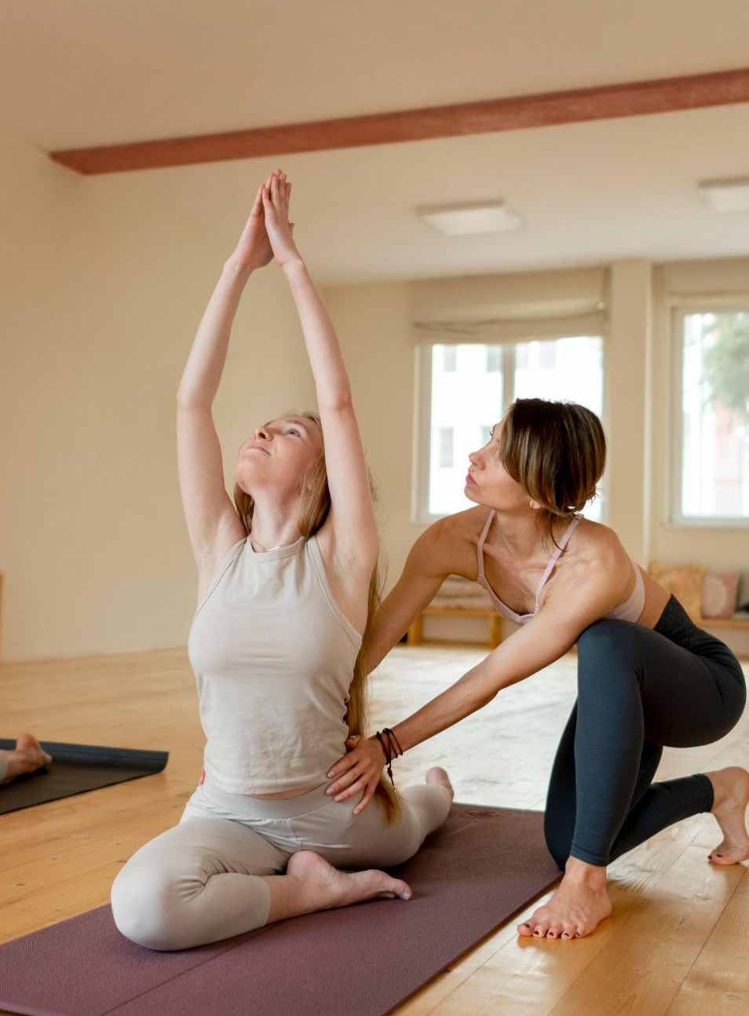
Thanks
Do you have any questions?
addyouremail@freepik.com
+91 620 421 838
yourcompany.com
Please keep this slide for attribution

Slide 35
https://plantillaspowerpoint.org

Slide 36
ALTERNATIVE RESOURCES

Slide 37
Full Edits
Here’s an assortment of alternative resources whose style fits that of this template

Slide 38
Full Edits
Here’s an assortment of alternative resources whose style fits that of this template

Slide 39
Full Edits
Here’s an assortment of alternative resources whose style fits that of this template

Slide 40
ALTERNATIVE RESOURCES
Here’s an assortment of alternative resources whose style fits that of this template

Slide 41
RESOURCES
Did you like the resources on this template? Get them for free at our other websites:
Photos
Yoga teacher at class teaching attendants
Yoga teacher at class teaching attendants I
Yoga teacher teaching class
Yoga teacher teaching class I
Yoga teacher teaching class II
Yoga teacher at class teaching attendants
Female yoga teacher teaching class
Yoga teacher teaching class
Yoga teacher at class teaching attendants
Vectors
Boho wedding invitation template
Boho youtube thumbnail template
Icons
Icon Pack: Yoga and pilates

Slide 42
ALTERNATIVE RESOURCES
Here’s an assortment of alternative resources whose style fits that of this template:
Photos
Medium shot teacher helping woman at yoga
Yoga teacher at class teaching attendants
Close up woman sitting on yoga mat
Full shot women doing yoga together
Woman doing yoga with teacher
Full shot woman one leg
Full shot woman meditating
Full shot happy women doing yoga
Full shot woman doing yoga with teacher

Slide 43
Fonts & colors used
This presentation has been made using the following fonts:
Italiana
(https://fonts.google.com/specimen/Italiana)
Roboto
(https://fonts.google.com/specimen/Roboto)
#3f3832
#ffffff
#d8c6bc
#f2aba9
#efdcc7
#dbb88d
#f9f1e5
#b0bebf
#d77848
#f0efe2

Slide 44
Use our editable graphic resources...
You can easily resize these resources without losing quality. To change the color, just ungroup the resource and click on the object you want to change. Then, click on the paint bucket and select the color you want. Group the resource again when you’re done.

Slide 46
...and our sets of editable icons
You can resize these icons without losing quality.
You can change the stroke and fill color; just select the icon and click on the paint bucket/pen.
In Google Slides, you can also use Flaticon’s extension, allowing you to customize and add even more icons.

Slide 47
Help & Support Icons
Avatar Icons

Slide 48
Creative Process Icons
Performing Arts Icons

