Slide 1
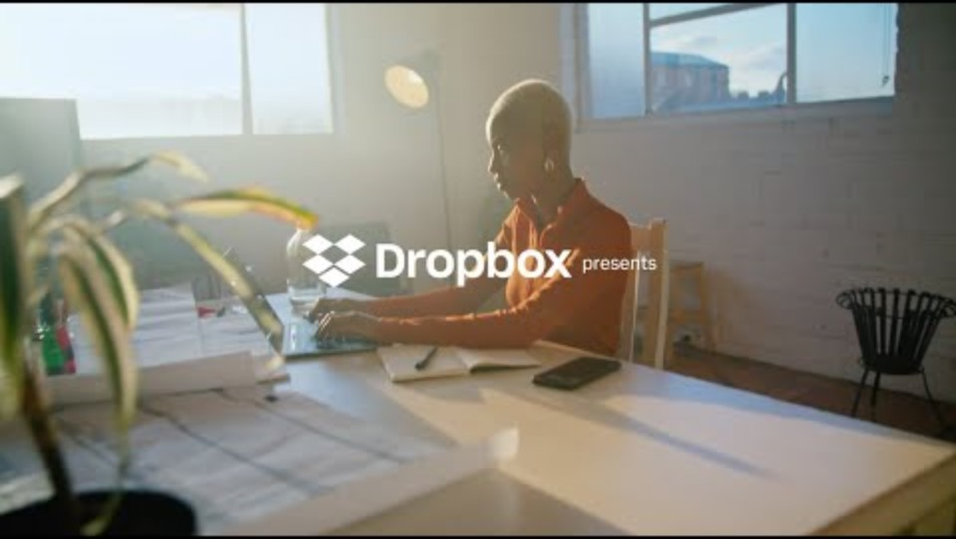

Slide 2
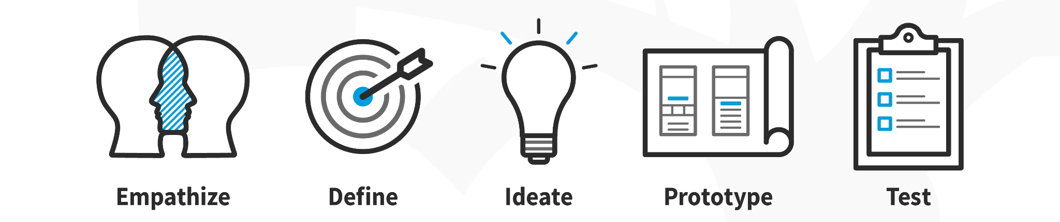
Design thinking Process

Slide 3

Empathize – Understanding the Users’ Needs
File recovery
Shared folders
01
The Empathize phase is vital, as it ensures that Dropbox is solving real-world challenges. Dropbox closely follows evolving user behavior—for example, noticing the shift towards remote work, which led them to integrate with tools like Zoom and Slack to meet new demands.

Slide 4

what Dropbox did in the Empathize phase! They saw people struggling with:
Losing important files (Oops, where did that folder go?!)
Trying to sync things across multiple devices, but failing miserably (Phone: "Sorry, I don’t talk to your laptop.")
Emailing large files that just don’t fit (like trying to shove a sofa into a tiny car).
01.
co-edit files
02.

Slide 5
people needed a super simple, no-headache way to store, access, and share files across all their devices

Slide 6


Ideate – Generating Innovative Solutions
minimalism and real-time collaboration
-
  Dropbox encourages brainstorming across diverse teams to generate multiple potential solutions. Dropbox holds internal hackathons and workshops
Smart Sync
03

Slide 7

What if people could share a file with just a link
What if you could access it anywhere, from a phone, tablet, or computer
“What can we do so people spend more time sharing files, and less time screaming at their computers?”
How about automatic syncing across all devices, no extra clicks

Slide 8
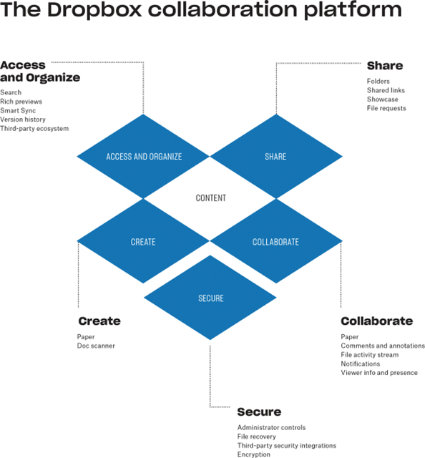

Slide 9


04
During the prototype phase for Dropbox Spaces, a virtual workspace concept, Dropbox allowed early testers to explore the feature and provide insights on usability and functionality. This phase helps detect early-stage flaws or usability
Prototype
Building and Experimenting

Slide 10

04
In the first prototype, Dropbox let people upload files into a cloud folder, and users could test if everything synced perfectly between their devices. It was like testing if your magic folder really worked!
They released a beta version to a small group of users, gathering feedback to improve the product. It’s like Dropbox saying, “Hey, try this out and tell us what’s broken!”—and then fixing everything before it was officially launched.

Slide 11
Test:
Validating and Iterating Solutions
A/B testing and user feedback loops
validate its solutions
Dropbox iteratively tested various versions of
refining the interface and feature set until it was intuitive for collaborative teams.
05
Dropbox Paper,

Slide 12
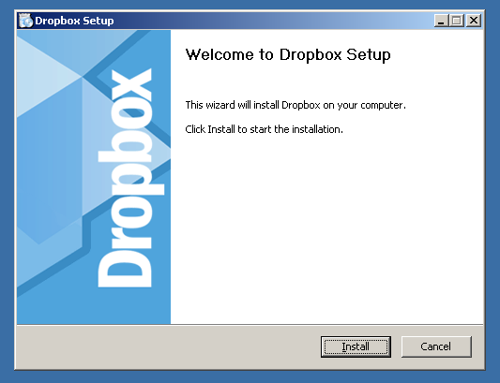
Dropbox
Test Phase: Now that Dropbox had built a working prototype, it was time to let more people in on the fun! They opened it up to a wider audience during their beta-testing phase—kind of like saying, “Hey, world, try this out and tell us what you think!”
What did they test?
How easy is it to use? Does the syncing really work, or are files getting lost in the cloud?
Does it solve the problem? Can people store, access, and share files without hassle?
05

Slide 13
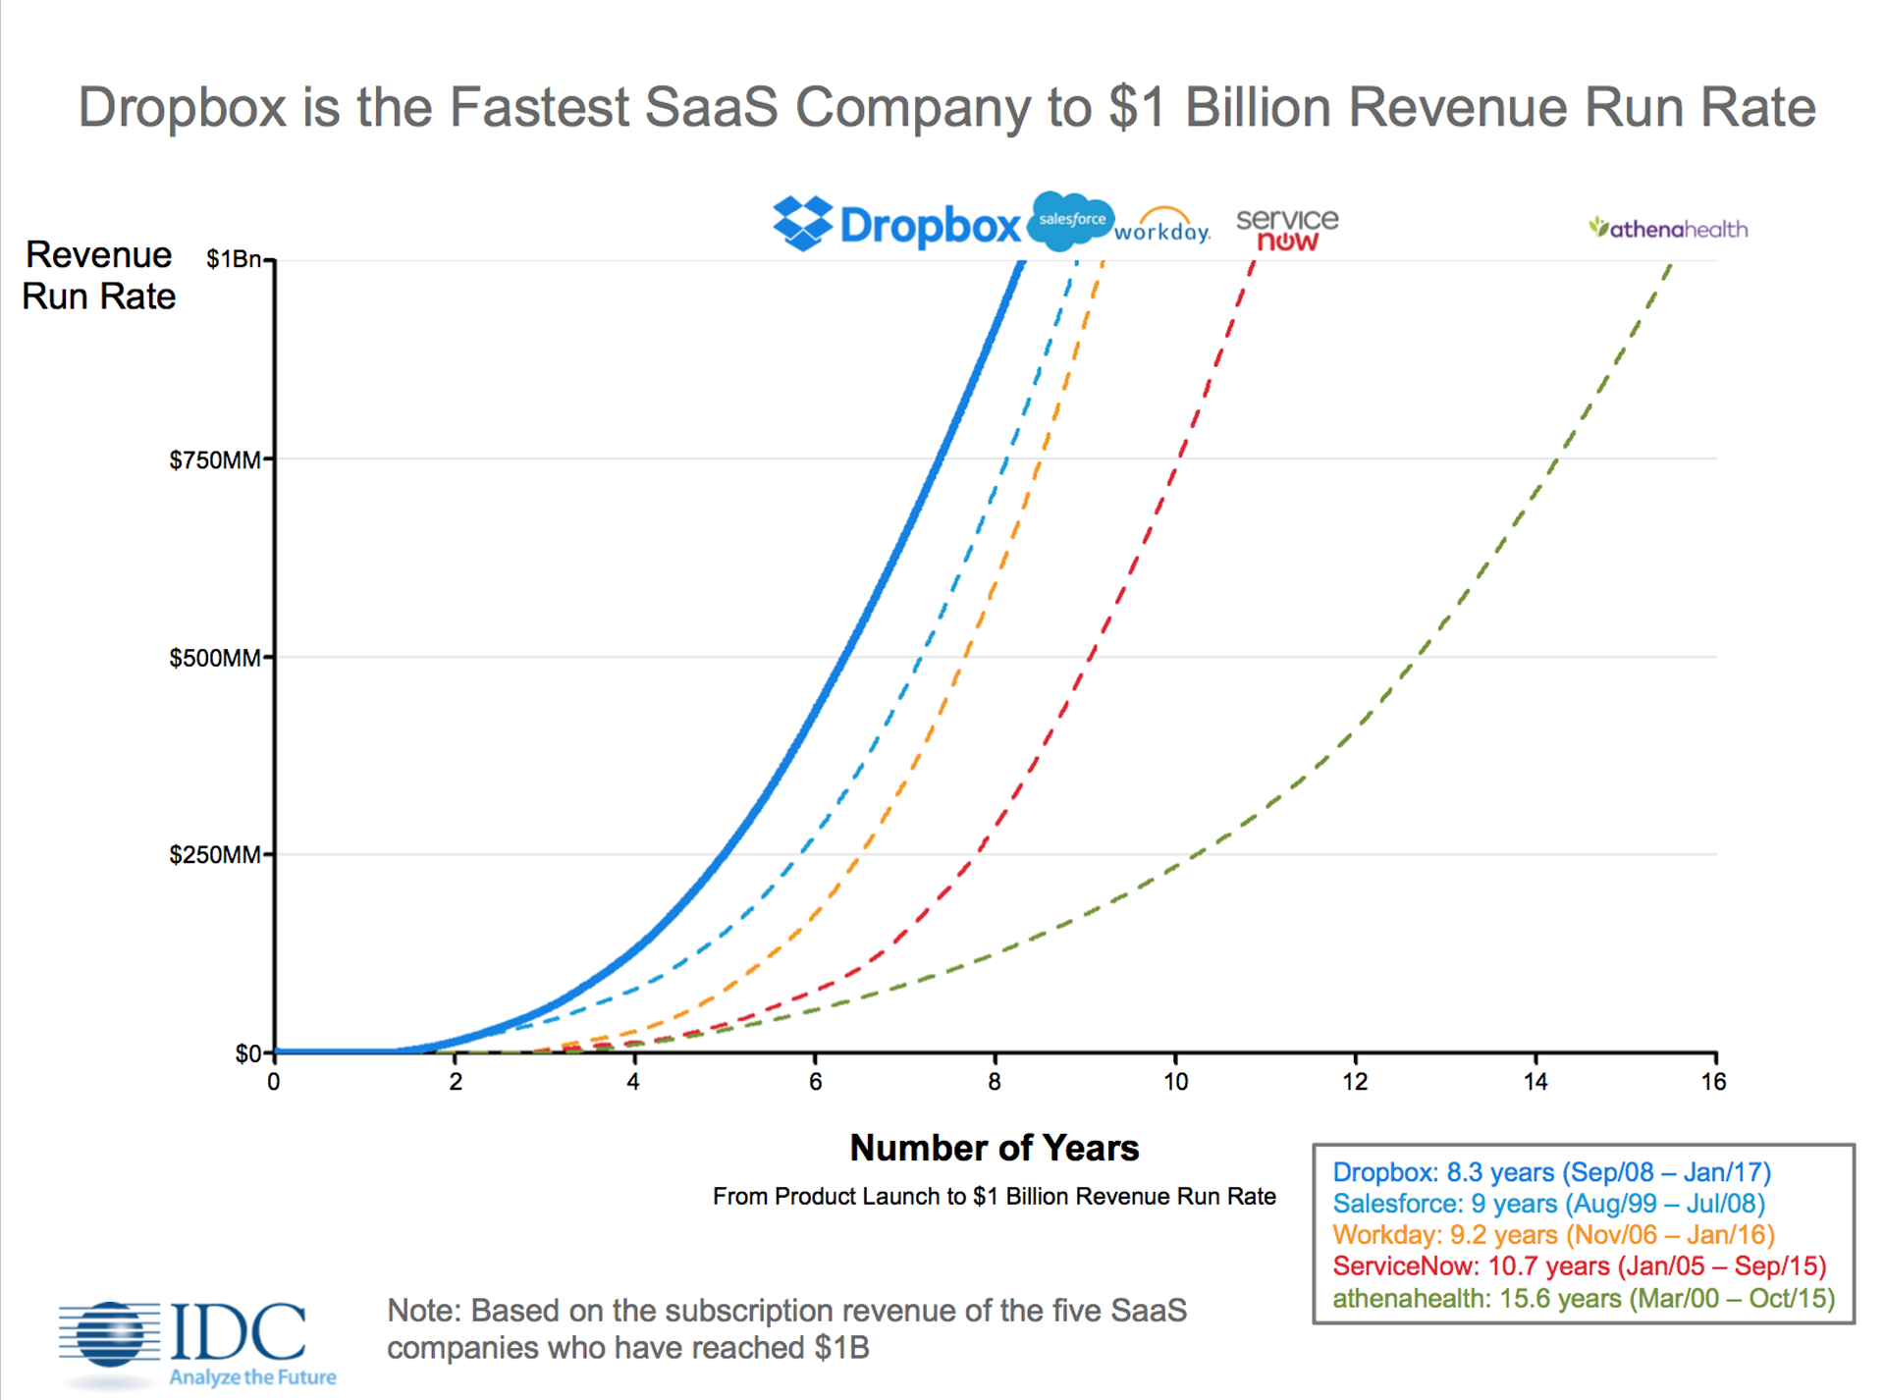
Dropbox
Graphs showing Dropbox’s rapid user growth
  Increasing file storage limits (because, hey, we all need more space!).
  Improving sync speed, so you weren’t waiting forever for that big file to update.
They also realized people needed mobile app integration and collaboration tools, so they added those features later, making Dropbox even more powerful!
05

Slide 14
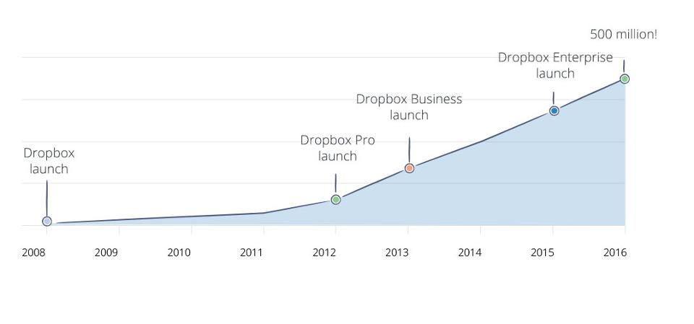
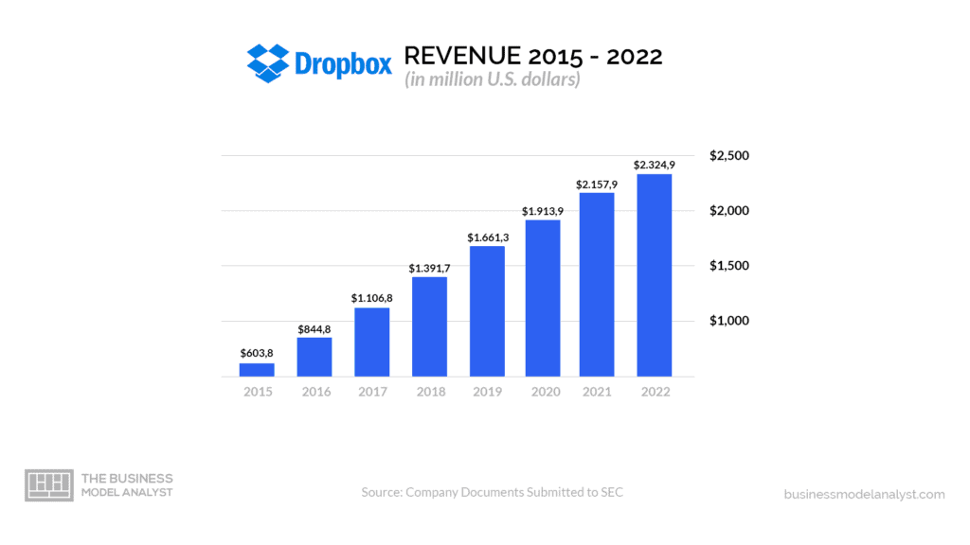

Dropbox
As of October 2024, Dropbox has a market valuation of approximately $8.44 billion, with an enterprise value of around $9.37 billion​
Stock Analysis

Slide 15
What is Dropbox ?
A cloud storage service that lets you store and access your files online.
01

Slide 16

2007
The idea for Dropbox started with one simple problem:
How to access files from anywhere?
Drew Houston
Co-Founder of Dropbox

Slide 17

2008
The launch of Dropbox
Drew Houston
Arash Ferdowsi
Co-Founder of Dropbox
Co-Founder of Dropbox

Slide 18
01
Identifying Needs
02
Targeted Marketing
03
The importance of consumer research.
Product Improvement
04
Staying Competitive
05
Consumer Satisfaction

Slide 19
Consumer Research at Dropbox

Slide 20
“It’s not about having a great idea. It’s about solving a real problem and making it simple for the user.”
Drew Houston
Co-Founder of Dropbox

Slide 21
&
A COMBINATION OF
Qualitative Quantitative
CONSUMER RESEARCH

Slide 22
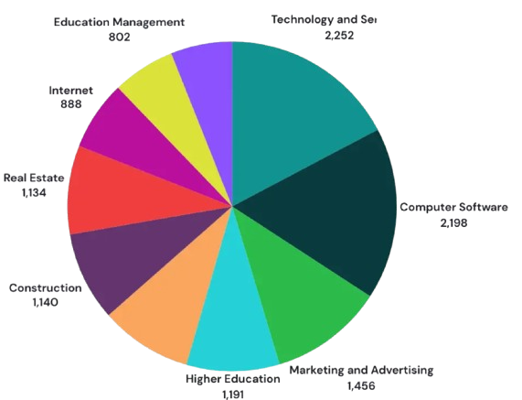
01
Surveys and Statistics
Top Industries that use dropbox
-
  Surveying Current Users
  Customer Demographic Research
  Collaborations and Industry-Specific Solutions
  Competitor Analysis
https://www.tiktok.com/@dropbox/video/7273522316649319726

Slide 23
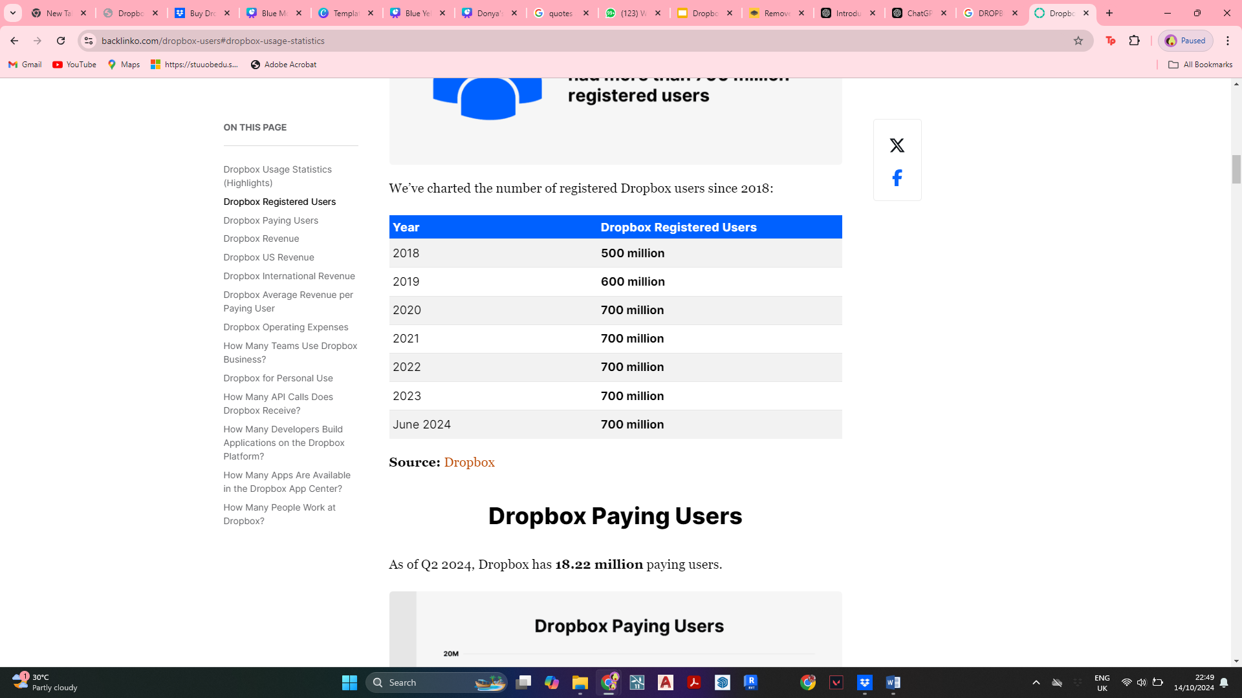
01
Surveys and Statistics
  Tracking users growth pattern
  Impact of Product Updates/Feature Introductions
  Influence of Marketing & Partnerships
  Pricing and Value Perception
-
Registered users

Slide 24

User Interviews
  Humanizing Data and Insights
  Uncovering Hidden Insights
  Building Trust with Users
  User-Centric Culture
-
02

Slide 25
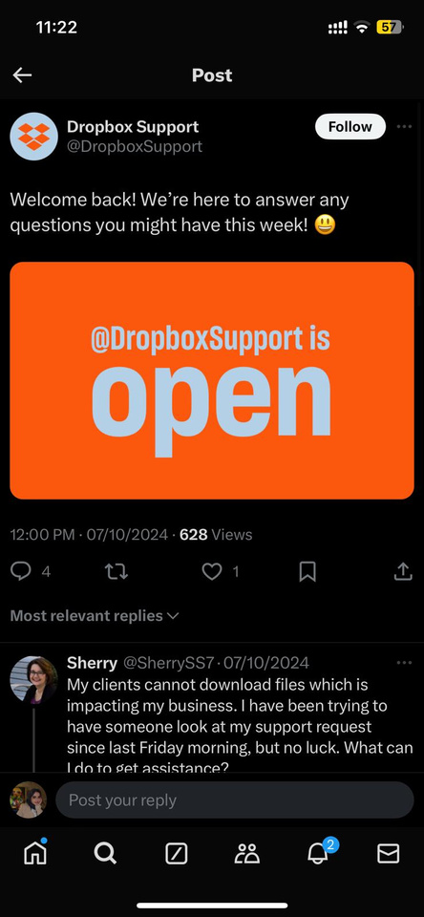
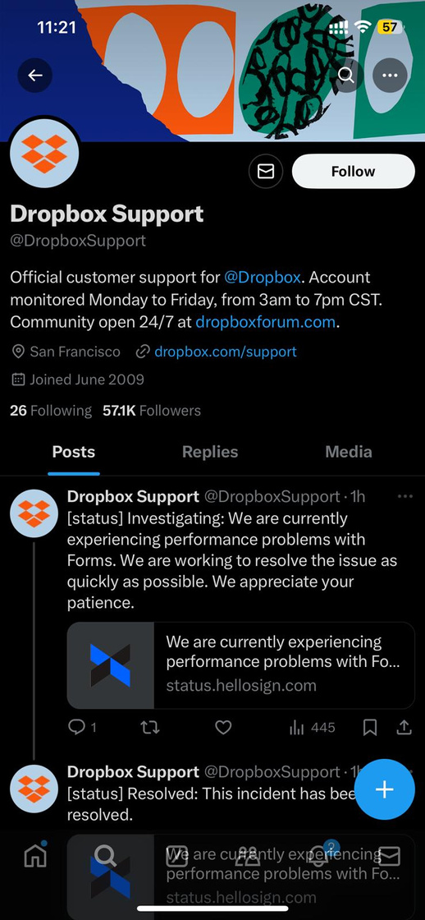
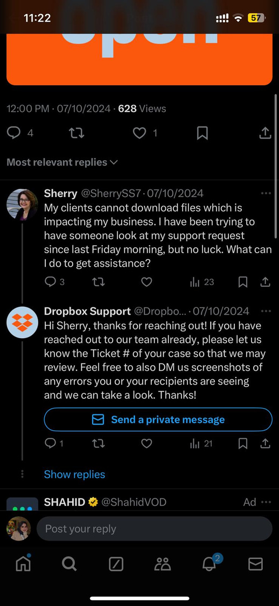
Social Listening
  Identifying Common Problems and Pain Points
  Customer Loyalty and Retention
  Social Listening as a Source of Qualitative Data
03

Slide 26
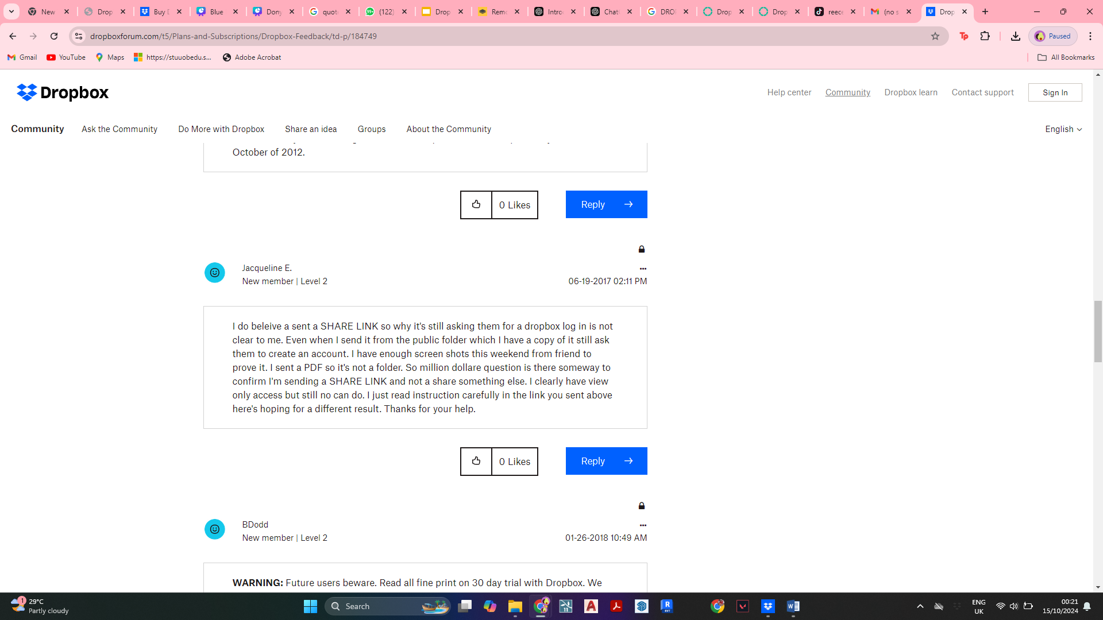

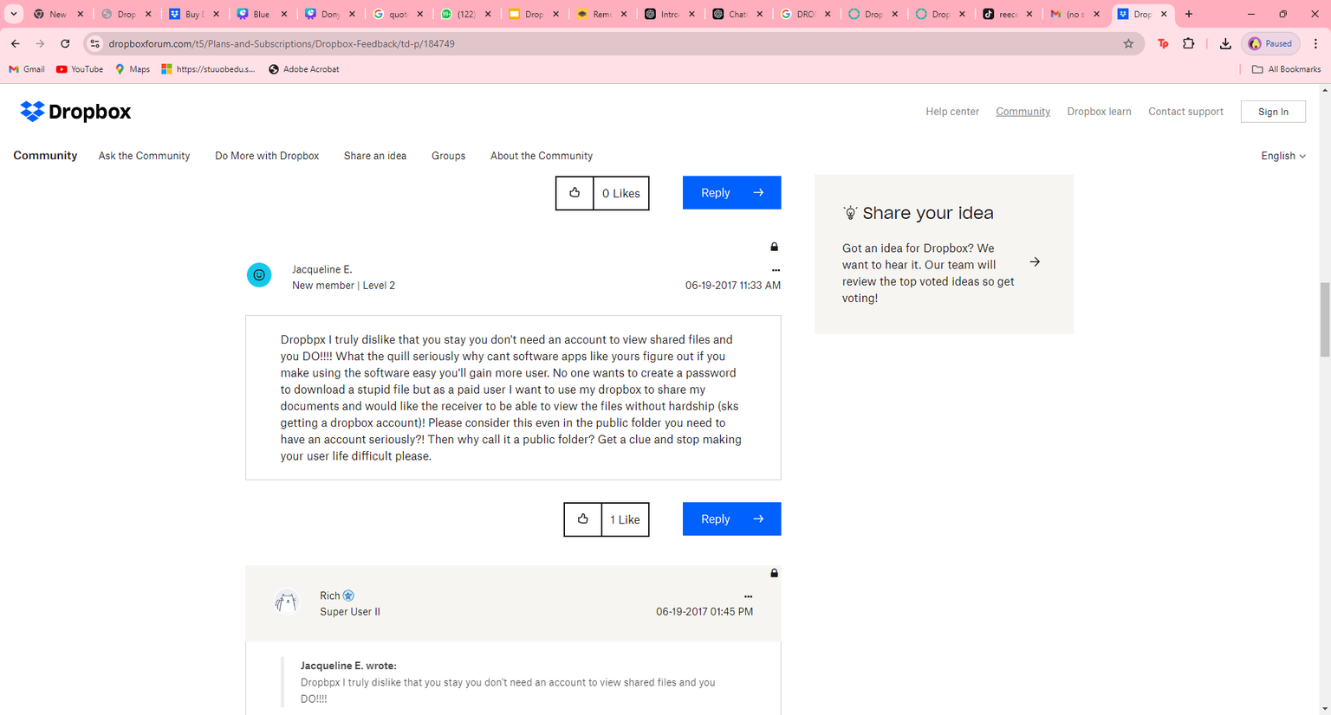
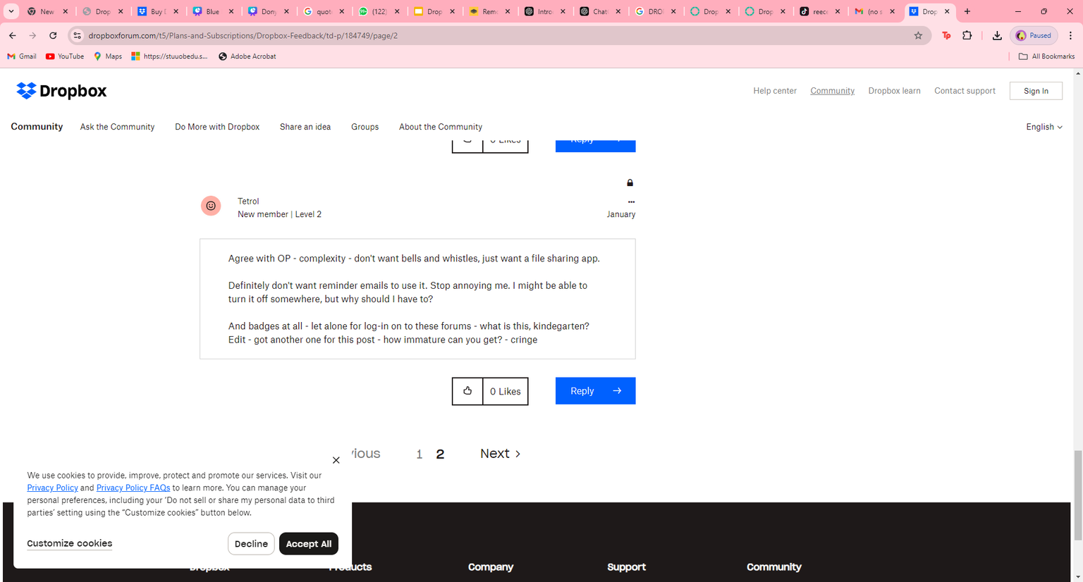
Customer Feedback
  Direct Feedback from Users
  Improving Product Development
  Enhancing Marketing and Communication
04

Slide 27
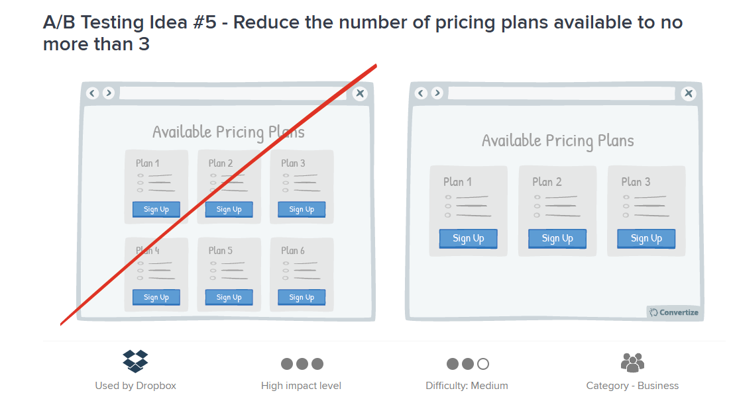
A/B
Testing
05
What is better?

Slide 28
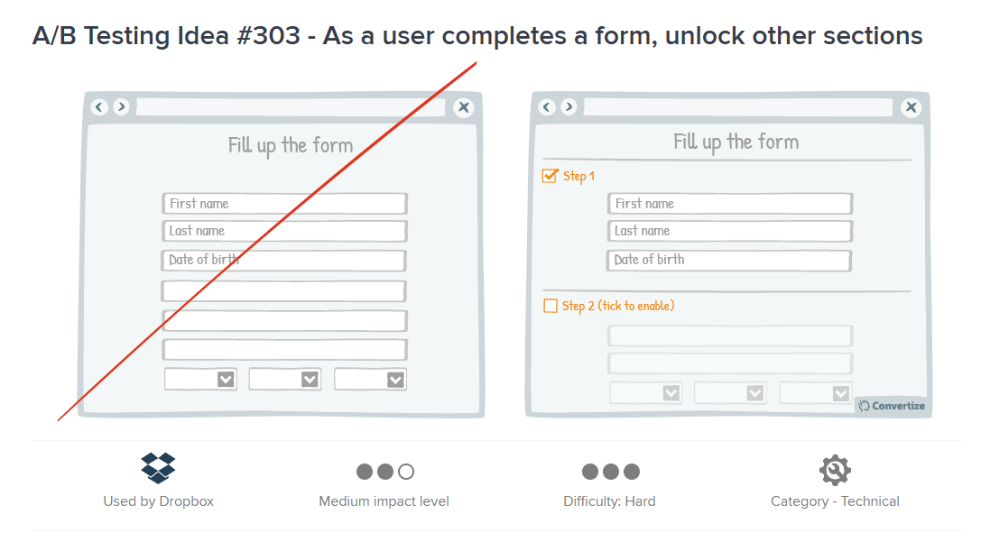
A/B
Testing
05
Sequential & Progressive

Slide 29
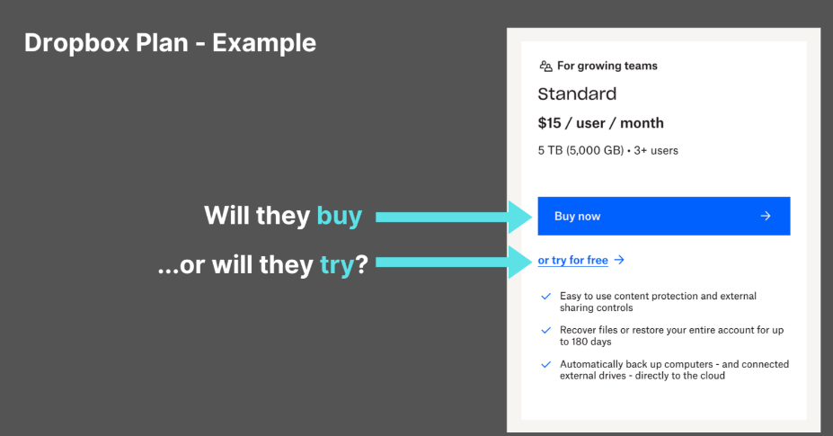
A/B
Testing
05
Consider their viewpoint to better address their needs.

Slide 30
A/B
Testing
05
Consider their viewpoint to better address their needs.

Slide 31
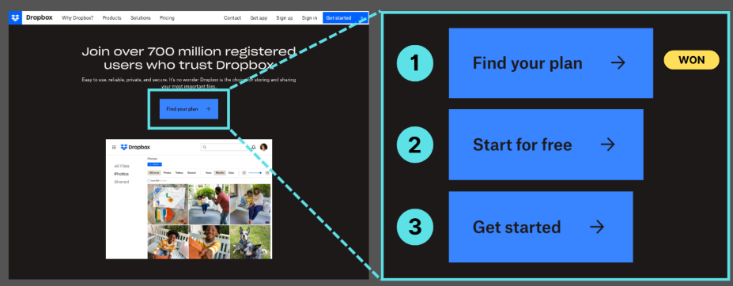
A/B
Testing
05
Using the right marketing word

Slide 32

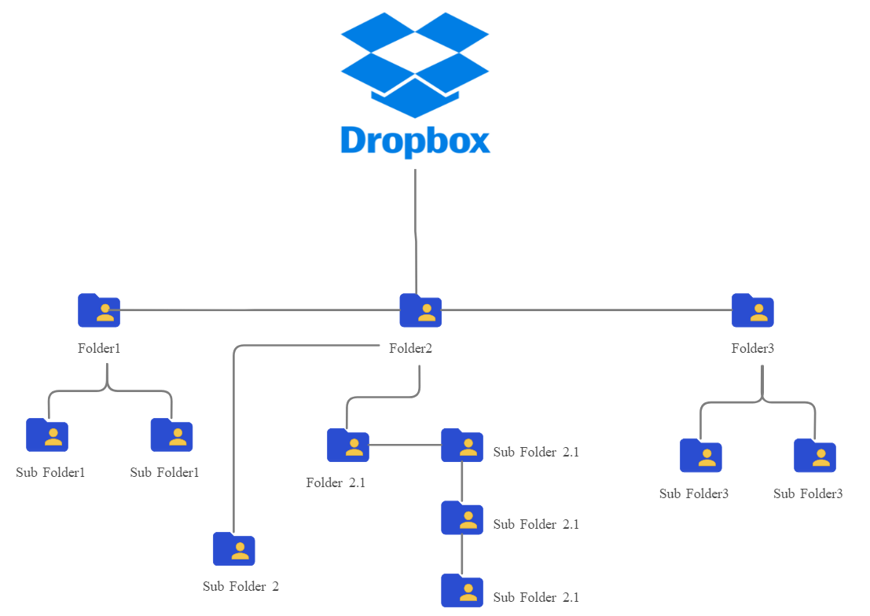
Ethical Dilemmas: Identify and visually represent the ethical dilemmas the company faces (e.g., environmental issues, labor practices, marketing tactics). Explain how the company addresses these challenges and discuss the strategies employed to mitigate ethical concerns.

Slide 33

Ethics in Technology
With more technological advancements, more ethical considerations arises.
More ethical implications placed in mind, from development to deployment to utilization.
(YoungWonks)

Slide 34
Ethics in Technology
Role of technology ethics
Foundation for ensuring responsible, sustainable and inclusive innovation.
Important to address potential harms and fostering public trust.
(YoungWonks)

Slide 35

Ethics in Technology
Cloud storage security means the operational and functional obstacles that organizations and consumers experience when storing data in the cloud.
(Basan)

Slide 36
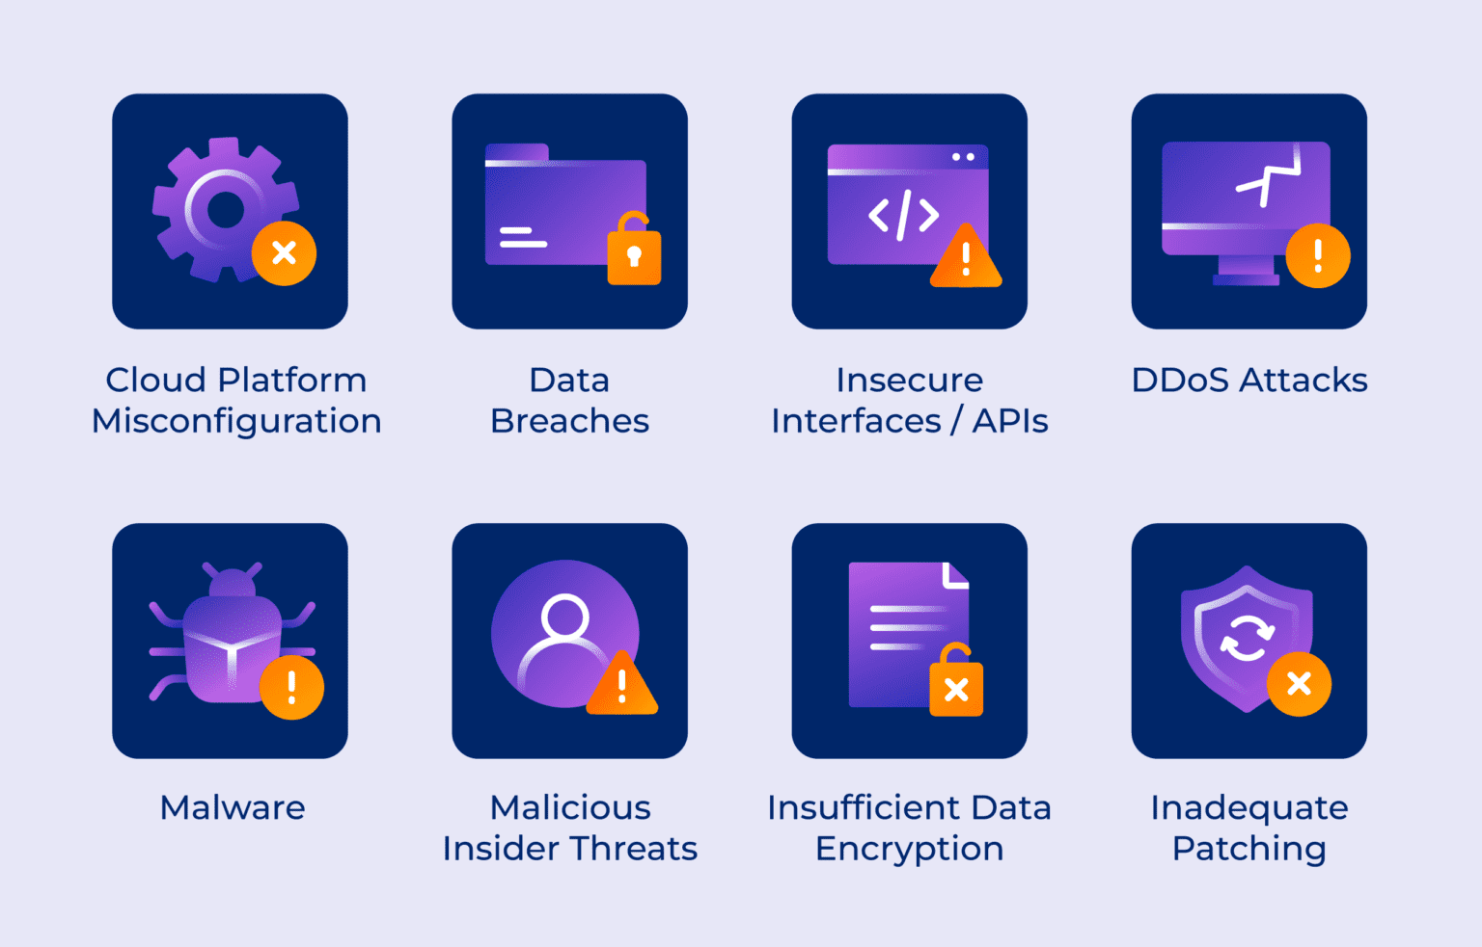
Potential Risks of Unethical Technology
(Basan)

Slide 37
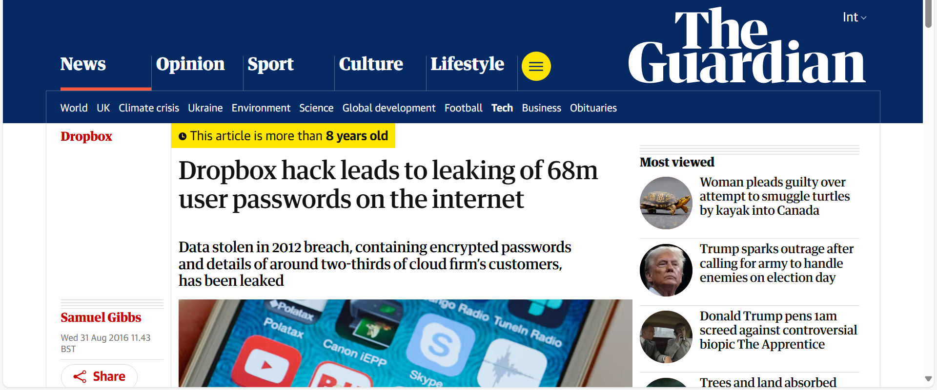
Ethical Dilemmas faced by Dropbox
Data Breaches in 2012
(Gibbs)
Solution: Dropbox practiced good user data security practice, encrypting the passwords and appears to have been in the process of upgrading the encryption from the SHA1 standard to a more secure standard called bcrypt.

Slide 38
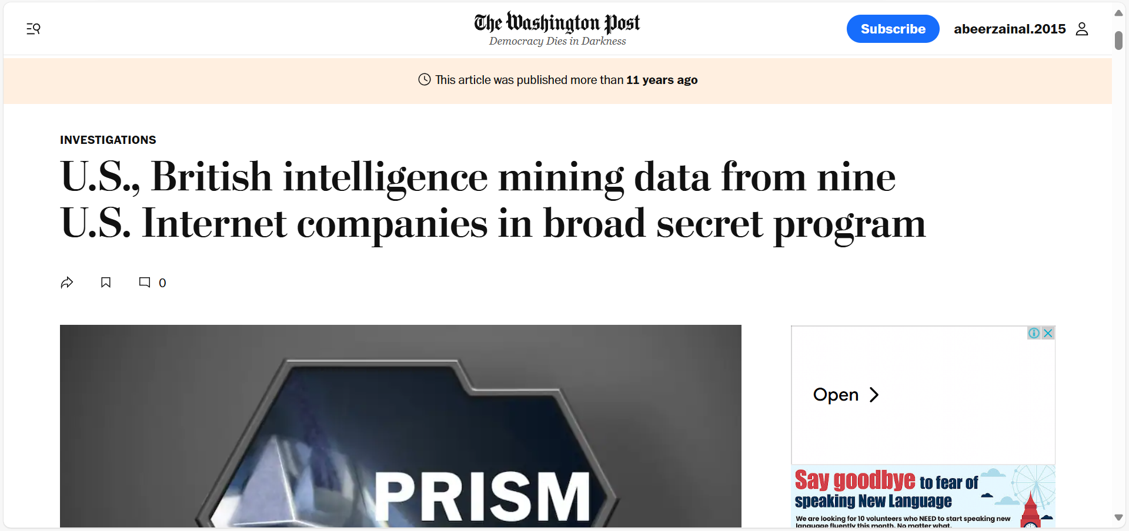
Ethical Dilemmas faced by Dropbox
Content Ownership Conflicts in 2013
(Gellman and Poitras)
Solution: Dropbox constantly denied and rejected any allegations in this regards, through updating the terms and conditions and, the privacy policy regulations.

Slide 39
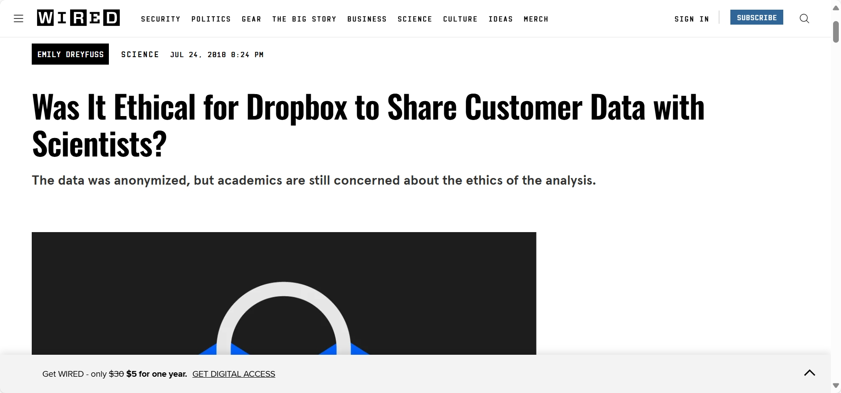
Ethical Dilemmas faced by Dropbox
User Trust in 2013
(Dreyfuss)
Solution: Dropbox constantly denied and rejected any allegations in this regards, through updating the terms and conditions and, the privacy policy regulations.

