Slide 1

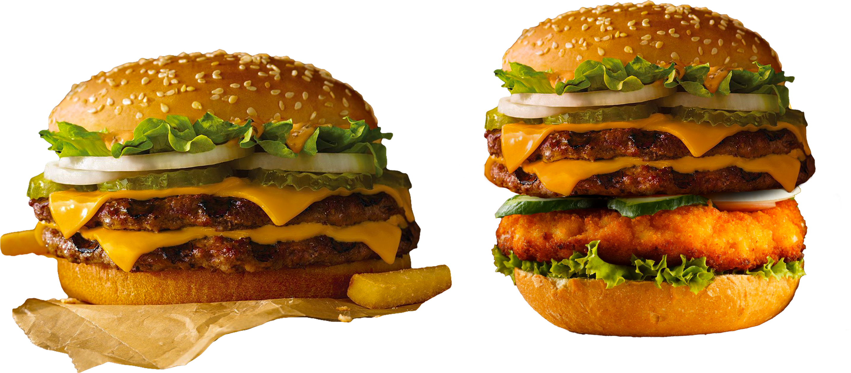



Salford & Co.
Product Presentation
Crafting Flavor, One Bite at a Time
Presented By:
Avery Davis
www.reallygreatsite.com

Slide 2

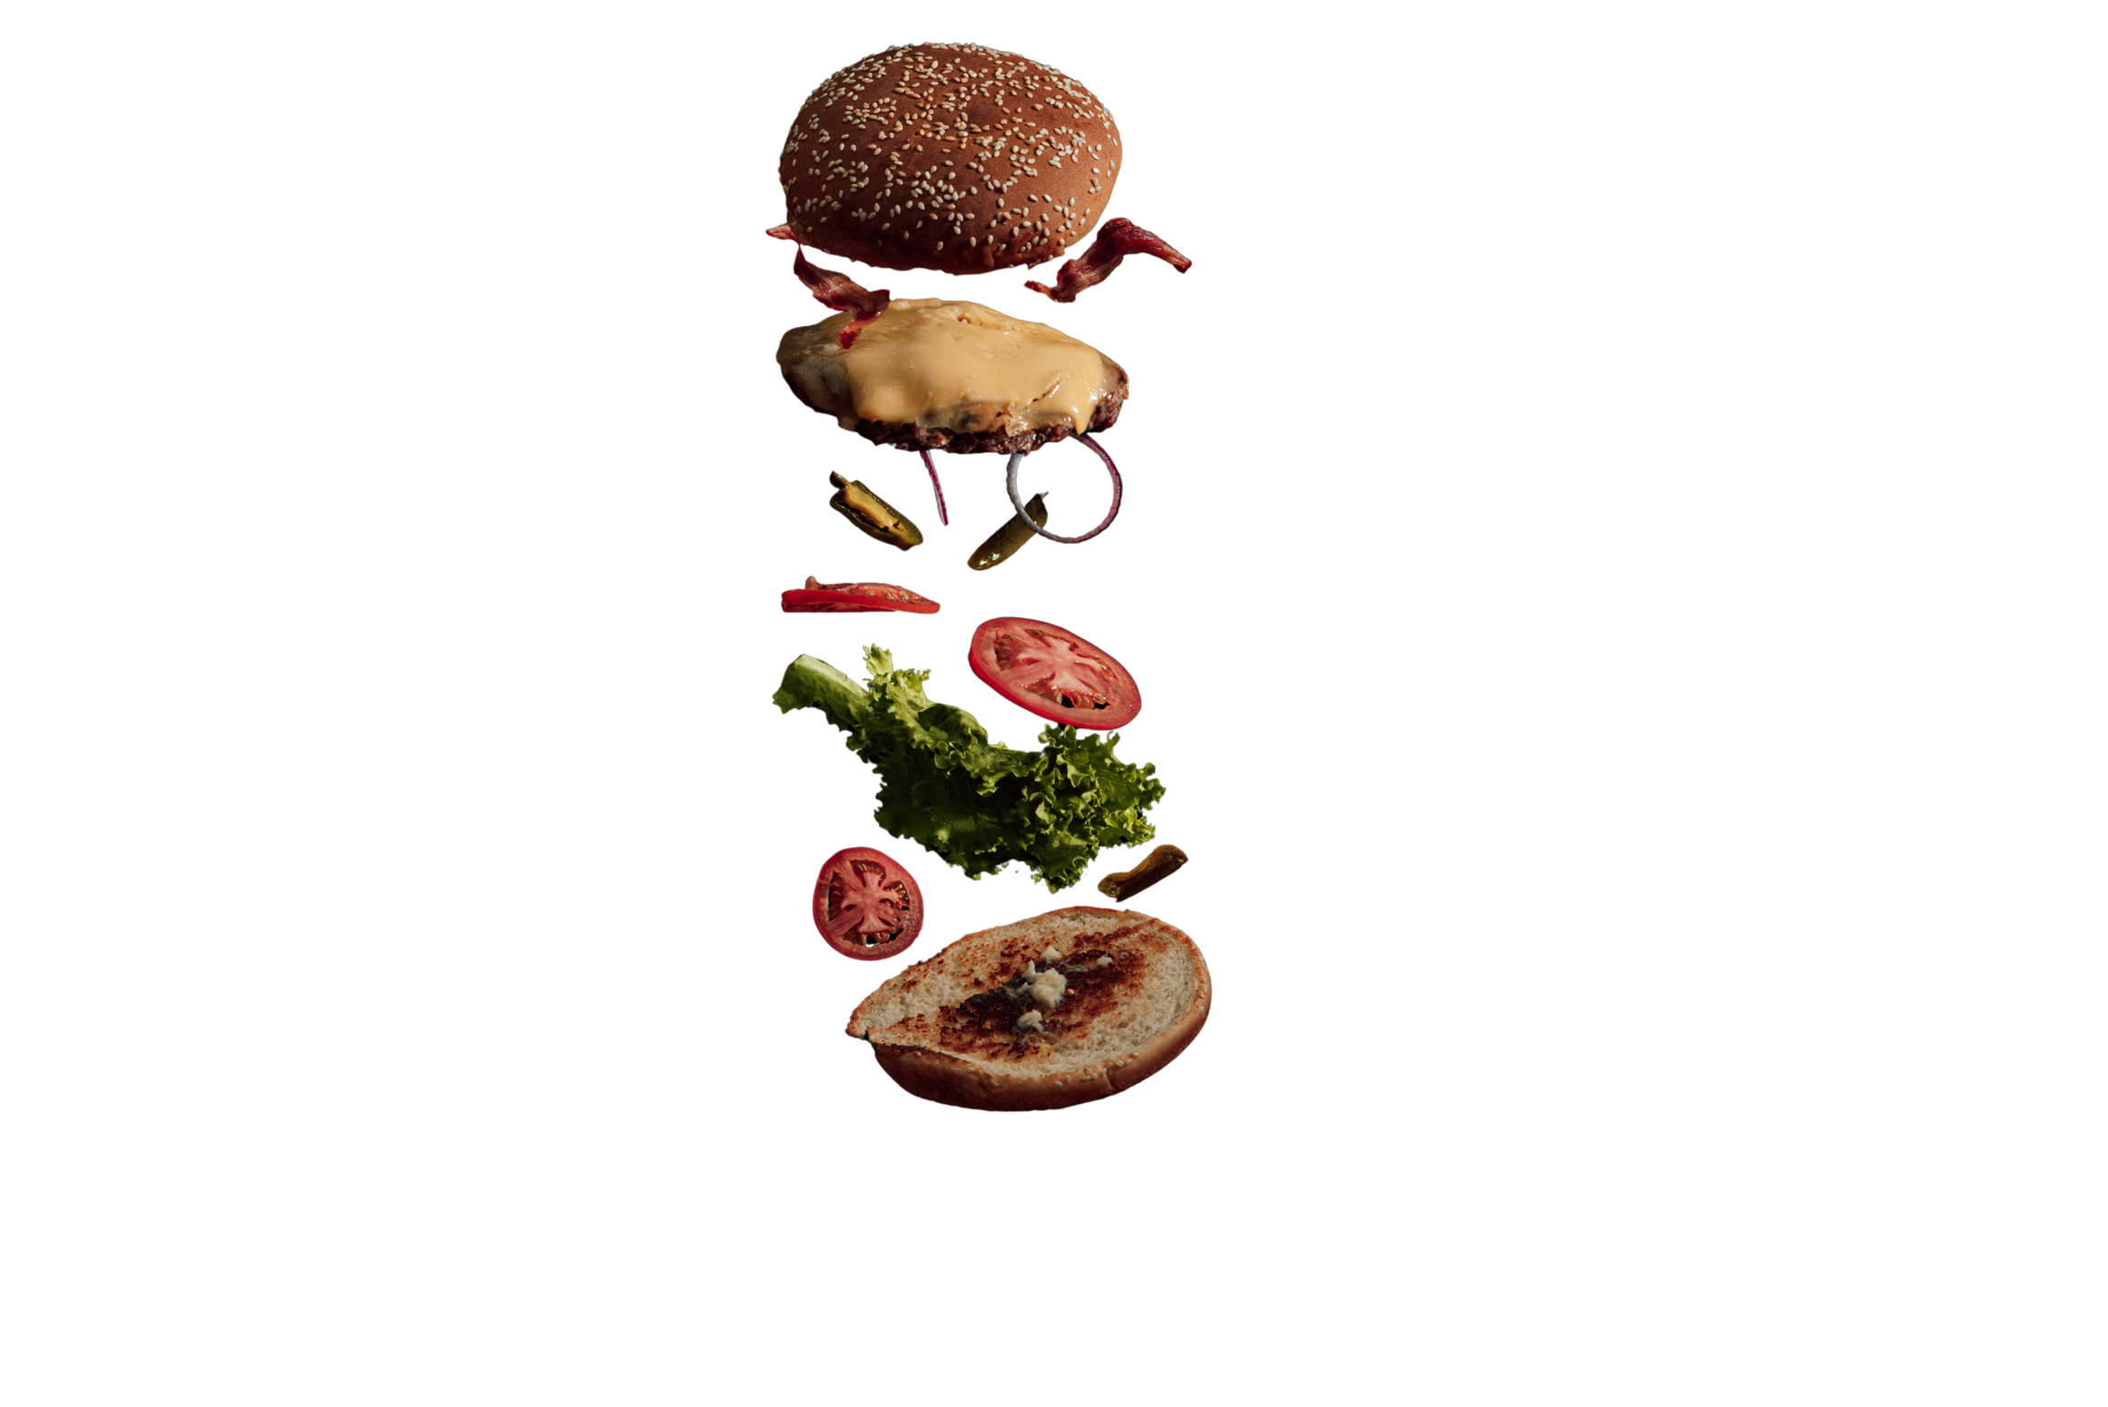
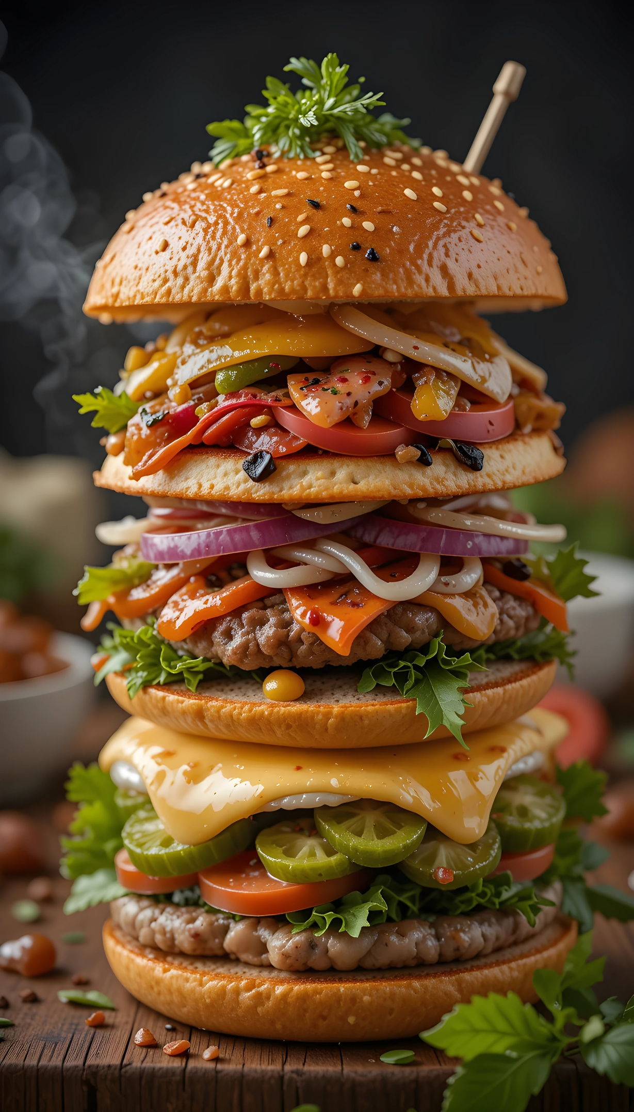


Salford & Co.
Introduction
Burgers have long been a staple of comfort food, beloved across cultures and age groups. This presentation introduces a new range of burgers that emphasize bold flavors, quality ingredients, and modern dietary trends. Our aim is to deliver satisfaction in every bite, whether it’s a classic beef burger or a plant-based alternative. Let’s take a closer look at what sets our burgers apart in a highly competitive market.

Slide 3
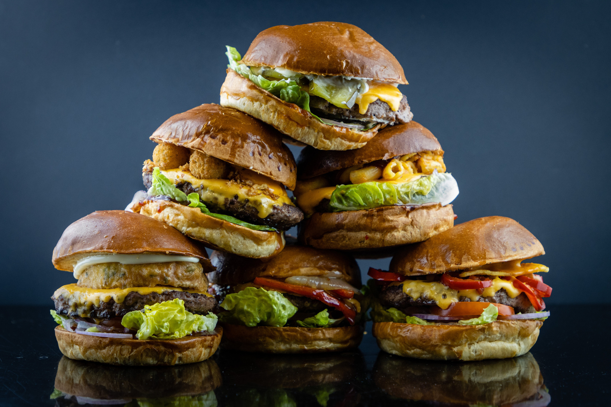
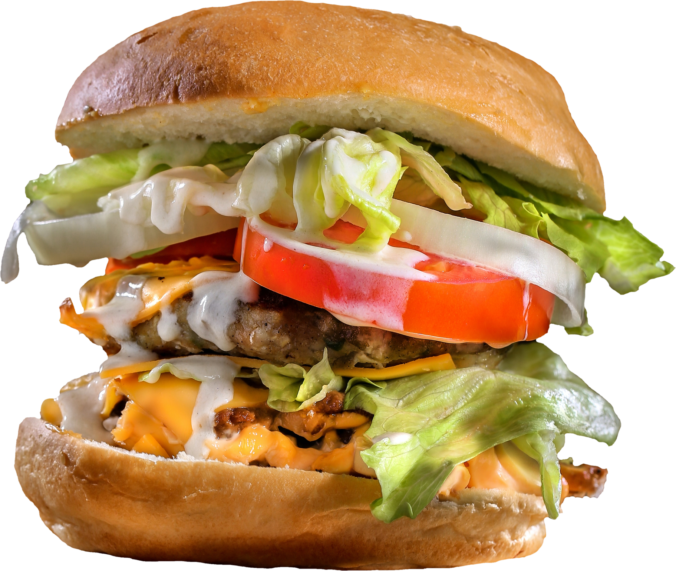

Fresh, Locally Sourced Ingredients
We use premium beef, fresh vegetables, and artisan buns made daily.
Burger Highlights
Homemade Sauces & Toppings
Signature sauces, pickles, caramelized onions, and more for extra flavor.
Salford & Co.

Slide 4

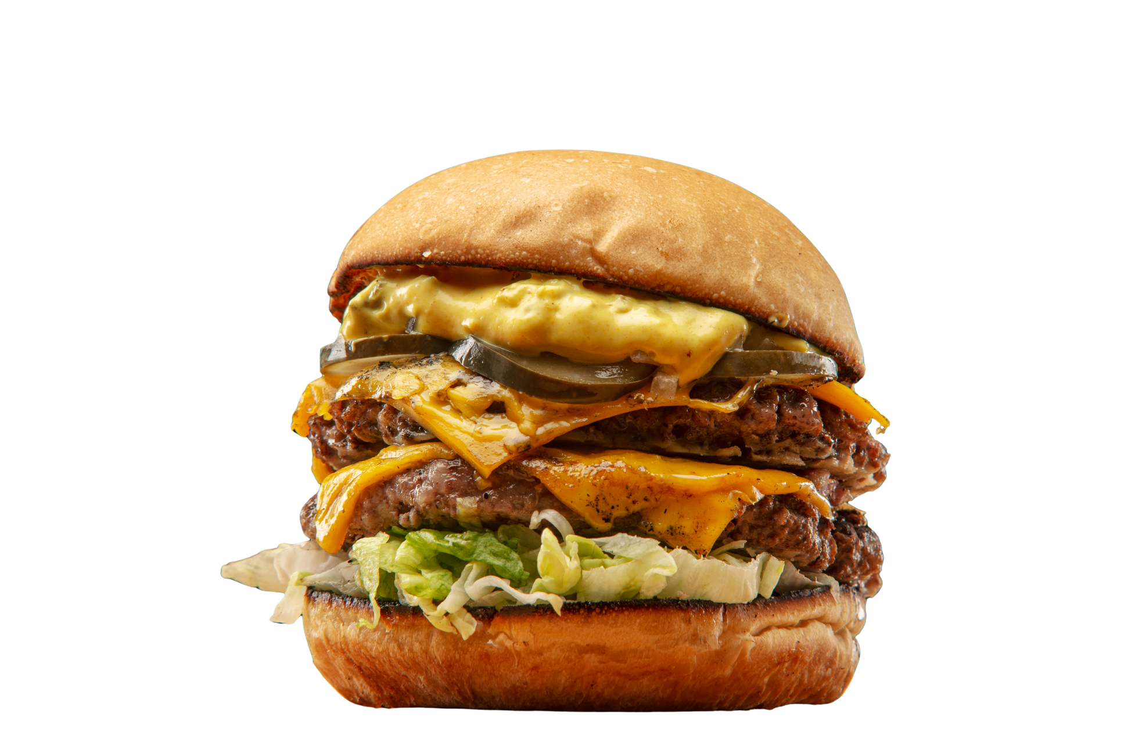
Salford & Co.
Our Philosophy
At the heart of our burger concept is the belief that quality and taste should never be compromised. Every burger is crafted with attention to detail—from the juiciness of the patty to the perfect toast on the bun. We focus on balancing flavor, texture, and presentation, ensuring every meal is both delicious and memorable. Our burgers are more than food—they’re an experience.
@reallygreatsite

Slide 5
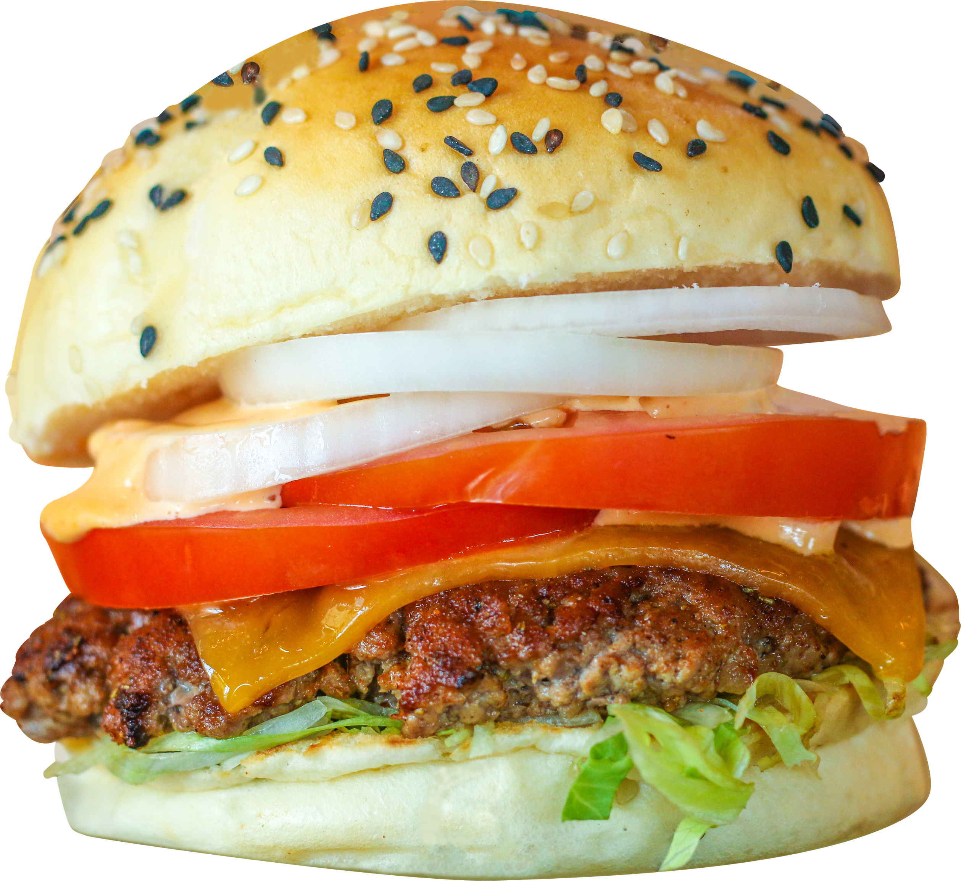
Target Audience
Salford & Co.
Families
Health-Conscious Diners
Food Enthusiasts
Enjoying a casual dining experience that suits all age groups.
Attracted to our low-calorie, grilled, or plant-based burger options.
Always seeking new and exciting flavor combinations.

Slide 6
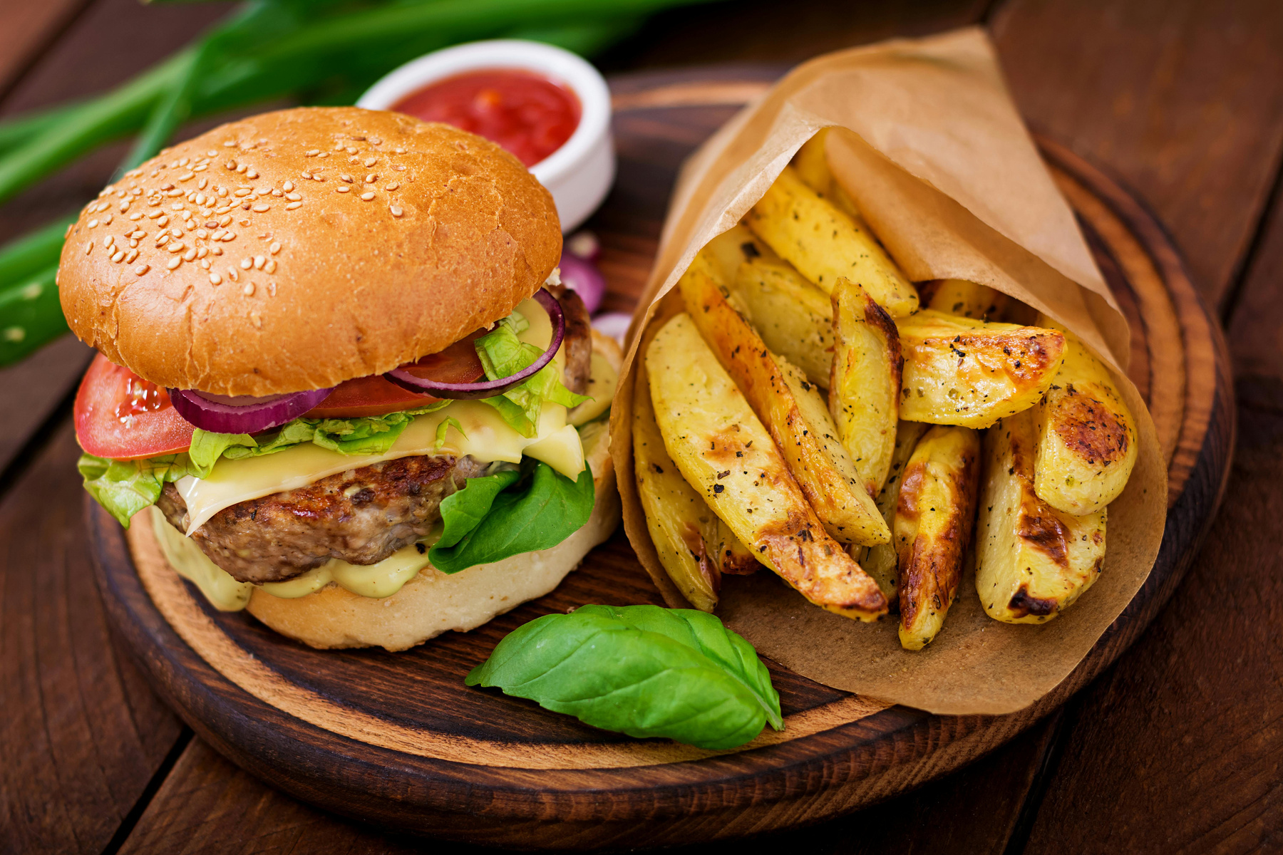
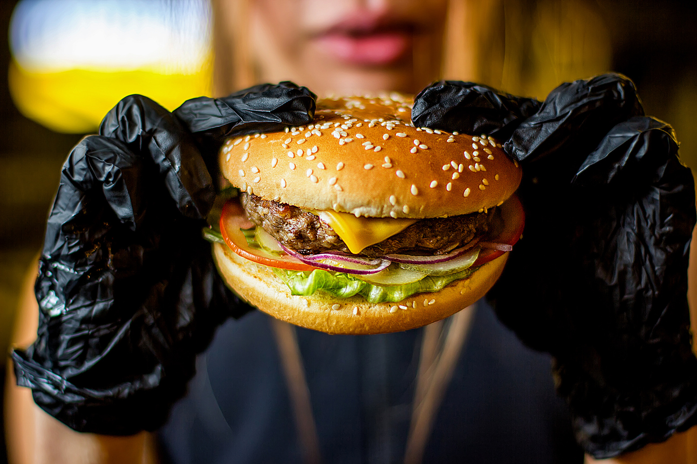
www.reallygreatsite.com
Quality Assurance
Food safety and quality control are central to our production process. We follow strict hygiene protocols in food handling, cooking, and packaging. Ingredients are inspected daily, and cooking standards are monitored to maintain consistency across all orders. This commitment to quality not only protects our customers but also builds long-term trust in our product.

Slide 7
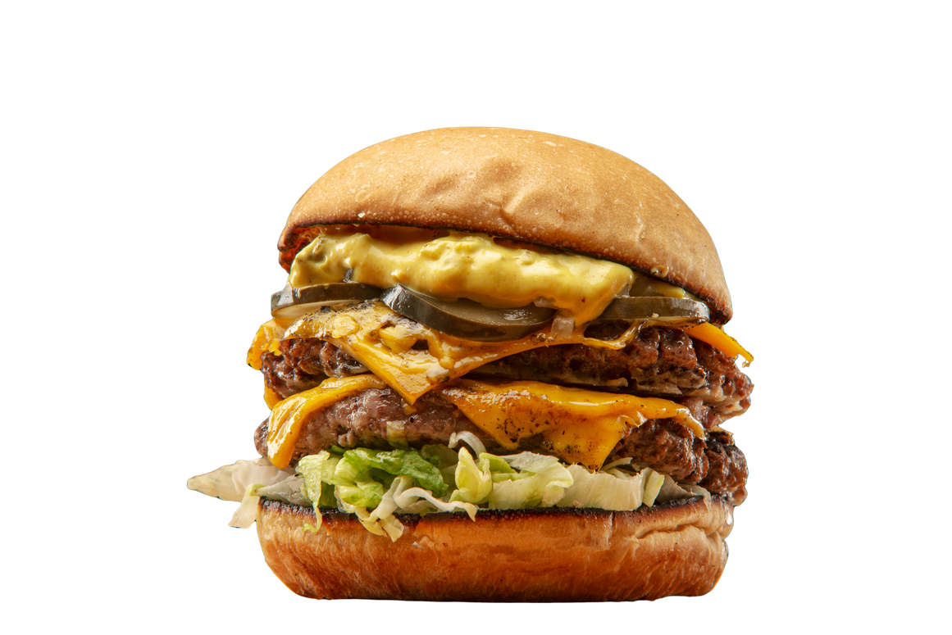
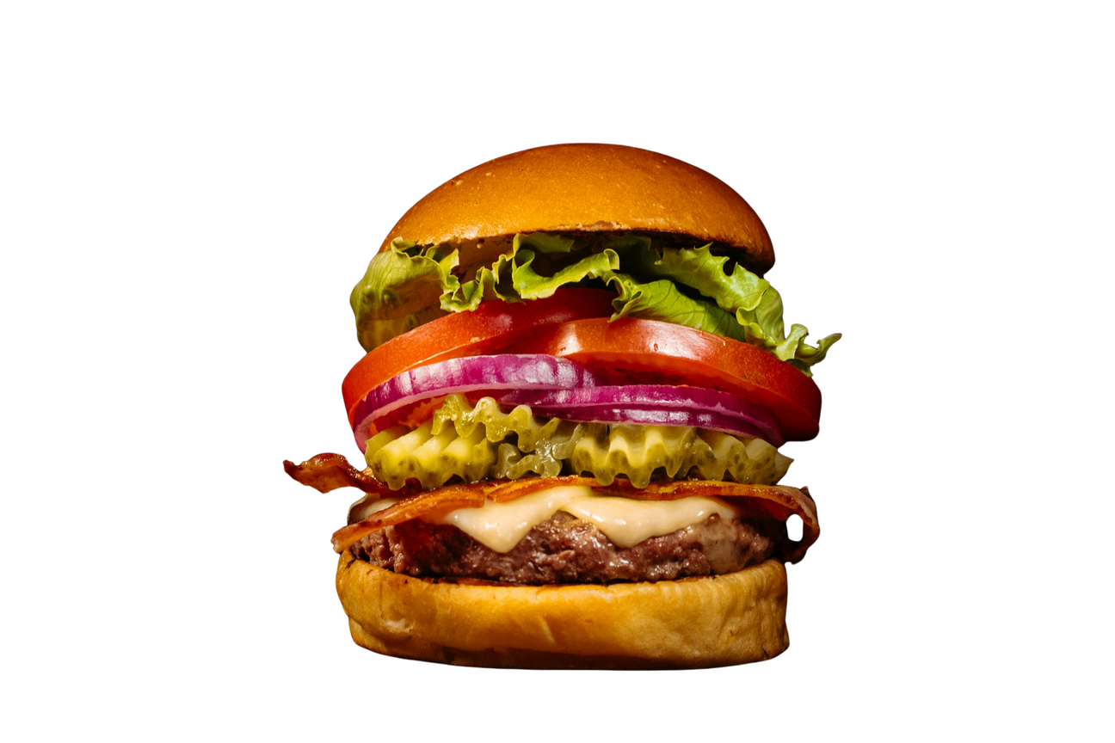
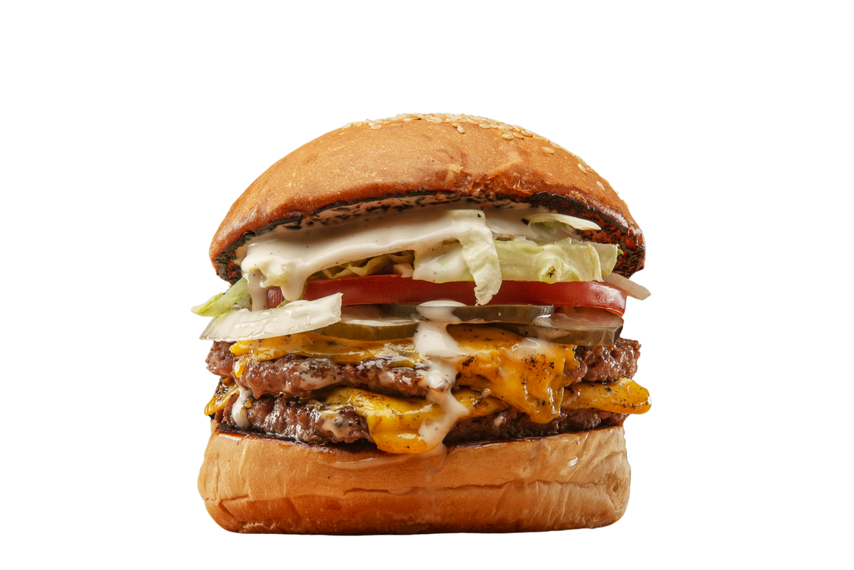

Menu Categories
Classic Beef Burgers
Vegan & Plant-Based Options
Specialty Burgers
Juicy, seasoned patties with traditional toppings and melted cheese.
Monthly limited-edition creations with international inspirations.
Made with lentils, beans, or soy protein for a healthy twist.

Slide 8
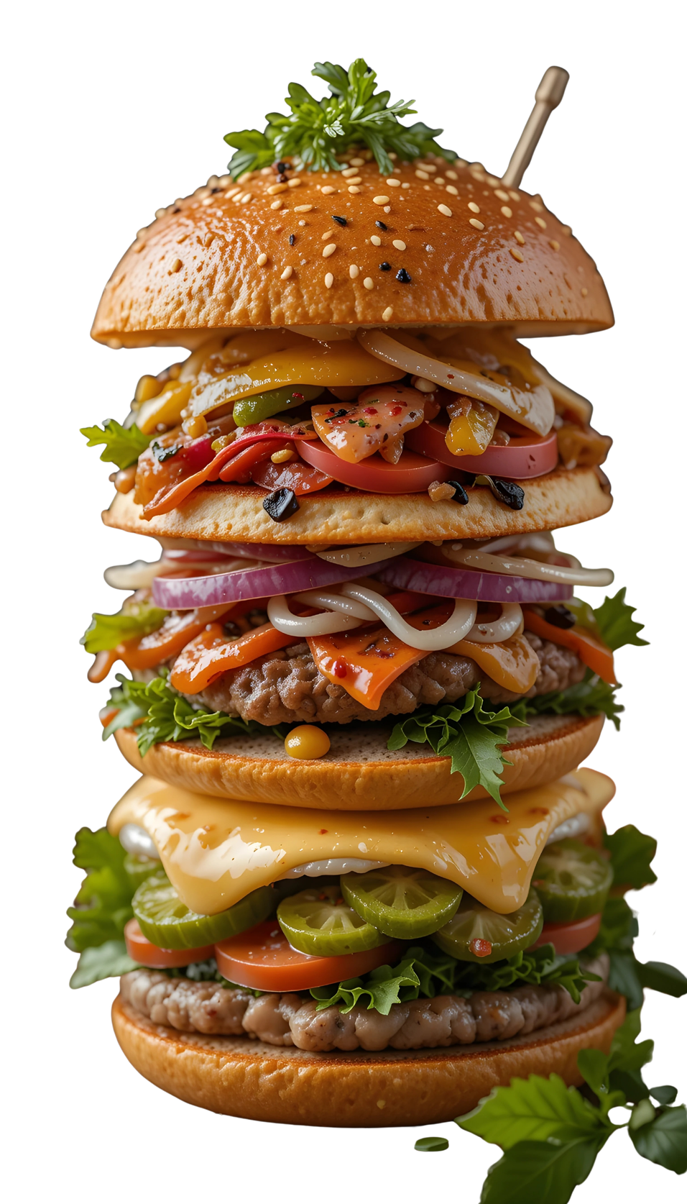
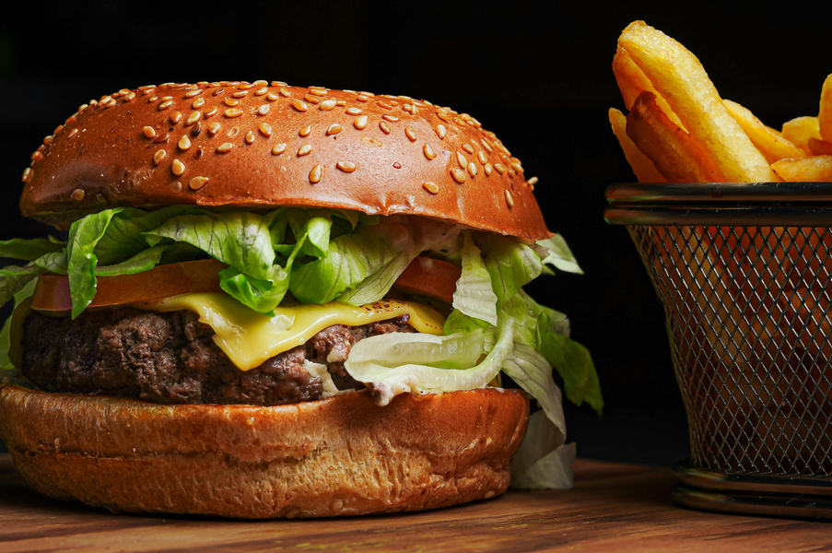
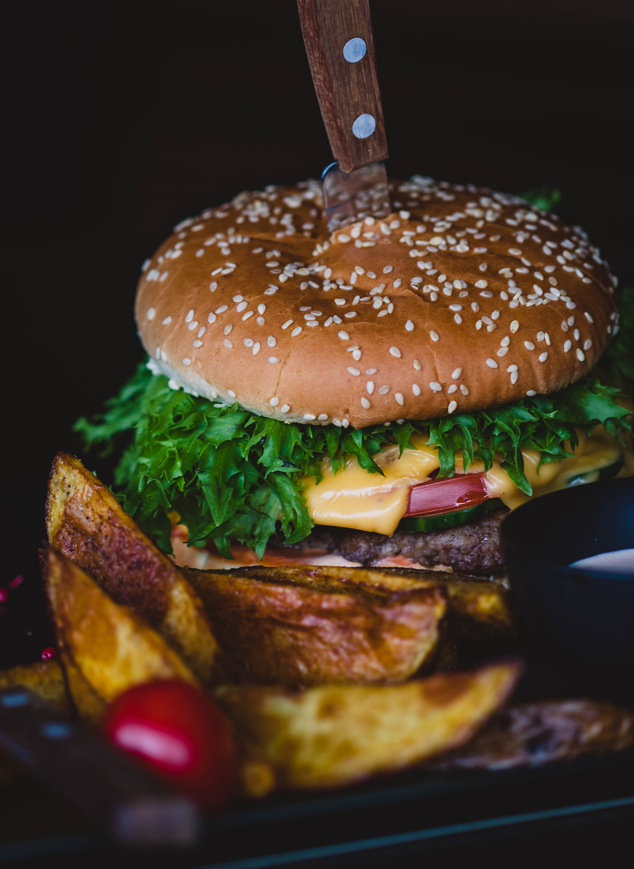
Consumer demand is shifting toward customizable, healthier, and more ethically sourced food options—even in fast food. Our burger products tap into these trends by offering flexible menus, plant-based innovations, and high-quality ingredients. This creates strong market potential not only among traditional fast food lovers but also within health-conscious and eco-aware demographics.
Salford & Co.
Market Trends & Opportunity

Slide 9
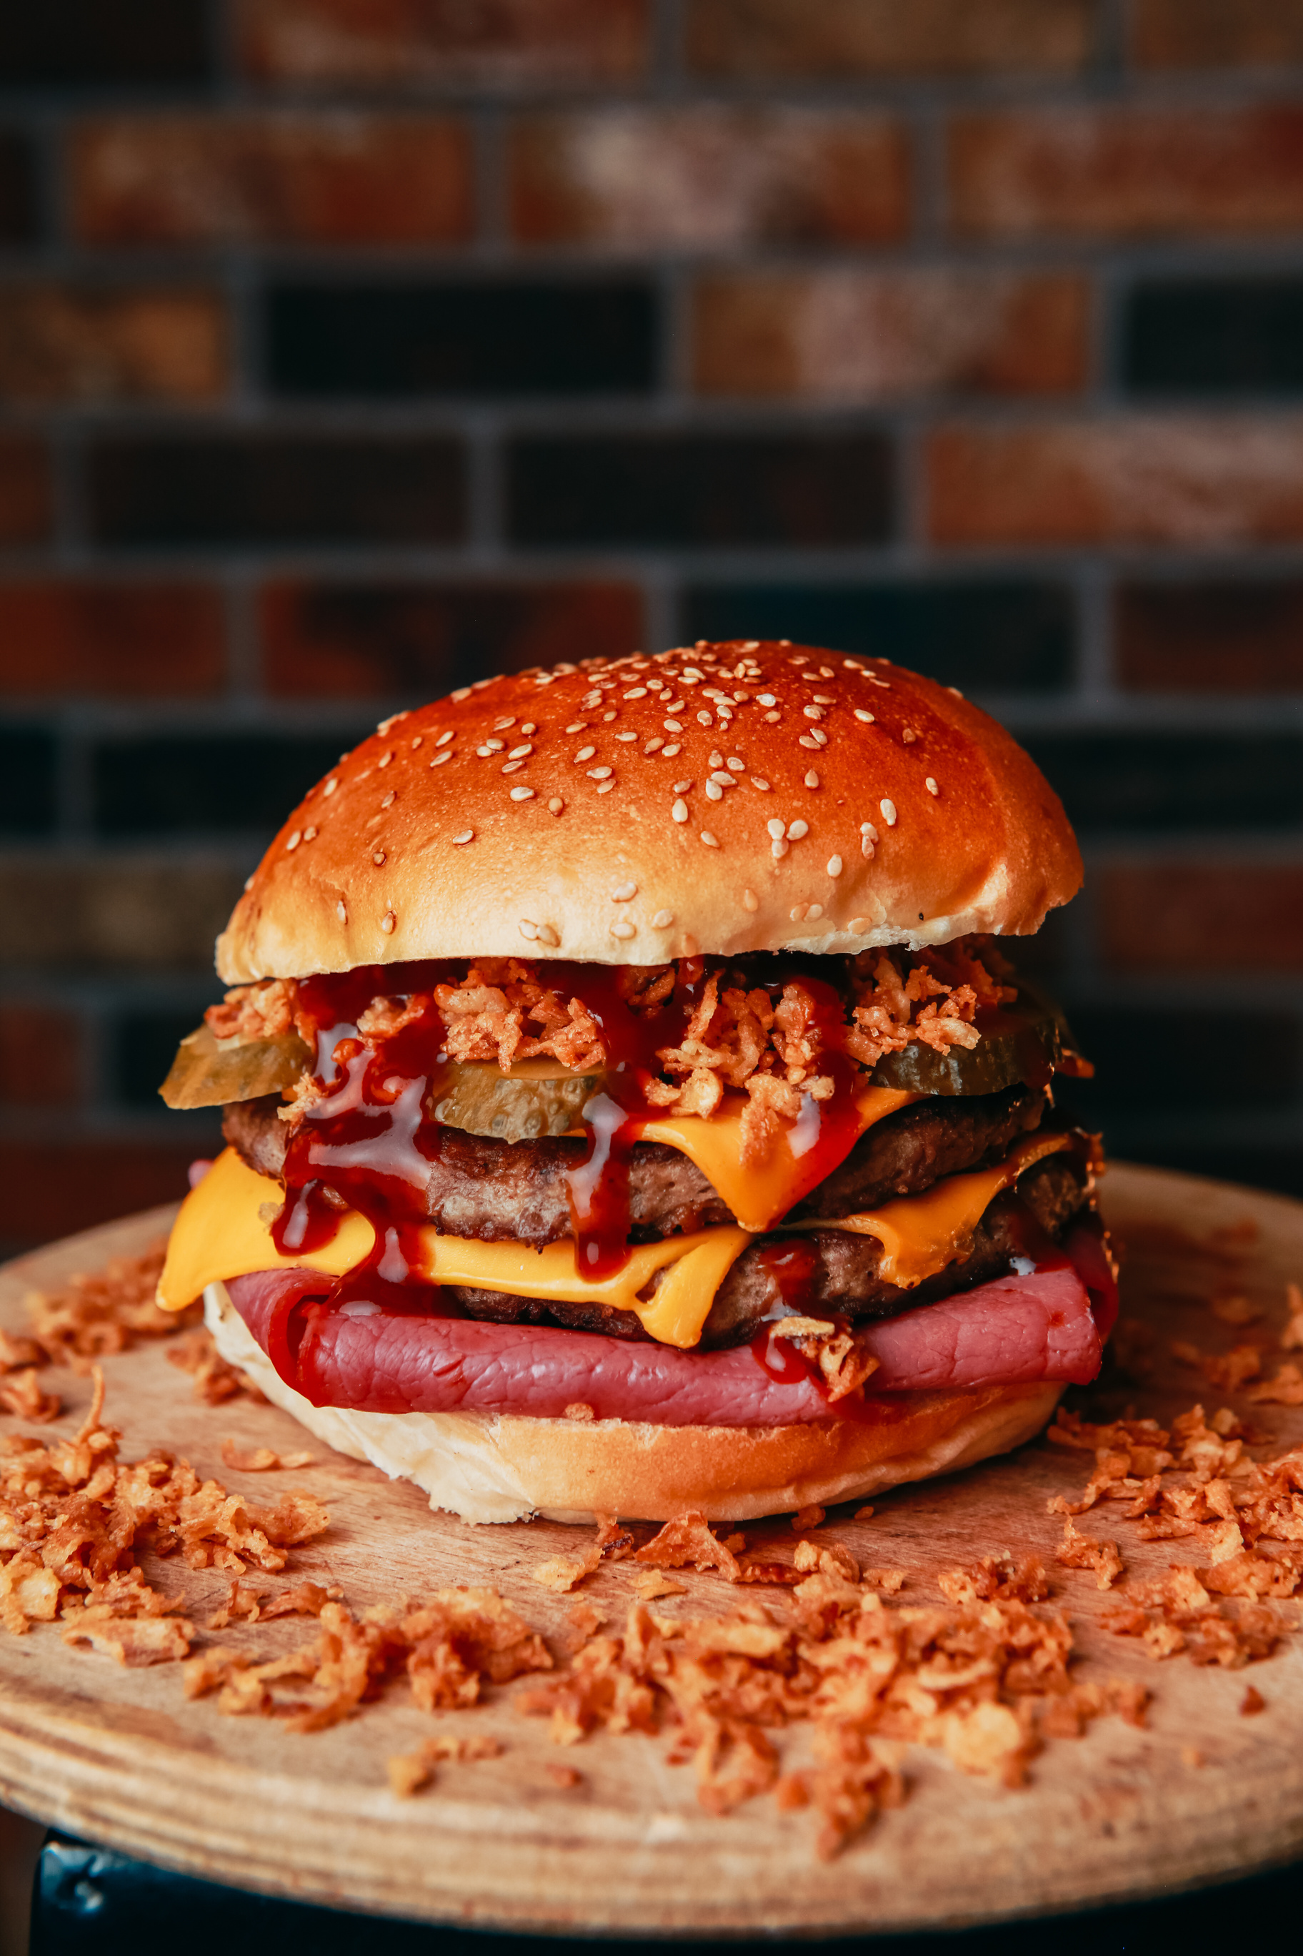
Salford & Co.
Takeaway & Pickup
Online Delivery Platforms
Fast and convenient options for customers on the go.
Available on major food apps with exclusive digital deals.
Event Catering
Dine-In Experience
Providing burgers at parties, offices, and public festivals.
Comfortable, modern dining spaces for casual meals and group gatherings.

Slide 10
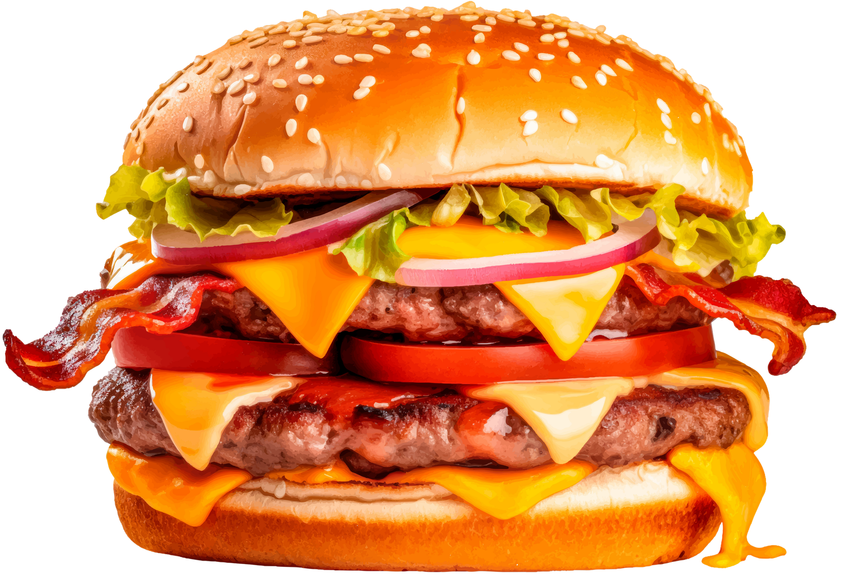

Salford & Co.
Thank you so much
We appreciate your time and interest in our burger product range.
We look forward to serving great taste, one burger at a time.
  @reallygreatsite
  +123-456-7890
  hello@reallygreatsite.com

