Slide 1


Climate Change
FREE PRESENTATION TEMPLATE

Slide 2



Welcome
Welcome to the world of fantasy! Join us on a journey to explore the mystical creatures, enchanted lands, and magical wonders that exist beyond our reality. Discover the wonders and secrets of this exciting realm and unlock the power of imagination.

Slide 3


Table of Contents
Introduction
01
02
Causes
The Extraordinary Realm
Unicorn Sightings
Consequences
03
04
Efforts
Wishes Granted
Spellcasting
Challenges
05
06
Conclusion
Happily Ever After
Embrace the Fantasy

Slide 4



Introduction
Definition of climate change and the importance of the topic

Slide 5






















Definition of climate change
Welcome to the Fantasy World, a realm of wonder and enchantment where anything is possible. Here, dragons breathe fire, unicorns prance through meadows, and rainbows shine brightly. This world is a place where wishes come true, where potions can be cursed and spells are cast. It's a place of treasure and adventure, where the impossible becomes possible. But the greatest treasure of all is the one that lies within.
The world of fantasy is a reflection of our deepest desires, our fondest dreams, and our wildest imaginations. It's a place where we can let go of the constraints of reality and explore the boundless possibilities of the human mind. In this introduction, we will delve into the mysteries of this realm, uncovering the magic and wonder that lies within. So come with us and let's embark on a journey through the Fantasy World.

Slide 6

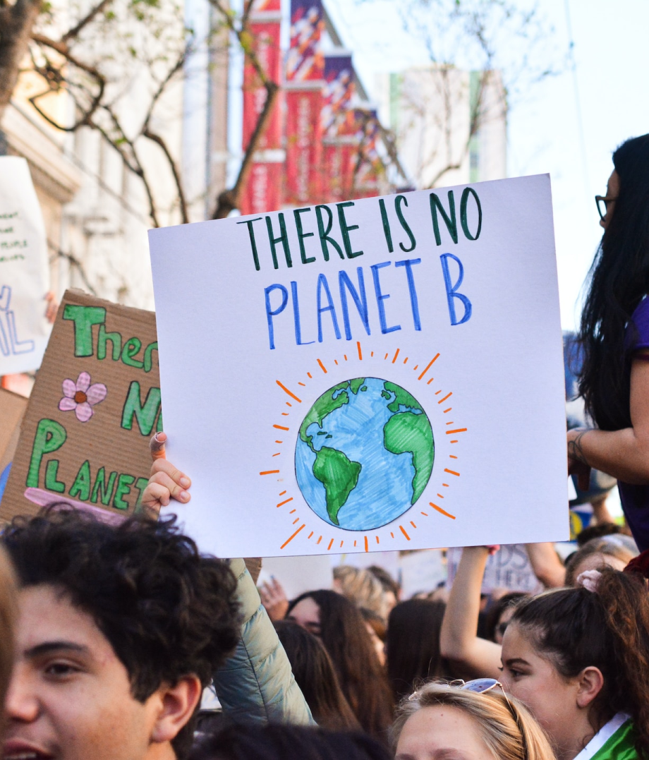












Importance of the topic
Unicorn Sightings
A record of the number of unicorns spotted in the fantasy realm and the beauty and mystery that surrounds these enchanting creatures.
Dragon Taming
A closer look at the art of taming dragons and the brave adventurers who dare to take on these fearsome creatures.

Slide 7
















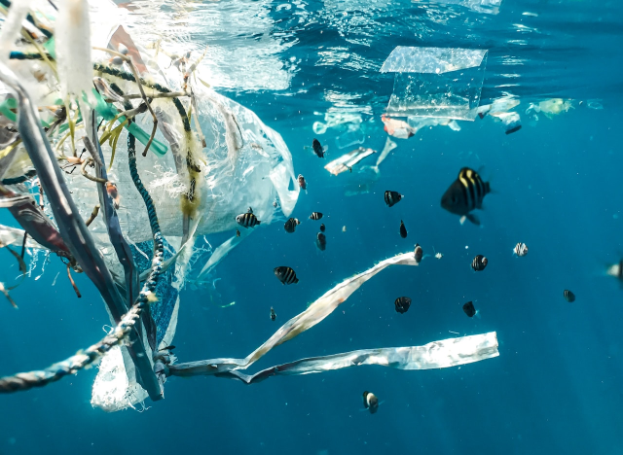
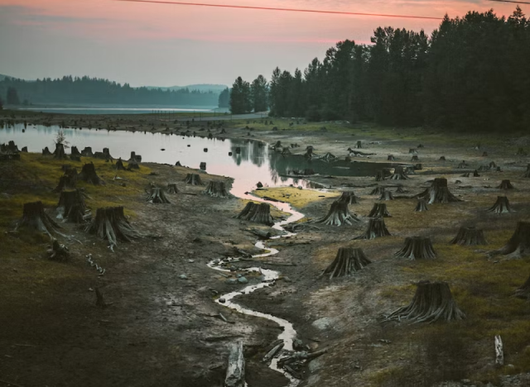

Causes of Climate Change
Unicorn Sightings
Dragon Taming
A record of the number of unicorns spotted in the fantasy realm and the beauty and mystery.
A closer look at the art of taming dragons and the brave adventurers who take on these creatures.

Slide 8



Fantasy is the gateway to the impossible, the land where the ordinary becomes extraordinary, and the impossible becomes possible. It is the realm of the imagination, where anything can happen and everything is possible.
The Dream Weaver

Slide 9
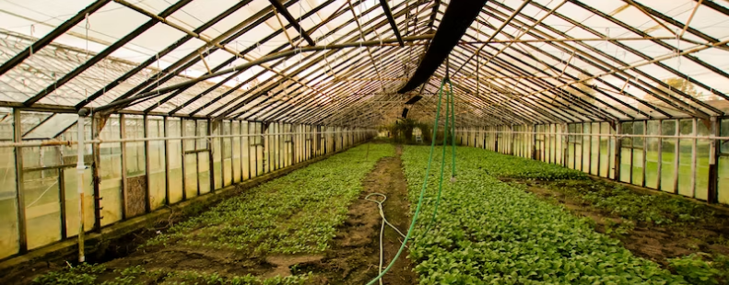
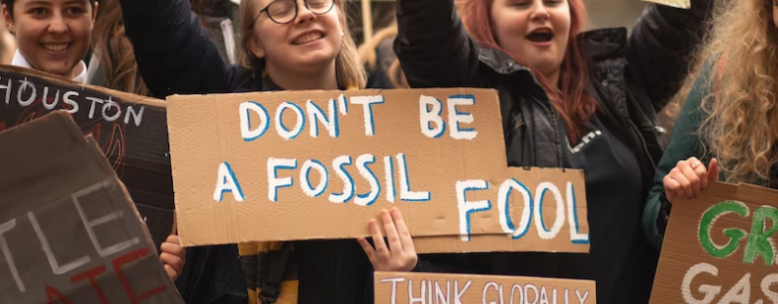
Dragon Taming Technique
A guide to taming and caring for dragons in the realm of magic.
The Art of Unicorn Sighting
Tips and tricks for spotting the elusive unicorns in their natural habitat.

Slide 10

Consequences of Climate Change
6.7M
4.4M
2.3M

Slide 11

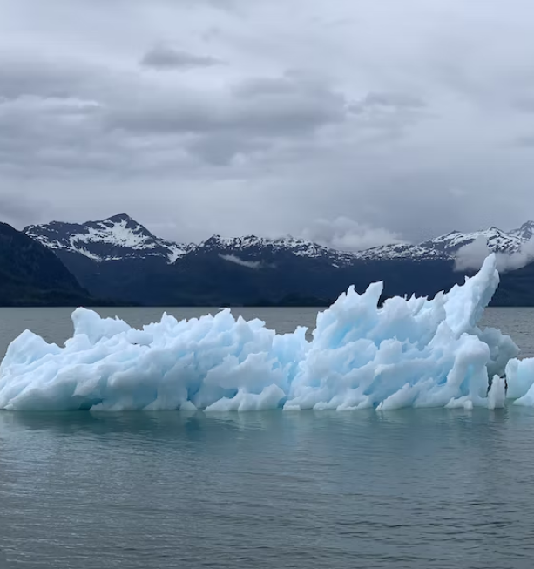








Global impacts
Elegant inhabitants of enchanted forests, known for their mastery of magic and their close connection to nature. They possess an innate sense of harmony and balance, making them protectors of the natural world.
"The Art of Archery": Discover the intricacies of the Art of Archery as practiced by the graceful and precise elves.
"The Music of the Elves": Immerse yourself in the enchanting music of the elves, whose songs have the power to heal.
"The Life of an Elf": Learn about the customs and daily life of the elves, from their familial structure to their religious beliefs.

Slide 12
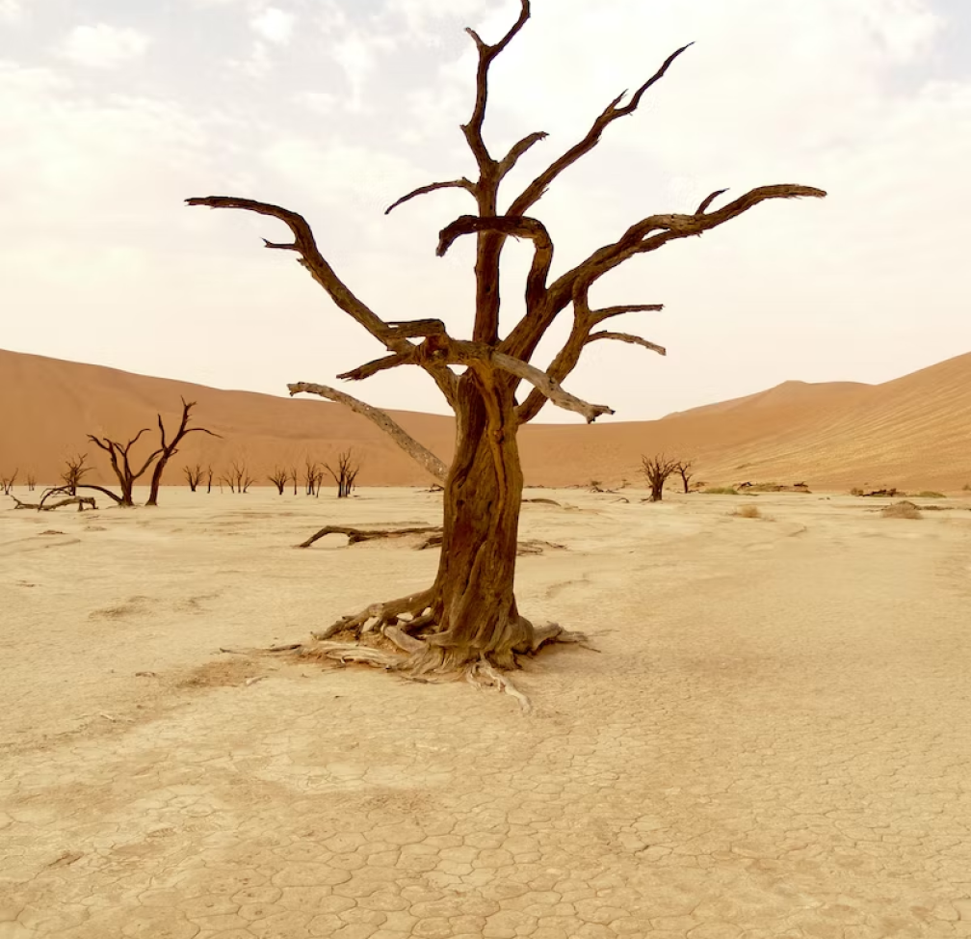
Increased frequency and intensity of extreme weather events

Slide 13
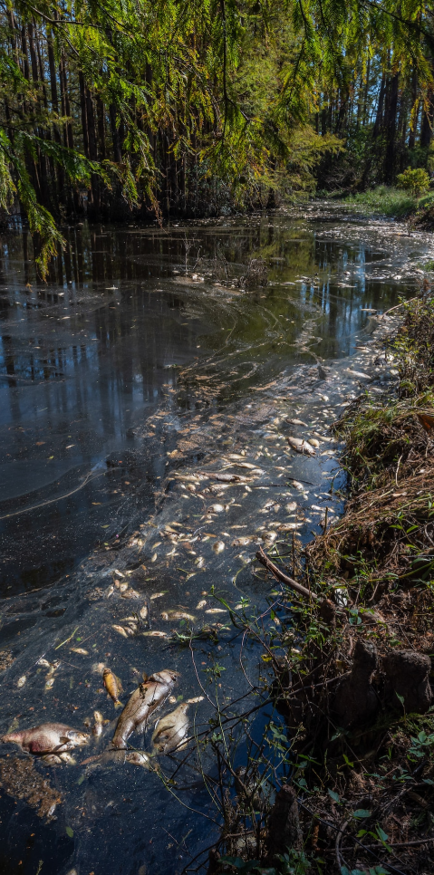
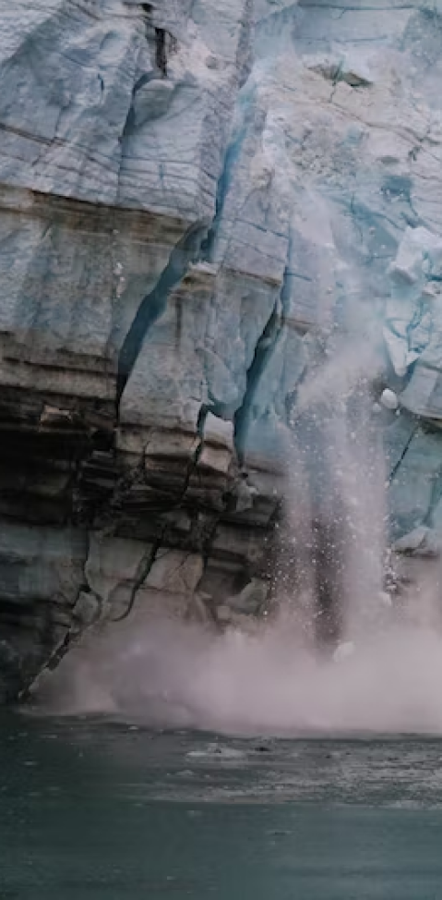
Impacts on wildlife and ecosystems
75%
Enchanted Creatures
possess the ability to cast spells.
60%
Magic-Wielding Individuals
practice the art of illusions.
90%
Spells Cast
are dark magic, foretelling danger.

Slide 14

234,567
UNICORN SIGHTINGS
A tally of the number of unicorns spotted in the fantasy realm.

Slide 15
Current Efforts to Address Climate Change
233 Coins
85%
Treasure Found
Wished Granted
456 Hours
535 Km
Duration of Spell Casting
Journey Distance

Slide 16





100
90
80
70
60
50
34.574
40
Total
30
20
10
0
1
2
3
4
5
6
7
8
Spellcasting Progress
Treasure Found
A record of the number of spells cast per year
A record of the amount of treasure found per month

Slide 17

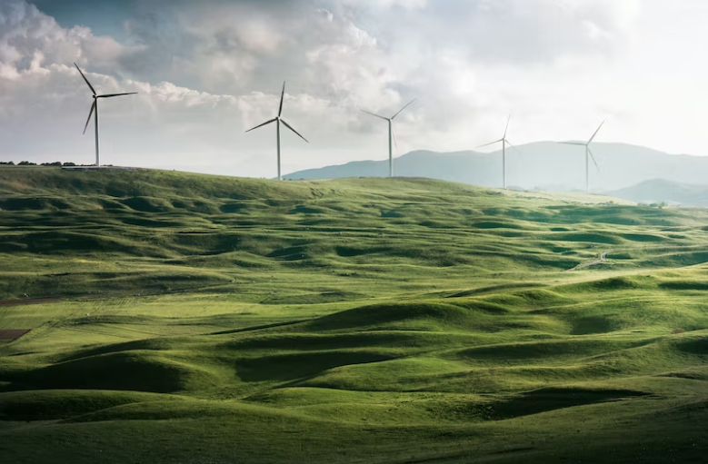

Clean energy technologies
A web application
A web application designed for discovering the world of fantasy

Slide 18

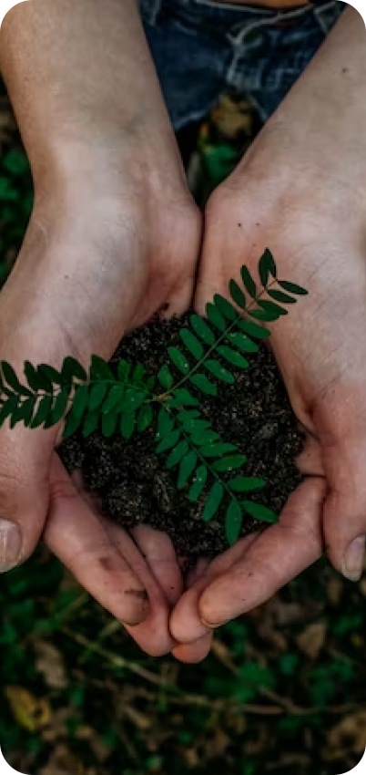
Clean energy technologies
An mobile app
An app designed for exploring and experiencing the enchanting realm of fantasy
  Explore a magical world
  Experience fantasy firsthand
  Immerse in a realm of magic
  Discover untold wonders
  Live your fantasy dreams

Slide 19
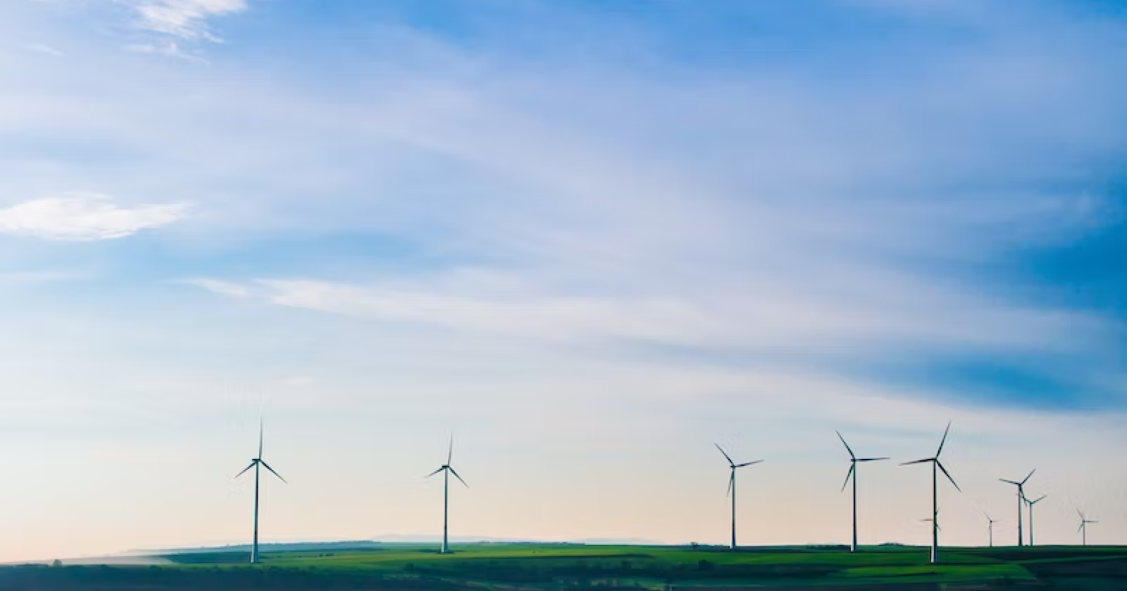
A Magic Picture

Slide 20
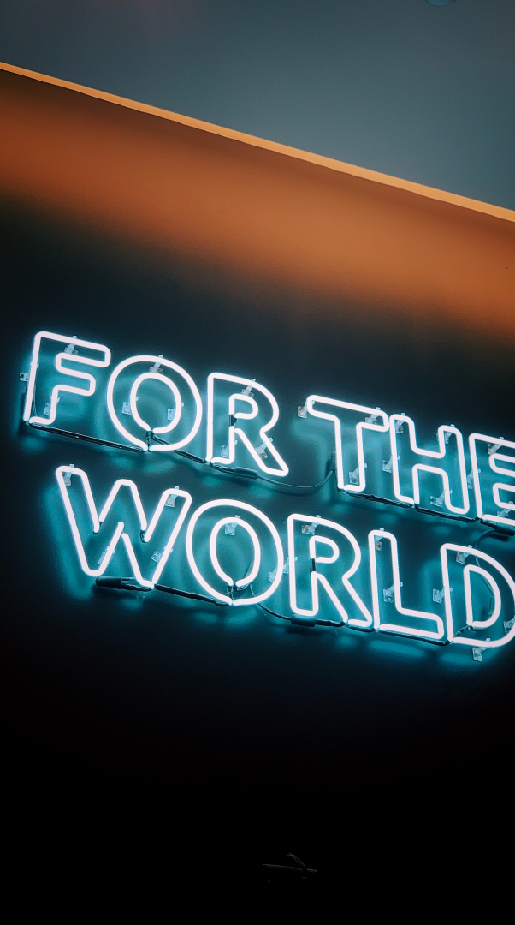
Challenges in Addressing Climate Change
Discover the secrets
Find your own path
1
2
Explore the lush, vibrant forest and uncover the mysteries that lie within.
Choose your own path through the forest, and see where it takes you.
Meet the creatures
Uncover the magic
3
4
Encounter the mythical creatures that call the forest home, from talking animals to fairies.
Learn about the powerful magic that pervades the forest and how it affects all who enter.

Slide 21

The Enchanted Forest
A magical forest filled with talking animals and enchanted creatures.
The Crystal Caves
A network of underground caves filled with precious gems and crystals.
The Dragon's Lair
A dangerous and mysterious place where dragons reside.
Political and economic obstacles

Slide 22









Public perception and understanding
Spellcasting Competition
Treasure
Hunt
Great
Adventure
A significant event in the history of the fantasy realm, in which the greatest spellcasters of the realm.
A significant event in the history of the fantasy realm, in which a massive and awesome treasure hunt was organized.
A notable year in the history of the fantasy realm, in which a large number of adventurers set out to explore.

Slide 23


























Future Implications of Climate Change
War
Foundation
Festival
A volcanic eruption devastates a nearby city, forcing its inhabitants.
An elf helps humans obtain the Crystal of the Unicorn from the Elven Forest.
The civilization of the Shimmering City is founded by a group of powerful wizards.
Obtain
Invasion
A group of adventurers sets out to recover an ancient artifact.
A powerful sorcerer and a cunning thief cross paths, leading to a partnership.

Slide 24












The Organization
Valtorin
Lucian
Lyrisa
The Assassin
The Conjurer
The Dreamer
Chloe Ng
Aurielle
Elvina
Kaelen
The Mage
The Priestess
The Oracle
The Sentinel
Theronis
Cedric
Seraphina
To download more editable chart, click here
The Warrior
The Timekeeper
The Lightbringer

Slide 25






Thank you for choosing EaTemp
We offer free and high-quality slides templates for your presentations. We appreciate you choosing us and hope our templates have been helpful.
As a new website, we rely on your support to grow, so please help us by sharing our site with your friends and colleagues.
eatemp._
@eatemp
eatempofficial
@eatemp.official

