Slide 1
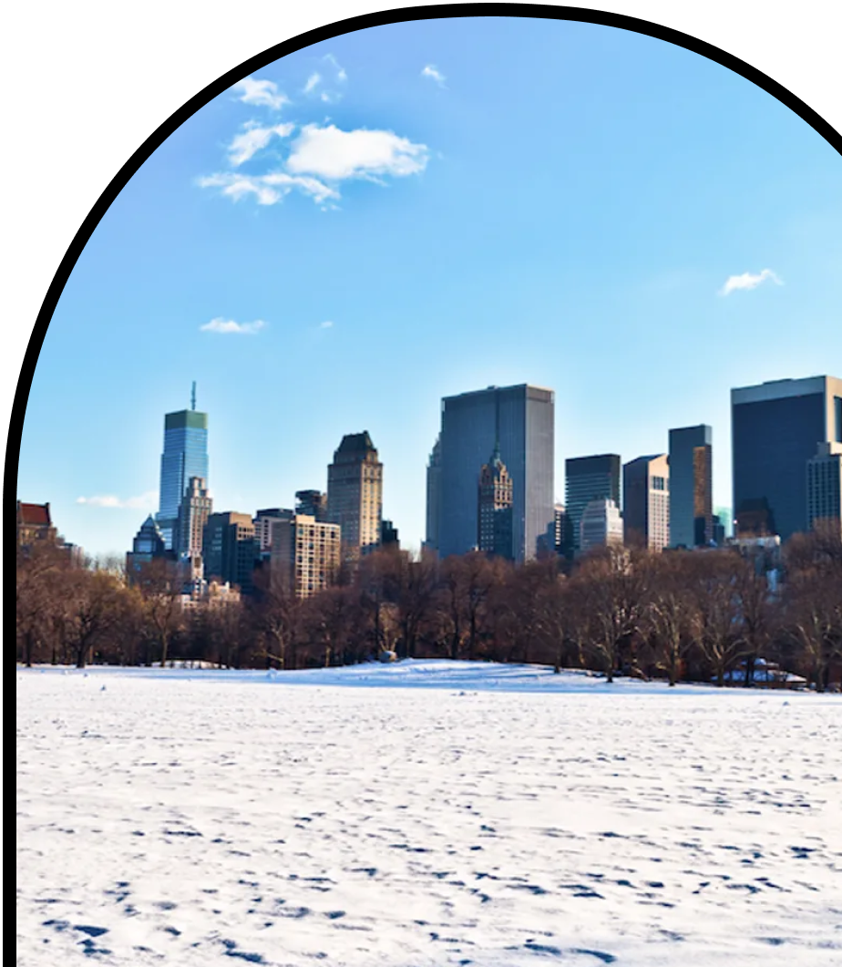
Anchor Layer Teacher Guide
A curriculum companion for Anchor Layer users
Grade K
Sunlight & Warmth
Unit Web Link • Pacing Guide • Other Units

Slide 2
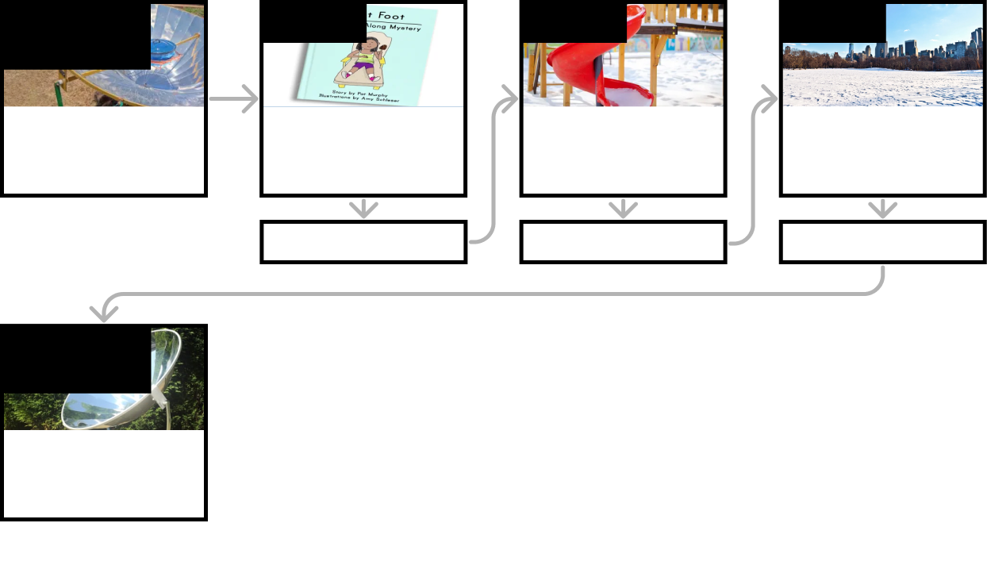
Sunlight & Warmth • Grade K
Anchor Layer Teacher Guide
Unit Summary
In this unit, students make observations to explore how sunlight warms the Earth's surface. The Sun's energy heats up the pavement, keeps us warm, and can even melt marshmallows. Using what they learn, students think about ways that shade and structures can reduce the warming effect of the Sun.
Performance Expectations | Science & Engineering Practices | Disciplinary Core Ideas | Crosscutting Concepts
• K-PS3-1. Make observations to determine the effect of sunlight on Earth’s surface. • K-PS3-2. Use tools and materials to design and build a structure that will reduce the warming effect of sunlight on an area. • K-2-ETS1-1. Ask questions, make observations, and gather information about a situation people want to change to define a simple problem that can be solved through the development of a new or improved object or tool. • K-2-ETS1-3. Analyze data from tests of two objects designed to solve the same problem to compare the strengths and weaknesses of how each performs. | • Analyzing and Interpreting Data • Developing and Using Models • Engaging in Argument from Evidence • Obtaining, Evaluating, and Communicating Information | • LS1.C. Organization for Matter and Energy Flow in Organisms • ESS3.A. Natural Resources • ESS2.E. Biogeology | • Systems and System Models • Patterns
Anchor Phenomenon
Lesson 1
Lesson 2
Lesson 3
Sunlight, Heat, & Earth’s Surface
Solar Sizzle
Sunlight, Heat, & Earth’s Surface
How could you walk barefoot across hot pavement without burning your feet?
Sunlight, Warming, & Engineering
How could you warm up a frozen playground?
Sunlight & Warmth
Why does it get cold in winter?
Anchor Connection
Anchor Connection
Anchor Connection
Performance Task
Sunlight, Heat, & Earth’s Surface
Can you use the Sun to cook food?
‹#›

Slide 3
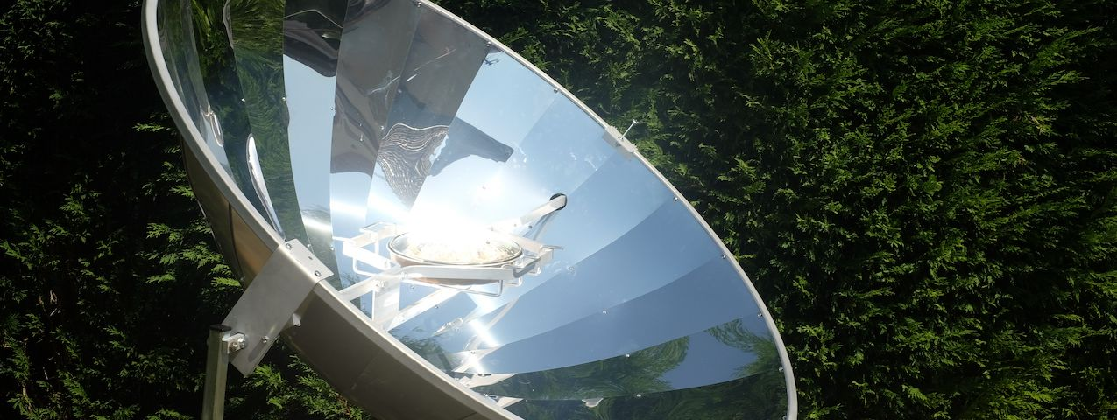
Sunlight & Warmth • Grade K
Anchor Layer Teacher Guide
Anchor Phenomenon Background
How can we use mirrors to cook food?
People all over the world cook a variety of foods in a variety of ways. Most food is heated with fire or electricity, but those aren’t the only ways to heat food.
Sunlight can also be used to cook food. In some of the hottest places on Earth, it can be hot enough outside that simply setting food out in direct sunlight will cook the food. However, most places on Earth simply never get hot enough to directly cook food.
Solar cookers help people to heat food with sunlight, even if they live somewhere that isn’t particularly hot. The solar cookers in this lesson use mirrors. The mirrors take a large amount of sunlight, that is spread out over a large area, and reflect it all onto a small area. By taking sunlight that is spread out and focusing it down onto a small area, it makes that small area much, much hotter.
This is why the mirrored area of the cookers is so big, while the pot is so small. This detail is not mentioned in the Anchor Layer lesson itself, but you may consider adding it in for your students if you decide to do so.
There are other types of solar cookers that use things like lenses or sealed boxes instead of mirrors. Each of them works in a slightly different way, but they all use energy from sunlight to heat things up!
‹#›

Slide 4
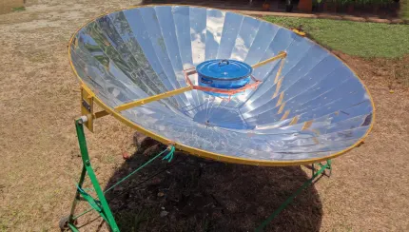
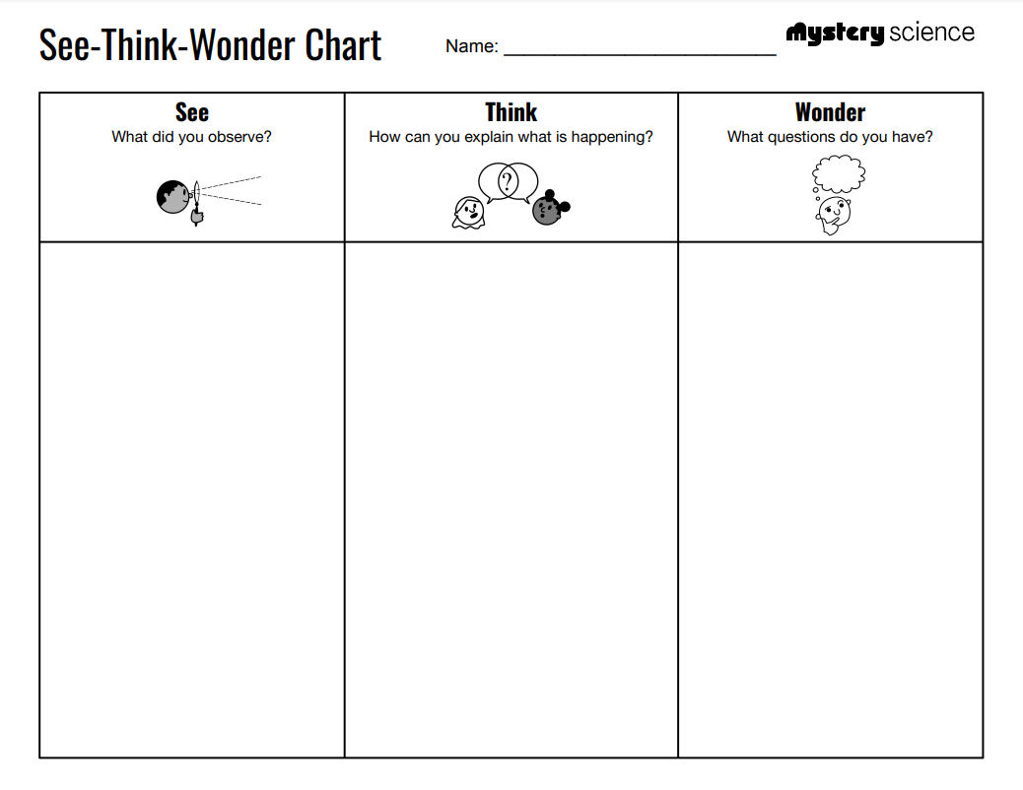
Sunlight & Warmth • Grade K
Anchor Layer Teacher Guide
Anchor Phenomenon: Solar Sizzle
Sunlight, Heat, & Earth’s Surface
Anchor Phenomenon Lesson Overview
Note: This lesson is part of this unit’s Anchor Layer. If you have the Anchor Layer turned on, we recommend teaching all of the lessons in this unit in order.
The anchor phenomenon for this unit is a cooker that can be used to heat food, even though it doesn't have any obvious heat source.
During the introduction, students generate observations and questions about the phenomenon and create a list of possible explanations for the phenomenon. Students will use these initial ideas to track how their understanding grows throughout the unit.
Anchor Phenomenon 15 mins
Guided Inquiry 20 mins
Student Work Samples & Notes
Students will gather clues during and after each lesson in this unit to help them improve their understanding and explanations. It is important to encourage students to recognize that even if they don't know the perfect answer yet, they are going to learn a lot throughout the unit and will have an opportunity to revisit the phenomenon over time.
A bunch of little mirrors
A metal stand
A metal pot
The mirrors look blue and white
I think maybe there is a fire we can’t see
I think maybe it’s hot from the Sun
How does it get hot?
Why do people use it?
How do people make it?
‹#›

Slide 5
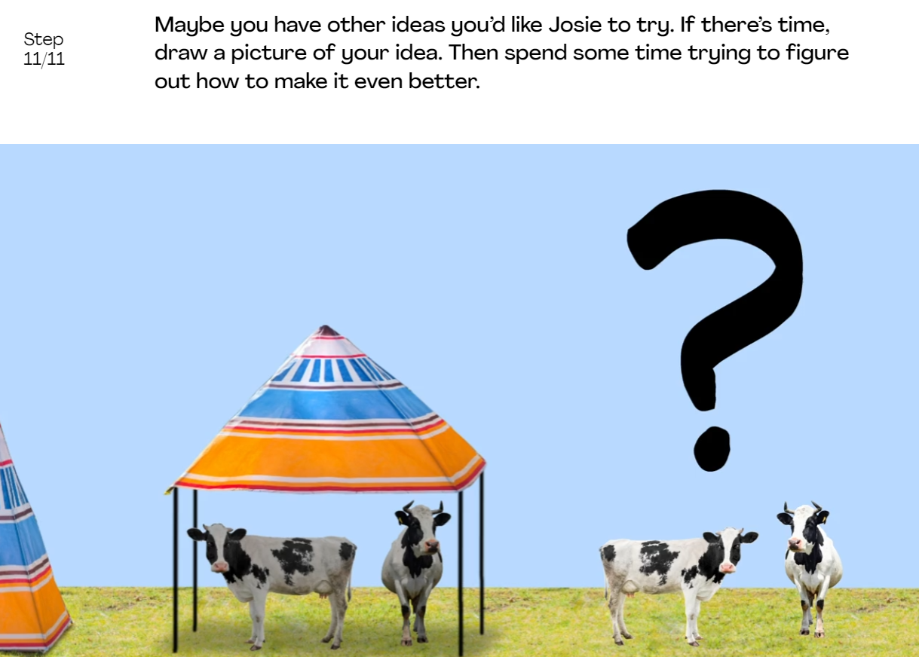
Sunlight & Warmth • Grade K
Anchor Layer Teacher Guide
Lesson 1: How could you walk barefoot across hot pavement without burning your feet?
Sunlight, Heat, & Earth’s Surface (pg 1 of 2)
Overview
In this Read-Along lesson, students listen to an illustrated digital storybook with student participation. If you would prefer to read the book aloud yourself, you can switch to the non-narrated version. In the story, Keya needs to find a way to get from the swimming pool to the ice cream truck without burning her bare feet on the hot pavement.
In the activity, Cool Cows, students notice that cows (like people) use shade to stay cool. Then, they think through how they would design a shade structure for cows.
Anchor Connection on Next Page
Digital Book (W/Audio) 20 mins
Hands-On Activity 25 mins
Anchor Connection 15 mins
Assessment 20 mins
Activity Notes
Students need the printout for the Read-Along.
In this activity, students are presented with a problem: How can Farmer Josie’s cows stay cool in a sunny field with no shade trees? In a series of steps, students consider the problem and come to an understanding of what attributes a solution must have. Then they help Farmer Josie come up with a solution.
At the end, we include the option of having students draw their imagined solutions. If you would like your students to draw their ideas, make sure to have paper and crayons ready!
‹#›

Slide 6
Sunlight & Warmth • Grade K
Anchor Layer Teacher Guide
Lesson 1: How could you walk barefoot across hot pavement without burning your feet?
Sunlight, Heat, & Earth’s Surface (pg 2 of 2)
Anchor Connection
In this lesson, students observed how sunlight causes the surface of the Earth to warm. This only happens during the day because the Sun is only out during the day. This explains why the solar cooker only works during the day.
Students revisit the See-Think-Wonder chart that they worked on during the Anchor Phenomenon. They should understand that sunlight causes objects to warm up. If you gather enough sunlight, you can even use it to cook food.
Connecting Storyline Question
If the heat comes from the Sun, why is the pot hot on the bottom and not the top?
Digital Book (W/Audio) 20 mins
Hands-On Activity 25 mins
Anchor Connection 15 mins
Assessment 20 mins
‹#›

Slide 7
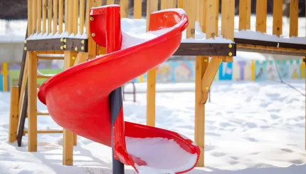
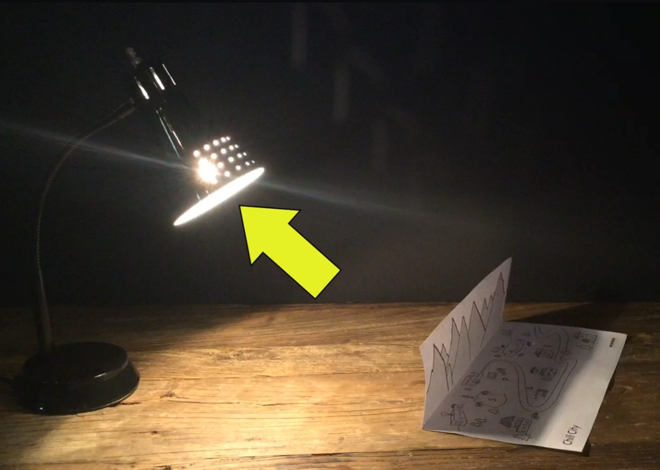
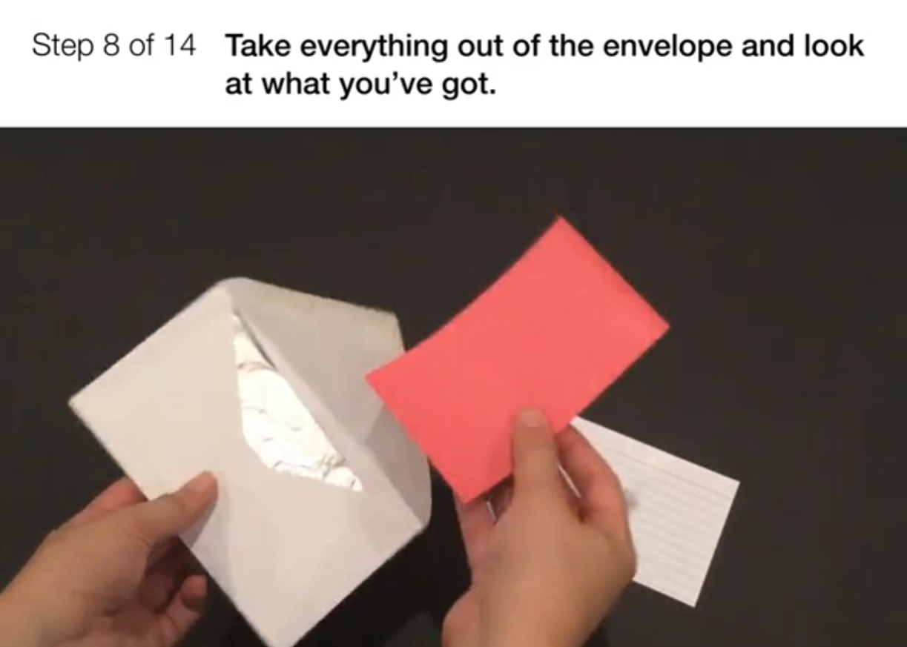
Sunlight & Warmth • Grade K
Anchor Layer Teacher Guide
Lesson 2: How could you warm up a frozen playground?
Sunlight, Warming, & Engineering (pg 1 of 2)
Overview
In this lesson, students think about their experiences with hot and cold weather, and learn about a real city where the sun never shines in winter.
In the activity, Chill City, students experiment with different types of materials (opaque, transparent, and reflective) to figure out how to reflect light. They use this to bring light and warmth to an imaginary paper town.
Anchor Connection on Next Page
Exploration 7 mins
Hands-On Activity 25 mins
Wrap-up 3 mins
Anchor Connection 15 mins
Assessment 20 mins
Activity Notes
In this activity, students fold their worksheet so that part of the paper acts as the mountains, casting a shadow over “Chill City,” the paper town on the worksheet.
For this to work, you need a light source that is NOT overhead. We have used desk lamps, table lamps, or light from a window.
We recommend preparing the materials and assembling envelopes before beginning the lesson. See the lesson page for additional prep notes.
‹#›

Slide 8
Sunlight & Warmth • Grade K
Anchor Layer Teacher Guide
Lesson 2: How could you warm up a frozen playground?
Sunlight, Warming, & Engineering (pg 2 of 2)
Anchor Connection
In this lesson, students observed how sunlight causes the surface of the Earth to warm. This only happens during the day because the Sun is only out during the day. This explains why the solar cooker only works during the day.
Students revisit the See-Think-Wonder chart that they worked on during the Anchor Phenomenon. They should understand that light can change direction by reflecting off of other objects. Solar cookers use mirrors to reflect sunlight onto pots to cook food.
Connecting Storyline Question
What happens if the solar cooker is in the shade?
Exploration 7 mins
Hands-On Activity 25 mins
Wrap-up 3 mins
Anchor Connection 15 mins
Assessment 20 mins
‹#›

Slide 9
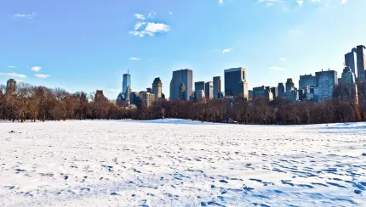
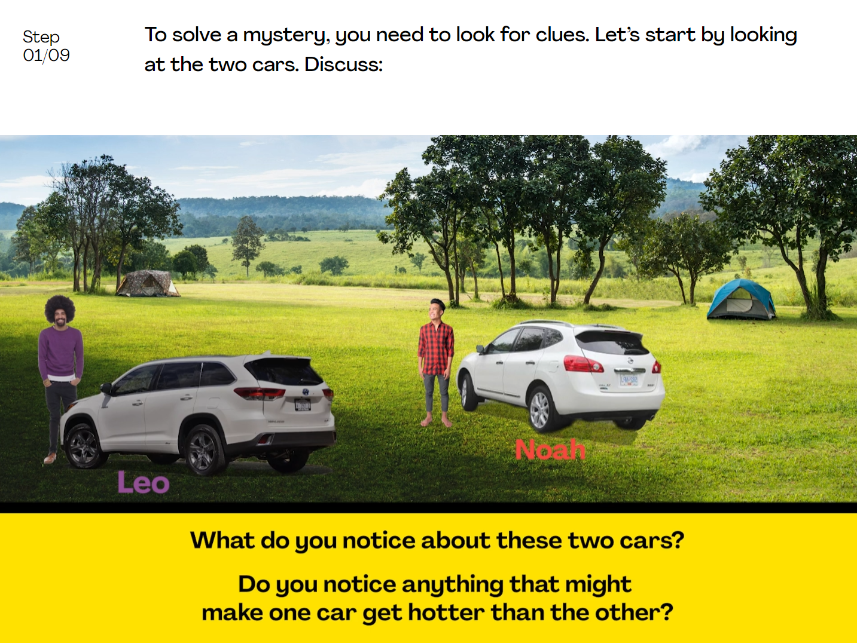
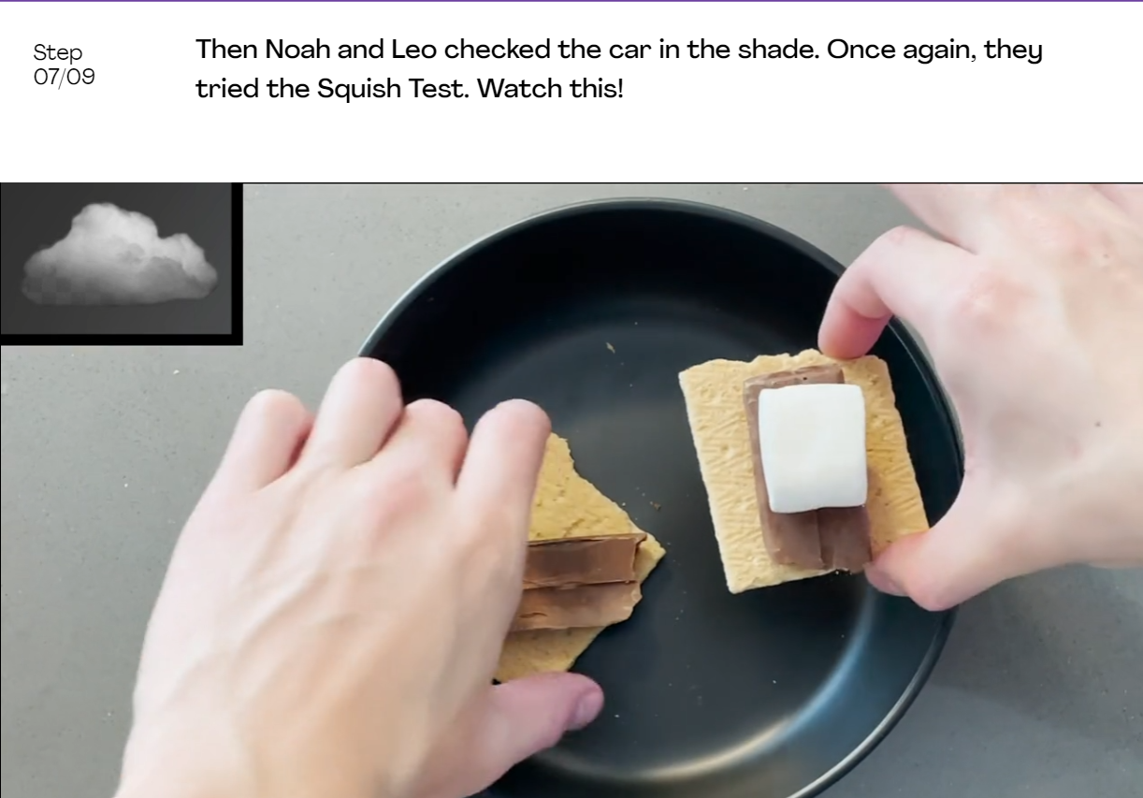
Sunlight & Warmth • Grade K
Anchor Layer Teacher Guide
Lesson 3: Why does it get cold in winter? (pg 1 of 2)
Sunlight & Warmth
Overview
In this lesson, students observe the path of the Sun in the summer and in the winter and realize that light from the Sun keeps the Earth warm.
In the activity, Mysterious Melting Marshmallows, students solve a mystery: what made the marshmallows melt? (The answer, of course, is the heat of the Sun.)
Anchor Connection on Next Page
Exploration 10 mins
Hands-On Activity 30 mins
Anchor Connection 15 mins
Assessment 20 mins
Activity Notes
This activity does not require supplies.
In this activity, students solve a mystery: Why do marshmallows and chocolate melt in one car, but not in another car parked nearby? Be prepared to help your students think and talk about what they notice in the video.
In a series of steps, students consider the problem and think about experiments that will help them solve the mystery. After watching the results of some experiments, students realize that the heat of the Sun melted the marshmallows. (If you want to keep your car cool, park in the shade!)
‹#›

Slide 10
Sunlight & Warmth • Grade K
Anchor Layer Teacher Guide
Lesson 3: Why does it get cold in winter? (pg 2 of 2)
Sunlight & Warmth
Anchor Connection
In this lesson, students observed how sunlight can cause food to heat up. This is the same thing that happens with the cooker they have studied throughout the unit. Sunlight is what causes the food to heat up!
Students revisit the See-Think-Wonder chart that they worked on during the Anchor Phenomenon. They should understand that if objects are in the shade, they won’t get hot. Solar cookers have to be in full Sun to work correctly.
Connecting Storyline Question
Will solar cookers work anywhere?
Exploration 10 mins
Hands-On Activity 30 mins
Anchor Connection 15 mins
Assessment 20 mins
‹#›

Slide 11
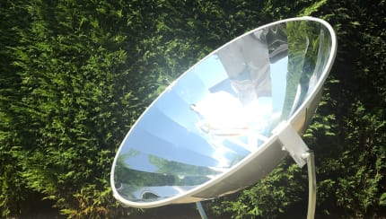
Sunlight & Warmth • Grade K
Anchor Layer Teacher Guide
Performance Task: Can you use the Sun to cook food?
Sunlight, Heat, & Earth’s Surface
Overview
In this performance task, students investigate the effect of sunlight on Earth's surface.
After a brief review of the unit, students gather observations of how shade influences the warming effect of sunlight, and then use those observations to predict where sunlight can be used to cook food.
Unit Review 15 mins
Hands-On Activity 30 mins
Performance Task Notes
Students can work as a class, in small groups, or individually. Each student will need one copy of the Where will the cooker get hot? worksheet.
With your students, begin the lesson. It begins with a brief unit review. Then, move through the activity. The activity includes a step-by-step guide and discussion questions throughout.
Crosscutting Concepts
Cause and Effect: By understanding cause and effect relationships, we can understand how things work. The solar cooker in this Anchor Layer is covered in mirrors. Mirrors cause sunlight to reflect, which has the effect of changing the direction of that light. Sunlight causes a warming effect. These cause and effect relationships explain how the solar cooker is able to warm up food.
‹#›

