Slide 1

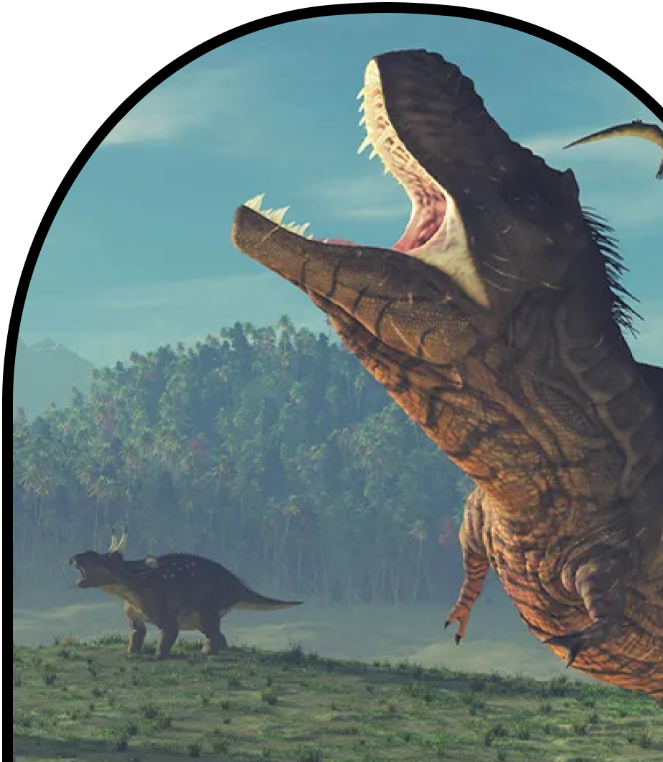
Anchor Layer Teacher Guide
A curriculum companion for Anchor Layer users
Grade 3
Fossils & Changing Environments
Unit Web Link • Pacing Guide • Other Units

Slide 2
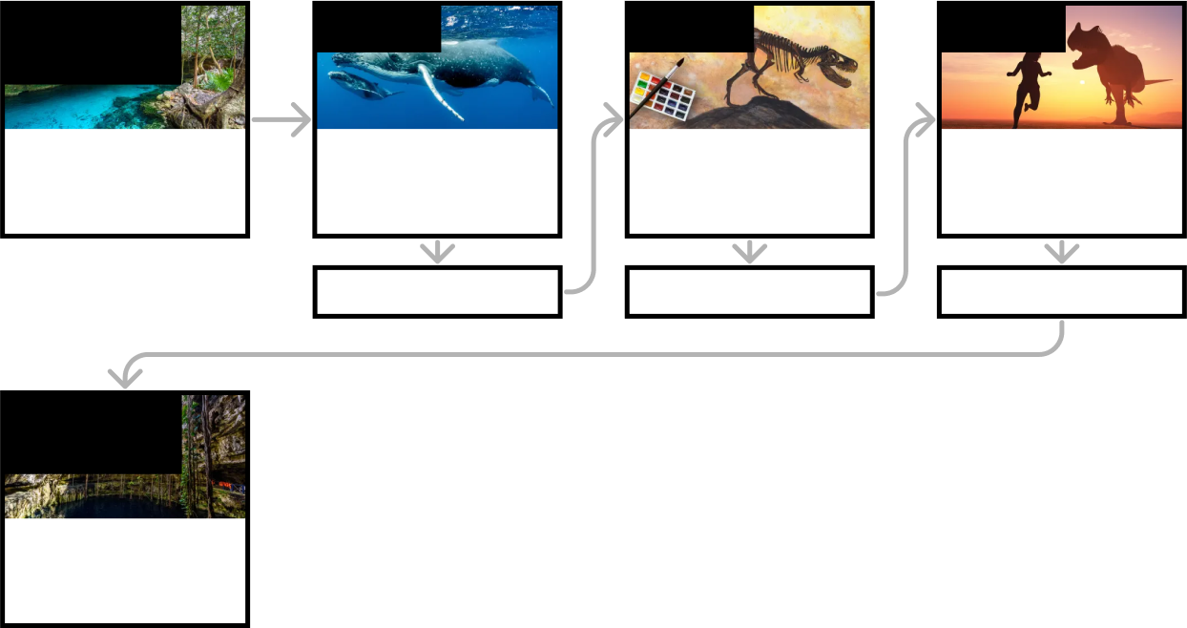
Fossils & Changing Environments • Grade 3
Anchor Layer Teacher Guide
Unit Summary
In this unit, students develop an understanding of how animals and their environments have changed through time. The anchor phenomenon for this unit is a water-filled cave that contains footprints, fossils, and ancient fire pits. Fossils provide a window into the animals and habitats of the past. Analyzing the traits of animals that are alive today and comparing them to fossils, provides evidence of how these ancient organisms and environments of the past may have appeared. The anchor phenomenon for this unit is a water-filled cave that contains footprints, fossils, and ancient fire pits. How can these things be found deep underwater? Assessments
Performance Expectations | Science & Engineering Practices | Disciplinary Core Ideas | Crosscutting Concepts
• 3-LS4-1. Analyze and interpret data from fossils to provide evidence of the organisms and the environments in which they lived long ago. | • Analyzing and Interpreting Data • Engaging in Argument from Evidence • Using Mathematics and Computational Thinking • Planning and Carrying Out Investigations | • LS4.A: Evidence of Common Ancestry and Diversity | • Scale, Proportion, and Quantity • Structure and Function • Patterns
Anchor Phenomenon
Lesson 1
Lesson 2
Lesson 3
Fossil Evidence & Habitat Change
Watery Cave
Habitats, Fossils, & Environments Over Time
Where can you find whales in a desert?
Fossil Evidence & Dinosaurs
How do we know what dinosaurs looked like?
Fossil Evidence, Trace Fossils, & Animal Behavior
Can you outrun a dinosaur?
Anchor Connection
Anchor Connection
Anchor Connection
Performance Task
Fossil Evidence & Habitat Change
Watery Cave
‹#›

Slide 3
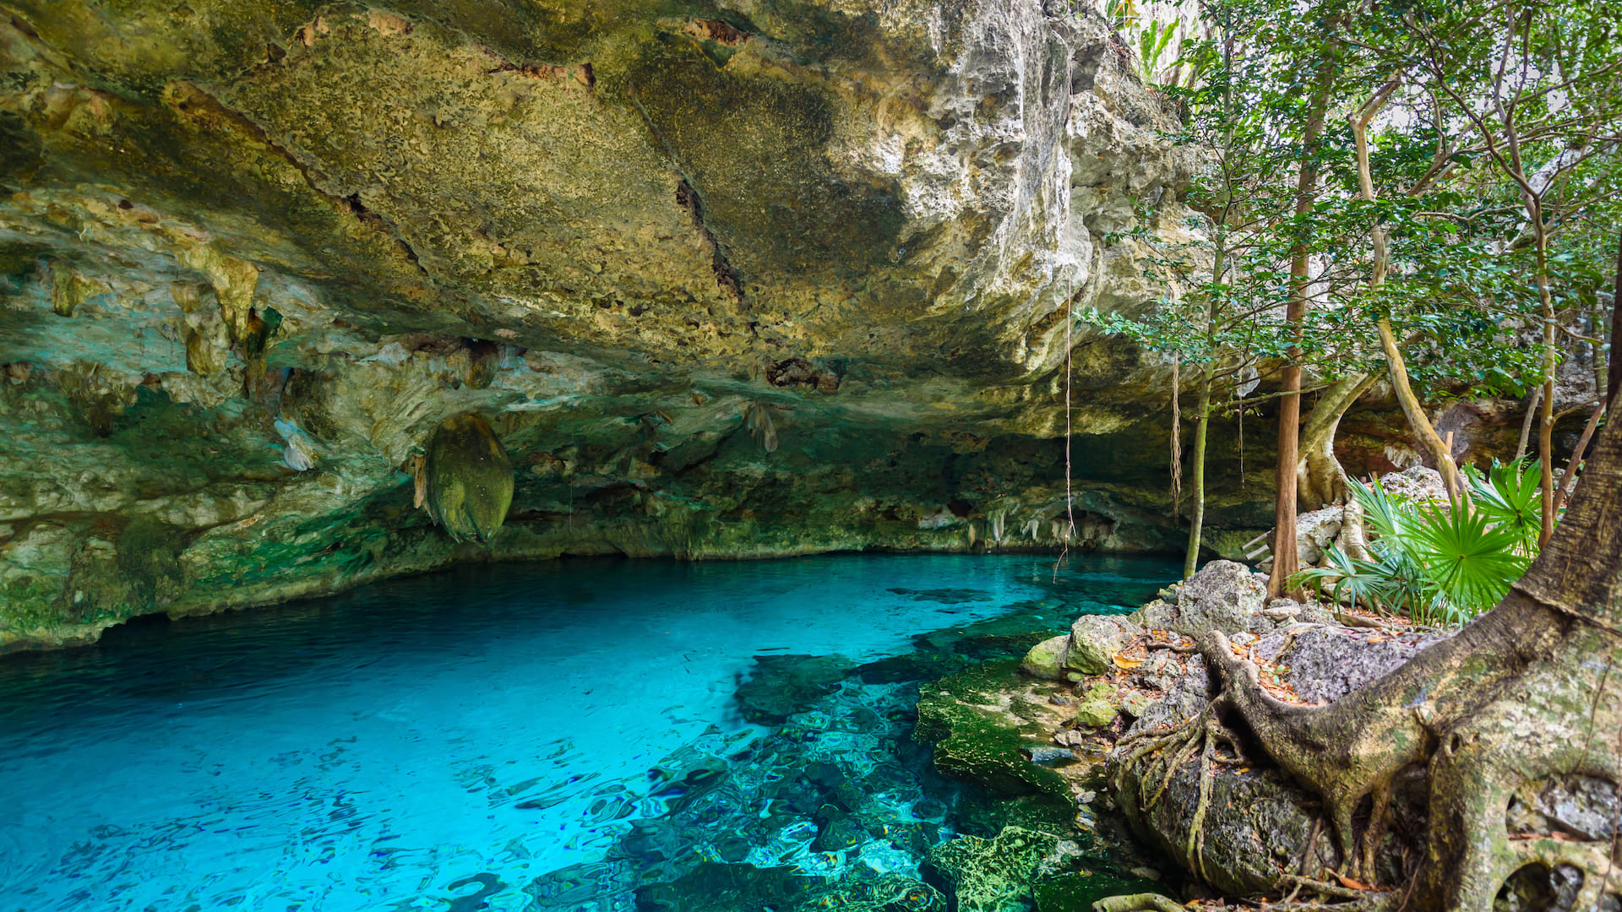
Fossils & Changing Environments • Grade 3
Anchor Layer Teacher Guide
Anchor Phenomenon Background
How did footprints, burned wood, and animal bones end up deep in a watery cave?
There are many different things that have been found all around the world that tell us about the past. Fossils tell us about the existence of dinosaurs. Ancient pottery and ruins tell us about the lives of people from long ago. Clay tablets hold information about early societies.
It would be an amazing experience to discover ancient footprints, fire pits, and bear fossils. However, finding these things underwater in a cave is both amazing and confusing! How can these things end up deep underwater?
The key to understanding this cave is that it wasn’t always filled with water. Thousands of years ago, a huge amount of water was frozen as glaciers. This meant there was less water in the oceans, so ocean levels were lower than we see today. As those glaciers melted, the water poured into the oceans and ocean levels rose. During this process, some caves became filled with water—this is one of those caves. This unit actually focuses on multiple giant cave systems composed of many smaller, connected caves. They are all presented as a single cave in this lesson for simplicity.
The footprints in the cave were likely made by small animals that walked in the cave when the ground was muddy. This likely happened when there was enough water in the cave to make the ground wet but not so much water that these animals couldn’t walk in and out.
Scientists studied the rock underneath the burned wood and found that the rock had been changed and discolored by very high heat. Other rock nearby had not. If the burned wood had simply been washed into the cave, the rock would not be heated up. This is the key piece of evidence that humans carried wood into the caves and set that wood on fire inside of the cave.
The bear skull is similar to modern bears. The bones are too far inside for the bears to have simply swam there; they would have drowned! There are also bear footprints in the cave, providing further evidence that these animals walked into the cave before it flooded.
‹#›

Slide 4

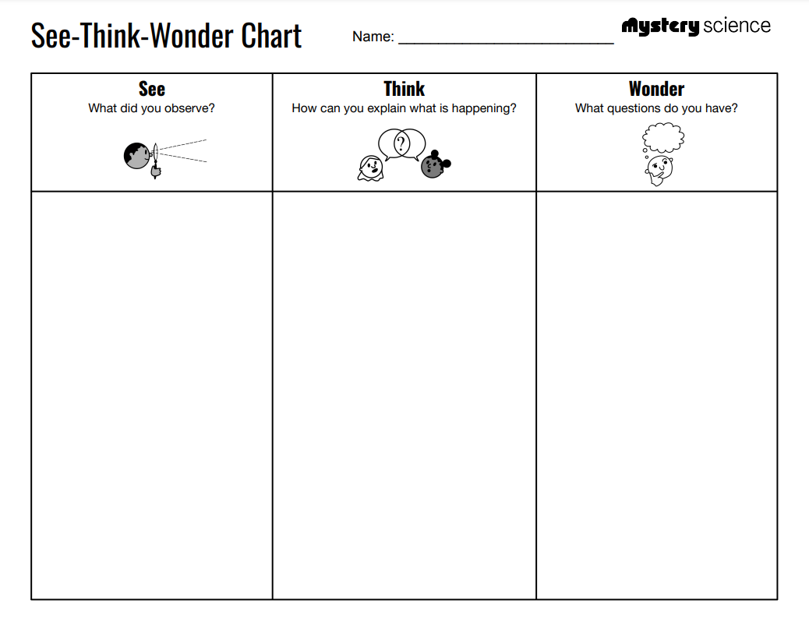
Fossils & Changing Environments • Grade 3
Anchor Layer Teacher Guide
Anchor Phenomenon: Watery Cave
Fossil Evidence & Habitat Change
Anchor Phenomenon Lesson Overview
This lesson is part of this unit’s Anchor Layer. It builds off of the first four lessons in this unit. If you have the Anchor Layer turned on, we recommend teaching the first four lessons of this unit in order. The performance task can be completed at any time after the Lesson 3.
The anchor phenomenon for this unit is a water-filled cave that contains footprints, fossils, and ancient fire pits. How can these things be found deep underwater?
During the introduction, students generate observations and questions about the phenomenon and create an initial conceptual model to explain how and why they think this is happening. Students will use these initial ideas to track how their understanding grows throughout the unit.
Anchor Phenomenon 10 mins
Guided Inquiry 15 mins
Hands-On Activity 15 mins
Wrap-up 2 mins
Student work samples & notes
Students will gather clues during and after each lesson in this unit to help them improve their explanations. It is important to encourage students to recognize that even if they don't know the perfect answer yet, they are going to learn a lot throughout the unit and will have an opportunity to change or add to their first explanation.
The Moon looks gray and white in most pictures
The Moon looks blue and white in one picture
The sky around the Moon is either blue or black
The camera made the Moon blue
The Moon is out during the day
Somebody must have colored the picture
Why is the Moon different colors?
When do you see the Moon?
Does the Moon change colors?
‹#›

Slide 5
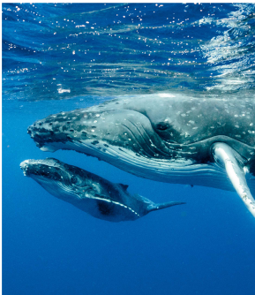
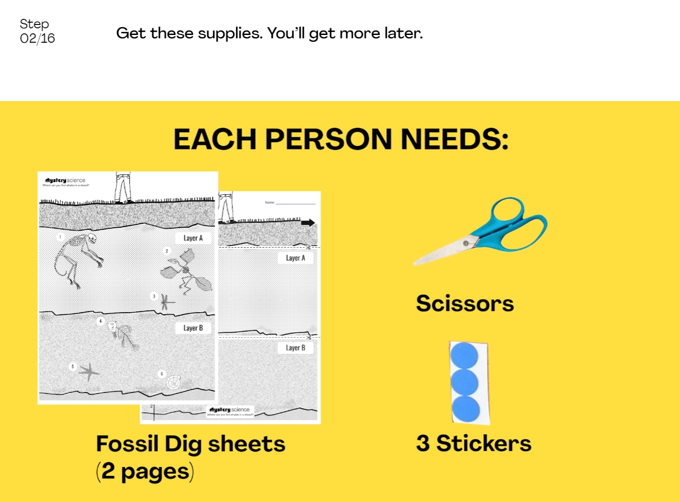
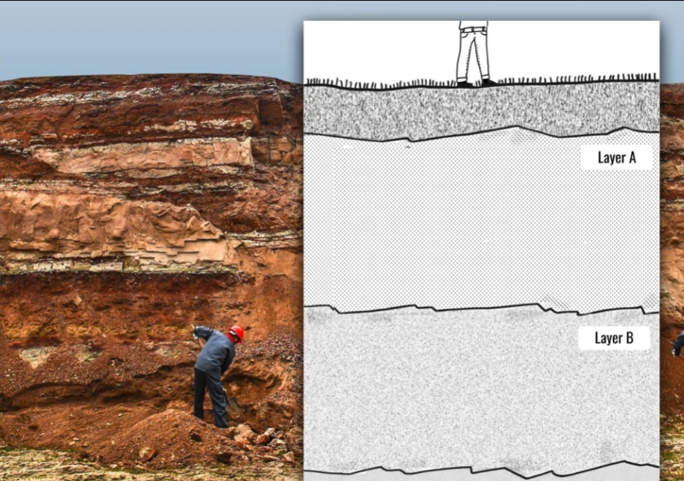
Fossils & Changing Environments • Grade 3
Anchor Layer Teacher Guide
Lesson 1: Where can you find whales in the desert? (pg 1 of 2)
Habitats, Fossils, & Environments Over Time
Overview
In this lesson, students explore the idea that the rock under our feet sometimes contains fossils, and investigate how these fossils reveal changes in habitat through time.
In the activity, Fossil Dig, students use paper to create a model fossil dig. They identify traits of fossils to determine what the habitat looked like when these organisms were alive. Then they use this information to figure out where some Mystery Fossils belong in their fossil dig.
Exploration 10 mins
Hands-On Activity 30 mins
Wrap-Up 10 mins
Anchor Connection 15 mins
Assessment 25 mins
Activity Notes
We suggest students work in pairs. We recommend preparing the mystery fossils before clas. Mystery Fossils will print two per page so you may want to cut each page in half before class. Each student needs a ½ sheet for the activity.
Anchor Connection on Next Page
‹#›

Slide 6
Fossils & Changing Environments • Grade 3
Anchor Layer Teacher Guide
Lesson 1: Where can you find whales in the desert? (pg 2 of 2)
Habitats, Fossils, & Environments Over Time
Anchor Connection
This cave wasn’t always filled with water. The cave we are studying used to be totally dry. Then it filled with water as the oceans became deeper and larger!
Students will revisit the explanation and/or drawing that they initially worked in during the Anchor Phenomenon. They should understand that there is evidence that humans went into the caves long ago and made wood fires. This would only be possible if the cave used to be dry.
If time permits, you can explain that up until ~8,000 years ago, huge amounts of water used to be frozen as glaciers. As this water melted, the oceans became deeper and larger.
Students can update their explanations and/or drawings by adding that the cave wasn’t always filled with water. This might mean that they decide to
completely change some or all of their explanations if they hadn’t considered that the cave used to be dry. Other students may not need to update their explanations at all. Students may also update that there is evidence of wood fires in the cave, and that this is only possible if the cave used to be dry.
Connecting Storyline Question
Did the bones in the cave come from an animal that lived on land or in the water?
Exploration 10 mins
Hands-On Activity 30 mins
Wrap-Up 10 mins
Anchor Connection 15 mins
Assessment 25 mins
‹#›

Slide 7
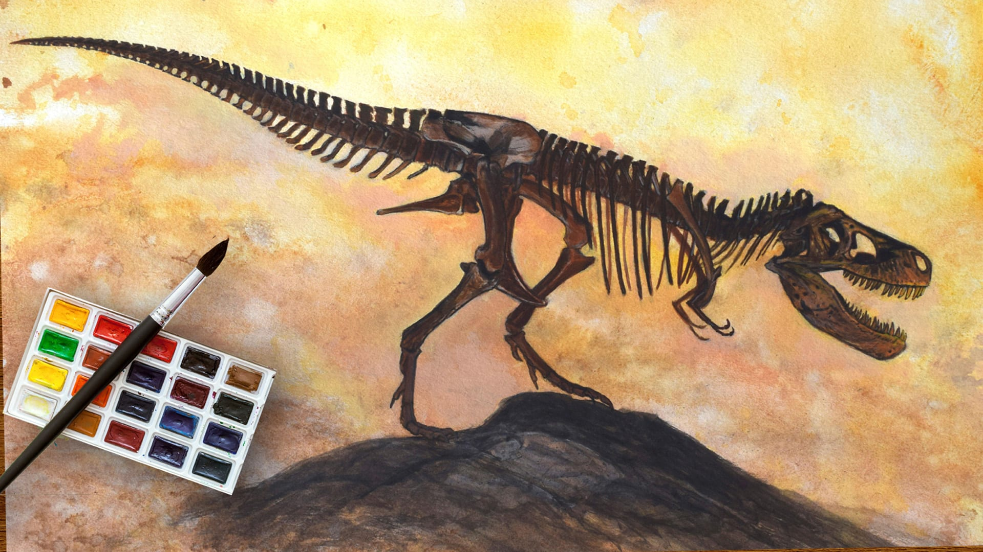
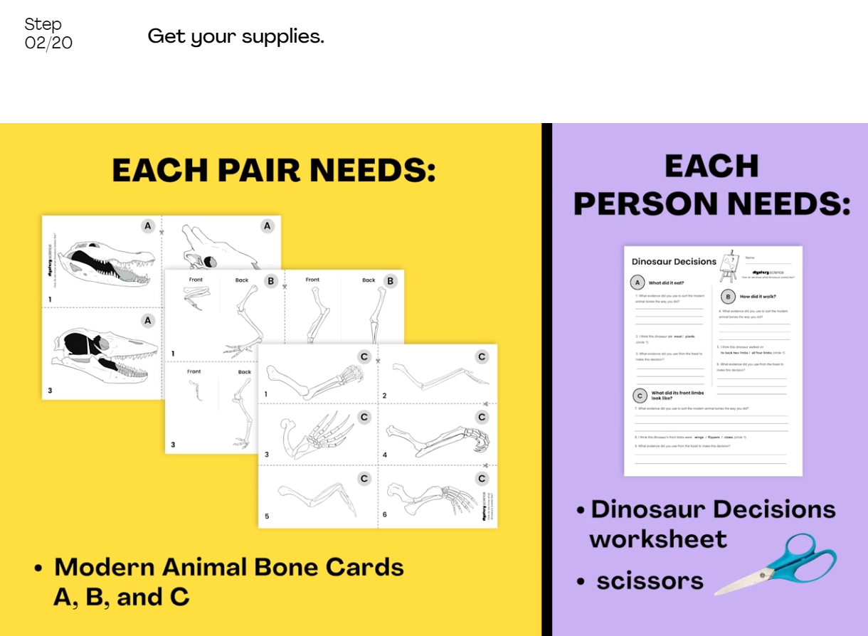
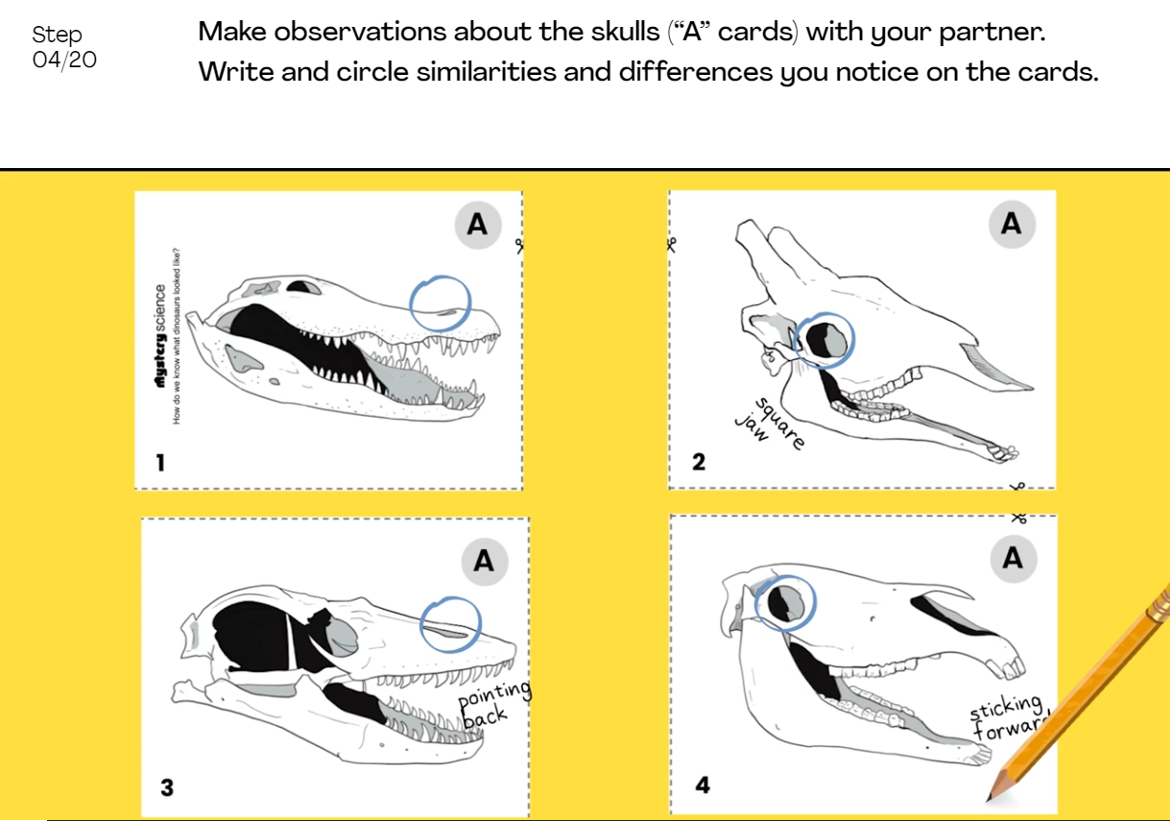
Fossils & Changing Environments • Grade 3
Anchor Layer Teacher Guide
Lesson 2: How do we know what dinosaurs looked like?
Fossil Evidence & Dinosaurs
Lesson Overview
In this lesson, students analyze data from dinosaur fossils in order to provide evidence about the appearance and behavior of those dinosaurs when they were living.
In the activity, Dinosaur Detectives, students compare the traits of dinosaur fossils with the traits of modern animals in order to help a paleoartist draw a dinosaur as accurately as possible.
Exploration 10 mins
Hands-On Activity 30 mins
Wrap-Up 10 mins
Anchor Connection 15 mins
Assessment 25 mins
Activity Notes
We suggest students work in pairs. Extra Evidence Bone Cards will print two per page so you will need to prep these cards by cutting along the thick black line in the middle of the page. Each pair of students will need a 1/2 sheet for the activity. Wait to distribute these cards until Step 16 of the activity.
This activity involves students annotating illustrations of animal bones. Students are asked to write observations and circle patterns on their Animal Bone Cards. Prior to beginning the activity, it may be helpful to have a discussion about how circling similarities and writing notes on diagrams can be a useful way to compare and contrast multiple images.
Anchor Connection on Next Page
‹#›

Slide 8
Fossils & Changing Environments • Grade 3
Anchor Layer Teacher Guide
Lesson 2: How do we know what dinosaurs looked like?
Fossil Evidence & Dinosaurs
Anchor Connection
Skulls can tell us a great deal about the animals that they came from. The skull in the cave has teeth that indicate it could eat both meat and plants. The limb bones are almost an exact match for the bear that is shown in the lesson. Animals like this are very, very unlikely to have lived underwater. Therefore, the bear probably entered the cave when it was still dry.
Students will revisit the explanation and/or drawing that they initially worked in during the Anchor Phenomenon. They should understand that the skull in the cave likely belonged to an animal that ate plants and meat. It also walked on all fours. It likely entered the cave when the cave was dry.
Connecting Storyline Question
Were the shapes in the ground made by animals in the cave?
Exploration 10 mins
Hands-On Activity 30 mins
Wrap-Up 10 mins
Anchor Connection 15 mins
Assessment 25 mins
‹#›

Slide 9
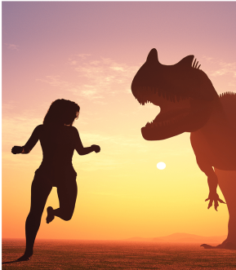
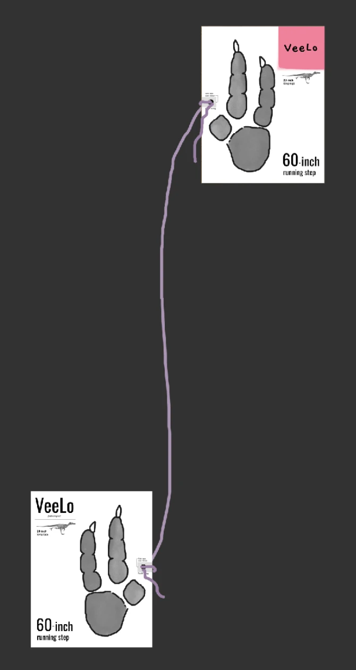
Fossils & Changing Environments • Grade 3
Anchor Layer Teacher Guide
Lesson 3: Can you outrun a dinosaur? (pg 1 of 2)
Fossil Evidence, Trace Fossils, & Animal Behavior
Lesson Overview
In this lesson, students will learn about how fossil dinosaur tracks reveal how quickly a dinosaur was running.
In the activity, Outrunning CeeLo, students figure out if they could have won a race with a dinosaur that was just their size. To determine the winner, students will compare the length of their running steps with the dinosaur’s steps.
Exploration 20 mins
Hands-On Activity 30 mins
Anchor Connection 15 mins
Assessment 25 mins
Activity notes
For the activity, you will need an area where your students can run for eight steps. Ideally the area will be at least 55 feet (about 17 meters) long. That’s about ⅔ the length of a high school basketball court.
Before class, make the Dinosaur Step measuring strings. Find the black circle on the side of each Dinosaur Footprint printout. Fold two layers of clear tape over the spot to reinforce it. Then use your hole punch to punch a hole where marked. This is where you will tie the string.
For more detailed prep instructions as well as common alternatives depending on the space you have for the activity, see our lesson page.
Anchor Connection on Next Page
‹#›

Slide 10
Fossils & Changing Environments • Grade 3
Anchor Layer Teacher Guide
Lesson 3: Can you outrun a dinosaur? (pg 2 of 2)
Fossil Evidence, Trace Fossils, & Animal Behavior
Anchor Connection Main Ideas
The footprints in the cave were likely formed when the ground was soft and wet but not fully underwater.
Students will revisit the explanation and/or drawing that they initially worked in during the Anchor Phenomenon. They should understand that the animals that left footprints in the cave did so when the cave was wet inside but not completely full of water. The smaller footprints likely came from a small animal called a Paca, and the larger prints came from an ancient bear.
Connecting Storyline Question
Is the cave still changing today?
Exploration 20 mins
Hands-On Activity 30 mins
Anchor Connection 15 mins
Assessment 25 mins
‹#›

Slide 11
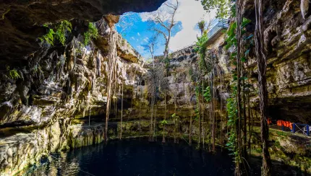
Fossils & Changing Environments • Grade 3
Anchor Layer Teacher Guide
Performance Task: How are you a part of the watery cave's story?
Fossil Evidence & Habitat Change
Lesson Overview
In this performance task, students will apply what they have learned about the watery cave in a writing task. You have the choice of having students write a narrative text, an informational text, or an opinion text.
Review each of the options below, and select the one that best suits your needs. Note that this performance task does not include a typical step-by-step walkthrough, so that teachers have more control over the level of depth they go into with their students.
My Watery Cave Story (Narrative text option)
Watery Cave Tours (Informational text option)
What do you think? (Opinion text option)
Unit Review 10 mins
Hands-On Activity 50 mins
Crosscutting Concepts
Systems:
This is a great opportunity to reinforce the crosscutting concept of systems.
A system is a group of related parts that interact with one another. The water, the cave, and the objects found in the cave all interacted in different ways over time.
Stability and Change:
This is a great opportunity to reinforce the crosscutting concept of stability and change. Some interactions cause systems to change, such as when a dry cave becomes filled with water. Other interactions cause systems to be very stable. The cave has been filled with water for thousands of years, and the objects in the cave are well preserved
Student work notes and Unit Assessment info on following page
‹#›

