Slide 1
How to make informed financial decisions
This session is aimed at Key Stage Three (recommended for Year 7 or 8)

Slide 2
Unit outline
Session 1 | Session 2 | Session 3 | Session 4 | Session 5 | Session 6
How to open a bank account | How to read a bank statement | How to save money | How to use bank cards | How to manage debt | A guide to banking

Slide 3
Having a respectful learning environment
We will listen to each other respectfully
We will avoid making judgements or assumptions about others
We will comment on what has been said, not the person who has said it
We won’t put anyone on the spot and we have the right to pass
We will not share personal stories or ask personal questions
If there is a question that you do not wish to ask aloud, you can write it on a Post-it Note which will be collected throughout the session and answered at the end
Notes:
Teacher delivery
Students should be invited to ask questions and they should be provided with an opportunity to ask questions anonymously. It is useful to have a question box or allocated space on the whiteboard for students to share questions.
It is suggested that students are provided with post-its or slips to write their questions on and as the teacher circulates throughout the lesson these questions can be collected and answers throughout the session or using an allocated ‘question time’ at the end of the session.
Students can be invited to respond to questions asked by their peers. If responses to questions are based on personal preference or opinion, the teacher should be clear to preface any answers with this.

Slide 4
Session 5
How to manage debt

Slide 5
By the end of the session, I will be able to:
Explain the difference between good and bad debt
Describe how borrowing works and different forms of borrowing

Slide 6

What does ‘debt’ mean?
Debt is when someone borrows money and is responsible for paying back the person or company who loaned them that money

Slide 7
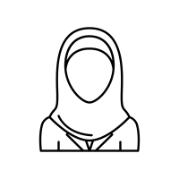
Cultural considerations
Borrowing money is a personal decision which can be based on a number of factors and circumstances.
For some people, borrowing money is not an option as it does not align with their values.
As a matter of faith, a Muslim cannot lend money to, or receive money from someone and expect to benefit. Interest (known as riba) is not allowed.
To make money from money is forbidden – wealth can only be generated through legitimate trade and investment in assets.

Slide 8


How do people pay for expensive items?
How might someone pay for a new jumper? Is this different to how they might pay for a house?
Notes:
Teacher explanation
Targeted questioning
Which costs more?
Which is more important?
How might someone pay for a laptop?
What is the term used when you borrow money to buy a house?

Slide 9


Paying for expensive items
A jumper is an ‘affordable’ expense for many people.
Some people might earn enough money to buy clothing with cash, others may need to save up over a few months or consider using a credit card.
A house is much more expensive and most people have to borrow money from the bank to buy a house. This is called a mortgage.
It takes a long period of time to pay back, usually 20- to 30-years. Some people consider it an investment because they hope that the value of their house will grow overtime: however, this isn’t guaranteed.

Slide 10
The relationship between borrowing and debt
Debt is when someone borrows money and is responsible for paying back the person or company who loaned them that money
Notes:
Teacher explanation
Different amounts are borrowed e.g. a laptop costs less than a house
Some debts might consist of many small purchased and others one high cost item
Some debts are accrued by spending on luxuries and others created due to change in circumstances i.e. job loss

Slide 11


Good debt vs bad debt
Which of these items might be considered ‘good’ debt and which might be considered ‘bad’ debt?

Slide 12
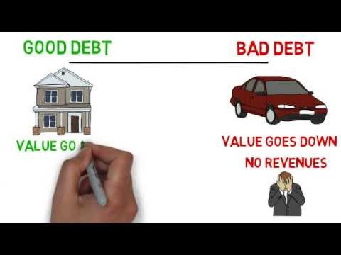
Good debt vs bad debt
Video | https://youtu.be/uv_P9yJY9jQ

Slide 13
Good debt vs bad debt
There is certainly an argument to be made that no debt is good debt.
But borrowing money and taking on debt is the only way many people can afford to purchase important expensive items like a home.
While those kinds of loans are usually justifiable and provide value to the person taking on the debt, there is another end of the spectrum that involves debt that’s taken on for items that decrease in value.
Bad debt involves borrowing money to purchase items that lose value (depreciate) or only for the day to day purchases, like clothing.

Slide 14

Good debt
Education. In general, the more education an individual has, the greater their earning potential.
Education also has a positive correlation with the ability to find employment.
Owning a business. Money that is borrowed to start a business can also come under the heading of good debt.
If the business is successful, then profit will be made.
Owning a home.
This often involves taking out a loan, referred to as mortgage, to buy a home. Owning a home can give people a sense of safety and security.
Resource 1 | Good debt vs bad debt

Slide 15
Bad debt
Cars. While some people may find it impossible to live without a car, borrowing money to buy one isn’t a great idea from a financial perspective. By the time a car leaves the car lot, the vehicle already is worth less than the price is was bought for.
If money needs to be borrowed to buy a car, then look for a loan with low or no interest.
Clothes and consumables. It’s often said that clothes are worth less than half of what consumers pay for them. Of course you need clothes—and food, and furniture, and all kinds of other things—but borrowing to buy them by using a high-interest credit card or other options isn’t a good use of debt.
Resource 1 | Good debt vs bad debt information page
Notes:
For more information on low-interest loans: https://www.investopedia.com/best-auto-loan-rates-4846394

Slide 16
Good debt vs bad debt
Is all ‘bad debt’ bad?
Borrow money
Buy a car
Drive to work
Earn money
Notes:
Teacher explanation
Use prompt question
Is it bad to borrow money to buy a car if you need it to get to work?

Slide 17
Now, we will:
Explain the difference between good and bad debt
Describe how borrowing works and different forms of borrowing

Slide 18

What is interest?

Slide 19
What is interest?
Money that is paid as a reward to savers or as a fee on borrowed money
Interest
Deposits
Customers
Bank
Loans
Interest
Notes:
Teacher explanation
Banks accept money (deposits) from customers and they also make loans (lend money) to customers.
They pay interest on deposits and charge interest loans. That helps them make a profit.

Slide 20

Borrowing and interest rates
All loans will charge an interest rate, which is the cost of borrowing. It is calculated as the percentage paid back on every pound borrowed.
Interest rates will change depending on how the economy is doing. People need to borrow money all the time though, regardless of the state of the economy, so it’s important they try to find the best deal on a loan.
Interest rates on borrowing are often known as APR (annual percentage rate). Importantly, how much someone will have to pay back on the amount borrowed will depend on the APR and how long it will take to pay back the money (loan period).

Slide 21

APR (annual percentage rate)
The APR is the cost of a loan (how much was borrowed plus the interest and any fees) per year.
The higher the APR, the more expensive it is to borrow.
Example:
If Neeta borrows £1,000 from the bank with 33% APR and paid this back over one year, she’d be borrowing £1,330 in total which she’d have to pay back.
This includes £1,000 loan + £330 interest

Slide 22

Questions to ask
In pairs, think of 4 questions you would advise someone to ask before borrowing money
Do you really need to borrow the money?
Will you be able to pay the money back? If so, how long will it take?
Have you considered the interest rates (APR) and how long it takes to pay back the money?
Are there any alternative borrowing options?

Slide 23

Borrowing options
If someone needs to borrow money, what options do they have?
Overdraft | Credit Card | Friends & Family
Payday Loans | Personal Bank Loans | Buy Now Pay Later
Resource 2 | Borrowing options
Notes:
Teacher delivery
Students to discuss initial thoughts in pairs before moving to next slide

Slide 24

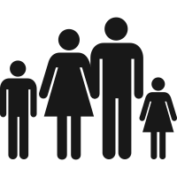
Borrowing options
Overdraft
An overdraft happens when there’s not enough money in an account to complete a transaction, but the bank permits it to go through anyway. It’s basically a short-term loan from the bank that kicks in when the account balance drops to zero.
Credit card
The credit card company pays the shop/business and then sends the bill to the credit card owner (amount borrowed) each month. If the bill is paid in full, no interest is charged. However, if a smaller amount is paid or an amount isn’t paid back on time, interest will be charged on the whole amount, making it more expensive to pay back.
Friends and family
This involves asking people close to you for money. It may be interest free, but for some people it can feel awkward or uncomfortable, especially if someone has difficulty paying back the money.

Slide 25
Borrowing options
Payday loans
Payday loans are short-term, very high-interest (high cost) loans available to consumers, usually for smaller amounts of money. The interest may be up to 1,500% which is huge! This is compared to an average of 22.8% for a credit card, meaning a lot more will be paid back than was borrowed.
Personal bank loans
A fixed amount of money, usually borrowed from the bank. It is repayable by set monthly installments over an agreed period of time. A fixed rate of interest and sometimes extra fees are added to the value of the loan. Repayments are usually made by direct debit from a bank account. If the payments are not made on time, then a fee may be charged.
Buy Now Pay Later
Buy now pay later schemes do exactly what they say – a consumer gets the opportunity to buy something without having to pay for it until a later date. Repayment plans can look different. For example, a person may be required to make repayments every 2 weeks for up to 3 months. If payments are late, fees and interest are normally added.
Which of these three forms of borrowing do you think are lower risk and which do you think are higher risk?
Personal bank loans have the lowest risk and payday loans and Buy Now Pay Later are higher risk. It’s important to read the terms for all loans.
Notes:
Teacher explanation
Further guidance
Personal bank loans - Some lenders give loans with a variable interest rate. This means that the interest rate may go up or down during the term of the loan. If the interest rate goes up, you will need to increase your payments to make sure you pay off the whole loan in time.
Buy Now Pay Later - a company (usually not the company that you’re buying the item from) offers a form of borrowing where no charges or interest are added if the money is paid back on time. However, if the money isn’t paid back on time interest and fees can be added. Also these loans are not yet regulated by the Financial Conduct Authority, meaning the customer isn’t protected if something goes wrong.

Slide 26
Optional activity: What are the risks?

Slide 27
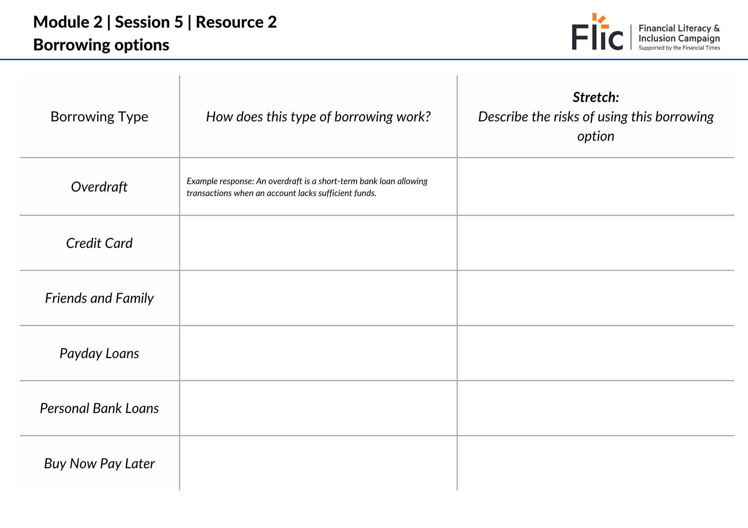
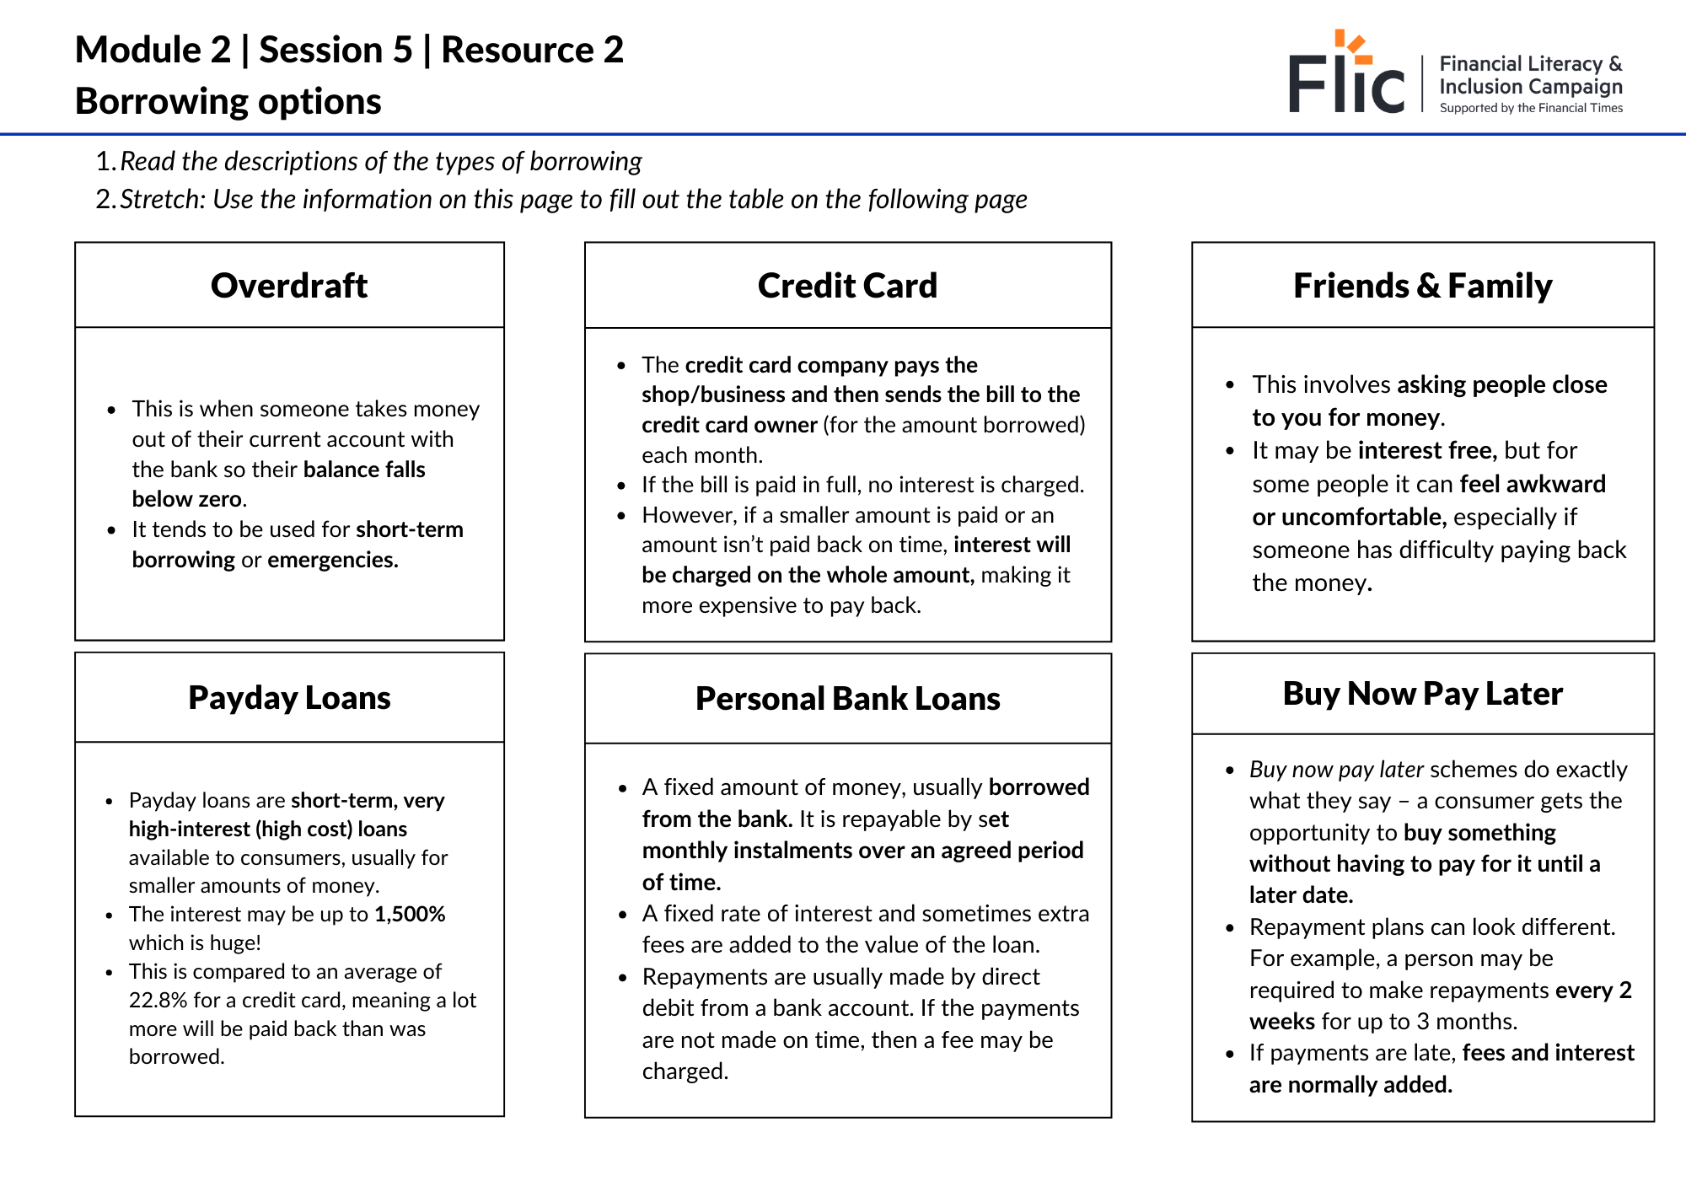
Borrowing options: describe and assess
Describe each type of borrowing
What might the risks of each one be?
Resource 3 | Assess the different borrowing options available

Slide 28
End of optional alternative activity

Slide 29

Borrowing options
Sam has just got a new job. It takes him two hours to get to work by public transport, but he could get there in less than half the time if he drives there. Sam thinks it’s time to buy a car.
What borrowing option should he consider and why?
Payday loan
Personal bank loan
Buy Now
Pay Later

Slide 30
Borrowing options
Sam has just got a new job. It takes him two hours to get to work by public transport, but he could get there in less than half the time if he drives there. Sam thinks it’s time to buy a car.
What borrowing option should he consider and why?
Payday loan
Personal bank loan
Buy Now
Pay Later
Notes:
Teacher delivery
Optional use of mini whiteboards for whole class assessment for learning
Teacher explanation
Prompt question
Before buying the car, are there any other financial factors that Sam should consider? E.g. fuel costs, car maintenance, insurance
What makes a personal loan the best option
Personal bank loans - benefits from a fixed interest rate
What are some of the problems associated with these borrowing options?
Payday loan - higher interest rates, not used to borrow large amount of money
Buy Now Pay Later - not used to borrow large amount of money

Slide 31
Borrowing options
Sam has just got a new job. It takes him two hours to get to work by public transport, but he could get there in less than half the time if he drives there. Sam thinks it’s time to buy a car.
Sam decides to use a personal bank loan
Using full sentences, respond to the following questions
Before buying the car, are there any other financial factors that Sam should consider?
What makes a personal loan the best option?
What are some of the problems associated with these borrowing options?

Slide 32
Borrowing options
Using full sentences, respond to the following questions
Before buying the car, are there any other financial factors that Sam should consider?
  Can he afford the costs associated with car ownership: insurance, road tax, fuel, parking permits
What makes a personal loan the best option? He can plan regular repayments at an agreed interest rate
  Fixed amount of money: only borrowing what he needs to buy the car
What are some of the problems associated with these borrowing options?
  If he misses a payment, he will incur extra fees His credit rating could be impacted

Slide 33


Borrowing and credit score
All borrowing options (except for student finance) affect people’s credit score.
A credit score is a number that is a quick summary of a person’s credit (borrowing) history.
It affects the ability to borrow money at a later date e.g. to take out a mortgage to buy a home.

Slide 34
Optional additional activity

Slide 35
Borrowing options | Buy Now Pay Later
Neeta has recently graduated and needs to buy clothes for her new job. She does some online shopping and the total cost is higher than she expected.
Neeta chose to pay for her clothes using Buy Now Pay Later. What are some of the potential problems associated with this borrowing option?
Notes:
Teacher explanation
Further guidance
Buy Now Pay Later - a company (usually not the company that you’re buying the item from) offers a form of borrowing where no charges or interest are added if the money is paid back on time. However, if the money isn’t paid back on time interest and fees can be added. Also these loans are not yet regulated by the Financial Conduct Authority, meaning the customer isn’t protected if something goes wrong.
Prompt questions
What could Neeta have done instead? - think back to session 3: ways to save when spending
How can Neeta be sure that she can afford the repayments?
What are the possible short and long term consequences if Neeta is unable to pay

Slide 36

Over to you
What information would you add to the shopping website that Neeta is using so that she understands the possible consequences of using Buy Now Pay Later?
Write 4-6 bullet points of ‘things you should know before borrowing money’.
Stretch: How likely is it that websites would include this information?

Slide 37
End of optional additional activity

Slide 38
By the end of the session, I will be able to:
Explain the difference between good and bad debt
Describe how borrowing works and different forms of borrowing

Slide 39
Borrowing plans
Before you borrow any money, you should always have a plan to pay it back
For many borrowing options, repayments on the amount borrowed automatically get taken from your current account
How is a borrowing plan connected to a personal budget?
Notes:
Teacher explanation
Repayments should feature as an outgoing/expense line in a personal budget

Slide 40
Any questions?
?

Slide 41

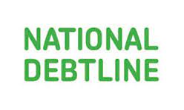
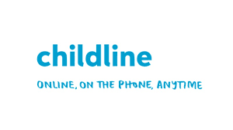
Services available for people who have concerns about their personal finances
Citizens Advice – Debt and Money –
Links to advice on a number of topics, including financial difficulties, cost of living and communicating with creditors.
National Debtline – Debt and Money
A debt advice charity run by the Money Advice Trust, offering a free and confidential debt advice service.
Childline Helpline
0800 1111
Talk to an adult about anything.
Contact via phone / web.
At school, you can speak with an adult you trust.
This could be your form tutor, head of year or the school’s safeguarding officer.

Slide 42
Links to learn more!
Articles to extend learning
Please visit the FT FLIC Learning Hub for further resources
Household Debt: Key Economic Indicators - House of Commons Library (2025)
Money Statistics May 2025
My Pocket Skill: Save now, spend later

