Slide 1
TERPENOIDS
OKPAKO, ESEOGHENE

Slide 2
What are Terpenoids?
Terpenoids are defined as hydrocarbons of plant origin having the general formula (C₅H₈)n; where n is the number of linked isoprene units
Isoprene units are 5 carbon which could be IPP or DMAPP arranged in a head to tail fashion ( isoprene rule) to give terpenoids
They are regarded as derivatives of polymers of isoprene
i.e when terpenes are modified chemically such as by oxidation or rearrangement of carbon skeleton → TERPENOIDS
They represent the essence or active constituent of plants known as essential oils

Slide 3
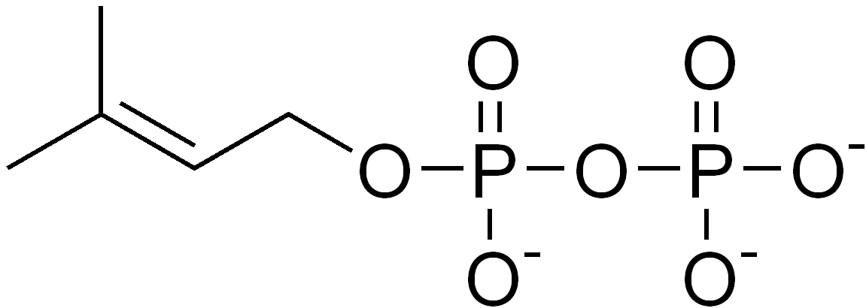

Isoprene units
DMAPP
IPP

Slide 4
Isoprene Rule
It states two or more isoprene units are joined in a head to tail fashion
It can only be a guiding principle but not a fixed rule
Carotenoids are joined in a tail to tail at their central and there are some terpenoids whose carbon content is not a multiple of five

Slide 5
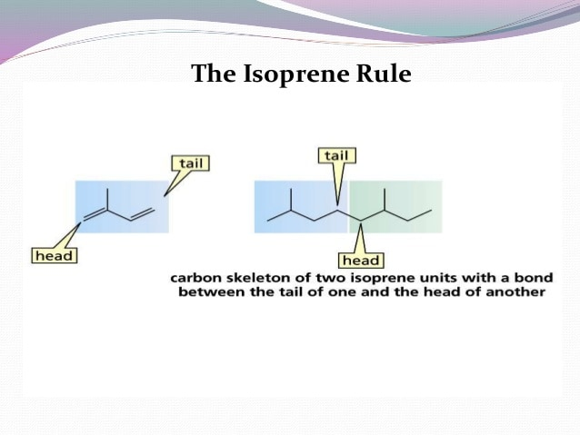

Slide 6
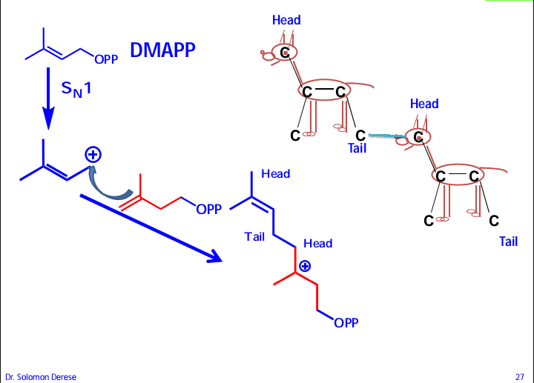

Slide 7
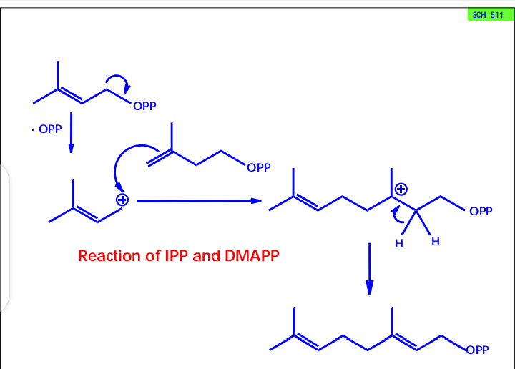

Slide 8
Occurrence
They occur in fruits, flowers, leaves, stem barks and roots of nearly all the plants that have a pleasant smell
Animals
Microbes
Insect
Plant pathogens
Endophytes
marine
Citral --- lemon
Geraniol – rose
Santalal --- sandal wood
Zinziberene ----- ginger
Cineole ----- eucalyptus
Pinene ----- turpentine
Camphor ----- camphor
Linalool ----- jasmine
Terpineol ----cardamon

Slide 9
Physical Properties of Terpenoids
Odorous
Volatile (monoterpenes and sesquiterpenes) at room temperature (triterpenes & diterpenes are not steam volatile)
Soluble in organic solvent and usually insoluble in water
They represent the essence or active constituent of plants known as essential oils
Lighter than water
Have high refractive index
Are optically active

Slide 10
Chemical Properties
They are unsaturated
They undergo addition reaction with hydrogen, halogen, halogen acids to form addition products
They undergo polymerization and dehydrogenation in the ring
On thermal decomposition terpenoid gives terpene as one of its products
Terpenoids are modified terpenes where in methyl groups have been moved or removed or oxygen atoms added
Oxidised by nearly all oxidising agents

Slide 11
Extraction of terpenes
Expression
Hydrodistillation
Extraction by means of volatile solvents
Enfluerage
Fractional distillation
Hot maceration process

Slide 12
Biosynthesis of terpenoids
The isoprene units are provided from dimethylallyl pyrophosphate (DMAPP) and isopentenyl pyrophosphate (IPP), which exist in equilibrium.
DMAPP and IPP are structural isomers to each other.
This pair of building blocks are produced by two distinct metabolic pathways:
the mevalonate pathway and
the non-mevalonate pathway.
These two pathways are mutually exclusive in most organisms, except for some bacteria and land plants

Slide 13
Examples of pathways for organisms
Organism Pathways
Bacteria MVA or MEP
Archaea MVA
Green Algae MEP
Plants MVA and MEP
Animals MVA
Fungi MVA

Slide 14
The cytosol localized Mevalonate pathway provides C5 units for sesquiterpene and triterpene biosynthesis.
The methylerythritol phosphate (MEP or non-mevalonate) pathway, localized in the plastids, is thought to provide IPP and dimethylallyl diphosphate for hemiterpene, monoterpene, and diterpene and tetraterpene biosynthesis.
The non-mevalonate pathway or the 2-C-methyl-D-erythritol 4-phosphate (MEP) pathway starts with pyruvate and glyceraldehyde 3-phosphate (G3P) as the carbon source.
The mevalonate pathway begins with acetyl CoA as the carbon source.

Slide 15
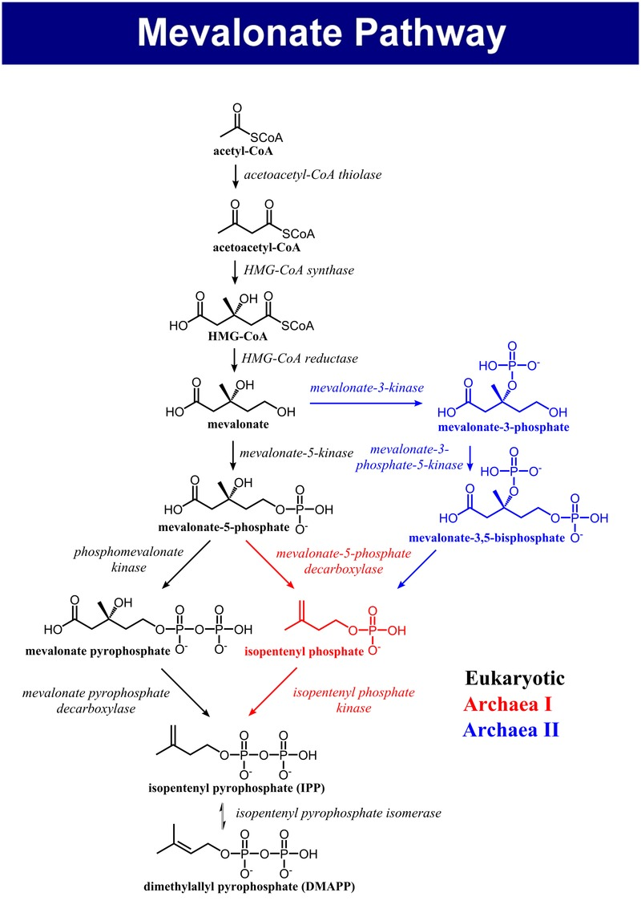

Slide 16
Mevalonate pathway
Three molecules of acetyl-coenzyme A are used to form mevalonic acid.
Two molecules combine initially in a Claisen condensation to give acetoacetyl-CoA, and a third is incorporated via a stereospecific aldol addition giving the branched-chain ester β-Hydroxy-β-MethylGlutaryl-CoA (HMG-CoA).
The mevalonate pathway does not use malonyl derivatives and it thus diverges from the acetate pathway at the very first step.

Slide 17
In the second step, it should be noted that, on purely chemical grounds, acetoacetyl-CoA is the more acidic substrate, and might be expected to act as the nucleophile rather than the third acetyl-CoA molecule.
The enzyme thus achieves what is a less favourable reaction.
The conversion of HMG CoA into (3R)- MVA involves a two-step reduction of the thioester group to a primary alcohol.
The six-carbon compound MVA is transformed into the five-carbon phosphorylated isoprene units in a series of reactions, beginning with phosphorylation of the primary alcohol group.
Decarboxylation / dehydration then give IPP.

Slide 18
IPP is isomerized to the other isoprene unit, DMAPP, by an isomerase enzyme which stereospecifically removes the pro-R proton (HR) from C-2, and incorporates a proton from water on to C-4.
Whilst the isomerization is reversible, the equilibrium lies heavily on the side of DMAPP.

Slide 19
Non mevelonate pathway
This pathway is called the non-mevalonate route or alternatively, the 1-deoxy-d-xylulose-5-phosphate (DOXP) or 2C-methyl-d-erythritol-4-phosphate (MEP) pathway
This pathway occurs in plant chloroplasts, algae, cyanobacteria, eubacteria, and apicomplexan parasites
The non-mevalonate pathway starts with condensation of pyruvate and glyceraldehyde 3-phosphate to produce DOXP, catalyzed by 1-deoxy-d-xylulose-5-phosphate synthase (DXS) using thiamine pyrophosphate as cofactor
DOXP is subsequently reduced into MEP by DOXP reductoisomerase (IspC).

Slide 20
DOXP is subsequently reduced into MEP by DOXP reductase (dxr).
MEP is converted into 4-diphosphocytidyl-2-C-methylD-erythritol (CDPME) by CDPME synthase (ispD).
CDPME is subsequently transformed into 1-hydroxy-2-methyl-2-(E)-butenyl-4-diphosphate (HMBPP) through two intermediates, 4-(cytidine 5′-diphospho)-2-C-methyl-D-erythritol (CDPMEP) and 2-C-methyl-D-erythritol2,4-cyclodiphosphate (MEC) by CDPME kinase (ispE), MEC synthase (ispF) and HMBPP synthase (ispG), respectively.
Finally, HMBPP reductase catalyzes HMBPP into a 5-6:1 ratio of IPP and DMAPP,
while IPP isomerase (idi) inter-converts IPP and DMAPP to adjust the ratio according to the cellular requirements

Slide 21
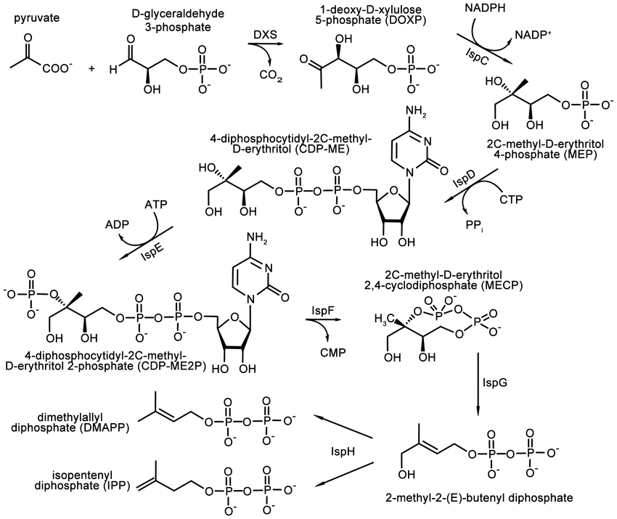

Slide 22
Condensation/Classification of isoprene units
IPP + DMAPP → geranylpyrophosphate GPP
GPP + IPP/DMAPP → farnesylpyrophosphate FPP
GPP+ GPP → geranylgeranyl pyrophosphate
GPP + FPP → geranylfarnesylpyrophosphate
FPP+IPP/DMAPP → GPP/ Diterpene
FPP+FPP → farnesylfarnesylpyrophosphate/triterpene

Slide 23
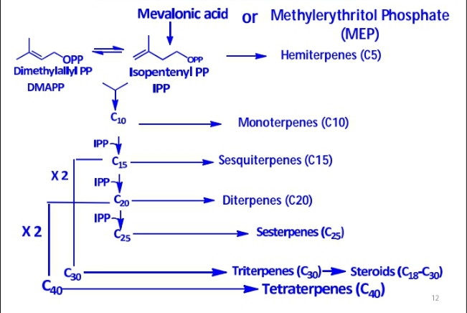

Slide 24
Classification of terpenes
Class Number of carbon atoms
Hemiterpenes 5
Monoterpene 10
Sesquiterpene 15
Diterpene 20
Sesterpene 25
Triterpene 30
Sesquaterpene 35
Tetraterpene 40

Slide 25
Each class can be further sub-divided into subclasses according to the number of rings present in the structure.
Acyclic
Monocyclic
Bicyclic
Tricyclic
Tetracyclic

Slide 26
Hemiterpenes
consist of a single isoprene unit. Isoprene itself is the only hemiterpene, but oxygen-containing derivatives such as prenol and isovaleric acid are hemiterpenoids.

Slide 27
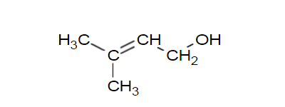
Prenol
Prenol occurs naturally in citrus fruits, cranberry, bilberry, currants, grapes, raspberry, blackberry, tomato, white bread, hop oil, coffee, arctic bramble, cloudberry and passion fruit.
Prenol is a building block of isoprenoid alcohol

Slide 28
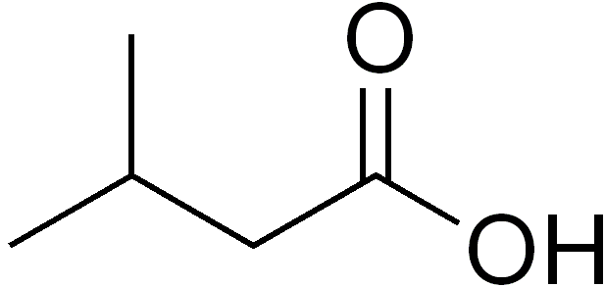
Isovaleric acid
classified as a short-chain fatty acid.
it has an unpleasant odor.
The compound occurs naturally and can be found in many foods, such as cheese, soy milk, and apple juice.
are widely used in perfumery

Slide 29
Monoterpenes
consist of two isoprene units and have the molecular formula C₁₀H₁₆.
They can be classified as thus:
Acyclic e.g myrcene (present in hops), linalool (present in lavender),
Monocyclic e.g limonene (present in citrus fruits) menthol
Bicyclic e.g camphor, eucalyptus
Other Examples of monoterpenes and monoterpenoids include geraniol, terpineol (present in lilacs),
Iridoids derive from monoterpenes.
Examples of iridoids include aucubin and catalpol.

Slide 30
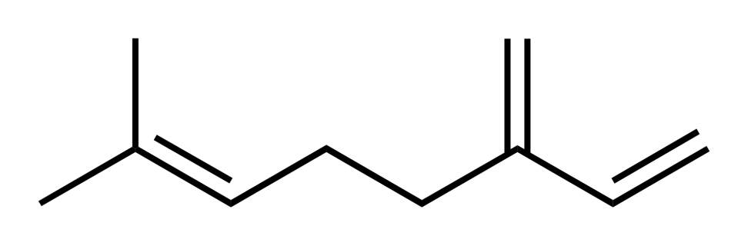
Myrcene
extracted from any number of plants, such as verbena or wild thyme, the leaves of which contain up to 40% by weight of myrcene
Other plants include: cannabis, Houttuynia, lemon grass, mango, Myrcia, West Indian bay tree, and cardamom.
used in the perfumery industry
contributes a peppery and balsam aroma in beer.
As of October 2018, the U.S. FDA withdrew authorization for the use of myrcene as a synthetic flavoring substance for use in food

Slide 31
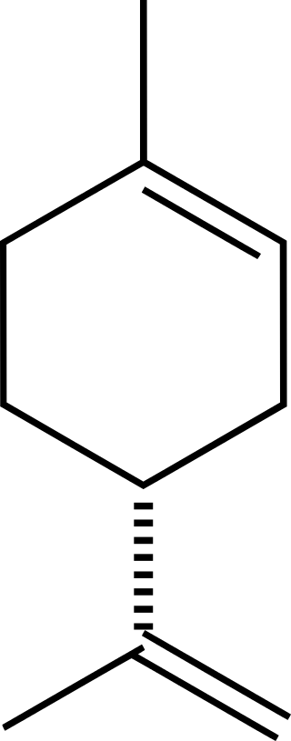
Limonene
is the majorcomponent in the oil of citrus fruit peels.
used in chemical synthesis as a precursor to carvone
formed from geranyl pyrophosphate
is common as a dietary supplement and as a fragrance ingredient for cosmetics products

Slide 32
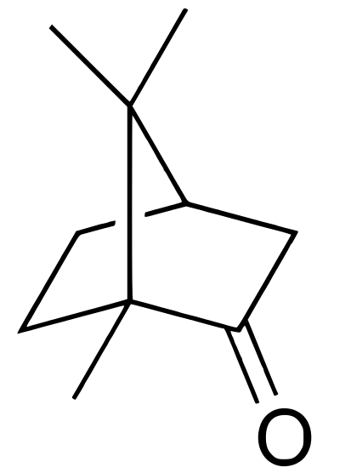
Camphor
found in the wood of the camphor laurel (Cinnamomum camphora),
commonly applied as a topical medication as a skin cream or ointment to relieve itching from insect bites, minor skin irritation, or joint pain.
The action on nerve endings also induces a slight local analgesia.
typically by steam inhalation, to inhibit coughing and relieve upper airway congestion due to the common cold

Slide 33
Iridoids
monoterpenoids in the general form of cyclopentanopyran, found in a wide variety of plants and some animals
Iridoids are typically found in plants as glycosides, most often bound to glucose
Structurally, they are bicyclic cis-fused cyclopentane-pyrans.
Cleavage of a bond in the cyclopentane ring gives rise to a subclass known as secoiridoids, such as oleuropein and amarogentin.
Aucubin and catalpol are two of the most common iridoids in the plant kingdom.
Iridoids are prevalent in the plant subclass Asteridae, such as Ericaceae, Loganiaceae, Gentianaceae, Rubiaceae, Verbenaceae, Lamiaceae, Oleaceae, Plantaginaceae, Scrophulariaceae, Valerianaceae, and Menyanthaceae
Iridoids can consist of ten, nine, or rarely eight carbons in which C11 is more frequently missing than C10.

Slide 34
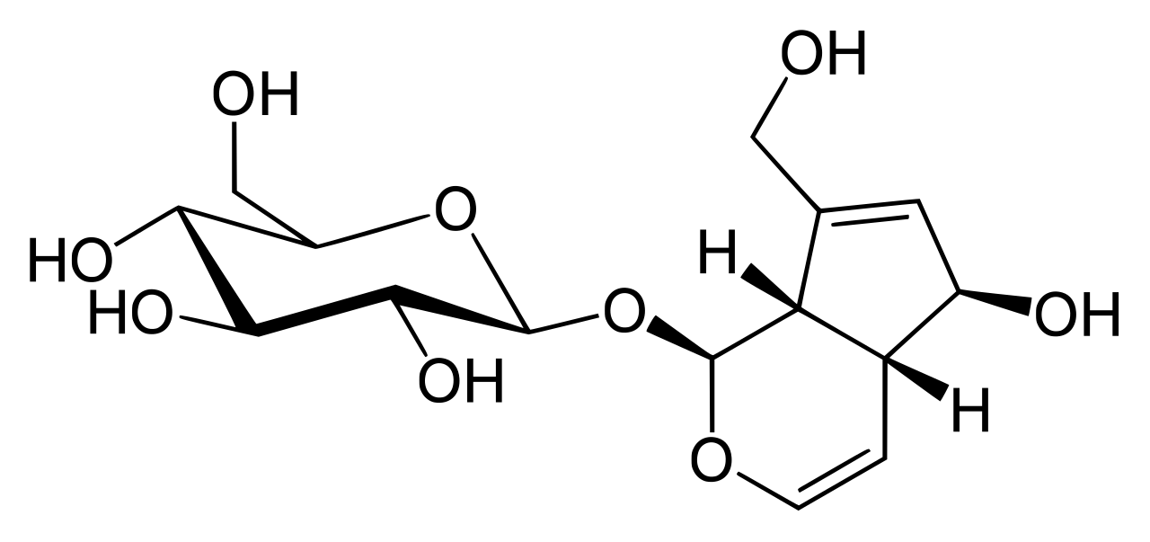
Aucubin
Aucubin, as other iridoids, is found in asterids such as Aucuba japonica (Garryaceae) etc
These plants are used in traditional Chinese and folk medicine
Aucubin was found to protect against liver damage induced by carbon tetrachloride or alpha-amanitin in mice and rats when 80 mg/kg was dosed intraperitoneally
Aucubin has 10 carbons with the C11 carbon missing

Slide 35
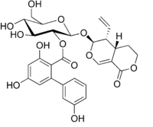
Amarogentin
is a chemical compound found in gentian (Gentiana lutea) or in Swertia chirata
Gentian root is used as a herbal bitter in the treatment of digestive disorders and is an ingredient of many proprietary medicines
is one of the most bitter natural compounds known and is used as a scientific basis for measuring bitterness.
shows an antileishmanial activity

Slide 36
Sesquiterpenes
consist of three isoprene units and have the molecular formula C₁₅H₂₄.
Examples of sesquiterpenes and sesquiterpenoids include humulene, farnesenes, farnesol, geosmin.
(The sesqui- prefix means one and a half.)

Slide 37

Farnesol
Farnesol is present in many essential oils such as citronella, neroli, cyclamen, lemon grass, tuberose, rose, musk, balsam, and tolu
It is used in perfumery to emphasize the odors of sweet, floral perfumes.
It enhances perfume scent by acting as a co-solvent that regulates the volatility of the odorants.
It is especially used in lilac perfumes.
Farnesol is a natural pesticide for mites and is a pheromone for several other insects.

Slide 38
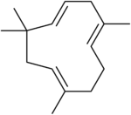
Humulene
derived from farnesyl diphosphate (FPP)
It was first found in the essential oils of Humulus lupulus (hops),
is an isomer of β-caryophyllene, and the two are often found together as a mixture in many aromatic plants
Is an active contributer to the insect repellent properties of commiphora leptophloeos leaf oil
is being studied for potential anti-inflammatory effects

Slide 39
Diterpenes
are composed of four isoprene units and have the molecular formula C₂₀H₃₂.
They derive from geranylgeranyl pyrophosphate. Examples of diterpenes and diterpenoids are cafestol, kahweol, cembrene and taxadiene (precursor of taxol).
Diterpenes also form the basis for biologically important compounds such as phytol, tanshinone, carnosol,
Commonly present resins and trees of Leguminosae, Buseraceae, Lamiaceae, Euphorbiaceae, Solanaceae and Meliaceae

Slide 40
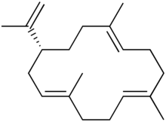
Cembrene
monocyclic diterpene isolated from corals of the genus Nephthea
biosynthesized by macrocyclization of geranylgeranyl pyrophosphate
Is a trail pheromone for termites

Slide 41
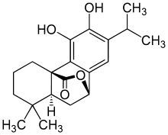
Carnosol
found in the herbs rosemary (Rosmarinus officinalis)
It has been studied in-vitro for anti-cancer effects in various cancer cell types

Slide 42
Sesterterpene
terpenes having 25 carbons and five isoprene units, are rare relative to the other sizes.
(The sester- prefix means two and a half.) An example of a sesterterpenoid is geranylfarnesol.
Rarely found.
Found in protective waxes of insects and fungi
They are phytotoxic

Slide 43
Triterpene
consist of six isoprene units and have the molecular formula C₃₀H₄₈.
The linear triterpene squalene, the major constituent of shark liver oil, is derived from the reductive coupling of two molecules of farnesyl pyrophosphate.
Squalene is then processed biosynthetically to generate either lanosterol or cycloartenol, the structural precursors to all the steroids.
Saponins belong to this class
Commonly found in Leguminosae, Cucurbitaceae, Meliaceae, Apocynaceae and Moraceae
Found in any part of the plant as free or glycosidic form

Slide 44

Squalene
It is a colourless oil although impure samples appear yellow.
It was originally obtained from shark liver oil (hence its name, as Squalus is a genus of sharks).
All plants and animals produce squalene as a biochemical intermediate.
biosynthesised by coupling two molecules of farnesyl pyrophosphate

Slide 45
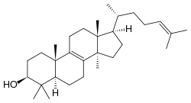
Lanosterol
is the compound from which all animal and fungal steroids are derived
Lanosterol was shown to improve lens clarity in subjects with lens clouding due to aging or physical stressors
is an ingredient in over-the-counter ophthalmic products to prevent cataracts

Slide 46
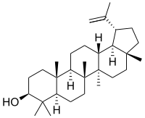
Lupeol
pharmacologically active pentacyclic triterpenoid
Lupeol is found in a variety of plants, including mango, Acacia visco and Abronia villosa
It has several potential medicinal properties, like anticancer and anti-inflammatory activity
It also has antiprotozoal, antimicrobial properties

Slide 47
Sesquaterpene
are composed of seven isoprene units and have the molecular formula C₃₅H₅₆. Sesquarterpenes are typically microbial in their origin. Examples of sesquarterpenoids are ferrugicadiol and tetraprenylcurcumene.

Slide 48
Tetraterpene
carotenoids
contain eight isoprene units and have the molecular formula C₄₀H₆₄.
Biologically important tetraterpenoids include the acyclic lycopene, the monocyclic gamma-carotene, and the bicyclic alpha- and beta-carotenes

Slide 49

Lycopene
is a bright red carotenoid hydrocarbon found in tomatoes and other red fruits and vegetables, such as red carrots, watermelons, grapefruits, and papayas. It is not present in strawberries or cherries.
In plants, algae, and other photosynthetic organisms, lycopene is an intermediate in the biosynthesis of many carotenoids, including beta-carotene, which is responsible for yellow, orange, or red pigmentation, photosynthesis, and photoprotection
Lycopene may increase the risk of bleeding when taken with anticoagulant drugs

Slide 50
Polyterpene
consist of long chains of many isoprene units.
Natural rubber consists of polyisoprene in which the double bonds are cis.
Some plants produce a polyisoprene with trans double bonds, known as gutta-percha

Slide 51
Apocarotenoids
“apocarotenoid” refers to any compound derived from the oxidative cleavage of carotenoids by enzymatic (carotenoid cleavage dioxygenases (CCD’s)) or non-enzymatic means.
Their formation is regulated by:-
developmental stimuli
environmental stimuli
sub-cellular compartmentalization
They are more soluble and volatile than carotenoids
They are not simply breakdown products as there can be modifications post cleavage and their functions include:
hormones (they regulate plant development)
volatiles and
signals in response to stress
they fine tune carotenoid biosynthesis flux
they famous for the pleasant aromas and give rise to fragrance and palatable flavors of many flowers and fruits
Examples include : abscisic acid, strigolactone, vitamin A (all retinoids), crocin

Slide 52

Retinol
also called vitamin A
Dietary sources include fish, dairy products, and meat and orange coloured fruits and vegetables
Retinol is used to treat vitamin A deficiency.

Slide 53

Abscisic acid
is a plant hormone
ABA functions in many plant developmental processes, including seed and bud dormancy
the control of organ size and stomatal closure.

Slide 54
Test for terpenes/terpenoids
Salkowski test is used to detect terpenoids. Extract (5 ml) was mixed with chloroform (2 ml), and concentrated H₂SO₄(3 ml) was carefully added to form a layer.
A reddish brown colouration of the inter face indicates the presence of terpenoids.

Slide 55
Importance of terpenoids
Many terpenoid or terpenoid derivatives are used as traditional drugs with different medicinal values identified from different natural sources

Slide 56
REMEMBER TO SUBMIT YOUR ASSIGNMENT

