Slide 1
Meta skills: Team working
Slides by Dave Jarrold and Dr Mila Duncheva, Edinburgh Napier University

Slide 2
Learning outcomes

Slide 3
Learning outcome 1
Understanding of the importance of working collaboratively and sharing of information via various means with other operatives and teams, and situational awareness for successful delivery, and to collectively solve problems, provide feedback, implement changes, avoid slippage and improve processes.

Slide 4
Learning outcome 2
Understand why it is important to avoid working in silos and that risk in interfaces is greater for offsite solutions.

Slide 5
Learning outcome 3
Understand the function and interface of other roles externally, in the office, factory and on site, how these roles interact with one-another and the context of their own role, and the importance of collaboration for successful and streamlined delivery.

Slide 6
Learning outcome 4
Be able to demonstrate the ability to work safely and effectively as a trusted and respected member of a team with confidence in knowledge, experience and training of ones-self and co-workers.

Slide 7
Learning outcome 5
Be able to demonstrate leadership skills and the ability to make decisions, particularly at an early stage in the project life cycle.

Slide 8
Working collectively as a trusted team member and without silos
Notes:
Learning outcomes 1, 2 and 4

Slide 9
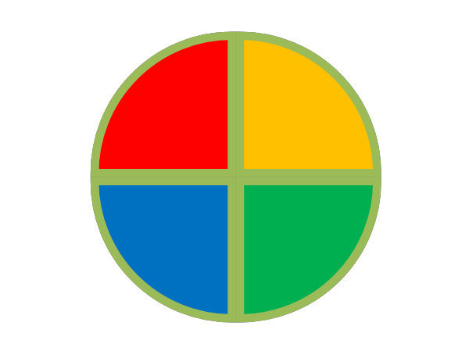
Operating Styles
How you do
what you do,
And why knowing that is useful…
Notes:
Facilitator Notes
We each have a preferred style of operating. To understand what this is, how to describe it, and then how to use the insights – we need a tool.
You might want to expand at this point on why you see this as particularly valuable for this module, course or profession – although we will be looking at this in the first exercise.

Slide 10
Challenges
What are the challenges you face
in your work at school / college/ university /
company?
What will the challenges be
in the future in this context?
Notes:
Amend slide: Choose an option (school / college/ university / company) and delete the others as appropriate for the context you are delivering the training in
Facilitator Notes
Break the group into smaller groups of around 4-6 people.
If it’s a small group you could have them discuss each question in turn.
If it’s a larger group you can split them and have some groups discuss the first question and some discuss the second.
Allow the groups a few minutes to discuss and come up with their main challenges.
Plenary this and capture the challenges for each question on a flip chart or white board.
Once you have captured the challenges identify how an insight into our personal operating styles, and the styles of others, can support us in tackling these challenges (you will be able to do this having reviewed the background information provided).
This should provide the group with a solid rationale to buy into the workshop and be invested in the outcomes.

Slide 11
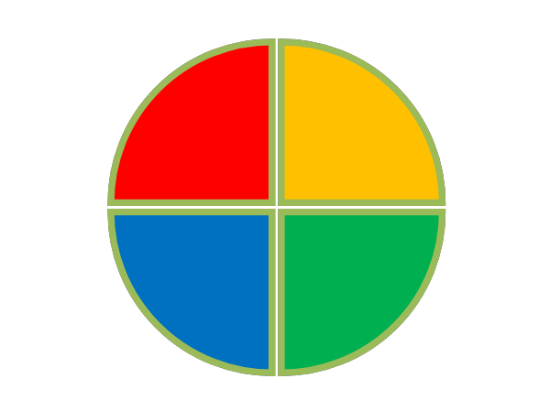
What is DiSC?
D
i
C
S
Notes:
Facilitator Notes
Behavioural profiling tool
Based upon the idea that human observable behaviour can be categorised into four distinct dimensions of Dominance, Influence, Steadiness and Compliance
Everyone has a unique profile comprising of all four dimensions to varying degrees
One or two of these dimensions are likely to be more prominent than the others
Caveats:
Human behaviour is far more complex than 4 quadrants. There is a spectrum within each but the grouping gives us a way in to understand behaviours
We area mix of all these operating styles – but we are likely to have 1 or 2 that are more dominant than the rest.
This is not about labelling or limiting – it’s about understanding

Slide 12
What is DiSC?
Originates from work by Marston (1928) and Clarke (1940)
DiSC model represents observable behaviours categorized according to dimensions of:
Dominance; Influencing; Steadiness; Compliance
Used widely in:
recruitment & selection; teambuilding; professional development; couple counselling; psychology
Notes:
Facilitator Notes
Background to how the model was developed. Marston was a psychologist – Clarke was an engineer. The combination of their skills gives us a psychological model with a framework around it.
Marston was also instrumental in the development of the lie detector – and he was the creator of Wonder Woman.

Slide 13
What does it show…
Behaviour
Personality
Skills
Values & Beliefs
Intelligence
Notes:
Facilitator Notes
Opportunity to emphasise that this is purely about observable behaviour.
This is not a psychometric personality test. It’s not about labelling but about understanding behavioural styles.

Slide 14
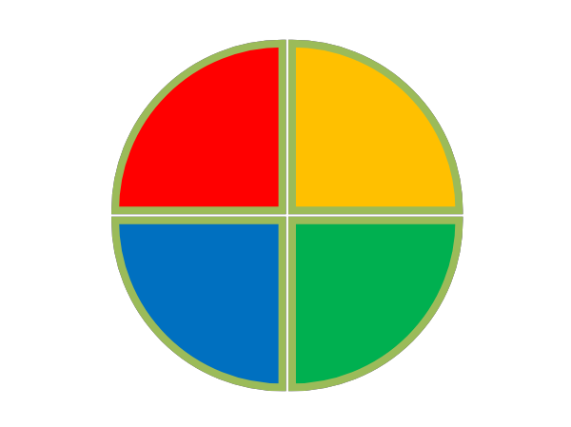

DISC Avatars
Notes:
Facilitator Notes
A good way to get into the model is to think about people who embody a given behavioural style.
Run this exercise with the whole group. Go through each of the following 4 slides in turn which details the extreme elements of each behavioural style.
And the group to identify who comes to mind. We are working in the public realm, politicians, sports people, celebrities, etc.
Capture these people – either on a flipchart sheet or a whiteboard. Draw a matrix or simply write up the headings of Red, Yellow, Green and Blue, and put the names under each heading. I sometimes use post it notes – and other times just write the names up.
Have some fun with the exercise.
The following slides detail fist impressions and likely behaviours of someone with a very dominant profile in the respective colours.

Slide 15

DISC Avatars…
Someone who appears…
Direct
Strong willed
Opinionated
Someone who’s actions are…
Direct
Forceful
Risk-taking
Self-confident
Notes:
Facilitator Notes
People who often come up are Trump, Piers Morgan, Katie Hopkins, Thatcher, Hitler, Serena Williams, Greta, Gorgon Ramsay.
People with strong opinions so often quite polarizing.

Slide 16
DISC Avatars…
Someone who appears…
Sociable
Outgoing
Lively
Someone who’s actions are…
Charming
Enthusiastic
Sociable
Optimistic
Talkative
Notes:
Facilitator Notes
This is the easy one. It’s pretty much every talk show host and stand up comedian you can think of.
Frequent responses are: James Corden, Kevin Heart, Holly Willoughby, Philip Scofield, Graham Norton, etc.

Slide 17
DISC Avatars…
Someone who appears…
Gentle
Accommodating
Supportive
Someone who’s actions are…
Patient
Calm & steady
Humble
Team player
Good listener
Notes:
Facilitator Notes
Getting trickier as the second two are quieter operating styles.
Frequent responses are: Obama (Barak and Michelle), Oprah, Ellen, Dwayne Johnson

Slide 18
DISC Avatars…
Someone who appears…
Private
Analytical
Logical
Someone who’s actions are…
Precise
Analytical
Sceptical
Reserved
Quiet
Notes:
Facilitator Notes
This is the hardest one so you can allow the leeway of fictional characters.
Frequent responses are: Mark Zuckerberg, Bill Gates, Alan Turing, Sherlock, Sheldon, Spock
Worth pointing out at this stage that there was very little disagreement with suggestions.
This is why the model is so useful. All we have when working with other people is their behaviors. That’s all we can make assessments on – and we all seem to be pretty much on the same page.

Slide 19

Qualities
Decisive
Fast-paced
Task Focussed
Strong Willed
Goal Orientated
Competitive
Cheerful
Inspirational
Outgoing
Enthusiastic
Persuasive
Uplifting
Conscientious Perfectionist Knowledgeable
Deep
Correct
Precise
Accommodating
Encouraging
Low key
Relaxed
Calm
Notes:
Facilitator Notes
Time to identify what you think your most dominant (and second most dominant) colour is likely to be.
Run through the details of each operating style and then take a straw pole in the room.
Ask if anyone is stuck between 2. Only 5% of the population have what we call a pure style (i.e. 1 very dominant colour). Most of us have two string elements in our preferred style.
If people are unsure the next couple of slides might help.

Slide 20

Drive and Motivation
SUCCESS
SOCIAL RECOGNITION
Getting immediate
results, taking
action, challenging
self and others
Expressing
enthusiasm,
taking action,
encouraging collaboration
QUALITY
Accuracy, challenging assumptions,
maintaining
stability,
Giving support, enjoying collaboration,
maintaining stability,
HELPING OTHERS
Notes:
Facilitator Notes
Knowing what motivates and drives us (and other people) can be very useful. Refer back to the challenges feedback if appropriate.
Explain how different factors will drive and motivate different operating styles.

Slide 21

Irritations and Fears
Inefficiency,
indecisiveness and
slow pace of others
Routine and formality and lack of variety
Being taken
advantage of,
vulnerability,
loss of control
Disapproval, being ignored,
loss of influence,
social rejection
Surprises, and undermining quality
Insensitivity, impatience to needs of others
Criticism,
slipshod methods,
getting it
wrong
Loss of stability, change, loss of harmony, offending
others
Notes:
Facilitator Notes
Conversely knowing what Irritates us (and others) is also useful. This will help explain why some tasks and situations are comfortable for others and why others tasks and situations are a struggle.
See if these factors resonate with people.

Slide 22
Communicating & Decisions
Facts
Feelings
Talk to Think
Think to Talk
Facts
Feelings
Notes:
Facilitator Notes
Knowing how we make decisions is also very helpful.
Red/Blue tend to make decisions based on facts. When the facts change so does their opinion. Yellow/Green tend to make decisions based on gut instinct. This is why it’s harder, and can take longer, for them to make a decision and also to change their opinion.
Conversely Red/Yellow will tend to talk to think, to verbalise ideas and bounce them around before deciding.
Blue/Green will tend towards introspection and think to talk. This can lead to frustration with some people thinking they are doing all the work while others sit silently. The flip side if the quiet operating styles are hoping you will be quiets so they can think.
Doing the same thing but in different ways.

Slide 23
It’s Situational
At School/College/University/Work
“Natural” Style
D I S C D I S C
Notes:
Facilitator Notes
We have a mixture of all dimensions.
Situational - can choose to bring up other dimensions in certain situations
In this example we have a natural style which is lively, outgoing and people focussed.
However, if we are working on a solo piece of work that requires accuracy and has a tight deadline, we need to adapt our style.
We can all adapt – but the bigger the gap between styles –the harder it is for us to adapt and change our style to suit our situation.
This brings in the difference between our natural style – and our adapted style.

Slide 24

Natural Style
Adapted Style
Natural
Style
Motivators
Belief System
Notes:
Facilitator Notes
The DISC model is about ‘how’ we do something.
Our bedrock at the sea bed is our belief system. Our moral code, our sense of justice and right/wrong.
Anchored to this are our motivators. We are motivated by the things we believe in.
Our motivators have a strong connection to our natural style. Only a small element of our natural style pokes above the sea level. But above this is our adapted style flapping in the wind. This is what we show the world. This is what we modify to operate in different situations.
Think of one of the high yellow people you identified in the avatars exercise. Maybe they’re not like that at all. Maybe their natural style is very different?
This model explains why our natural style is relatively fixed, and our adapted style changes given the prevailing situation.
However, if a significant emotional event impacts on our motivators (new job, new city, starting a family, etc.), we might reassess our motivators and redefine our natural style.

Slide 25
Your Likely Profile
Notes:
Facilitator Notes
Get people working in pairs at this stage and ask them to identify both their most dominant and second most dominant profile elements, remembering there is no right/wrong or good/bad.
If you are using the personal profile handout there is also the section to identify your less strong profile element.
Don’t get into strengths and weaknesses just yet.
On the next 4 slides we look at the likely strengths and potential weaknesses of each operating style.
Run through each slide and discuss the strengths and potential weaknesses with the group.
Remind them that our weaknesses are our strengths overplayed. For example high red, goal focussed and driven can be perfect in the right circumstances, but can also be overbearing and domineering in the wrong situation.

Slide 26

Probable STRENGTHS:
Confident, determined
Loves challenges
Focused
Influencing others
Possible WEAKNESSES:
Poor listener
Can be seen as arrogant
May push too hard
Doesn’t wait for feedback
Notes:
Facilitator Notes

Slide 27

Probable STRENGTHS
Quick to build relationships
Friendly and sociable
Adaptable, imaginative
Skilful presenter
Possible WEAKNESSES
May lack focus
Too casual for some
Poor planning and follow-up
Can lose interest
Notes:
Facilitator Notes

Slide 28

Probable STRENGTHS
Builds deep, long-term relationships
Natural listener
Sincere and warm
Persistent
Possible WEAKNESSES
Slow to adapt
May struggle to make opinions heard
Avoids rejection
Takes difficulties personally
Notes:
Facilitator Notes

Slide 29

Probable STRENGTHS
Knowledgeable and detailed
Air of competence
Asks probing questions
Thorough follow-up
Possible WEAKNESSES
Initial interaction may be difficult & stuffy
Questions may be seen as critical & insensitive
Overlooks others’ feelings
Focus on inconsequential details
Notes:
Facilitator Notes

Slide 30
What does this mean for you?
Notes:
Facilitator Notes
Back into pairs and ask people to identify their top 3 strengths – and also the areas that they could develop to counteract the elements that are less positive.
Again if you are using the handout then students should complete this – if not they can simply make their own notes on this.
Unless you have a very trusting group I would advise not feeding this back to the wider group but keep it for personal reflection.

Slide 31
Tips for Interacting
DO
Be direct & to the point
Focus on results and objectives
Be brief
DON’T
Hesitate or waffle
Focus on feelings
Try to take over
Notes:
Facilitator Notes
You can take some time on this – on run through quickly.
The aim of these slides is to round off the personal section of the workshop with some insights into how to adapt our style to be effective.
The maxim is not to treat others how you want to be treated – it is to treat others the way they want to be treated.

Slide 32
Tips for Interacting
DO:
Be friendly & sociable
Be entertaining & stimulating
Be open & flexible
DON’T
Bore me with details
Tie me down with routine
Ask me to work alone
Notes:
Facilitator Notes
You can take some time on this – on run through quickly.
The aim of these slides is to round off the personal section of the workshop with some insights into how to adapt our style to be effective.
The maxim is nit to treat others how you want to be treated – it is to treat others the way they want to be treated.

Slide 33
Tips for Interacting
DO
Be patient & supportive
Slow down & work at my pace
Ask my opinion & give me time to answer
DON’T:
Take advantage of my good nature
Push me to make quick decisions
Spring last minute surprises
Notes:
Facilitator Notes
You can take some time on this – on run through quickly.
The aim of these slides is to round off the personal section of the workshop with some insights into how to adapt our style to be effective.
The maxim is nit to treat others how you want to be treated – it is to treat others the way they want to be treated.

Slide 34
Tips for Interacting
DO
Be well prepared & thorough
Put things in writing
Let me consider all the details
DON’T
Get too close or hug me
Be flippant on important issues
Change my routine without notice
Notes:
Facilitator Notes
You can take some time on this – on run through quickly.
The aim of these slides is to round off the personal section of the workshop with some insights into how to adapt our style to be effective.
The maxim is nit to treat others how you want to be treated – it is to treat others the way they want to be treated.

Slide 35

Team Context
Notes:
Facilitator Notes
Having spent some time looking at the personal aspects of DISC – we move to looking at the team aspects.
In the same way that we produce a personal bar chart to show someone's personal profile, so we can combine profiles to create a team profile.

Slide 36
Team Profile
In your Groups:
on the top half of the A3 paper, create a graph chart showing your team members’ colours.
NB: include ‘second’ colours as well
(half size and dotted)
Max/2
Ross/2
Sam
Ian
Sam/2
Ross
Max
James
Ian /2
James/2
Red
Yellow
Green
Blue
Notes:
Facilitator Notes
Split the room into small groups again of around 4-6 people.
On a sheet of paper ask them to complete the following exercise.
Starting with their most dominant colours – draw a block with a solid line on the appropriate colour. When everyone has done this for their most dominant colour, ask them to do the same for their second most dominant colour – this time with a broken line.
This creates a bar chart which illustrates the profile of their group.

Slide 37
Team Strengths & Risks
Max/2
Jaqui/2
Sam
Ian
Ian/2
Sam/2
Jacqui
Max
James
James/2
Red
Yellow
Green
Blue
Strengths
Risks
Notes:
Facilitator Notes
Next step is to assess the main strengths and the main risks this team will face.
Ask them to identify what the strengths/risks of the group on the slide.
Capture their insights then use the following slide to see if anything was missed.

Slide 38
Possible risks:
Nobody listens to the other person
Lack of attention to detail /poor planning
Things may get left to last minute
Possibility for superficial work
Potential for conflict between Sam and Jacqui over leadership
James may struggle to make his contribution heard/valued
Max/2
Jaqui/2
Sam
Ian
Ian/2
Sam/2
Jacqui
Max
James
James/2
Red
Yellow
Green
Blue
Possible strengths:
Lots of extrovert behaviour
Good communication
Task orientated / Fast paced
Driven – high achievers
Yellow members will promote fun working environment
Influence of Yellow/green may support good consensus and harmony in team
Notes:
Facilitator Notes
Having talked through this example ask the groups to identify their strengths and risks.

Slide 39
How can you ensure you work collaboratively?
What are the benefits of working collectively?
Why is it important to not work in silos (by yourself) in offsite projects?
How can you make sure that you are a trusted member of the team?
Notes:
Facilitator Notes
In your groups, think about how the DiSC tool you learned about can help you understand the benefits of working collectively, not working in isolation, and making sure that you are a trusted and respected member of your team.

Slide 40
Design team
Site management
Estimation and commercial
Collaborative working
Onsite assembly
Logistics
Factory
Notes:
Facilitator Notes
Remember that with offsite construction the collaboration between the designers, the factory, the logistics team and the onsite contractors is critical for success.

Slide 41
Understand other roles
Notes:
Learning outcome 3

Slide 42

Notes:
Facilitator Notes
All the organisations and project stages in offsite construction are centred around people. On a project team there will be people from different companies attending project meetings: designers, factory managers, logistical partners, general contractor managing the siteworks along with sub-contractors, and the client who would inspect before accepting handover.
If you look at a certain function, say design, there will likely be a few different companies working on the different aspects of the design: conceptual design by the architects, technical design by architectural technologists, structural engineers working on the superstructure, geotechnical engineers for the groundworks and excavation, etc.
If we then zoom into just one of these companies, as the geotechnical engineers, there will likely be a whole team working on this project – the lead engineer, an assistant engineer, an administration officer and perhaps a BIM person.
You are starting to understand just how complex the teams are in offsite construction, and we will take a look into some of the key responsibilities so that you understand others roles.

Slide 43

Digital design
Structural engineer:
Using computer simulations to predict how structures will react under different conditions, for example high winds or earth tremors
Making sure projects meet legal guidelines, environmental directives, and health and safety requirements
Inspecting unsafe buildings and recommending options for repairs or demolition
Working out the loads and stresses on different parts of a structure like the foundations, beams, and walls…
https://www.goconstruct.org/learn-about-construction/find-the-role-for-you/roles-in-construction/offsite/#slide-2
Notes:
Check website links are still active before uploading onto Moodle

Slide 44

Digital design
Architectural technologist:
The architectural design is passed to offsite manufacturing design technologist to determine the buildable details
Producing plans, elevations, technical details and building layouts
Coordinating filing, storage and retrieval of drawings
Drawing maps, diagrams or plans for construction projects and structures
Being able to define problems and find solutions for them …
https://www.goconstruct.org/learn-about-construction/find-the-role-for-you/roles-in-construction/offsite/#slide-2
Notes:
Check website links are still active before uploading onto Moodle

Slide 45

Digital design
3D visualiser:
Visualise concepts in various graphic mediums
Make sure the offsite construction system is represented as accurately and attractively as possible
Help the public and councillors understand the proposals during the planning process – assisting planning decisions
Work with both "still" representations and animations/ CGI (computer generated imagery)
Work with industry-standard design tools
Keep up to date with software advances …
https://www.goconstruct.org/learn-about-construction/find-the-role-for-you/roles-in-construction/offsite/#slide-2
Notes:
Check website links are still active before uploading onto Moodle

Slide 46

Estimating and commercial
Estimator:
Weighing up all the information about the building work and deciding exactly how much money it will take to do what the customer wants
Researching prices
Collecting quotes
Checking what the client wants
Using computer software
Collecting quotes from suppliers and sub-contractors
Drawing up bids for work …
https://www.goconstruct.org/learn-about-construction/find-the-role-for-you/roles-in-construction/offsite/#slide-1
Notes:
Check website links are still active before uploading onto Moodle

Slide 47

Estimating and commercial
Planner:
Helping to draft and review planning applications
Conducting appropriate research to inform planning applications
Assisting with consultations and negotiations with consultants and developers
Helping to enforce planning controls for developments
Helping to prepare policy or guidance documents on how to manage historic environments
Helping to advise on the refurbishment or re-use of listed buildings …
https://www.goconstruct.org/learn-about-construction/find-the-role-for-you/roles-in-construction/offsite/#slide-1
Notes:
Check website links are still active before uploading onto Moodle

Slide 48

Estimating and commercial
Quantity surveyor:
Preparing tender and contract documents
Working out the cost of repair and maintenance work
Establishing exactly what a client wants
Weighing up commercial risks
Allocating work to subcontractors
Valuing completed work and arranging payments
Making sure a project meets every legal and quality standard
Making sure that the client gets value for their money
Advising on the maintenance costs of specific buildings...
https://www.goconstruct.org/learn-about-construction/find-the-role-for-you/roles-in-construction/offsite/#slide-1
Notes:
Check website links are still active before uploading onto Moodle

Slide 49

Logistics
Dispatch manager:
Ensuring offsite construction products are dispatched on time and in accordance with quality requirements
Managing and motivating a team of staff, ensuring an effective distribution operation
Monitoring site production to ensure orders are completed on time and in full
Planning work rotas
Organising staff training and recruitment
Ensuring vehicles and drivers comply with legal requirements
Ensuring compliance with health and safety regulations…
https://www.goconstruct.org/learn-about-construction/find-the-role-for-you/roles-in-construction/offsite/#slide-4
Notes:
Check website links are still active before uploading onto Moodle

Slide 50

Logistics
HGV driver:
Driving
Planning delivery schedules
Planning routes with transport managers
Supervising or helping to load and unload goods
Lifting and carrying
Making sure loads are safely secured
Following traffic reports and adapting routes if necessary
Completing delivery paperwork
Keeping up to date log books …
https://www.goconstruct.org/learn-about-construction/find-the-role-for-you/roles-in-construction/offsite/#slide-4
Notes:
Check website links are still active before uploading onto Moodle

Slide 51

Logistics
Signaller:
Directing the movement of vehicles on a work site
Recommending and laying out safe, on-site traffic systems
Providing clear, correct and safe directions to plant operators
Communicating with drivers and plant operators verbally and by radio and/or industry standard hand signals
Understanding risks (e.g. blind spots) and how to manage these effectively
Managing traffic to avoid excessive queuing …
https://www.goconstruct.org/learn-about-construction/find-the-role-for-you/roles-in-construction/offsite/#slide-4
Notes:
Check website links are still active before uploading onto Moodle

Slide 52

Offsite manufacture
Goods in manager:
Receiving and registering materials to inspecting items for quality and quantity, ensuring that a variety of tasks are completed quickly and accurately by the team
Working closely with suppliers and section staff to ensure all material arriving is in accordance with purchase order specifications
Monitoring storage space and tracking stock levels
Ensuring stock is stored correctly and safely
Managing pick schedules around production plans
Maintaining inventory levels …
https://www.goconstruct.org/learn-about-construction/find-the-role-for-you/roles-in-construction/offsite/#slide-3
Notes:
Check website links are still active before uploading onto Moodle

Slide 53

Offsite manufacture
Welding fabricator:
Welder Fabricators utilise their knowledge of a range of welding and joining processes, such as gas metal arc welding (MIG and TIG), to manufacture required items.
They cut materials into the required shapes, then weld or join them into the correct structure as dictated by the drawings.
Cutting and joining metal and other materials into a wide range of structures.
Using computers and geometric development methods to form structures. …
https://www.goconstruct.org/learn-about-construction/find-the-role-for-you/roles-in-construction/offsite/#slide-3
Notes:
Check website links are still active before uploading onto Moodle

Slide 54

Offsite manufacture
Concrete finisher:
Knowledge of a variety of finishing techniques and employ processes to help prevent surface cracking
Checking the concrete forms for accurate construction
Setting and aligning the forms
Spreading, levelling and smoothing the concrete using a variety of specialist equipment
Moulding expansion joints and edges
Monitoring the effects of weather conditions on the concrete curing process
Facilitating concrete pouring. …
https://www.goconstruct.org/learn-about-construction/find-the-role-for-you/roles-in-construction/offsite/#slide-3
Notes:
Check website links are still active before uploading onto Moodle

Slide 55

Onsite placement
Lifting equipment inspector:
General lifting accessories, including chain slings, webbing slings and wire rope slings
Bespoke lifting and handling equipment
Manually operated lifting equipment such as chain hoists, wire rope, lifting and pulling machines and beam trolleys
Power operated lifting equipment (including but not limited to electric, pneumatic, and hydraulic powered systems, powered winches, etc)
Runway beams and light crane structures
Electric overhead travelling cranes…
https://www.goconstruct.org/learn-about-construction/find-the-role-for-you/roles-in-construction/offsite/#slide-5
Notes:
Check website links are still active before uploading onto Moodle

Slide 56

Onsite placement
Crane operator:
Controlling equipment with levers, wheels or foot pedals
Moving material according to a plan or schedule
Setting up and repairing equipment
Making minor repairs to machinery
Conducting daily maintenance checks and reporting any issues to supervisor
Keeping records of material movement
Overhead crane operator ensuring that travel routes are clear, avoid lifting over other people, will often sling the loads themselves…
https://www.goconstruct.org/learn-about-construction/find-the-role-for-you/roles-in-construction/offsite/#slide-5
Notes:
Check website links are still active before uploading onto Moodle

Slide 57

Onsite placement
Offsite product installer:
Setting out and sole plates
Inspection of routed services
Refer to technical drawings
Place and assemble offsite products
Ensure installation meets construction schedule
Work to specific tolerances
Communicate with the logistics partner, the factory, the design team and the site manager
Be up to date on technology for onsite work
Comply with health and safety regulations…
https://www.goconstruct.org/learn-about-construction/find-the-role-for-you/roles-in-construction/offsite/#slide-5
Notes:
Check website links are still active before uploading onto Moodle

Slide 58

Site management
Construction manager:
Handling health and safety on a project
Setting benchmarks of work to be done
Setting and agreeing budgets for the work
Managing and recruiting staff for the project
Being directly responsible for the work being carried out and the decision making
Working on-site - inspecting work, checking materials and their delivery and storage, checking everyone is following safety rules …
https://www.goconstruct.org/learn-about-construction/find-the-role-for-you/roles-in-construction/offsite/#slide-5
Notes:
Check website links are still active before uploading onto Moodle

Slide 59

Site management
Electrician:
Following very strict safety regulations
Keeping up to date with the different types of legislation covering electrical equipment
Highly skilled in inspecting electrical systems, equipment and components for faults that need repairing
Transporting data along fibre-optic cables and programming computer-controlled "intelligent" buildings and factories.…
https://www.goconstruct.org/learn-about-construction/find-the-role-for-you/roles-in-construction/offsite/#slide-5
Notes:
Check website links are still active before uploading onto Moodle

Slide 60

Site management
Painter and decorator:
Applying paint, stains, varnishes and other finishes
Using brushes, rollers or spraying equipment
Applying primers and undercoats, or varnishes and glazes
Wallpapering
Calculating the materials needed for a project
Removing old paint or wallpaper by sanding or scraping, or by using heat guns, liquid paint removers or steam strippers
Erecting scaffold towers and ladders
Mixing paint to an agreed shade .…
https://www.goconstruct.org/learn-about-construction/find-the-role-for-you/roles-in-construction/offsite/#slide-5
Notes:
Check website links are still active before uploading onto Moodle

Slide 61
Leadership and decision making
Notes:
Learning outcome 5

Slide 62
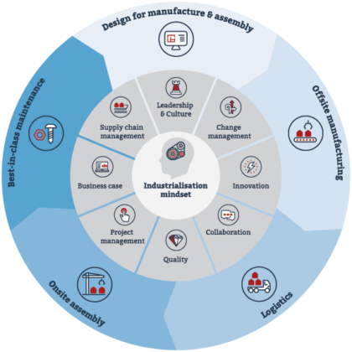
Project
lifecycle
Offsite management school
Notes:
Now that you understand the importance of the different roles in the project lifecycle, we will have a final activity to practice leadership and decision making

Slide 63
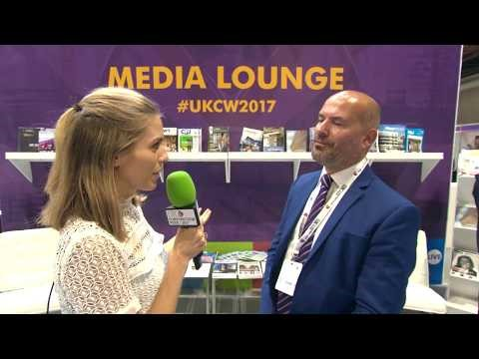
Leadership
https://www.youtube.com/watch?v=aPl867aHOZA
Notes:
Now that you understand the importance of the different roles in the project lifecycle, we will have a final activity to practice leadership and decision making
Play this short video of Mark Farmer, or if the link is not active any longer, select an approximately 5 minute video of a known leader in offsite construction and insert a new image and a new link.

Slide 64
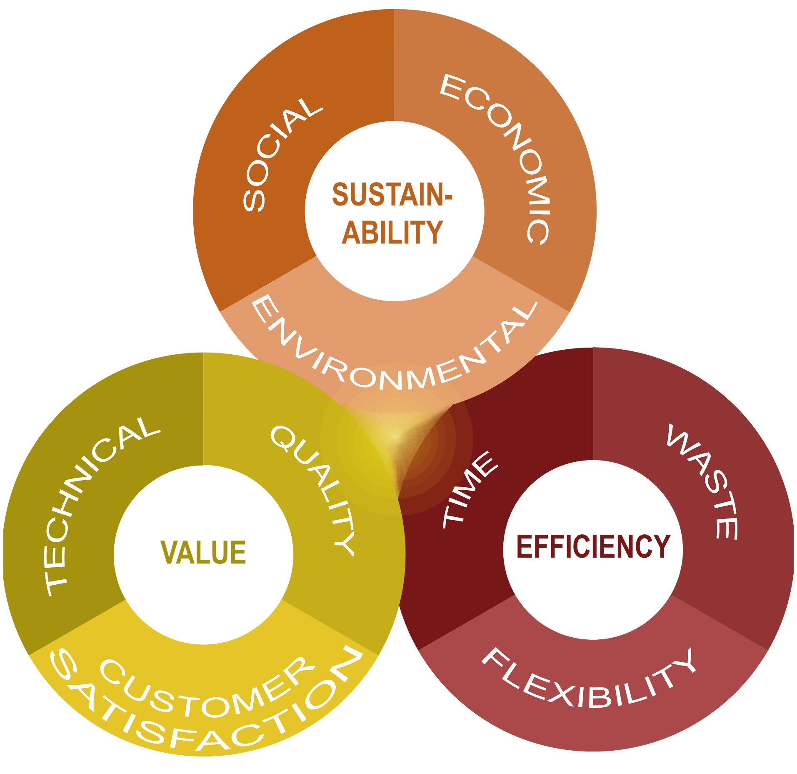
Project
balance
Hairstans and Duncheva
Notes:
Making decisions in offsite construction involves balancing value, sustainability and efficiency

Slide 65
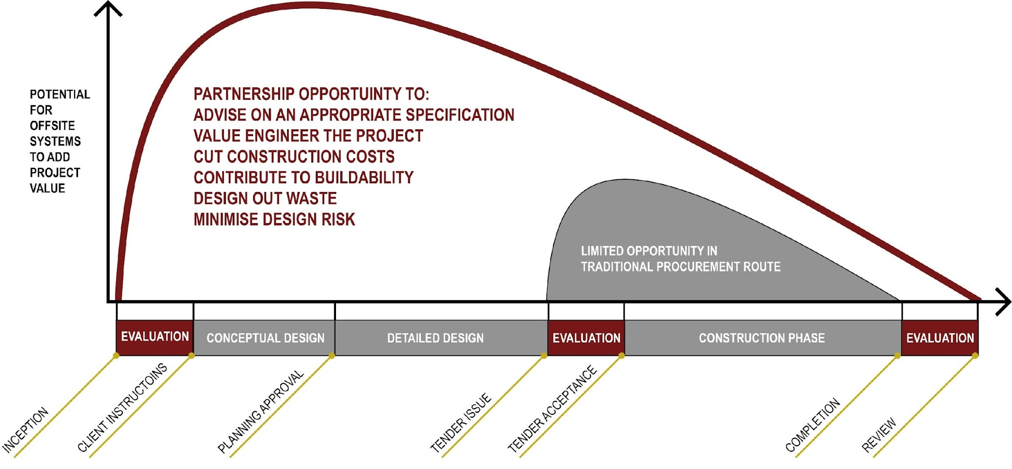
Stewart Milne Timber Systems
Notes:
The earlier in the process that the decisions regarding offsite construction are made, the better

Slide 66
Activity
Discuss in small groups of 3 or 4:
What are the personal qualities of a good leader
What knowledge and technical skills does a leader need in offsite construction
How can we modernise the construction industry with decision making in offsite construction
https://www.youtube.com/watch?v=aPl867aHOZA
Notes:
If needed replay the video

Slide 67
Write down your key points using a Venn Diagram
Personal qualities
Decision making
Knowledge and skills
Notes:
Material: A1 pads and marker pens
Ask for 3 volunteers to present
Ideally end with a statement of how relevant this team working exercise is for the students coursework (if it includes a group project) and for employment opportunities

Slide 68
Questions?
Dave Jarrold and Dr Mila Duncheva,
Edinburgh Napier University

Slide 70

META SKILLS: TEAM WORKING by DAVE JARROLD and DR MILA DUNCHEVA is licensed under a Creative Commons Attribution-NonCommercial-ShareAlike 4.0 International License

