Slide 1


Principal
Professional
Learning
May 2025
Notes:
Seated in networks.

Slide 2


Objective
Consulting with parents and other adults regarding the academic, social, physical, and emotional well-being of students.
During this training, principals will receive network achievement and enrollment data, as well as examples of effective parent engagement.
In a workshop, principals will hone in on needs and come up with a network plan that will frame network meetings next year in ways that operationalize the tools received today.
Notes:
We want networks to tackle this objective together. By the end of our time together, we want networks to identify areas of strength and concern, have an action plan to address areas, outline how network meetings could be reimagined next year, and identify data that will be tracked in network meetings next year.
You will leave with lots of ideas. Goal is to come up with what you will tackle as a network. There will be things you will want to explore as a school with your BLT later. But your goal is to have consensus on “which thing are we collectively most passionate about?”

Slide 3

Today’s Agenda
8:00-8:30
Network Data Slide Intro, and Spotlight of Network Collaborative Efforts around APTT and a Common Data Network Sheet
Network Enrollment Data Intro, Spotlights from Schools on Initiatives to Recruit and Academically Engage Families
8:30-9:30
Explain Protocol, Workshop as Network

Slide 4

Shared Norms**
Meeting Norms
Be on time and prepared
Stay engaged
Speak your truth
Assume best intent
Don’t take offense

Slide 5
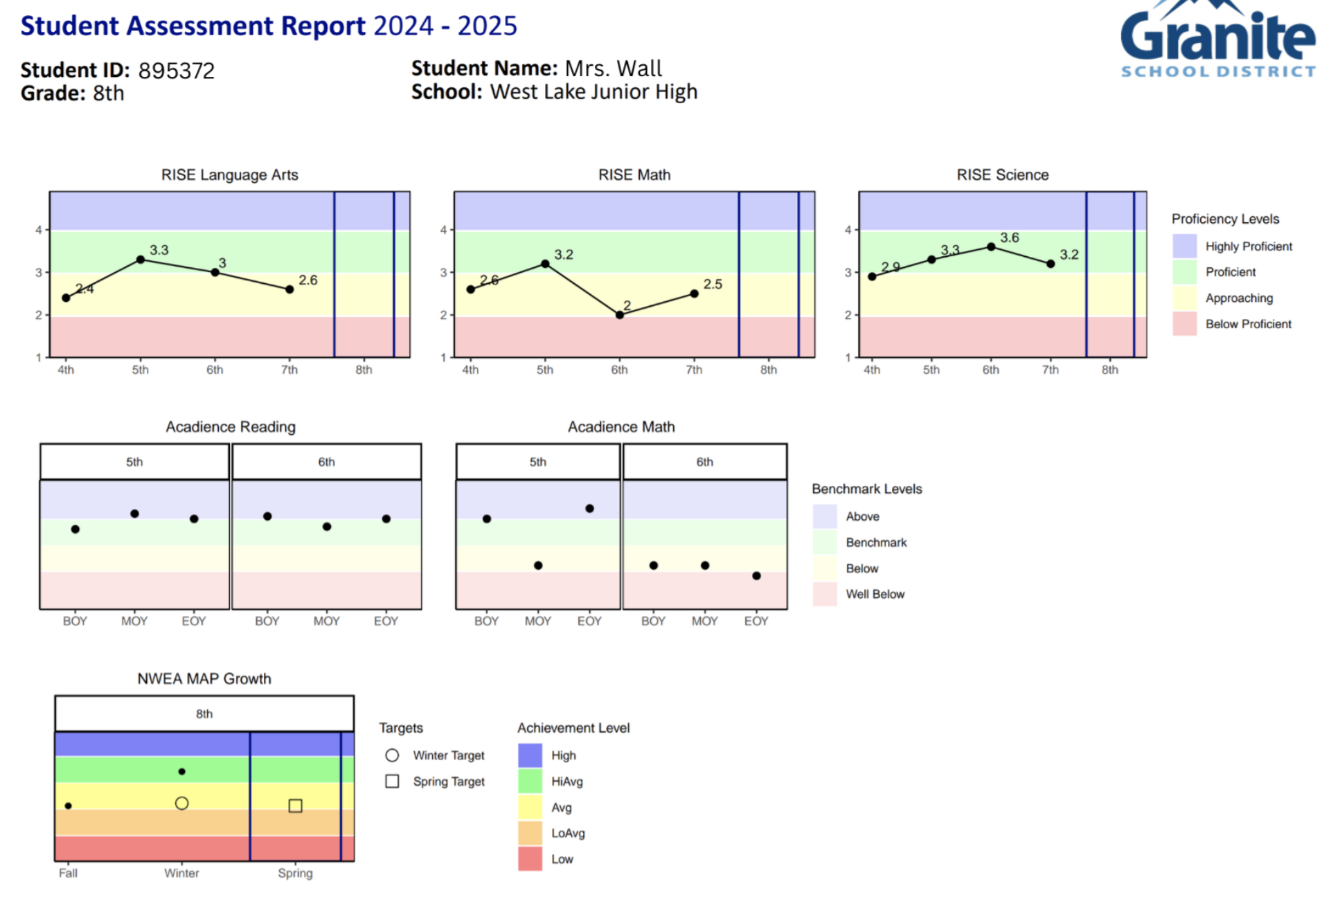

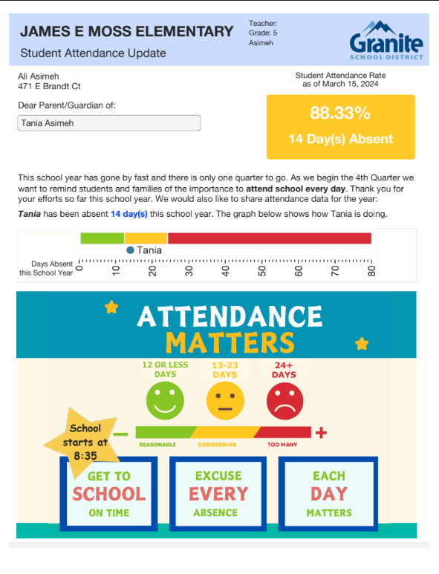
Granger Network Video and Data Sheets
These reports are in Assessment Team/Secure Channel/2025-2026/Fall Student Growth Reports.
English video link here Spanish video link here

Slide 6
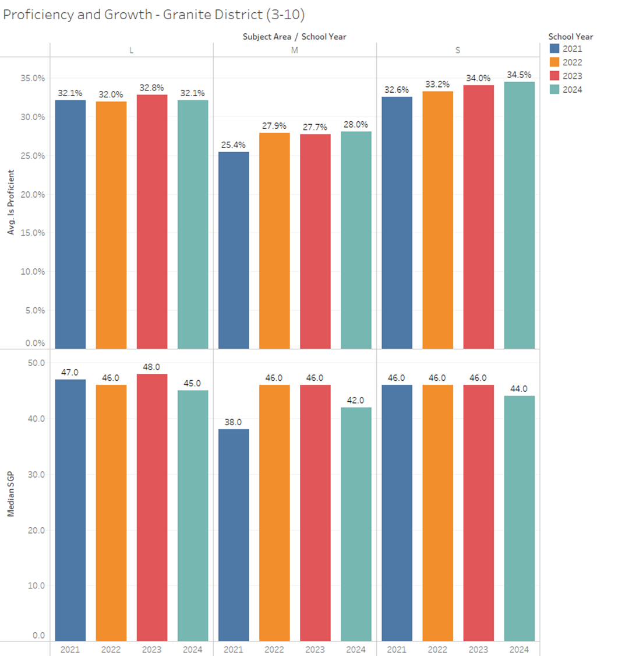
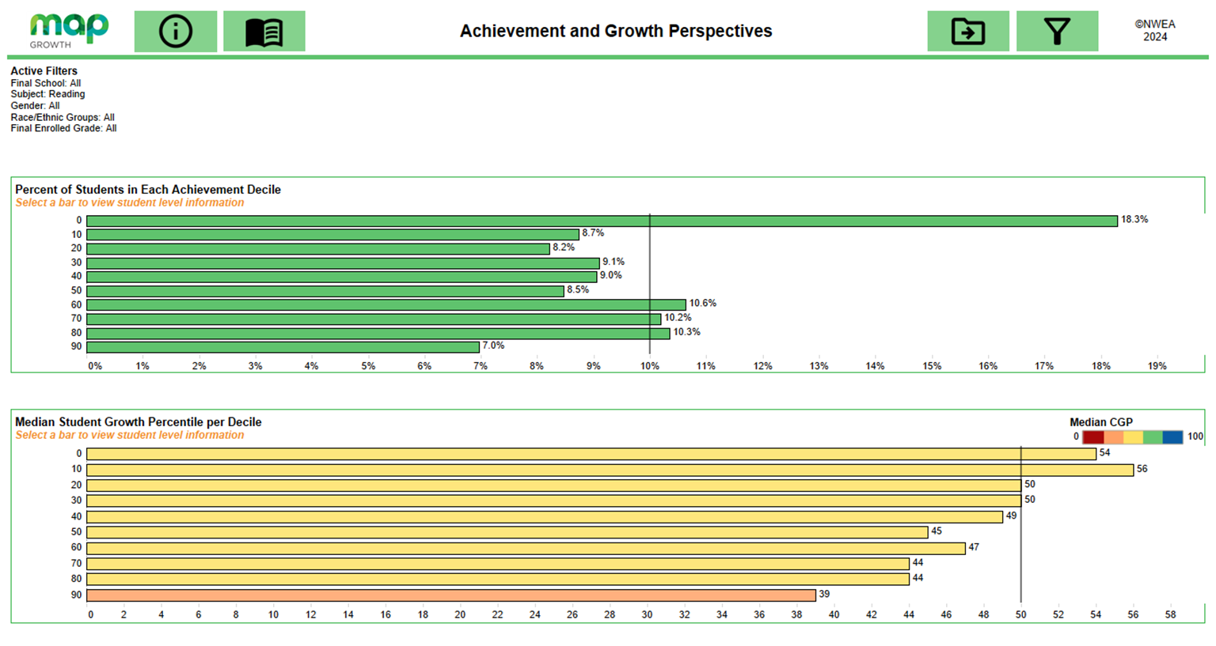
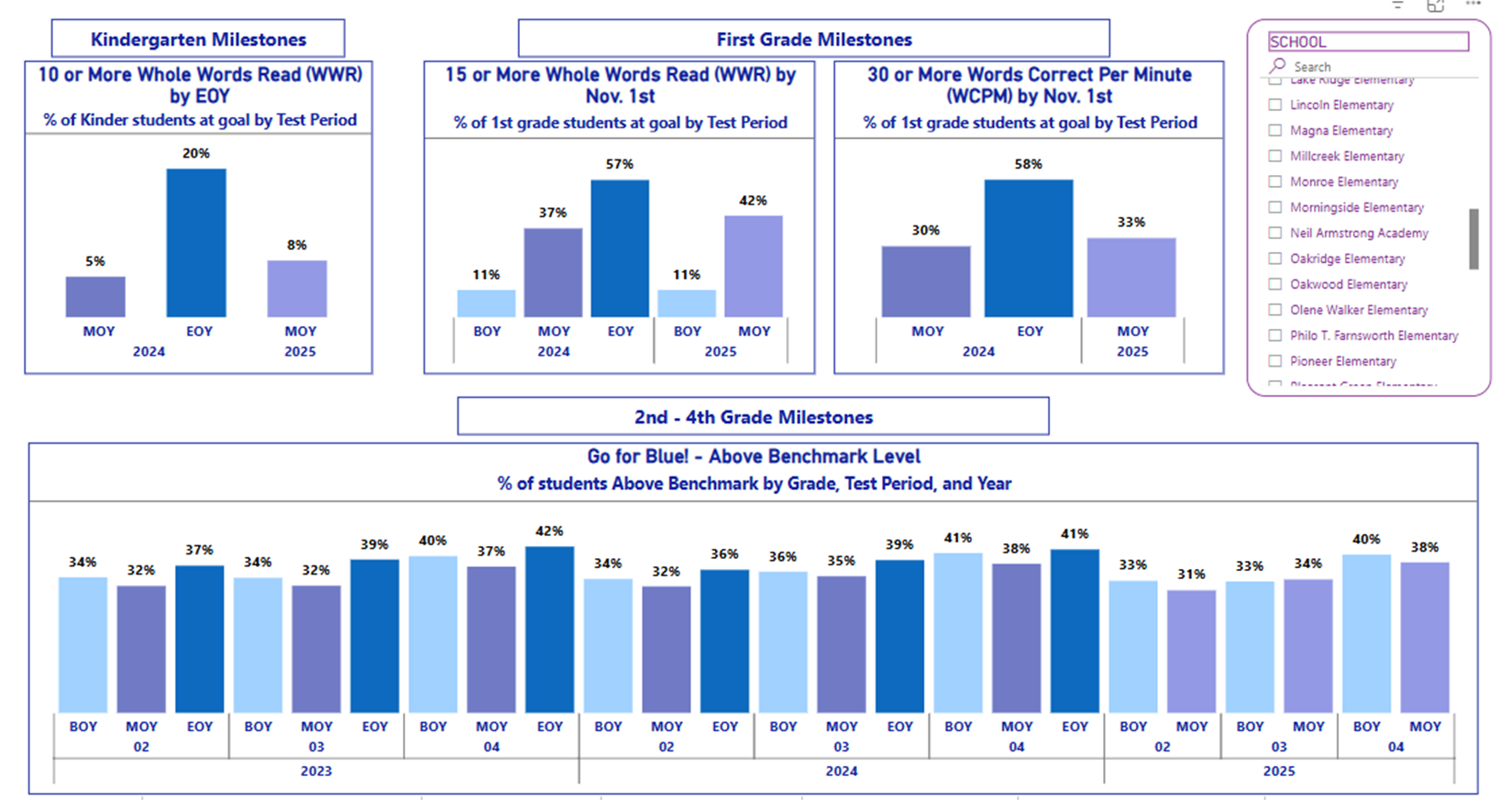
Network Academic Data
RISE proficiency and Growth
NWEA Map
Early Literacy
In which percentile are most of our network’s students?
Are there groups of students in percentiles that we are growing more than others?
What trends in subjects are there for proficiency and growth?
What trends are notable in the milestone literacy data for our network?

Slide 7
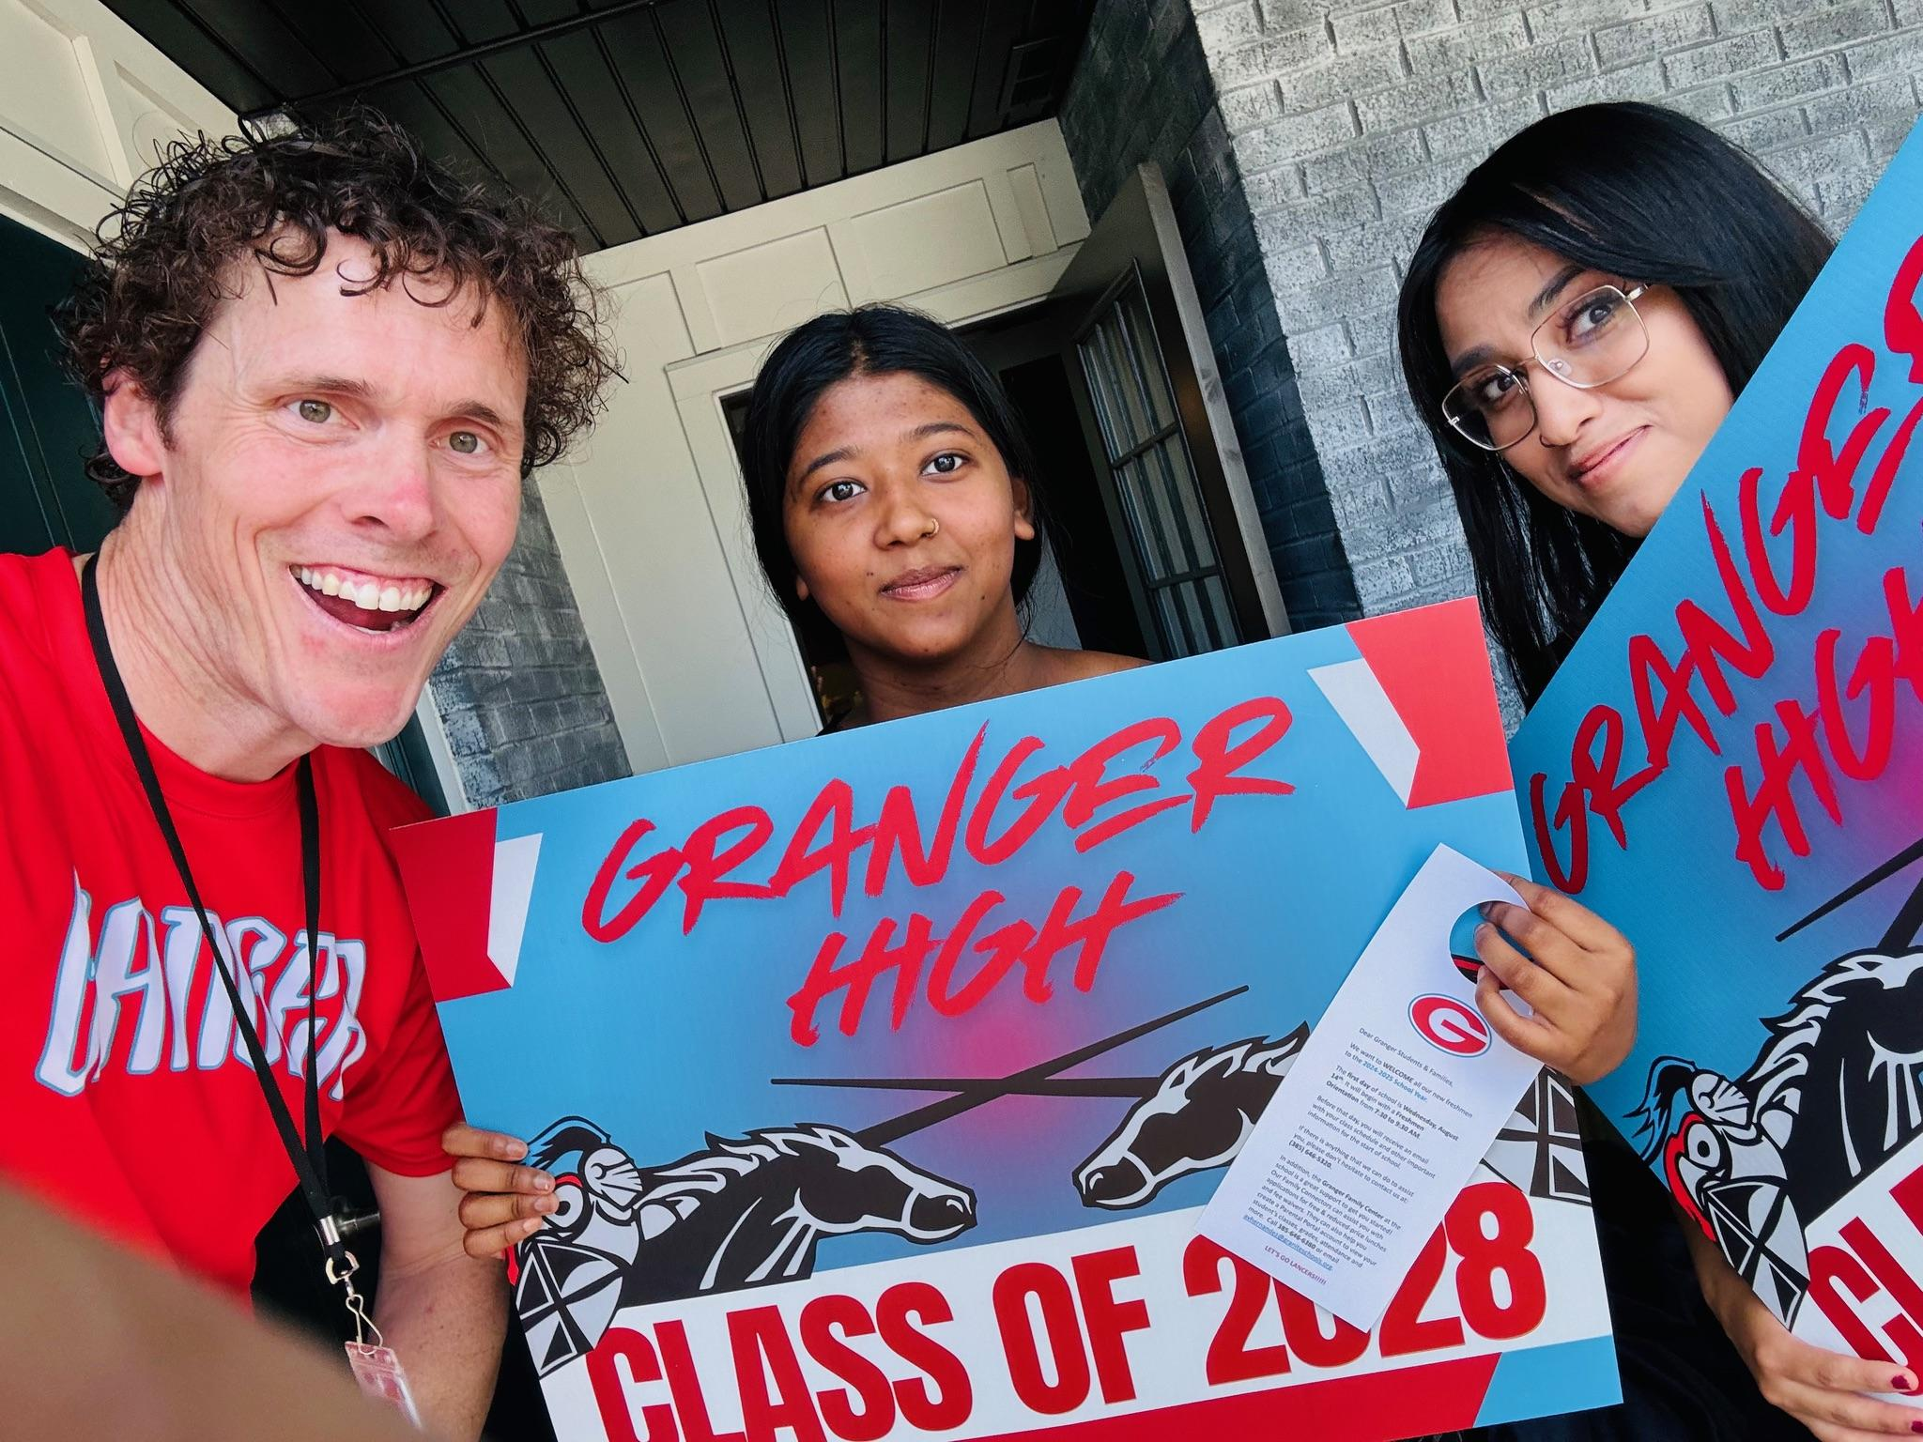
Home Visits
Keep to 5 “Non-negotiables”:
  Visits are voluntary
  Educators are trained & compensated
  We don’t “target” students
  Teachers go in pairs
  We share hopes, dreams, & goals
Junior high school = 20 minute, scheduled visit (text to set up).
High school = Unannounced drop by on the porch to give a lawn sign & door hanger with information.
Most successful during the summertime
Creates a positive interaction first (Even when I later have had to discipline/suspend the student)
And modified porch visits
Notes:
Crucial: there are different types of home visits.
Future slides (not going to cover, but here as a resource) - asynchronous benefit

Slide 8
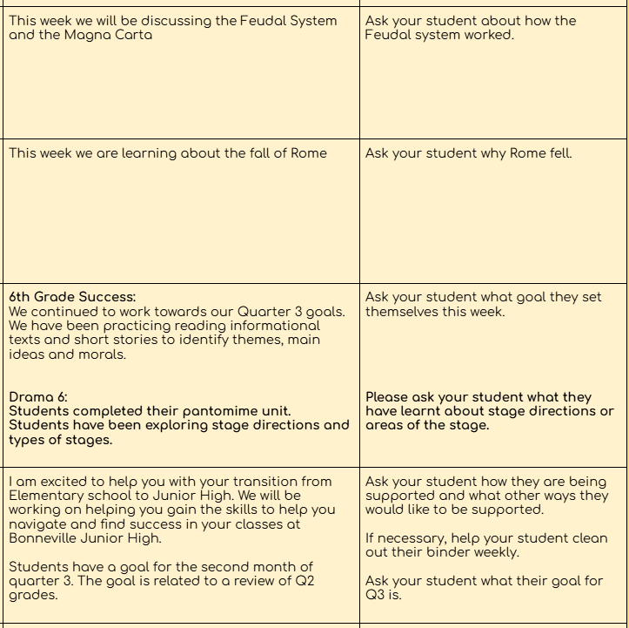
Example: Weekly Newsletter
Teacher name, email, and content
Outlines the content taught each class that week
Suggests a question that the parent can ask their child to demonstrate their learning
Bonneville Junior High:
6th grade newsletter
7th grade newsletter
8th grade newsletter
Facilitating Transparency for Parents on Content Taught and How to Support
Notes:
Takeaways:
One community wanted more consistent communication from teachers on what their students were doing in the classroom. A weekly newsletter was created. It is updated each week so parents know what their child is learning and a question to ask them at home. Parents love the transparency as it gets away from the typical “how was school today?” question.
Minimal work from teachers (updating once a week), but high output in terms of being valued by parents.

Slide 9

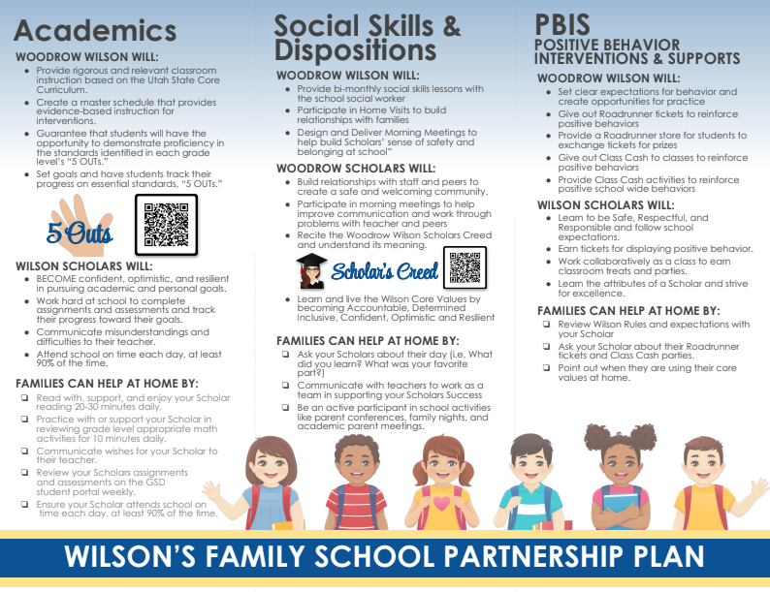
Creating Family-Friendly Compacts
Parent compacts are required for Title I schools. Their components include:
What the parent can do to facilitate student learning
Student expectations
And how the school’s role in facilitating learning
But having a parent compact is best practice for all schools! These outline how parents can support their child.
If a school would like help in designing a compact, the Community and Family Engagement Department would love to help!
Examples of Compacts:
Granger Elementary
Moss Elementary
Hillsdale Elementary
Truman Elementary
Wilson Elementary
Notes:
Takeaway:
A parent compact is a brief document that outlines the teacher’s role in student learning, and also what the parents do to support learning at home, and what the student’s responsibilities are when it comes to learning.
The document explicitly outlines what everyone needs to do for the child to be successful. Simple, yet profound in outlining roles.
The best compacts also provide resources for families.
Compacts are required for Title I schools. But having one is best practice as it provides clarity for families.
Linked here are examples of compacts for several schools.
If you would like to have a compact, reach out to parent and family engagement. They can customize one of their templates easily for you.

Slide 10
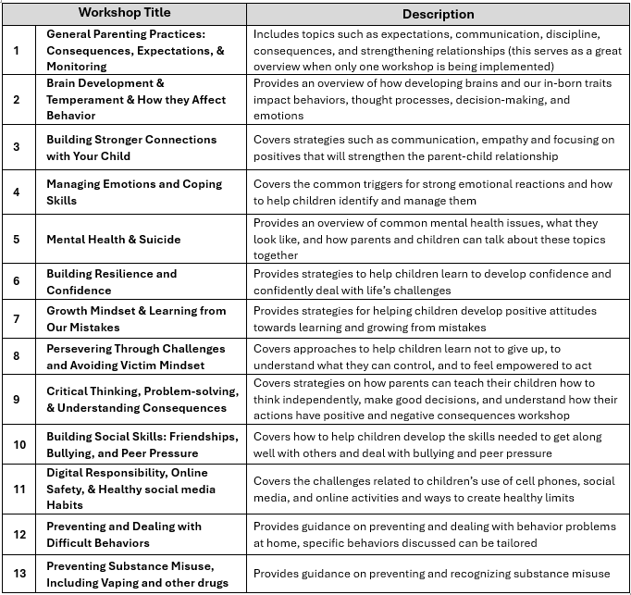
Project CREST
A resource to provide resiliency nights for schools and/or networks
Workshops can be designed for parents/caregivers and students to learn separately, together, or some combination, depending on the amount of time available.
The length of workshops can also be adjusted as necessary, but we recommend no shorter than 30 minutes.
*Capacity is limited. Reach out to Shawn Nielson if interested.
Notes:
Takeaway:
Project CREST is an initiative that many of you use to build facets of resiliency in students.
This organization has several ways they can interface with schools. One that we will highlight is that they can host a district resilience night, focusing on over a dozen topics.
If your network is interested in hosting a resilience night, please coordinate through Shawn Nielson.

Slide 11
Nudge Letters - A Network Initiative?
How to request these letters for your school:
Go to the Student Services Intranet site, scroll to attendance resources, and then select Nudge Letters
You must click on “[Order]” to place an order
These letters can be requested for your entire network at any interval of frequency.
Student Services can email to principals the most improved attendance by network at the end of each quarter.
If desired, networks can use network funds to have student Nudge Letters printed and sent to schools after the end of each quarter (or at any interval)
Networks might use these to consider how to have network attendance initiatives.
(student name and parent information will appear here)
Notes:
Main takeaways:
Nudge letters have been promoted several times before.
Just making you aware that this can be a network initiative.
You can have network competitions, awarding schools with the most improved attendance
You can select the intervals to send these letters (does not need to be quarterly)
Network funds can pay for these letters
There is no charge for schools to be sent a digital file of every student, but there is a printing charge for printing.
These letters can be sorted in multiple ways, depending on preference (by teacher, by home room, etc)

Slide 12
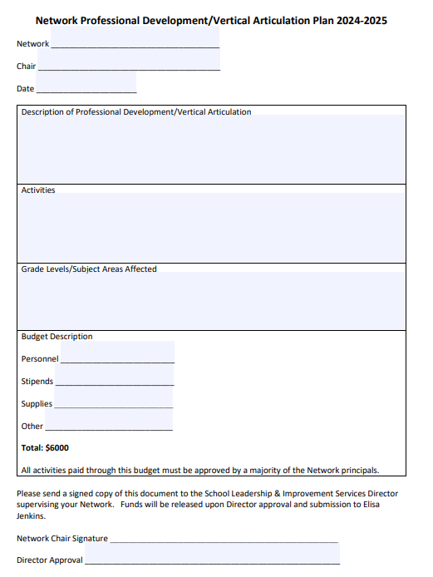

Paying for network initiatives
TSSA (PROG 5678) funding can be used to provide a light meal or snack to school parent engagement events.
Remember the event must primarily build parent capacity to support their child academically. Not just informational (such as SEPs) and not entertainment events. Think literacy nights, math nights, etc.
Read full TSSA Parent Engagement FAQ here
First look to use your network budget.
Network budgets are set up under program 9196. A network’s budget is set up under the location of the network chair. Elisa Jenkins in the point of contact for these funds, which is $6,000. In order to spend, network chair submits their network plan. Once approved by their L&I director, the network budget is set up in QSS.
Schools can contribute their own school funding on network initiatives.
The most appropriate funding source would be Student Body (PROG 2120). Schools can add more funding into Student Body from School Operations (PROG 2001) as needed.
To facilitate purchasing services which all schools in the network will contribute:
First utilize the available network funds
Then have the person making the payment (presumably the network chair) make the purchase(s), billing their own school’s account (i.e. Student Body).
In rectifying the purchase later, you will facilitate a Journal Entry that will move the expense(s) to accounts at all the other schools proportionate to how many students they each have.
What if the event is being paid (in part) by a donation? If part of the event will be paid by a donor, they can donate either through GEF or to the school directly (if through the school directly, make sure to fill out a donation form). The donation should go to the school responsible for the network funds. The best way to set up the donation is into the school’s Student Body account, setting up a Cost Center unique to this donation. If schools need assistant with this process, they can call the Accounting Department if needed.
School Network Plan template
Notes:
Main takeaways: first use your network funds. This is the minimum amount of money you should spend on network initiatives. Schools can pool other funding to support network initiatives. This slide is a reference for some of the logistics of facilitating journal entries and handling donations for network events.

Slide 13




Consistent Parent Engagement Efforts
Principal Reflections on Parent Events
Notes:
Main takeaways:
Parent engagement is most effective when it leads to improved student outcomes. True parent engagement builds the capacity of parents to support their children academically. These events typically aren’t “one and done”; rather, there is a mapped out plan for parent engagement that builds on and reinforces content taught to parents throughout the year.
Consistent parent events that allow parents to get into the weeds with what their child is doing and concrete ways the parent can support their child - these are the types of events that make an impact on student outcomes.

Slide 14
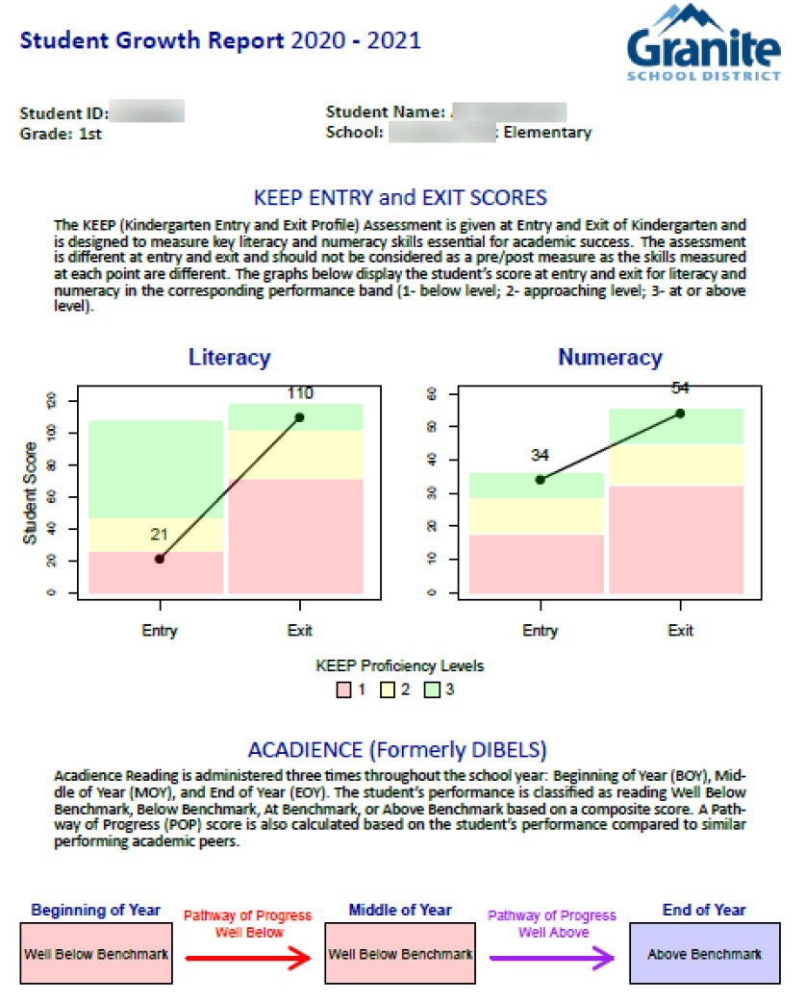
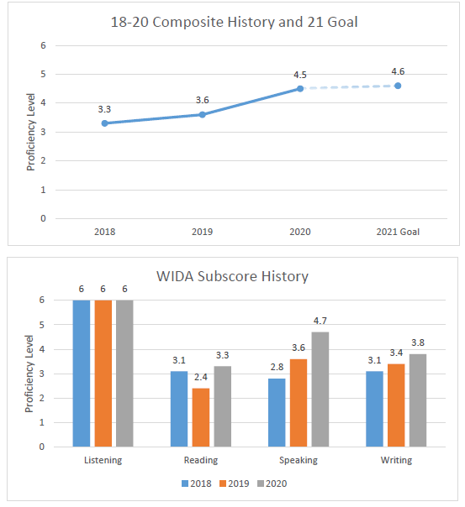
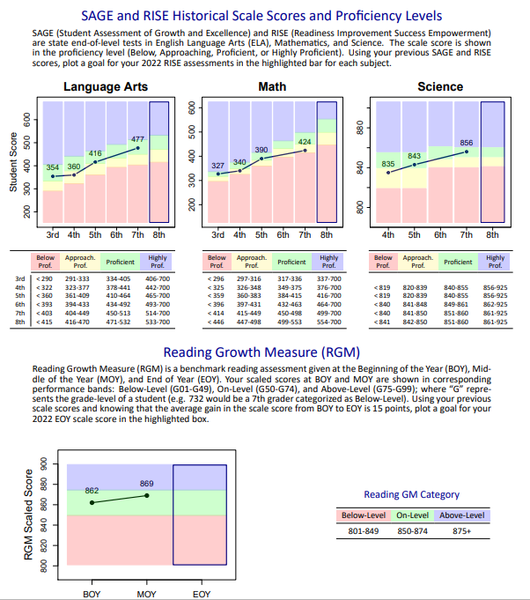
SEPs / Parent Teacher Conferences
Academic parent evenings should include three components:
Data to provide to the parent in a way they understand
Goals established for the student, also presented in a way the parent can understand
Parent resources tied to student learning which inform the parent how they can support their child academically (see next slide)
Explanatory videos (for a teacher audience): how to explain these Fall data sheets to parents of 1st, 5th, 7th, and 10th grade students
Notes:
Main takeaways:
We have some amazing resources for parents that are used by many schools throughout the district, and often during SEPs.
But what we are finding is that teachers aren’t very comfortable knowing how to explain these to parents, so they don’t. Teachers usually just hand these to a parent.
Suggested practice: about a week before SEPs, the principal explains to teachers how to use these sheets. Otherwise, a teacher wouldn’t feel comfortable explaining these to a parent. They feel that they won’t know how to answer questions, etc.
By principals explaining/modeling how to use these sheets, we are eliminating a barrier for this being a valuable tool for parents.
We had one principal do this. She went around to each PLC, modeled how to read different student data reports to the point where her teachers felt comfortable having a conversation with parents in SEPs that were anchored in these data sheets.
And a success story is (advance to the next slide) we had a parent say this was the first time they understood how their student was doing.
When teacher is more comfortable sharing data, they are less likely to lean into difficult conversations about low achievement.

Slide 15

This is the first time that I really feel like I know how my child is doing.
Notes:
Again, the difference was the teacher using the data sheet provided by Student Assessment.
It would take maybe out ten minutes in a faculty meeting or going around to PLCs of the principal explaining to the teachers what the sheet is and how to use it so they feel comfortable using this tool with parents. Worth the time in doing so.

Slide 16

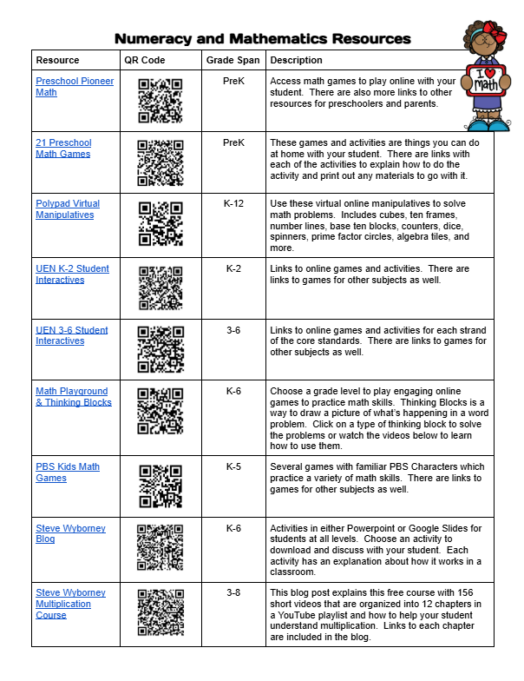
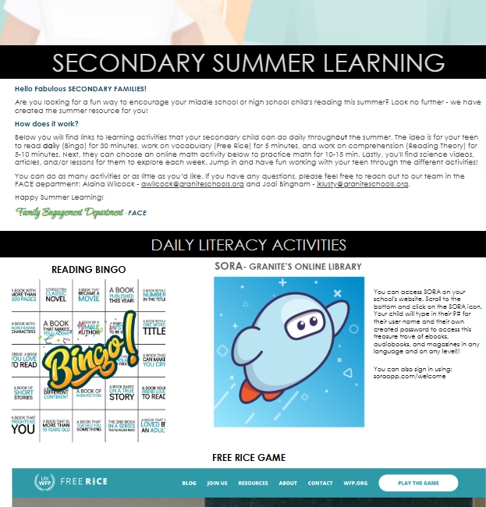
Question to consider:
How can parent resources be promoted at school or network events?
Elementary Math and Secondary Math Resources linked here.
Elementary Summer Calendar linked here
Secondary Summer Calendar linked here
Secondary Literacy Resources linked here and here.
Literacy and Numeracy Resources
Notes:
Main takeaway:
Schools and networks have amazing curricular resources. We are perhaps remiss when we don’t find meaningful ways to share them with families so they can support their students’ learning at home.
Please familiarize yourself with these various literacy and numeracy resources; you can consider as networks or as schools how your parents can take advantage of these resources.

Slide 17
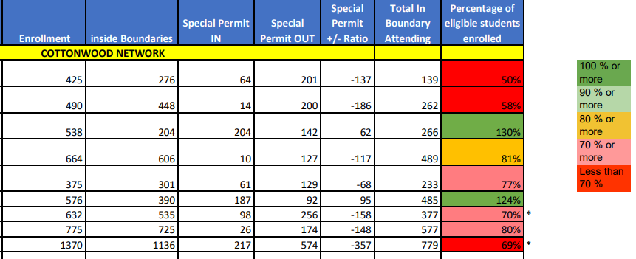
Enrollment Data by School
Possible guiding questions:
What can explain the number of students that permit out of my school each year?
What can explain the number of students that permit into my school this year?
What efforts can be made to recruit more families to enroll in my school?
Some data that can inform parent perceptions and the need for targeted parent outreach
Notes:
Main takeaway:
Of all the data we are presenting you with, we are calling the least attention to enrollment data by school.
As networks, you could briefly peruse these data that indicate your open enrollment data (i.e. % of kids transferring in and transferring out), but this exercise will not be as helpful as the data that will be shared on the next slide.
Note: special permits in can include ALC and DLI.
Don’t be complacent if you are above 100.

Slide 18
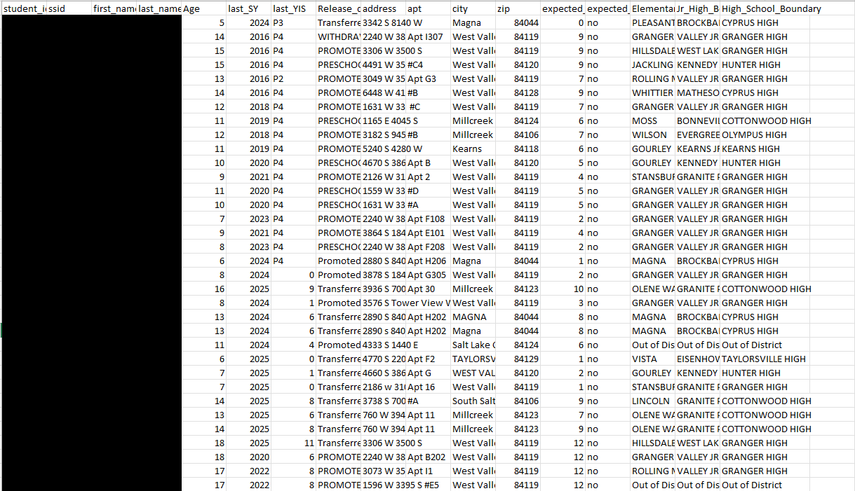
How to read this file of student records
Last school year the student attended in Granite
Expected grade level in 2025-2026
Last grade level the student was in when enrolled in Granite
Last known address (may not be accurate)
Notes:
Main takeaways:
In a collaborative effort with IS and research analysts in the district, we found all students who ever were in Granite but who have dropped for some reason (and as far as we know, they still live in the same school boundary).
We were able to sort these lists and create a folder for you that outlines students who once attended in Granite, no longer do, and live in your school boundary.
These data give you as the school principal an opportunity to reach out to students in your boundary to find out if they still live at that home, and advertise your school.
This slide outlines how to read the various columns.

Slide 19


Reaching out to Unenrolled Students
Shared Network Drive:
-List of students who at one point enrolled in Granite, are no longer enrolled, are of age to attend your school, and their last known address was in your school boundary.
One approach you can take:
-Create a promotional flyer that highlights your school
-Stop by the home with two staff members, indicating you are introducing yourselves community members
-Build relationships, inviting the family to school events, letting them know we miss having them in our school system and would love it if they consider enrolling now or some future time.
Notes:
Main takeaway:
Kearns Junior did this exercise last summer. They found over 200 potential students who once attended GSD and as far as they knew still lived in the school boundary. They visited around 65 homes.
In those porch visits, there was not one negative interaction. All were positive, and the school was able to introduce themselves, build connections between the home and the school, and shared with them promotional materials of why their local school was the best option.
As a result 12 students came back and enrolled in the school.
Again - the suggestion is that you look at your list of students and be strategic in who you reach out to.

Slide 20
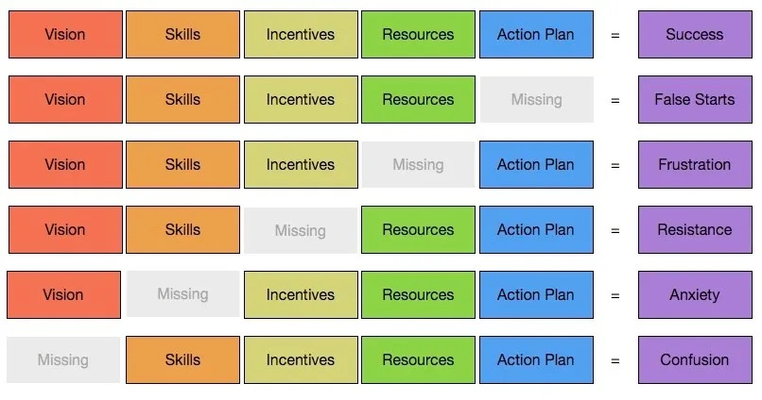
Protocol
Notes:
Ideas to perhaps put somewhere as reference on the protocol sheet:
#1. Have a shared folder for communication...google works best...take good notes, keep past records, etc.
#2. Plan meetings out for the whole year...same time, schedule place...we rotated in the Cottonwood Network, but in Hunter Network we keep it in one place
#3. Decide early on a network goal...we focused on our network night and getting our graduates out to the school
#4. If a network night is happening...make it a big deal...go big or go home...hahaha!
#5. Assign out tasks to the whole group...check in monthly to make sure deadlines are met

Slide 21
In Your Networks
Start creating your Network Plan for 2025-2026. Please consider:
Identifying areas of strength and barriers in your network.
Creating an action plan to address these areas.
Outlining how network meetings will be utilized next year.
Identifying now some data that will be tracked in network meetings.
  What data will we track to measure our progress?
  How often will we view these data?
We will pause discussion and invite a brief share out of your ideas generated so far in 25 minutes.

