Slide 1

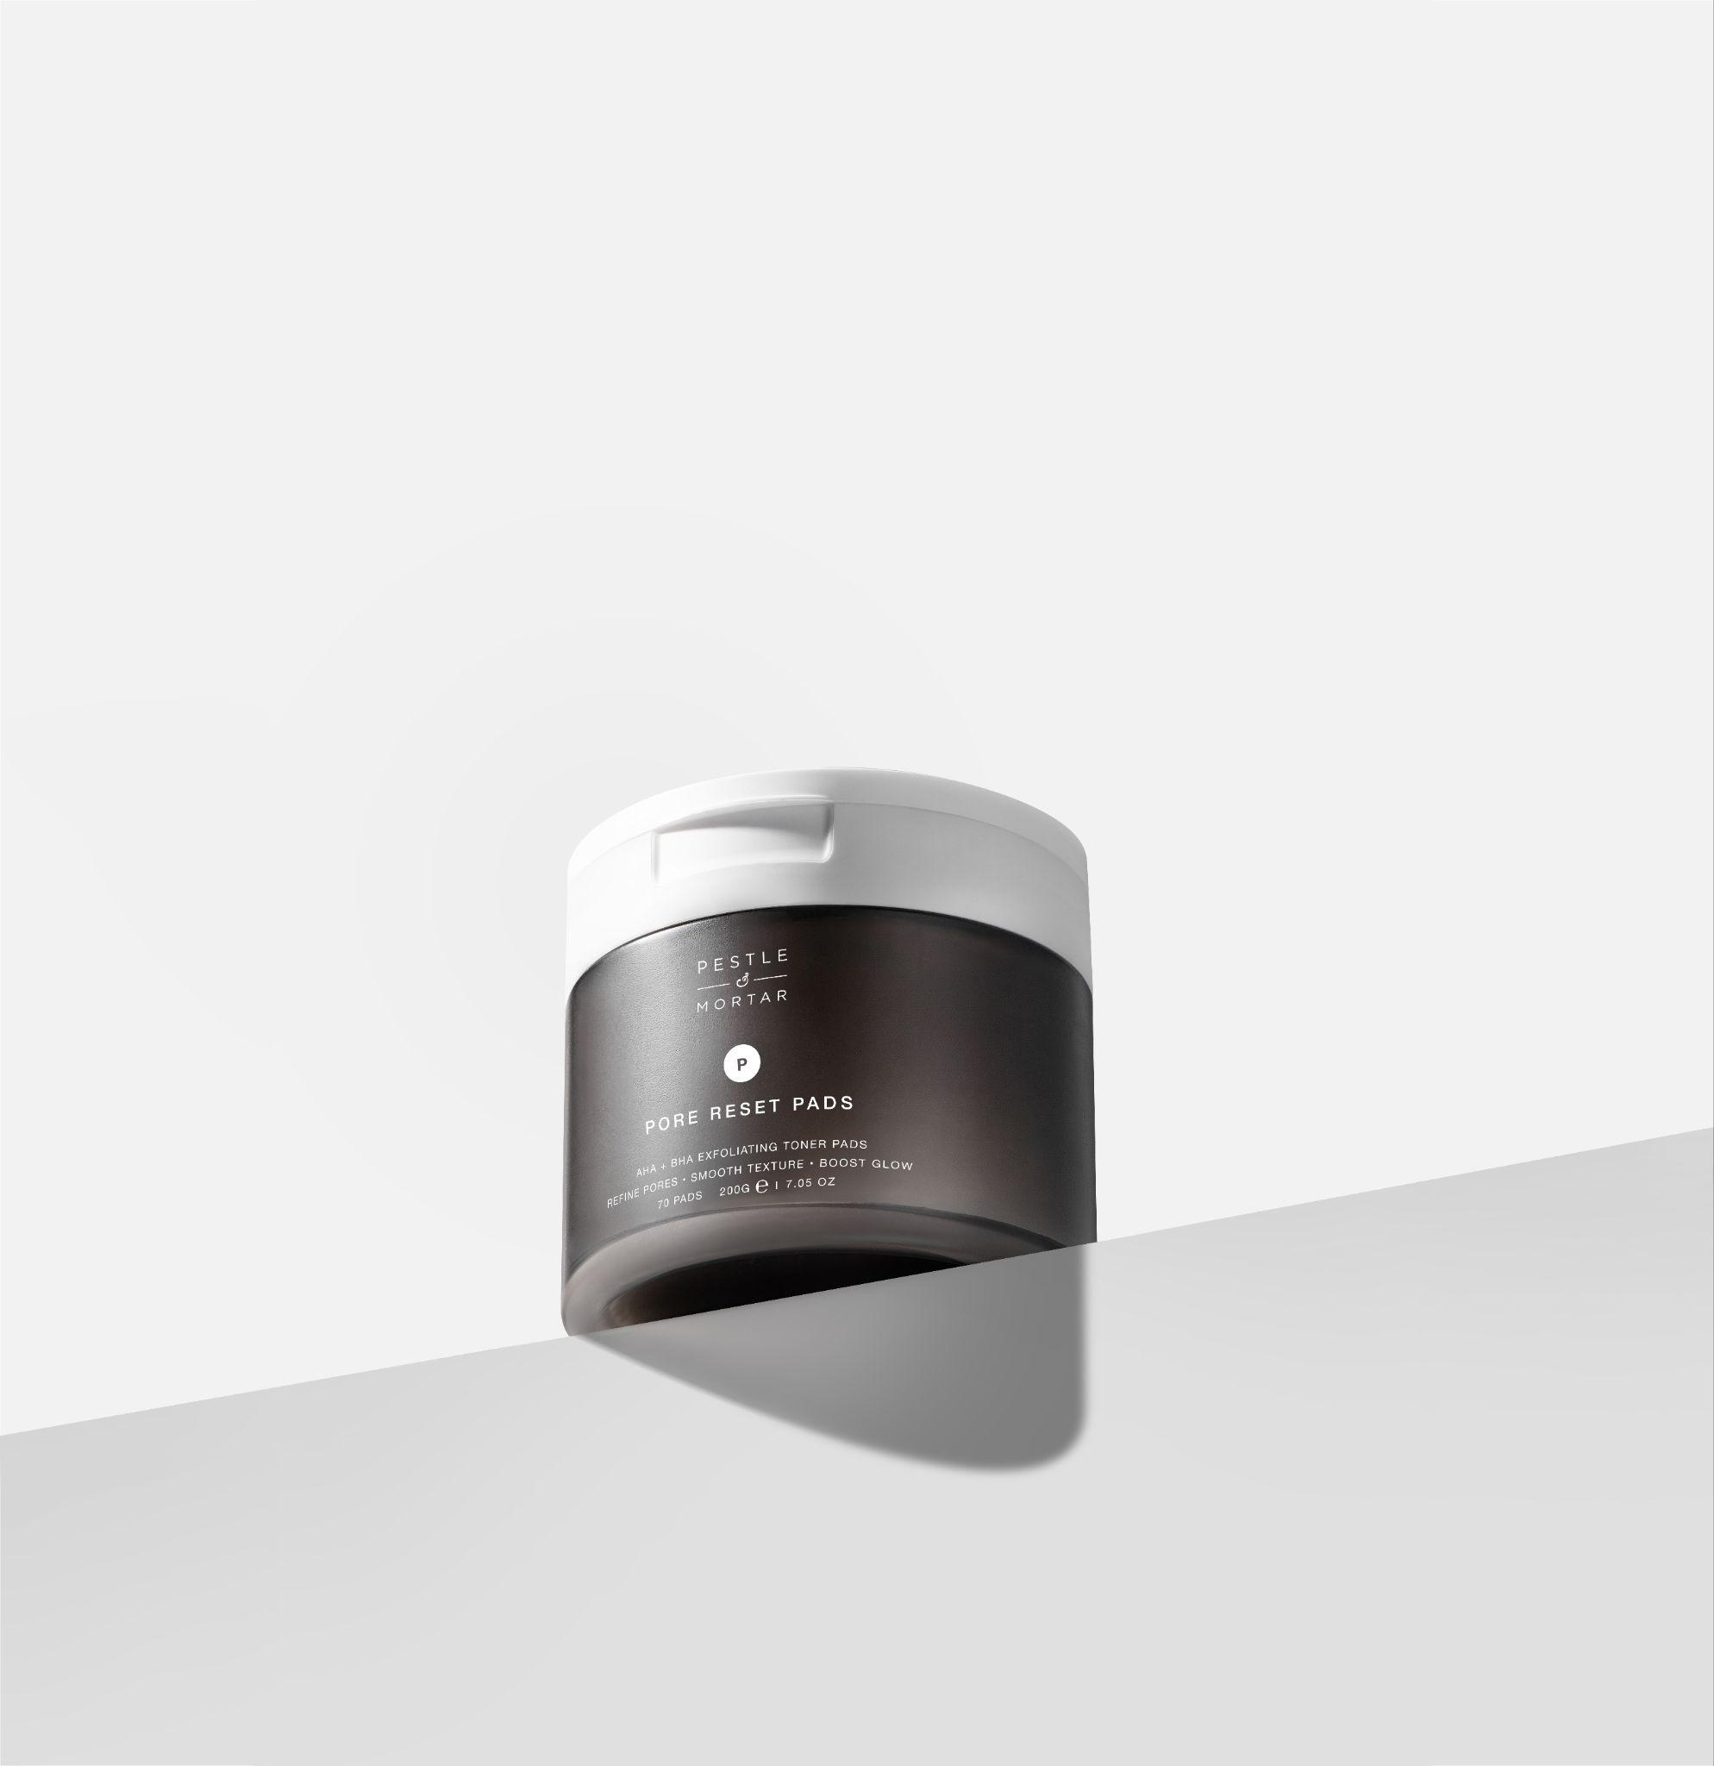
NEW
No sting.
Just smooth.
Pre-soaked exfoliating toner pads — refine pores, smooth texture and boost glow, without stripping the skin.
PORE RESET PADS
AHA + BHA
NO STINGING
70 PADS
BARRIER-FIRST

Slide 2
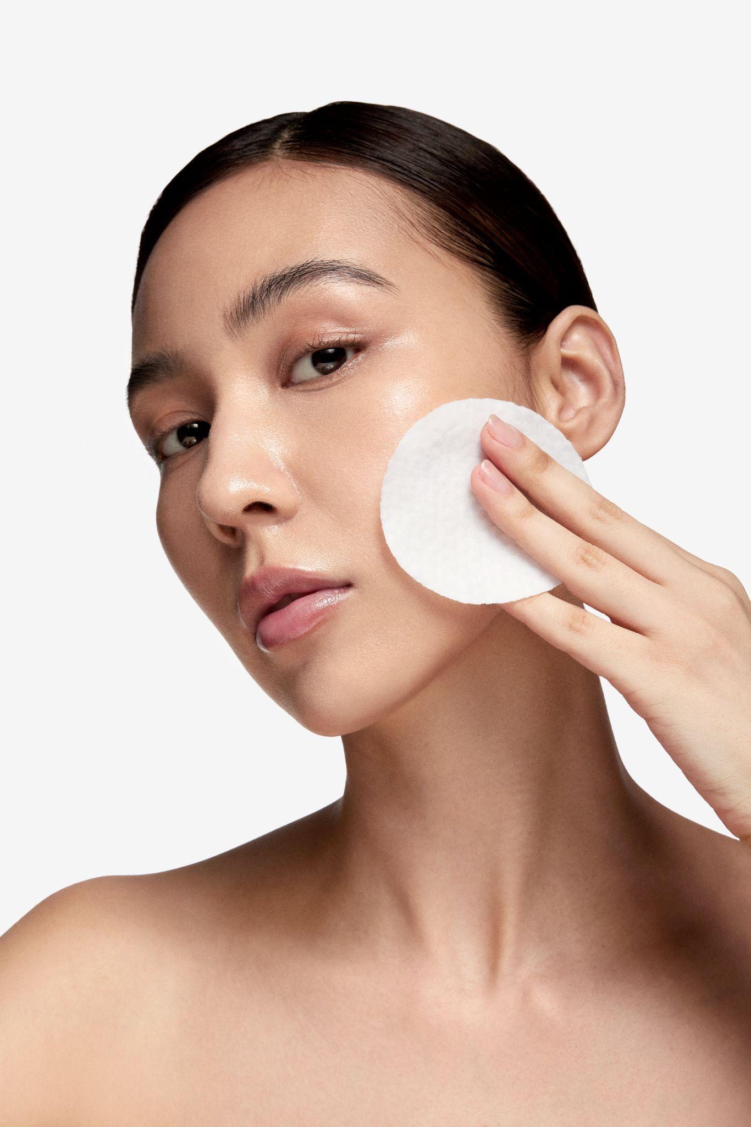
THE CATEGORY PROBLEM
Most acid pads exfoliate
then leave skin stripped.
Sting, irritation, a sticky film — and rarely the smooth, clear skin your customer actually wants. A gap on shelf for a barrier-first acid pad.
02 / 16

Slide 3
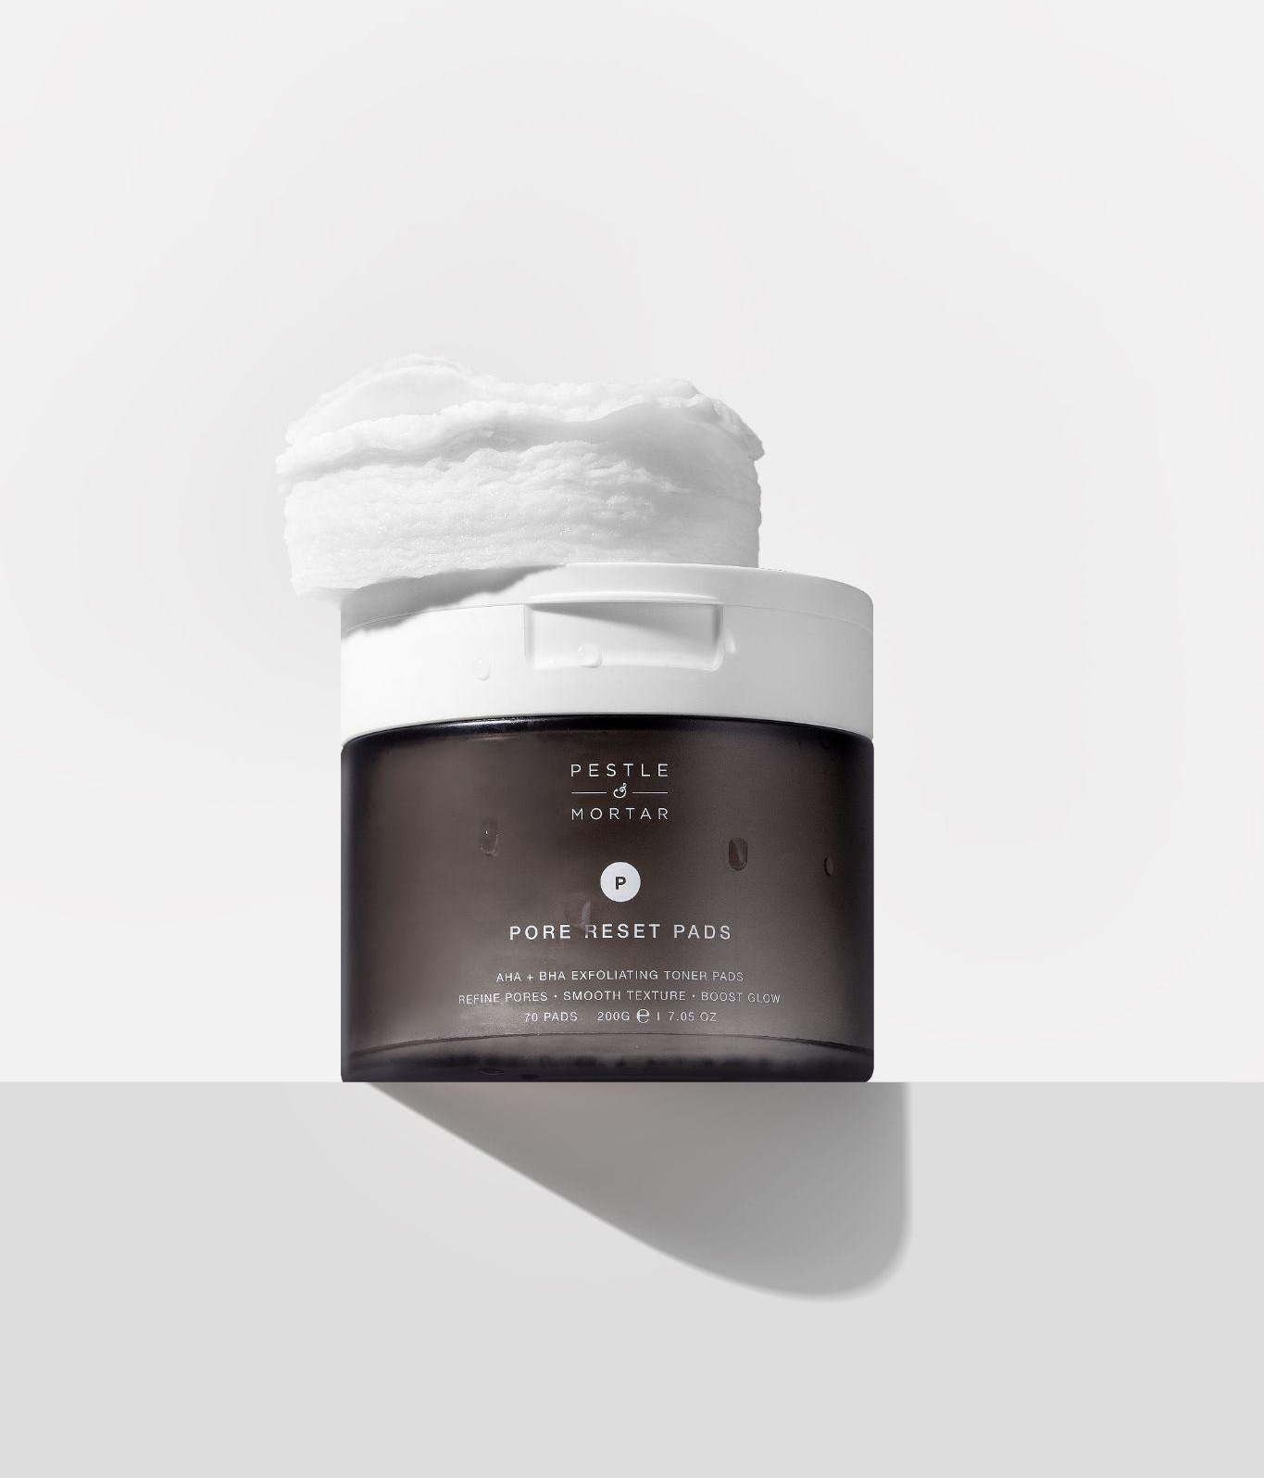
[IMAGE: pore_reset_pads_editorial.jpg]
NEW
Pore Reset Pads.
Three exfoliating acids and a calming Centella complex — clear, calm and renew skin in a single step.
3
70
2 Sides
ACIDS · AHA + BHA
PADS PER JAR
PER USE
+
Refines pores and smooths uneven texture.
+
Boosts glow without stripping the skin.
+
Calms and supports the skin barrier.
70 pads · leave-on toner
03 / 16

Slide 4
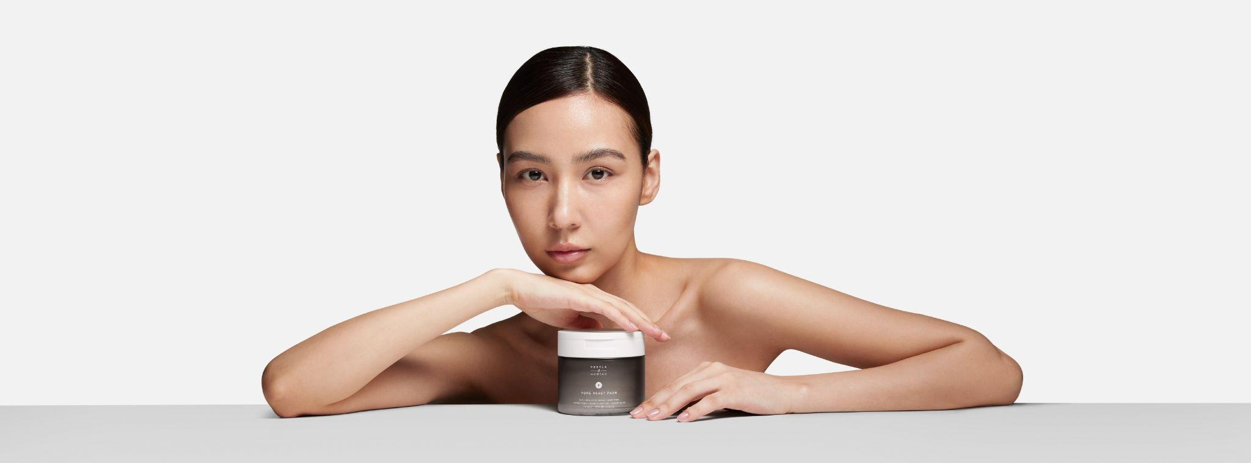
[IMAGE: pore_reset_pads_lifestyle.jpg]
K-BEAUTY INSPIRED · MADE FOR SENSITIVE SKIN
No sting. Just smooth.

Slide 5
AHA + BHA Zero Pore Complex.
— LACTIC ACID (AHA)
— GLYCOLIC ACID (AHA)
Refines texture, fades pigmentation and hydrates.
Exfoliates, accelerates cell turnover and brightens.
— SALICYLIC ACID (BHA)
— CENTELLA ASIATICA COMPLEX
Unclogs pores, dissolves excess oil and refines texture.
Calms redness, soothes irritation and supports the barrier.
Formulated without drying alcohol — strong enough to refine, gentle enough for sensitive skin.
05 / 16

Slide 6
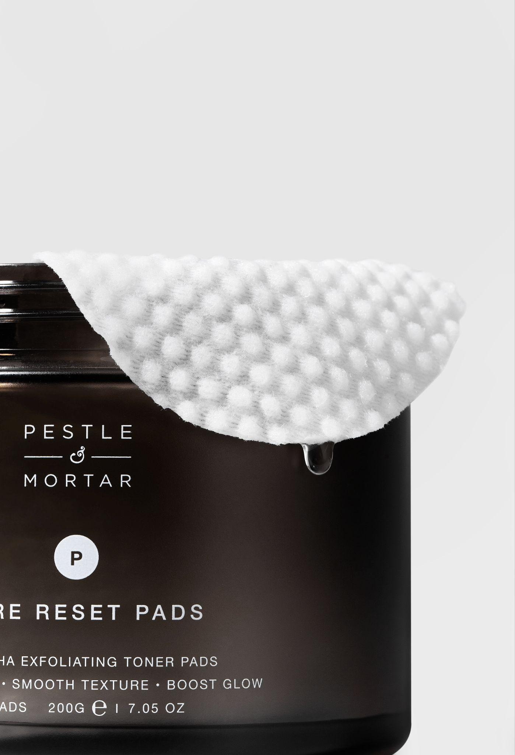
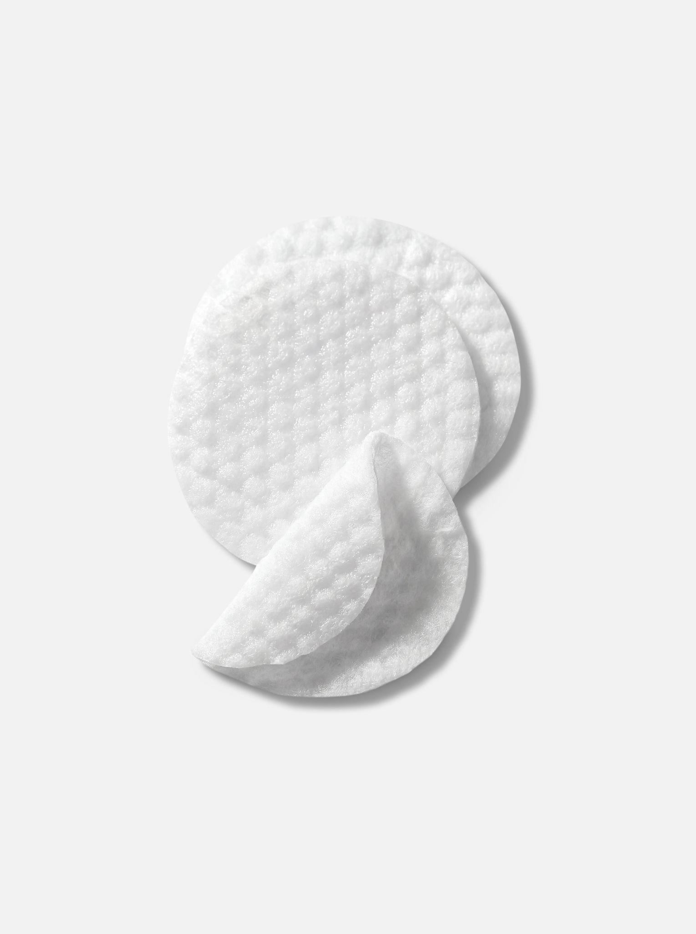
ONE PAD · TWO PHASES
Exfoliate and soothe in one step.
— TEXTURED SIDE
— SMOOTH SIDE
Sweeps away dead cells and clears congestion for a brighter, smoother surface.
Flips to tone and flood skin with a calming Centella complex — left renewed, not raw.
PORE RESET PADS · STOCKIST PITCH · CONFIDENTIAL
06 / 16

Slide 7
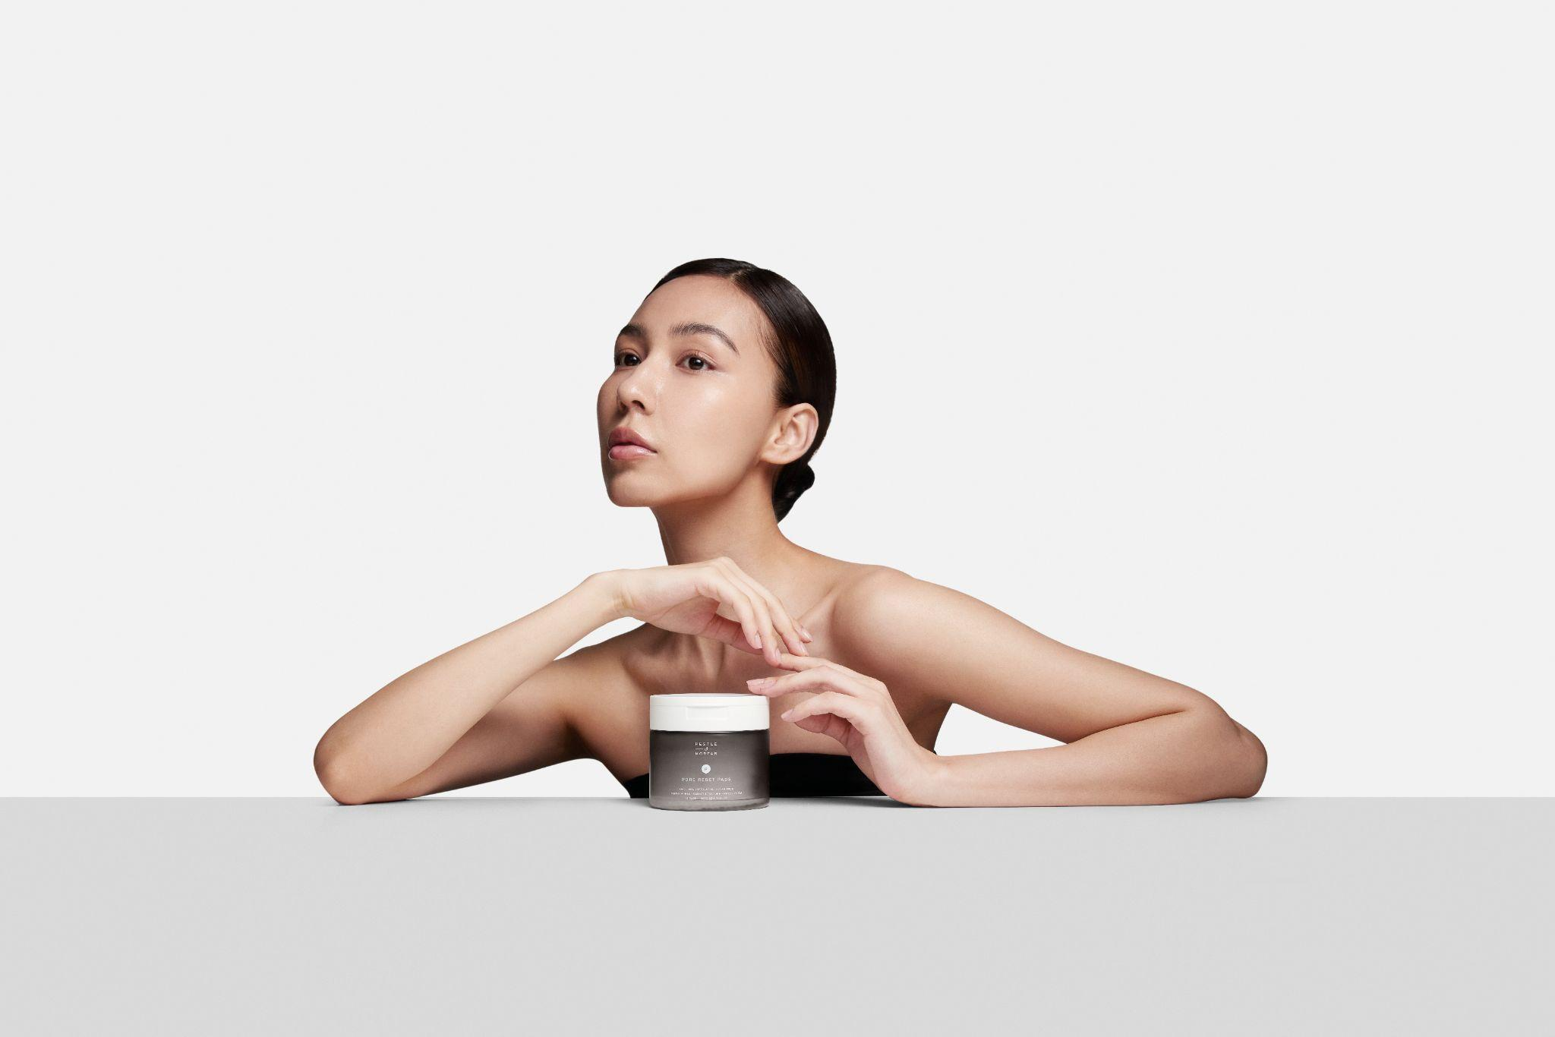
WHY IT SELLS
Strong on results. Kind to skin.
— NO STING, JUST SMOOTH
A barrier-first formula, free from drying alcohol.
— HONEST GUIDANCE
Clear usage, real before-and-after expectations, no guesswork.
— NON-STICKY FINISH
Glides on, no residue — makeup goes straight over the top.
— SENSITIVE-SKIN FRIENDLY
Centella, Allantoin and Panthenol soothe after every use.
PORE RESET PADS · STOCKIST PITCH · CONFIDENTIAL
07 / 16

Slide 8

THE FOUNDER
[IMAGE: sonia_deasy_portrait.jpg]
“What always frustrated me about exfoliators was the trade-off — results, but skin left stripped for days. Pore Reset Pads solve both in one step.”
Sonia Deasy
CO-FOUNDER · PESTLE & MORTAR
08 / 16

Slide 9
HOW TO USE
Two minutes. Two nights a week.
01 STEP
02 STEP
03 STEP
04 STEP
Cleanse
Exfoliate
Tone
Pat in
Start on thoroughly cleansed skin.
Sweep the textured side outwards — avoid the eye area.
Flip and glide the smooth side across skin.
Press the remaining toner in. No rinse. Always follow with SPF.
Use 2–3 times weekly, or as tolerated. SPF is essential while using acids and for one week after.
09 / 16

Slide 10
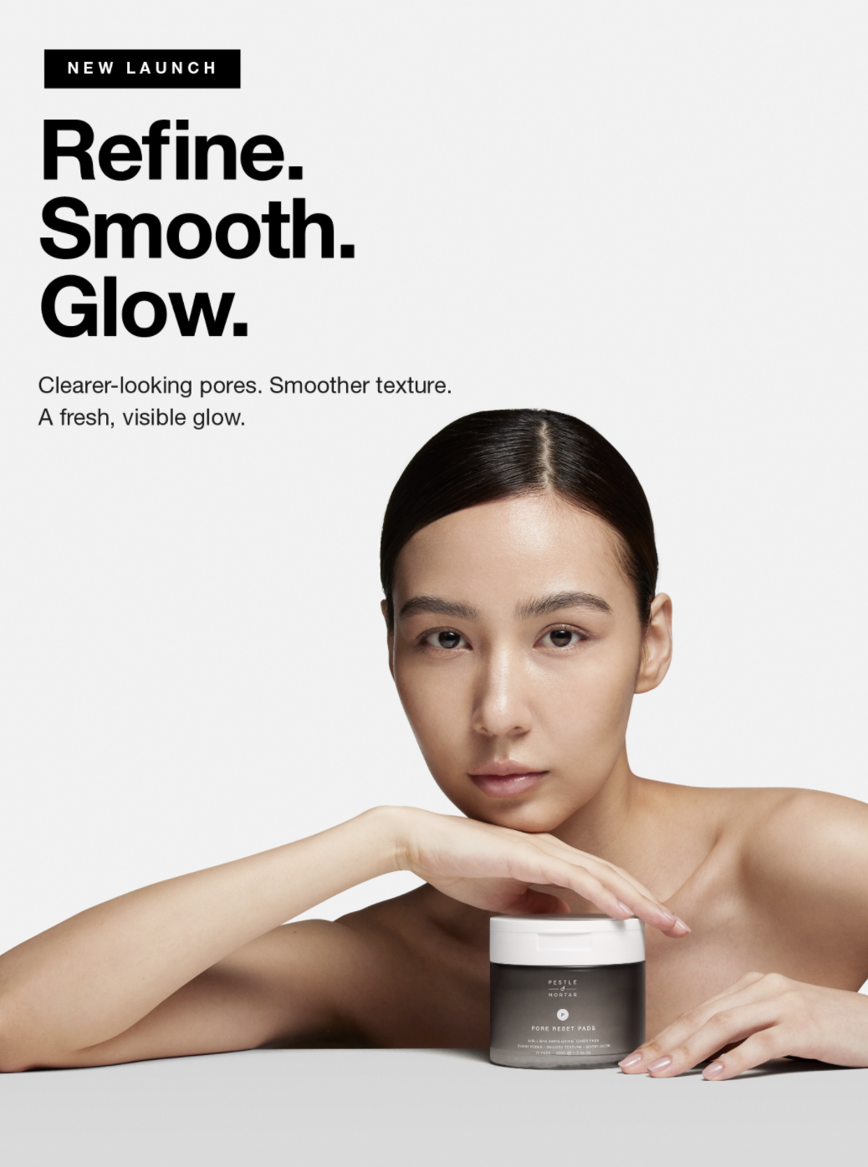
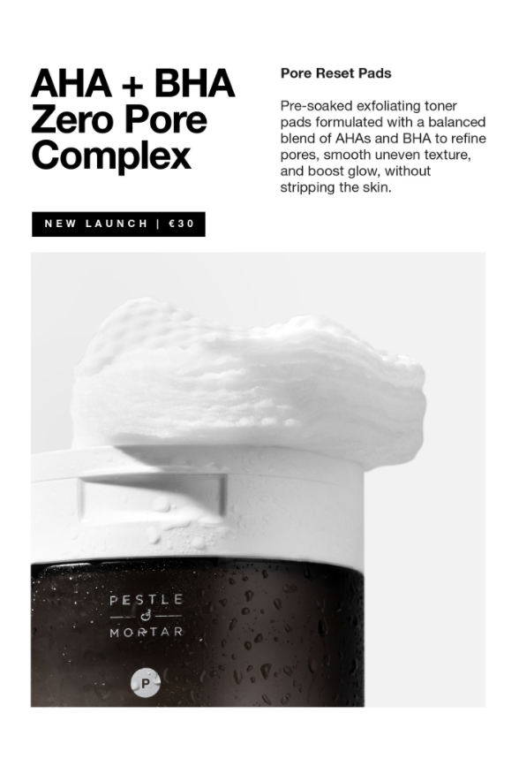
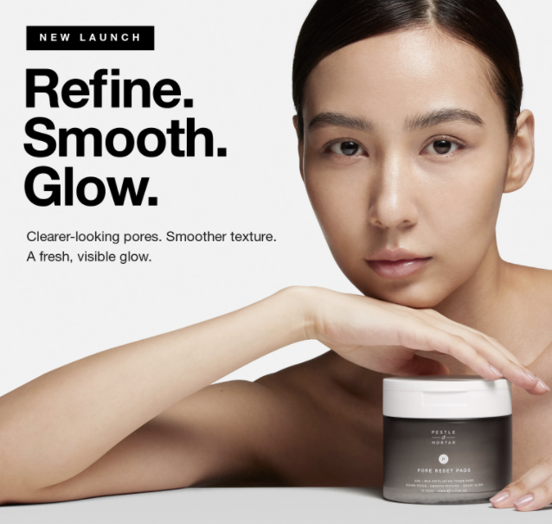
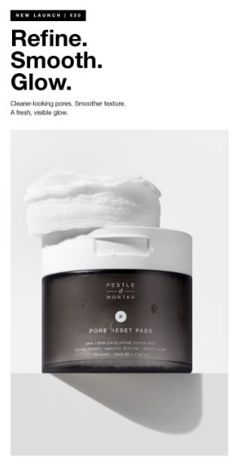
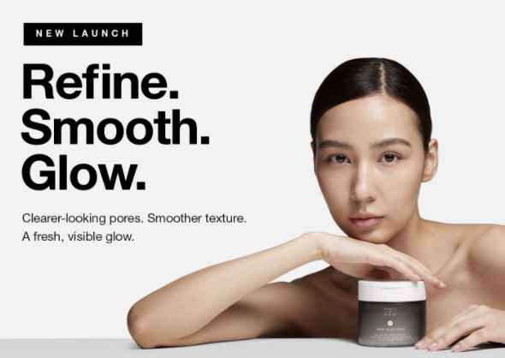
THE COMMERCIAL OFFER
Strong margin. Built-in launch support.
RRP €30
MOQ / 6
70 / jar
RECOMMENDED RETAIL
MINIMUM ORDER QTY
PADS
— LAUNCH CAMPAIGN
Always-on social and digital driving demand to your doors.
— IN-STORE & POS
Shelf talkers and digital assets on request.
— BA & STAFF TRAINING
Cheat sheets and product training for your team.
10 / 16

Slide 11
THE CAMPAIGN · LAUNCH ACTIVATION
A 360° launch. Driving demand to your doors.
Every Pore Reset Pads stockist plugs into a fully-resourced, always-on launch motion — paid, organic, PR, email and in-store all firing at once.
PAID SOCIAL
ORGANIC SOCIAL
PR & EARNED
IN-STORE & POS
Meta and TikTok ads in three formats. Hook-tested, results-led, optimised weekly.
Founder-led content across Instagram and TikTok. Education, application, customer voice.
Targeted press hits in beauty, lifestyle and wellness titles. National and Irish.
Counter cards, frames, tester cards, BA prompts. Day-one POS kit on opening order.
WEEK 0 · TEASE
WEEK 1 · LAUNCH
WEEKS 2-3 · AMPLIFY
WEEKS 4-5 · CONVERT
PORE RESET PADS · STOCKIST PITCH · CONFIDENTIAL
11 / 16

Slide 12
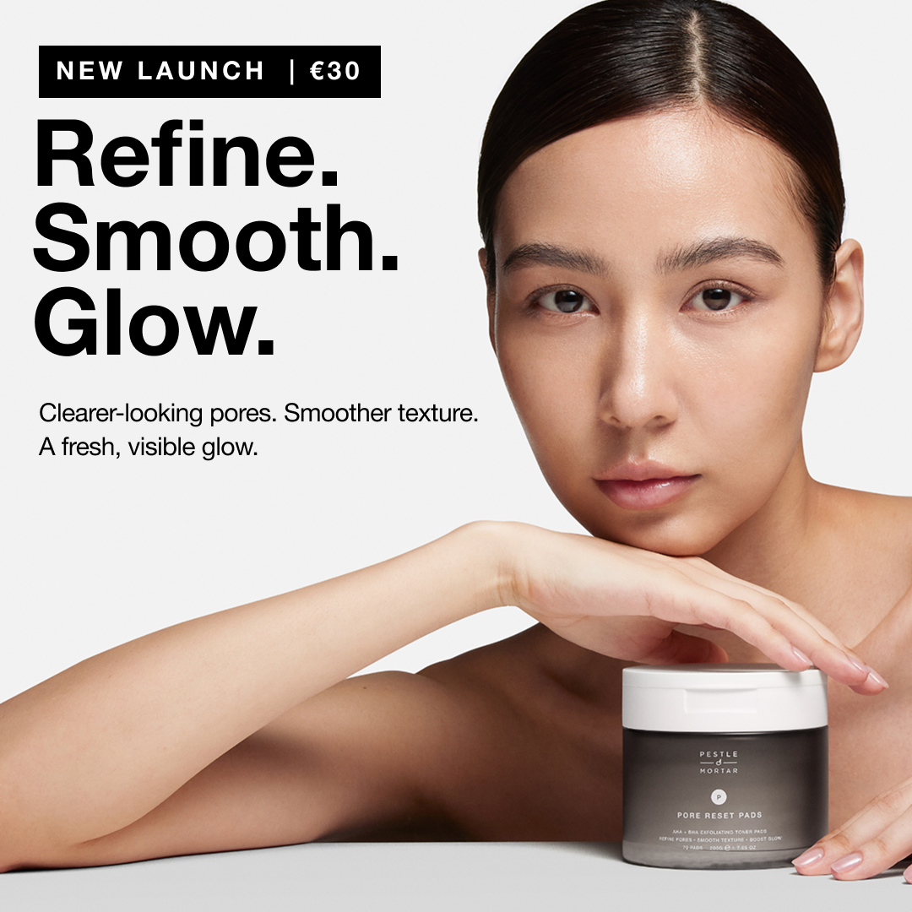
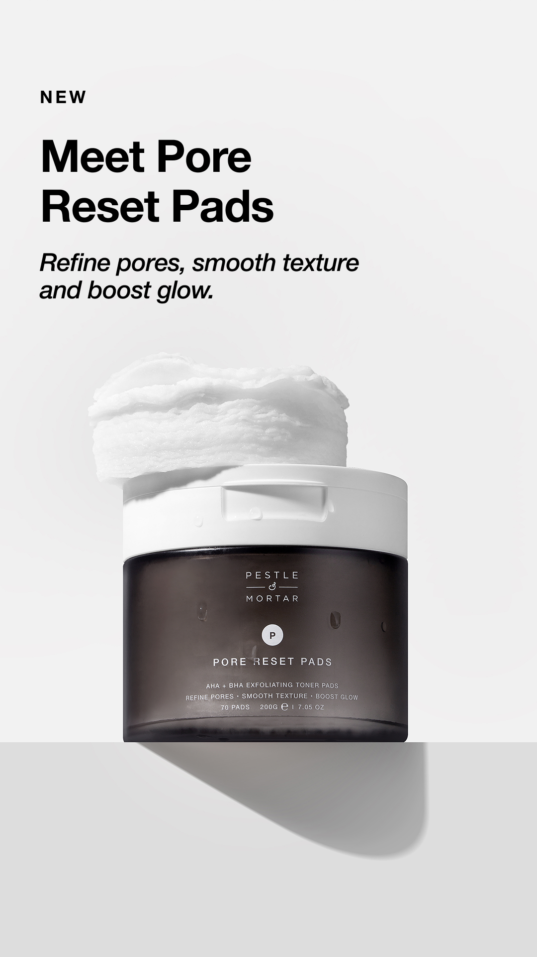
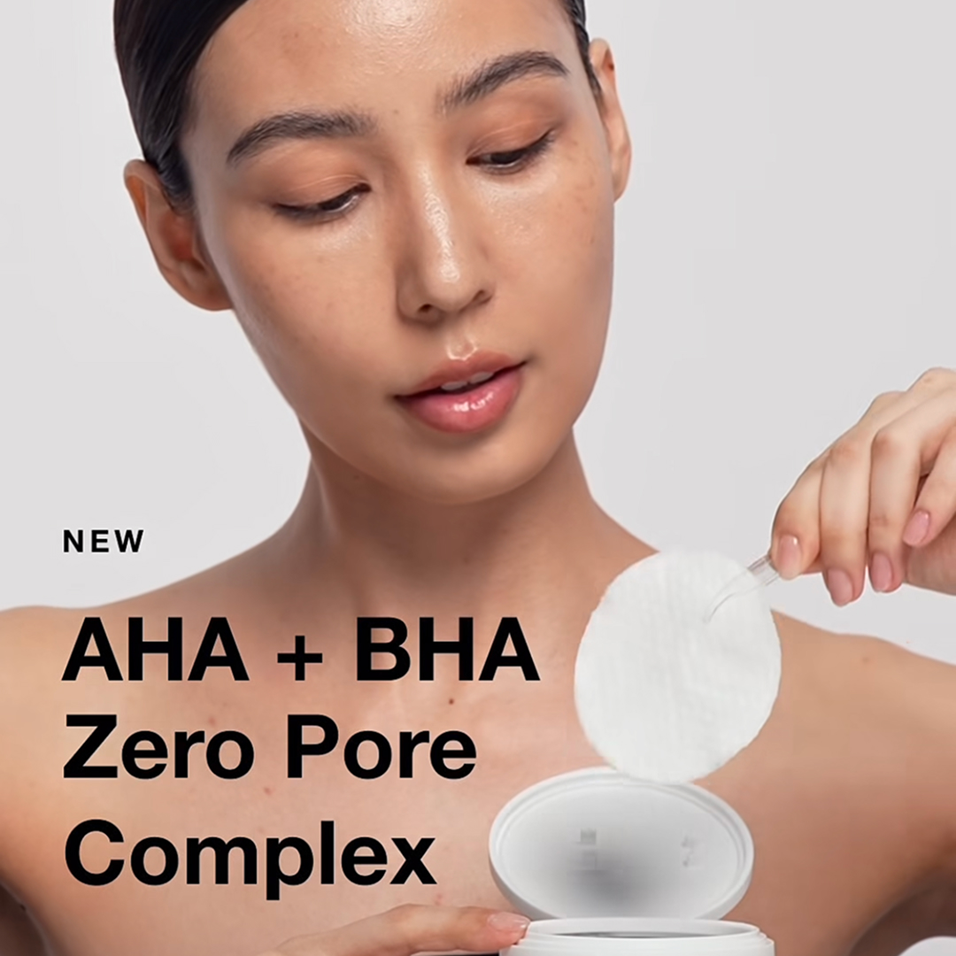
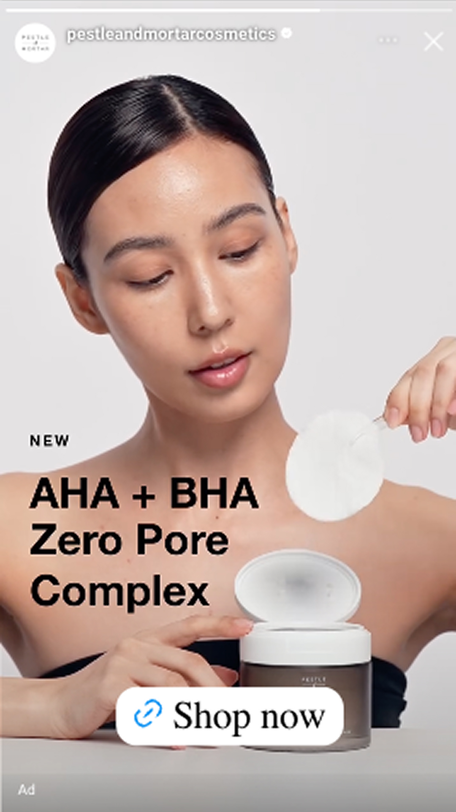
PAID SOCIAL · META + TIKTOK
Hero ads. Three formats. Built to convert.
Always-on Meta and TikTok ads in the three working formats — feed square, vertical and full-screen story. Locked monochrome creative, hook-tested weekly.
IMAGE · FEED · 1:1
IMAGE · STORIES · 9:16
REEL · FEED · 1:1
REEL · STORIES · 9:16
— WEEKLY HOOK-TEST · 3-5 CONCEPTS PER WEEK · HOOK / STORY / OFFER · A/B BY FORMAT
PORE RESET PADS · STOCKIST PITCH · CONFIDENTIAL
12 / 16

Slide 13
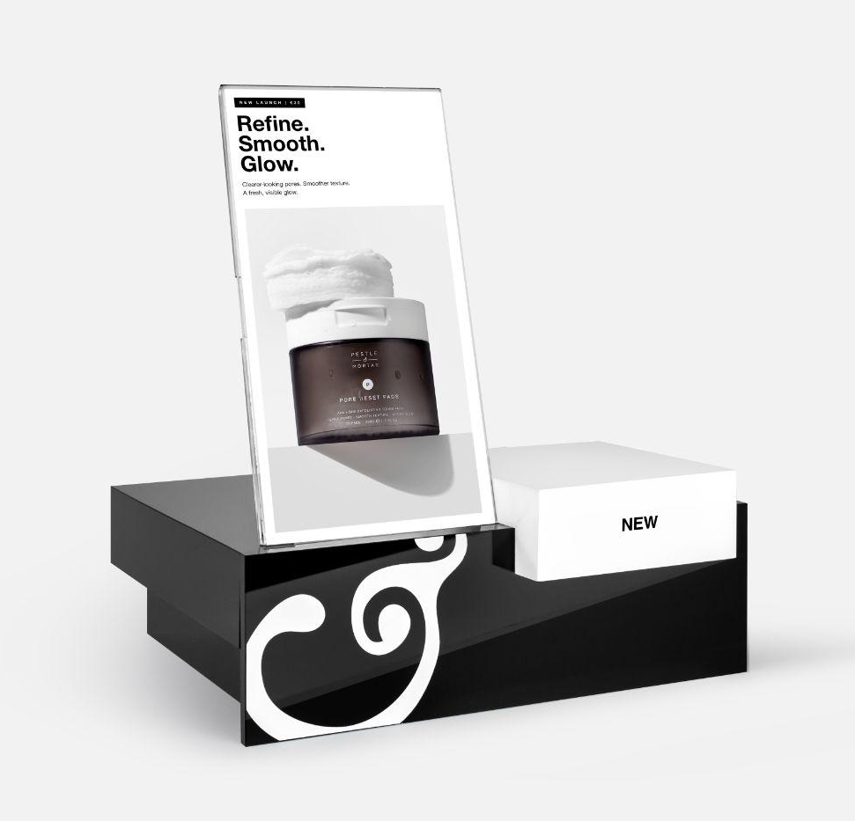
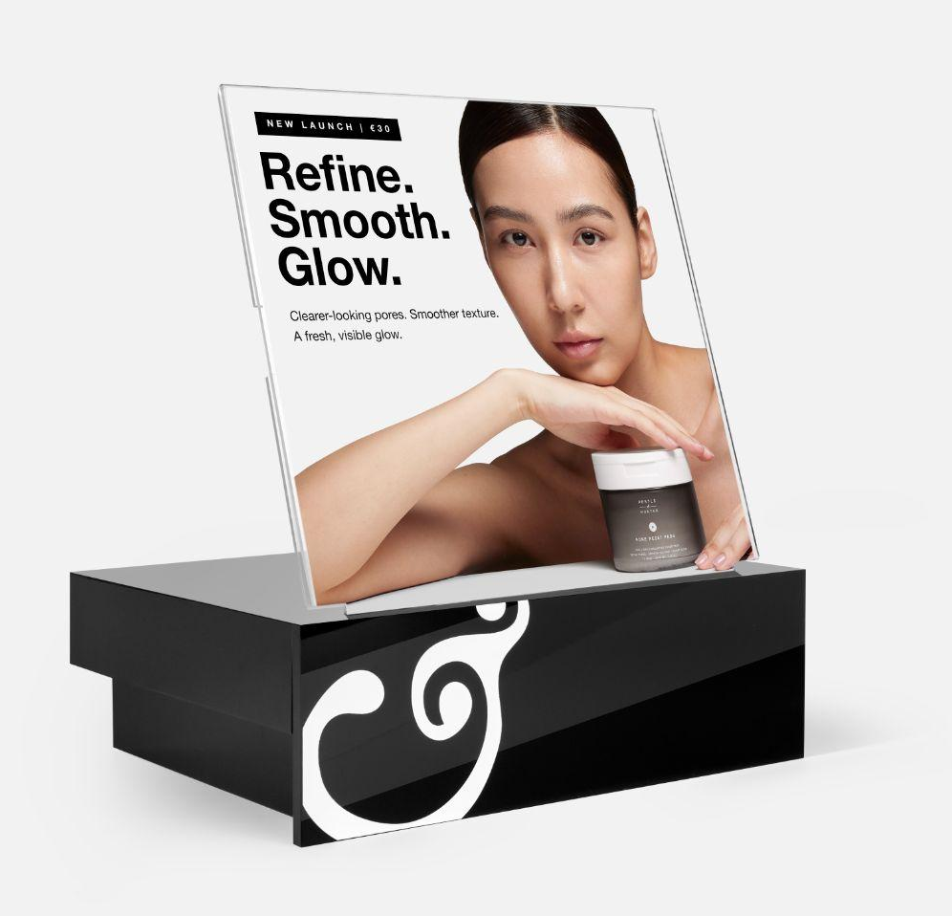
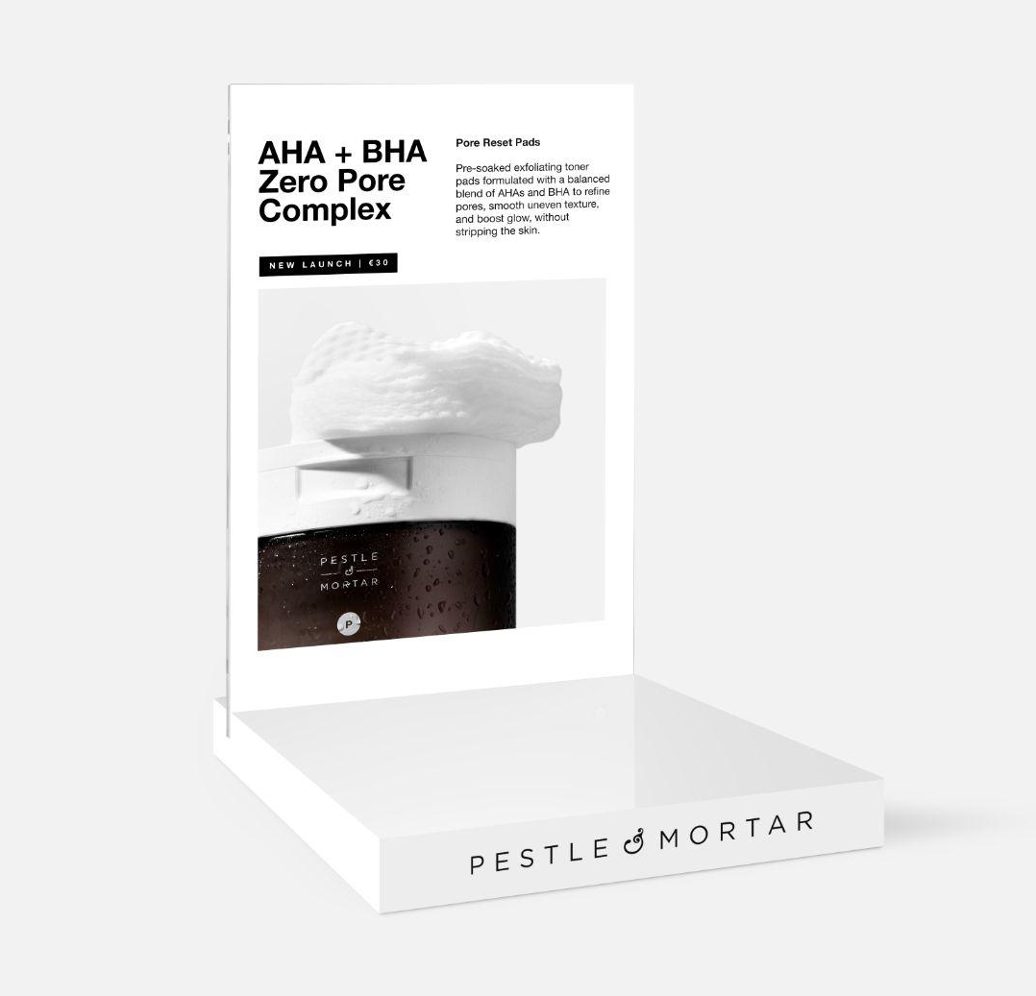
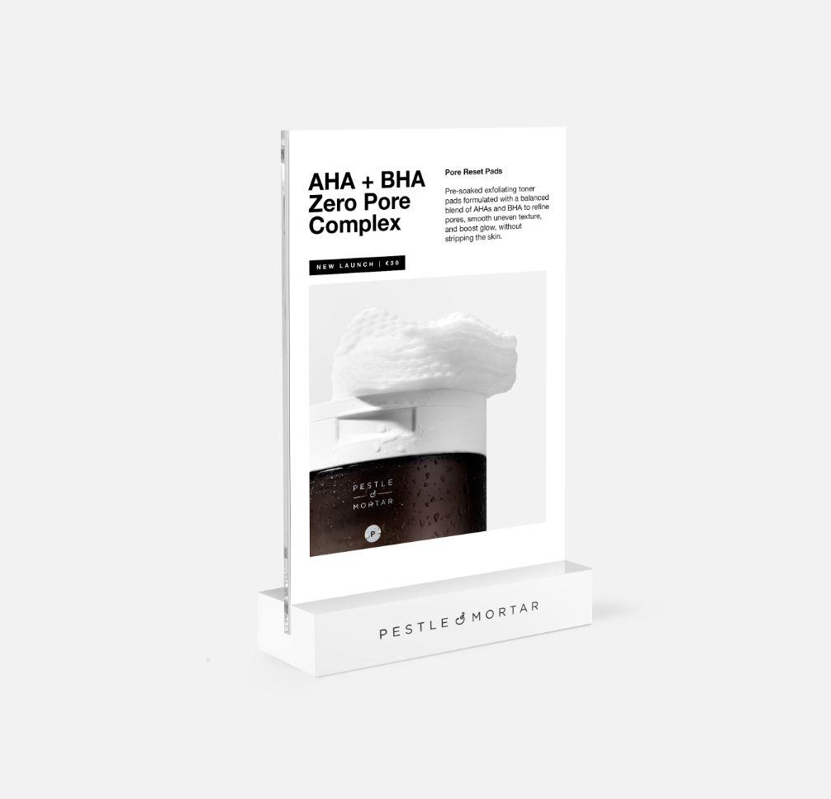
POINT OF SALE · LAUNCH KIT
Built to sell on shelf.
Every stockist can avail of Point-of-Sale kits — designed in the same monochrome language as the brand.
TRAY EXTENSION · SMALL ACRYLIC · NEW BLOCK
TRAY EXTENSION · MEDIUM ACRYLIC
A5 FRAME · COUNTER STAND
A6 FRAME · COUNTER STAND
PORE RESET PADS · STOCKIST PITCH · CONFIDENTIAL
13 / 16

Slide 14
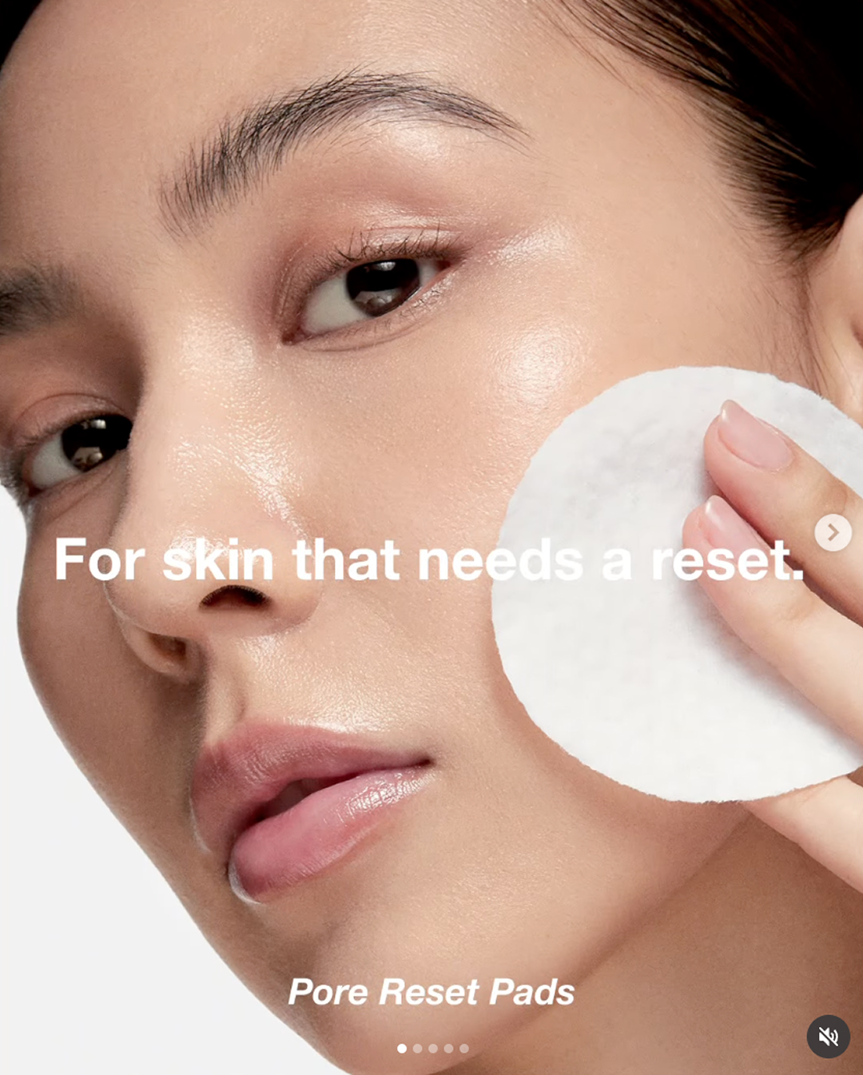
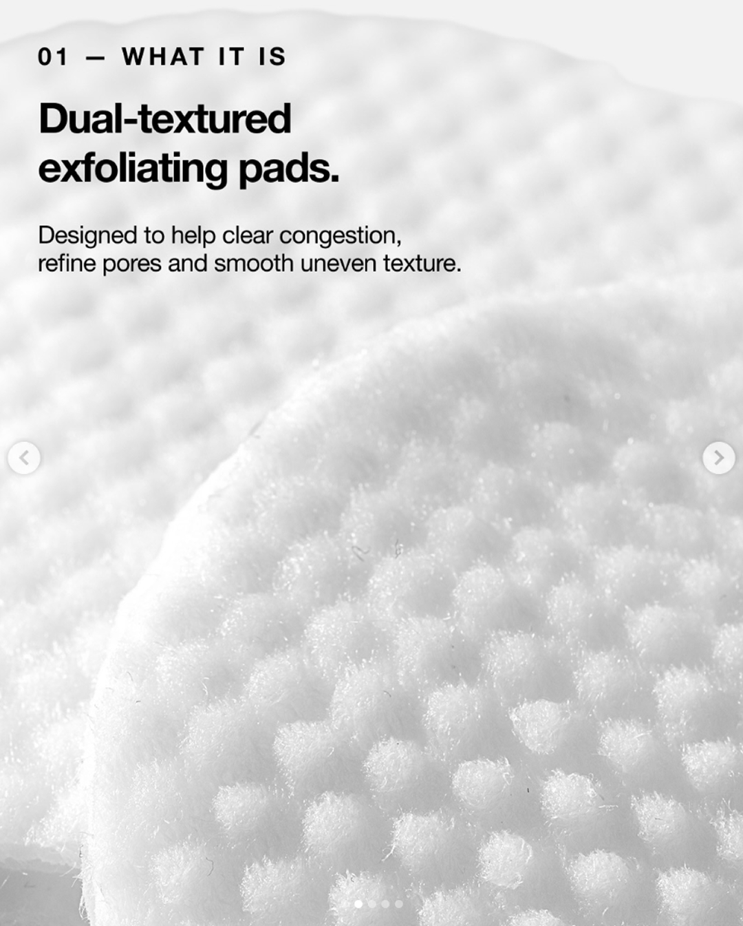
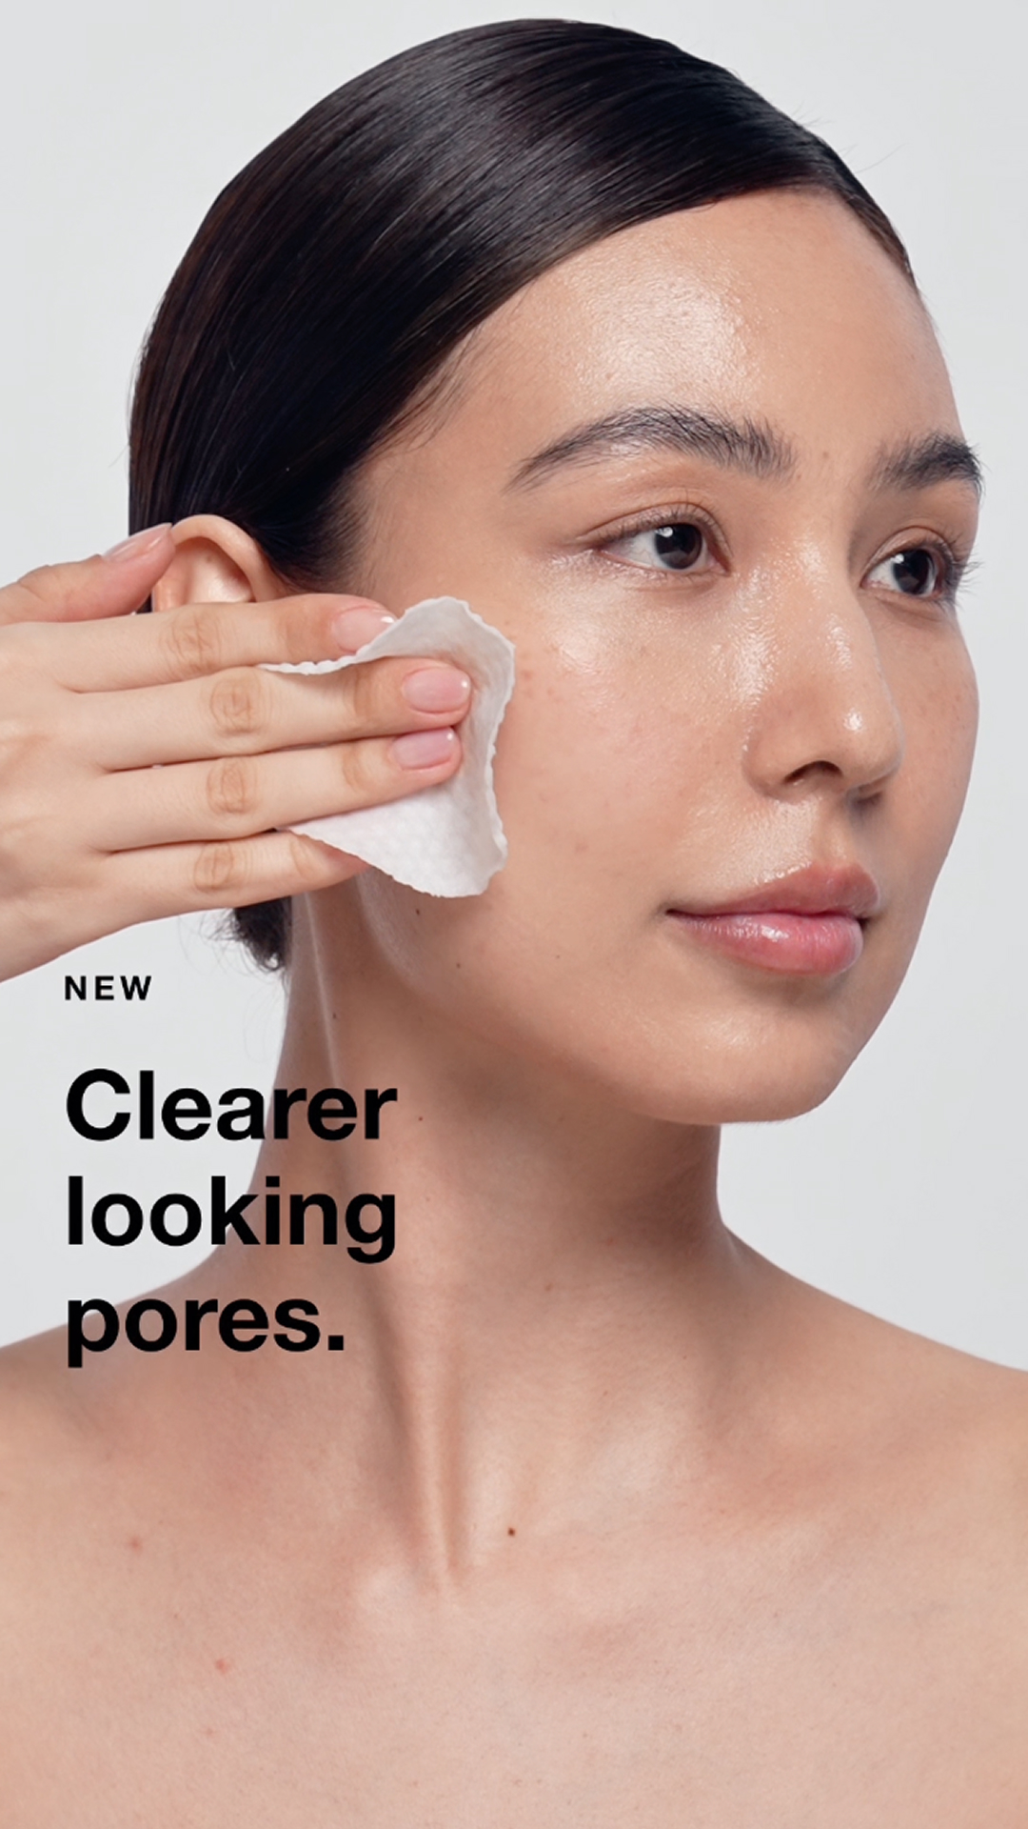
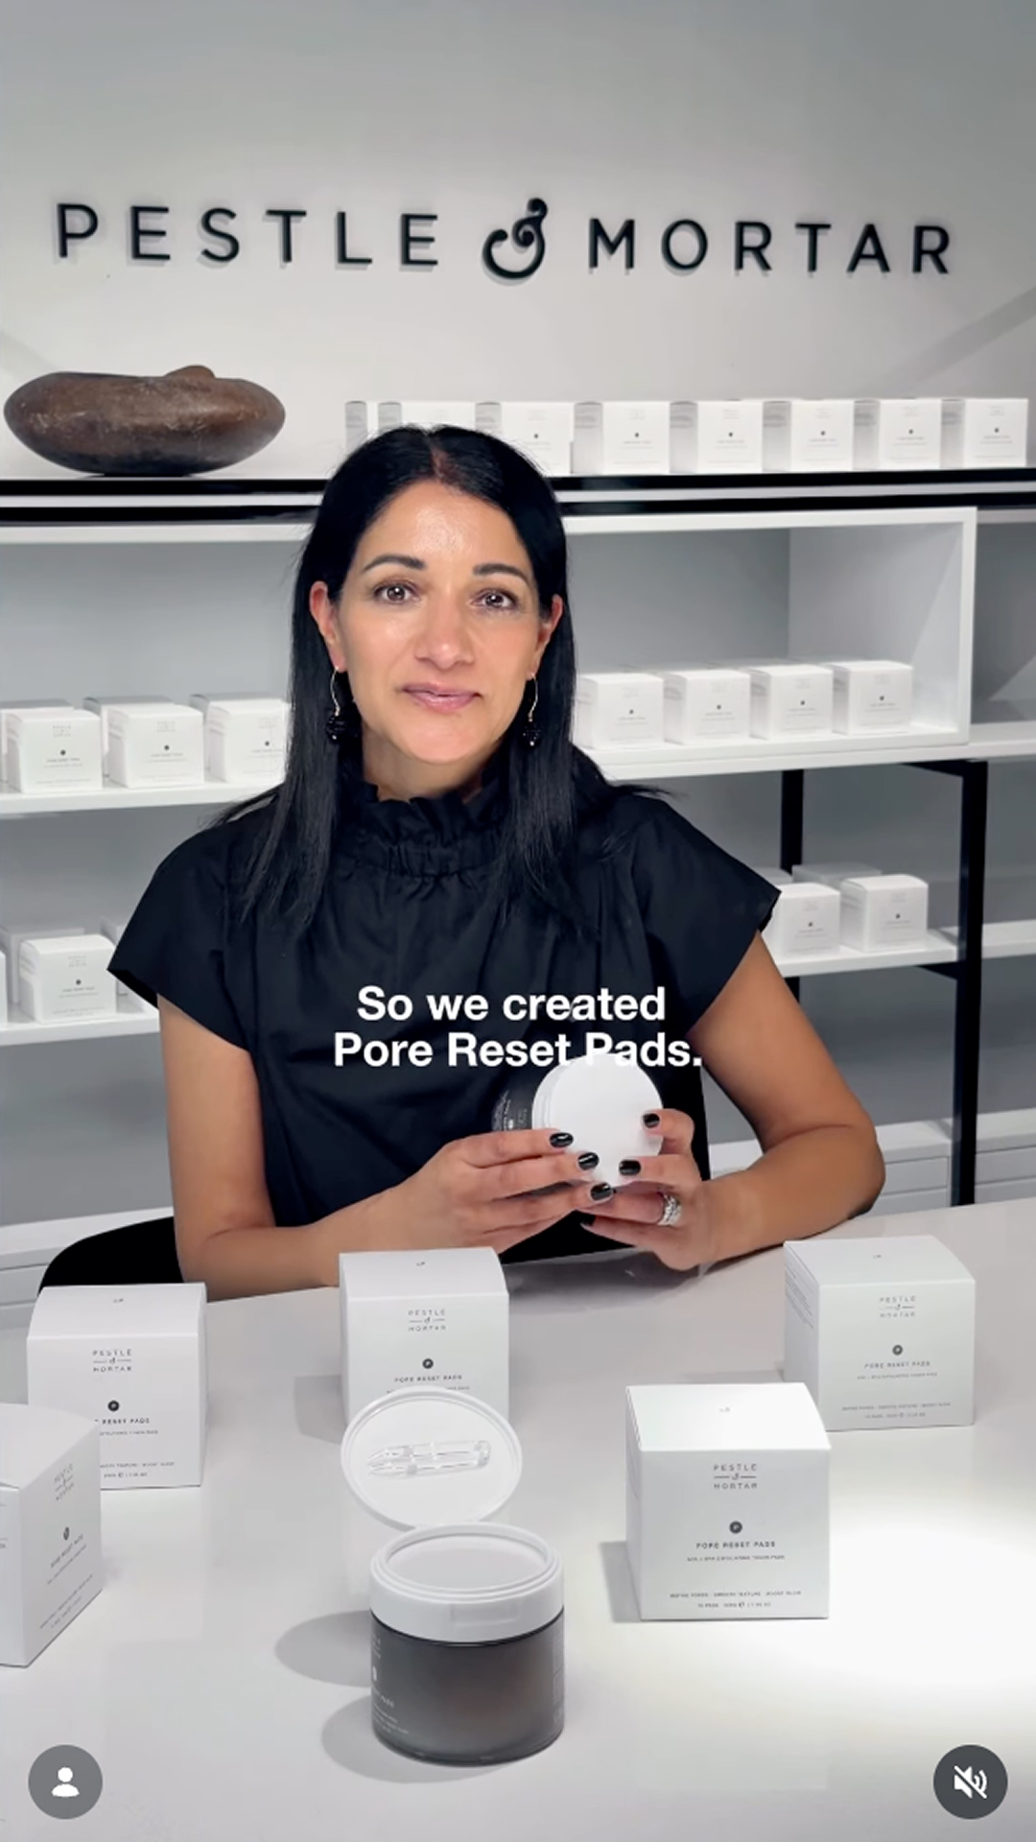
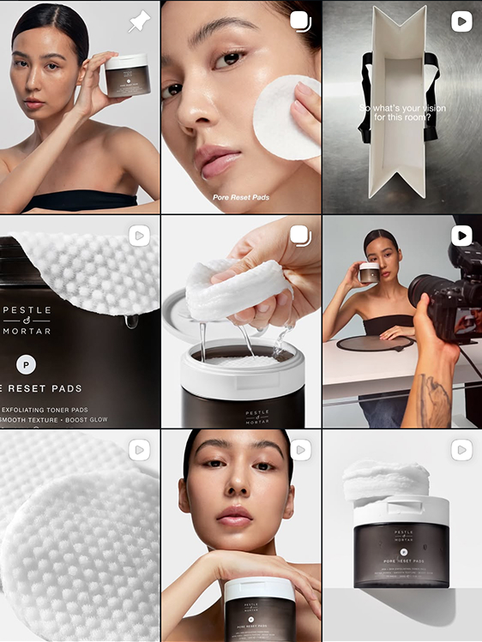
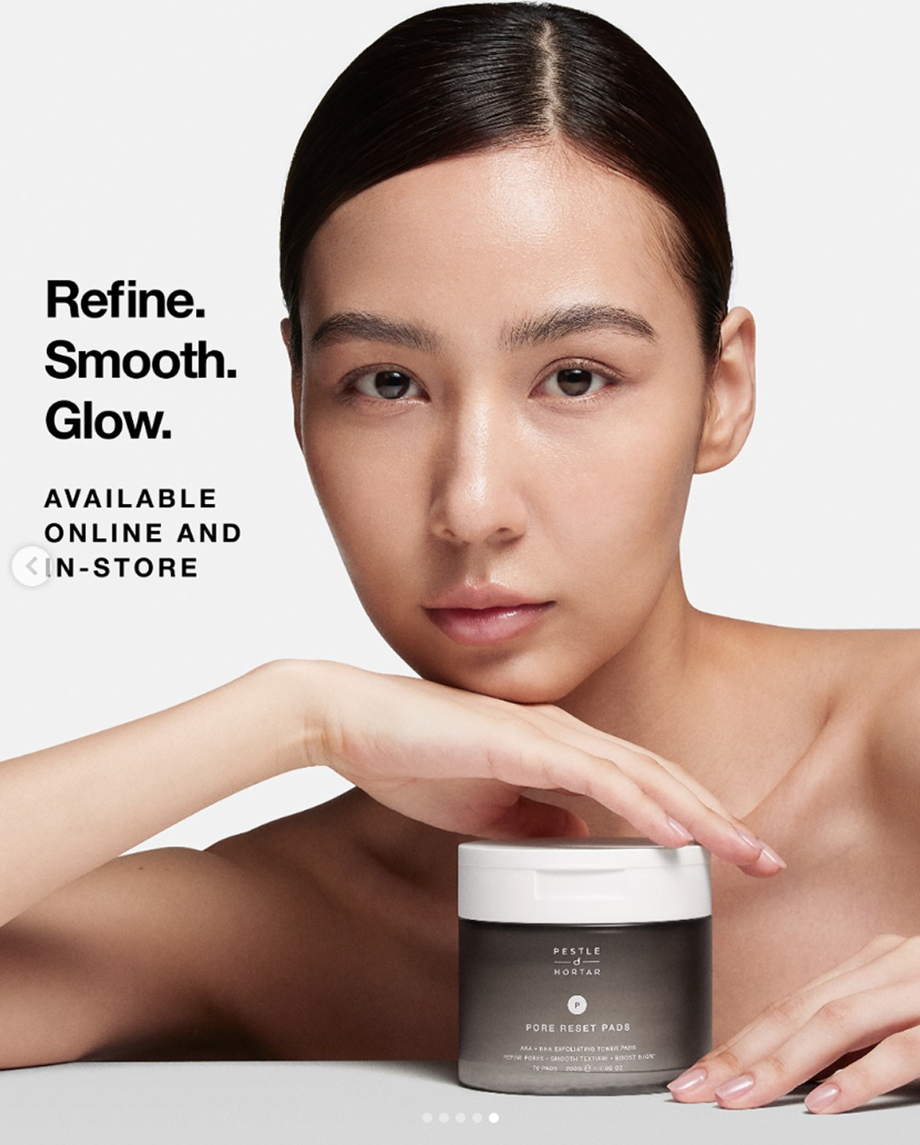

ORGANIC SOCIAL · INSTAGRAM + TIKTOK
Always-on content. Founder-led. Skin-first.
Weekly cadence across Feed, Reels and TikTok — founder education, application demos, ingredient deep-dives and customer voice. All driving traffic into your store.
FEED CAROUSEL · EDUCATION
REEL · HOW TO USE
REEL · FOUNDER VOICE
SOCIAL GRID
PORE RESET PADS · STOCKIST PITCH · CONFIDENTIAL
14 / 16

Slide 15
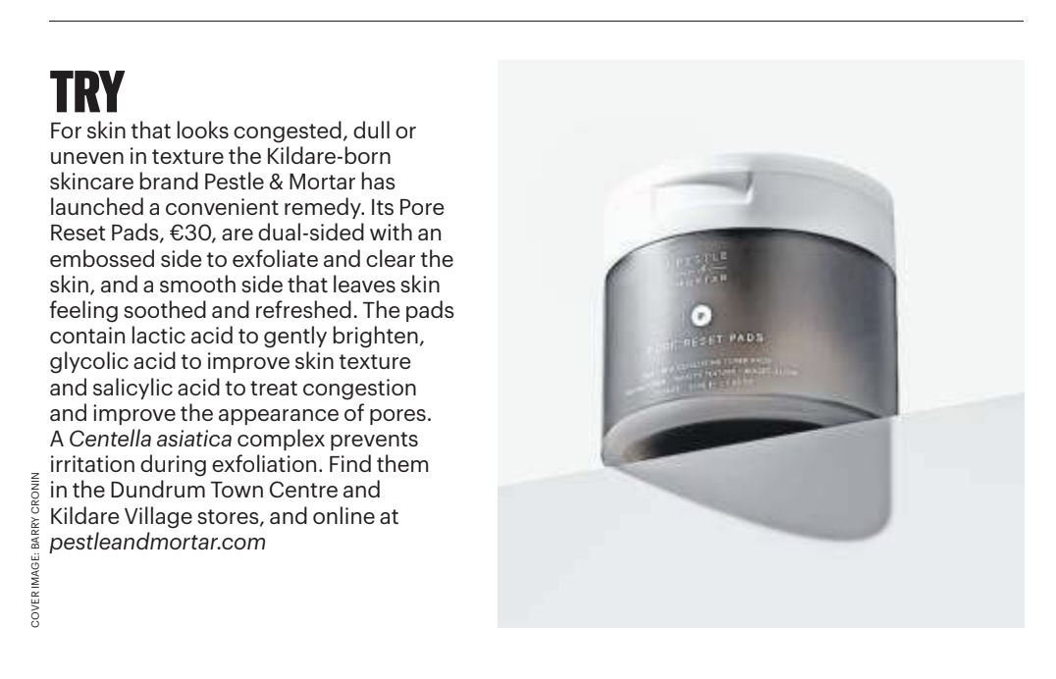
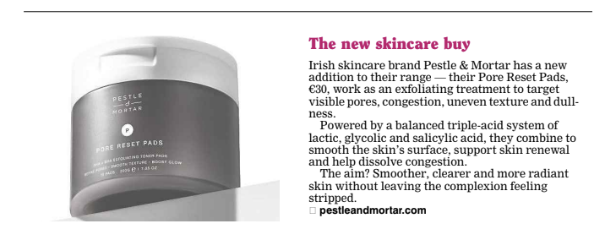
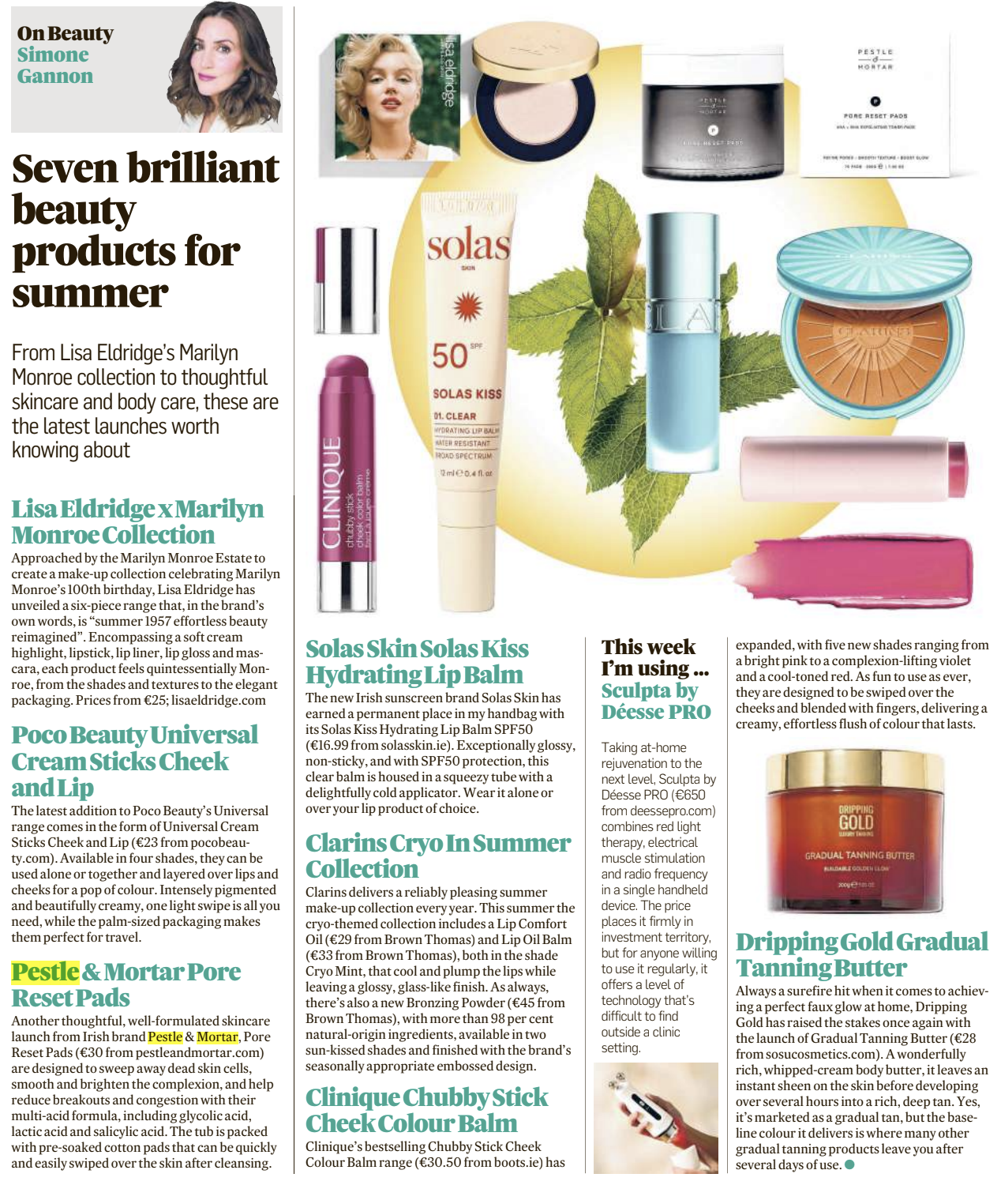
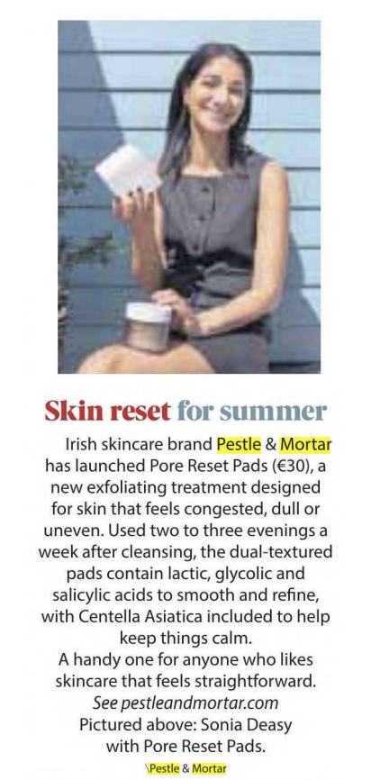
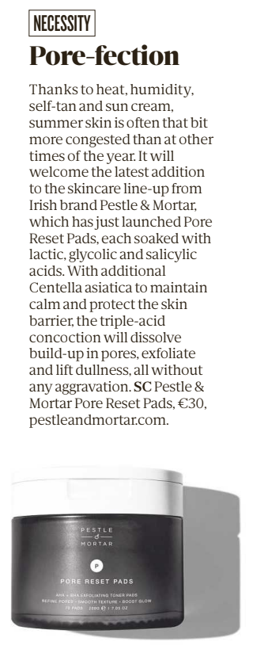
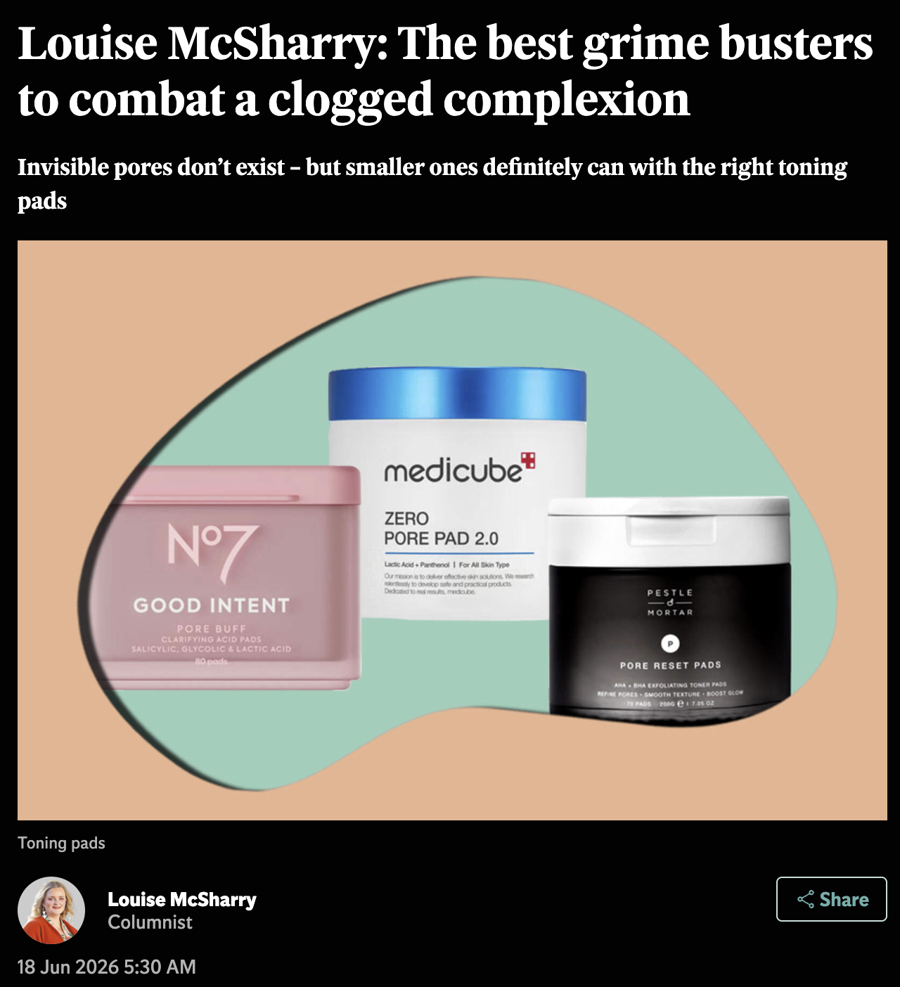
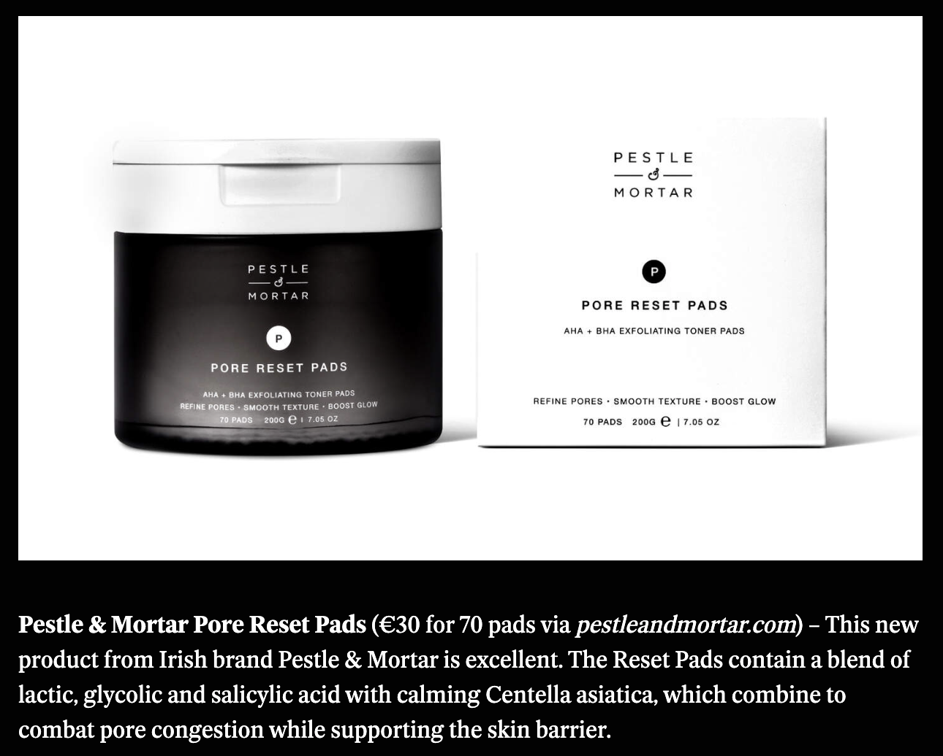
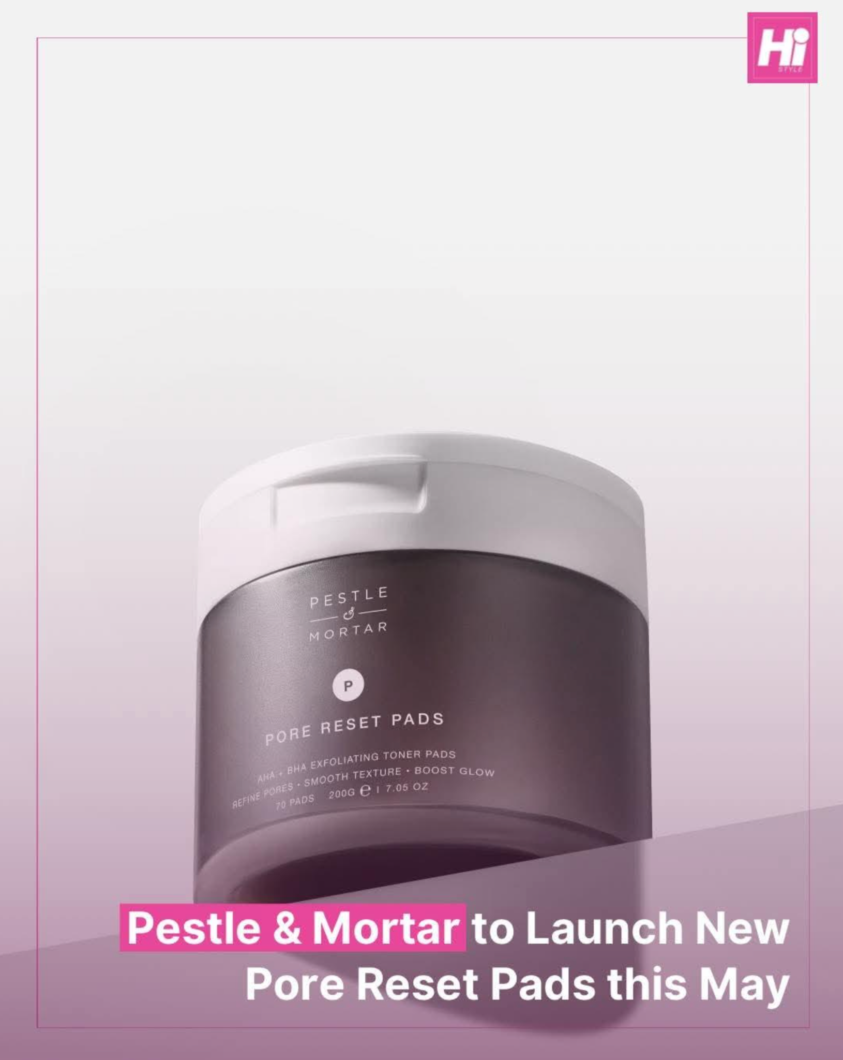
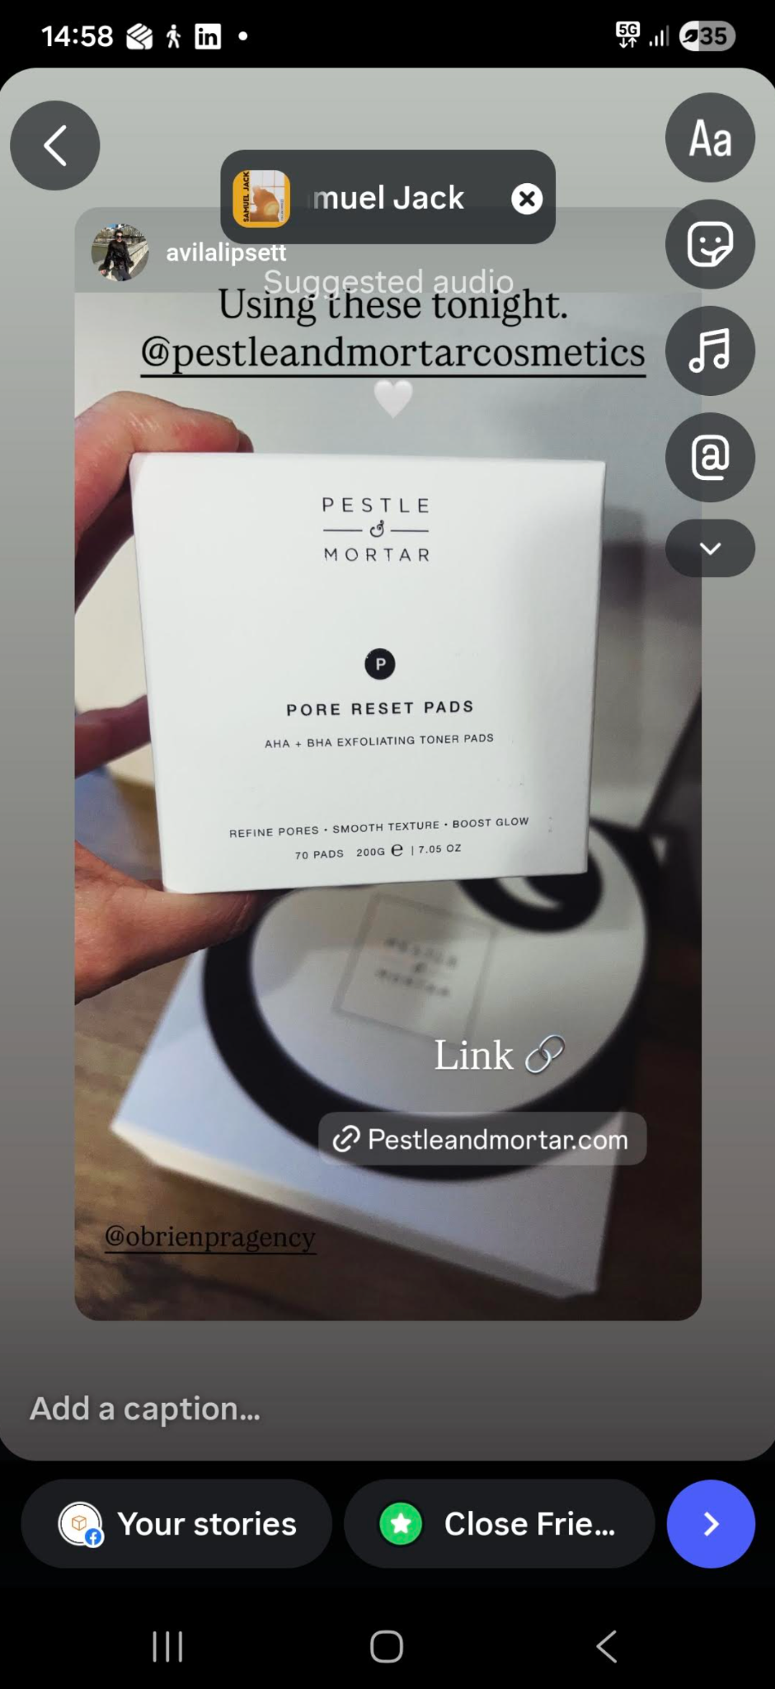
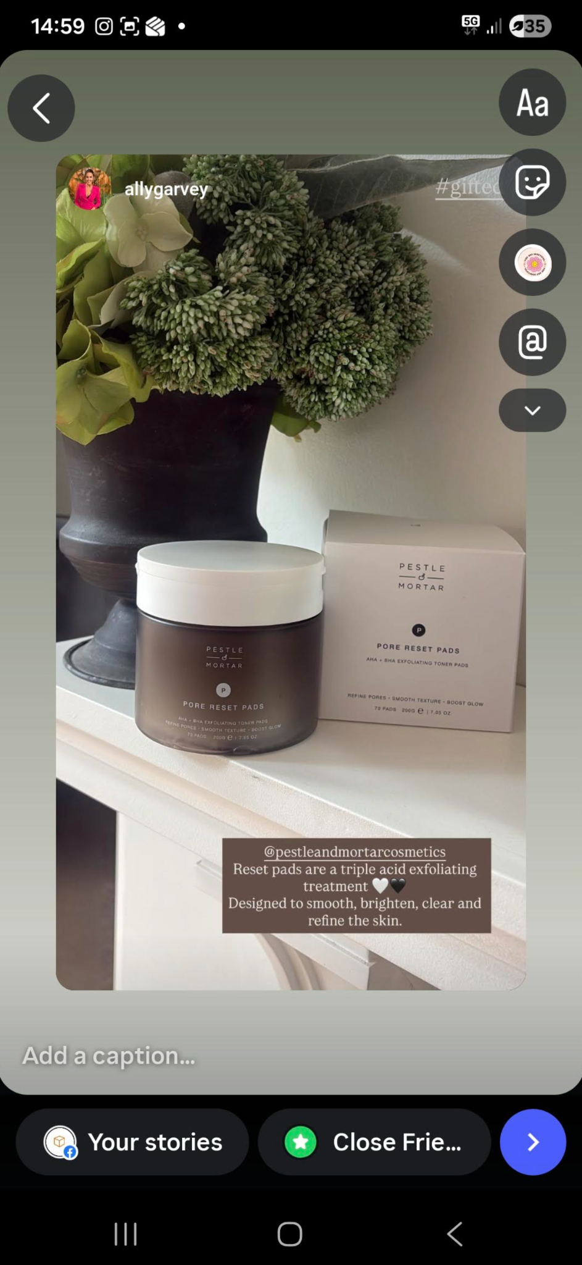
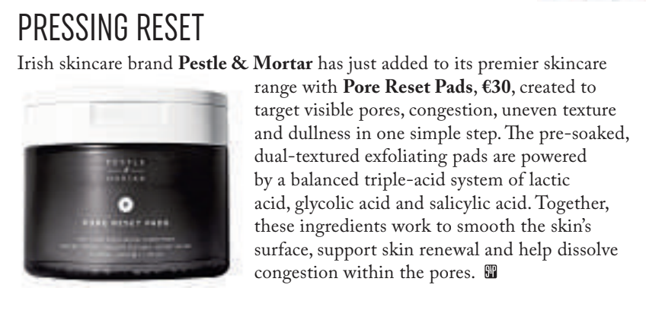
PR & EARNED · LAUNCH COVERAGE
Earned coverage. Drives in-store demand.
Targeted Irish and UK press strategy across beauty, lifestyle and wellness — pre-launch teasers, launch hero features, and always-on editorial. Demand built before customers reach your door.
— FEATURED COVERAGE
SUNDAY TIMES
IRISH EXAMINER
IRISH TIMES MAGAZINE
FARMERS JOURNAL
SUNDAY INDEPENDENT
IRISH INDEPENDENT
HI MAGAZINE
SOCIAL INFLUENCERS
SOCIAL & PERSONAL
15 / 16

Slide 16
NEXT STEPS
Launch Pore Reset Pads
with us.
ADD TO YOUR 2026 RANGE
CONTACT
Claire (Field Rep) · accountmanager@pestleandmortar.com
Katie (Sales Development) · accountmanager@pestleandmortar.com
Lauren (Sales Development) · accountmanager@pestleandmortar.com

