Slide 1




Measuring mixed emotions
How can we effect change in our community? > SEL > Measuring mixed emotions

Slide 2
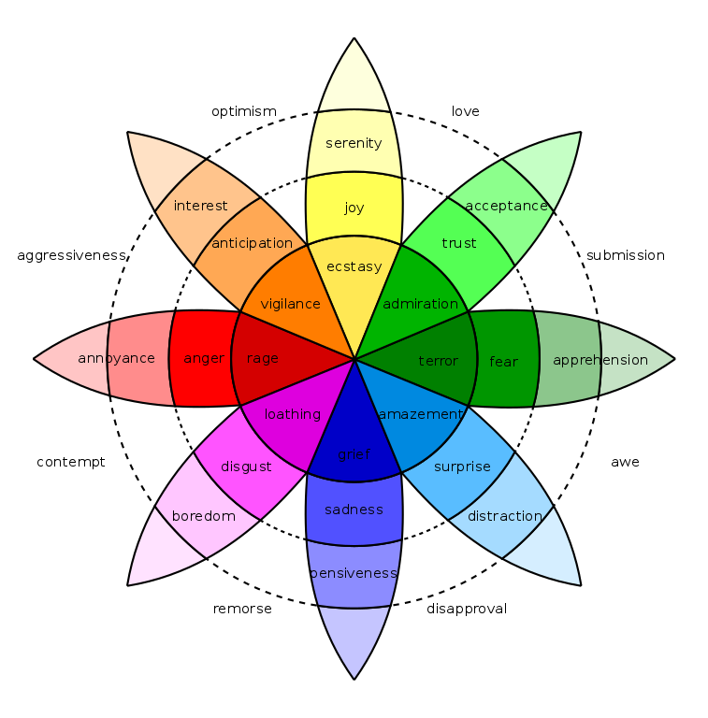
Plutchik’s Wheel of Emotions
joy - sadness
anger - fear
trust - disgust
surprise - anticipation

Slide 3
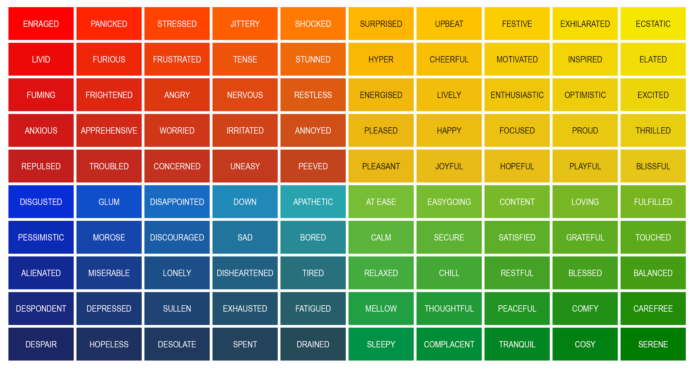
How are you feeling?

Slide 4
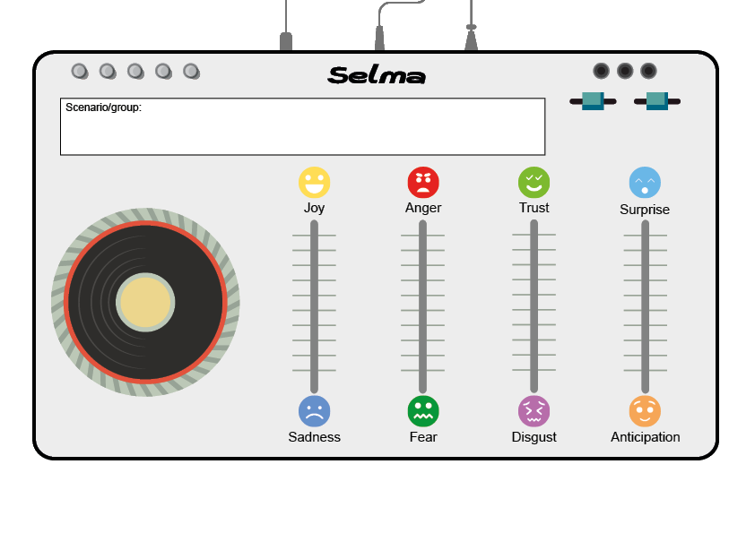
Emotion Mixing Deck

Slide 5



Scenario One
During an online conversation with a close friend, you discover that they have recently been targeted online for being female.
Your friend writes a blog about her career ambitions and regularly shares links to media coverage of gender based issues in the workplace such as the gender pay gap, and the lack of women in senior positions in business.
In recent weeks, your friend has received a number of negative comments under her blog posts - some anonymous and some from people at your school. There have also been offensive memes shared on social media, some aimed at your friend and some aimed at women in general.

Slide 6

Scenario Two
You are part of a clan on a popular online multiplayer game. You can see messages from other players in the game as well as messages from other clan members.
While playing, you notice a large number of messages coming from five members. It is clear that they are ganging up on other players in the game; players that they have decided are members of the LGBTQ community.
They are attacking the players verbally over message chat and audio, moving as a gang to digitally stalk LGBTQ players in the game and deliberately excluding LGBTQ players from other in-game activities/groups.

Slide 7

Scenario Three
You have recently been invited by a school friend to join a closed Facebook group formed to discuss issues in your local community.
Upon entering the group and reading some of the conversations, it becomes clear that one of the admins spends all their time saying hateful things about immigrants. Some of the comments from other users suggest that this admin has also deleted messages from other people who have commented on their behaviour.
The atmosphere in the group has become tense, with some members siding with the admin and other members opposing them. As these are members of your local community, these feelings have also transferred offline.

Slide 8








www.hackinghate.eu
#SELMA_eu

