Slide 1

SOCIAL AND RELIGIOUS REFORMERS

Slide 2
In this chapter we will study
Indian renaissance
Raja ram mohan roy
Arya samaj
Sathya shodhak samaj
Prarthana samaj
Vivekananda
Aligharh movement

Slide 3
The 19th Century in Indian history is referred as the period of ‘Indian Renaissance
Indians came into contact with Western civilization. As a result,
❖ They got the advantage of English education.
❖ Rationalism grew among Indians.
❖ This rational attitude stimulated the Indians to question superstitions and the contradictions in their traditions, and also Become aware of their own interests.
❖ Indians had a scientific outlook and were rational

Slide 4
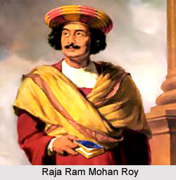
Brahmo Samaj: Raja Ram Mohan Roy
Raja Ram Mohan Roy the founder
He has been called ‘The Father of Indian Renaissance’.
He had studied the culture and principles of religions like Hinduism, Islam, Sufi, Christianity and Buddhism

Slide 5
Reformations
Questioned the practice of idol-worship.
❖ He argued that modern science and English education were essential for an Indian revival.
❖ He opposed exploitation of women.
❖ He led an organized attack against the practice of sati and child marriage
❖ He tried to develop rationalism among people through journalism

Slide 6
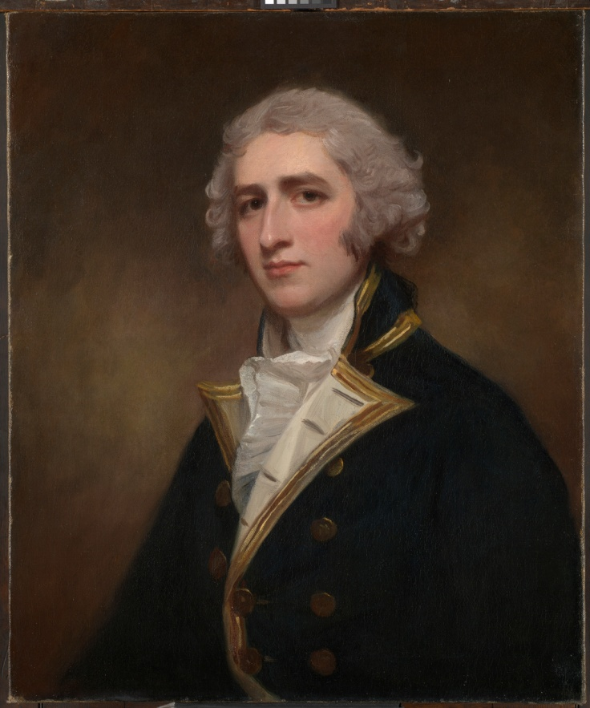
Ram Mohan Roy supported the Prohibition of Sati Act which was introduced by Lord William Bentinck

Slide 7
He started a newspaper in Bengali called ‘Samvada Kaumudi’.
❖ It attempted to bring in reforms in the traditions and customs in Hindu religion.
❖ It opposed idol-worship and polytheism, and encouraged monotheism.
❖ It condemned performance of yagas and rituals, and Opposed the priestly class.
❖ English education exposed Indians to Western political thought.

Slide 8
Young Bengal Movement
This movement was started by Henry Louis Vivian Derozio(1809-1831)
Derozio was called Anglo-Indian.
Derozio served as a professor at Hindu College in Calcutta
tried to instil the same spirit of free enquiry in the minds of his students and colleagues.

Slide 9
worked towards creating text books to inculcate new education system. This angered many traditionalists
started the ‘Academic Association (1828), a free thinking debate association
worked towards; rational thinking, Women Rights, discrimination
movement was limited to Calcutta and a few areas of Bengal

Slide 10
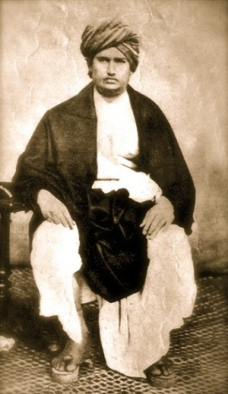
Arya Samaj : 1875
Arya Samaj was established by Dayananda Saraswati
❖ Emphasized that the Vedas were the source of truth and knowledge.
❖ He advised people to ‘Back to the Vedas’.
❖ He condemned idol worship and the caste system.
❖ He advocated that caste should be decided based on the ability and not on the birth of the person

Slide 11
Arya Samaj : 1875
Rejected the innumerable meaningless practices and dominance of the priestly class.
❖ He encouraged widow marriage.
❖ He urged people to use swadeshi goods.
❖ He propounded his teachings in a book called ‘Satyartha Prakasha’.
❖ ‘Purification Ritual’ was the main activity of Arya Samaj

Slide 12
Arya Samaj : 1875
The Samaj established schools and colleges in many places
❖ The principles of Swarajya and Swadharma advocated by Dayananda Saraswati proclaimed that ‘India should be for Indians

Slide 13
Prarthana Samaj :
Prarthana Samaj was established by Atmaram Panduranga in Mumbai.
❖ It was founded on the principle that service to mankind is service to God
❖ It gave priority to spread of education.
❖ Deccan Education Society, it aimed to develop the educational field.
❖ It encouraged widow marriage, female literacy, intercaste marriage,

Slide 14
Eating together by people of all castes,
❖ Opposed child marriage, caste system, idol worship and purdah system.
❖ It maintained that all religions were paths towards the truth and hence needed to be respected.
❖ Orphanages, national schools and shelter homes for women were established.

Slide 15
M.G.Ranade popularized Prarthana Samaj
He propagated Hindu-Muslim unity.
❖ Ranade was active in the National Congress party.
❖ He started a high school for educating girls

Slide 16
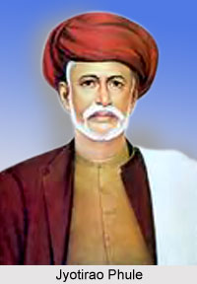
Satyashodhak Samaj
Satyashodak Samaj was established by Jyotiba
❖ Satyashodak Samaj urged for prohibition of liquor.
❖ It vehemently opposed gender inequality, denial of human rights, and exploitation of people and practice of untouchability.
❖ It started a movement for social justice.
❖ Jyotiba Phule established a primary school for girls.

Slide 17
He condemned the slavery being forced on shudras and casteless classes including dalits
❖ He advocated free and compulsory education in order to bring about reform in the social system
❖ Shahu Maharaj who was deeply influenced by Satyashodhak Samaj
❖ Phule wrote in detail about exploitation in his book ‘Ghulamagiri’ (‘Slavery’)
❖ Dr.B.R.Ambedkar was influenced by Phule’s principles.

Slide 18
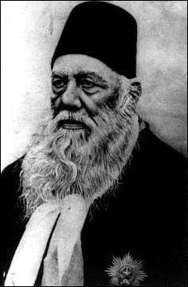
Aligarh reformation movement:
The Aligarh Movement aimed at promoting harmony of Eastern and Western ideas through transformation of the Muslims in their political, social, educational, religious and philosophical beliefs

Slide 19
Intention to provide modern education to the Muslim community, he started ‘The Anglo-Oriental College’. Later on, this college was renamed ‘Aligarh Muslim University’.
❖ Its main objective was to provide religious education along with western education
❖ He supported female literacy and condemned polygamy and ideas against widow marriage

Slide 20
Ramakrishna Mission:
Ramakrishna Paramahamsa was a priest at the Ramakrishna Paramahamsa Dakshineshwar Kali Temple
He believed that spiritual realization was more important than any religion or God.
He believed in idol-worship

Slide 21
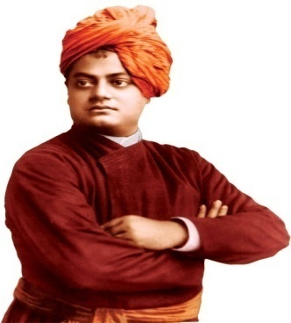
Swami Vivekananda
Swami Vivekananda established Ramakrishna Mission in order to propagate the ideals of his teacher, Ramakrishna Paramahamsa.
❖ The main objective of this organization was to spread the message of equality of all religions and to put that into practice
❖ Vivekananda opened the eyes of Indians to the importance of loving life.
❖ He stressed the significance of the individual, his presence and ability.

Slide 22
He maintained that apart from prayer and practice of yoga, social service was also necessary for achievement of salvation
❖ Vivekananda emphasized that nation and religion were like the two faces of a coin
❖ In 1893, at the Chicago Conference of World Religions, Swami Vivekananda upheld the greatness of India

Slide 23
Theosophical society
It was founded by Madame Blavatsky and HS Alcott
❖ founded on the principles of establishment of universal brotherhood, comparative study of ideology, and exploration of natural principles and the latent energy of the individual

Slide 24
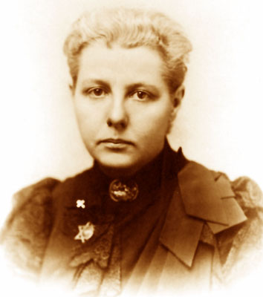
Annie Besant
Annie Besant, an Irish lady started the activities of Theosophical Society in India and gave it new vitality
She aroused pride in Indian culture through her lectures
She attempted to establish equality, universal brotherhood and harmony in society

Slide 25
Annie Besant
Annie Besant gave her full support to the freedom struggle
❖ started periodical: New India
❖ Started Home Rule League Movement in 1916.
❖ She contributed immensely to Indian philosophy and the Independence struggle.
❖ She became first woman president of INC in 1917

Slide 26
Sri Narayana Guru; 1903
He was born in Chembalanti / Chembalandi of Kerala
This movement aimed at strengthening the backward and exploited communities.
The caste differences were too much in Kerala:
Restrictions were there on women’s dress, not allowed to use facilities like tanks and roads
One Caste, One Religion and One God for human beings was the basic idea

Slide 27
He built alternate temples for the backward communities
started ‘Vaikom Satyagraha Movement’ in 1924
Gandhiji and Periyar, the architects of self-respect movement
The Satyagraha for entry of untouchables into
Guruvayoor temple was a major incident

Slide 28
Periyar
a Non-Brahmin movement started in South India
The Justice Party started in 1916 continued the movement in Tamil Nadu.
Self-Respect Movement’ led by E.V.Ramaswami Naicker
Ramaswami started Self Respect League in 1926
He was called Periyar (Senior Person)

Slide 29
Periyar was born in Erode in a rich family
He said Tamil was the language of Dravidians.
He championed equality and criticized caste and gender-based discrimination
He participated in the temple entry movement in 1924
He started an association called 'Dravida Kazhagam'.
He also started an English magazine under the title ‘Revolt’

Slide 30
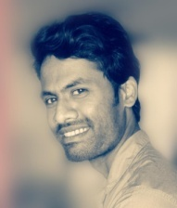

Thank you
Prepared by:
Praveen Banakar

