Slide 1



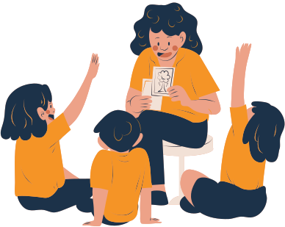



Teacher’s
day
@reallygreatsite
Honoring the pillars of knowledge and guidance

Slide 2
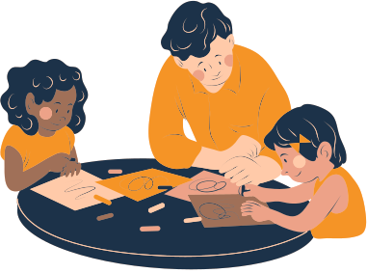


what is
Teacher’s Day?
@reallygreatsite
A global celebration to appreciate teachers’ dedication
Varies in dates around the world (e.g., October 5 internationally)

Slide 3

history of
@reallygreatsite
Teacher’s Day?
Origin of the celebration (UNESCO declaration in 1994)
Different countries honor great educators
To recognize the role of teachers in shaping society

Slide 4
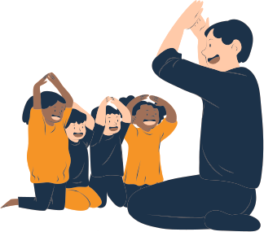

Role of Teachers
@reallygreatsite
Mentors, guides, and motivators
Builders of character, not just academics
Shaping the next generation of leaders, thinkers, and creators

Slide 5
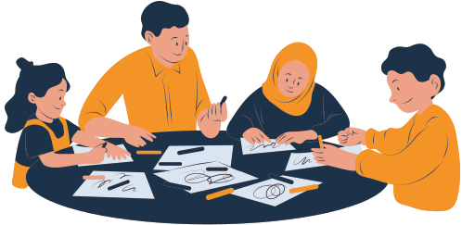
The Challenges Teachers Face
@reallygreatsite
Adapting to new technology and teaching methods
Managing large classes and diverse students
Balancing professional and personal life
Underappreciation in some societies

Slide 6
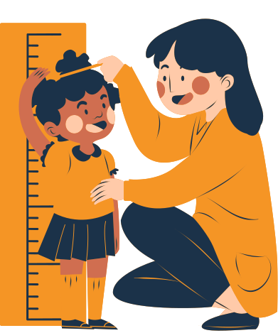


Modern Teaching in the Digital Age
@reallygreatsite
Online learning and hybrid classrooms
Use of AI, digital platforms, and interactive tools
Importance of continuous learning for teachers

Slide 7

Gratitude from Students
@reallygreatsite
Handwritten notes or messages
Expressing verbal gratitude
Small gifts or flowers
Performing songs/poems/skits in honor of teachers

Slide 8


School & Community Celebrations
Cultural programs, speeches, and awards
@reallygreatsite
Student-led events to showcase appreciation
Community recognition of educators’ contributions

Slide 9
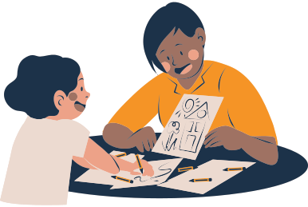
Inspirational Quotes
@reallygreatsite
“Teachers are the quiet architects of tomorrow’s world.”
“A lesson taught with heart lasts longer than any written word.”
“Every great mind was once shaped by the patience of a teacher.”

Slide 10

@reallygreatsite
thank
you
Teachers as the foundation of education and growth
Let’s honor and support our teachers every day, not just on Teacher’s Day
www.reallygreatsite.com

